Slide 1
Superscalar Complexity

Slide 2
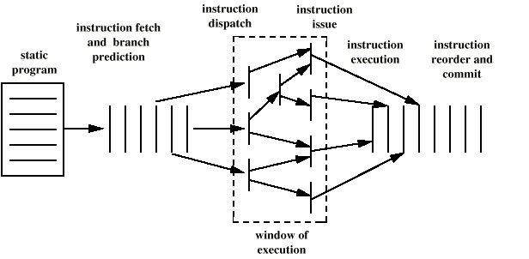
View of Superscalar Execution

Slide 3
Generic Superscalar Processor Models
Issue queue based
FU
Fetch
Wakeup
select
Regfile
bypass
Rename
D-cache
FU
commit
schedule
execute
Reservation based
Reg
FU
Fetch
bypass
Rename
D-cache
ROB
Wakeup
select
FU
commit
schedule
execute

Slide 4
Register Renaming

Slide 5
Register Renaming
Alpha 21264+, MIPS R10K+, Pentium 4 use explicit register renaming
  Registers are not read until instruction dispatches (begins execution)
  Register renaming ensures no conflicts
RAT
R1 PR23
R2 PR2
DIV R5, R4, R2
ADD R7, R5, R1
SUB R5, R3, R2
LW R7, 1000(R5)
R3 PR17
R4 PR45
R5 PR13
R6 PR20
R7 PR30
…

Slide 6
Register Renaming
Assume that PR37 is free and allocated to DIV’s destination register R5
RAT
R1 PR23
R2 PR2
DIV R5, R4, R2
ADD R7, R5, R1
SUB R5, R3, R2
LW R7, 1000(R5)
DIV PR37, PR45, PR2
R3 PR17
R4 PR45
R5 PR13
PR37
R6 PR20
R7 PR30
…

Slide 7
Register Renaming
Assume that PR37 is free and allocated to DIV’s destination register R5
RAT
R1 PR23
R2 PR2
DIV R5, R4, R2
ADD R7, R5, R1
SUB R5, R3, R2
LW R7, 1000(R5)
DIV PR37, PR45, PR2
R3 PR17
R4 PR45
R5 PR37
R6 PR20
R7 PR30
…

Slide 8
Register Renaming
Assume that PR4 is free and allocated to ADD’s destination register R7
RAT
R1 PR23
R2 PR2
DIV R5, R4, R2
ADD R7, R5, R1
SUB R5, R3, R2
LW R7, 1000(R5)
DIV PR37, PR45, PR2
ADD PR4 , PR37, PR23
R3 PR17
R4 PR45
R5 PR37
R6 PR20
R7 PR30
PR4
…

Slide 9
Register Renaming
RAT
R1 PR23
R2 PR2
DIV R5, R4, R2
ADD R7, R5, R1
SUB R5, R3, R2
LW R7, 1000(R5)
DIV PR37, PR45, PR2
ADD PR4 , PR37, PR23
SUB PR42, PR17, PR2
R3 PR17
R4 PR45
R5 PR37
PR42
R6 PR20
R7 PR4
…

Slide 10
Register Renaming
RAT
R1 PR23
R2 PR2
DIV R5, R4, R2
ADD R7, R5, R1
SUB R5, R3, R2
LW R7, 1000(R5)
DIV PR37, PR45, PR2
ADD PR4 , PR37, PR23
SUB PR42, PR17, PR2
LW PR19, 1000(PR42)
R3 PR17
R4 PR45
R5 PR42
R6 PR20
R7 PR4
PR19
…

Slide 11
MIPS R10000, Recycling Physical Registers
Register Map
Instruction Queue
(Reservation Stations)
I1:DIV R5, R4, R2
I2:ADD R7, R5, R1
I3:SUB R5, R3, R2
I4:LW R7, 1000(R5)
Active List
R1 PR23
…
Head
Tail
R2 PR2
R3 PR17
R4 PR45
R5 PR13
R6 PR20
R7 PR30
…
Register Free List
PR37, PR4, PR42, PR19, …
Commit

Slide 12
MIPS R10000, Recycling Physical Registers
Register Map
Instruction Queue
(Reservation Stations)
I1:DIV R5, R4, R2
I2:ADD R7, R5, R1
I3:SUB R5, R3, R2
I4:LW R7, 1000(R5)
Active List
R1 PR23
…
Head
Tail
R2 PR2
R3 PR17
R4 PR45
R5 PR13
R6 PR20
R7 PR30
…
Register Free List
PR37, PR4, PR42, PR19, …
Commit

Slide 13
MIPS R10000, Recycling Physical Registers
Register Map
Instruction Queue
(Reservation Stations)
I1:DIV R5, R4, R2
I2:ADD R7, R5, R1
I3:SUB R5, R3, R2
I4:LW R7, 1000(R5)
Active List
R1 PR23
…
Head
R2 PR2
I1: PR13
R3 PR17
Tail
DIV PR37,
PR45, PR2
R4 PR45
R5 PR37
R6 PR20
R7 PR30
…
Register Free List
PR4, PR42, PR19, …
Commit

Slide 14
MIPS R10000, Recycling Physical Registers
Register Map
Instruction Queue
(Reservation Stations)
I1:DIV R5, R4, R2
I2:ADD R7, R5, R1
I3:SUB R5, R3, R2
I4:LW R7, 1000(R5)
Active List
R1 PR23
DIV 2,45:37
…
Head
R2 PR2
I1: PR13
R3 PR17
I2: PR30
ADD PR4,
PR37, PR23
R4 PR45
Tail
R5 PR37
R6 PR20
R7 PR4
…
Register Free List
PR42, PR19, …
Commit

Slide 15
MIPS R10000, Recycling Physical Registers
Register Map
Instruction Queue
(Reservation Stations)
I1:DIV R5, R4, R2
I2:ADD R7, R5, R1
I3:SUB R5, R3, R2
I4:LW R7, 1000(R5)
Active List
R1 PR23
DIV 2,45:37
…
Head
R2 PR2
ADD 37,23: 4
I1: PR13
R3 PR17
I2: PR30
SUB PR42,
PR17, PR2
R4 PR45
I3: PR37
R5 PR42
Tail
R6 PR20
R7 PR4
…
Register Free List
PR19, …
Commit

Slide 16
MIPS R10000, Recycling Physical Registers
Register Map
Instruction Queue
(Reservation Stations)
I1:DIV R5, R4, R2
I2:ADD R7, R5, R1
I3:SUB R5, R3, R2
I4:LW R7, 1000(R5)
Active List
R1 PR23
DIV 2,45:37
…
Head
R2 PR2
ADD 37,23: 4
I1: PR13
R3 PR17
SUB 17, 2:42
I2: PR30
LW PR19,
1000(PR2)
R4 PR45
I3: PR37
R5 PR42
I4: PR4
R6 PR20
Tail
R7 PR19
…
Register Free List
…
Commit

Slide 17
MIPS R10000, Recycling Physical Registers
Register Map
Instruction Queue
(Reservation Stations)
I1:DIV R5, R4, R2
I2:ADD R7, R5, R1
I3:SUB R5, R3, R2
I4:LW R7, 1000(R5)
Active List
R1 PR23
DIV 2,45:37
…
Head
R2 PR2
ADD 37,23: 4
I1: PR13
R3 PR17
SUB 17, 2:42
I2: PR30
R4 PR45
LW 42 :19
I3: PR37
R5 PR42
I4: PR4
R6 PR20
Tail
R7 PR19
…
Register Free List
…
Commit

Slide 18
MIPS R10000, Recycling Physical Registers
Register Map
Instruction Queue
(Reservation Stations)
I1:DIV R5, R4, R2
I2:ADD R7, R5, R1
I3:SUB R5, R3, R2
I4:LW R7, 1000(R5)
Active List
R1 PR23
…
Head
R2 PR2
ADD 37,23: 4
I1: PR13
R3 PR17
I2: PR30
R4 PR45
I3: PR37
R5 PR42
I4: PR4
R6 PR20
Tail
R7 PR19
…
Register Free List
…
Commit
I4, producing register 19, completes, broadcasts a completion signal to IQ

Slide 19
MIPS R10000, Recycling Physical Registers
Register Map
Instruction Queue
(Reservation Stations)
I1:DIV R5, R4, R2
I2:ADD R7, R5, R1
I3:SUB R5, R3, R2
I4:LW R7, 1000(R5)
Active List
R1 PR23
…
Head
R2 PR2
ADD 37,23: 4
I1: PR13
R3 PR17
I2: PR30
R4 PR45
I3: PR37
R5 PR42
I4: PR4
R6 PR20
Tail
R7 PR19
…
Register Free List
…
Commit
I1, producing register 37, completes, broadcasts a completion signal to IQ

Slide 20
MIPS R10000, Recycling Physical Registers
Register Map
Instruction Queue
(Reservation Stations)
I1:DIV R5, R4, R2
I2:ADD R7, R5, R1
I3:SUB R5, R3, R2
I4:LW R7, 1000(R5)
Active List
R1 PR23
…
R2 PR2
ADD 37,23: 4
I1: PR13
Head
R3 PR17
I2: PR30
R4 PR45
I3: PR37
R5 PR42
I4: PR4
R6 PR20
Tail
R7 PR19
…
Register Free List
…, PR13
Commit
I2, producing register 4, completes, broadcasts a completion signal to IQ
I1, commits

Slide 21
Register Rename Logic
Map
Table
Physical
Source
Regs
Physical
Dest
Regs
Logical
Source
Regs
Mux
Free Pool
Logical
Dest
Regs
Dependence
Check
Logic
Logical
Source Reg

Slide 22
Instr Scheduling: Wakeup & Select
Wakeup Logic
  To notify the resolution of data dependency of input operands
  Wake up instructions with zero input dependency
Select Logic
  Choose and fire ready instructions
  Deal with structure hazard
Wakeup-select is likely on the critical path
  Associative match

Slide 23
Wakeup Logic
tag1
tagIW
…
or
=
=
or
rdyL
tagL
tagR
rdyR
.
.
.
.
.
.
rdyL
tagL
tagR
rdyR

Slide 24
Scalar Scheduler (Issue Width = 1)
Tag Broadcast Bus
T14
=
T39
Select Logic
To Execute Logic
T16
=
T39
=
T8
T6
=
T17
=
T42
T39
=
T15
=
T17
T39
=
From Prof. G. Loh’s Slide

Slide 25
Superscalar Scheduler (Width = 4)
Tag Broadcast Bus [3..0]
T14
=
T39
Select Logic
To Execute Logic
=
=
=
T16
=
=
=
=
T39
=
T8
=
=
=
T6
=
=
=
=
T17
=
T42
=
=
=
T39
=
=
=
=
T15
=
T17
=
=
=
T39
=
=
=
=
Snapshot of RS (only 4 entries shown)
Adapted from Prof. G. Loh’s Slide

Slide 26
Selection Logic
Issue window
req
grant
anyreq
enable
Arbiter cell
enable

Slide 27
Simple (?) Select Logic Implementation
Reservation Station
Req0
Grant0
Req1
Grant1
Req2
Grant02
Req3
Grant3
Req0
Grant0
Req1
Grant1
Req2
Grant02
Req3
Grant3
Tree-like
Arbitrated
Selection
Logic
AnyQueue
Enable
AnyQueue
Enable
Req0
Grant0
Req1
Grant1
Req2
Grant02
Req3
Grant3
AnyQueue
Enable
Req0
Grant0
Req1
Grant1
Req2
Grant02
Req3
Grant3
AnyQueue
Enable
[Palarchala ISCA’97]
1

Slide 28
Simple Select Logic Implementation
Reservation Station
Req0
Grant0
Req1
Grant1
Req2
Grant02
Req3
Grant3
Req0
Grant0
Req1
Grant1
Req2
Grant02
Req3
Grant3
AnyQueue
Enable
AnyQueue
Enable
Req0
Req1
Req2
Req3
Grt0
Grt1
Grt2
Grt3
Req0
Grant0
Req1
Grant1
Req2
Grant02
Req3
Grant3
AnyQueue
Enable
Priority
Decoder
Req0
Grant0
Req1
Grant1
Req2
Grant02
Req3
Grant3
AnyQueue
Enable
AnyQueue
Enable
1
[Palarchala ISCA’97]

Slide 29
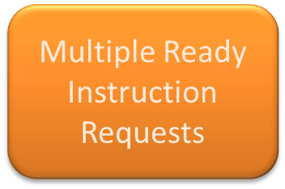
Simple Select Logic Implementation
Reservation Station
Req0
Grant0
Req1
Grant1
Req2
Grant02
Req3
Grant3
Req0
Grant0
Req1
Grant1
Req2
Grant02
Req3
Grant3
AnyQueue
Enable
AnyQueue
Enable
Req0
Grant0
Req1
Grant1
Req2
Grant02
Req3
Grant3
AnyQueue
Enable
Req0
Grant0
Req1
Grant1
Req2
Grant02
Req3
Grant3
AnyQueue
Enable
1
[Palarchala ISCA’97]

Slide 30

Simple Select Logic Implementation
Reservation Station
Req0
Grant0
Req1
Grant1
Req2
Grant02
Req3
Grant3
Req0
Grant0
Req1
Grant1
Req2
Grant02
Req3
Grant3
AnyQueue
Enable
AnyQueue
Enable
Req0
Grant0
Req1
Grant1
Req2
Grant02
Req3
Grant3
AnyQueue
Enable
Req0
Grant0
Req1
Grant1
Req2
Grant02
Req3
Grant3
AnyQueue
Enable

Slide 31




Issues to Distinctive Functional Units
Distributed Instruction Windows (e.g., MIPS R1000 or Alpha 21264)
Reservation Station
Faster to have separate instruction schedulers for different instruction types

Slide 32


Dual Issues to Multiple Units
Req0
Req1
Req2
Req3
Grant0
Grant1
Grant2
Grant3
Req0
Req1
Req2
Req3
Grant0
Grant1
Grant2
Grant3
[Palarchala Dissertation]

Slide 33
Bypass Delay
The number of bypass paths equals 2xIW²xS
(S is the number of pipeline stages)
Wire length ~ IW, hence, delay ~ IW²
The layout and pipeline depth (capacitive load)
also matter

Slide 34
Other structures
Registers
Caches

Slide 35
Limitations of ILP
Assume an ideal processor model
  Register renaming
    Infinite number of virtual registers
    All WAW and WAR hazards can be removed
  Branch prediction
    Perfect branch prediction
  Jump prediction
    All jumps are perfectly predicted
  Memory address alias analysis
    All memory addresses are known exactly
  Perfect caches
    All memory accesses take 1 clock cycle

Slide 36
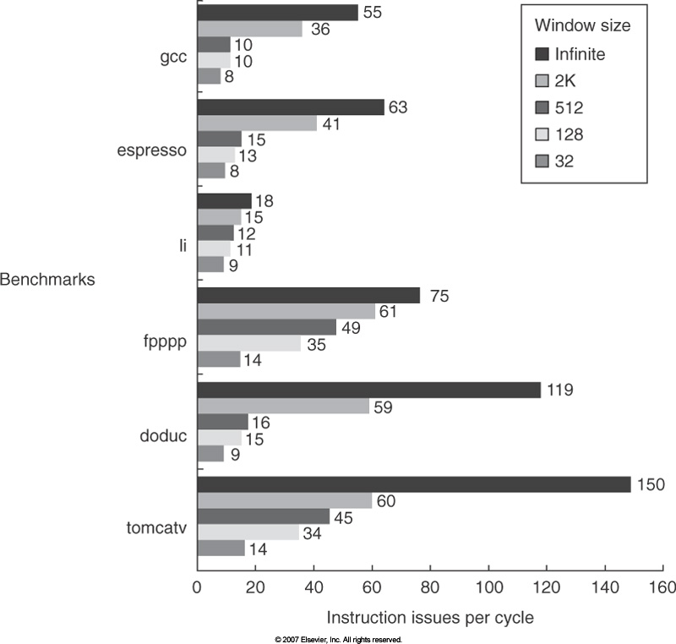
Impact of Window Size

Slide 37
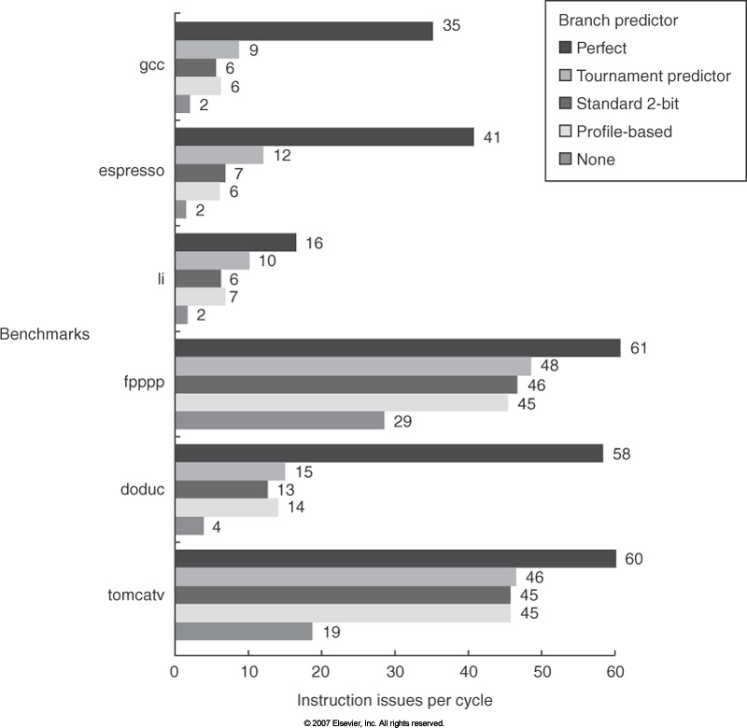
Impact of Branch Prediction
2K window
Max. 64 instruction issues per cycle

Slide 38
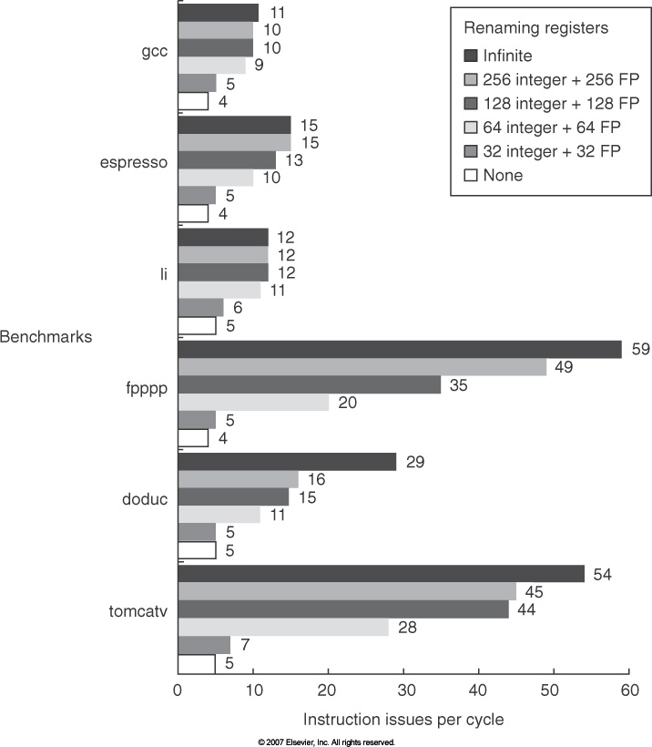
Impact of Finite Registers
2K window
Max. 64 instruction issues per cycle
8K entry tournament predictors
2K jump and return predictors

Slide 39
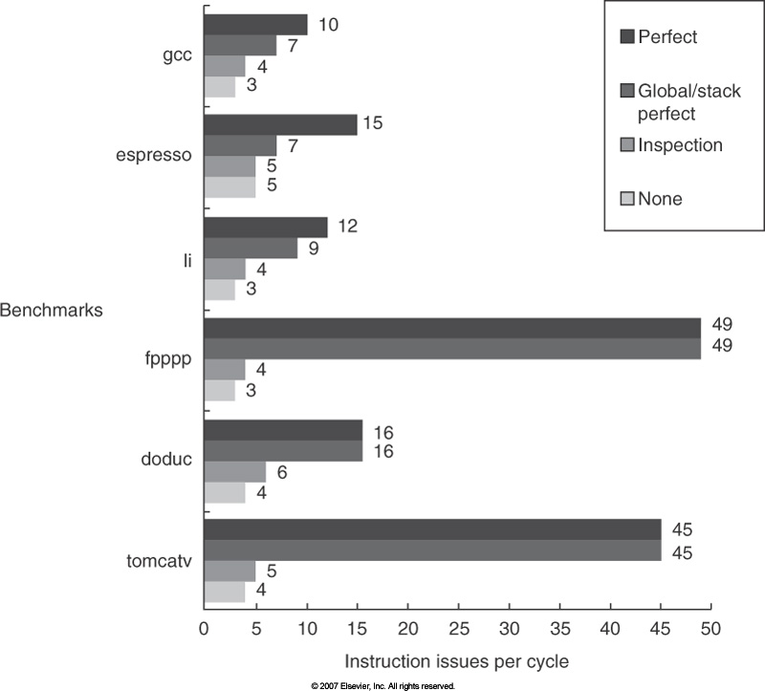
Impact of Imperfect Alias Analysis
2K window
Max. 64 instruction issues per cycle
8K entry tournament predictors
2K jump and return predictors
256 integer and 256 FP registers

Slide 40
Limits of Multiple-Issue Processors: Revisited
Doubling the issue rate above the current 3-6 issue, i.e. 6-12 issue requires
  Issue 3-4 data memory accesses per cycle
  Resolve two or three branches per cycle
  Rename and access more than 20 registers per cycle
  Fetch 12-24 instructions per cycle
  ➔ The complexity of implementing these capabilities would sacrifice the maximum clock rate
Another issue is power!
  Modern microprocessors are primarily power limited.
    Static power grows proportionally to the transistor count
    Dynamic power is proportional to the product of the number of switching transistors and the switching rate
  Microprocessors trying to achieve both a high IPC and a high CR must switch more transistors and switch them faster!

Slide 41
Limits of Multiple-Issue Processors
Energy inefficiency of multiple-issue processors
  Multiple instruction issue incurs overhead in logic that grows faster than the issue rate increase
    Dependence checking, register renaming, wakeup and select, etc.
    Without voltage reduction, higher IPC will lead to lower performance/watt!
  Growing gap between peak issue rate and sustained performance
    The number of transistor switching is proportional to the peak issue rate
    The performance is proportional to the sustained rate
    Thus, growing gap translates to increasing energy per unit performance!
For example, speculation is inherently inefficient
  It can never be perfect, thus there is inherently waste in executing computations before we know that whether the path is taken or not
Increasing clock rate is also not energy efficient
  Increasing clock rate will increase transistor switching frequency
  Faster clock rate need deeper pipeline, but it will increase the overhead of pipelining

Slide 42
Example: Pentium 4
A Superscalar CISC Machine

Slide 43
Pentium 4 alternate view

Slide 44
Pentium 4 pipeline
20 stages !

Slide 45
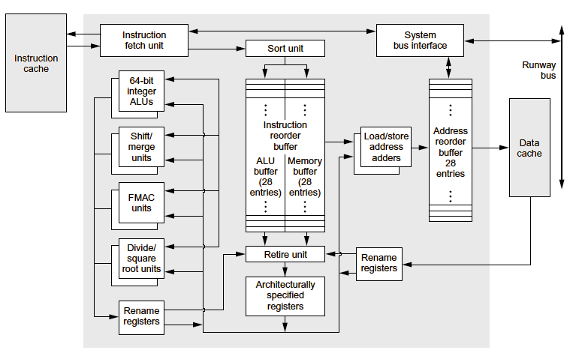
HP PA-RISC 8000

Slide 46
Processor Performance with Time
Year of introduction
Notes:
Log scale->growing exponentially
Specint = classic benchmark for integer performance
Moore’s law says: # transistors on chip doubles every 18 months-2years => ideally, performance double stoo
Pretty good prediction for this benchmark.

Slide 47
Price being paid
Notes:
Price paid == power
Greater power -> greater performance on benchmark
At top end (RHS)
Performance on spec = 100
Watts / spec = .1
.6*1000 = 10W (~1997)
2000s – high performance Intel server cores – 150W! :-(
Too hot! In 2001 – Intel VP says chips in 10 years (now) will be hotter than the surface of the sun. Yikes.

Slide 48
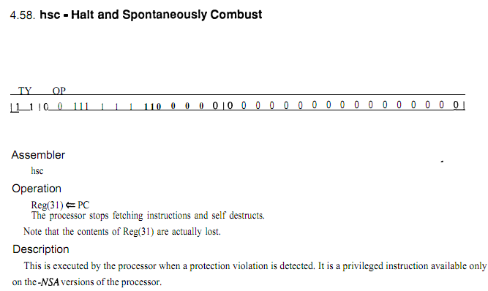
MIPS-X (1988)
ftp://reports.stanford.edu/pub/cstr/reports/csl/tr/86/289/CSL-TR-86-289.pdf
Notes:
MIPS-X out of Stanford – caught on fire on command.

