Slide 1

ECE411: Computer Organization and Design
DRAM and Its Internal Architecture
Notes:
Today we will learn about DRAM and its internal architechture; what are the tradefoos in desigining a dram

Slide 2
Memory Subsystem Organization
Memory subsystem organization
  Channel
  DIMM
  Rank
  Chip
  Bank
  Row/Column
Notes:
SO this is the organization that exists within the DRAM
We will first go bottom up and then look at it top down as well

Slide 3
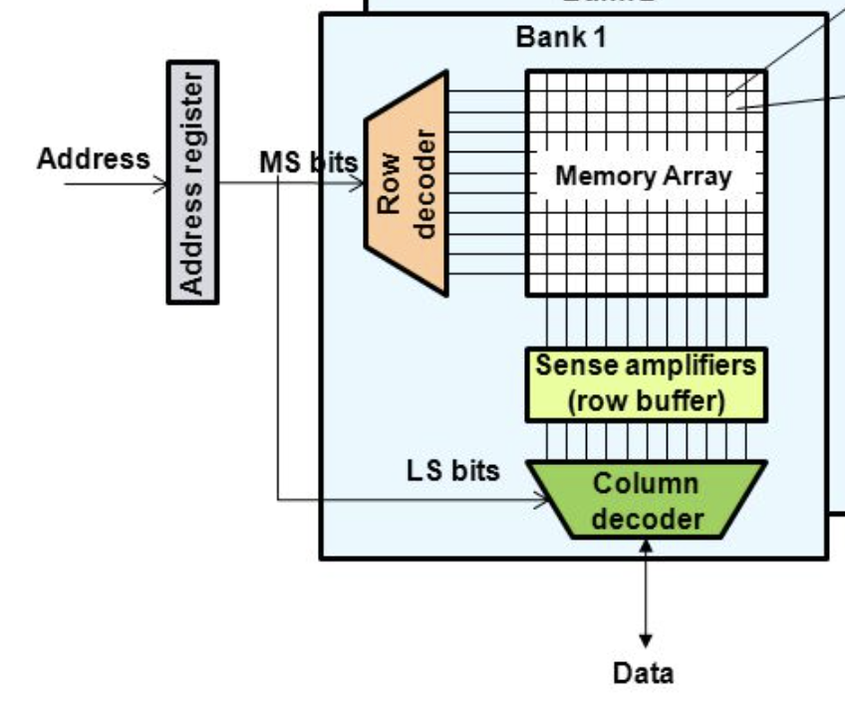
The DRAM Bank Structure
Notes:
The DRAM bank 2D structure of a
DRAM Row also called DRAM page (Not related to virtual pages)
Sense Amplifiers also called row buffers
First the row gets sensed and stored in the row buffer
The column address picks 8 bits out of the entire row
The DRAM chip contains multiple of these banks

Slide 4
DRAM Chip
Consists of multiple banks (8 is a common number today)
Banks share command/address/data buses
The chip itself has a narrow interface (4-16 bits per read)
Changing the number of banks, size of the interface (pins), whether or not command/address/data buses are shared has significant impact on DRAM system cost
Notes:
DRAM industry focused on cost,

Slide 5
DRAM Rank and Module
Rank: Multiple chips operated together to form a wide interface
All chips comprising a rank are controlled at the same time
  Respond to a single command
  Share address and command buses, but provide different data
A DRAM module consists of one or more ranks
  E.g., DIMM (dual inline memory module)
  This is what you plug into your motherboard
If we have chips with 8-bit interface, to read 8 bytes in a single access, use 8 chips in a DIMM
Notes:
Each chip has 8 bit interface, but we want a wider interface
Increasing the pin count on each chip is expensive,

Slide 6
A 64-bit Wide DIMM (One Rank)
Notes:
Each chip has the same interface, 8 of them together provide 64 bits

Slide 7
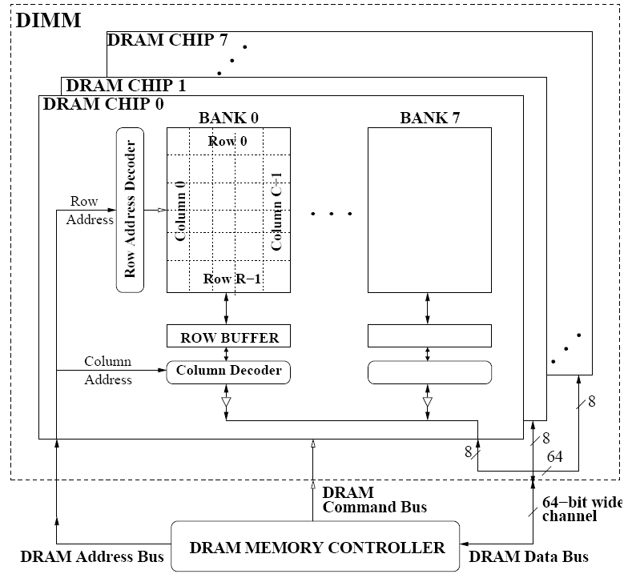
A 64-bit Wide DIMM (One Rank)
Advantages:
  Acts like a high-capacity DRAM chip with a wide interface
  Flexibility: memory controller does not need to deal with individual chips
Disadvantages:
  Granularity: Accesses cannot be smaller than the interface width
Mutlu+, “Stall-Time Fair Memory Access Scheduling for Chip Multiprocessors,” MICRO 2007.
Notes:
Wasting bw if we don’t need 64 bits

Slide 8
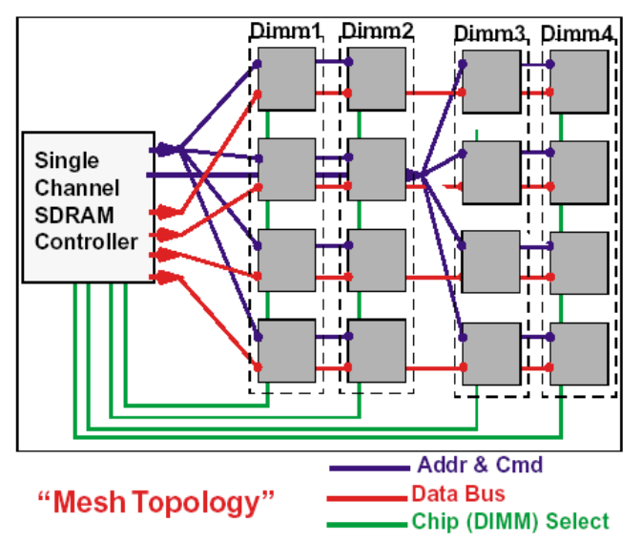
Multiple DIMMs
Advantages:
  Enables even higher capacity
Disadvantages:
  Interconnect complexity and energy consumption can be high
  → Scalability is limited by this

Slide 9
DRAM Channels
2 Independent Channels: 2 Memory Controllers
Mutlu+, “Stall-Time Fair Memory Access Scheduling for Chip Multiprocessors,” MICRO 2007.
Notes:
2 completely different accesses in parallel; double bandwidth without any restrictions
So this is great
But its very expensive, since pin area on the processor side also needs to increase.

Slide 10

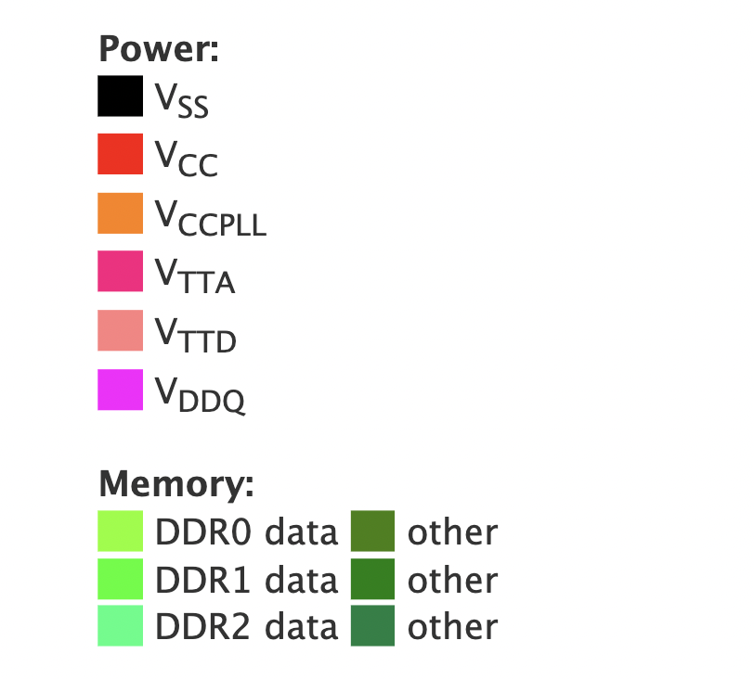
PIN Out Diagram
Notes:
1366 Pins
650 for power
400 for DDR channels

Slide 11
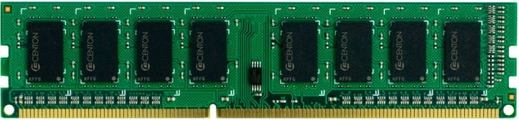
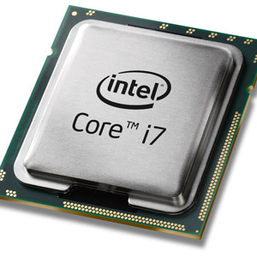
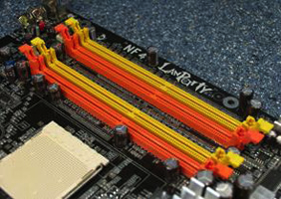
Memory Subsystem
“Channel”
DIMM (Dual in-line memory module)
Processor
Memory channel
Memory channel
Notes:
We will now quickly go over the same structure, top down.
Questions before that?
One channel; 2 DIMs attached to it

Slide 12
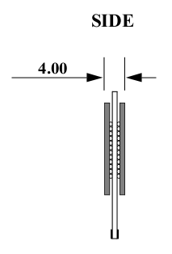
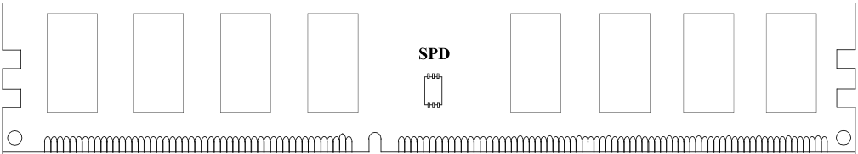
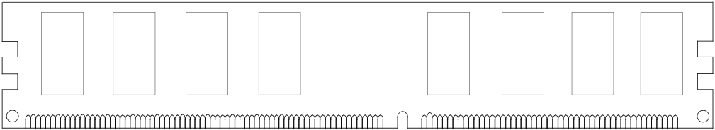
Breaking down a DIMM
DIMM (Dual in-line memory module)
Side view
Front of DIMM
Back of DIMM
Notes:
One side of DIMM is a rank

Slide 13
Breaking down a DIMM
DIMM (Dual in-line memory module)
Side view
Front of DIMM
Back of DIMM
Rank 0: collection of 8 chips
Rank 1
Notes:
Each rank is a collection of 8 chips ehre

Slide 14
Rank
Rank 0 (Front)
Rank 1 (Back)
<0:63>
<0:63>
Addr/Cmd
CS <0:1>
Data <0:63>
Memory channel
Notes:
Ranks share Addr/Cmd and data busses
Cannot access rnaks in paralelle

Slide 15
Breaking down a Rank
. . .
Chip 0
Chip 1
Chip 7
Rank 0
<0:63>
<0:7>
<8:15>
<56:63>
Data <0:63>
Notes:
Within a rank you get 64 bits, with 8 bits coming form each chip

Slide 16
Breaking down a Chip
8 banks
Chip 0
Bank 0
<0:7>
<0:7>
<0:7>
...
<0:7>
<0:7>
Notes:
Banks share cmd addr and data busses

Slide 17
Breaking down a Bank
2kB
1B (column)
row 16k-1
Bank 0
...
row 0
<0:7>
Row-buffer
1B
1B
1B
...
<0:7>

Slide 18
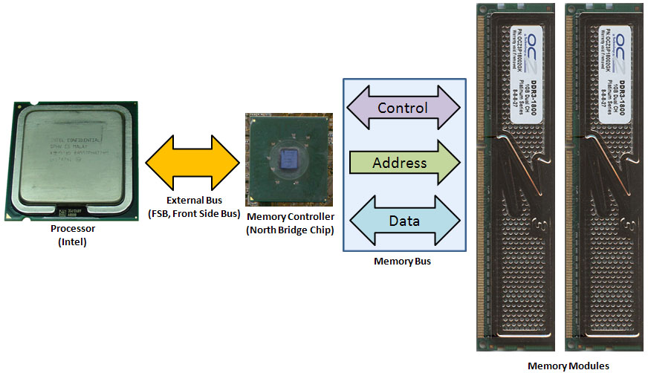
CPU-DRAM
Notes:
These days the memory controller is integrated on chip

Slide 19
Burst Access
One command access, multiple bytes are read/written.
Hardware provides multiple burst length option and software can set.

Slide 20
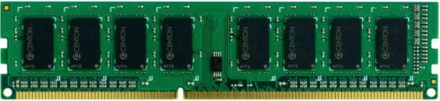


Example: Transferring a cache block
Physical memory space
0xFFFF…F
Channel 0
...
DIMM 0
Mapped to
0x40
Rank 0
64B
cache block
0x00

Slide 21
Example: Transferring a cache block
Physical memory space
Chip 0
Chip 1
Rank 0
Chip 7
0xFFFF…F
. . .
...
<0:7>
<8:15>
<56:63>
0x40
64B
cache block
Data <0:63>
0x00

Slide 22
Example: Transferring a cache block
Physical memory space
Chip 0
Chip 1
Rank 0
Chip 7
0xFFFF…F
. . .
Row 0
Col 0
...
<0:7>
<8:15>
<56:63>
0x40
64B
cache block
Data <0:63>
0x00

Slide 23
Example: Transferring a cache block
Physical memory space
Chip 0
Chip 1
Rank 0
Chip 7
0xFFFF…F
. . .
Row 0
Col 0
...
<0:7>
<8:15>
<56:63>
0x40
64B
cache block
Data <0:63>
8B
0x00
8B

Slide 24
Example: Transferring a cache block
Physical memory space
Chip 0
Chip 1
Rank 0
Chip 7
0xFFFF…F
. . .
Row 0
Col 1
...
<0:7>
<8:15>
<56:63>
0x40
64B
cache block
Data <0:63>
8B
0x00

Slide 25
Example: Transferring a cache block
Physical memory space
Chip 0
Chip 1
Rank 0
Chip 7
0xFFFF…F
. . .
Row 0
Col 1
...
<0:7>
<8:15>
<56:63>
0x40
8B
64B
cache block
Data <0:63>
8B
0x00
8B

Slide 26
Example: Transferring a cache block
Physical memory space
Chip 0
Chip 1
Rank 0
Chip 7
0xFFFF…F
. . .
Row 0
Col 1
...
<0:7>
<8:15>
<56:63>
0x40
8B
64B
cache block
Data <0:63>
8B
0x00
A 64B cache block takes 8 I/O cycles to transfer.
During the process, 8 columns are read sequentially.

Slide 27
SRAM vs. DRAM
DRAM = Dynamic RAM
SRAM: 6 transistors per bit
  built with normal high-speed CMOS technology
DRAM: 1 transistor per bit
  built with special DRAM process optimized for density

Slide 28
Hardware Structures
SRAM
DRAM
wordline
wordline
b
b
b
Bit lines
Notes:
Coupled inverters
Each inverter is 2 transisors

Slide 29
DRAM Read/Write
Write
  Charge bitline HIGH or LOW and set wordline HIGH
Read
  After bitline is precharged, the wordline is set
  Depending on the charge bitline becomes slightly higher or lower
DRAM
wordline
b

Slide 30
DRAM Chip Organization
Bit lines
Row Decoder
Row
Address
Memory
Cell Array
Word lines
Sense Amps
Row Buffer
Column
Address
Column Decoder
Data Bus

Slide 31
DRAM Chip Organization
Differences with SRAM
    reads are destructive: contents are erased after reading
  Row buffer/DRAM Page
    Read lots of bits all at once, and then parcel them out based on different column addresses
    Read from the same row buffer from different locations order

Slide 32
DRAM Read Operation
Row Decoder
0x1FE
Memory
Cell Array
Sense Amps
Row Buffer
0x001
0x002
0x000
Column Decoder
Data Bus
Accesses need not be sequential

Slide 33
Destructive Read
V_{dd}
sense amp
bitline
voltage
1
0
Wordline Enabled
Sense Amp Enabled
After read of 0 or 1, cell contains
something close to 1/2
V_{dd}
storage
cell voltage

Slide 34
Need for Writeback of DRAM Page
So after a read, the contents of the DRAM cell are gone
The values are stored in the row buffer
Write them back into the cells for the next read in the future
DRAM cells
Sense Amps
Row Buffer

Slide 35
Refresh
Fairly gradually, the DRAM cell will lose its contents even if it’s not accessed
  This is why it’s called “dynamic”
  Contrast to SRAM which is “static” in that once written, it maintains its value forever (so long as power remains on)
All DRAM rows need to be regularly read and re-written
1
0
Gate Leakage
If it keeps its value even if power is removed, then it’s “non-volatile” (e.g., flash, HDD, DVDs)

Slide 36
DRAM Refresh (I)
DRAM capacitor charge leaks over time
The memory controller needs to read each row periodically to restore the charge
  Activate + precharge each row every N ms
  Typical N = 64 ms
Implications on performance?
  -- DRAM bank unavailable while refreshed
  -- Long pause times: If we refresh all rows in burst, every 64ms the DRAM will be unavailable until refresh ends
Burst refresh: All rows refreshed immediately after one another
Distributed refresh: Each row refreshed at a different time, at regular intervals

Slide 37
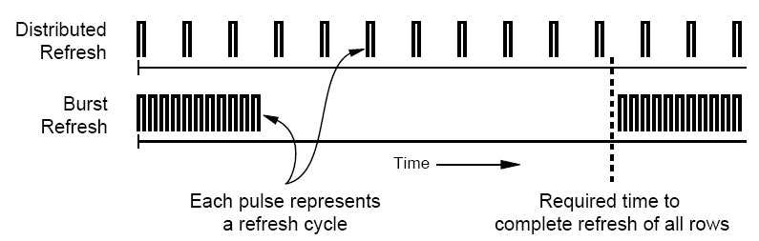
DRAM Refresh (II)
Distributed refresh eliminates long pause times
How else we can reduce the effect of refresh on performance?
  Can we reduce the number of refreshes?

Slide 38
DRAM Read Timing
Accesses are asynchronous:
triggered by RAS and CAS signals, which can in theory occur at arbitrary times (subject to DRAM timing constraints)

Slide 39
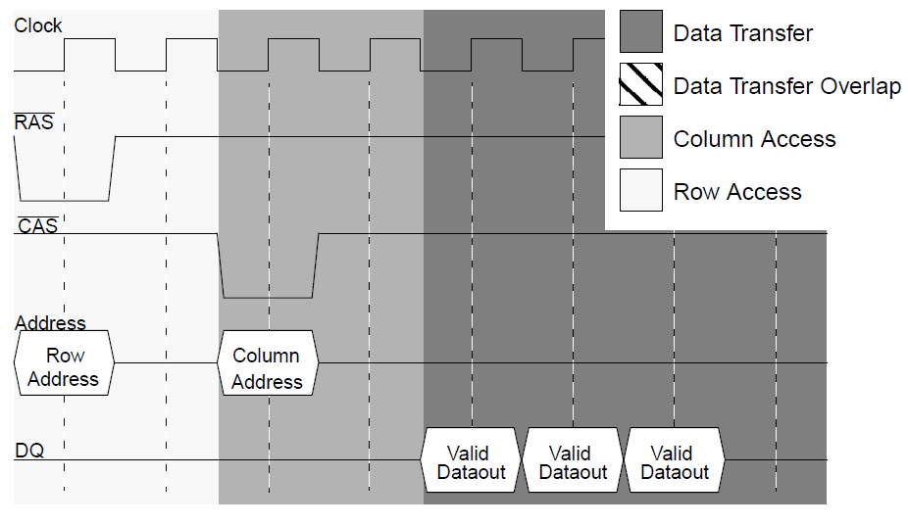
SDRAM Read Timing
Double-Data Rate (DDR) DRAM
transfers data on both rising and
falling edge of the clock
Command frequency
does not change
Burst Length
Timing figures taken from “A Performance Comparison of Contemporary
DRAM Architectures” by Cuppu, Jacob, Davis and Mudge
Notes:
elimination of multiple column address strobes, data read on each cycle during data streaming

Slide 40
DRAM Page Mode
A DRAM bank is a 2D array of cells: rows x columns
A “DRAM row” is also called a “DRAM page”
“Sense amplifiers” also called “row buffer”
Each address is a <row,column> pair
Access to a “closed row”
  Activate command opens row (placed into row buffer)
  Read/write command reads/writes column in the row buffer
  Precharge command closes the row and prepares the bank for next access
Access to an “open row”
  No need for activate command

Slide 41
DRAM Page Mode
Access to a “closed row”
  Activate command opens row (placed into row buffer)
  Read/write command reads/writes column in the row buffer
  Precharge command closes the row and prepares the bank for next access
Access to an “open row”
  No need for activate command
Row Decoder
Memory
Cell Array
Sense Amps
Row Buffer
Column Decoder
Data Bus
www.ece.cmu.edu/~omutlu/ece741

Slide 42
DRAM Bank Operation
Access Address:
(Row 0, Column 0)
Columns
(Row 0, Column 1)
(Row 0, Column 85)
(Row 1, Column 0)
Row address 0
Row address 1
Row decoder
Rows
Row Buffer
CONFLICT !
HIT
Row 1
HIT
Row 0
Empty
Column address 0
Column mux
Column address 0
Column address 1
Column address 85
Data

Slide 43
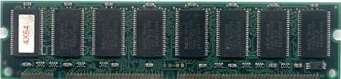
Memory Controller
Like Write-Combining Buffer,
Scheduler may coalesce multiple
accesses together, or re-order to
reduce number of row accesses
Read
Queue
Write
Queue
Response
Queue
Commands
Data
To/From CPU
Scheduler
Buffer
Memory
Controller
Bank 0
Bank 1

Slide 44
Latency Components: Basic DRAM Operation
CPU → controller transfer time
Controller latency
  Queuing & scheduling delay at the controller
  Access converted to basic commands
Controller → DRAM transfer time
DRAM bank latency
  Simple CAS if row is “open” OR
  RAS + CAS if array precharged OR
  PRE + RAS + CAS (worst case)
DRAM → CPU transfer time (through controller)

Slide 45
Open Page vs. Close Page Policies
Open Page: Keep the row opened until a conflict
  A row buffer hit will take only CAS delay: say 12.5 ns
  A row buffer conflict will take PRE+RAS+CAS: say 37.5 ns
Close Page: Close the row buffer after access
  A row buffer miss take RAS + CAS: say 12.5 + 12.5 = 25ns
Right policy depends on row buffer hit rate
  Server processors typically use close page policy

Slide 46
DRAM scheduling
Scheduling memory requests in the dram system to increase the DRAM utilization
Suggested Reading
  Rixner et al., “Memory Access Scheduling,” ISCA 2000.
  Mutlu and Moscibroda, “Parallelism-Aware Batch Scheduling: Enhancing both Performance and Fairness of Shared DRAM Systems,” ISCA 2008.

Slide 47
DRAM Scheduling Policies-I
FCFS (first come first served)
  Oldest request first
FR-FCFS (first ready, first come first served)
  1. Row-hit first
  2. Oldest first
  Goal: Maximize row buffer hit rate → maximize DRAM throughput
  Actually, scheduling is done at the command level
    Column commands (read/write) prioritized over row commands (activate/precharge)
    Within each group, older commands prioritized over younger ones

Slide 48
DRAM Scheduling Policies-II
A scheduling policy is essentially a prioritization order
Prioritization can be based on
  Request age
  Row buffer hit/miss status
  Request type (prefetch, read, write)
  Requestor type (load miss or store miss)
  Request criticality
    Oldest miss in the core?
    How many instructions in core are dependent on it?

Slide 49
Why are DRAM Controllers Difficult to Design?
Need to obey DRAM timing constraints for correctness
  There are many (50+) timing constraints in DRAM
  tWTR: Minimum number of cycles to wait before issuing a read command after a write command is issued
  tRC: Minimum number of cycles between the issuing of two consecutive activate commands to the same bank
  …
Need to keep track of many resources to prevent conflicts
  Channels, banks, ranks, data bus, address bus, row buffers
Need to handle DRAM refresh
Need to optimize for performance (in the presence of constraints)
  Reordering is not simple
  Predicting the future?

Slide 50
Multiple Banks (Interleaving) and Channels
Multiple banks
  Enable concurrent DRAM accesses
  Bits in address determine which bank an address resides in
Multiple independent channels serve the same purpose
  But they are even better because they have separate data buses
  Increased bus bandwidth
Enabling more concurrency requires reducing
  Bank conflicts
  Channel conflicts
How to select/randomize bank/channel indices in address?
  Lower order bits have more entropy
  Randomizing hash functions (XOR of different address bits)

Slide 51
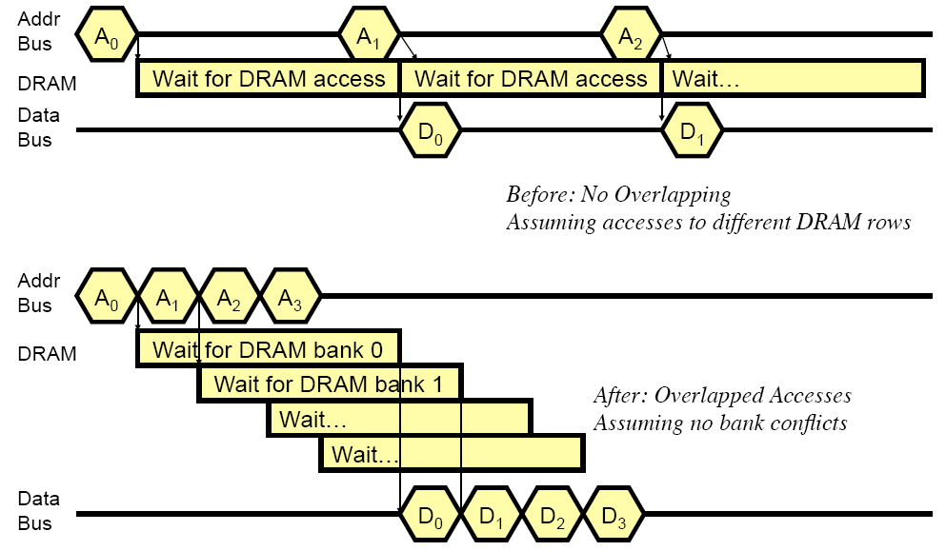
How Multiple Banks/Channels Help

Slide 52
Multiple Channels
Advantages
  Increased bandwidth
  Multiple concurrent accesses (if independent channels)
Disadvantages
  Higher cost than a single channel
    More board wires
    More pins

Slide 53
Address Mapping (Single Channel)
Single-channel system with 8-byte memory bus
  2GB memory, 8 banks, 16K rows & 2K columns per bank
Row interleaving
  Consecutive rows of memory in consecutive banks
Cache block interleaving
    Consecutive cache block addresses in consecutive banks
    64 bytes cache blocks
    Accesses to consecutive cache blocks can be serviced in parallel
    How about random accesses? Strided accesses?
Row (14 bits)
Bank (3 bits)
Column (11 bits)
Byte in bus (3 bits)
Row (14 bits)
High Column
Bank (3 bits)
Low Col.
Byte in bus (3 bits)
8 bits
3 bits

Slide 54
Bank Mapping Randomization
DRAM controller can randomize the address mapping to banks so that bank conflicts are less likely
3 bits
Column (11 bits)
Byte in bus (3 bits)
XOR
Bank index (3 bits)

Slide 55
Takeaways
DRAM Chip Organization
Destructive Read
SDRAM Read Timing
Memory Controller
Memory Scheduling
Open-Page vs. Close Page
DIMM Organization
DRAM Refresh

