Slide 1
Instruction-level Parallelism

Slide 2
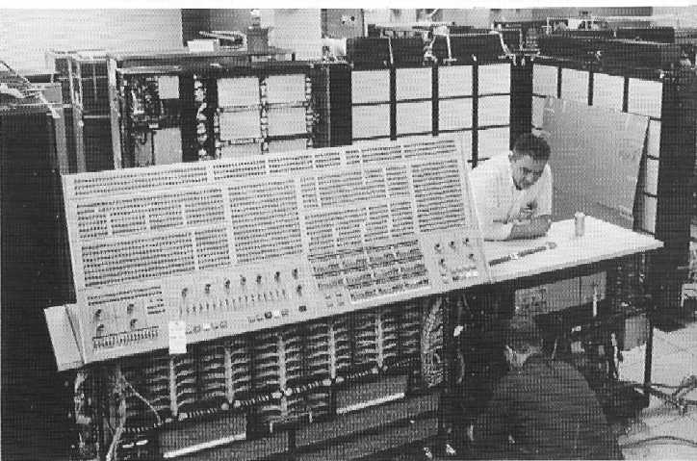
Tomasulo’s Algorithm
Developed for architecture of IBM 360/91 (1967)
360/91 system’s goal was to significantly improve performance (especially floating-point) without requiring people to change their code
Sound familiar?
16MHz
2MB Mem
50X faster
Than SOA

Slide 3
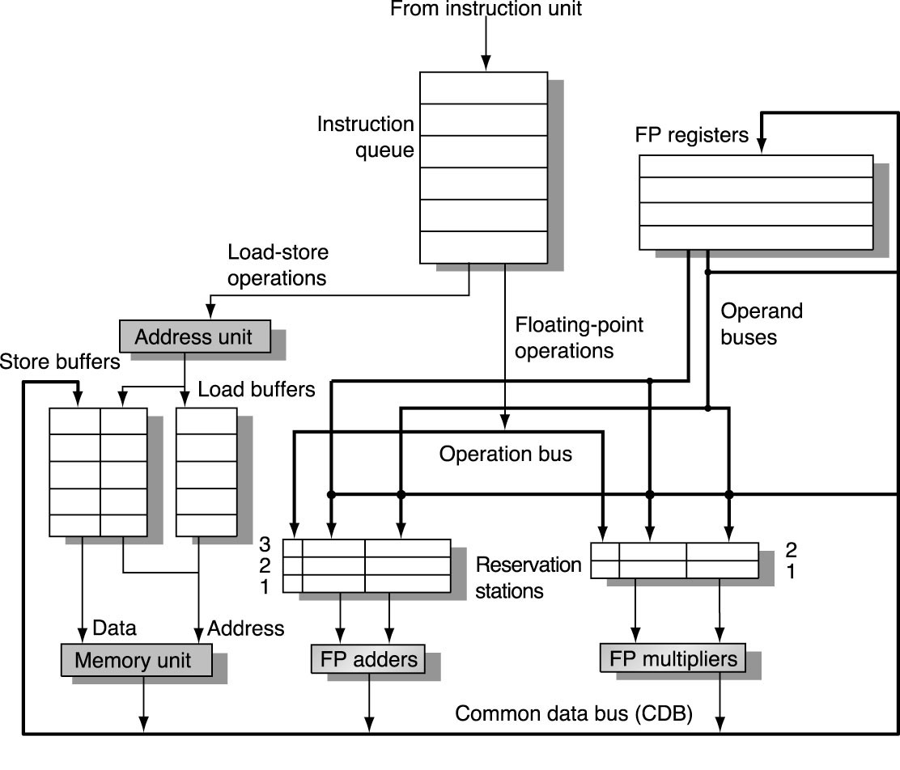
Tomasulo Organization

Slide 4
Tomasulo Algorithm
Consider three input instructions
Common Data Bus broadcasts results to all FUs
RS’s (FU’s), registers, etc. responsible for collecting own data off CDB
Load and Store Queues treated as FUs as well

Slide 5
Reservation Station Components
Op—Operation to perform in the unit (e.g., + or –)
Qj, Qk—Reservation stations producing source registers
Vj, Vk—Value of Source operands
Rj, Rk—Flags indicating when Vj, Vk are ready
Busy—Indicates reservation station is busy
Register result status—Indicates which functional unit will write each register, if one exists. Blank when no pending instructions that will write that register.
Notes:
What you might have thought
1. 4 stages of instruction executino
2.Status of FU: Normal things to keep track of (RAW & structura for busyl):
Fi from instruction format of the mahine (Fi is dest)
Add unit can Add or Sub
Rj, Rk - status of registers (Yes means ready)
Qj,Qk - If a no in Rj, Rk, means waiting for a FU to write result; Qj, Qk means wihch FU waiting for it
3.Status of register result (WAW &WAR)s:
which FU is going to write into registers
Scoreboard on 6600 = size of FU
6.7, 6.8, 6.9, 6.12, 6.13, 6.16, 6.17
FU latencies: Add 2, Mult 10, Div 40 clocks

Slide 6
Three Stages of Tomasulo Algorithm
1. Issue—get instruction from FP Op Queue
If reservation station free, the scoreboard issues instr & sends operands (renames registers).
2. Execution—operate on operands (EX)
When both operands ready then execute; if not ready, watch CDB for result
3. Write result—finish execution (WB)
Write on Common Data Bus to all waiting units; mark reservation station available.

Slide 7
Tomasulo Example
ADDD F4, F2, F0
MULD F8, F4, F2
ADDD F6, F8, F6
SUBD F8, F2, F0
ADDD F2, F8, F0
Multiply takes 10 clocks, add/sub take 4

Slide 8
Tomasulo – cycle 0
ADDD F4, F2, F0
MULD F8, F4, F2
ADDD F6, F8, F6
SUBD F8, F2, F0
ADDD F2, F8, F0
Instruction Queue
ADDD F2, F8, F0
F0
F2
F4
F6
F8
0.0
2.0
SUBD F8, F2, F0
4.0
ADDD F6, F8, F6
6.0
MULD F8, F4, F2
8.0
ADDD F4, F2, F0
1
2
3
1
2
FP adders
FP mult’s
Notes:
First instruction
-issue to RS
-read operands
-mark register

Slide 9
Tomasulo – cycle 1
ADDD F4, F2, F0
MULD F8, F4, F2
ADDD F6, F8, F6
SUBD F8, F2, F0
ADDD F2, F8, F0
Instruction Queue
F0
F2
F4
F6
F8
0.0
2.0
ADDD F2, F8, F0
4.0
add1
SUBD F8, F2, F0
6.0
ADDD F6, F8, F6
8.0
MULD F8, F4, F2
1
2
3
ADDD
2.0
0.0
1
2
FP adders
FP mult’s
Notes:
Add will begin execute, Blow up next, because this
One is a little more interesting

Slide 10
Tomasulo – cycle 2
ADDD F4, F2, F0
MULD F8, F4, F2
ADDD F6, F8, F6
SUBD F8, F2, F0
ADDD F2, F8, F0
Instruction Queue
F0
F2
F4
F6
F8
0.0
2.0
Op Qj Qk Vj Vk Busy
4.0
add1
MULD add1 - - 2.0 Y
ADDD F2, F8, F0
6.0
SUBD F8, F2, F0
8.0
mult1
ADDD F6, F8, F6
1
2
3
ADDD
2.0
0.0
1
2
MULD
add1
2.0
FP adders
FP mult’s

Slide 11
Tomasulo – cycle 2
ADDD F4, F2, F0
MULD F8, F4, F2
ADDD F6, F8, F6
SUBD F8, F2, F0
ADDD F2, F8, F0
Instruction Queue
F0
F2
F4
F6
F8
0.0
2.0
4.0
add1
ADDD F2, F8, F0
6.0
SUBD F8, F2, F0
8.0
mult1
ADDD F6, F8, F6
1
2
3
ADDD
2.0
0.0
1
2
MULD
add1
2.0
FP adders
FP mult’s

Slide 12
Tomasulo – cycle 3
ADDD F4, F2, F0
MULD F8, F4, F2
ADDD F6, F8, F6
SUBD F8, F2, F0
ADDD F2, F8, F0
Instruction Queue
F0
F2
F4
F6
F8
0.0
2.0
4.0
add1
6.0
add2
ADDD F2, F8, F0
8.0
mult1
SUBD F8, F2, F0
1
2
3
ADDD
2.0
0.0
ADDD
mult1
6.0
1
2
MULD
add1
2.0
FP adders
FP mult’s

Slide 13
Tomasulo – cycle 4
ADDD F4, F2, F0
MULD F8, F4, F2
ADDD F6, F8, F6
SUBD F8, F2, F0
ADDD F2, F8, F0
Instruction Queue
F0
F2
F4
F6
F8
0.0
2.0
4.0
add1
6.0
add2
8.0
add3
ADDD F2, F8, F0
1
2
3
ADDD
2.0
0.0
ADDD
mult1
6.0
1
2
MULD
add1
2.0
SUBD
2.0
0.0
FP adders
FP mult’s

Slide 14
Tomasulo – cycle 5
ADDD F4, F2, F0
MULD F8, F4, F2
ADDD F6, F8, F6
SUBD F8, F2, F0
ADDD F2, F8, F0
Instruction Queue
F0
F2
F4
F6
F8
0.0
2.0
2.0
-
6.0
add2
8.0
add3
ADDD F2, F8, F0
1
2
3
ADDD
2.0
0.0
ADDD
mult1
6.0
1
2
MULD
2.0
2.0
SUBD
2.0
0.0
FP adders
FP mult’s
2.0 (add1 result)

Slide 15
Tomasulo – cycle 6
ADDD F4, F2, F0
MULD F8, F4, F2
ADDD F6, F8, F6
SUBD F8, F2, F0
ADDD F2, F8, F0
Instruction Queue
F0
F2
F4
F6
F8
0.0
2.0
add1
2.0
-
6.0
add2
8.0
add3
1
2
3
ADDD
add3
0.0
ADDD
mult1
6.0
1
2
MULD
2.0
2.0
SUBD
2.0
0.0
FP adders
FP mult’s

Slide 16
Tomasulo – cycle 8
ADDD F4, F2, F0
MULD F8, F4, F2
ADDD F6, F8, F6
SUBD F8, F2, F0
ADDD F2, F8, F0
Instruction Queue
F0
F2
F4
F6
F8
0.0
2.0
add1
2.0
-
6.0
add2
2.0
-
1
2
3
ADDD
2.0
0.0
ADDD
mult1
6.0
1
2
MULD
2.0
2.0
SUBD
2.0
0.0
FP adders
FP mult’s
2.0 (add3 result)

Slide 17
Tomasulo – cycle 9
ADDD F4, F2, F0
MULD F8, F4, F2
ADDD F6, F8, F6
SUBD F8, F2, F0
ADDD F2, F8, F0
Instruction Queue
F0
F2
F4
F6
F8
0.0
2.0
add1
2.0
6.0
add2
2.0
1
2
3
ADDD
2.0
0.0
ADDD
mult1
6.0
1
2
MULD
2.0
2.0
FP adders
FP mult’s
Notes:
Skip to cycle 12, where the add will complete

Slide 18
Tomasulo – cycle 12
ADDD F4, F2, F0
MULD F8, F4, F2
ADDD F6, F8, F6
SUBD F8, F2, F0
ADDD F2, F8, F0
Instruction Queue
F0
F2
F4
F6
F8
0.0
2.0
-
2.0
6.0
add2
2.0
1
2
3
ADDD
2.0
0.0
ADDD
mult1
6.0
1
2
MULD
2.0
2.0
FP adders
FP mult’s
2.0 (add1 result)
Notes:
Skip to 15, when the multiply will complete

Slide 19
Tomasulo – cycle 15
ADDD F4, F2, F0
MULD F8, F4, F2
ADDD F6, F8, F6
SUBD F8, F2, F0
ADDD F2, F8, F0
Instruction Queue
F0
F2
F4
F6
F8
0.0
2.0
-
2.0
6.0
add2
2.0
1
2
3
ADDD
4.0
6.0
1
2
MULD
2.0
2.0
FP adders
FP mult’s
4.0 (mult1 result)

Slide 20
Tomasulo – cycle 16
ADDD F4, F2, F0
MULD F8, F4, F2
ADDD F6, F8, F6
SUBD F8, F2, F0
ADDD F2, F8, F0
Instruction Queue
F0
F2
F4
F6
F8
0.0
2.0
-
2.0
6.0
add2
2.0
1
2
3
ADDD
4.0
6.0
1
2
FP adders
FP mult’s

Slide 21
Tomasulo – cycle 19
ADDD F4, F2, F0
MULD F8, F4, F2
ADDD F6, F8, F6
SUBD F8, F2, F0
ADDD F2, F8, F0
Instruction Queue
F0
F2
F4
F6
F8
0.0
2.0
2.0
10.0
-
2.0
1
2
3
ADDD
4.0
6.0
1
2
FP adders
FP mult’s
10.0 (add2 result)

Slide 22
Tomasulo Summary
Prevents Register as bottleneck
Avoids WAR, WAW hazards
Lasting Contributions
Dynamic scheduling
Register renaming (in what way does the register name change?)
Load/store disambiguation
Notes:
Can dispatch multiple insts in 1 cycle, because all
Reading locally

Slide 23
Limitations
Exceptions/interrupts
Can’t identify a particular point in the program at which an interrupt/exception occurs
How do you know where to go back to after an interrupt handler completes?
OOO completion???
Interaction with pipelined ALUs
Reservation station couldn’t be released until instruction completes, would need many reservation stations.

