Slide 1
Cache Memories

Slide 2
Cache Organization -- Recap
A typical cache has three dimensions
tag index block offset
tag data
tag data
tag data
tag data
tag data
tag data
tag data
tag data
Number of sets (cache size)
tag data
Blocks/set (associativity)
tag data
tag data
tag data
.
.
.
tag data
tag data
tag data
tag data
Bytes/block (block size)

Slide 3
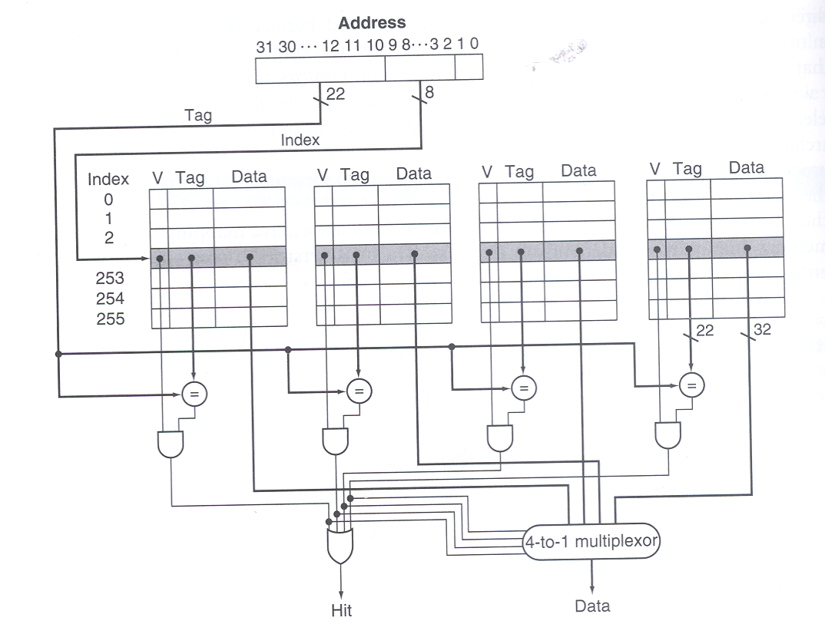
A 4-way set associative cache

Slide 4
Putting it all together
64 KB cache, direct-mapped, 32-byte cache block
31 30 29 28 27 ........... 17 16 15 14 13 12 11 10 9 8 7 6 5 4 3 2 1 0
tag
index
11
word offset
16
valid
tag
data
0
1
2
...
...
...
...
2045
2046
2047
64 KB / 32 bytes =
2 K cache blocks/sets
256
=
hit/miss
32

Slide 5
A set associative cache
32 KB cache, 2-way set-associative, 16-byte blocks
31 30 29 28 27 ........... 17 16 15 14 13 12 11 10 9 8 7 6 5 4 3 2 1 0
tag
index
10
word offset
18
valid
tag
data
valid
tag
data
0
1
2
...
...
...
...
1021
1022
1023
32 KB / 16 bytes / 2 =
1 K cache sets
=
=
hit/miss

Slide 6
Three Cs (Cache Miss Terms)
Compulsory Misses:
Cold start misses (caches do not have valid data at the start of the program)
0x1234
Processor
Cache

Slide 7
Three Cs (Cache Miss Terms)
Capacity Misses:
Increase cache size
0x1234
0x5678
0x91B1
0x1111
Processor
Cache

Slide 8
Three Cs (Cache Miss Terms)
Conflict Misses:
Increase cache size and/or associativity.
Associative caches reduce conflict misses
0x1234
0x5678
0x91B1
0x1111
Processor
Cache

Slide 9
Cache Parameters
Cache size = Number of sets * block size * associativity
128 blocks, 32-byte blocks, direct mapped, size = ?
128 KB cache, 64-byte blocks, 512 sets, associativity = ?

Slide 10
Sample Problem
A cache has a capacity of 32 KB and 256-byte lines. On a machine with a 32-bit virtual address space, how many bits long are the tag, set, and offset fields for
A direct-mapped implementation?
A four-way set-associative implementation?
A fully-associative implementation?

Slide 11
Sample Problem Version II
A cache has a capacity of 32 KB and 256-byte in a set. On a machine with a 32-bit address space, how many bits long are the tag, set, and offset fields for
A direct-mapped implementation?
A four-way set-associative implementation?
A eight-way set-associative implementation?

Slide 12
Another example
16 KB, 4-way set-associative cache, 32-bit address, byte-addressable memory, 32-byte cache blocks/lines
how many tag bits?
Where would you find the word at address 0x200356A4?
index
tag data
tag data
tag data
tag data

Slide 13
PIRW
Placement
Identification
Replacement
Writes

Slide 14
Replacement Policies for Associative Caches
Least-Recently-Used (LRU): Evict the line that has been least recently referenced
Need to keep track of order that lines in a set have been referenced
Overhead to do this gets worse as associativity increases
Random: Just pick one at random
Easy to implement
Slightly lower hit rates than LRU on average
Not-Most-Recently-Used: Track which line in a set was referenced most recently, pick randomly from the others
Compromise in both hit rate and implementation difficulty
Virtual memories use similar policies, but are willing to spend more effort to improve hit rate

Slide 15
LRU: Precise Tracking
Precise LRU tracking requires a stack for each set
When a block is accessed by the processor, check if its name is in the stack. If so, remove it from the stack. Push the name of block at the top of the stack
The position (depth) of a block name in the stack gives the relative recency of access to this block compared to others
For a 4-way set associative cache with blocks A, B, C, D.
Assume a sequence of accesses C, D, A, B, A, C, B, D
Assume that the stack is initially empty, the configuration of the stack after each access would be [C,-,-,-], [D, C,-,-], [A, D, C,-], [B, A, D, C], [A, B, D, C], [C, A, B, D], [B, C, A, D], [D, B, C, A]
The one on the right most position (bottom of the stack) is the least recently used
Each name takes two bits, so the stack is an 8-bit register with associated logic (Slog₂S where S is associativity)

Slide 16
LRU Example
MRU
MRU-1
LRU+1
LRU
A
B
C
D
Access C
C
A
B
D
Access D
D
C
A
B
Access E
MISS, replacement
needed
E
D
C
A
Access C
C
E
D
A
Access G
MISS, replacement
needed
G
C
E
D

Slide 17
LRU From Hardware Perspective
LRU
Way3
Way2
Way1
Way0
State
machine
Access
update
Access D
A
B
C
D
LRU policy increases cache access times
Additional hardware bits needed for LRU state machine

Slide 18
LRU: Approximate Tracking (Pseudo-LRU)
LRU stacks expensive to implement at high ‘S’
Most caches use approximate LRU
A popular approach uses S-1 bits for an S-way cache
The blocks are hierarchically divided into a binary tree
At each level of the tree, one bit is used to track the least recently used
For a 4-way set associate cache, blocks are first divided into two halves, each half has two blocks
The 1st bit tracks the more recently used half
The 2nd bit (3rd) tracks the more recently block in the first (second) half
The one to replace is the less recently used block in the less recently used half
used in the CPU cache of many commercial processors

Slide 19
Pseudo LRU Algorithm (4-way SA)
Tree-based
O(N): 3 bits for 4-way
Cache ways are the leaves of the tree
Combine ways as we proceed towards the root of the tree
AB/CD bit (L0)
A/B bit (L1)
C/D bit (L2)
Way A
Way B
Way C
Way D
Way3
Way2
Way1
Way0
A
B
C
D

Slide 20
Pseudo LRU Algorithm
AB/CD bit (L0)
Less hardware than LRU &
Faster than LRU
A/B bit (L1)
C/D bit (L2)
Way A
Way B
Way C
Way D
L2L1L0 = 010,
a way needs to be replaced, which way would be chosen?
L2L1L0 = 000,
there is a hit in Way B, what is the new updated L2L1L0?
LRU update algorithm
Replacement Decision
CD
AB
AB/CD
CD
AB
AB/CD
Way hit | L2 | L1 | L0
Way A | --- | 0 | 0
Way B | --- | 1 | 0
Way C | 0 | --- | 1
Way D | 1 | --- | 1
L2 | L1 | L0 | Way to replace
X | 1 | 1 | Way A
X | 0 | 1 | Way B
1 | X | 0 | Way C
0 | X | 0 | Way D

Slide 21
Pseudo LRU example
For a 4-way cache with blocks A, B, C, & D.
Assume that A and B form the first half (half 0) and C and D form the second half (half 1)
Within the first half, A is block 0 and B is block 1.
Within the second half, C is block 0 and D is block 1.
Assume sequence of accesses C, D, A, B, A, C, B, D
The configuration of the tree after each access would be [1, -, 0], [1, -, 1], [0, 0, 1], [0, 1, 1], [0, 0, 1], [1, 0, 0], [0, 1, 0], [1, 1, 1]
Note that a replacement after C, D, A, B, A, C would have chosen B rather than D (D would be picked by LRU).

Slide 22
LRU Algorithms
True LRU
Expensive in terms of speed and hardware
Need to remember the order in which all N lines were last accessed
N! scenarios – O(log N!) ≈ O(N log N) LRU bits
2-ways → AB BA = 2 = 2!
3-ways → ABC ACB BAC BCA CAB CBA = 6 = 3!
Pseudo LRU: O(N)
Approximates LRU policy with a binary tree

Slide 23
How about an approximate LRU for 8-way?

Slide 24
A Sample Replacement Policy Question
A byte-addressable computer has a small 32-byte cache. Assume 4-byte cache lines. When a given program is executed, the processor reads data from the following sequence of hex addresses: 200, 204, 208, 20C, 2F4, 2F0, 200, 204, 218, 21C, 24C, 2F4. This pattern is repeated four times.
(a) Show the contents of the cache at the end of each pass throughout this loop if a direct-mapped cache is used. Compute the hit rate for this example. Assume that the cache is initially empty.
(b) Repeat part (a) for a fully-associative cache that uses the LRU-replacement algorithm.
(c) Repeat part (a) for a fully-associative cache that uses the approximate LRU replacement algorithm.

Slide 25
You should be able to complete the answer
200, 204, 208, 20C, 2F4, 2F0, 200, 204, 218, 21C, 24C, 2F4 (Hex Address)
4-byte blocks so block address sequence in Hex is
80, 81, 82, 83, BD, BC, 80, 81, 86, 87, …
Direct mapped, 8 blocks
1000 0000, 1000 0001, 1000 0010, 1000 0011, 1010 1101, 1010 1100, 1000 0000, 1000 0001, 1000 0110, 1000 0111,
For direct map, there is no room for policy
Complete your answer…
For fully associative cache, it is really an 8-way, 1-set cache, all block address bits are used
Complete your answer…

Slide 26
Another Question
Consider a 128 byte 2-way set associative write-back cache with 16 byte blocks. Assume LRU replacement and that dirty bits are used to avoid writing back clean blocks. Complete the table below for a sequence of memory references (occurring from left to right).
Address (in decimal): 064 032 064 000 112 064 128 048 240 000 read/write: r r r r w w r r r w
Assume that cache starts empty

Slide 27
You should complete the answer
16 byte blocks, 4 LSB byte offset
064 032 064 000 112 064 128 048 240 000
There are 4 sets with 2 blocks each
V D Tag Data
V D Tag Data
Block Addr. | 4 | 2 | 4 | 0 | 7 | 4 | 8
R/W | R | R | R | R | W | W | R | R | R | W
Set# | 0 | 2 | 0 | 0 | 3 | 0
Tag | 1 | 0 | 1 | 0 | 1 | 1
H/M | M | M | H | M
Writeback? | N | N

