Slide 1
Cache Memories

Slide 2
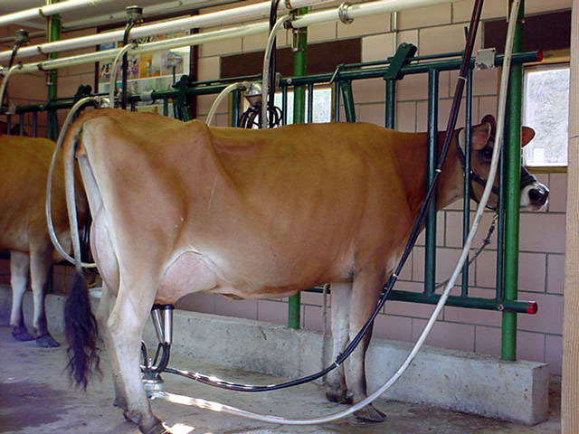
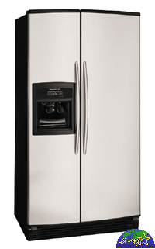
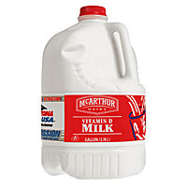
Model of Memory Hierarchy
Increasing Speed
SRAM
Physical Memory
DRAM
Virtual Memory
DISK
Reg
File
L1
Data cache
L2
Cache
Main
Memory
L1
Inst cache
Increasing Capacity

Slide 3
Four Central Questions in Designing a Cache
P-I-R-W:
placement: where can a block of memory go?
identification: how do i find a block of memory?
replacement: how do i make space for new blocks?
write policy: how do i propagate changes?
need to consider these for all levels of the memory hierarchy
L1/L2/L3 caches now
main memory, disks have similar issues, addressed later

Slide 4
Types of Caches
type of cache | mapping of data from memory to cache | complexity of searching the cache
direct mapped (DM) | a memory value can be placed at a single corresponding location in the cache | fast indexing mechanism
set-associative (SA) | a memory value can be placed in any of a set of locations in the cache | slightly more involved search mechanism
fully-associative (FA) | a memory value can be placed in any location in the cache | extensive hardware resources required to search (CAM)

Slide 5
Direct Mapping
Direct mapping:
A memory value can only be placed at a single corresponding location in the cache
Tag
Index
Data
00000
0
00000
0
0x55
0x55
0x0F
00000
0x0F
1
00000
00000
1
00001
0
11111
11111
0
0xAA
0xAA
0xF0
11111
0xF0
11111
11111
1

Slide 6
Direct-Mapped: One cache location for each address

Slide 7
Fully Associative Mapping
Fully-associative mapping:
A memory value can be placed anywhere in the cache
Tag
Data
000000
0000
0x55
000000
0x55
0000
0x55
0x55
0x0F
0x0F
0x0F
000001
0x0F
0000
000001
0000
000110
000110
111110
1111
111110
1111
0xAA
0xAA
0xAA
0xAA
0xF0
0xF0
0xF0
111111
0xF0
1111
111111
1111

Slide 8
Fully-Associative: Anything Can Go Anywhere

Slide 9
Set Associative Mapping (2-Way)
Set-associative mapping:
A memory value can be placed in any location of a set in the cache
Tag
Index
Data
Way 0
Way 1
0000 0
0x55
0
0000 0
0
0x55
0x0F
1
0000 1
0x0F
1
0000 1
0
1111 0
0
0xAA
1111 0
0xAA
0xF0
1111 1
0xF0
1
1111 1

Slide 10
Compromise: Set-Associative Caches

Slide 11
Write-through Policy
0x1234
0x1234
0x5678
0x1234
0x5678
0x1234
Processor
Cache
Memory

Slide 12
Write-back Policy
0x1234
0x1234
0x1234
0x5678
?????
0x9ABC
0x5678
0x1234
0x5678
Processor
Cache
Write miss
Memory

