Slide 1
ECE411: Computer Organization and Design Lecture 2: Instruction Set Architecture
Rakesh Kumar

Slide 2
Instruction Set Architecture (ISA)
Q: What is the function of ISA?
serves as an interface between software and hardware
provides a mechanism by which the software tells the hardware what should be done
high level language code : C, C++, Java, Fortran,
compiler
assembly language code: architecture specific statements
assembler
machine language code: architecture specific bit patterns
SW
ISA
HW

Slide 3
Interface Design
Q: What does interface mean in computer systems/architecture design?
a good interface:
lasts through many implementations (portability, compatibility)
is used in different ways (generality)
provides convenient functionality to higher levels
permits an efficient implementation at lower levels
use
imp 1
interface
use
imp 2
use
imp 3

Slide 4
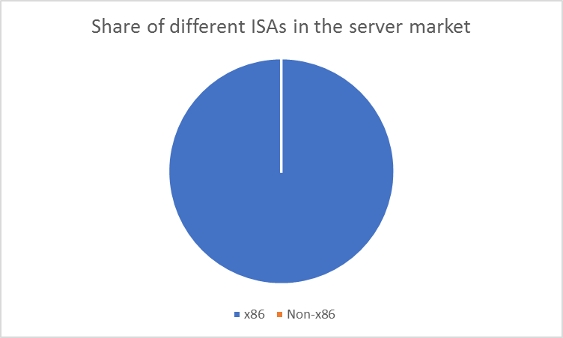
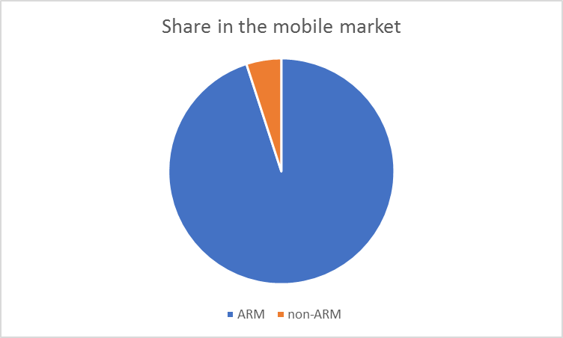
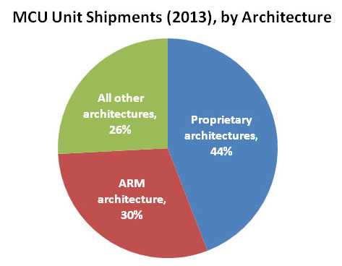
Today’s ISAs

Slide 5
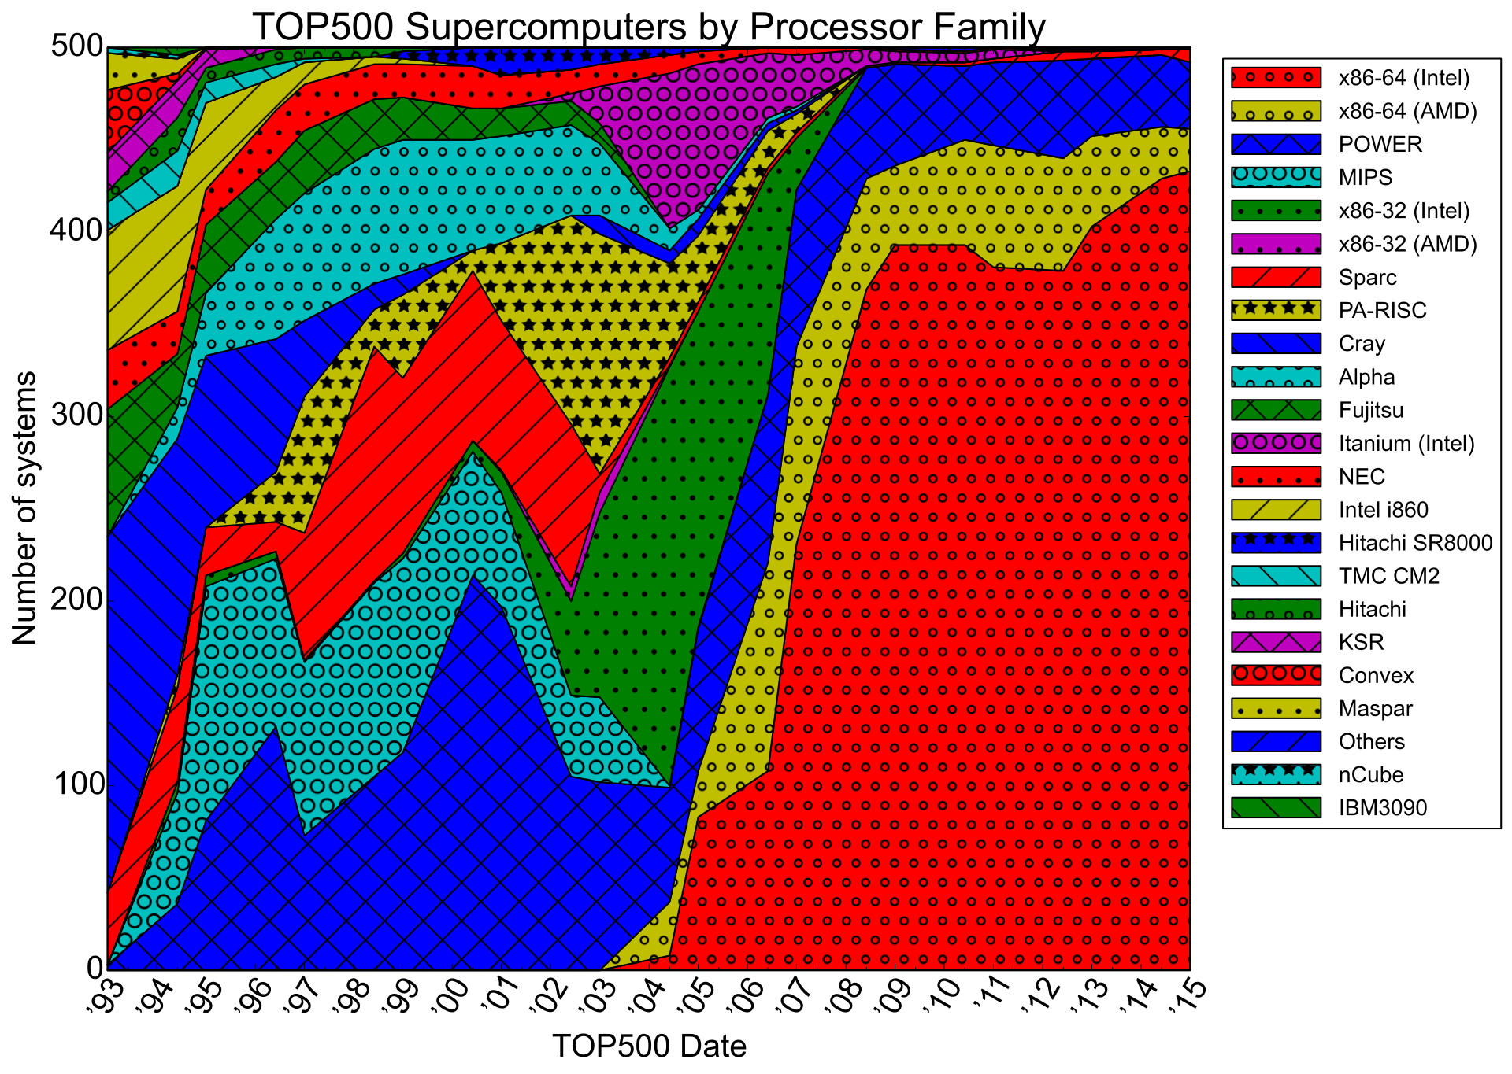

Slide 6
Case Study: ARM in server space
1. There’s no desktop development environment (where apps can be developed/debugged before deploying on the cloud). 2. Very few players, so no reason to develop a software ecosystem. 3. Very public failures, discourages new efforts.
4. Poor performance of existing ARM servers
5. Geopolitics will discourage ARM further 6. Resurgence of AMD means that need for ARM is weaker.

Slide 7
Case Study: RISC-V

Slide 8
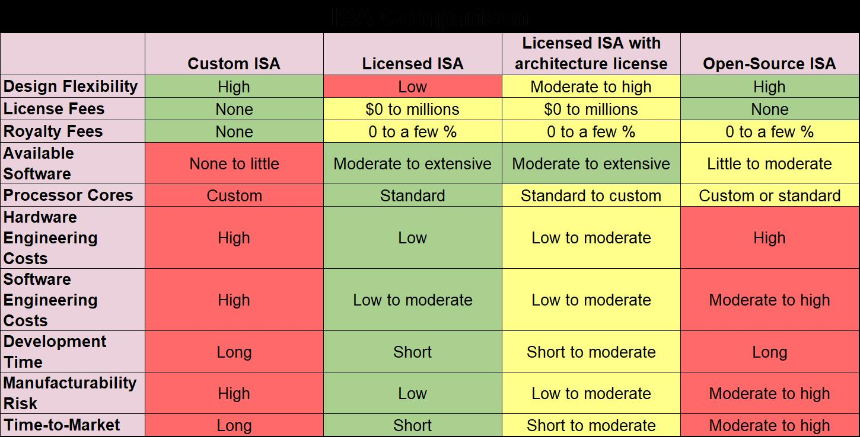
https://www.forbes.com/sites/tiriasresearch/2018/04/05/what-you-need-to-know-about-processor-architectures/#72fec5344f57

Slide 9
Interface Design
Q: What does interface mean in computer systems/architecture design?
a good interface:
lasts through many implementations (portability, compatibility)
is used in different ways (generality)
provides convenient functionality to higher levels
permits an efficient implementation at lower levels
use
imp 1
interface
use
imp 2
use
imp 3

Slide 10
Instruction Set Design Issues
Q: As a hardware architect, what you should consider in ISA design?
instruction set design issues include:
where are operands stored?
registers, memory, stack, accumulator
how many explicit operands are there?
0, 1, 2, or 3
how is the operand location specified?
register, immediate, indirect, . . .
what type & size of operands are supported?
byte, int, float, double, string, vector. . .
what operations are supported?
add, sub, mul, move, compare . . .

Slide 11
Instruction Length
variable:
fixed:
x86 – Instructions vary from 1 to 17 Bytes long
MIPS, PowerPC, and most other RISC’s:
all instruction are 4 Bytes long
Notes:
VAX: virtual address extension (developed by DEC in middle 1970s)

Slide 12
Instruction Length
variable-length instructions (x86):
require multi-step, complex fetch and decode (-)
allow smaller binary programs that require less disk storage, less DRAM at runtime, less memory, bandwidth and better cache efficiency (+)
fixed-length instructions (RISC’s)
allow easy fetch and decode (+)
simplify pipelining and parallelism (+)
result in larger binary programs that require more disk storage, more DRAM at runtime, more memory bandwidth and lower cache efficiency (-)

Slide 13
Case Study: ARM
How can we overcome the limitation of fixed-length instructions?
ARM (Advanced RISC Machine)
started with fixed, 32-bit instruction length
added thumb instructions
a subset of the 32-bit instructions
all encoded in 16 bits
all translated into equivalent 32-bit instructions within the processor pipeline at runtime
can access only 8 general purpose registers
motivated by many resource constrained embedded applications that require less disk storage, less DRAM at runtime, less memory bandwidth and better cache efficiency
Q: How about RISC-V?
Notes:
65% of the size of ARM code, and provides 1.6x of the performance of ARM, it is very good for embedded applications with restricted memory bandwidth where code density and footprint is important.

Slide 14
How many registers?
most computers have a small set of registers
on-chip memory to hold values that will be used soon
a typical instruction use 2 or 3 register values
advantages of a small number of registers:
it requires fewer instruction bits to specify which one
less hardware
faster access (shorter wires, fewer gates)
faster context switch (when all registers need saving)
advantages of a larger number:
fewer loads and stores needed
easier to express several operations in parallel

Slide 15
Where do operands reside?
When the ALU needs them?
stack machine:
push loads memory into 1st register (“top of stack”), moves other regs down
pop does the reverse
add combines contents of first two registers, moves rest up
accumulator machine:
only 1 register (called the “accumulator”)
instruction includes store and ACC← ACC + MEM
register-memory machine :
arithmetic instructions can use data in registers and/or memory
load-store machine (aka register-register machine):
arithmetic instructions can only use data in registers

Slide 16
Classifying ISAs
accumulator (before 1960, e.g., 68HC11):
1-address add A acc ← acc + mem[A]
stack (1960s to 1970s):
0-address add tos ← tos + next
memory-memory (1970s to 1980s):
2-address add A, B mem[A] ← mem[A] + mem[B]
3-address add A, B, C mem[A] ← mem[B] + mem[C]
register-memory (1970s to present, e.g., 80x86):
2-address add R1, A R1 ← R1 + mem[A]
load R1, A R1 ← mem[A]
register-register (load/store) (1960s to present, e.g., MIPS):
3-address add R1, R2, R3 R1 ← R2 + R3
load R1, R2 R1 ← mem[R2]
store R1, R2 mem[R1] ← R2

Slide 17
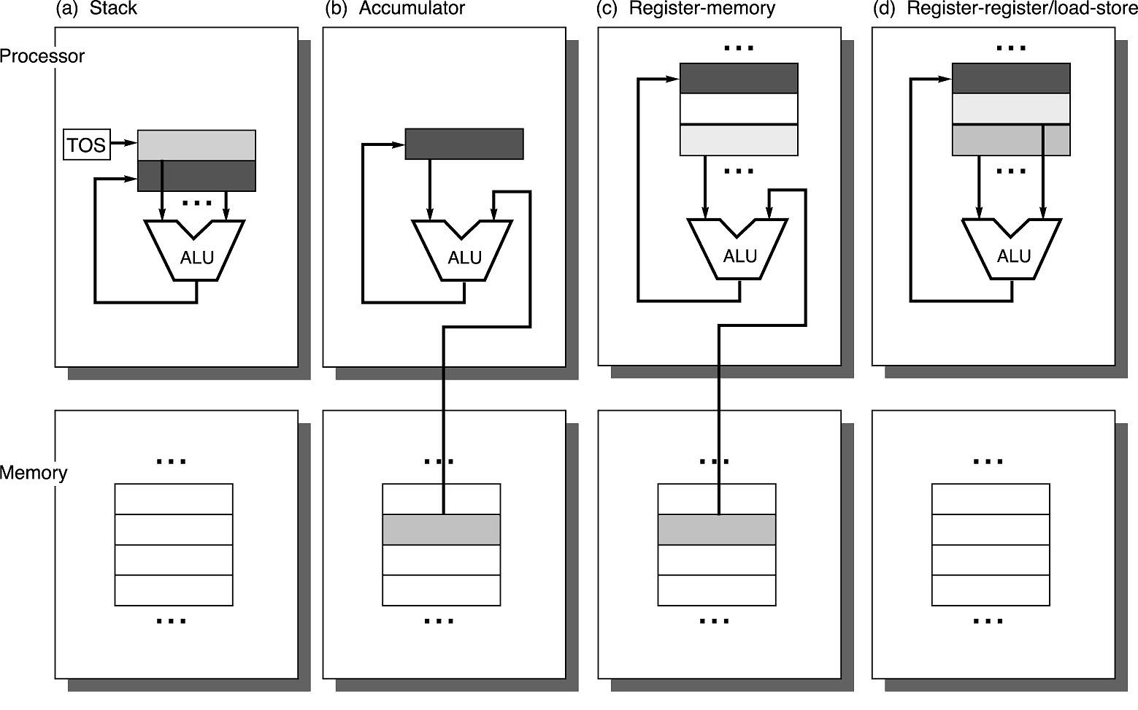
Operand Locations in Four ISA Classes
General Purpose Registers

Slide 18
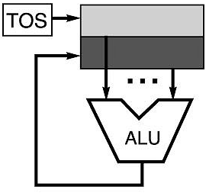
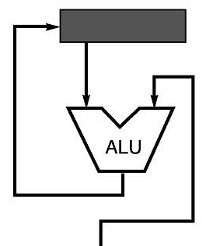
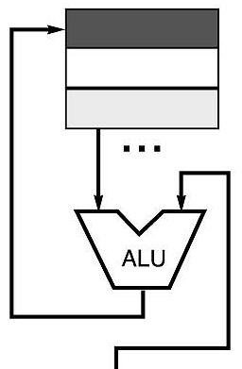
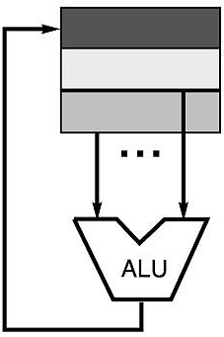
Four Instruction Sets
code sequence C = A + B
stack | accumulator | Register (register-memory) | register (load-store)
push A push B add pop C | load A add B store C | load R1, A add R1, B store C, R1 | load R1,A load R2, B add R3, R1, R2 store C, R3
memory
memory

Slide 19
More About General Purpose Registers
why do almost all new architectures use GPRs?
registers are much faster than memory (even cache)
register values are available immediately
when memory isn’t ready, processor must wait (“stall”)
registers are convenient for variable storage
compiler assigns some variables just to registers
more compact code since small fields specify registers (compared to memory addresses)
processor
memory
disk
registers
cache

Slide 20
Latency Numbers Every Programmer Should Know
Registers 0.5 – 2 ns
L1 cache reference 0.5 ns
Branch mispredict 5 ns
L2 cache reference 7 ns 14x L1 cache
Mutex lock/unlock 25 ns
Main memory reference 100 ns 20x L2 cache, 200x L1 cache
Compress 1K bytes with Zippy 3,000 ns 3 us
Send 1K bytes over 1 Gbps network 10,000 ns 10 us
Read 4K randomly from SSD* 150,000 ns 150 us ~1GB/sec SSD
Read 1 MB sequentially from memory 250,000 ns 250 us
Round trip within same datacenter 500,000 ns 500 us
Read 1 MB sequentially from SSD* 1,000,000 ns 1,000 us 1 ms ~1GB/sec SSD, 4X memory
Disk seek 10,000,000 ns 10,000 us 10 ms 20x datacenter roundtrip
Read 1 MB sequentially from disk 20,000,000 ns 20,000 us 20 ms 80x memory, 20X SSD
Send packet CA->Netherlands->CA 150,000,000 ns 150,000 us 150 ms
Credits: measured by Google (numbers vary on different machines)

Slide 21
Stack Architecture
instruction set:
add, sub, mult, div, . . .
push A, pop A
example: A*B - (A+C*B)
push A
push B
mul
push A
push C
push B
mul
add
sub
A
B
A*B
A
C
B
B*C
A+B*C
result
A
A*B
A
C
A
A*B
A*B
A
A*B
A*B

Slide 22
Stacks: Pros and Cons
pros
good code density (implicit top of stack)
low hardware requirements
easy to write a simpler compiler for stack architectures
cons
stack becomes the bottleneck
little ability for parallelism or pipelining
data is not always at the top of stack when need, so additional instructions like swap are needed
difficult to write an optimizing compiler for stack architectures

Slide 23
Accumulator Architectures
instruction set:
add A, sub A, mult A, div A, . . .
load A, store A
example: A*B - (A+C*B)
load B
mul C
add A
store D
load A
mul B
sub D
acc = acc +,-,*,/ mem[A]
B
B*C
A+B*C
A+B*C
A
A*B
result

Slide 24
Accumulators: Pros and Cons
pros
very low hardware requirements
easy to design and understand
cons
accumulator becomes the bottleneck
little ability for parallelism or pipelining
high memory traffic

Slide 25
Memory-Memory Architecture
instruction set:
(3 operands) add A, B, C sub A, B, C mul A, B, C
(2 operands) add A, B sub A, B mul A, B
example: A*B - (A+C*B)
(3 operands) (2 operands)
mul D, A, B mov D, A
mul E, C, B mul D, B
add E, A, E mov E, C
sub E, D, E mul E, B
add E, A
sub E, D

Slide 26
Memory-Memory: Pros and Cons
pros
requires fewer instructions (especially if 3 operands)
easy to write compilers for (especially if 3 operands)
cons
very high memory traffic (especially if 3 operands)
variable number of clocks per instruction
with two operands, more data movements are required

Slide 27
Register-Memory Architecture
instruction set:
add R1, A sub R1, A mul R1, B
load R1, A store R1, A
example: A*B - (A+C*B)
load R1, A
mul R1, B /* A*B */
store R1, D
load R2, C
mul R2, B /* C*B */
add R2, A /* A + CB */
sub R2, D /* AB - (A + C*B) */
R1 = R1 +,-,*,/ mem[B]

Slide 28
Register-Memory: Pros and Cons
pros
some data can be accessed w/o loading first
instruction format easy to encode
good code density
cons
operands are not equivalent (execution time is determined by the slowest part)

Slide 29
Load-Store (Register-Register) Architecture
instruction set:
add R1, R2, R3 sub R1, R2, R3 mul R1, R2, R3
load R1, A store R1, A move R1, R2
example: A*B - (A+C*B)
load R1, A
load R2, B
load R3, C
mul R7, R3, R2 /* C*B */
add R8, R7, R1 /* A + C*B */
mul R9, R1, R2 /* A*B */
sub R10, R9, R8 /* A*B - (A+C*B) */
R3 = R1 +,-,*,/ R2

Slide 30
Register-Register: Pros and Cons
pros
simple, fixed length instruction encodings
instructions take similar number of cycles
relatively easy to pipeline and make superscalar
cons
higher instruction count
not all instructions need three operands
dependent on good compiler

Slide 31
Registers: Advantages and Disadvantages (Review)
advantages
faster than cache or main memory (no addressing mode or tags)
deterministic (no misses)
can replicate (multiple read ports)
short identifier (typically 3 to 8 bits)
reduce memory traffic
disadvantages
need to save and restore on procedure calls and context switch
can’t take the address of a register (for pointers)
fixed size (can’t store strings or structures efficiently)
compiler must manage
limited number
Every ISA designed after 1980 uses a load-store ISA (e.g., RISC, to simplify CPU design).

Slide 32
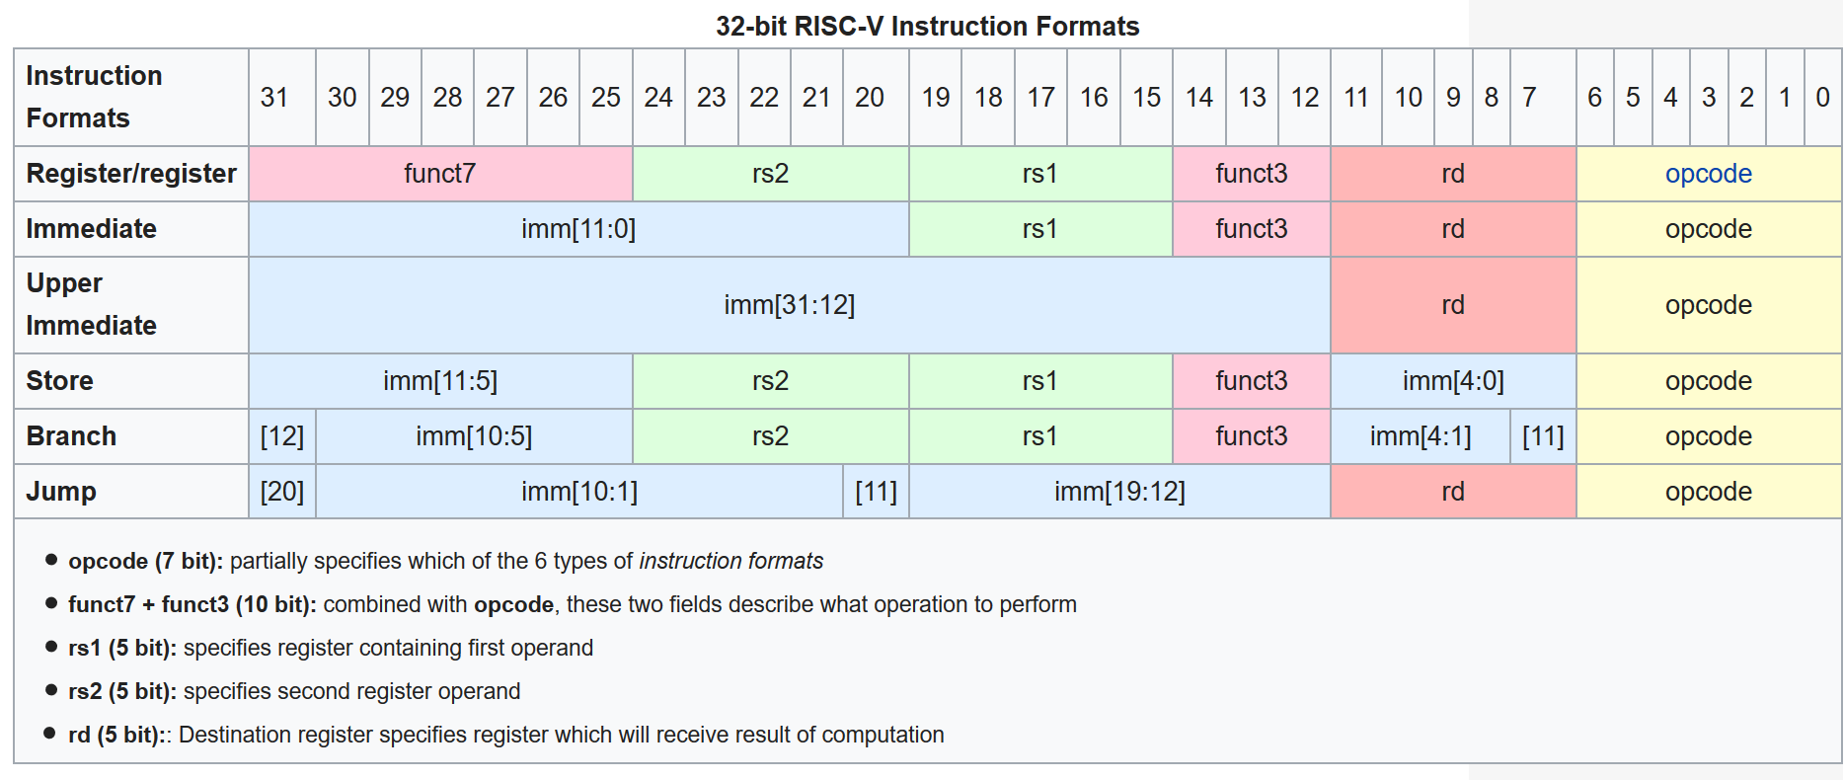
Instruction Format
RISC-V ISA manual: https://riscv.org/wp-content/uploads/2017/05/riscv-spec-v2.2.pdf

Slide 33
Types of Operations
arithmetic and logic: AND, ADD
data transfer: MOVE, LOAD, STORE
control BRANCH, JUMP, CALL
system OS CALL, VM
floating point ADDF, MULF, DIVF
decimal ADDD, CONVERT
string MOVE, COMPARE
graphics (DE)COMPRESS

Slide 34
Conditional branch
how do you specify the destination of a branch/jump?
theoretically, the destination is a full address
16 bits for LC3b
32 bits for MIPS, RISC-V
studies show that almost all conditional branches go short distances from the current program counter (loops, if-then-else)
we can specify a relative address in much fewer bits than an absolute address
e.g., beq $1, $2, 100=>if ($1 == $2) PC = PC + 100 * 4

Slide 35
Jumps
need to be able to jump to an absolute address sometimes
jump -- j 10000 => PC = 10000
need to be able to do procedure calls and returns
jump and link--jal 100000 => $31 = PC + 4; PC = 10000
used for procedure calls
jump register -- jr $31 => PC = $31
used for returns, but can be useful for lots of other things
OP
target
Notes:
Jal: jump and link. Jumps to the calculated address and stores the return address in $31
JR: jump to the address contained in register $31

Slide 36
ISA Tradeoffs (An Example of MIPS)
what if?
64 registers
20-bit immediate
4 operand instruction (e.g., Y = AX + B)
6 bits
5 bits
5 bits
5 bits
5 bits
6 bits
r format
i format
j format
OP
rs
rt
rd
sa
funct
OP
rs
rt
immediate
OP
target
Notes:
SA: shift offset

Slide 37
Byte Ordering
how should bytes within multi-byte word be ordered in memory?
conventions
Sun’s, Mac’s are “big endian” machines
least significant byte has highest address
Alphas, PC’s are “little endian” machines
least significant byte has lowest address

Slide 38
Byte Ordering Example
big endian
least significant byte has highest address
little endian
least significant byte has lowest address
example
variable x has 4-byte representation 0x01234567
address given by &x is 0x100
big endian
0x100
0x101
0x102
0x103
01
01
23
23
45
45
67
67
little endian
0x100
0x101
0x102
0x103
67
67
45
45
23
23
01
01

Slide 39
Reading Byte-Reversed Listings
Disassembly
text representation of binary machine code
generated by program that reads the machine code
Example fragment
Deciphering numbers
value: 0x12ab
pad to 4 bytes: 0x000012ab
split into bytes: 00 00 12 ab
reverse: ab 12 00 00
address instruction code assembly rendition
8048365: 5b pop %ebx
8048366: 81 c3 ab 12 00 00 add $0x12ab,%ebx
804836c: 83 bb 28 00 00 00 00 cmpl $0x0,0x28(%ebx)

Slide 40
Takeaways
Function of ISA
ISA Design Issues
Classical ISAs: Their Pros and Cons
RISC-V Instruction Format
Practice RISC-V in your MPs
Byte ordering: big-endian vs. little-endian

Slide 41
Announcement
Next lecture
performance, energy, and power metric: [HP2] Chapter 1.5, 1.8
MP assignment
MP1 deadline: 9/1/2022

