Slide 1

ECE411: Computer Organization and Design
Lecture 1: Course Introduction
Rakesh Kumar
Notes:
Briefly introduce the project;
Introduce yourself and the team.

Slide 2
Which is faster?
for (i=0; i<N; i=i+1)
for (j=0; j<N; j=j+1) {
r = 0;
for (k=0; k<N; k=k+1)
r = r + y[i][k] * z[k][j];
x[i][j] = r;
}
for (jj=0; jj<N; jj=jj+B)
for (kk=0; kk<N; kk=kk+B)
for (i=0; i<N; i=i+1) {
for (j=jj; j<min(jj+B-1,N); j=j+1)
r = 0;
for (k=kk; k<min(kk+B-1,N); k=k+1)
r = r + y[i][k] * z[k][j];
x[i][j] = x[i][j] + r;
}
Significantly Faster!

Slide 3
Which is faster?
load R1, addr1
store R1, addr2
add R0, R2 -> R3
subtract R4, R3 -> R5
add R0, R6 ->R7
store R7, addr3
load R1, addr1
add R0, R2 -> R3
add R0, R6 -> R7
store R1, addr2
subtract R4, R3 -> R5
store R7, addr3
Twice as fast on some
machines and same on others

Slide 4
Which is faster?
loop1: add ...
load ...
add ...
bne R1, loop1
loop2: add ...
load ...
bne R2, loop2
loop1: add ...
load ...
add ...
bne R1, loop1
nop
nop
loop2: add ...
load ...
bne R2, loop2
Identical performance on several machines

Slide 5
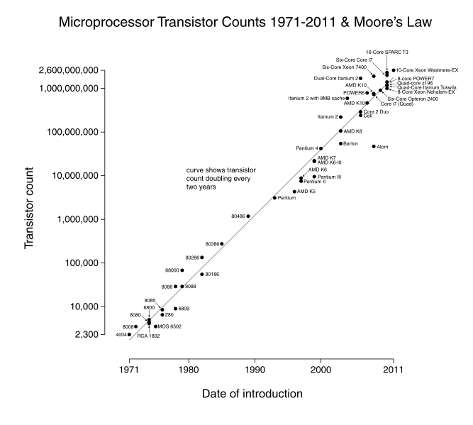
Processor Design is Hard/Interesting!
1.2 trillion (cerebras)
21billion(GV100 Volta)
Modern processors have more than a billion transistors!

Slide 6
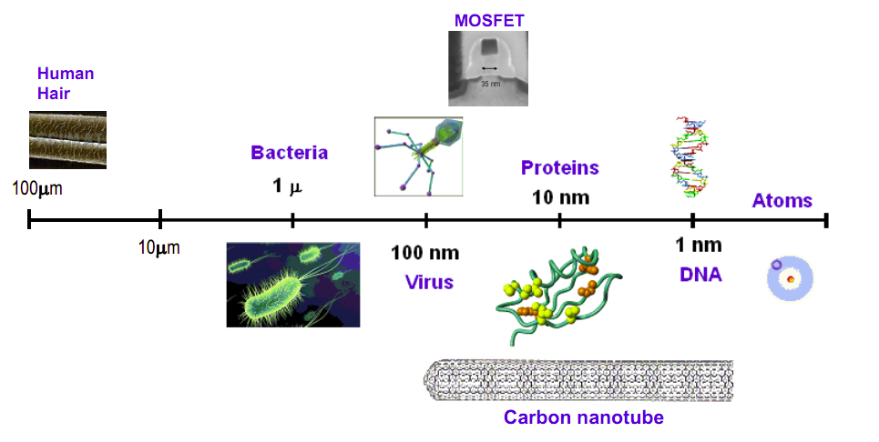
Processor Design is Hard/Interesting!
7nm processors being shipped!

Slide 7
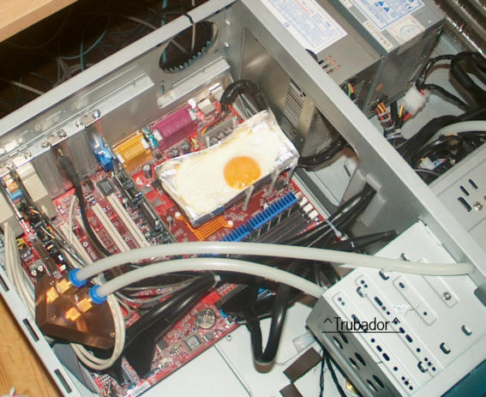

Processor Design is Hard/Interesting!
Very recently, power density of a
processor higher than a nuclear reactor!
FDIV Pentium bug cost 500 million dollars!

Slide 8
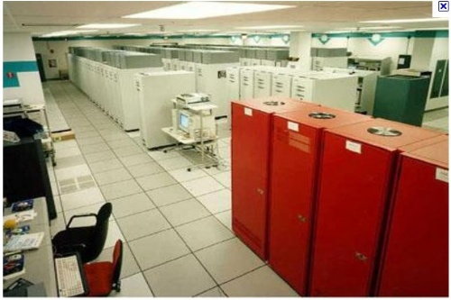

Power Efficiency Challenges
ASCI Red @ Sandia Labs
1997 (850KW)
~1.5Teraflops
2022 (5W)
power/energy-constrained computing devices
  mobile: 1~5W power budget w/ 5Whr battery capacity
Notes:
to deliver teraflops of performance, we used to build a super computer consuming 850KW in 1997 and we are expected to deliver teraflops of performance under 5W in the near future.
however, as the end of technology scaling is in sight, future architecture…

Slide 9
About the Instructor
Rakesh Kumar
  Office hours (CSL208)
    Tuesday 3:30-4:30pm CDT
  Email (rakeshk@illinois.edu, with subject title [ECE411] please)

Slide 10

Computing is everywhere!
http://images.slideplayer.com/26/8674558/slides/slide_3.jpg

Slide 11
Computer Organization
Q: What are the major components we have in a computer today?
organization of modern computers
Processor
Accelerator
Memory
Network
Storage Subsystem

Slide 12
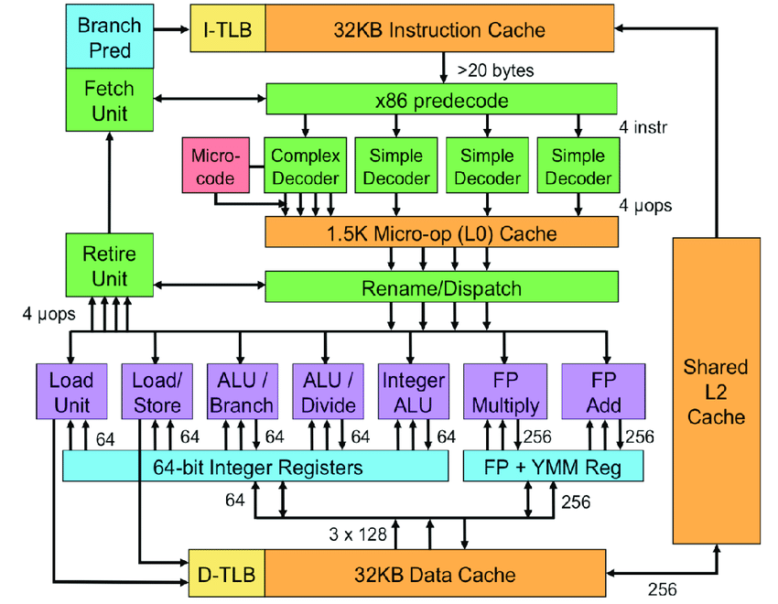
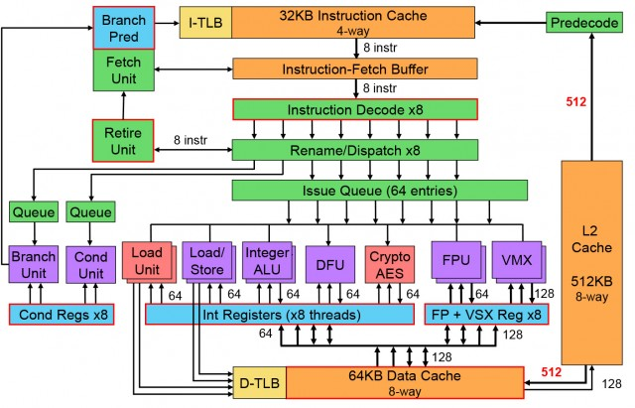
Microprocessor Architecture
Intel Sandy Bridge Processor
IBM Power 8 Processor

Slide 13
Course Objective
to understand fundamental concepts in computer architecture and how they impact application performance and energy efficiency
to become confident in programming for performance, scalability, and efficiency
to be able to understand and evaluate architectural descriptions of even today’s most complex processors
to gain experience designing a working CPU completely from scratch
to learn experimental techniques used to evaluate advanced architectural concepts

Slide 14
Course Content & Prerequisites
fundamental concepts in computer organization focusing on uni-processor architecture
  pipelining
  memory hierarchy
  instruction-level parallelism & dynamic scheduling
  storage I/O subsystems
  impact of technology on performance and energy efficiency
  hardware accelerators
  advanced architecture topics
prerequisites
  ECE 385 (programming and debugging skills) and ECE 391 (virtual memory part)
  Linux
  C++ programming
  SystemVerilog
  Quartus

Slide 15
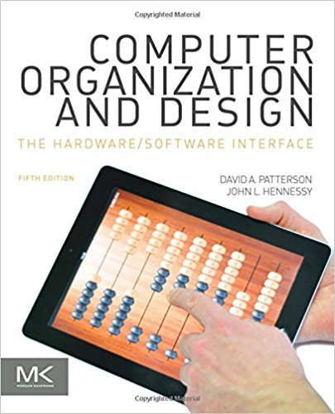
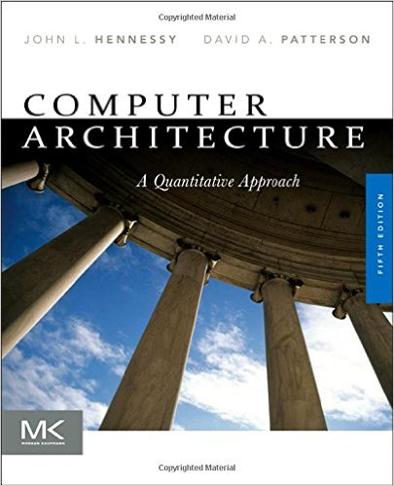

Textbooks
course textbook
  [HP1] Patterson & Hennessy. Computer Organization and Design (5th Ed.); Morgan Kaufmann; ISBN: 978-0-12-407726-3
recommended textbook
  [HP2] Hennessy & Patterson. Computer Architecture: A Quantitative Approach (5th Ed.); The Morgan Kaufmann, ISBN: 978-0123838728
  [PW] Patterson & Waterman. The RISC-V Reader: An Open Architecture Atlas; ISBN: 978-0-9992491-1-6

Slide 16
Lectures and MPs
Lectures
  important to attend lecture as a notable fraction of materials are not explained in textbooks
MP assignments
  there will be 5 MP assignments using SystemVerilog and vcs/dc
  MP0, MP1, MP2, and MP3 done individually
  MP4 done in teams of three (design project – 4 checkpoints, final competition, presentation)
  48% of final grade (2%+3%+6%+12%+25%)

Slide 17
Late MP Submission Policy
Late MP submission
  10% penalty for 1-day delay; 30% penalty for 2-day delay; 60% penalty for 3-day delay; Not acceptable for >3 days delay
  One chance to submit MP1, MP2, or MP3 assignment late by 3 days without any penalty considering unexpected events (e.g., sickness, pandemic, etc); not acceptable for >3 days delay (as this would affect the follow-up MPs); use this one chance wisely as no exception will be made after that regardless of the reasons

Slide 18
Lab Session
Motivation
  TAs will address the potential questions you may have
  Provide guidance on MPs
Schedule
  Almost one lab session per week
  Usually happen on Wednesdays
  Release the time/location

Slide 19
Exams & Grading
Exams (two midterms + one final)
  mid-term 1
    Sep 20 (15%)
  mid-term 2
    Oct 20 (15%)
  final
    Dec 16 (20%)
  there may be a review session before each exam
  Close-book/notes but one A4-page cheat sheet allowed.

Slide 20
Website and Discussion Group
Course website
  Lecture notes, handouts, MP assignment, etc.
  announcements
Campuswire
  posting clarification questions
  general forum to communicate with students, TAs, instructor about aspects of the course.
  must join by the end of the day
Canvas
  Grade tacking, exam grading, etc.
Course schedule
  Google calendar
  Add the calendar to your own calendar, easy for you to manage TA/lab session schedules

Slide 21
Teaching Assistants
  Srijan Chakraborty (srijanc2@illinois.edu)
  Siddharth Agarwal (sa10@illinois.edu)
  Stanley Wu (zaizhou3)
  Zhuxuan Liu (zhuxuan2)
  Yian Wang (yian2)

Slide 22
Academic Integrity
you are encouraged to discuss assignments w/ anyone you feel may be able to help you (except during exams)
everything you turn in must be your work or that of your team
we encourage collaboration
  verbal discussion of problems/solutions
  diagrams, notes, other communication aids
unacceptable
  copying/exchanging of program/verilog code or text by any means
  giving/receiving help on exams, or using any notes/aid beyond those explicitly permitted

Slide 23
Ready for ECE411?
Requires a lot of time commitment
Skills in SystemVerilog (programming & debugging)
Plan your study well

Slide 24
What Is Computer Architecture?
Role in the full computing system stack
Role of computer architects
  to make design trade-offs across HW/SW interface to satisfy functional, performance, power/energy, and cost requirements

Slide 25
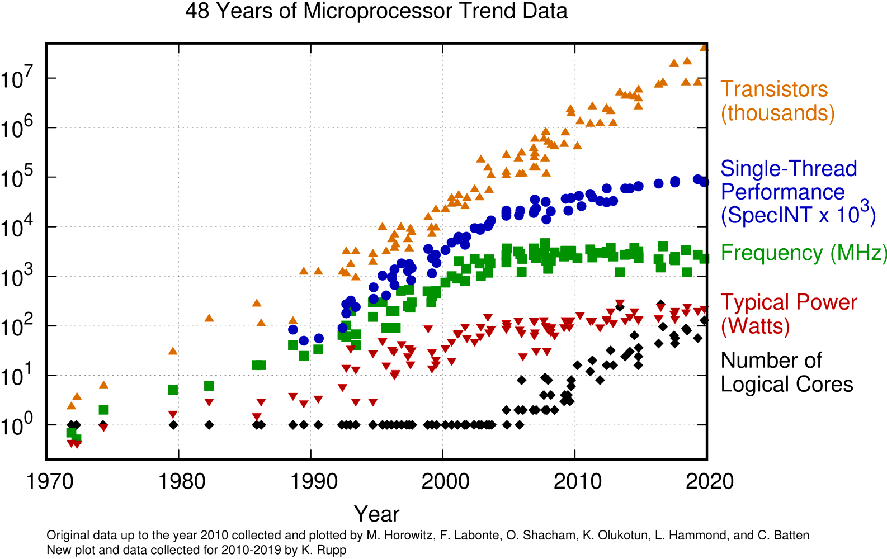
Processor Architecture: Historical Trend
Clock frequency: Good indicator for performance
What drove clock frequency increase in the past?
  highest clock rate of Intel processors from 1990 to 2008
    due to semiconductor technology improvements
    deeper pipeline
    circuit design techniques
  this historical trend has subsided over the past 10 years
  If it had kept up, today’s clock rates would be more than 30GHz
Source data is here

Slide 26
Processor Architecture: Historical Trend
Why did we stop increasing the clock frequency?
Slowing down semiconductor technology scaling;
(2) excessive power consumption
Source data is here

Slide 27
Processor Architecture: Historical Trend
Moore’s Law: the number of transistors in a dense integrated circuit doubles every two years
1965: double every year; 1975: double every year until 1980, after that double every two years;
2010: further slow down seen from industry; Trend is continuing (e.g., TSMC, Samsung)
Source data is here

Slide 28
Processor Architecture: Historical Trend
Classic Dennard’s Scaling: when transistors get smaller, their power density stays constant such that the power consumption remains in proportion with area.
Proposed in 1974 by Robert H. Dennard at IBM
  Each technology generation
    Transistor dimensions scaled by 30% (0.7x)
    Area reduced by 0.5x
    V (voltage) is reduced by 30% (0.7x)
    Circuit delay reduced by 30% (0.7x)
    Frequency = 1 / delay = 1.4x
    Capacitance = area / distance = 0.5/0.7 = 0.7x
    Power = CV²f = 0.5x
1.4× faster trs
2.5
0.7× capacitance
2
chip power
2× more trs
1.5
0.7× voltage
1
1
1.5
2
2.5
3
  2.8× more chip capability at the same power
chip capability

Slide 29
Processor Architecture: Historical Trend
Dennard’s Scaling ended in 2005-2007
0.7× transistor feature size scaling per generation
  1.4× more chip capability at the same power
2.5
chip power
2
2× more trs
0.7× capacitance
1.5
1
1
1.5
2
2.5
3
chip capability
Notes:
However, such an amazing benefit of technology scaling has almost ended. Currently, we can’t scale the voltage anymore although we can scale the capacitance. So, although, we can integrate 2x more thransistors, you have to slow them down to meet the power constraint. As a result, now we have only 1.4x more chip capability for the same power consumption

Slide 30
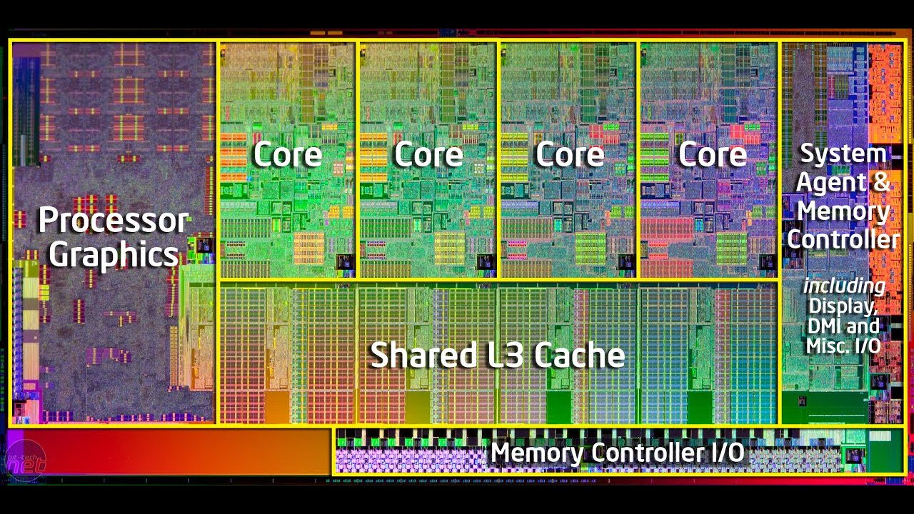
Processor Architecture: Historical Trend
What did we do to improve performance after stopping clock frequency increase?
(1) Increase the number of cores;
Source data is here

Slide 31
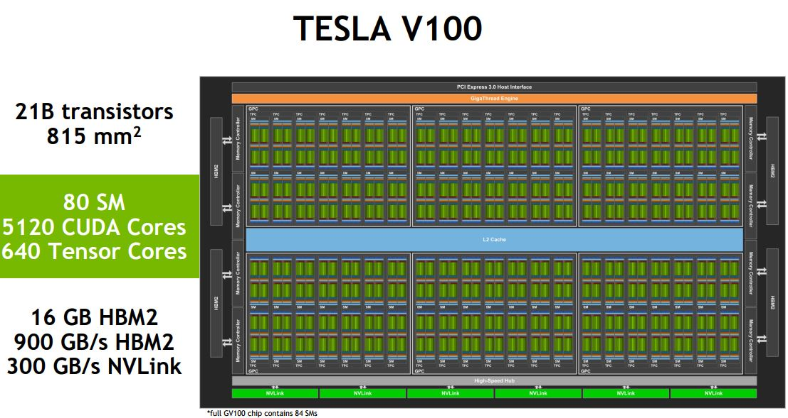
Processor Architecture: Historical Trend
What did we do to improve performance after stopping clock frequency increase?
(1) Increase the number of cores; (2) specialized hardware, GPU, accelerators.
Source data is here

Slide 32
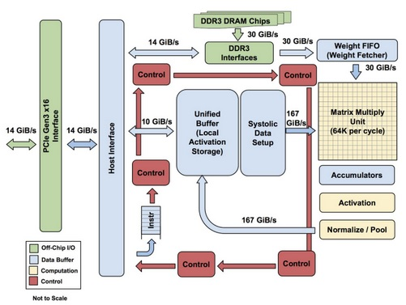
Processor Architecture: Historical Trend
What did we do to improve performance after stopping clock frequency increase?
(1) Increase the number of cores; (2) specialized hardware, GPU, accelerators.
Google TPU
Source data is here

Slide 33
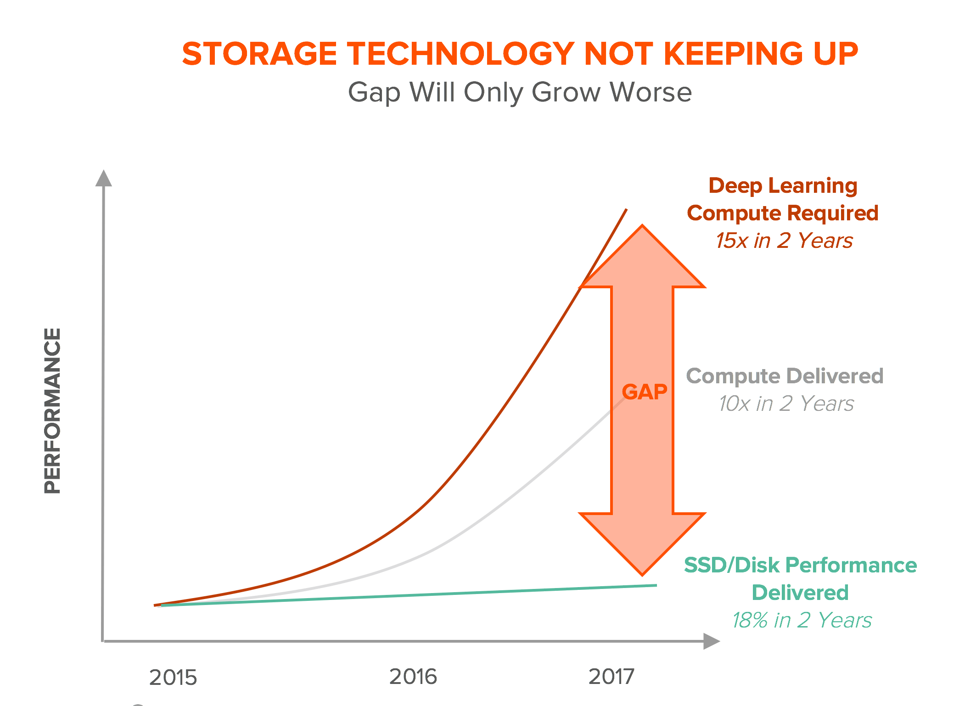
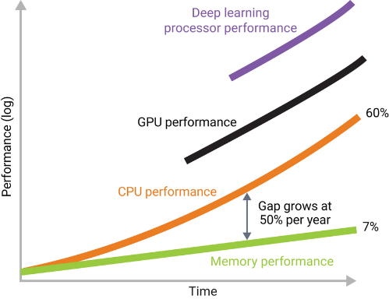
Memory/Storage Architecture: Historical Trend
The gap between compute and memory/storage is increasing
https://medium.com/@abruyns/memory-holds-the-keys-to-ai-adoption-5acd5e06508b
Pure Storage Inc.

Slide 34
Von-Neumann
Computer Architecture

Slide 35
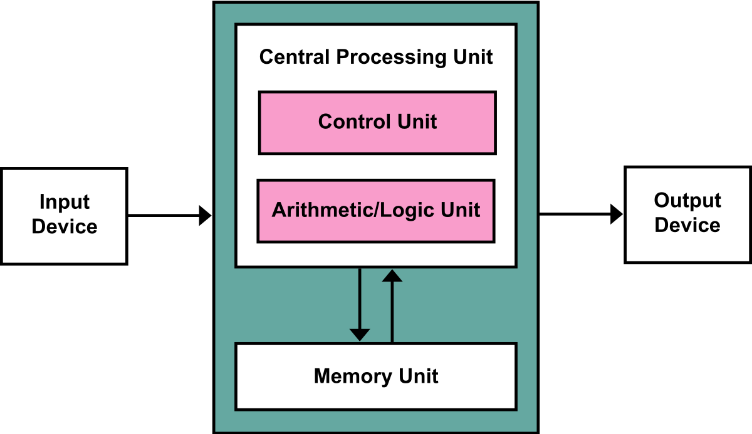
Von-Neumann Computer Organization

Slide 36
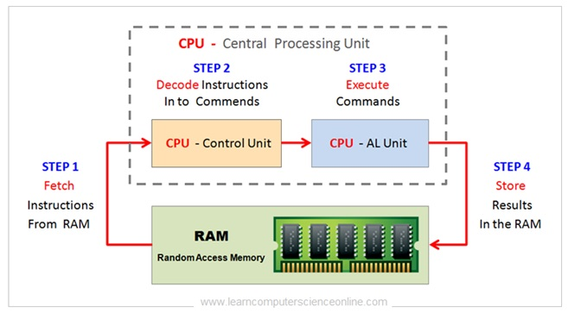
Instruction Execution Cycles

Slide 37
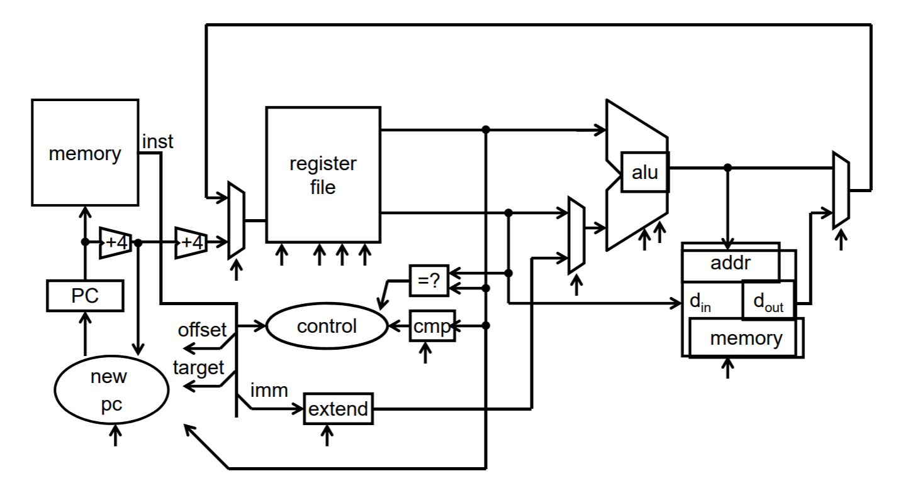
A Simple Processor
Notes:
Arithmetic Logic Unit (ALU), Register File, Memory, and RISC-V Instructions

Slide 38
A Simple Processor (Detailed Explanation)
executes instructions, which are represented as bit patterns with specific fields interpreted differently
contains a register file, which holds data that will be referenced by instructions
has a program counter that holds the address of the instruction being executed
can access memory
  use address to select the location we want to access
  random-access: time to access a piece of data is independent of which address the data is stored in
I/O
  keyboard, mouse, display, network
  long-term data storage: hard disk, CD-ROM, SSD, etc.

Slide 39
Takeaways
Moore’s Law
Dennard Scaling
Historical Trends of Computer Architecture
Von-Neumann Architecture

Slide 40
Announcement
Next lecture
  instruction set architecture
    [HP2] Appendix A
MP assignment
  MP0 Released on Monday 8/22/2022
  MP1 releasing tomorrow
  MP0 Deadline: Thursday 8/25/2022
  Lab Session: Wednesday 8/24/2022, Zoom link posted in Campuswire
  Lab session will be recorded

