Slide 1
Discrete and Continuous Randonm Variables; Group Activity Solution
ECE 313
Probability with Engineering Applications
Lecture 9
Professor Ravi K. Iyer
Department of Electrical and Computer Engineering
University of Illinois

Slide 2
Today’s Topics
Group Activity – Solution included in the lecture slides see online
Random Variables
  Examples
  Discrete
  Continuous,
  Probability mass Function (pmf); Cumulative Distribution Function (CDF), Probability Density Function (pdf),
  Start on example Distributions
Announcements:
  Homework 3 due Wednesday, February 22nd in class.
  Homework 4, out Wed Feb 22nd due following Wednesday in class

Slide 3
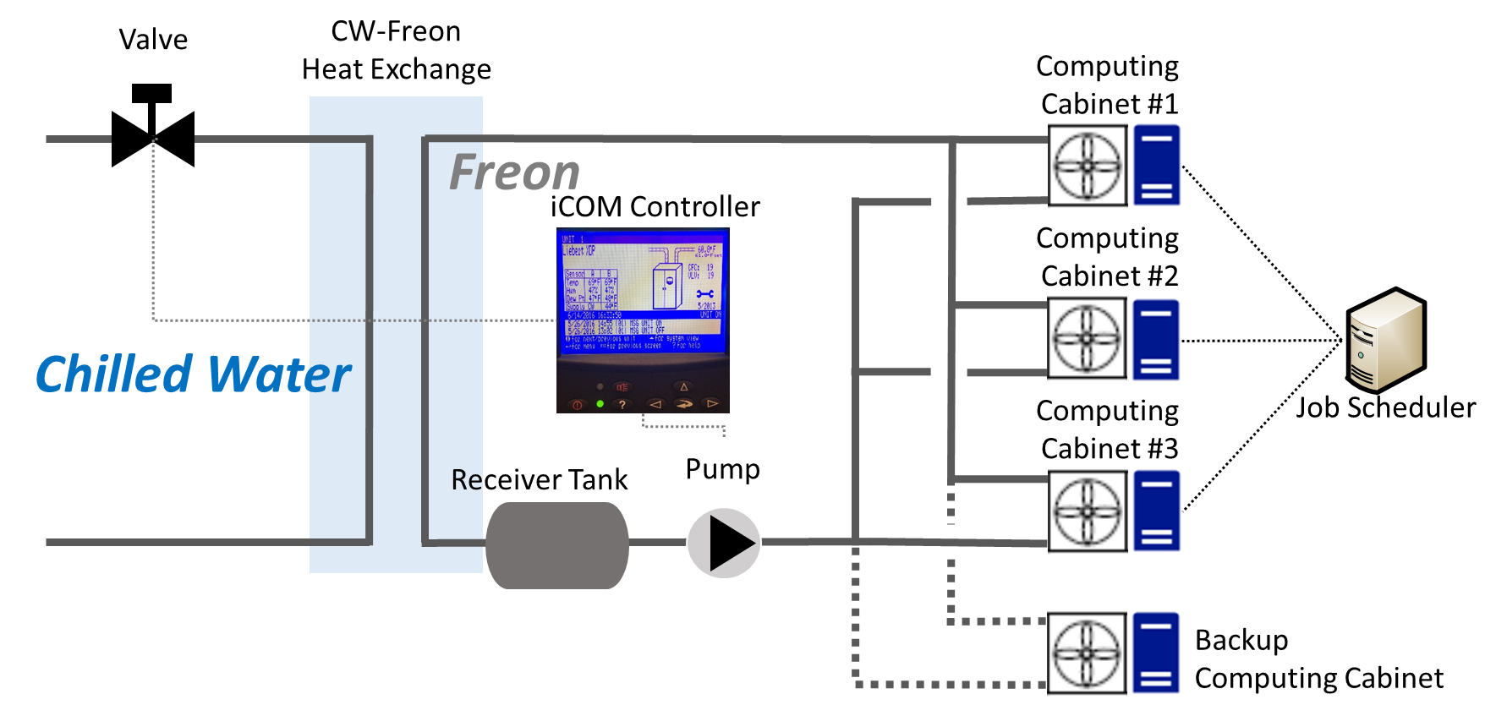
Group Activity: Super computing node with cooling
TMR with a Twist
Imagine a node of a new supercomputer with its cooling system set up as in the figure below – similar to what we looked at iearlier n class.
The computing nodes are in three cabinets with a backup node in a separate cabinet, ready to switch in, in the event that any one single cabinet fails. The three ‘primary’ cabinets run in a triple modular redundant (TMR) mode with an additional backup (TMR + backup).
The job scheduler’s functionality includes:
  General scheduling
  The ability to vote of the outputs of the three cabinets
  Upon detecting a failure, switching out the failed cabinet and switching in the backup cabinet
In addition to keeping a set of compute cabinet operational, it is critical to keep the cooling system functional. The valve, pump and the controller plays a critical role in the cooling system.
Notes:
Recall in class we said that either the backup starts after any one single cabinet fails or after two cabinet fail. Both are ok.

Slide 4
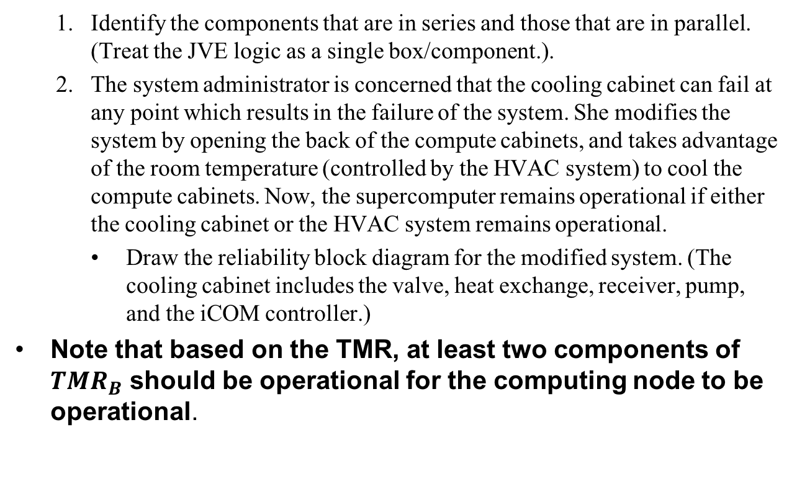
Group Activity: TMR with Backup
  Identify the components that are in series and those that are in parallel. (Treat the JVE logic as a single box/component.).
  The system administrator is concerned that the cooling cabinet can fail at any point which results in the failure of the system. She modifies the system by opening the back of the compute cabinets, and takes advantage of the room temperature (controlled by the HVAC system) to cool the compute cabinets. Now, the supercomputer remains operational if either the cooling cabinet or the HVAC system remains operational.
    Draw the reliability block diagram for the modified system. (The cooling cabinet includes the valve, heat exchange, receiver, pump, and the iCOM controller.)
Note that based on the TMR, at least two components of $TMR_{B}$ should be operational for the computing node to be operational.

Slide 5
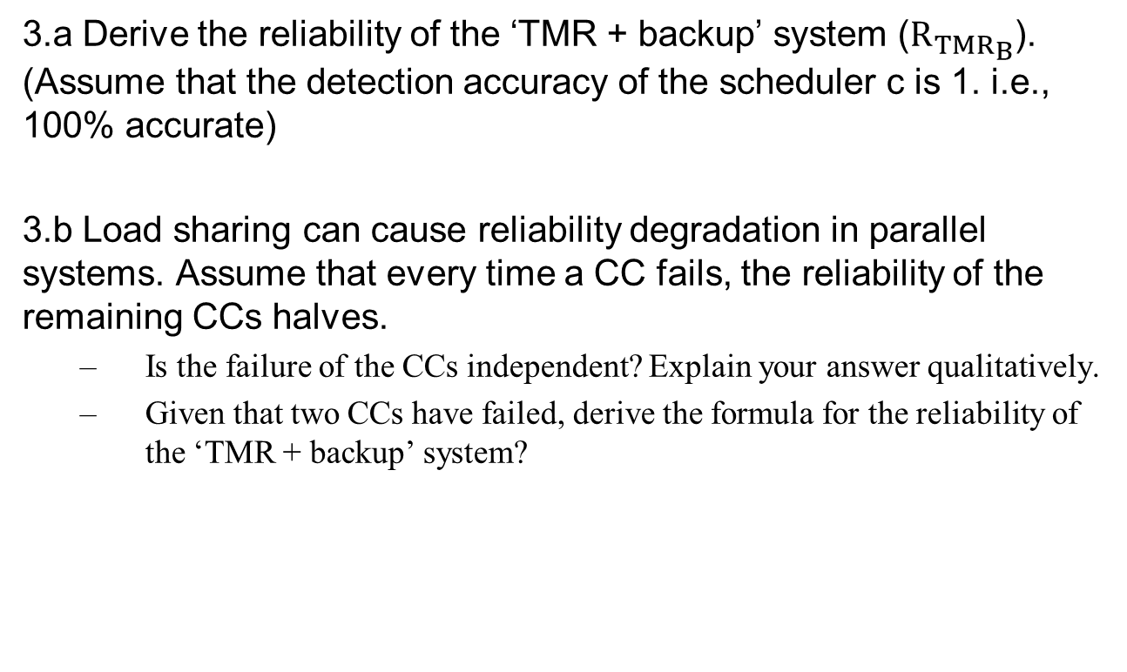
Group Activity: TMR with Backup
3.a Derive the reliability of the ‘TMR + backup’ system (${R_{TMR}}_{B}$). (Assume that the detection accuracy of the scheduler c is 1. i.e., 100% accurate)
3.b Load sharing can cause reliability degradation in parallel systems. Assume that every time a CC fails, the reliability of the remaining CCs halves.
  Is the failure of the CCs independent? Explain your answer qualitatively.
  Given that two CCs have failed, derive the formula for the reliability of the ‘TMR + backup’ system?

Slide 6
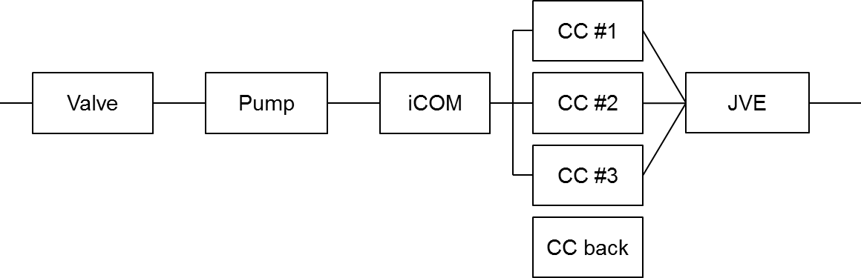
Group Activity: Solution
The compute cabinets are in parallel, and the Valve, Pump, iCOM and the scheduler is in series to the set of computing cabinets. The HVAC is in parallel with the the Valve, Pump, and the iCOM.
Draw the reliability block diagram of the system.
With the modification by the sysadmin, HVAC is added in parallel to the cooling cabinet.
HVAC
Notes:
The relation of the backup and the computing cabinets is complicated because the backup is not on at all time.
When the backup comes in after the first failure, then it simply restores the TMR.
When the backup comes in after the second failure, then the backup is in series with the remaining CC.
The backup kicks in when one of the three CC fails. The system fails if the backup + the remaining cc fails.

Slide 7
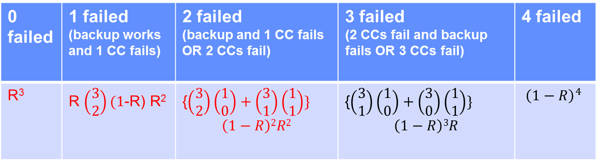
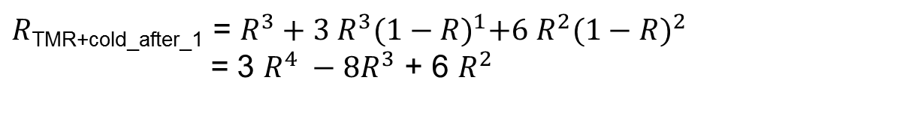
TMR + Cold start after 1 CC has failed
0 failed | 1 failed (backup works and 1 CC fails) | 2 failed (backup and 1 CC fails OR 2 CCs fail) | 3 failed (2 CCs fail and backup fails OR 3 CCs fail) | 4 failed
R³ | R $\left(\begin{matrix}3 \\ 2\end{matrix}\right)(1$-R) R² | {$\left(\begin{matrix}3 \\ 2\end{matrix}\right)\left(\begin{matrix}1 \\ 0\end{matrix}\right)+\left(\begin{matrix}3 \\ 1\end{matrix}\right)\left(\begin{matrix}1 \\ 1\end{matrix}\right)\}$ $$\left(1−R\right)2R2$$ | {$\left(\begin{matrix}3 \\ 1\end{matrix}\right)\left(\begin{matrix}1 \\ 0\end{matrix}\right)+\left(\begin{matrix}3 \\ 0\end{matrix}\right)\left(\begin{matrix}1 \\ 1\end{matrix}\right)\}$ $$\left(1−R\right)3R$$ | $${\left(1−R\right)}^{4}$$
$R$_{TMR+cold_after_1} = $R^{3}+3 R^{3}{(1−R)}^{1}+6 R^{2}{(1−R)}^{2}$
= 3 $R^{4} −8R^{3}$ + 6 $R^{2}$

Slide 8
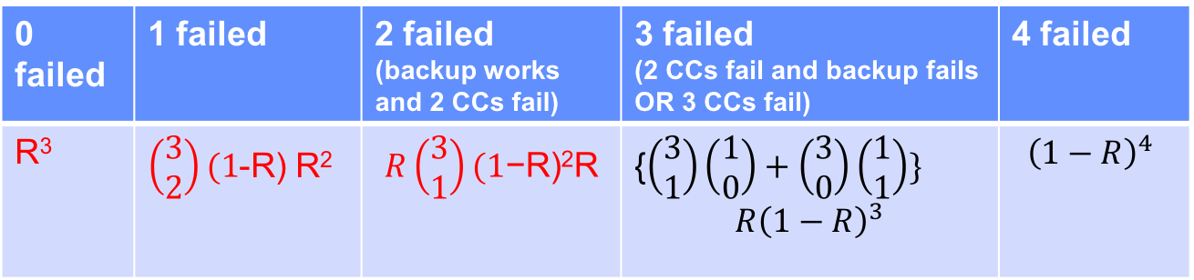
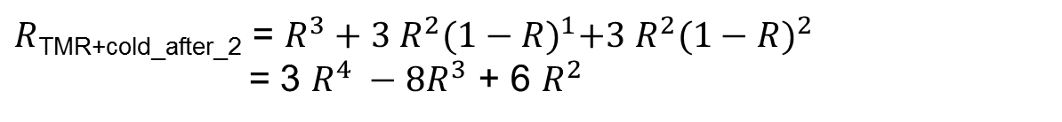
TMR + Cold start after 2CCs have failed
0 failed | 1 failed | 2 failed (backup works and 2 CCs fail) | 3 failed (2 CCs fail and backup fails OR 3 CCs fail) | 4 failed
R³ | $\left(\begin{matrix}3 \\ 2\end{matrix}\right)(1$-R) R² | $$R\left(\begin{matrix}3 \\ 1\end{matrix}\right)(1\text{−}\text{R}\text{)2}\text{R}$$ | {$\left(\begin{matrix}3 \\ 1\end{matrix}\right)\left(\begin{matrix}1 \\ 0\end{matrix}\right)+\left(\begin{matrix}3 \\ 0\end{matrix}\right)\left(\begin{matrix}1 \\ 1\end{matrix}\right)\}$ $$R{\left(1−R\right)}^{3}$$ | $${\left(1−R\right)}^{4}$$
$R$_{TMR+cold_after_2} = $R^{3}+3 R^{2}{(1−R)}^{1}+3 R^{2}{(1−R)}^{2}$
= 3 $R^{4} −8R^{3}$ + 6 $R^{2}$

Slide 9
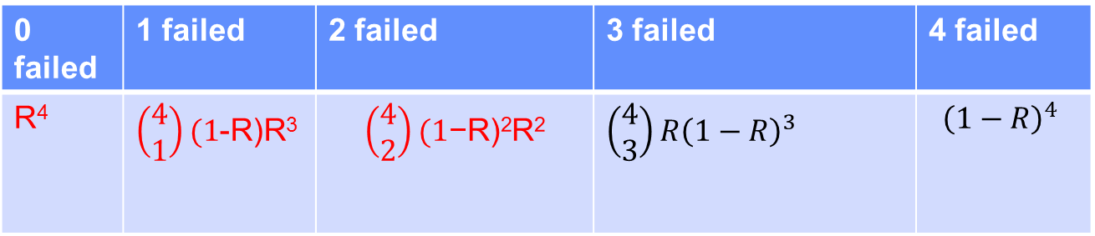
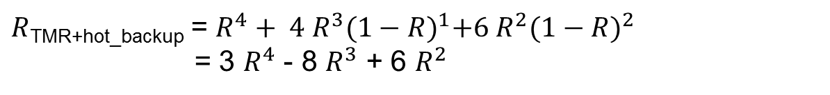
2 out of 4 (TMR + hot standby)
0 failed | 1 failed | 2 failed | 3 failed | 4 failed
R⁴ | $\left(\begin{matrix}4 \\ 1\end{matrix}\right)(1$-R)R³ | $$\left(\begin{matrix}4 \\ 2\end{matrix}\right)(1\text{−}\text{R}\text{)2}\text{R}\text{2}$$ | $$\left(\begin{matrix}4 \\ 3\end{matrix}\right)R{\left(1−R\right)}^{3}$$ | $${\left(1−R\right)}^{4}$$
$R$_{TMR+hot_backup} = $R^{4}+ 4 R^{3}{(1−R)}^{1}+6 R^{2}{(1−R)}^{2}$
= 3 $R^{4}$ - 8 $R^{3}$ + 6 $R^{2}$

Slide 10
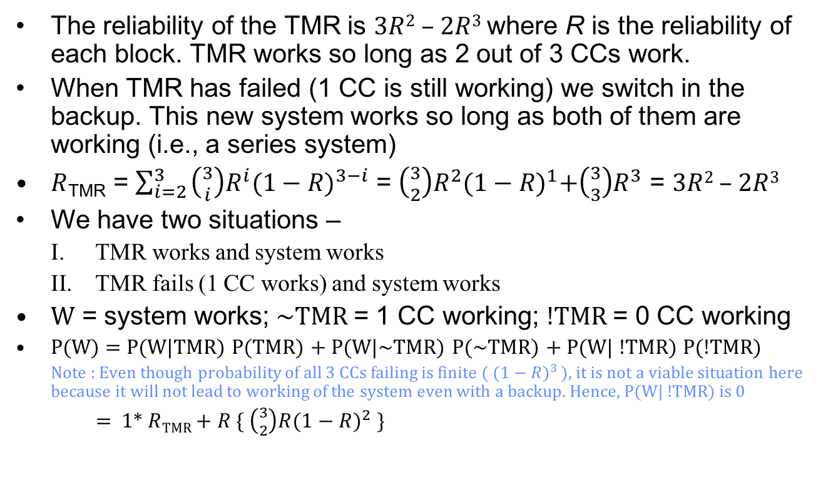
Using the Theorem of Total Probability
The reliability of the TMR is 3$R$² – 2$R$³ where R is the reliability of each block. TMR works so long as 2 out of 3 CCs work.
When TMR has failed (1 CC is still working) we switch in the backup. This new system works so long as both of them are working (i.e., a series system)
$R$_{TMR} = $\sum_{i=2 }^{3}{\left({3 \atop i}\right)R^{i}{(1−R)}^{3−i}}$ = $\left({3 \atop 2}\right)R^{2}{(1−R)}^{1}+\left({3 \atop 3}\right)R^{3}$ = 3$R$² – 2$R$³
We have two situations –
  TMR works and system works
  TMR fails (1 CC works) and system works
W = system works; ~TMR = 1 CC working; !TMR = 0 CC working
P(W) = P(W|TMR) P(TMR) + P(W|~TMR) P(~TMR) + P(W| !TMR) P(!TMR)
  Note : Even though probability of all 3 CCs failing is finite ( ${(1−R)}^{3 }$), it is not a viable situation here because it will not lead to working of the system even with a backup. Hence, P(W| !TMR) is 0
    = 1* $R$_{TMR} + $R$ { $\left({3 \atop 2}\right)R{(1−R)}^{2} \}$

Slide 11
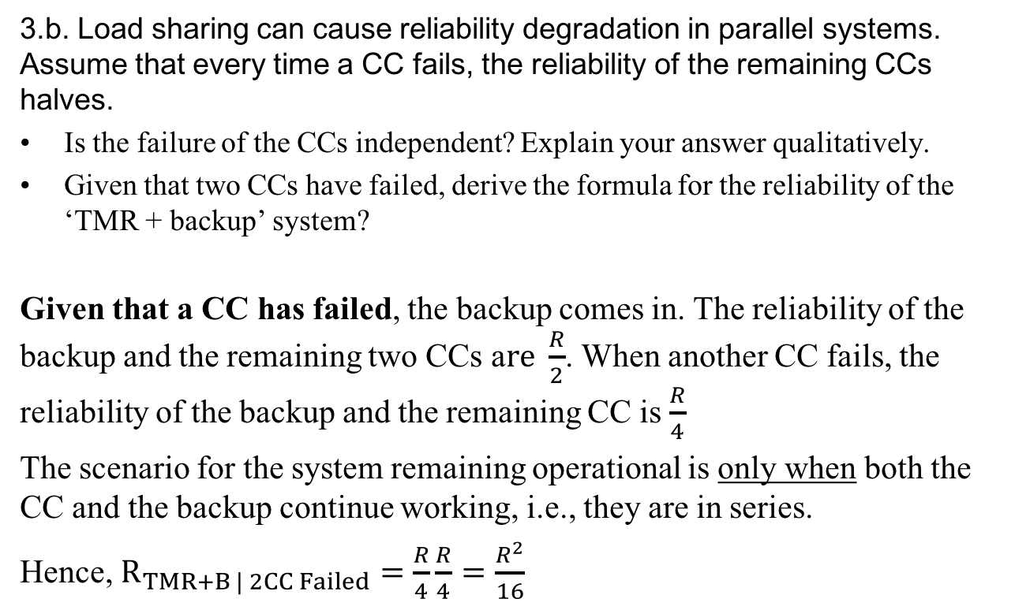
Group Activity: Solution
3.b. Load sharing can cause reliability degradation in parallel systems. Assume that every time a CC fails, the reliability of the remaining CCs halves.
Is the failure of the CCs independent? Explain your answer qualitatively.
Given that two CCs have failed, derive the formula for the reliability of the ‘TMR + backup’ system?
Given that a CC has failed, the backup comes in. The reliability of the backup and the remaining two CCs a$re \frac{R}{2}$. When another CC fails, the reliability of the backup and the remaining CC is $\frac{R}{4}$
The scenario for the system remaining operational is only when both the CC and the backup continue working, i.e., they are in series.
Hence, $R_{TMR+B | 2CC Failed}=\frac{R}{4}\frac{R}{4}=\frac{R^{2}}{16}$
Notes:
Reliability degrades when a CC fails.

Slide 12
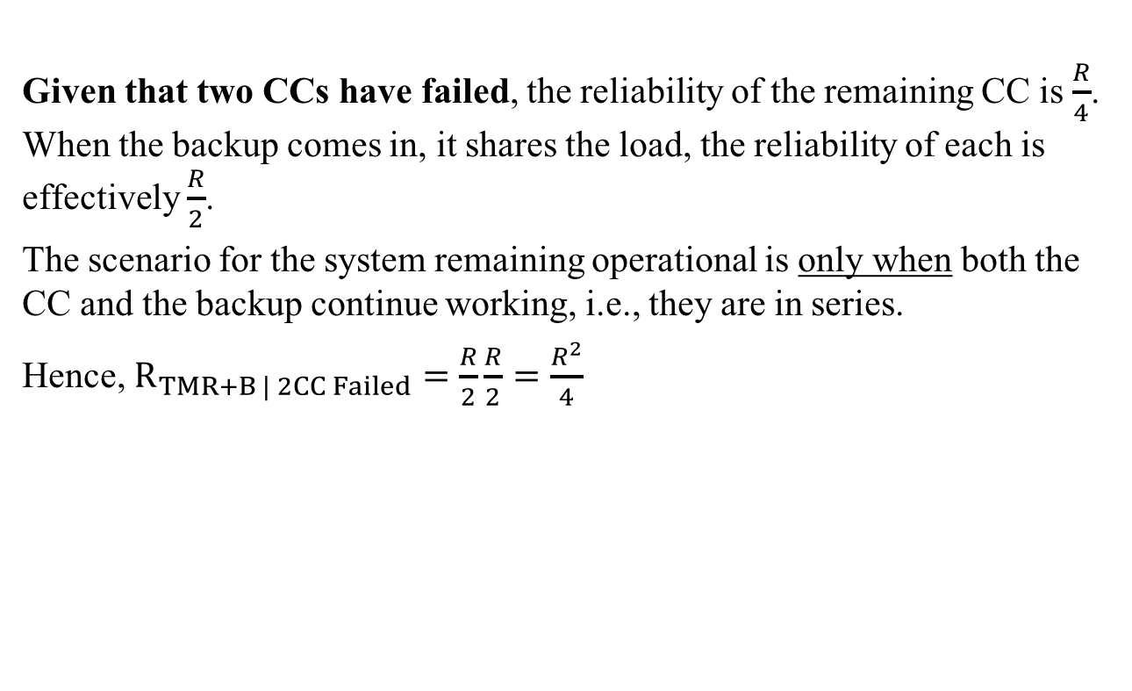
Group Activity: Solution
Given that two CCs have failed, the reliability of the remaining CC is $\frac{R}{4}$. When the backup comes in, it shares the load, the reliability of each is effectively $\frac{R}{2}$.
The scenario for the system remaining operational is only when both the CC and the backup continue working, i.e., they are in series.
Hence, $R_{TMR+B | 2CC Failed}=\frac{R}{2}\frac{R}{2}=\frac{R^{2}}{4}$
Notes:
Reliability degrades when a CC fails.

Slide 14
Random Variable
Definition: Random Variable
A random variable X on a sample space S is a function X: S → ℜ that assigns a real number X(s) to each sample point s ∈ S.
Example: Consider a random experiment defined by a sequence of three Bernoulli trials. The sample space S consists of eight triples (where 1and 0 respectively denote success and a failure on the nth trail). The probability of successes , p, is equal 0.5.
Sample points
111
110
101
100
011
010
001
000
P(s)
0.125
0.125
0.125
0.125
0.125
0.125
0.125
0.125
X(s)
3
2
2
1
2
1
1
0
Note that two or more sample
points might give the same value
for X (i.e., X may not be
a one-to-one function.), but that two
different numbers in the range
cannot be assigned to the same
sample point (i.e., X is well
defined function).

Slide 15
Random Variable (cont.)
Event space
For a random variable X and a real number x, we define the event A_{x} to be the subset of S consisting of all sample points s to which the random variable X assigns the value x.
A_{x} = {s ∈ S | X(s) = x}; Note that:
The collection of events A_{x} for all x defines an event space
In the previous example the random variable defines four events:
A₀ = {s ∈ S | X(s) = 0} = {(0, 0, 0)}
A₁ = {(0, 0, 1), (0, 1, 0), (1, 0, 0)}
A₂ = {(0, 1, 1), (1, 0, 1), (1, 1, 0)}
A₃= {(1, 1, 1)}
Discrete random variable
The random variable which is either
finite or countable.

Slide 16
Discrete/Continuous Random Variables
The discrete random variables are either a finite or a countable number of possible values.
Random variables that take on a continuum of possible values are known as continuous random variables.
Example: A random variable denoting the lifetime of a car, when the car’s lifetime is assumed to take on any value in some interval (a,b) is continuous.

Slide 17
Random Variables Example 1
Let X denote the random variable that is defined as the sum of two fair dice; then

Slide 18
Random Variables Example 1 (Cont’d)
i.e., the random variable X can take on any integral value between two and twelve, and the probability that it takes on each value is given.
Since X must take on one of the values two through twelve, we must have:
(check from the previous equations).

Slide 19
Random Variables Example 2
Suppose that our experiment consists of tossing two fair coins. Letting Y denote the number of heads appearing, then
Y is a random variable taking on one of the values 0, 1, 2 with respective probabilities:

Slide 20
Random Variables Example 3
Suppose that we toss a coin until the first head appears
Assume a probability p of coming up heads, on each flip.
Letting N ( a R.V) denote the number of flips required, and assume that the outcome of successive flips are independent,
N is a random variable taking on one of the values 1, 2, 3, . . . , with respective probabilities

Slide 21
Random Variables Example 3 (Cont’d)
As a check, note that

Slide 22
Random Variables Example 4
Suppose that our experiment consists of seeing how long a commodity smart phone can operate before failing.
Suppose also that we are not primarily interested in the actual lifetime of the phone but only if the phone lasts at least two years.
We can define the random variable I by
If E denotes the event that the phone lasts two or more years, then the random variable I is known as the indicator random variable for event E. (Note that I equals 1 or 0 depending on whether or not E occurs.)

Slide 23
Random Variables Example 5
Suppose that independent trials, each of which results in any of m possible outcomes with respective probabilities p1, . . . , pm,
are continually performed. Let X denote the number of trials needed until each outcome has occurred at least once.
Rather than directly considering P{X = n} we will first determine P{X > n}, the probability that at least one of the outcomes has not yet occurred after n trials. Letting Ai denote the event that outcome i has not yet occurred after the first n trials, i = 1,...,m, then:

Slide 24
Random Variables Example 5 (Cont’d)
Now, is the probability that each of the first n trials results in a non-i outcome, and so by independence
Similarly, is the probability that the first n trials all result in a non-i and non-j outcome, and so
As all of the other probabilities are similar, we see that

Slide 25
Random Variables Example 5 (Cont’d)
Since
By using the algebraic identity:
We see that:

Slide 26
Discrete/Continuous Random Variables
So far the random variables of interest were either a finite or a countable number of possible values (discrete random variables).
Random variables can also take on a continuum of possible values (known as continuous random variables).
Example: A random variable denoting the lifetime of a car, when the car’s lifetime is assumed to take on any value in some interval (a,b).

Slide 27
Discrete Random Variables:
Probability Mass Function (pmf)
A random variable that can take on at most countable number of possible values is said to be discrete.
For a discrete random variable , we define the probability mass function of by:
is positive for at most a countable number of values of .
i.e., if must assume one of the values x1, x2, …, then
Since take values xi:

Slide 28
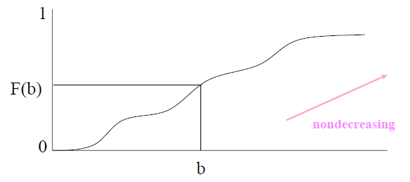
Cumulative Distribution Function (CDF)
The cumulative distribution function (cdf) (or distribution function) of a random variable is defined for any real number by
denotes the probability that the random variable
takes on a value that is less than or equal to .

Slide 29
Cumulative Distribution Function (CDF)
Some properties of cdf are:
  is a non-decreasing function of b,
Property (i) follows since for the event is contained in the event , and so it must have a smaller probability.
Properties (ii) and (iii) follow since must take on some finite value.
All probability questions about can be answered in terms of cdf . For example:
i.e. calculate by first computing the probability that
and then subtract from this the probability that .

Slide 30
Cumulative Distribution Function
The cumulative distribution function can be expressed in terms of by:
Suppose has a probability mass function given by
then the cumulative distribution function of is given by

Slide 31
Cumulative Distribution Function
The cumulative distribution function can be expressed in terms of by:
Suppose has a probability mass function given by
then the cumulative distribution function of is given by

Slide 32
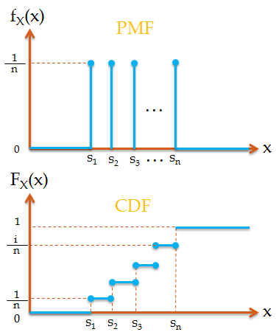
Review: Discrete Random Variables
Discrete Random Variables:
  Probability mass function (pmf):
    Properties:
  Cumulative distribution function (CDF):
    A stair step function

Slide 33
Discrete/Continuous Random Variables
Random variables can also take on a continuum of possible values (known as continuous random variables).
Example: A random variable denoting the lifetime of a car, when the car’s lifetime is assumed to take on any value in some interval (a,b).

Slide 34
Continuous Random Variables
Random variables whose set of possible values is uncountable
X is a continuous random variable if there exists a nonnegative function f(x) defined for all real , having the property that for any set of B real numbers
f(x) is called the probability density function (pdf) of the random variable X
The probability that X will be in B may be obtained by integrating the probability density function over the set B. Since X must assume some value, f(x) must satisfy

Slide 35
Continuous Random Variables Cont’d
All probability statements about X can be answered in terms of f(x)
e.g. letting B=[a,b], we obtain
If we let a=b in the preceding, then ?????
The relationship between the cumulative distribution F(∙) and the probability density f(∙)
Differentiating both sides of the preceding yields

Slide 36
Continuous Random Variables Cont’d
All probability statements about X can be answered in terms of f(x)
e.g. letting B=[a,b], we obtain
If we let a=b in the preceding, then
This equation states that the probability that a continuous random variable will assume any particular value is zero
The relationship between the cumulative distribution F(∙) and the probability density f(∙)
Differentiating both sides of the preceding yields

Slide 37
Continuous Random Variables Cont’d
That is, the density function is the derivative of the cumulative distribution function.
A somewhat more intuitive interpretation of the density function
when ε is small
The probability that X will be contained in an interval of length ε around the point a is approximately εf(a)

Slide 38
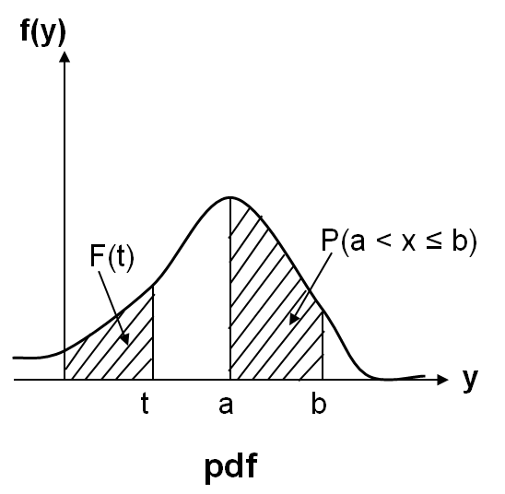
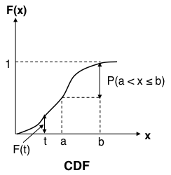
Review: Continuous Random Variables
Continuous Random Variables:
  Probability distribution function (pdf):
    Properties:
    All probability statements about X can be answered by f(x):
  Cumulative distribution function (CDF):
    Properties:
    A continuous function

Slide 39
The Bernoulli Random Variable
Where is the probability that the trial is a success
X is said to be a Bernoulli random variable with its probability mass function is given by the above equation some for

Slide 40
The Binomial Random Variable
n independent trials, each of which results in a “success” with p and in a “failure” with probability 1-p
If X represents the number of successes that occur in n trials, X is said to be a binomial random variable with parameters (n,p)
The probability mass function of a binomial random variable having parameters (n,p) is given by
is the number of different groups of i objects that can be chosen from a set of n objects
Equation (1)

Slide 41
The Binomial Random Variable
Equation (1) may be verified by first noting that the probability of any particular sequence of the n outcomes containing i successes and n-i failures is, by the assumed independence of trials,
Equation (1) then follows since there are different sequences of the n outcomes leading to I successes and n - i failures. For instance if n=3, i=2, then there are ways in which the three trials can result in two successes.
By the binomial theorem, the probabilities sum to one:

Slide 42
Binomial Random Variable Example 1
Four fair coins are flipped. Outcomes are assumed independent, what is the probability that two heads and two tails are obtained?
Letting X equal the number of heads (“successes”) that appear, then X is a binomial random variable with parameters (n = 4, p = 1/2). Hence by the binomial equation,

Slide 43
Binomial Random Variable Example 2
It is known that an item produced by a certain machine will be defective with probability 0.1; independent of any other item. What is the probability that in a sample of three items, at most one will be defective?
If X is the number of defective items in the sample, then X is a binomial random variable with parameters (3, 0.1). Hence, the desired probability is given by:

Slide 44
Binomial RV Example 3
Suppose that an airplane engine will fail, when in flight, with probability 1−p independently from engine to engine; suppose that the airplane will make a successful flight if at least 50 percent of its engines remain operative. For what values of p is a four-engine plane preferable to a two-engine plane?
Because each engine is assumed to fail or function independent of other engines: the number of engines remaining operational is a binomial random variable. Hence, the probability that a four-engine plane makes a successful flight is:

Slide 45
Binomial RV Example 3 (Cont’)
The corresponding probability for a two-engine plane is:
The four-engine plane is safer if:
Or equivalently if:
Hence, the four-engine plane is safer when the engine success probability is at least as large as 2/3, whereas the two-engine plane is safer when this probability falls below 2/3.

Slide 46
Geometric Distribution Examples
3. Consider a repeat loop
repeat S until B
The number of tries until B (success) (i.e. includes B) is reached will be a geometrically distributed random variable with parameter p.

Slide 47
Geometric Distribution: Examples
Some Examples where the geometric distribution occurs
1. The probability the ith item on a production line is defective is given by the geometric pmf.
2. The pmf of the random variable denoting the number of time slices needed to complete the execution of a job

Slide 48
Discrete Distributions
Geometric pmf (cont.)
To find the pmf of a geometric Random Variable (RV), Z note that the event [Z = i] occurs if and only if we have a sequence of (i – 1) “failures” followed by one success - a sequence of independent Bernoulli trials each with the probability of success equal to p and failure q.
Hence, we have
for i = 1, 2,..., (A)
  where q = 1 - p.
Using the formula for the sum of a geometric series, we have:
CDF of Geometric distr.:

Slide 49
Discrete Distributions the Modified Geometric pmf (cont.)
The random variable X is said to have a modified geometric pmf, specify by
for i = 0, 1, 2,...,
The corresponding Cumulative Distribution function is:
for t ≥ 0

Slide 50
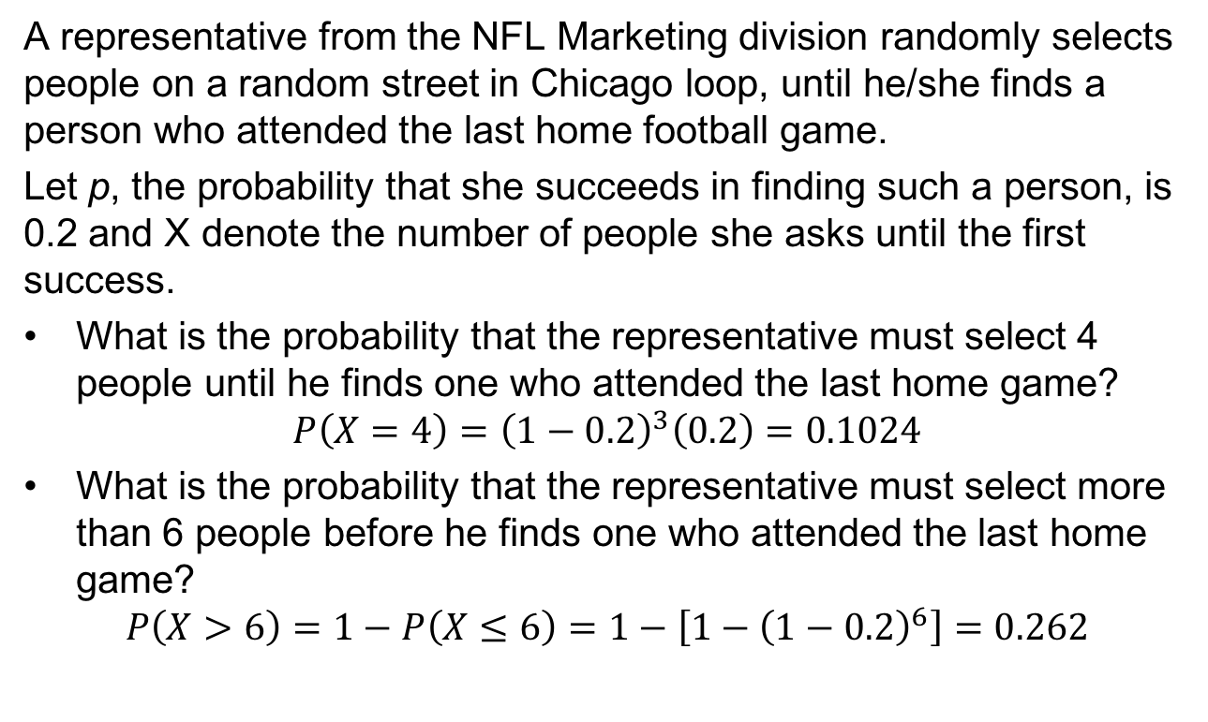
Example: Geometric Random Variable
A representative from the NFL Marketing division randomly selects people on a random street in Chicago loop, until he/she finds a person who attended the last home football game.
Let p, the probability that she succeeds in finding such a person, is 0.2 and X denote the number of people she asks until the first success.
What is the probability that the representative must select 4 people until he finds one who attended the last home game?
$$P\left(X=4\right)={\left(1−0.2\right)}^{3}\left(0.2\right)=0.1024$$
What is the probability that the representative must select more than 6 people before he finds one who attended the last home game?
$$P\left(X>6\right)=1−P\left(X≤6\right)=1−\left[1−{\left(1−0.2\right)}^{6}\right]=0.262$$

Slide 51
The Poisson Random Variable
A random variable X, taking on one of the values 0,1,2,…, is said to be a Poisson random variable with parameter λ, if for some λ>0,
defines a probability mass function since

Slide 52
Poisson Random Variable
Consider smaller intervals, i.e., let $n→∞$
$$P\left(X=k\right)=\lim_{n→∞}{\frac{{λt}^{k}}{k!}\left[\frac{n\left(n−1\right)…(n−k+1)}{n∙n∙n…n}\right]}{\left(1−\frac{λt}{n}\right)}^{n}{\left(1−\frac{λt}{n}\right)}^{−k}$$
$$=\lim_{n→∞}{\frac{{λt}^{k}}{k!}\left[1∙\left(1−\frac{1}{n}\right)\left(1−\frac{2}{n}\right)…(1−\frac{k+1}{n})\right]{\left(1−\frac{λt}{n}\right)}^{n}{\left(1−\frac{λt}{n}\right)}^{−k} }$$
$=$ $\frac{{λt}^{k}}{k!}e^{−λt}$
Which is a Poisson process with $α=$ $λt$

