Slide 1
Announcements
Final Project Presentation
  Saturday, May 6, 12pm – 5pm, ECEB 1013, 1015, 2013, 2015
  Sign up by filling the Doodle poll on Piazza today by 5pm deadline.
  7 minutes for the presentation, 3-5 minutes going through Matlab code, 3-5 minutes for questions, 3 minutes buffer time.
Final Report will be due on Monday, May 8, 11:59pm (no grace period)
Final Exam Review on Tue, May 9, 5:00 PM - 7:00 PM, Siebel 0216 (usual ECE 313 classroom location)
Additional TA hours (walk-in is ok if we are available)
  Friday, May 5, 3-4 (Saboo), 4-5pm (Phuong)
  Mon, May 8, 3-5 (Saboo); Tue, May 9, 3-5 (Phuong)

Slide 2
Key concepts substantially learned post-midterm
Bernoulli, Poisson binomial approximation
Exponential and related: K-stage Erlang, hypoexponential, hyperexponential
Normal
Reliability function, instantaneous failure rate function, TMR
Conditional probability
Expected Value, Variance, Covariance and Correlation
Joint, conditional distribution
Independent random variables
Central Limit Theorem, Law of large number (strong and weak)
Markov, Chebyshev inequality

Slide 3
Solutions

Slide 4
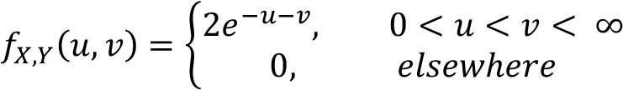
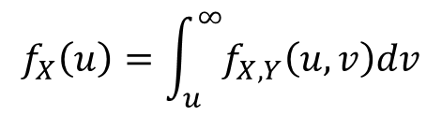
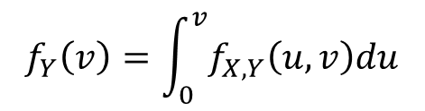
Problem 1
The jointly continuous random variable X and Y have joint pdf
v
v = u
u

Slide 5
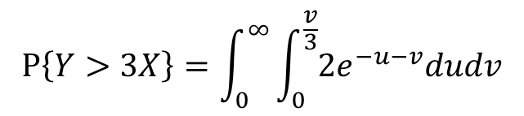
Problem 1 (cont.)
The jointly continuous random variable X and Y have joint pdf
Find P[Y > 3X]
v = 3u
v
v = u
u

Slide 6
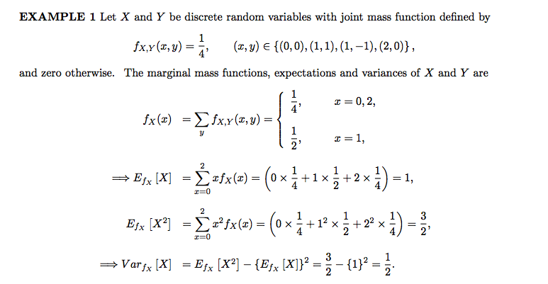
Problem 2

Slide 7
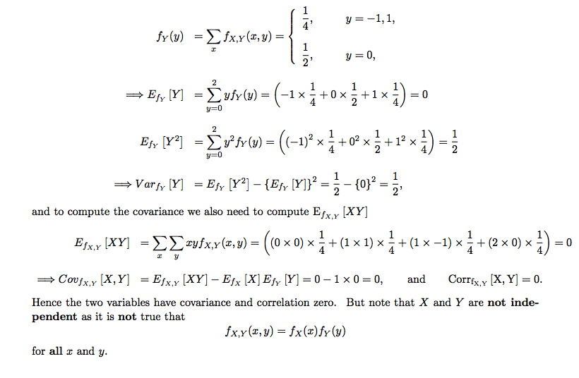
Problem 2 (cont.)

Slide 8
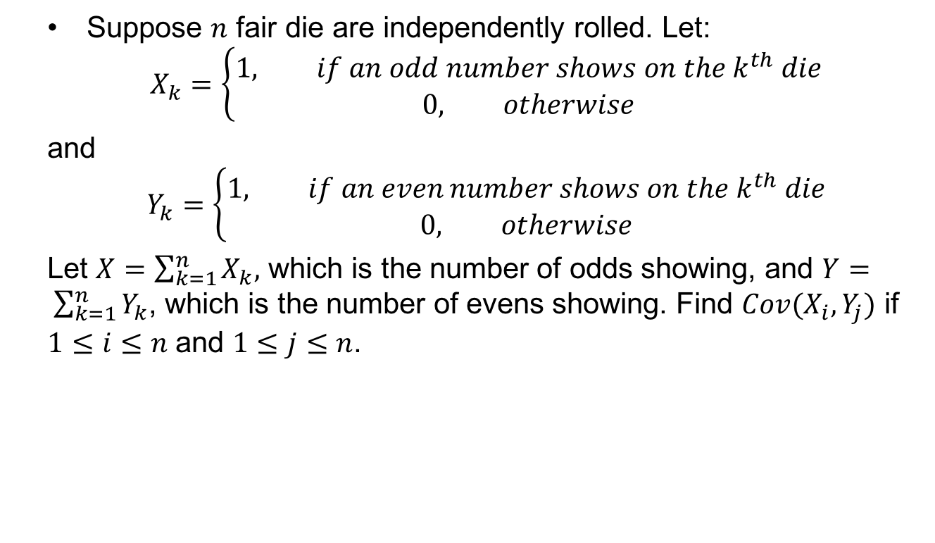
Problem 3
Suppose $n$ fair die are independently rolled. Let:
$$X_{k}=\left\{\begin{aligned}1, if an odd number shows on the k^{th} die \\ &0, otherwise\end{aligned}\right.$$
and
$$Y_{k}=\left\{\begin{aligned}1, if an even number shows on the k^{th} die \\ &0, otherwise\end{aligned}\right.$$
Let $X=\sum_{k=1}^{n}{X_{k},}$ which is the number of odds showing, and $Y= \sum_{k=1}^{n}{Y_{k}}$, which is the number of evens showing. Find $Cov(X_{i}, Y_{j})$ if $1≤i≤n$ and $1≤j≤n$.

Slide 9
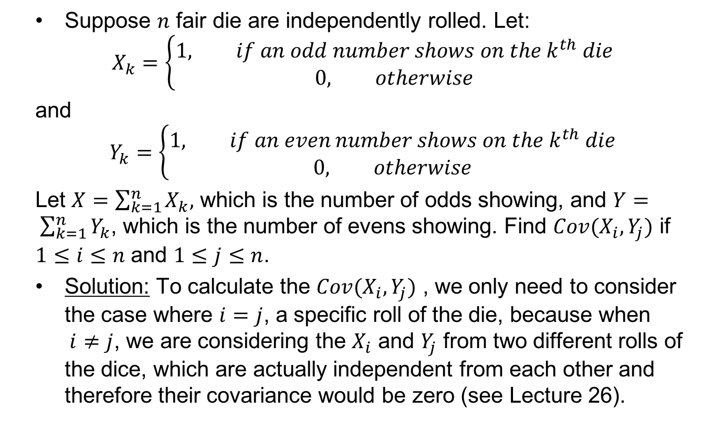
Problem 3 (cont.)
Suppose $n$ fair die are independently rolled. Let:
$$X_{k}=\left\{\begin{aligned}1, if an odd number shows on the k^{th} die \\ &0, otherwise\end{aligned}\right.$$
and
$$Y_{k}=\left\{\begin{aligned}1, if an even number shows on the k^{th} die \\ &0, otherwise\end{aligned}\right.$$
Let $X=\sum_{k=1}^{n}{X_{k},}$ which is the number of odds showing, and $Y= \sum_{k=1}^{n}{Y_{k}}$, which is the number of evens showing. Find $Cov(X_{i}, Y_{j})$ if $1≤i≤n$ and $1≤j≤n$.
Solution: To calculate the $Cov(X_{i}, Y_{j})$ , we only need to consider the case where $i=j$, a specific roll of the die, because when $i≠j$, we are considering the $X_{i}$ and $Y_{j}$ from two different rolls of the dice, which are actually independent from each other and therefore their covariance would be zero (see Lecture 26).

Slide 10
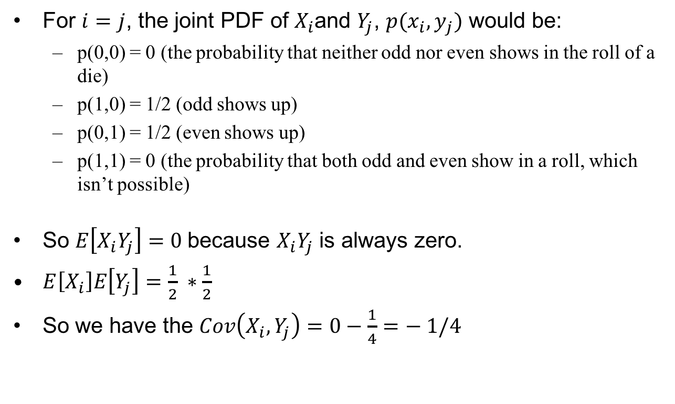
Problem 3 (cont.)
For $i=j$, the joint PDF of $X_{i}$and $Y_{j}$, $p(x_{i}, y_{j})$ would be:
  p(0,0) = 0 (the probability that neither odd nor even shows in the roll of a die)
  p(1,0) = 1/2 (odd shows up)
  p(0,1) = 1/2 (even shows up)
  p(1,1) = 0 (the probability that both odd and even show in a roll, which isn’t possible)
So $E\left[X_{i}Y_{j}\right]=0$because $X_{i}Y_{j}$ is always zero.
$E\left[X_{i}\right]E\left[Y_{j}\right]=\frac{1}{2} ∗\frac{1}{2}$
So we have the $Cov\left(X_{i}, Y_{j}\right)=0−\frac{1}{4}=− 1/4$

Slide 11
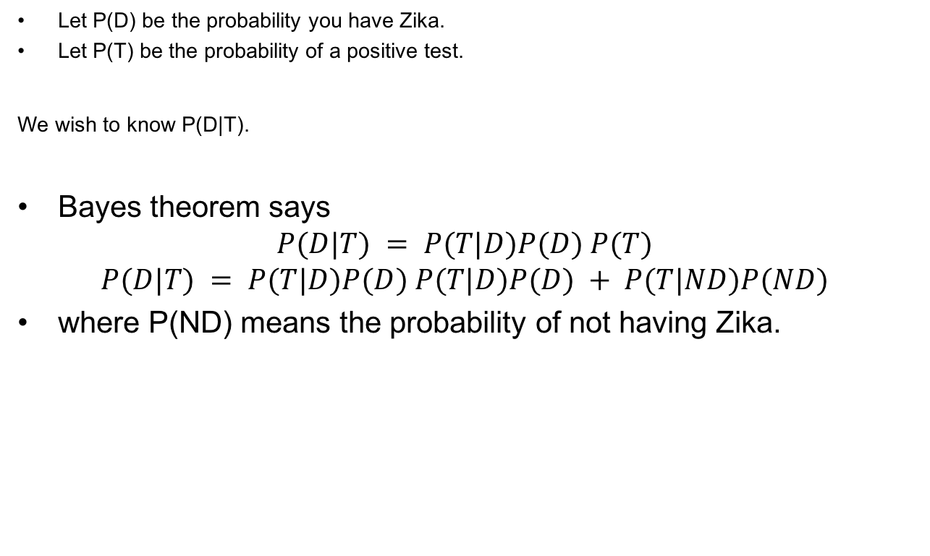
Problem 4
Let P(D) be the probability you have Zika.
Let P(T) be the probability of a positive test.
We wish to know P(D|T).
Bayes theorem says
$$P(D|T) = P(T|D)P(D) P(T)$$
$$P(D|T) = P(T|D)P(D) P(T|D)P(D) + P(T|ND)P(ND)$$
where P(ND) means the probability of not having Zika.

Slide 12
Problem 4 (cont.)
We have
P(D) = 0.0001 (the a priori probability you have Zika).
P(ND) = 0.9999 P(T|D) = 1 (if you have Zika the test is always positive).
P(T|ND) = 0.01 (1% chance of a false positive).
Plugging these numbers in we get
P(D|T) = 1 × 0.0001 1 × 0.0001 + 0.01 × 0.9999 ≈ 0.01
That is, even though the test was positive your chance of having Zika is only 1%, because your P(D) is indeed very low.
However, if you went to Florida recently then your starting P(D) is 0.005. In this case
P(D|T) = 1 × 0.005 1 × 0.005 + 0.01 × 0.995 ≈ 0.33
and you should be a lot more worried.

Slide 13
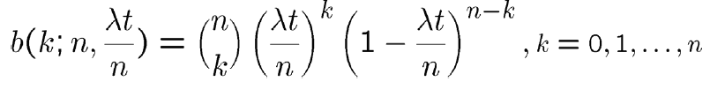
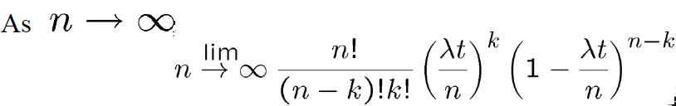
Review: Poisson Distribution
Let X be a discrete random variable, representing the “no. of arrivals in an interval (0,t]”. Assume λ is the rate of arrival of the jobs.
In a small interval, Δt, prob. of new arrival is λΔt.
If Δt is small enough, probability of two arrivals in Δt may be neglected
Suppose interval (0,t] is divided into n subintervals of length t/n
Suppose arrival of a job in any interval is independent of the arrival of a job in any other interval.
For a large n, the n intervals can be thought of as constituting a sequence of Bernoulli trials with probability of success p = λt/n
Therefore, probability of k arrivals in a total of n intervals, is given by:

Slide 14
Review: Expectations
Expectation:
  The Discrete Case
  The Continuous Case
Expectation of function of a random variable
  Corollary:

Slide 15
Review: Moments
Moments:
Variance:
    Corollary:

Slide 16
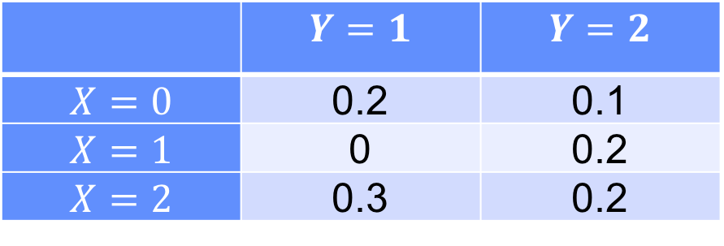
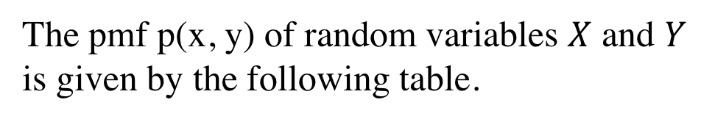
Joint distribution
The pmf p(x, y) of random variables $X$ and $Y$
is given by the following table.
 | $$Y=1$$ | $$Y=2$$
$$X=0$$ | 0.2 | 0.1
$$X=1$$ | 0 | 0.2
$$X=2$$ | 0.3 | 0.2

Slide 17
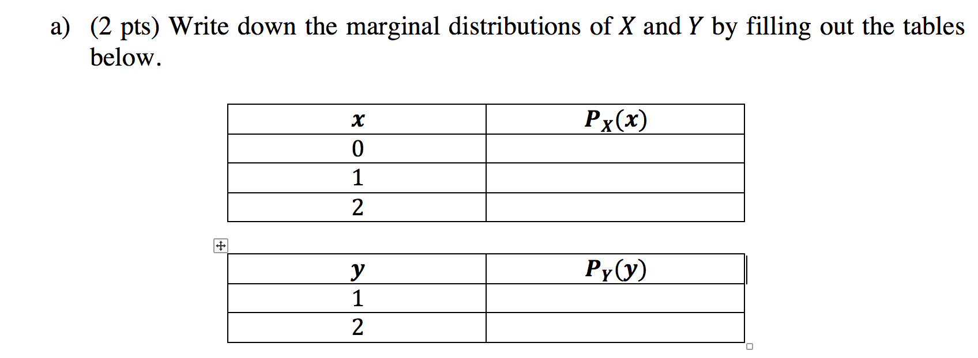
Joint distribution

Slide 18
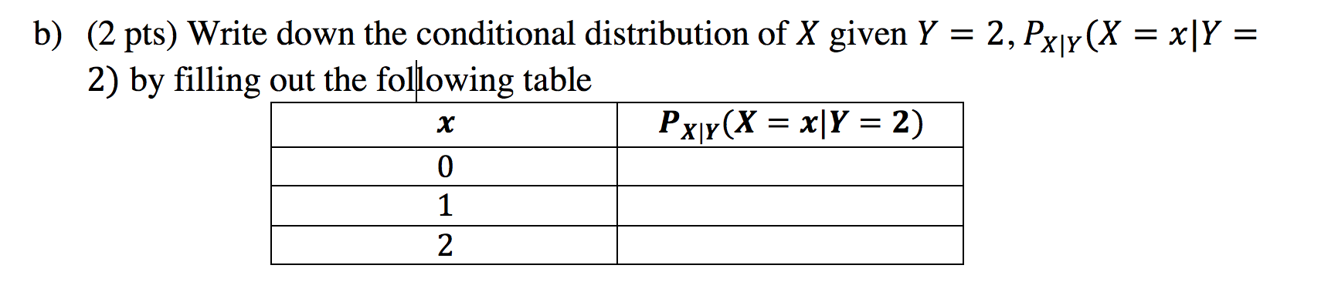
Joint distribution

Slide 19
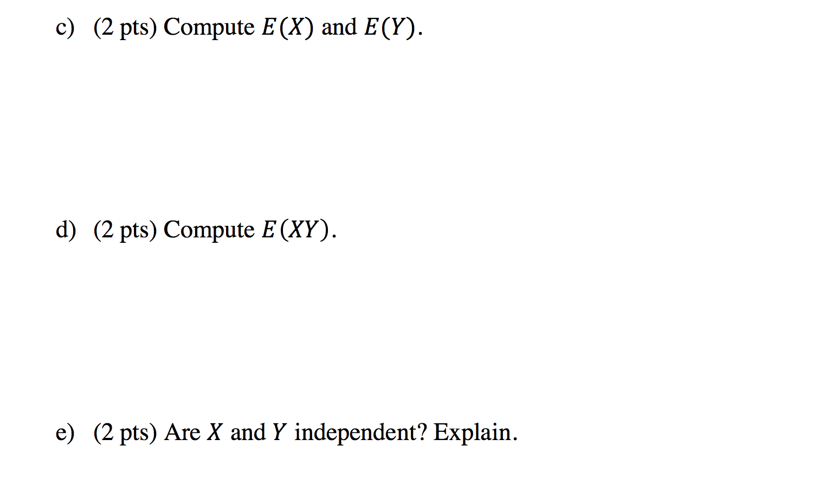
Joint distribution

Slide 20
Review: Covariance and Variance
The covariance of any two random variables, X and Y, denoted by Cov(X,Y), is defined by
If X and Y are independent then it follows that Cov(X,Y)=0
For any random variable X, Y, Z, and constant c, we have:
  Cov (X,X) = Var(X),
  Cov (X,Y) = Cov(Y,X),
  Cov (cX,Y) = cCov(X,y),
  Cof (X,Y+Z) = Cov(X,Y) + Cov(X,Z).

Slide 21
Review: Covariance and Variance
Covariance and Variance of Sums of Random Variables
A useful expression for the variance of the sum of random variables can be obtained from the preceding equation
If are independent random variables, then the above equation reduces to

Slide 22
Covariance Example
Three balls numbered one through three are in a bag. Two balls are drawn at random, without replacement, with all possible outcomes having equal probability.
Let X be the number on the first ball drawn and Y be the number on the second ball drawn.
(a) Are X and Y independent?
(b) Find E[X].
(c) Find Var(X).
(d) Find E[XY].
(e) Find the correlation coefficient, ρX,Y

Slide 23
Covariance Example (Solution)
(a) We find the marginal pmfs of X and Y and their joint pmf:
When picking the first ball we have 3 possibilities {1, 2, 3}, so X is uniformly distributed with P(X = x) = 1/3.
For the second ball, depending on which number was on the first ball, we can calculate the probability of each number using the law of total probability as follows:
P(Y = k) = P(Y = k | X = k)P(X = k)+ P(Y = k | X ≠ k)P(X ≠ k)
The probability of seeing a number on second ball if it has been already seen in the first ball, P(Y = k | X = k), is zero.
And the probability of seeing a number on second ball that has not been seen in the first ball, P(Y = k | X ≠ k), is 1/2.
So for the pmf of Y we have:
P(Y = k) = 0 (1/3) + (1/2) (2/3) = 1/3

Slide 24
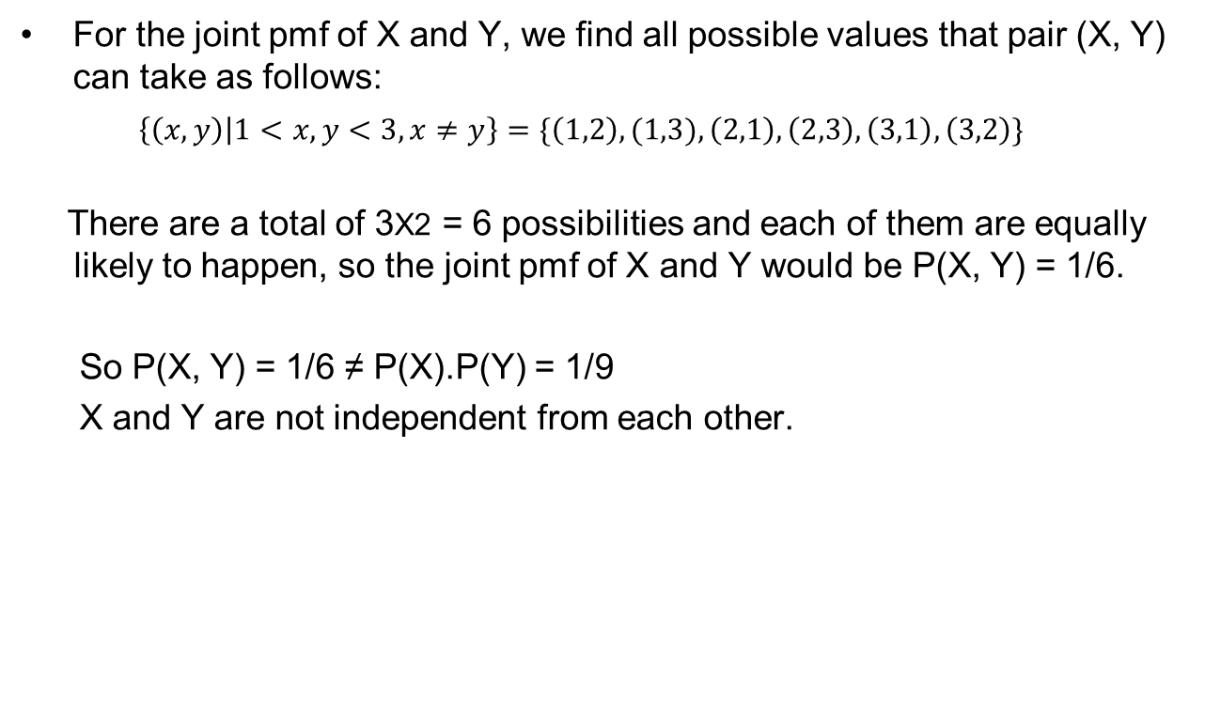
Covariance Example (Solution)
For the joint pmf of X and Y, we find all possible values that pair (X, Y) can take as follows:
$\left\{\left(x,y\right) | 1<x,y<3, x≠y\right\}=\{\left(1,2\right), (1,3),\left(2,1\right),\left(2,3\right),\left(3,1\right),\left(3,2\right)\}$
There are a total of 3X2 = 6 possibilities and each of them are equally likely to happen, so the joint pmf of X and Y would be P(X, Y) = 1/6.
So P(X, Y) = 1/6 ≠ P(X).P(Y) = 1/9
X and Y are not independent from each other.

Slide 25
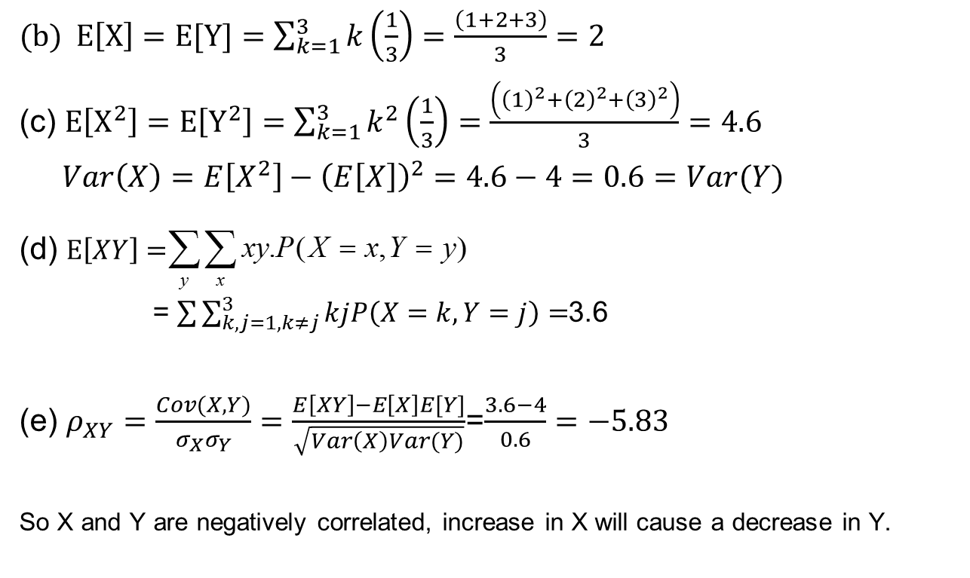
Covariance Example (Solution)

Slide 26
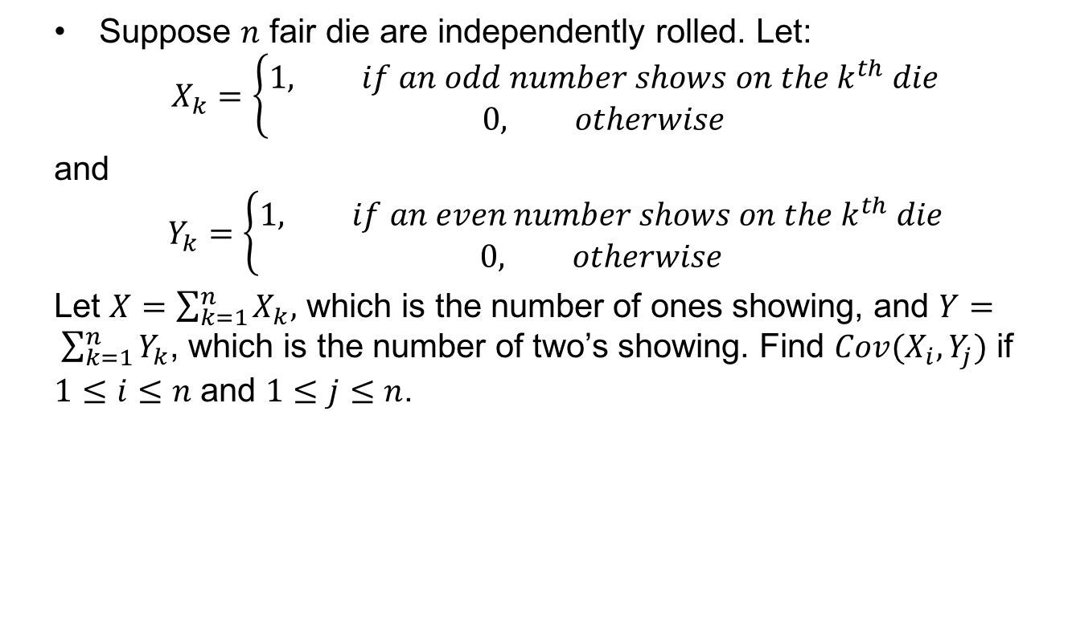
Covariance – Problem 1
Suppose $n$ fair die are independently rolled. Let:
$$X_{k}=\left\{\begin{aligned}1, if an odd number shows on the k^{th} die \\ &0, otherwise\end{aligned}\right.$$
and
$$Y_{k}=\left\{\begin{aligned}1, if an even number shows on the k^{th} die \\ &0, otherwise\end{aligned}\right.$$
Let $X=\sum_{k=1}^{n}{X_{k},}$ which is the number of ones showing, and $Y= \sum_{k=1}^{n}{Y_{k}}$, which is the number of two’s showing. Find $Cov(X_{i}, Y_{j})$ if $1≤i≤n$ and $1≤j≤n$.

Slide 27
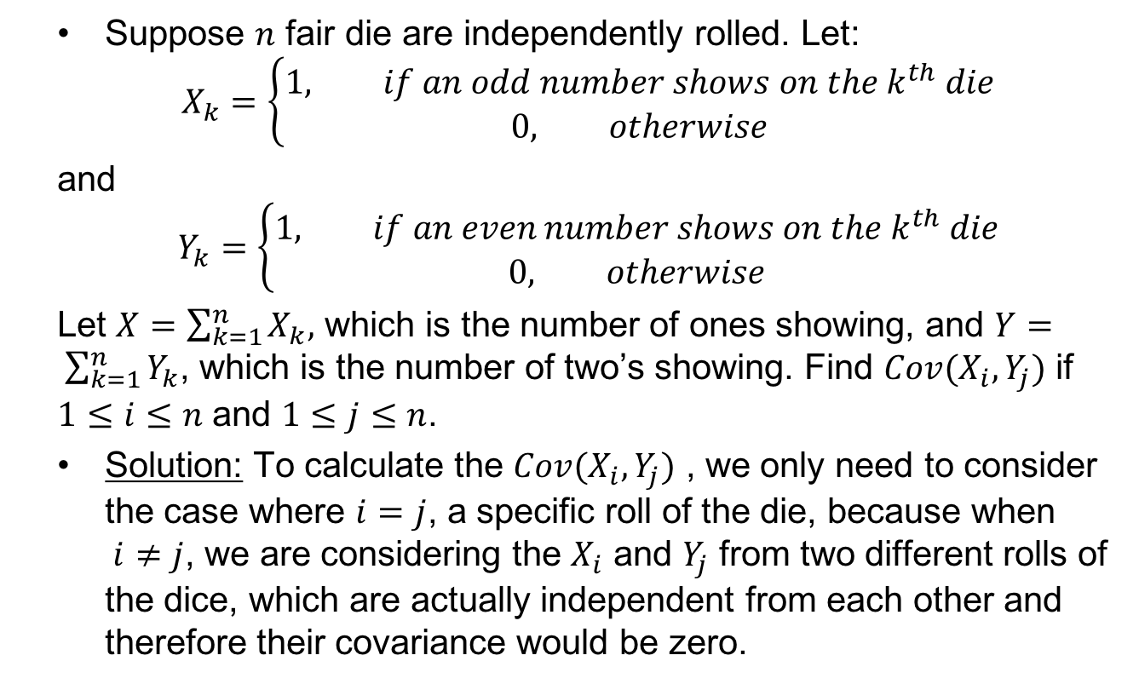
Covariance – Problem 1
Suppose $n$ fair die are independently rolled. Let:
$$X_{k}=\left\{\begin{aligned}1, if an odd number shows on the k^{th} die \\ &0, otherwise\end{aligned}\right.$$
and
$$Y_{k}=\left\{\begin{aligned}1, if an even number shows on the k^{th} die \\ &0, otherwise\end{aligned}\right.$$
Let $X=\sum_{k=1}^{n}{X_{k},}$ which is the number of ones showing, and $Y= \sum_{k=1}^{n}{Y_{k}}$, which is the number of two’s showing. Find $Cov(X_{i}, Y_{j})$ if $1≤i≤n$ and $1≤j≤n$.
Solution: To calculate the $Cov(X_{i}, Y_{j})$ , we only need to consider the case where $i=j$, a specific roll of the die, because when $i≠j$, we are considering the $X_{i}$ and $Y_{j}$ from two different rolls of the dice, which are actually independent from each other and therefore their covariance would be zero.

Slide 28
Covariance – Problem 1 (Cont.)
For $i=j$, the joint PDF of $X_{i}$and $Y_{j}$, $p(x_{i}, y_{j})$ would be:
  p(0,0) = 0 (the probability that neither odd nor even shows in the roll of a die)
  p(1,0) = 1/2 (odd shows up)
  p(0,1) = 1/2 (even shows up)
  p(1,1) = 0 (the probability that both odd and even show in a roll, which isn’t possible)
So $E\left[X_{i}Y_{j}\right]=0$because $X_{i}Y_{j}$ is always zero.
$E\left[X_{i}\right]E\left[Y_{j}\right]=\frac{1}{2} ∗\frac{1}{2}$
So we have the $Cov\left(X_{i}, Y_{j}\right)=0−\frac{1}{4}=− 1/4$

Slide 29
Review: Limit Theorems
Markov’s Inequality: If X is a random variable that takes only nonnegative values, then for any value a>0:
Chebyshev’s Inequality: If X is a random variable with mean μ and variance σ² then for any value k>0,
Strong law of large numbers: Let X₁,X₂,… be a sequence of independent random variables having a common distribution, and let E[X_{i}]=μ Then, with probability 1,

Slide 30
Review: Limit Theorems
Central Limit Theorem: Let X_{1,} X₂,…be a sequence of independent, identically distributed random variables, each with mean μ and variance σ² then the distribution of
Tends to the standard normal as . That is,
Note that like other results, this theorem holds for any distribution of the X_{i} ‘s; herein lies its power.

Slide 31
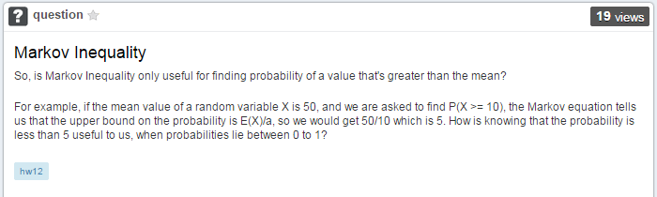
Piazza Question on Markov Inequality
The Markov inequality says that as E[X] gets smaller than a, then probability of P(X >= a) gets very close to 1.
Also as the value of a increases, the quotient E(X)/a will becomes smaller. This means that the probability of X being very, very large is small
Please note that the Markov inequality works for any random non-negative random variable with any distribution and the real use of Markov inequality is to prove the Chebychev's inequality.

Slide 32

Example – Chebyshev Inequality
The mean and standard deviation of the response time in a multi-user computer system are known to be 15 seconds and 3 seconds respectively.
Estimate the probability that the response time is more than 5 seconds from the mean.
The Chebyshev inequality with m = 15,σ = 3, and a = 5:

Slide 33
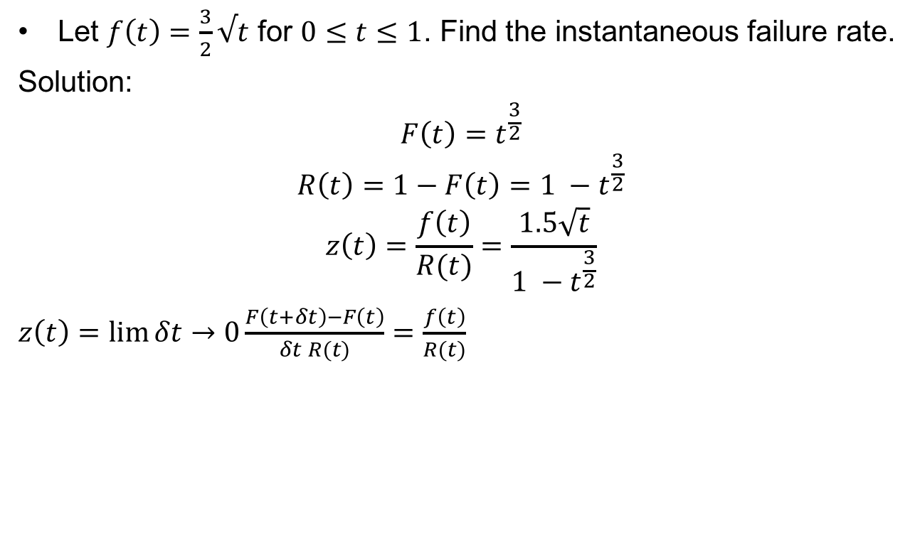
Instantaneous Failure Rate
Let $f\left(t\right)=\frac{3}{2}√t$ for $0≤t≤1$. Find the instantaneous failure rate.
Solution:
$$F\left(t\right)=t^{\frac{3}{2}}$$
$$R\left(t\right)=1−F\left(t\right)=1 −t^{\frac{3}{2}}$$
$$z\left(t\right)=\frac{f\left(t\right)}{R(t)}=\frac{1.5\sqrt{t}}{1 −t^{\frac{3}{2}}}$$
$z\left(t\right)=\lim{δt}→0\frac{F\left(t+δt\right)−F\left(t\right)}{δt R(t)}=\frac{f\left(t\right)}{R(t)}$

Slide 34
Example - Joint Distribution Functions
The jointly continuous random variable X and Y have joint pdf
v
v = u
u

Slide 35
Example - Joint Distribution Functions
The jointly continuous random variable X and Y have joint pdf
Find P[Y > 3X]
v = 3u
v
v = u
u

