Slide 1
Some problems on Joint Distributions,
ECE 313
Probability with Engineering Applications
Lecture 26
Professor Ravi K. Iyer
Dept. of Electrical and Computer Engineering
University of Illinois at Urbana Champaign

Slide 2
Today’s Topics
Problems on Joint distributions, Covariance, Exponential related distributions….:
Announcements:
  Final Exam on Thu, May 11, 8 am – 11 am.
    Three 8x11 sheets allowed: No other aids electronic or otherwise
    Exam Review session May 9, 5:30pm Place TBD
  Final Exam Review on Mon, May 8, 5:00 PM - 8:00 PM, ECEB – 1015
  Additional TA hours
    Friday, May 5, 3-4 (Saboo), 4-5pm (Phuong)
    Mon, May 8, 3-5 (Saboo); Tue, May 9, 3-5 (Phuong)
  HW 10 due today , May 1
  Final project MP3
    Final Presentation on Saturday, May 6, 12pm – 5pm
      Sign up for location, fill Doodle form on Piazza by Wed, May 3, 5pm.
    Final Report will be due on Monday, May 8, 11:59pm

Slide 3
Final Project Presentation Format
  Presentation ~ 10 Slides Max:
      1-2 Slides: Project Summary
        Patients and features selected and justify you choice.
        Why do you think your selected features would perform best on the complete patient set
        What concepts from class used for analysis, any additional concepts?
        Division of tasks
      3-6 Slides: Analysis Results
        Provide evidence for the techniques you used.
        For example show the results of your analysis for selection of features in the form of tables/graphs presenting the ML and MAP errors, correlations, etc.
        Did you change your features selected in Task 2 after doing Task 3? Provide insights and justification for your selection. How are the results in Task 3.3 different from results in Task 2?
        Present the performance for the ML and MAP rule for all 9 patients.
      1-2 Slides: Conclusions and key insights
        Example insights: Compare the results generated by ML and MAP rules.
        How were the projects useful in understanding the concepts learned in the class in practice? What suggestions do you have for improvement?
  Notes:
    Send your presentation to TAs by Fri, May 5, 5pm.
    Have your matlab/Python code ready to run (check it before your presentation!)
      Groups should run their Matlab/Python code for Task 3
      Present the performance for the ML and MAP rule for all 9 patients.

Slide 4
Final Project Timeline
  Final Project Presentation, Saturday, May. 6:
    Time: 1:00pm – 5:30 pm – Location:
    All the groups should sign up by Wednesday .
    Each group: 10 mins for presentation, 2 mins for questions
    Presentation ~ 10 slides:
        1 Slide: Project topic and summary
        1-2 Slides: Data collection technique and a sample of data
        2 Slides: Data analysis approach and concepts used from the class
        5 Slides: Results of analysis
          Provide evidence that your data and results are consistent
        1-2 Slides: Summary, conclusions, key insights, suggestions
          Your insights on the results are important.
          Provide two constructive suggestions on how to improve projects
Final Project Report,

Slide 5
Final Exam Important Dates
Final Exam Review Mon, May 8, 5:00 PM - 8:00 PM, ECEB – 1015
Final Exam, Wednesday, May11 8:00am – 11:00am,
  Location: 2015 and 2017 ECEB
  You are allowed to bring three 8”x11” sheet of notes.
  No calculators, laptops, or electronic gadgets are allowed.
  Expected to be between 2.5 – 3 hours, approx. 6-8 problems.
  Approx. 60% from the material after the midterm exam, and 40% from the material before the midterm, or a mixture of both
  Show all your work to get partial credit.

Slide 6


Review: Joint Distribution Functions
Joint distribution functions:
  For any two random variables X and Y, the joint cumulative probability distribution function of X and Y by:
  Discrete:
    The joint probability mass function of X and Y
    Marginal PMFs of X and Y:

Slide 7

Review: Joint Distribution Functions
Joint distribution functions:
  Continuous:
    The joint probability density function of X and Y:
    Marginal PDFs of X and Y:
    Relation between joint CDF and PDF

Slide 8
Review: Joint Distribution Functions
Function of two joint random variables
For example, if g(X,Y)=X+Y, then, in the continuous case

Slide 9

Review of Moments
Recall the definition of moments:
The first and second moments (mean and variance) of a single random variable convey important information about the distribution of the variable.
For example the variance of X measures the expected square of the deviation of X from its expected value, and is defined by:
Use of moments is even more important when considering more than one random variable at a time with joint distributions that are much more complex than distributions for individual random variables.

Slide 10






Covariance
The covariance of any two random variables, X and Y, denoted by Cov(X,Y), is defined by
Covariance generalizes variance, in the sense that Var(X) = Cov(X, X).
If either X or Y has mean zero, then E[XY] = Cov(X, Y ).
If X and Y are independent then it follows that Cov(X,Y) = 0.
But the reverse is false:
  Cov(X,Y) = 0 means X and Y are uncorrelated, but it doesn’t imply that X and Y are independent.

Slide 11

Review: Covariance and Variance
The covariance of any two random variables, X and Y, denoted by Cov(X,Y), is defined by
If X and Y are independent then it follows that Cov(X,Y)=0
For any random variable X, Y, Z, and constant c, we have:
  Cov (X,X) = Var(X),
  Cov (X,Y) = Cov(Y,X),
  Cov (cX,Y) = cCov(X,y),
  Cof (X,Y+Z) = Cov(X,Y) + Cov(X,Z).

Slide 12
Review: Covariance and Variance
Covariance and Variance of Sums of Random Variables
A useful expression for the variance of the sum of random variables can be obtained from the preceding equation
If are independent random variables, then the above equation reduces to

Slide 13
Independent Random Variables
Independent Random Variables: Two random variables X and Y are said to be independent if:
If X and Y are continuous:
If X is discrete and Y is continuous:

Slide 14
Review: Limit Theorems
Markov’s Inequality: If X is a random variable that takes only nonnegative values, then for any value a>0:
Chebyshev’s Inequality: If X is a random variable with mean μ and variance σ² then for any value k>0,
Strong law of large numbers: Let X₁,X₂,… be a sequence of independent random variables having a common distribution, and let E[X_{i}]=μ Then, with probability 1,

Slide 15
Review: Limit Theorems
Central Limit Theorem: Let X_{1,} X₂,…be a sequence of independent, identically distributed random variables, each with mean μ and variance σ² then the distribution of
Tends to the standard normal as . That is,
Note that like other results, this theorem holds for any distribution of the X_{i} ‘s; herein lies its power.

Slide 16
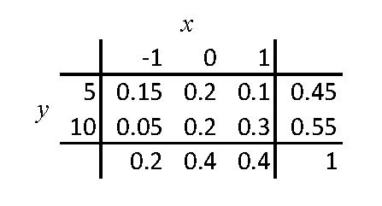



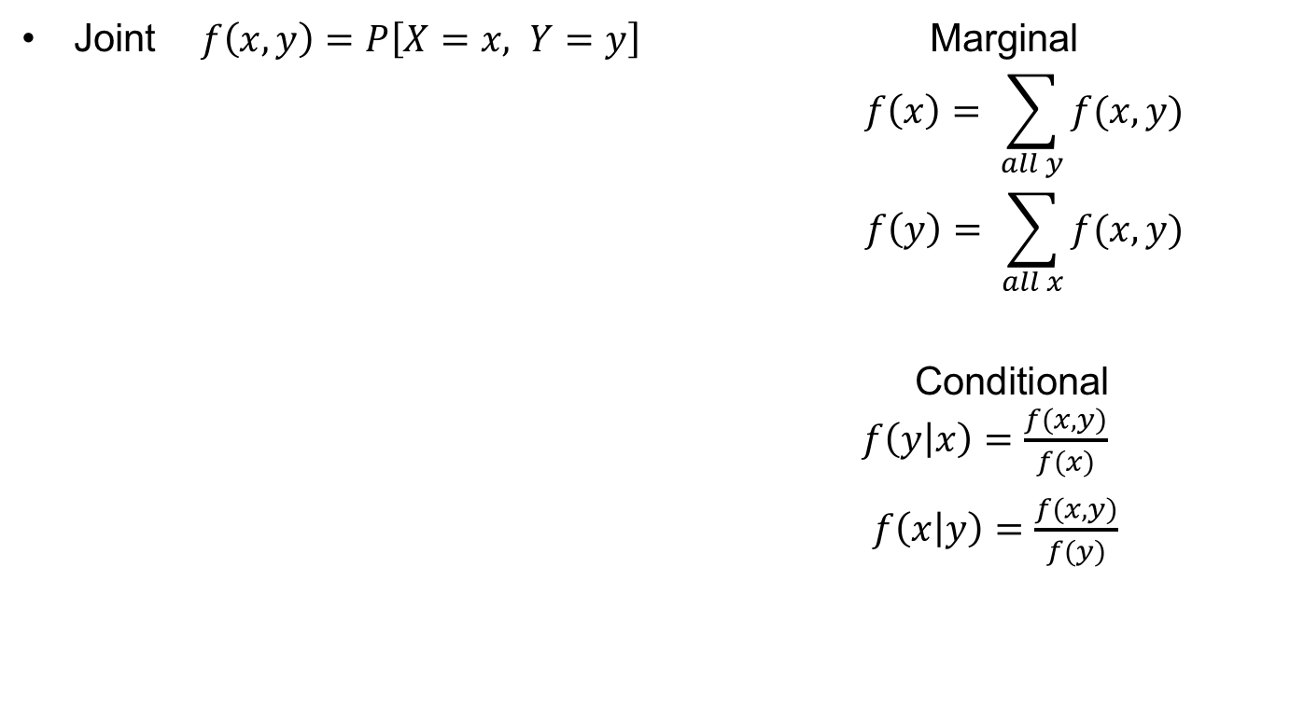
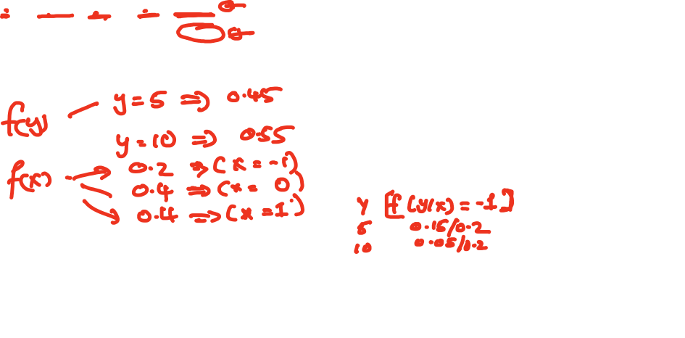
Review: Joint Distribution Functions
Joint $f\left(x,y\right)=P\left[X=x, Y=y\right]$ Marginal
$$f\left(x\right)= \sum_{all y}{f(x,y)}$$
$$f\left(y\right)= \sum_{all x}{f(x,y)}$$
Conditional $f\left(\left.y\right|x\right)=\frac{f(x,y)}{f(x)}$
$f\left(\left.x\right|y\right)=\frac{f(x,y)}{f(y)}$

Slide 17
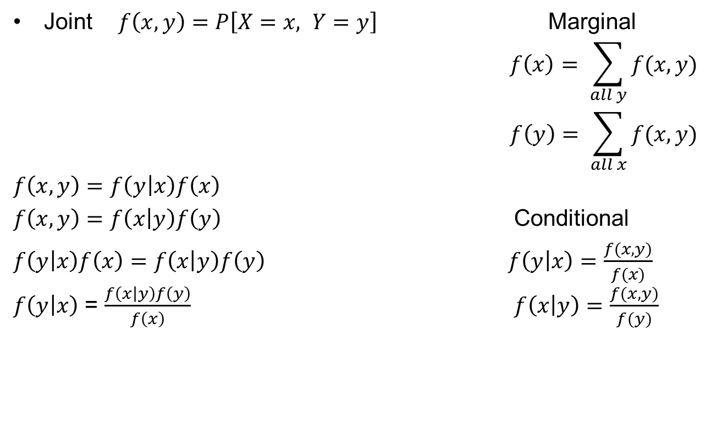
Review: Joint Distribution Functions
Joint $f\left(x,y\right)=P\left[X=x, Y=y\right]$ Marginal
$$f\left(x\right)= \sum_{all y}{f(x,y)}$$
$$f\left(y\right)= \sum_{all x}{f(x,y)}$$
$$f\left(x,y\right)=f\left(\left.y\right|x\right)f\left(x\right)$$
$f\left(x,y\right)=f\left(\left.x\right|y\right)f\left(y\right)$ Conditional
$f\left(\left.y\right|x\right)f\left(x\right)=f\left(\left.x\right|y\right)f\left(y\right)$ $f\left(\left.y\right|x\right)=\frac{f(x,y)}{f(x)}$ $f\left(\left.y\right|x\right)$ = $\frac{f\left(\left.x\right|y\right)f\left(y\right)}{f\left(x\right)}$ $f\left(\left.x\right|y\right)=\frac{f(x,y)}{f(y)}$

Slide 18
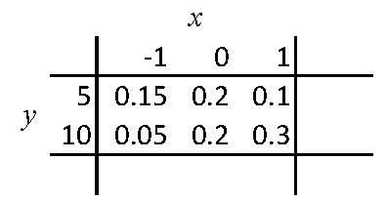






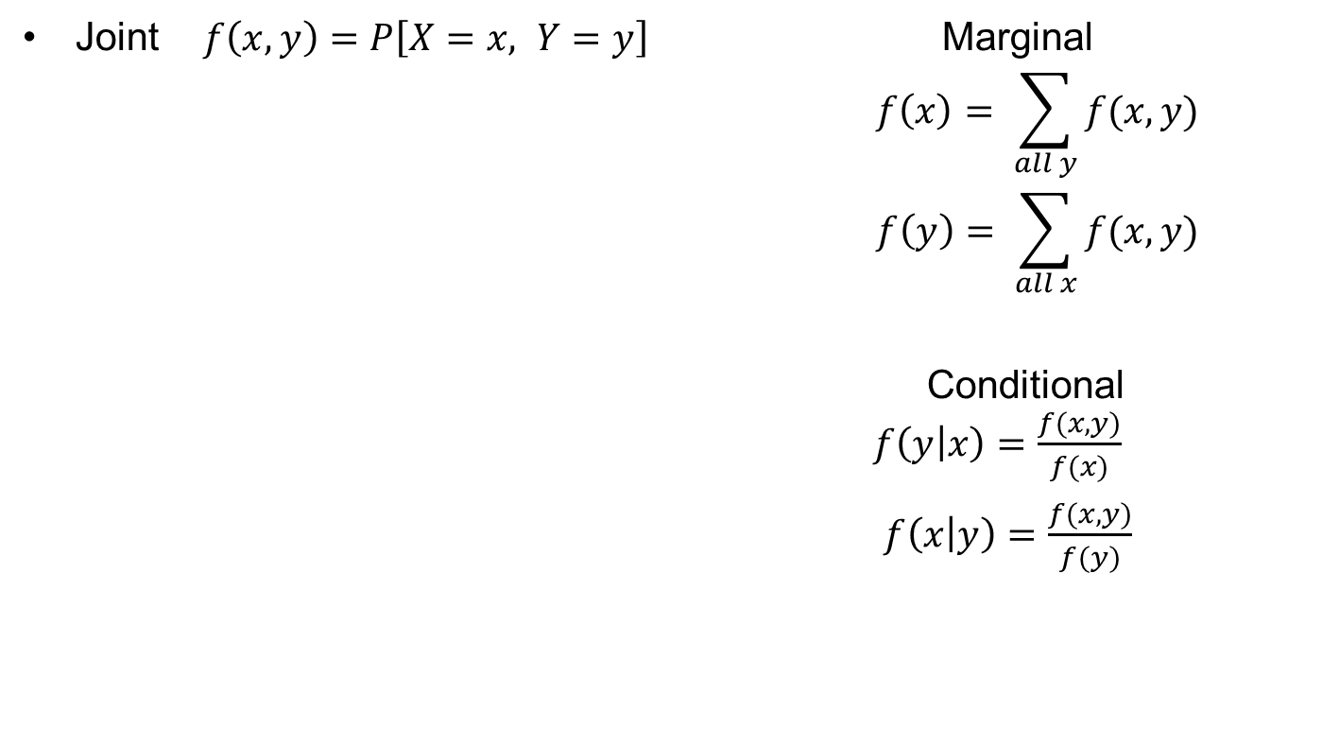

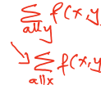
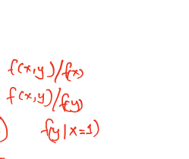




Review: Joint Distribution Functions
Joint $$f\left(x,y\right)=P\left[X=x, Y=y\right]$$ | Marginal $$f\left(x\right)=$$ $$f\left(y\right)=$$
 | Conditional $$f\left(\left.y\right|x\right)=$$ $$f\left(\left.x\right|y\right)=$$

Slide 19
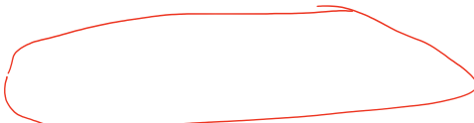





Review: Joint Distribution Functions
Joint $f\left(x,y\right)=P\left[X=x, Y=y\right]$ Marginal
$$f\left(x\right)= \sum_{all y}{f(x,y)}$$
$$f\left(y\right)= \sum_{all x}{f(x,y)}$$
$$f\left(x,y\right)=f\left(\left.y\right|x\right)f\left(x\right)$$
$f\left(x,y\right)=f\left(\left.x\right|y\right)f\left(y\right)$ Conditional
$f\left(\left.y\right|x\right)f\left(x\right)=f\left(\left.x\right|y\right)f\left(y\right)$ $f\left(\left.y\right|x\right)=\frac{f(x,y)}{f(x)}$ $f\left(\left.y\right|x\right)$ = $\frac{f\left(\left.x\right|y\right)f\left(y\right)}{f\left(x\right)}$ $f\left(\left.x\right|y\right)=\frac{f(x,y)}{f(y)}$

Slide 20





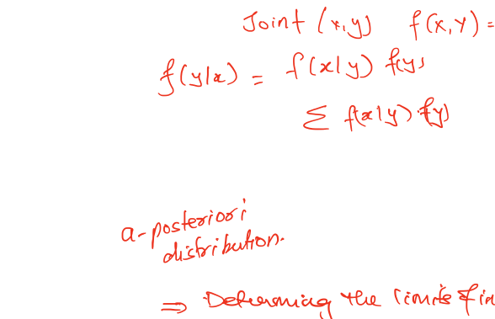


Slide 21
Review: Joint Distribution Functions
Joint distribution functions:
  For any two random variables X and Y, the joint cumulative probability distribution function of X and Y by:
  Discrete:
    The joint probability mass function of X and Y
    Marginal PMFs of X and Y:

Slide 22
Review: Joint Distribution Functions
Joint $f\left(x,y\right)=P\left[X=x, Y=y\right]$ Marginal
$$f\left(x\right)= \sum_{all y}{f(x,y)}$$
$$f\left(y\right)= \sum_{all x}{f(x,y)}$$
Conditional $f\left(\left.y\right|x\right)=\frac{f(x,y)}{f(x)}$
$f\left(\left.x\right|y\right)=\frac{f(x,y)}{f(y)}$

Slide 23
Review: Joint Distribution Functions
Joint $f\left(x,y\right)=P\left[X=x, Y=y\right]$ Marginal
$$f\left(x\right)= \sum_{all y}{f(x,y)}$$
$$f\left(y\right)= \sum_{all x}{f(x,y)}$$
$$f\left(x,y\right)=f\left(\left.y\right|x\right)f\left(x\right)$$
$f\left(x,y\right)=f\left(\left.x\right|y\right)f\left(y\right)$ Conditional
$f\left(\left.y\right|x\right)f\left(x\right)=f\left(\left.x\right|y\right)f\left(y\right)$ $f\left(\left.y\right|x\right)=\frac{f(x,y)}{f(x)}$ $f\left(\left.y\right|x\right)$ = $\frac{f\left(\left.x\right|y\right)f\left(y\right)}{f\left(x\right)}$ $f\left(\left.x\right|y\right)=\frac{f(x,y)}{f(y)}$

Slide 24
Review: Joint Distribution Functions
Joint $$f\left(x,y\right)=P\left[X=x, Y=y\right]$$ | Marginal $$f\left(x\right)=$$ $$f\left(y\right)=$$
 | Conditional $$f\left(\left.y\right|x\right)=$$ $$f\left(\left.x\right|y\right)=$$

Slide 25
Review: Joint Distribution Functions
Joint $f\left(x,y\right)=P\left[X=x, Y=y\right]$ Marginal
$$f\left(x\right)= \sum_{all y}{f(x,y)}$$
$$f\left(y\right)= \sum_{all x}{f(x,y)}$$
$$f\left(x,y\right)=f\left(\left.y\right|x\right)f\left(x\right)$$
$f\left(x,y\right)=f\left(\left.x\right|y\right)f\left(y\right)$ Conditional
$f\left(\left.y\right|x\right)f\left(x\right)=f\left(\left.x\right|y\right)f\left(y\right)$ $f\left(\left.y\right|x\right)=\frac{f(x,y)}{f(x)}$ $f\left(\left.y\right|x\right)$ = $\frac{f\left(\left.x\right|y\right)f\left(y\right)}{f\left(x\right)}$ $f\left(\left.x\right|y\right)=\frac{f(x,y)}{f(y)}$

Slide 27
Problem 1
Let X and Y be two continuous random variables with joint density function:
where c is a constant.
Part A: What is the value of c?
Part B: Find the marginal pdfs of X and Y.
Part C: Are X and Y independent? Why?
Part D: Find P{X + Y < 3}. Show your work on choosing the limits of integrals by marking the region of integral.

Slide 28
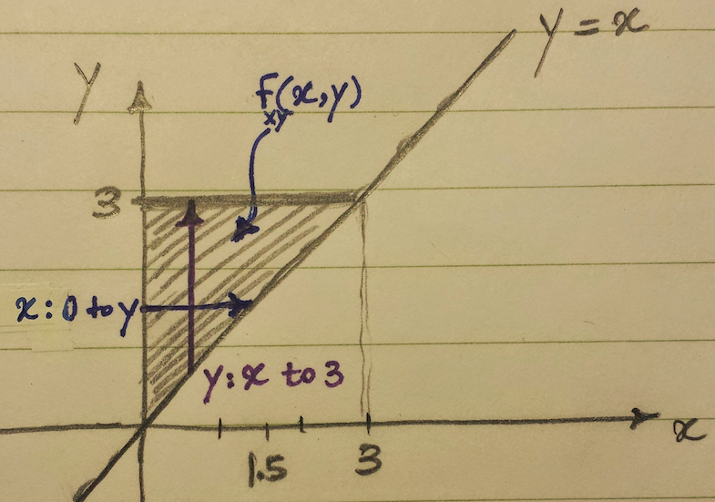
Problem 1 Solution
We first define the region on which the joint distribution function f(x,y) is defined:

Slide 29
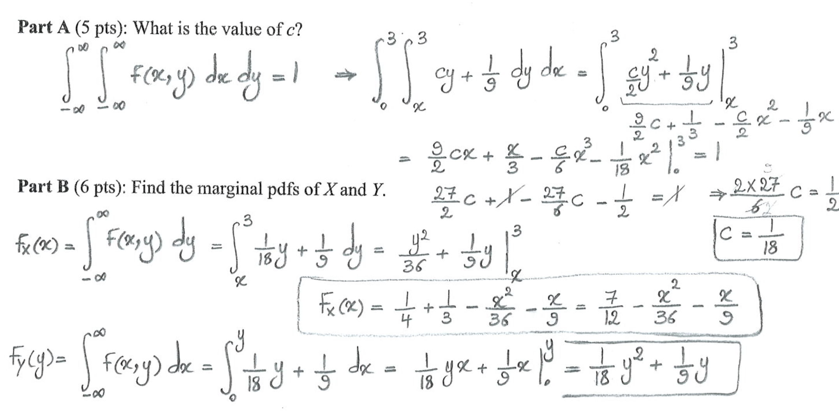
Problem 1 Solution

Slide 30
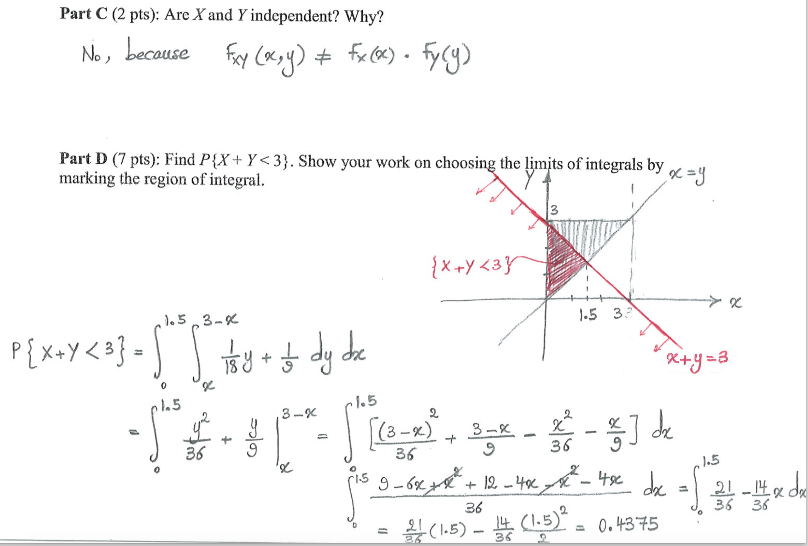
Problem 1 Solution

Slide 31
Problem 2
The joint density of X and Y is given by:
Find the region on which f(x, y) is defined
Find C.
Find the density function of X.
Find the density function of Y.
Find E[X].
Find E[Y].
Find P(X+Y<3), for X > 0.

Slide 32
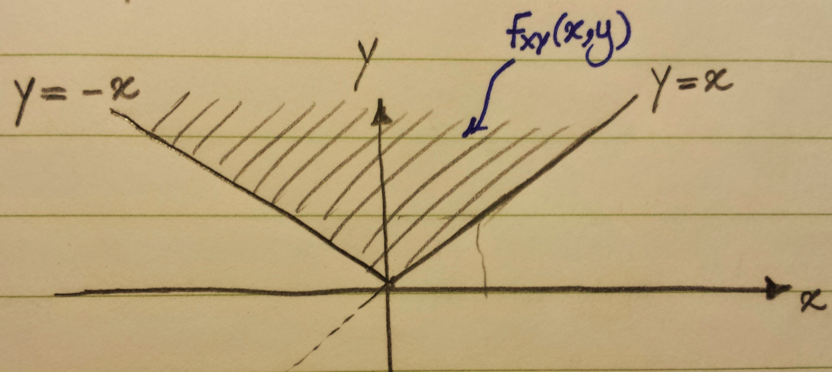
Problem 1 - Solution

Slide 33
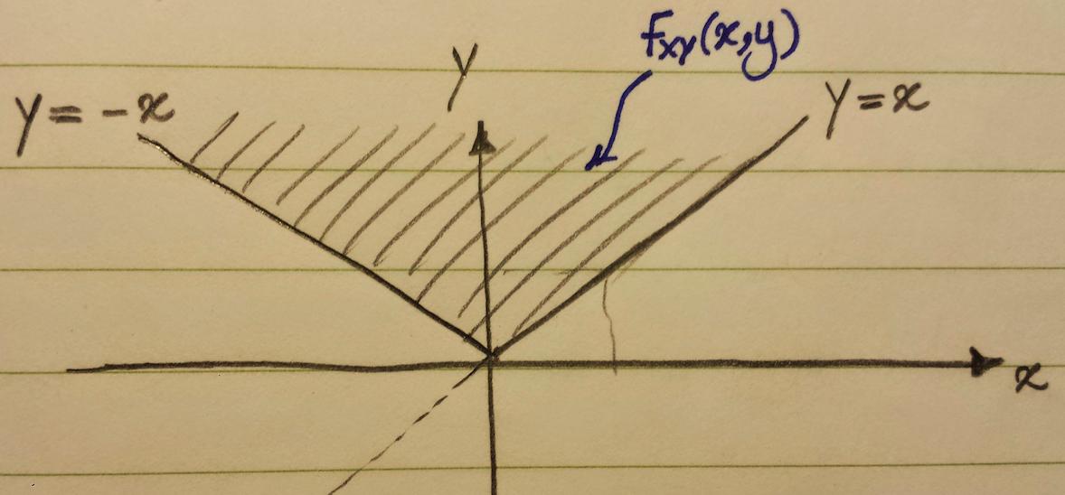
Problem 2 - Solution
In this solution, we will make use of the identity
Which follows because , is the density function
of a gamma random variable with parameters n+1 and λ and
must thus integrate to 1.
hence C=1/4

Slide 34
Problem 2 – Solution, Cont’d
Since the joint density is nonzero only when y>x and y>-x, we have, for x>0,
for x<0
u = y - x

Slide 35
Problem 2 – Solution, Cont’d
X > 0
X < 0

Slide 36
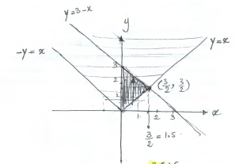
Problem 2 – Solution, Cont’d
To find , we first draw the line X + Y = 3.
For X > 0 :The region of integral is the triangle highlighted below, which is the intersection of regions and :

Slide 37
Problem 2 – Solution, Cont’d
So for X > 0:

Slide 38
Problem 2 – Solution, Cont’d
Note that for X < 0 : The region of integral would be the intersection of regions and .
Calculate P(X+Y<3), for X < 0 as homework.

Slide 39
Problem 3
At even time instants, a robot moves either +1cm or –1cm in the x-direction according to the outcome of a coin flip (heads: +1cm, tails: –1cm);
At odd time instants, a robot moves similarly according to another coin flip in the y-direction.
Assuming that the robot begins at the origin, let X and Y be the coordinates of the location of the robot after 2n time instants. (Assume that the coins are not fair, and are flipped independently from each other. P(head) = p for both coins)
a) What are the values X and Y can take?
b) What is the marginal pmf of X and Y?
c) What is the joint pmf P(X, Y)? What assumption did you have to make? Justify why the assumption is valid.

Slide 40
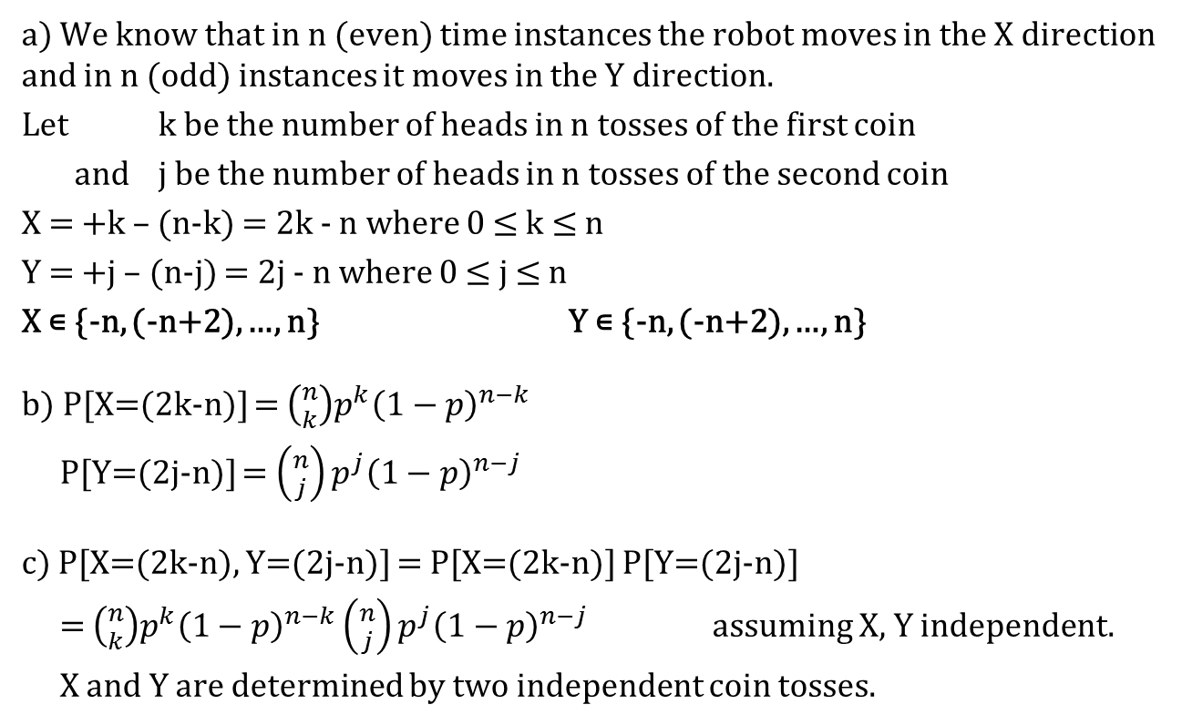
Problem 3 – Solution

Slide 41
Review: Joint Distribution Functions
Joint distribution functions:
  For any two random variables X and Y, the joint cumulative probability distribution function of X and Y by:
  Discrete:
    The joint probability mass function of X and Y
    Marginal PMFs of X and Y:

Slide 42




Review: Joint Distribution Functions
Joint distribution functions:
  Continuous:
    The joint probability density function of X and Y:
    Marginal PDFs of X and Y:
    Relation between joint CDF and PDF

Slide 43
Review: Joint Distribution Functions
Function of two joint random variables
For example, if g(X,Y)=X+Y, then, in the continuous case

Slide 44

Independent Random Variables
Independent Random Variables: Two random variables X and Y are said to be independent if:
If X and Y are continuous:
If X is discrete and Y is continuous:

Slide 45
Review of Moments
Recall the definition of moments:
The first and second moments (mean and variance) of a single random variable convey important information about the distribution of the variable.
For example the variance of X measures the expected square of the deviation of X from its expected value, and is defined by:
Use of moments is even more important when considering more than one random variable at a time with joint distributions that are much more complex than distributions for individual random variables.

Slide 46
Covariance
The covariance of any two random variables, X and Y, denoted by Cov(X,Y), is defined by
Covariance generalizes variance, in the sense that Var(X) = Cov(X, X).
If either X or Y has mean zero, then E[XY] = Cov(X, Y ).
If X and Y are independent then it follows that Cov(X,Y) = 0.
But the reverse is false:
  Cov(X,Y) = 0 means X and Y are uncorrelated, but it doesn’t imply that X and Y are independent.

Slide 47
Correlation Coefficient
The correlation between two random variable X and Y is measured using the correlation coefficient:
(ρX,Y is well defined if Var(X) > 0 and Var(Y ) > 0)
If Cov(X,Y) = 0, X and Y are called uncorrelated, which implies that E[XY] = E[X]E[Y].
If Cov(X,Y) > 0, X and Y are positively correlated, Y tends to increase as X does.
If Cov(X,Y) < 0, X and Y are negatively correlated, Y tends to decrease as X increases.

Slide 48
Properties of Covariance
For any random variable X, Y, Z, and constant c, we have:
  Cov (X,X) = Var(X),
  Cov (X,Y) = Cov(Y,X),
  Cov (cX,Y) = cCov(X,y),
  Cov (X,Y+Z) = Cov(X,Y) + Cov(X,Z).
  Whereas the first three properties are immediate, the final one is easily proven as follows:
The last property generalizes to give the following result:

Slide 49
Exam Review: Memory-less Property
Memory-less property of Exponential
1.0
F(x)
0.5
Conditional probability density function of
Y = X - t given X > t
t
y
0
0
1.25
2.50
3.75
5.00
x

Slide 50
Review: Functions of Random Variables
Functions of random variables
  Examples shown in the class
Reliability function and Mean time to failure:
  Let T denote the time to failure or lifetime of a component in the system
  If the component lifetime is exponentially distributed, then:

Slide 51
Review: Joint Distribution Functions
Joint distribution functions:
  For any two random variables X and Y, the joint cumulative probability distribution function of X and Y by:
  Discrete:
    The joint probability mass function of X and Y
    Marginal PMFs of X and Y:

Slide 52
Review: Joint Distribution Functions
Joint distribution functions:
  Continuous:
    The joint probability density function of X and Y:
    Marginal PDFs of X and Y:
    Relation between joint CDF and PDF

Slide 53
Review: Joint Distribution Functions
Function of two joint random variables
For example, if g(X,Y)=X+Y, then, in the continuous case

Slide 54
Independent Random Variables
Independent Random Variables: Two random variables X and Y are said to be independent if:
If X and Y are continuous:
If X is discrete and Y is continuous:

Slide 55
Review: Covariance and Variance
The covariance of any two random variables, X and Y, denoted by Cov(X,Y), is defined by
If X and Y are independent then it follows that Cov(X,Y)=0
For any random variable X, Y, Z, and constant c, we have:
  Cov (X,X) = Var(X),
  Cov (X,Y) = Cov(Y,X),
  Cov (cX,Y) = cCov(X,y),
  Cof (X,Y+Z) = Cov(X,Y) + Cov(X,Z).

Slide 56
Review: Covariance and Variance
Covariance and Variance of Sums of Random Variables
A useful expression for the variance of the sum of random variables can be obtained from the preceding equation
If are independent random variables, then the above equation reduces to

Slide 57
Review: Limit Theorems
Markov’s Inequality: If X is a random variable that takes only nonnegative values, then for any value a>0:
Chebyshev’s Inequality: If X is a random variable with mean μ and variance σ² then for any value k>0,
Strong law of large numbers: Let X₁,X₂,… be a sequence of independent random variables having a common distribution, and let E[X_{i}]=μ Then, with probability 1,

Slide 58
Review: Limit Theorems
Central Limit Theorem: Let X_{1,} X₂,…be a sequence of independent, identically distributed random variables, each with mean μ and variance σ² then the distribution of
Tends to the standard normal as . That is,
Note that like other results, this theorem holds for any distribution of the X_{i} ‘s; herein lies its power.

Slide 59
Review: Hazard Function
The time to failure of a component is the random variable T. Therefore the failure density function is defined by:
The probability of failure between time t and t+dt, given that there were no failures up to time t:
Where: => Reliability Function
Hazard Function:
An exponential failure density corresponds to constant hazard function

Slide 60
Review: Hazard Rate
Instantaneous hazard rate:
Cumulative hazard rate:
If the lifetime is exponentially distributed, then and we obtain the exponential reliability function.

Slide 61
Constraints on f(t) and z(t)

Slide 62
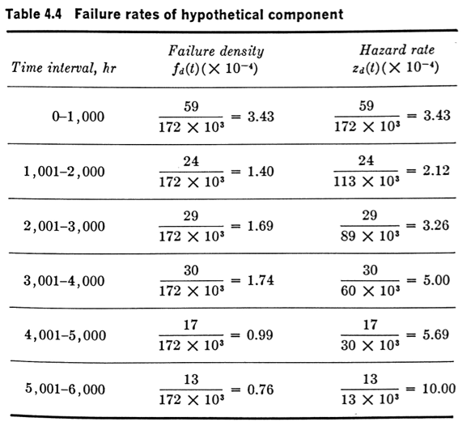
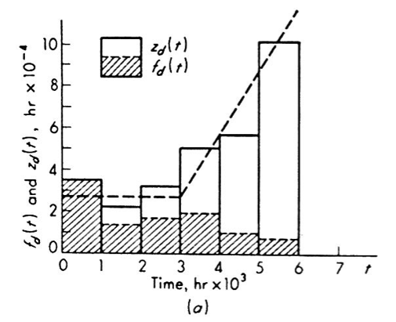
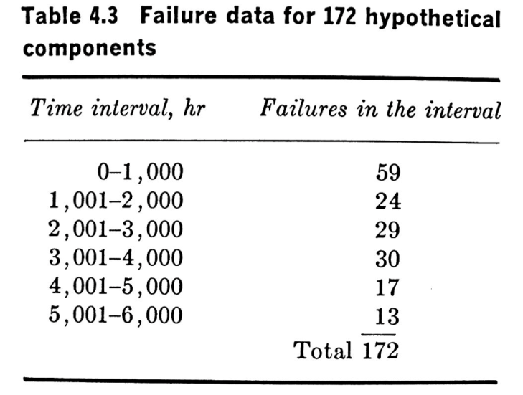
Review: Treatment of Failure Data
The probability density function over the time interval
The data hazard (inst. failure rate) over the interval :

Slide 63
Review: Phase-type exponential distributions
Exponential Distribution:
  Time to the event or Inter-arrivals => Poisson
  Phase-type Exponential Distributions:
  We have a process that is divided into k sequential phases, in which time that the process spends in each phase is:
    Independent
    Exponentially distributed
  The generalization of the phase-type exponential distributions is called Coxian Distribution
    Any distribution can be expressed as the sum of phase-type exponential distributions

Slide 64
Review: Phase-type exponential distributions
Four special types of phase-type exponential distributions:
Hypoexponential Distribution:
  Exponential distributions at each phase have different λ
K-stage Erlang Distribution:
  Exponential distributions in each phase are identical (with same λ)
  The number of phases (α) is an integer
Gamma Distribution
  Is a K-stage Erlang
  But the number of phases (α) is not an integer
Hyperexponential Distribution:
  A mixture of different exponential distributions

Slide 65
Review: Phase-type exponential distributions
k-phase hyperexponential:
  PDF:
  CDF:
  Failure rate:

Slide 66
Covariance and Variance Review
The covariance of any two random variables, X and Y, denoted by Cov(X,Y), is defined by
If X and Y are independent then it follows that Cov(X,Y)=0
For any random variable X, Y, Z, and constant c, we have:
  Cov (X,X) = Var(X),
  Cov (X,Y) = Cov(Y,X),
  Cov (cX,Y) = cCov(X,Y),
  Cov (X,Y+Z) = Cov(X,Y) + Cov(X,Z).

Slide 67
Covariance and Variance Review
Covariance and Variance of Sums of Random Variables
A useful expression for the variance of the sum of random variables can be obtained from the preceding equation
If are independent random variables, then the above equation reduces to

Slide 68
Cold Standby Example
Consider a dual redundant system composed of two identical components, where the secondary component acts as a backup of the primary one and will be powered on only after the primary component fails.
A detector circuit checks the output of primary component in order to identify it failure and a switch is used to configure and power on the secondary component.
Let the lifetime of the two components be two independent random variables X1 and X2, which are exponentially distributed with parameter λ.
Assume that the detection and switching circuits are perfect. What is the distribution of time to failure of the whole system? Derive the reliability function for the system.

Slide 69

Cold Standby Example (Cont’d)
Total lifetime of the system can be modeled by random variable Z which is a 2-stage Erlang distribution.
Remember for an r-phase Erlang distribution we have:
So for 2-stage Erlang we have:

Slide 70

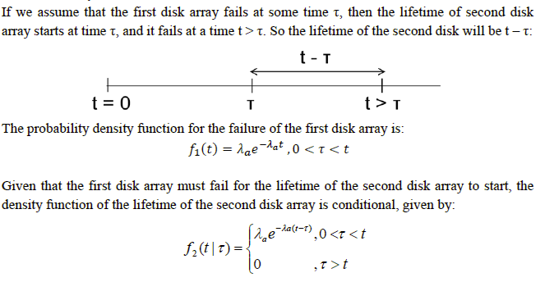
Cold Standby Example (Cont’d)
Remember the example in Class Project 3

Slide 71
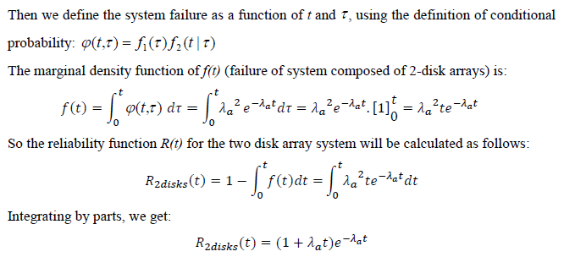
Cold Standby Example (Cont’d)
This is a two-stage Erlang distribution with the parameter λa

Slide 72
Cold Standby Example (Cont’d)
Now, assume that the lifetime of the two components (X1 and X2), are exponentially distributed with different parameters: λ1 and λ2.
Total lifetime of the system can be modeled by random variable Z, which is a 2-stage Hypo-exponential distribution.
Remember that a two-stage hypoexponential random variable, X, with parameters λ₁ and λ₂ (λ₁ ≠λ₂ ), is denoted by X~HYPO(λ_{1,} λ₂ ).
So the distribution of time to failure of the system would be:

