Slide 1
Inequalities, Covariance, examples
ECE 313
Probability with Engineering Applications
Lecture 25
Professor Ravi K. Iyer
Dept. of Electrical and Computer Engineering
University of Illinois at Urbana Champaign

Slide 2
Today’s Topics
CLT, Inequalities
Covariance Correlations:
Announcements:
  Final Exam on May 11, 8 am – 11 am.
  Three 8x11 sheets allowed: No other aids electronic or otherwise
  Exam Review session May 9, 5:30pm Place TBD
  HW 10 deadline extended to Monday, May 1
  Final project MP3
    Task 1 and Task 2 due today Wednesday, Apr 26 11;59pm
    Final Presentation on Saturday, May 6, 12pm – 5pm
    Final Report will be due on Monday, May 8, 11:59pm

Slide 3
Final Project Presentation Format
  Presentation ~ 10 Slides Max:
      2-3 Slides: Project Summary
        Patients and features selected and justify you choice.
        Why do you think your selected features would perform best on the complete patient set
        What concepts from class used for analysis, any additional concepts?
        Division of tasks
      3-5 Slides: Analysis Results
        Provide evidence for the techniques you used.
        For example show the results of your analysis for selection of features in the form of tables/graphs presenting the ML and MAP errors, correlations, etc.
        Did you change your features selected in Task 2 after doing Task 3? Provide insights and justification for your selection.
      1-2 Slides: Conclusions and key insights
        Example insights: Compare the results generated by ML and MAP rules.
        How were the projects useful in understanding the concepts learned in the class in practice? What suggestions do you have for improvement?
  DEMO ~
  Groups should run their Matlab code for Task 3, and present the performance for the ML and MAP rule.

Slide 4
Limit Theorems:
Strong Law of Large Numbers
The strong law of large numbers: The average of a sequence of independent random variables having the same distribution will, with probability 1, converge to the mean of that distribution.
Let X₁,X₂,… be a sequence of independent random variables having a common distribution, and let E[X_{i}]=μ Then, with probability 1,
The central limit theorem provides a simple method for computing approximate probabilities for sums/means of independent random variables.
It also explains the remarkable fact that the empirical frequencies of so many natural “populations” exhibit a bell-shaped (that is, normal) curve.

Slide 5
Limit Theorems:
Central Limit Theorem
Central Limit Theorem:
Let X_{1,} X₂,…be a sequence of independent, identically distributed random variables, each with mean μ and variance σ² then the distribution of
Tends to the standard normal as . That is,
Note that like other results, this theorem holds for any distribution of the X_{i} ‘s; herein lies its power.

Slide 6
Markov Inequality
Proposition - Markov’s Inequality: If X is a random variable that takes only nonnegative values, then for any value a>0
Proof: X is continuous with density f.

Slide 7
Chebychev’s Inequality
As a corollary, we obtain the following
Proposition - Chebyshev’s Inequality: If X is a random variable with mean μ and variance σ² then for any value k>0,
Proof: Since (X- μ)² is a nonnegative random variable, we can apply Markov’s inequality (with a=k²) to obtain
Since if and only if is equivalent to
And the proof is complete

Slide 8
Inequalities Example
The importance of Markov’s and Chebyshev’s inequalities is that they enable us to derive bounds on probabilities when only the mean, or both the mean and the variance, of the probability distribution are known. If the actual distribution were known, then the desired probabilities could be exactly computed, and we would not need to resort to bounds.
Example: Suppose we know that the number of items produced in a factory during a week is a random variable with mean 500.
  What can be said about the probability that this week’s production will be at least 1000?
  If the variance of a week’s production is known to equal 100, then what can be said about the probability that this week’s production will be between 400 and 600?

Slide 9
Inequalities Example (Cont’d)
Let X be the number of items that will be produced in a week.
  By Markov’s inequality,
  By Chebyshev’s inequality,
  Hence,
  And so the probability that this week’s production will be between 400 and 600 is at least 0.99.

Slide 10
Covariance
The covariance of any two random variables, X and Y, denoted by Cov(X,Y), is defined by
Covariance generalizes variance, in the sense that Var(X) = Cov(X, X).
If either X or Y has mean zero, then E[XY] = Cov(X, Y ).
If X and Y are independent then it follows that Cov(X,Y) = 0.
But the reverse is false:
  Cov(X,Y) = 0 means X and Y are uncorrelated, but it doesn’t imply that X and Y are independent.

Slide 11
Correlation Coefficient
The correlation between two random variable X and Y is measured using the correlation coefficient:
(ρX,Y is well defined if Var(X) > 0 and Var(Y ) > 0)
If Cov(X,Y) = 0, X and Y are called uncorrelated, which implies that E[XY] = E[X]E[Y].
If Cov(X,Y) > 0, X and Y are positively correlated, Y tends to increase as X does.
If Cov(X,Y) < 0, X and Y are negatively correlated, Y tends to decrease as X increases.

Slide 12
Covariance Example
Example: The joint density function of X,Y is given as follows:
  Verify that the preceding is a joint density function.
  Find Cov(X,Y).
  Are X and Y uncorrelated? Are X and Y independent?
To show that f(x,y) is a joint density function we need to show it is nonnegative, which is immediate and that

Slide 13
Covariance Example
To obtain E(Y), note that the density function of Y is
Thus Y is an exponential random variable with parameter 1
Compute E[X] and E[XY] as follows:
Now, the expected value of an exponential random variable
with parameter 1/y, and thus is equal to y. Consequently,

Slide 14
Covariance
Also
Integration by parts gives
Consequently,
So X and Y are positively correlated because Cov(X,Y) > 0.
Since Cov(X,Y) ≠ 0, X and Y are not independent.

Slide 15
Properties of Covariance
For any random variable X, Y, Z, and constant c, we have:
  Cov (X,X) = Var(X),
  Cov (X,Y) = Cov(Y,X),
  Cov (cX,Y) = cCov(X,y),
  Cov (X,Y+Z) = Cov(X,Y) + Cov(X,Z).
  Whereas the first three properties are immediate, the final one is easily proven as follows:
The last property generalizes to give the following result:

Slide 16
Properties of Covariance
A useful expression for the variance of the sum of random variables can be obtained from the preceding equation:
If are independent random variables, then the above equation reduces to:

Slide 17
Problem 1
Let X and Y be two continuous random variables with joint density function:
where c is a constant.
Part A: What is the value of c?
Part B: Find the marginal pdfs of X and Y.
Part C: Are X and Y independent? Why?
Part D: Find P{X + Y < 3}. Show your work on choosing the limits of integrals by marking the region of integral.

Slide 18
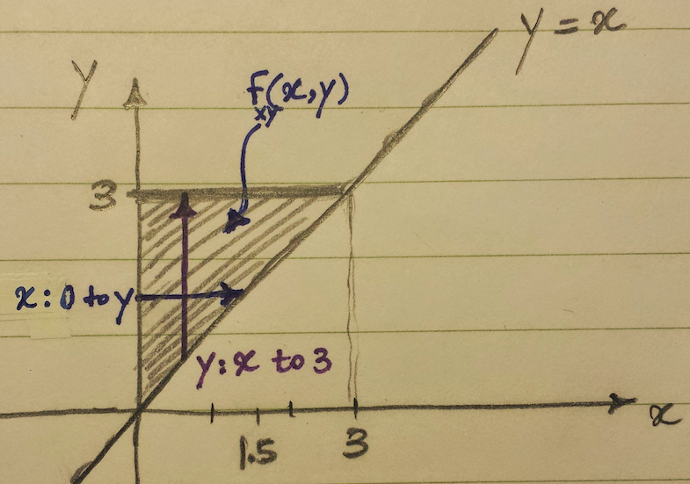
Problem 1 Solution
We first define the region on which the joint distribution function f(x,y) is defined:

Slide 19
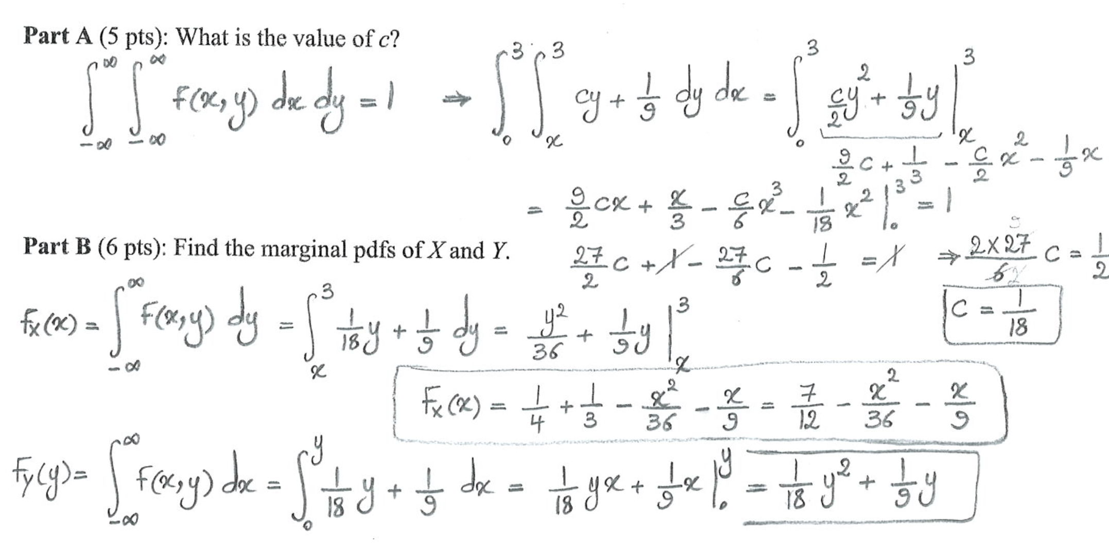
Problem 1 Solution

Slide 20
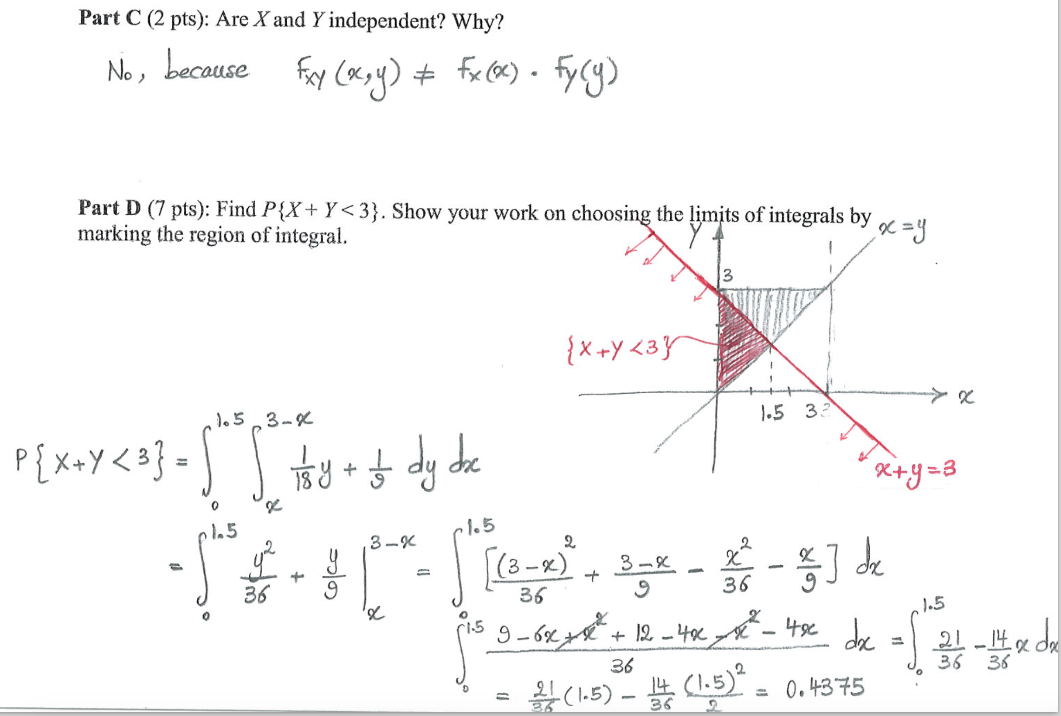
Problem 1 Solution

Slide 21
Problem 2
The joint density of X and Y is given by:
Find the region on which f(x, y) is defined
Find C.
Find the density function of X.
Find the density function of Y.
Find E[X].
Find E[Y].
Find P(X+Y<3), for X > 0.

Slide 22
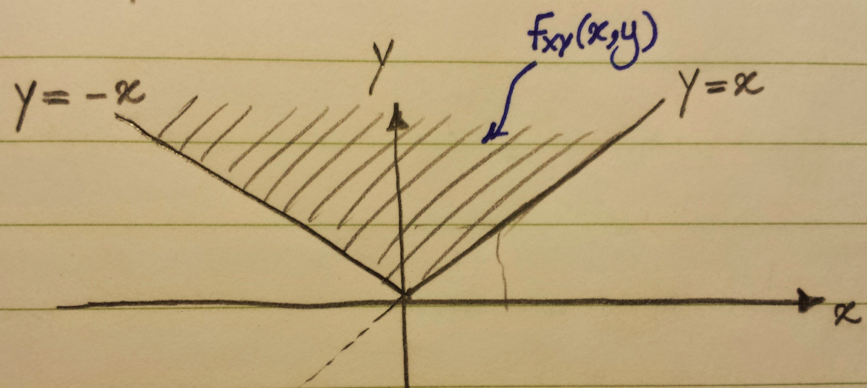
Problem 1 - Solution

Slide 23
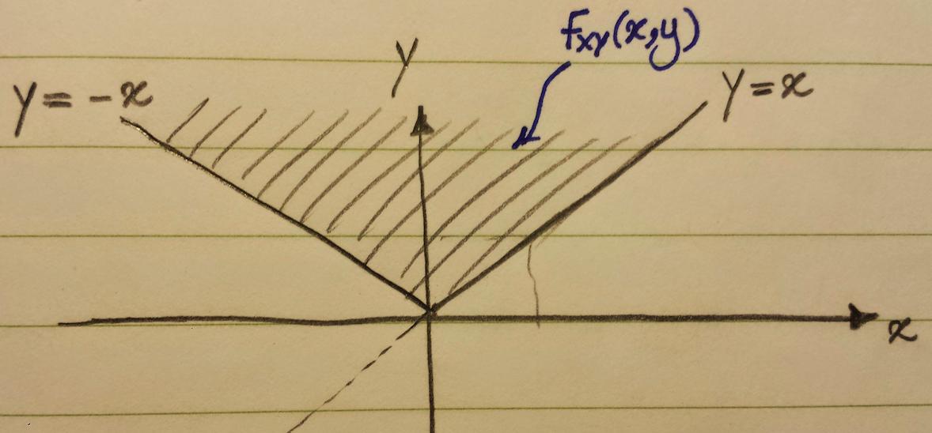
Problem 2 - Solution
In this solution, we will make use of the identity
Which follows because , is the density function
of a gamma random variable with parameters n+1 and λ and
must thus integrate to 1.
hence C=1/4

Slide 24
Problem 2 – Solution, Cont’d
Since the joint density is nonzero only when y>x and y>-x, we have, for x>0,
for x<0
u = y - x

Slide 25
Problem 2 – Solution, Cont’d
X > 0
X < 0

Slide 26
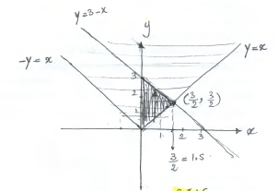
Problem 2 – Solution, Cont’d
To find , we first draw the line X + Y = 3.
For X > 0 :The region of integral is the triangle highlighted below, which is the intersection of regions and :

Slide 27
Problem 2 – Solution, Cont’d
So for X > 0:

Slide 28
Problem 2 – Solution, Cont’d
Note that for X < 0 : The region of integral would be the intersection of regions and .
Calculate P(X+Y<3), for X < 0 as homework.

Slide 29
Problem 3
At even time instants, a robot moves either +1cm or –1cm in the x-direction according to the outcome of a coin flip (heads: +1cm, tails: –1cm);
At odd time instants, a robot moves similarly according to another coin flip in the y-direction.
Assuming that the robot begins at the origin, let X and Y be the coordinates of the location of the robot after 2n time instants. (Assume that the coins are not fair, and are flipped independently from each other. P(head) = p for both coins)
a) What are the values X and Y can take?
b) What is the marginal pmf of X and Y?
c) What is the joint pmf P(X, Y)? What assumption did you have to make? Justify why the assumption is valid.

Slide 30
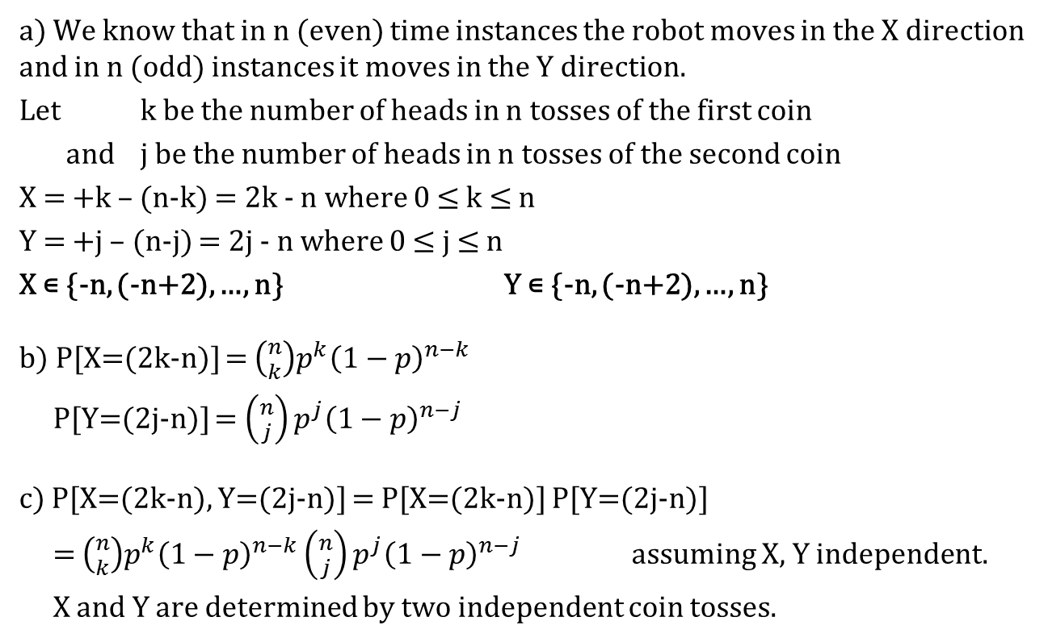
Problem 3 – Solution

