Slide 1
Expectations of Random Variables, Functions of Random Variables
ECE 313
Probability with Engineering Applications
Lecture 15
Ravi K. Iyer
Dept. of Electrical and Computer Engineering
University of Illinois at Urbana Champaign

Slide 2
Today’s Topics
Midterm Exam Statistics
review Erlang, Gamma and Hyper epenential distributions
Example of a failure detector with detection latency
Start on Expectations
Expectations of important random variables
Moments: Mean and Variance
Announcements
Homework 7.
Based on your Midterm exam, individual problems are assigned to you to solve. Checkout Compass.
Midterm available today. The grades are posted on Compass.
In-Class activity replaced by a brief concept quiz on Wednesday
Mini Project 2 grades posted this week
Final project dates will be announced soon

Slide 3
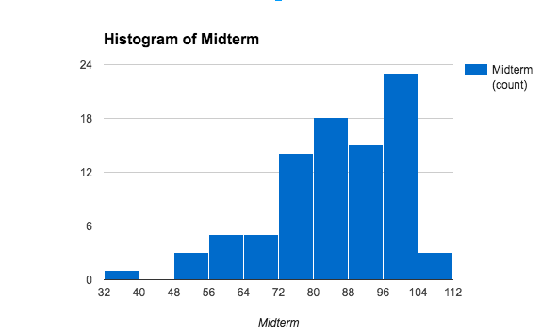
Midterm Histogram
MIN | 33
MAX | 105
MEDIAN | 85
MEAN | 84.6

Slide 4
Exam Statistics
Midterm Exam
 | Q1 | Q2 | Q3 | Q4 | Bonus | Total
Median | 34 | 15 | 20 | 17 | 5 | 85
Average | 33.3 | 14.2 | 16.8 | 15.5 | 4.8 | 84.6
Min | 15 | 0 | 4 | 5 | 1 | 33
Max | 40 | 20 | 20 | 20 | 7 | 105

Slide 5
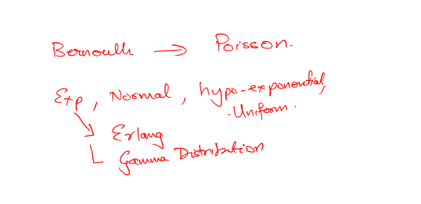

Slide 6

Erlang and Gamma Distribution
When r sequential phases have independent identical exponential distributions, the resulting density (pdf) is known as r-stage (or r-phase) Erlang:
The CDF (Cumulative distribution function is:
Also:

Slide 7
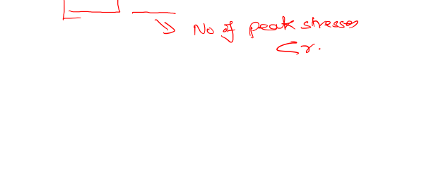
Erlang and Gamma Distribution (cont.)
The exponential distribution is a special case of the Erlang distribution with r = 1.
A component subjected to an environment so that N_{t}, the number of peak stresses in the interval (0, t], is Poisson distributed with parameter λ t.
The component can withstand (r -1) peak stresses and the rth occurrence of a peak stress causes a failure.
The component lifetime X is related to N_{t} so these two events are equivalent:

Slide 8

Erlang and Gamma Distribution (cont.)
Thus:
F(t) = 1 - R(t) yields the previous formula:
Conclusion: The component lifetime has an r-stage Erlang distribution.

Slide 9

Gamma Function and Density
If r (call it α) take nonintegral values, then we get the gamma density:
where the gamma function is defined by the integral:

Slide 10

Gamma Function and Density (cont.)
The following properties of the gamma function useful: Integration by parts shows that for α > 1:
In particular, if α is a positive integer, denoted by n, then:
Other useful formulas related to the gamma function are:
and

Slide 11
Gamma Function and Density (cont.)

Slide 12
Hyperexponential Distribution
A process with sequential phases gives rise to a hypoexponential or an Erlang distribution, depending upon whether or not the phases have identical distributions.
If a process consists of alternate phases, i. e. during any single experiment the process experiences one and only one of the many alternate phases, and
If these phases have independent exponential distributions, then
The overall distribution is hyperexponential.

Slide 13

Hyperexponential Distribution (cont.)
The density function of a k-phase hyperexponential random variable is:
The distribution function is:
The failure rate is:
which is a decreasing failure rate from Σα_{i}λ_{i} down to min {λ₁, λ₂,…}

Slide 14
Hyperexponential Distribution (cont.)
The hyperexponential is a special case of mixture distributions that often arise in practice:
The hyperexponential distribution exhibits more variability than the exponential, e.g. CPU service-time distribution in a computer system often expresses this.
If a product is manufactured in several parallel assembly lines and the outputs are merged, then the failure density of the overall product is likely to be hyperexponential.

Slide 15
Hyperexponential Distribution (cont.)

Slide 16
Example 3 (On-line Fault Detector)
Consider a model consisting of a functional unit (e.g., an adder) together with an on-line fault detector
Let T and C denote the times to failure of the unit and the detector respectively
After the unit fails, a finite time D (called the detection latency) is required to detect the failure.
Failure of the detector, however, is detected instantaneously.

Slide 18
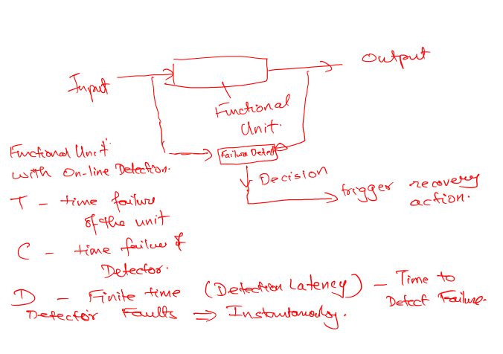

Slide 19
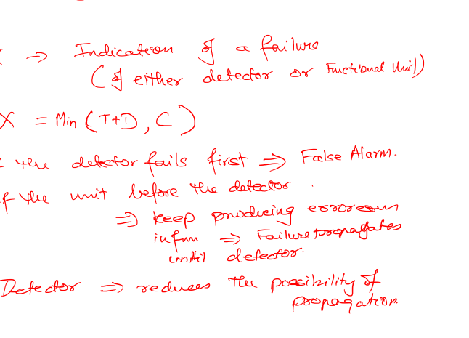

Slide 20
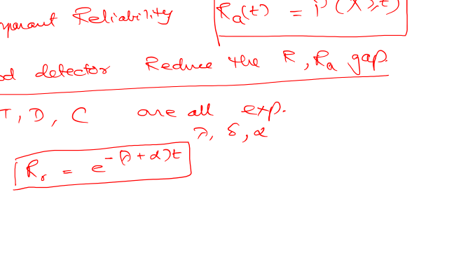

Slide 22
Example 3 (On-line Fault Detector) cont.
Let X denote the time to failure indication and Y denote the time to failure occurrence (of either the detector or the unit).
Then
X = min{T + D, C} and Y = min{T, C}.
If the detector fails before the unit, then a false alarm is said to have occurred.
If the unit fails before the detector, then the unit keeps producing erroneous output during the detection phase and thus propagates the effect of the failure.
The purpose of the detector is to reduce the detection time D.

Slide 23
Example 3 (On-line Fault Detector) cont.
We define:
Real reliability R_{r}(t) = P(Y ≥ t) and
Apparent reliability R_{a}(t) = P(X ≥ t).
A powerful detector will tend to narrow the gap between R_{r}(t) and R_{a}(t).
Assume that T, D, and C are mutually independent and exponentially distributed with parameters λ, δ, and α.

Slide 24
Example 3 (On-line Fault Detector) cont.
Then Y is exponentially distributed with parameter λ + α and:
T + D is hypoexponentially distributed so that:

Slide 25
Example 3 (On-line Fault Detector) cont.
And, the apparent reliability is:

Slide 26
Expectation of a Random Variable
The Discrete Case: If X is a discrete random variable having a probability mass function p(x), then the expected value of X is defined by
The expected value of X is a weighted average of the possible values that X can take on, each value being weighted by the probability that X assumes that value. For example, if the probability mass function of X is given by
then
is just an ordinary average of the two possible values 1 and 2 that X can assume.

Slide 27
Expectation of a Random Variable (Cont.)
Assume
Then
is a weighted average of the two possible values 1 and 2 where the value 2 is given twice as much weight as the value 1 since p(2) = 2p(1).
Find E[X] where X is the outcome when we roll a fair die.
Solution: Since

Slide 28
Expectation of a Random Variable (Cont.)
Expectation of a Bernoulli Random Variable: Calculate E[X] when X is a Bernoulli random variable with parameter p.
Since:
We have:
The expected number of successes in a single trial is just the probability that the trial will be a success.

Slide 29
Expectation of a Random Variable (Cont.)
Expectation of a Binomial Random Variable: Calculate E[X] when X is a binomially distributed with parameters n and p.
.

Slide 30
Expectation of a Random Variable (Cont.)
Expectation of a Geometric Random Variable: Calculate the expectation of a geometric random variable having parameter p.
We have:
The expected number of independent trials
we need to perform until we get our first success
equals the reciprocal of the probability that any one
trial results in a success.

Slide 31
Expectation of a Random Variable (Cont.)
Expectation of a Poisson Random Variable: Calculate E[X] if X is a Poisson random variable with parameter λ.
Use the identity:

Slide 32
The Continuous Case
The expected value of a continuous random variable: If X is a continuous random variable having a density function f (x), then the expected value of X is defined by:
Example: Expectation of a Uniform Random Variable, Calculate the expectation of a random variable uniformly distributed over (α, β)
The expected value of a random variable
Uniformly distributed over the interval (α, β)
is just the midpoint of the interval.

Slide 33
The Continuous Case (Cont.)
Expectation of an Exponential Random Variable: Let X be exponentially distributed with parameter λ. Calculate E[X].
Integrating by parts yields:

Slide 34
The Continuous Case Cont’d
Expectation of a Normal Random Variable): X is normally distributed with parameters μ and σ²:
Writing x as (x-μ) + μ yields
Letting y= x-μ leads to
Where f(x) is the normal density. By symmetry, the first integral must be 0, and so

Slide 35
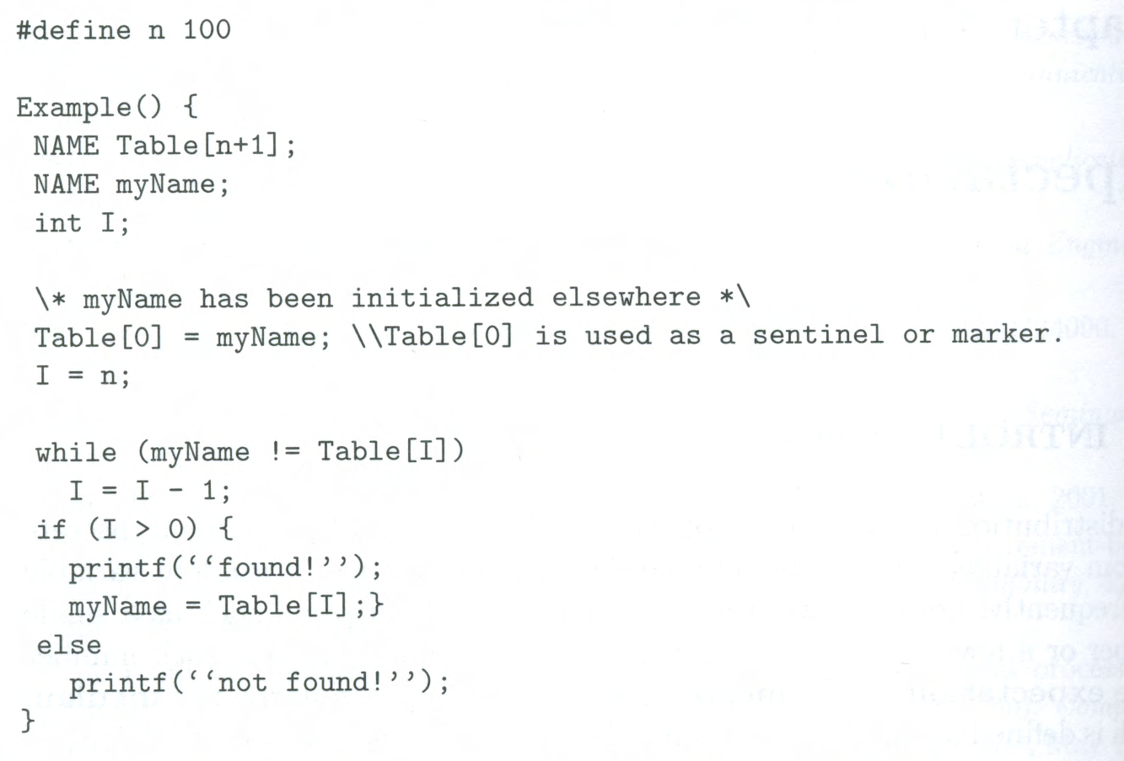
Example 1
Consider the problem of searching for a specific name in a table of names. A simple method is to scan the table sequentially, starting from one end, until we either find the name or reach the other end, indicating that the required name is missing from the table. The following is a C program fragment for sequential search:

Slide 36
Example 1 Cont’d
In order to analyze the time required for sequential search, let X be the discrete random variable denoting the number of comparisons “myName≠Table[I]” made. The set of all possible values of X is {1,2,…,n+1}, and X=n+1 for unsuccessful searches.
More interesting to consider a random variable Y that denotes the number of comparisons for a successful search. The set of all possible values of Y is {1,2,…,n}. To compute the average search time for a successful search, we must specify the pmf of Y. In the absence of any specific information, let us assume that Y is uniform over its range:
Then
Thus, on the average, approximately half the table needs to be searched

Slide 37
Example 2
If α_{i} denotes the access probability for name Table[i], then the average successful search time is E[Y] is minimized when names in the table are in the order of nonincreasing access probabilities; that is, α₁ ≥ α₂ ≥ … ≥ α_{n}.
Where the constant c is determined from the normalization requirement
Thus,
Where H_{n} is the partial sum of a harmonic series; that is: and C(=0.577) is the Euler Constant.
Now, if the names in the table are ordered as above, then the average search time is
Which is considerably less than the previous value (n+1)/2, for large n

Slide 38
Example 3
Zipf’s law has been used to model the distribution of Web page requests [BRES 1999]. It has been found that the probability of a request for the ith most popular page is inversely proportional to i [ALME1996, WILL 1996],
Where n is the total number of Web pages in the universe.
We assume the Web page requests are independent and the cache can hold only m Web pages regardless of the size of each Web page. If we adopt a removal policy called “least frequently used”, which always keeps the m most popular pages, then the hit ratio h(m)- the probability that a request can find its page in cache- is given by

Slide 39
Example 4
Let X be a continuous random variable with an exponential density given by
Then
Let u=λx, then du= λdx, and
Thus, if a component obeys an exponential failure law with parameter λ (known as the failure rate), then its expected life, or its mean time to failure (MTTF), is 1/ λ. Finally, if the service time requirement of a job is an exponentially distributed random variable with parameter μ (known as the service rate), then the mean (average) service time is 1/μ.

Slide 40
Problem 1
Using integration by parts, show (assuming that and
are all finite) that for a continuous random variable X:
This result states that the expectation of a random variable X equals the difference of the areas of the right-hand and left-hand shaded regions in Figure 4.P.1.(This formula applies to the case of discrete and mixed random variables as well.)

Slide 41
Moments
Let X be a random variable, and define another random variable Y as a function of X so that Suppose that we wish to compute E[Y] (provided the sum or the integral on the right-hand side is absolutely convergent). A special case of interest is the power function For k=1,2,3,…, is known as the kth moment of the random variable X. Note that the first moment is the ordinary expectation or the mean of X.
We define the kth central moment, of the random variable X by
Known as the variance of X, Var[X], often denoted by
The variance of a random variable X is
It is clear that Var[X] is always a nonnegative number.

Slide 42
Variance: 2nd Central Moment
We define the kth central moment, of the random variable X by
known as the variance of X, Var[X], often denoted by
Definition (Variance). The variance of a random variable X is
It is clear that Var[X] is always a nonnegative number.

Slide 43
Functions of a Random Variable
Let As an example, X could denote the measurement error in a certain physical experiment and Y would then be the square of the error (e.g. method of least squares).
Note that

Slide 44
Functions of a Random Variable (cont.)
Let X have the standard normal distribution [N(0,1)] so that
This is a chi-squared distribution with one degree of freedom

Slide 45
Functions of a Random Variable (cont.)
Let X be uniformly distributed on (0,1). We show that has an exponential distribution with parameter Observe that Y is a nonnegative random variable implying
This fact can be used in a distribution-driven simulation. In simulation programs it is important to be able to generate values of variables with known distribution functions. Such values are known as random deviates or random variates. Most computer systems provide built-in functions to generate random deviates from the uniform distribution over (0,1), say u. Such random deviates are called random numbers.

Slide 46
Example 1
Let X be uniformly distributed on (0,1). We obtain the cumulative distribution function (CDF) of the random variable Y, defined by Y = X^{n} as follows: for
Now, the probability density function (PDF) of Y is given by

Slide 47
Expectation of a Function of a Random Variable
Given a random variable X and its probability distribution or its pmf/pdf
We are interested in calculating not the expected value of X, but the expected value of some function of X, say, g(X).
One way: since g(X) is itself a random variable, it must have a probability distribution, which should be computable from a knowledge of the distribution of X. Once we have obtained the distribution of g(X), we can then compute E[g(X)] by the definition of the expectation.
Example 1: Suppose X has the following probability mass function:
Calculate E[X²].
Letting Y=X²,we have that Y is a random variable that can take on one of the values, 0², 1², 2² with respective probabilities

Slide 48
Expectation of a Function of a Random Variable (cont.)
Proposition 2: (a) If X is a discrete random variable with probability mass function p(x), then for any real-valued function g,
(b) if X is a continuous random variable with probability density function f(x), then for any real-valued function g:
Example 3, Applying the proposition to Example 1 yields
Example 4, Applying the proposition to Example 2 yields

Slide 49
Corollary
If a and b are constants, then
The discrete case:
The continuous case:

Slide 50
Moments
The expected value of a random variable X, E[X], is also referred to as the mean or the first moment of X.
The quantity is called the nth moment of X. We have:
Another quantity of interest is the variance of a random variable X, denoted by Var(X), which is defined by:

