Slide 1
Important Discrete Distributions:
Poisson, Geometric, & Modified Geometric
ECE 313
Probability with Engineering Applications
Lecture 10
Ravi K. Iyer
Department of Electrical and Computer Engineering
University of Illinois

Slide 2
Today’s Topics
Random Variables
  Example:
  Geometric/modified Geometric Distribution
  Poisson derived from Bernoulli trials; Examples
  Examples: Verifying CDF/pdf/pmf;
Announcements:
  Homework 4 out today
  In class activity next Wednesday,.

Slide 3
Binomial Random Variable (RV) Example:
Twin Engine vs 4-Engine Airplane
Suppose that an airplane engine will fail, when in flight, with probability 1−p independently from engine to engine. Also, suppose that the airplane makes a successful flight if at least 50 percent of its engines remain operative. For what values of p is a four-engine plane preferable to a two-engine plane?
Because each engine is assumed to fail or function independently: the number of engines remaining operational is a binomial random variable. Hence, the probability that a four-engine plane makes a successful flight is:

Slide 4
Binomial RV Example 3 (Cont’)
The corresponding probability for a two-engine plane is:
The four-engine plane is safer if:
Or equivalently if:
Hence, the four-engine plane is safer when the engine success probability is at least as large as 2/3, whereas the two-engine plane is safer when this probability falls below 2/3.

Slide 5
Geometric Distribution: Examples
Some Examples where the geometric distribution occurs
1. The probability the ith item on a production line is defective is given by the geometric pmf.
2. The pmf of the random variable denoting the number of time slices needed to complete the execution of a job

Slide 6
Geometric Distribution Examples
3. Consider a repeat loop
repeat S until B
The number of tries until B (success) is reached (i.e.,includes B), is a geometrically distributed Random Variable with parameter p.

Slide 7
Discrete Distributions
Geometric pmf (cont.)
To find the pmf of a geometric Random Variable (RV), Z note that the event [Z = i] occurs if and only if we have a sequence of (i – 1) “failures” followed by one success - a sequence of independent Bernoulli trials each with the probability of success equal to p and failure q.
Hence, we have the pdf
for i = 1, 2,..., (A)
  where q = 1 - p.
Using the formula for the sum of a geometric series, we have:
CDF of Geometric distr.:

Slide 8
Modified Geometric Distribution Example
Consider the program segment consisting of a while loop:
while ¬ B do S
the number of times the body (or the statement-group S) of the loop is executed: a modified geometric distribution with parameter p (probability the B is not true) – no. of failures until the first success.

Slide 9
Discrete Distributions the Modified Geometric pmf (cont.)
The random variable X is said to have a modified geometric pmf, specify by
for i = 0, 1, 2,...,
The corresponding Cumulative Distribution function is:
for t ≥ 0

Slide 10
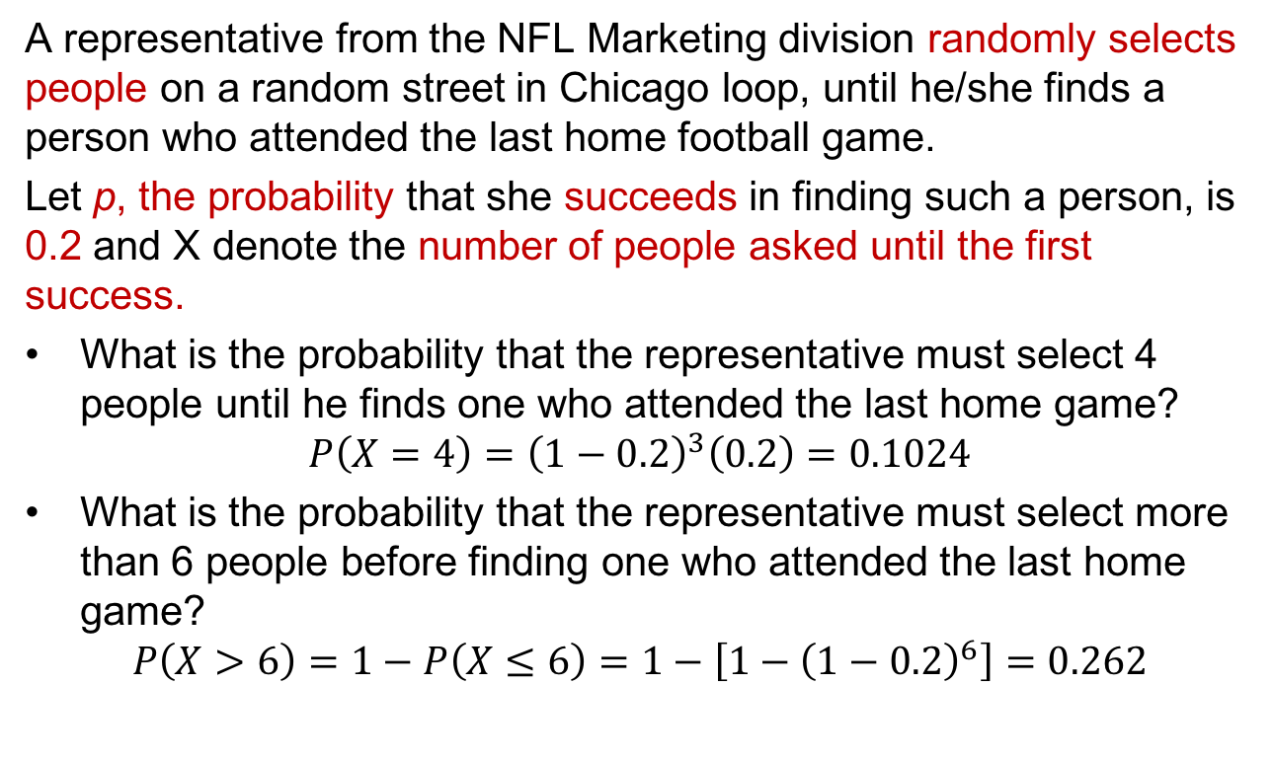
Example: Geometric Random Variable
A representative from the NFL Marketing division randomly selects people on a random street in Chicago loop, until he/she finds a person who attended the last home football game.
Let p, the probability that she succeeds in finding such a person, is 0.2 and X denote the number of people asked until the first success.
What is the probability that the representative must select 4 people until he finds one who attended the last home game?
$$P\left(X=4\right)={\left(1−0.2\right)}^{3}\left(0.2\right)=0.1024$$
What is the probability that the representative must select more than 6 people before finding one who attended the last home game?
$$P\left(X>6\right)=1−P\left(X≤6\right)=1−\left[1−{\left(1−0.2\right)}^{6}\right]=0.262$$

Slide 11
The Poisson Random Variable
A random variable X, taking on one of the values 0,1,2,…, is said to be a Poisson random variable with parameter λ, if for some λ>0,
defines a probability mass function since

Slide 12
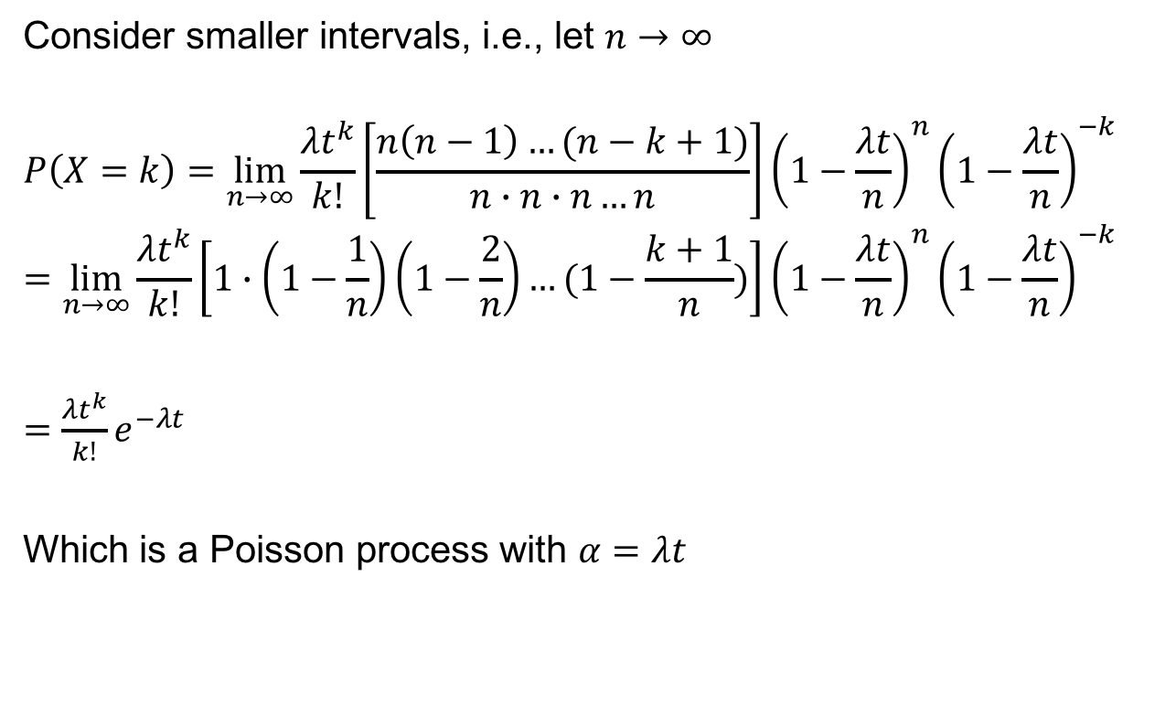
Poisson Random Variable
Consider smaller intervals, i.e., let $n→∞$
$$P\left(X=k\right)=\lim_{n→∞}{\frac{{λt}^{k}}{k!}\left[\frac{n\left(n−1\right)…(n−k+1)}{n∙n∙n…n}\right]}{\left(1−\frac{λt}{n}\right)}^{n}{\left(1−\frac{λt}{n}\right)}^{−k}$$
$$=\lim_{n→∞}{\frac{{λt}^{k}}{k!}\left[1∙\left(1−\frac{1}{n}\right)\left(1−\frac{2}{n}\right)…(1−\frac{k+1}{n})\right]{\left(1−\frac{λt}{n}\right)}^{n}{\left(1−\frac{λt}{n}\right)}^{−k} }$$
$=$ $\frac{{λt}^{k}}{k!}e^{−λt}$
Which is a Poisson process with $α=$ $λt$

Slide 13
Geometric Distribution Examples
3. Consider the program segment consisting of a while loop:
while ¬ B do S
the number of times the body (or the statement-group S) of the loop is executed: a modified geometric distribution with parameter p (probability the B is not true) – no. of failures until the first success.
4. Consider a repeat loop
repeat S until B
The number of tries until B (success) is reached will be a geometrically distributed random variable with parameter p.

Slide 14
Discrete Distributions
Geometric pmf (cont.)
To find the pmf of Z note that the event [Z = i] occurs if and only if we have a sequence of (i – 1) failures followed by one success - a sequence of independent Bernoulli trials each with the probability of success equal to p and failure q.
Hence, we have
for i = 1, 2,..., (A)
  where q = 1 - p.
Using the formula for the sum of a geometric series, we have:
CDF of Geometric distr.:

Slide 15
Discrete Distributions the Modified Geometric pmf (cont.)
The random variable X is said to have a modified geometric pmf, specify by
for i = 0, 1, 2,...,
The corresponding Cumulative Distribution function is:
for t ≥ 0

Slide 16
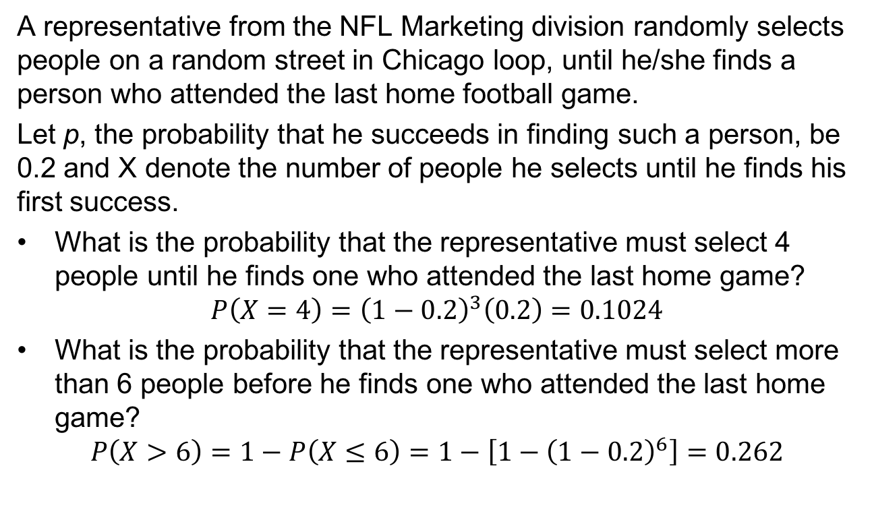
Example: Geometric Random Variable
A representative from the NFL Marketing division randomly selects people on a random street in Chicago loop, until he/she finds a person who attended the last home football game.
Let p, the probability that he succeeds in finding such a person, be 0.2 and X denote the number of people he selects until he finds his first success.
What is the probability that the representative must select 4 people until he finds one who attended the last home game?
$$P\left(X=4\right)={\left(1−0.2\right)}^{3}\left(0.2\right)=0.1024$$
What is the probability that the representative must select more than 6 people before he finds one who attended the last home game?
$$P\left(X>6\right)=1−P\left(X≤6\right)=1−\left[1−{\left(1−0.2\right)}^{6}\right]=0.262$$

Slide 17
The Poisson Random Variable
A random variable X, taking on one of the values 0,1,2,…, is said to be a Poisson random variable with parameter λ, if for some λ>0,
defines a probability mass function since

Slide 18
Poisson Random Variable
Consider smaller intervals, i.e., let $n→∞$
$$P\left(X=k\right)=\lim_{n→∞}{\frac{{λt}^{k}}{k!}\left[\frac{n\left(n−1\right)…(n−k+1)}{n∙n∙n…n}\right]}{\left(1−\frac{λt}{n}\right)}^{n}{\left(1−\frac{λt}{n}\right)}^{−k}$$
$$=\lim_{n→∞}{\frac{{λt}^{k}}{k!}\left[1∙\left(1−\frac{1}{n}\right)\left(1−\frac{2}{n}\right)…(1−\frac{k+1}{n})\right]{\left(1−\frac{λt}{n}\right)}^{n}{\left(1−\frac{λt}{n}\right)}^{−k} }$$
$=$ $\frac{{λt}^{k}}{k!}e^{−λt}$
Which is a Poisson process with $α=$ $λt$

Slide 19
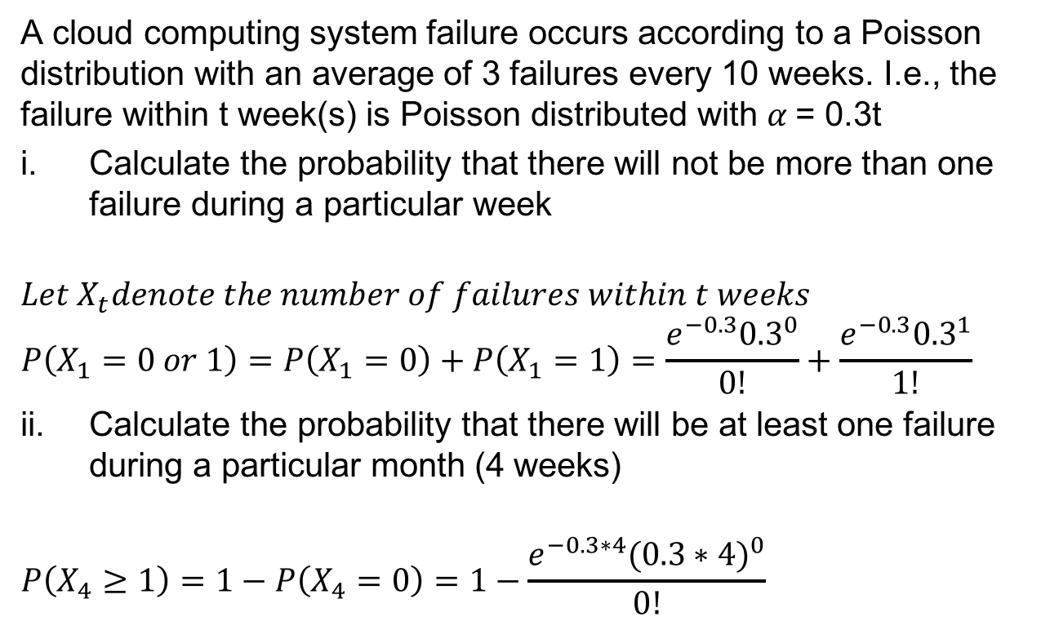
Example: Poisson Random Variables
A cloud computing system failure occurs according to a Poisson distribution with an average of 3 failures every 10 weeks. I.e., the failure within t week(s) is Poisson distributed with $α$= 0.3t
Calculate the probability that there will not be more than one failure during a particular week
$$Let X_{t}denote the number of failures within t weeks$$
$$P\left(X_{1}=0 or 1\right)=P\left(X_{1}=0\right)+P\left(X_{1}=1\right)=\frac{e^{−0.3}{0.3}^{0}}{0!}+\frac{e^{−0.3}{0.3}^{1}}{1!}$$
Calculate the probability that there will be at least one failure during a particular month (4 weeks)
$$P\left(X_{4}≥1\right)=1−P\left(X_{4}=0\right)=1−\frac{e^{−0.3∗4}({0.3∗4)}^{0}}{0!}$$

Slide 20
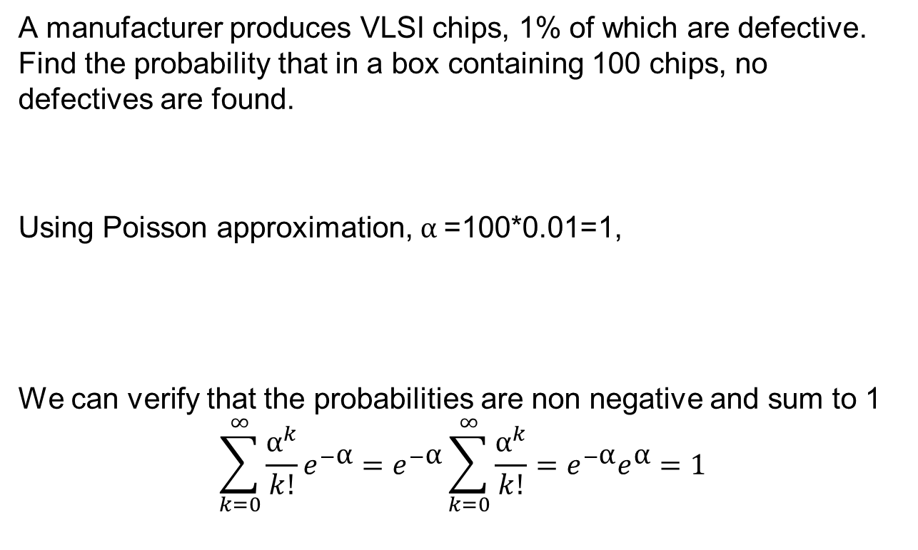
Poisson Random Variable
A manufacturer produces VLSI chips, 1% of which are defective. Find the probability that in a box containing 100 chips, no defectives are found.
Using Poisson approximation, $\text{α}$=100*0.01=1,
We can verify that the probabilities are non negative and sum to 1
$$\sum_{k=0}^{∞}{\frac{{\text{α}}^{k}}{k!}e^{−\text{α}}}=e^{−\text{α}}\sum_{k=0}^{∞}{\frac{{\text{α}}^{k}}{k!}}=e^{−\text{α}}e^{\text{α}}=1$$

Slide 21


Example: PDF, PMF
Verify whether below are valid PDF/PMF.
$p\left(x\right)=\left\{\begin{aligned}\frac{1}{10}\left(3x−2\right), x=0,1,2,3 \\ &0, otherwise\end{aligned}\right.$
Answer:
$\sum_{k=0}^{∞}{p}$(x=k)=$\sum_{k=0}^{3}{p}$(x=k)=1
$However$, p(x=0)= $\frac{−2}{10}<0$
Therefore, it is not a valid PMF.
$f\left(x\right)=\left\{\begin{aligned}\frac{1}{4}x^{3}, 0≤x≤2 \\ &0, otherwise\end{aligned}\right.$
Answer:
$f\left(x\right)≥0$
$\int_{−∞}^{∞}{f\left(x\right)dx=\int_{0}^{2}{\frac{1}{4}x^{3}dx=1 }}$
Therefore, it is a valid PDF.

Slide 22

Example: CDF
Verify whether the following is a valid CDF
$F\left(x\right)= \left\{\begin{aligned}0, x<0 \\ { x}^{2}, 0 ≤x<1 \\ 1, x ≥1\end{aligned}\right.$
Answer:
$\lim_{x→−∞}{F\left(x\right)=0}$
$\lim_{x→∞}{F\left(x\right)=1}$
Is F(x) monotonically non-decreasing? Yes
Therefore, it is a valid CDF.

Slide 23
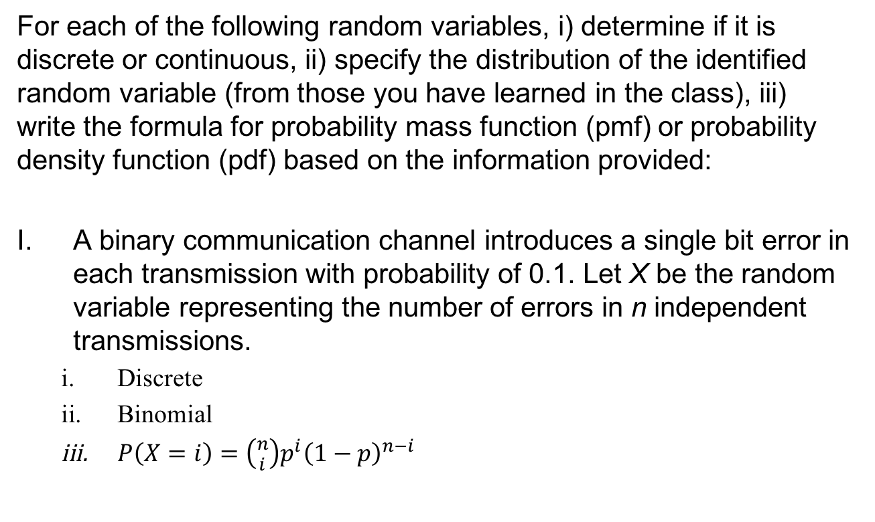
Example: Identify Random Variables
For each of the following random variables, i) determine if it is discrete or continuous, ii) specify the distribution of the identified random variable (from those you have learned in the class), iii) write the formula for probability mass function (pmf) or probability density function (pdf) based on the information provided:
A binary communication channel introduces a single bit error in each transmission with probability of 0.1. Let X be the random variable representing the number of errors in n independent transmissions.
  Discrete
  Binomial
  $P\left(X=i\right)=\left({n \atop i}\right)p^{i}{\left(1−p\right)}^{n−i}$

Slide 24

Example: Identify Random Variables
A sequence of characters is transmitted over a channel that introduces errors with probability 0.2. Let N be the random variable representing the number of error-free characters transmitted before an error occurs.
  Discrete
  Modified Geometric
  $P\left(N=i\right)={\left(1−p\right)}^{i}p$

Slide 25
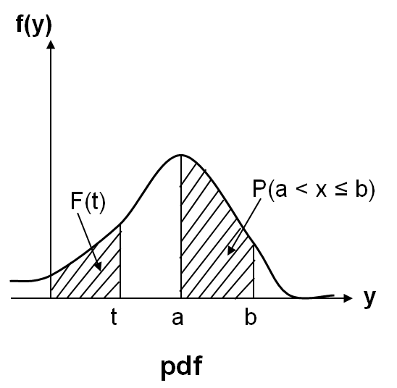
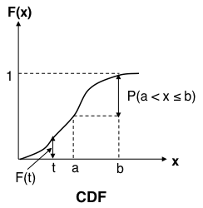
Review: Continuous Random Variables
Continuous Random Variables:
  Probability distribution function (pdf):
    Properties:
    All probability statements about X can be answered by f(x):
  Cumulative distribution function (CDF):
    Properties:
    A continuous function

Slide 26
Normal or Gaussian Distribution

Slide 27
Normal or Gaussian Distribution
Extremely important in statistical application because of the central limit theorem:
  Under very general assumptions, the mean of a sample of n mutually independent random variables is normally distributed in the limit n → ∞.
Errors in measurement often follows this distribution.
During the wear-out phase, component lifetime follows a normal distribution.
The normal density is given by:
where are two parameters of the distribution.

Slide 28
Normal or Gaussian Distribution (cont.)
Normal density with parameters μ =2 and σ =1
σ =1
0.4
f_{x}(x)
0.2
μ = 2
-5.00
-2.00
1.00
4.00
7.00
x

Slide 29
Normal or Gaussian Distribution (cont.)
The distribution function (CDF) F(x) has no closed form, so between every pair of limits a and b, probabilities relating to normal distributions are usually obtained numerically and recorded in special tables.
These tables apply to the standard normal distribution [Z ~ N(0,1)] --- a normal distribution with parameters μ = 0 , σ = 1 --- and their entries are the values of:

Slide 30
Normal or Gaussian Distribution (cont.)
Since the standard normal density is clearly symmetric, it follows that for z > 0:
The tabulations of the normal distribution are made only for z ≥ 0 To find P(a ≤ Z ≤ b), use F(b) - F(a).

Slide 31
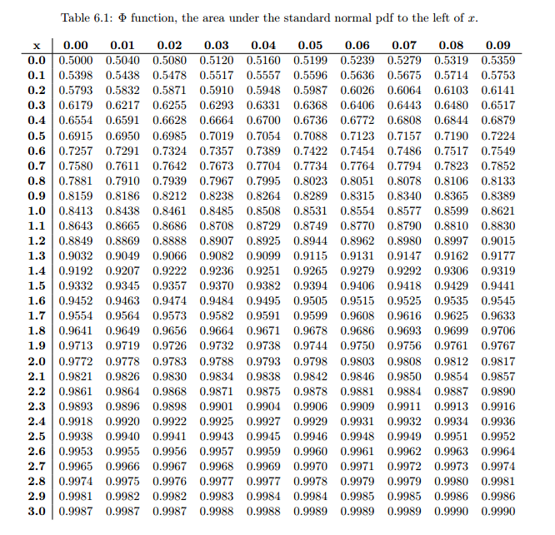
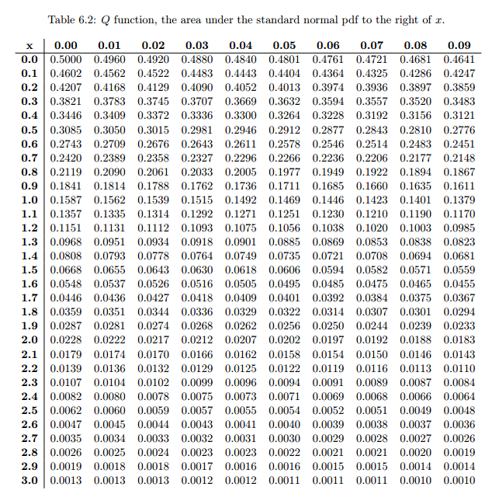
Normal or Gaussian Distribution (cont.)
The CDF of the N(0,1) distribution ( ) is denoted in the tables by , and its complementary CDF is denoted by , so:

Slide 32
Normal or Gaussian Distribution (cont.)
For a particular value, x, of a normal random variable X, the corresponding value of the standardized variable Z is:
The Cumulative distribution function of X can be found by using:
alternatively:
Similarly, if X is normally distributed with parameters μ and σ2 then
Z = αX + β is normally distributed with parameters αμ + β and α²σ².

Slide 33
Normal or Gaussian Distribution Example 1
An analog signal received at a detector (measured in microvolts) may be modeled as a Gaussian random variable N(200, 256) at a fixed point in time. What is the probability that the signal will exceed 240 microvolts? What is the probability that the signal is larger than 240 microvolts, given that it is larger than 210 microvolts?

Slide 34
Normal or Gaussian Distribution Example 1 (cont.)
Next:

Slide 35
Normal or Gaussian Distribution Example 2
Assuming that the life of a given subsystem, in the wear-out phase, is normally distributed with μ = 10,000 hours and σ = 1,000 hours, determine the reliability for an operating time of 500 hours given that
  (a) The age of the component is 9,000 hours,
  (b) The age of the component is 11,000.
The required quantity under (a) is R_{9,000}(500) and under (b) is R_{11,000}(500).

