Slide 1
More on Bernoulli trials: Improving Reliability with Triple Modular Redundancy
ECE 313
Probability with Engineering Applications
Lecture 7
Professor Ravi K. Iyer
Department of Electrical and Computer Engineering
University of Illinois

Slide 2
Today’s Topics
Reliability Evaluation Applications
  Another non series-parallel example
  Introducing N Modular Redundancy – Special Case of Triple Modular redundancy (TMR)
Random Variables: Discrete and Continuous
Prob. Mass Function (pmf), Cumulative Distribution Function (CDF)
Announcements:
  Homework 3 released Wednesday, Feb 15,
  In class group activity Wednesday as well

Slide 3
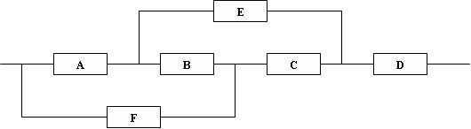

Non-Series Parallel System Example
B
B Working
B Not Working
E
A
E
A
C
D
D
F
C
F
B (“ short ”) works
B (“ open ”) fails
R_{sys} = R_{B} P(system works | B works) + (1 - R_{B}) {R_{D}[1 - (1 - R_{A}R_{E})(1 - R_{F}R_{C})]}

Slide 4

Non-Series-Parallel-Systems (cont.)
B Working
A
D
F
E
B (“ short ”) works, C (“ short ”) works
A
C
D
A
E
D
F
B (“ short ”) works
B (“ short ”) works, C (“ open ”) fails
Reduction with B and C replaced
P(system works | B works) = R_{C}{R_{D}[1 - (1 - R_{A})(1 - R_{F})]} + (1 - R_{C})(R_{A}R_{D}R_{E})
Letting R_{A} ....R_{F} = R_{m} yields R_{sys} = R⁶_{m} - 3R⁵_{m} + R⁴_{m} + 2R³_{m}

Slide 5
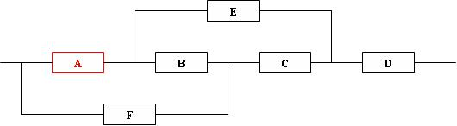
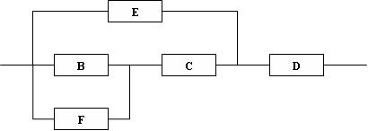
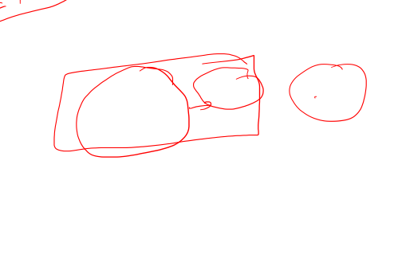
Non-Series Parallel System Example
A Working

Slide 6

Non-Series Parallel System Example
A Not Working

Slide 7
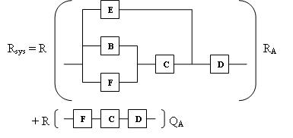
Non-Series Parallel System Example

Slide 8
Example
Consider a binary communication channel transmitting coded words of n bits each. Assume that the probability of successful transmission of a single bit is p (and the probability of an error is q = 1-p), and the code is capable of correcting up to e (e >=0) errors.
For example, if no coding or parity checking is used, then e = 0. If a single error correcting Hamming code is used then e =1.
If we assume that the transmission of successive bits is independent, then the probability of successful word transmission is:

Slide 9

Sequence of Bernoulli Trials
N-Modular Redundancy
Consider a system with n components that requires m (≤n) or more components to function for the correct operation of the system (called m-out-of-n system).
If we let m=n, then we have a series system; if we let m = 1, then we have a system with parallel redundancy.
Assume: n components are statistically identical and function independently of each other.
Let R denote the reliability of a component ( and q = 1 – R) gives its unreliability), then the experiment of observing the status of n components can be thought of as a sequence of n Bernoulli trials with the probability of success equal R.

Slide 10
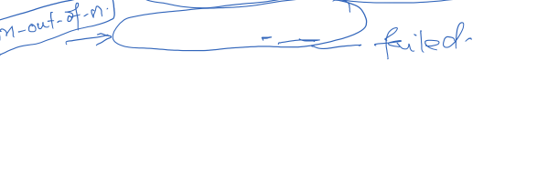
Bernoulli Trials Example (cont.)
Now the reliability of the system is:
It is easy to verify that:

Slide 11
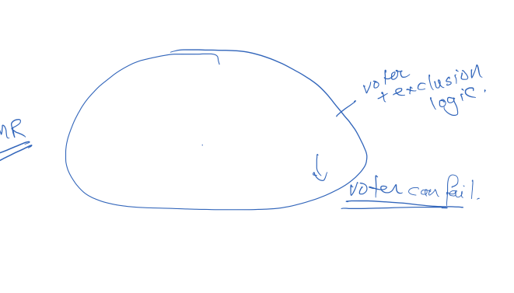
Bernoulli Trials
TMR System Example
As special case of m-out-of-n system, consider a system with triple modular redundancy (TMR) i.e. (a 3-out-of-2 system) two are required to be working for the system to function properly (i.e., n = 3 and m = 2). This is achieved by feeding the outputs of the three components into a majority voter.
R
Input
Output
R
Voter
R

Slide 12

Bernoulli Trials
TMR System Example (cont.)
The reliability of TMR system is given by the expression:
and thus Note that:
Thus TMR increases reliability over the simplex system only if the simplex reliability is greater than 0.5; otherwise decreases reliability
Note: the voter output corresponds to a majority; it is possible for two or more malfunctioning units to agree on an erroneous vote.

Slide 13
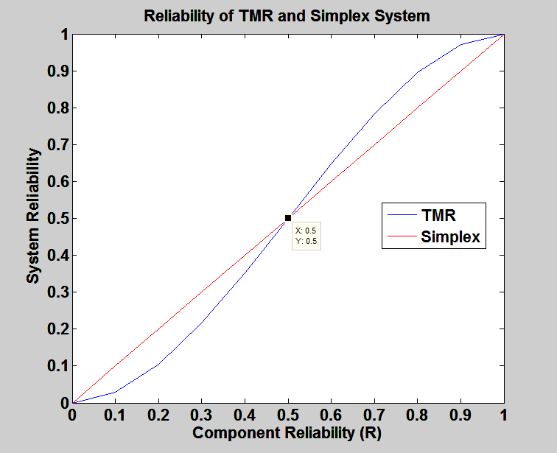

Reliability of TMR vs. Simplex

Slide 14
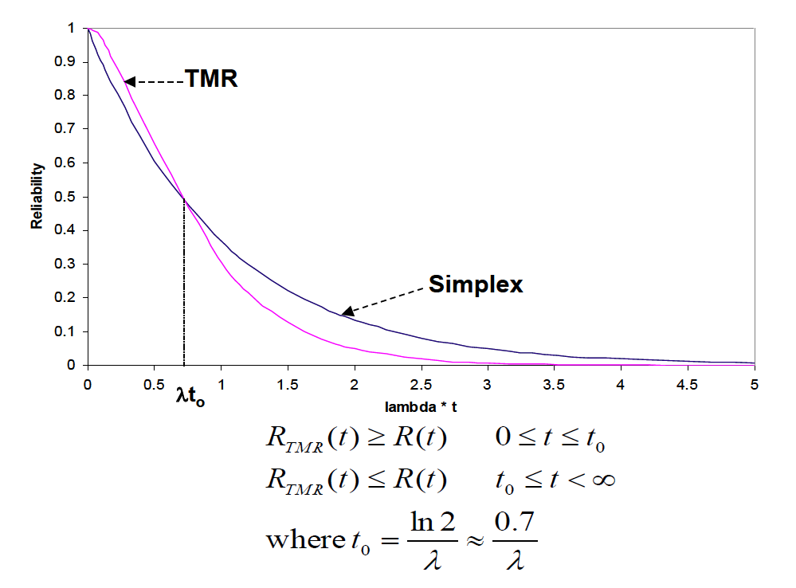

Reliability of TMR vs. Simplex

Slide 15

TMR with Compensating Error
In the computation of TMR reliability, we assumed that when two units have failed they both produce incorrect results and, hence after voting, the wrong answer will be produced by the TMR configuration.
In the case that two faulty units produce the opposite answers (one correct and the other incorrect) the overall result will be correct.
Assuming that the probability of such a compensating error is c, derive the reliability expression for the TMR configuration.

Slide 16
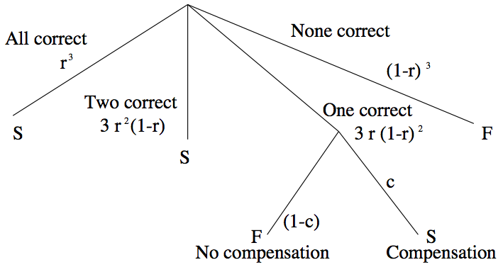
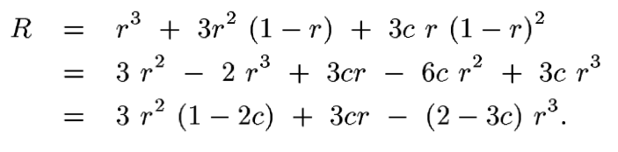





TMR with Compensating Error
All Working
None Working
Two Working
One Working
Two Correct (Compensation)
One Correct

Slide 17
Random Variable
Definition: Random Variable
A random variable X on a sample space S is a function X: S → ℜ that assigns a real number X(s) to each sample point s ∈ S.
Example: Consider a random experiment defined by a sequence of three Bernoulli trials. The sample space S consists of eight triples (where 1and 0 respectively denote success and a failure on the nth trail). The probability of successes , p, is equal 0.5.
Sample points
111
110
101
100
011
010
001
000
P(s)
0.125
0.125
0.125
0.125
0.125
0.125
0.125
0.125
X(s)
3
2
2
1
2
1
1
0
Note that two or more sample
points might give the same value
for X (i.e., X may not be
a one-to-one function.), but that two
different numbers in the range
cannot be assigned to the same
sample point (i.e., X is well
defined function).

Slide 18







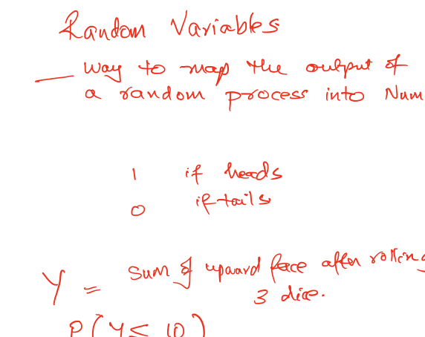


Slide 19
Discrete/Continuous Random Variables
The discrete random variables are either a finite or a countable number of possible values.
Random variables that take on a continuum of possible values are known as continuous random variables.
Example: A random variable denoting the lifetime of a car, when the car’s lifetime is assumed to take on any value in some interval (a,b) is continuous.

Slide 20
Random Variable (cont.)
Event space
For a random variable X and a real number x, we define the event A_{x} to be the subset of S consisting of all sample points s to which the random variable X assigns the value x.
A_{x} = {s ∈ S | X(s) = x}; Note that:
The collection of events A_{x} for all x defines an event space
In the previous example the random variable defines four events:
A₀ = {s ∈ S | X(s) = 0} = {(0, 0, 0)}
A₁ = {(0, 0, 1), (0, 1, 0), (1, 0, 0)}
A₂ = {(0, 1, 1), (1, 0, 1), (1, 1, 0)}
A₃= {(1, 1, 1)}
Discrete random variable
The random variable which is either
finite or countable.

Slide 21
Random Variables Example 1
Let X denote the random variable that is defined as the sum of two fair dice; then

Slide 22
Random Variables Example 1 (Cont’d)
i.e., the random variable X can take on any integral value between two and twelve, and the probability that it takes on each value is given.
Since X must take on one of the values two through twelve, we must have:
(check from the previous equations).

Slide 23
Random Variables Example 2
Suppose that our experiment consists of tossing two fair coins. Letting Y denote the number of heads appearing, then
Y is a random variable taking on one of the values 0, 1, 2 with respective probabilities:

Slide 24
Random Variables Example 3
Suppose that we toss a coin until the first head appears
Assume a probability p of coming up heads, on each toss.
Letting N ( a R.V) denote the number of flips required, and assume that the outcome of successive flips are independent,
N is a random variable taking on one of the values 1, 2, 3, . . . , with respective probabilities

Slide 25
Random Variables Example 3 (Cont’d)
As a check, note that

Slide 26
Random Variables Example 4
Suppose that our experiment consists of seeing how long a commodity smart phone can operate before failing.
Suppose also that we are not primarily interested in the actual lifetime of the phone but only if the phone lasts at least two years.
We can define the random variable I by
If E denotes the event that the phone lasts two or more years, then the random variable I is known as the indicator random variable for event E. (Note that I equals 1 or 0 depending on whether or not E occurs.)

Slide 27
Random Variables Example 5
Suppose that independent trials, each of which results in any of m possible outcomes with respective probabilities p1, . . . , pm,
are continually performed. Let X denote the number of trials needed until each outcome has occurred at least once.
Rather than directly considering P{X = n} we will first determine P{X > n}, the probability that at least one of the outcomes has not yet occurred after n trials. Letting Ai denote the event that outcome i has not yet occurred after the first n trials, i = 1,...,m, then:

Slide 28
Random Variables Example 5 (Cont’d)
Now, is the probability that each of the first n trials results in a non-i outcome, and so by independence
Similarly, is the probability that the first n trials all result in a non-i and non-j outcome, and so
As all of the other probabilities are similar, we see that

Slide 29
Random Variables Example 5 (Cont’d)
Since
By using the algebraic identity:
We see that:

Slide 30
Discrete/Continuous Random Variables
So far the random variables of interest were either a finite or a countable number of possible values (discrete random variables).
Random variables can also take on a continuum of possible values (known as continuous random variables).
Example: A random variable denoting the lifetime of a car, when the car’s lifetime is assumed to take on any value in some interval (a,b).

Slide 31
Discrete Random Variables:
Probability Mass Function (pmf)
A random variable that can take on at most countable number of possible values is said to be discrete.
For a discrete random variable , we define the probability mass function of by:
is positive for at most a countable number of values of .
i.e., if must assume one of the values x1, x2, …, then
Since take values xi:

Slide 32
Cumulative Distribution Function
The cumulative distribution function can be expressed in terms of by:
Suppose has a probability mass function given by
then the cumulative distribution function of is given by

Slide 33
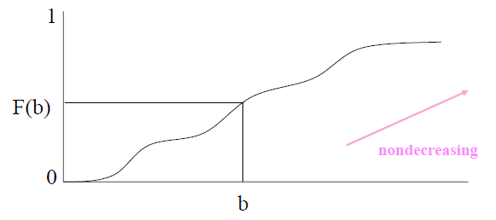
Cumulative Distribution Function (CDF)
The cumulative distribution function (cdf) (or distribution function) of a random variable is defined for any real number by
denotes the probability that the random variable
takes on a value that is less than or equal to .

Slide 34
Cumulative Distribution Function (CDF)
Some properties of cdf are:
  is a non-decreasing function of b,
Property (i) follows since for the event is contained in the event , and so it must have a smaller probability.
Properties (ii) and (iii) follow since must take on some finite value.
All probability questions about can be answered in terms of cdf . For example:
i.e. calculate by first computing the probability that
and then subtract from this the probability that .

Slide 35
Cumulative Distribution Function
The cumulative distribution function can be expressed in terms of by:
Suppose has a probability mass function given by
then the cumulative distribution function of is given by

Slide 36
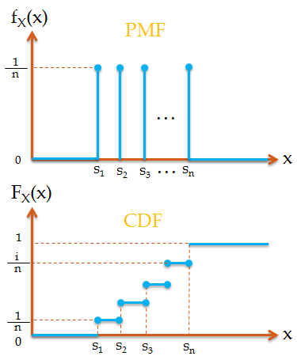
Review: Discrete Random Variables
Discrete Random Variables:
  Probability mass function (pmf):
    Properties:
  Cumulative distribution function (CDF):
    A stair step function

Slide 37
Discrete/Continuous Random Variables
So far the random variables of interest were either a finite or a countable number of possible values (discrete random variables).
Random variables can also take on a continuum of possible values (known as continuous random variables).
Example: A random variable denoting the lifetime of a car, when the car’s lifetime is assumed to take on any value in some interval (a,b).

Slide 38
Continuous Random Variables
Random variables whose set of possible values is uncountable
X is a continuous random variable if there exists a nonnegative function f(x) defined for all real , having the property that for any set of B real numbers
f(x) is called the probability density function of the random variable X
The probability that X will be in B may be obtained by integrating the probability density function over the set B. Since X must assume some value, f(x) must satisfy

Slide 39
Continuous Random Variables Cont’d
All probability statements about X can be answered in terms of f(x)
e.g. letting B=[a,b], we obtain
If we let a=b in the preceding, then ?????
The relationship between the cumulative distribution F(∙) and the probability density f(∙)
Differentiating both sides of the preceding yields

Slide 40
Continuous Random Variables Cont’d
All probability statements about X can be answered in terms of f(x)
e.g. letting B=[a,b], we obtain
If we let a=b in the preceding, then
This equation states that the probability that a continuous random variable will assume any particular value is zero
The relationship between the cumulative distribution F(∙) and the probability density f(∙)
Differentiating both sides of the preceding yields

Slide 41
Continuous Random Variables Cont’d
That is, the density of the derivative of the cumulative distribution function.
A somewhat more intuitive interpretation of the density function
when ε is small
The probability that X will be contained in an interval of length ε around the point a is approximately εf(a)

Slide 42
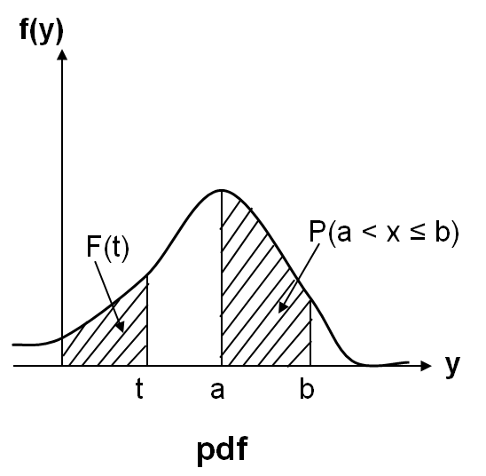
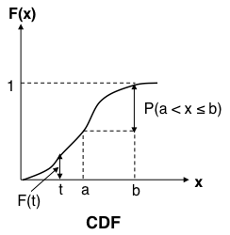
Review: Continuous Random Variables
Continuous Random Variables:
  Probability distribution function (pdf):
    Properties:
    All probability statements about X can be answered by f(x):
  Cumulative distribution function (CDF):
    Properties:
    A continuous function

