Slide 1
Limit Theorems and Inequalities
ECE 313
Probability with Engineering Applications
Lecture 24
Professor Ravi K. Iyer
Dept. of Electrical and Computer Engineering
University of Illinois at Urbana Champaign

Slide 2
Today’s Topics
Binary Hypothesis testing: the continuous case
Limit Theorems
  Law of large numbers
  Central Limit Theorem
Inequalities:
  Markov inequality
  Chebychev inequaliy
Announcements:
MP #3Project review presentations today
  All groups must have signed up
MP #3
    Final Project Presentation on Wednesday, 5.00 – 8.00 PM Siebel 1109 All Projects all group members ATTEND
    Final Report due on Friday May 9
    ADDITIONAL OFFICE HOURs for (PROJECT RELATED HELP) SEE PIAZZA
  Final exam on May 11, 8:00-11:00am 3 - 8x11 sheets of notes allowed
  Review session see Piazza place TBD

Slide 3

Maximum Likelihood (ML) and the MAP Decision Rule: Review
Maximum likelihood (ML) decision rule declares the hypothesis that maximizes the probability (likelihood) of the observation
Construct a likelihood matrix, of conditional probabilities
. The sum of elements in each row of the likelihood matrix
ML rule is specified by underlining the larger entry in each column of likelihood matrix. If the entries in a column are identical, then either can be underlined.
A Posteriori probability is a conditional probability that an observer would declare a hypothesis, given an observation k:
Given an observation X = k, the MAP decision rule chooses the hypothesis with the larger a-posteriori probability The posteriori probabilities are unknown, so we use Bayes’ formula to calculate

Slide 4
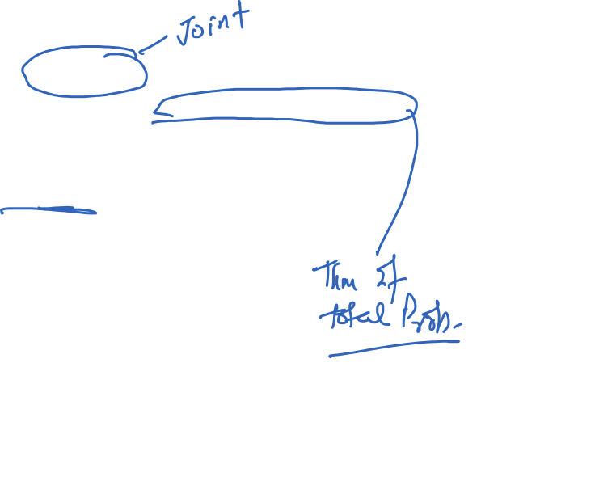
Maximum a posteriori probability (MAP) Decision Rule (Cont’d)
Remember : ,
MAP decision rule is specified by underlying the larger entry in each column of the joint probability matrix.
If the entries in a column are identical, then either can be underlined.

Slide 5
Average Error Probability
Remember the conditional probabilities of:
The average error probability is defined as:
is the sum of entries in the H₀ row of the likelihood matrix, (joint probability matrix) that are not underlined (divided by )
is the sum of entries in the H₀ row of the likelihood matrix, (joint probability matrix) that are not underlined (divided by )
is the sum of all the entries in the joint probability matrix that are not underlined.
Among all decision rules, MAP is the one that minimizes =>Optimal

Slide 6
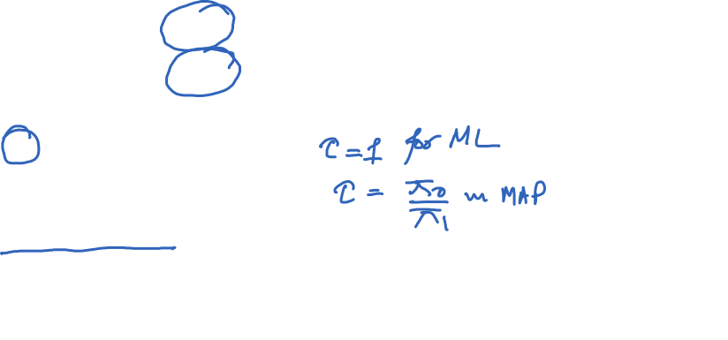
Likelihood Ratio Test (LRT)
A way to generalize the ML and MAP decision rules into a single framework is using a LR. .
Define the likelihood ratio
A decision rule can be expressed as an LRT with threshold :
If the threshold is is increased, then there are fewer observations that lead to deciding is true.
As increases, decreases, and increases.

Slide 7
Likelihood Ratio Test (LRT) (Cont’d)
If the observation is X = k:
The ML rule declares hypothesis is true, if and otherwise it declares is true.
So the ML rule can be specified using an LRT with :
The MAP rule declares hypothesis is true, if and otherwise it declares is true.
So the MAP rule can be specified using an LRT with :
For uniform priors , MAP and ML decision rules are the same

Slide 8

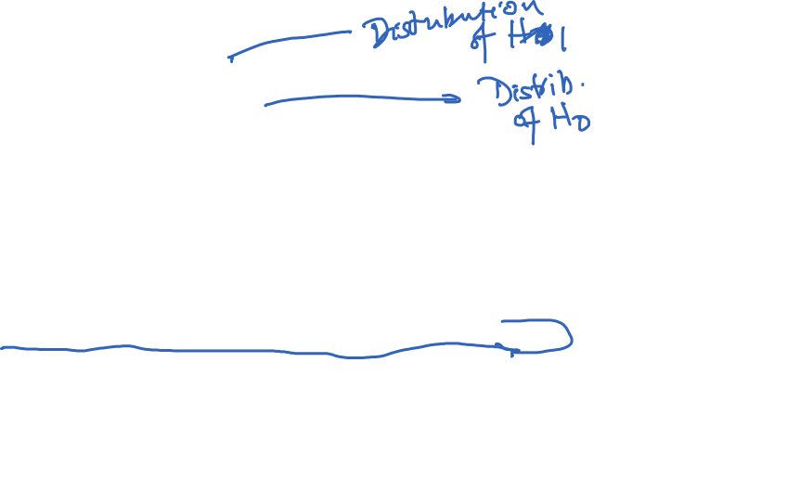
Example 3
An observation X is drawn from a standard normal distribution (i.e. N(0,1)) if hypothesis H1 is true and from a uniform distribution with support [-a, a], if hypothesis H0 is true.
As shown in the figure, the pdfs of the two distributions are equal when |u| = b.
Describe the maximum likelihood (ML) decision rule in terms of observation X and constant values a and b.
Shade and label the regions in the figure such that the area of one region is the
and the area of the other region is the .
Express the and for ML decision rule in terms of a and b and the $Φ$(u), i.e., the CDF of the standard normal distribution.
Determine the maximum a posteriori probability (MAP) decision rule for a = 2/3, b = 0.6, and the probability of hypothesis H1 being true,

Slide 9
Example 3 (Cont’d)

Slide 10
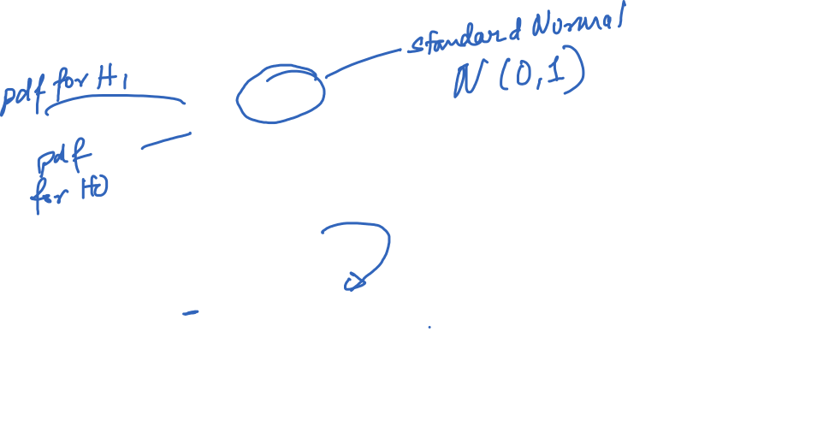
Example 3 (Cont’d)
$Λ\left(u\right)=\frac{f_{1}(u)}{f_{0}(u)}=\frac{\frac{1}{\sqrt{2π}}e^{−\frac{u^{2}}{2}}}{\frac{1}{3}}$=$\frac{3}{\sqrt{2π}}e^{−\frac{u^{2}}{2}}$

Slide 11
Limit Theorems:
Strong Law of Large Numbers
The strong law of large numbers, is probably the most well-known result in probability theory. It states that the average of a sequence of independent random variables having the same distribution will, with probability 1, converge to the mean of that distribution.
Let X₁,X₂,… be a sequence of independent random variables having a common distribution, and let E[X_{i}]=μ Then, with probability 1,
As an example suppose that a sequence of independent trials is performed. Let E be a fixed event and denote P(E) the probability that E occurs on any particular trial. Letting

Slide 12
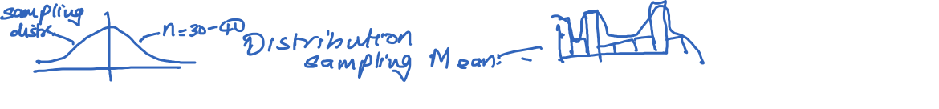
Limit Theorems:
Central Limit Theorem
We have by the strong law of large numbers that, with probability 1,
Since X₁+…+X_{n} represents the number of times that the event E occurs in the first n trials, we may interpret this equation as stating that, with probability 1, the proportion of time that the event E occurs is just P(E).
central limit theorem.
The central limit theorem provides a simple method for computing approximate probabilities for sums of independent random variables.
It also explains the remarkable fact that the empirical frequencies of so many natural “populations” exhibit a bell-shaped (that is, normal) curve.

Slide 13

Limit Theorems:
Central Limit Theorem
Central Limit Theorem:
Let X_{1,} X₂,…be a sequence of independent, identically distributed random variables, each with mean μ and variance σ² then the distribution of
Tends to the standard normal as . That is,
Note that like other results, this theorem holds for any distribution of the X_{i} ‘s; herein lies its power.

Slide 14

Central Limit Theorem Example
From past experience an instructor knows that the test scores of each student taking final examination is a random variable with a mean of 75 and standard deviation of 8. How many students would have to take the examination to ensure, with probability at least .95, that the class mean would be at least 73?
Hint: The central limit theorem applies to both the sum of a sequence of independent and identically distributed random variables, and their mean.

Slide 15
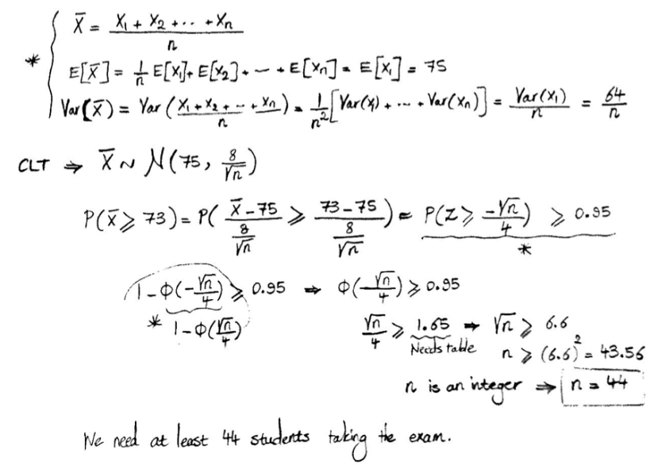
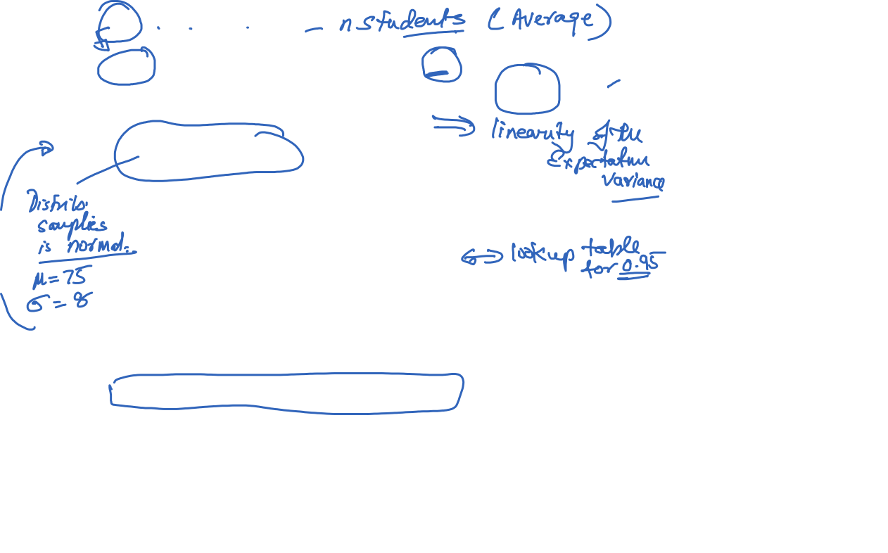
Central Limit Theorem Example (Cont’d)

Slide 16
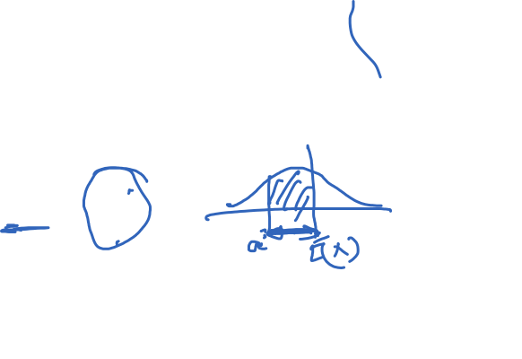
Markov Inequality
Proposition - Markov’s Inequality: If X is a random variable that takes only nonnegative values, then for any value a>0
Proof: X is continuous with density f.

Slide 17
Chebychev’s Inequality
A corollary, we obtain the following
Proposition - Chebyshev’s Inequality: If X is a random variable with mean μ and variance σ² then for any value k>0,
Proof: Since (X- μ)² is a nonnegative random variable, we can apply Markov’s inequality (with a=k²) to obtain
Since if and only if is equivalent to
And the proof is complete

Slide 18
Inequalities Example
The importance of Markov’s and Chebyshev’s inequalities is that they enable us to derive bounds on probabilities when only the mean, or both the mean and the variance, of the probability distribution are known. If the actual distribution were known, then the desired probabilities could be exactly computed, and we would not need to resort to bounds.
Example: Suppose we know that the number of items produced in a factory during a week is a random variable with mean 500.
  What can be said about the probability that this week’s production will be at least 1000?
  If the variance of a week’s production is known to equal 100, then what can be said about the probability that this week’s production will be between 400 and 600?

Slide 19
Inequalities Example (Cont’d)
Let X be the number of items that will be produced in a week.
  By Markov’s inequality,
  By Chebyshev’s inequality,
  Hence,
  And so the probability that this week’s production will be between 400 and 600 is at least 0.99.

Slide 20
Final Project Presentation Format
  Presentation ~ 10 Slides Max:
      2-3 Slides: Project Summary
        Patients and features selected and justify you choice.
        Why do you think your selected features would perform best on the complete patient set
        What concepts from class used for analysis, any additional concepts?
        Division of tasks
      3-5 Slides: Analysis Results
        Provide evidence for the techniques you used.
        For example show the results of your analysis for selection of features in the form of tables/graphs presenting the ML and MAP errors, correlations, etc.
        Did you change your features selected in Task 2 after doing Task 3? Provide insights and justification for your selection.
      1-2 Slides: Conclusions and key insights
        Example insights: Compare the results generated by ML and MAP rules.
        How were the projects useful in understanding the concepts learned in the class in practice? What suggestions do you have for improvement?
  DEMO ~
  Groups should run their Matlab code for Task 3, and present the performance for the ML and MAP rule.

Slide 21
Limit Theorems:
Strong Law of Large Numbers
The strong law of large numbers, is probably the most well-known result in probability theory. It states that the average of a sequence of independent random variables having the same distribution will, with probability 1, converge to the mean of that distribution.
Let X₁,X₂,… be a sequence of independent random variables having a common distribution, and let E[X_{i}]=μ Then, with probability 1,
As an example suppose that a sequence of independent trials is performed. Let E be a fixed event and denote P(E) the probability that E occurs on any particular trial. Letting

Slide 22
Limit Theorems:
Central Limit Theorem
We have by the strong law of large numbers that, with probability 1,
Since X₁+…+X_{n} represents the number of times that the event E occurs in the first n trials, we may interpret this equation as stating that, with probability 1, the proportion of time that the event E occurs is just P(E). central limit theorem.
The central limit theorem provides a simple method for computing approximate probabilities for sums of independent random variables.
It also explains the remarkable fact that the empirical frequencies of so many natural “populations” exhibit a bell-shaped (that is, normal) curve.

Slide 23
Limit Theorems:
Central Limit Theorem
Central Limit Theorem:
Let X_{1,} X₂,…be a sequence of independent, identically distributed random variables, each with mean μ and variance σ² then the distribution of
Tends to the standard normal as . That is,
Note that like other results, this theorem holds for any distribution of the X_{i} ‘s; herein lies its power.

Slide 24
Central Limit Theorem Example
From past experience an instructor knows that the test scores of each student taking final examination is a random variable with a mean of 75 and standard deviation of 8. How many students would have to take the examination to ensure, with probability at least .95, that the class mean would be at least 73?
Hint: The central limit theorem applies to both the sum of a sequence of independent and identically distributed random variables, and their mean.

Slide 25
Central Limit Theorem Example (Cont’d)

Slide 26
Markov Inequality
Proposition - Markov’s Inequality: If X is a random variable that takes only nonnegative values, then for any value a>0
Proof: X is continuous with density f.

Slide 27
Chebychev’s Inequality
A corollary, we obtain the following
Proposition - Chebyshev’s Inequality: If X is a random variable with mean μ and variance σ² then for any value k>0,
Proof: Since (X- μ)² is a nonnegative random variable, we can apply Markov’s inequality (with a=k²) to obtain
Since if and only if is equivalent to
And the proof is complete

Slide 28
Inequalities Example
The importance of Markov’s and Chebyshev’s inequalities is that they enable us to derive bounds on probabilities when only the mean, or both the mean and the variance, of the probability distribution are known. If the actual distribution were known, then the desired probabilities could be exactly computed, and we would not need to resort to bounds.
Example: Suppose we know that the number of items produced in a factory during a week is a random variable with mean 500.
  What can be said about the probability that this week’s production will be at least 1000?
  If the variance of a week’s production is known to equal 100, then what can be said about the probability that this week’s production will be between 400 and 600?

Slide 29
Inequalities Example (Cont’d)
Let X be the number of items that will be produced in a week.
  By Markov’s inequality,
  By Chebyshev’s inequality,
  Hence,
  And so the probability that this week’s production will be between 400 and 600 is at least 0.99.

