Slide 1
Binary Hypothesis Testing (continued.)
ECE 313
Probability with Engineering Applications
Lecture 22
Ravi K. Iyer
Dept. of Electrical and Computer Engineering
University of Illinois at Urbana Champaign

Slide 2
Today’s Topics and Announcements
Likelihood Ratio Test
Examples on binary hypothesis testing
Group Activity 6
Announcements:
Progress meeting with individual groups:
  Mon, Apr 24, 1pm-5pm at 249 CSL, 10 mins per group
    Make 3 slides presenting Task 0-2 results
    1 slide on Task 0-1; 1 slide on Task 2; 1 slides on task division and problems encountered
  Fri, Apr 21, 5pm is the deadline to sign up for progress meeting. Must keep to this deadline
HW 10 is released today. HW 10 is due on Wed, Apr 26 in class.

Slide 3
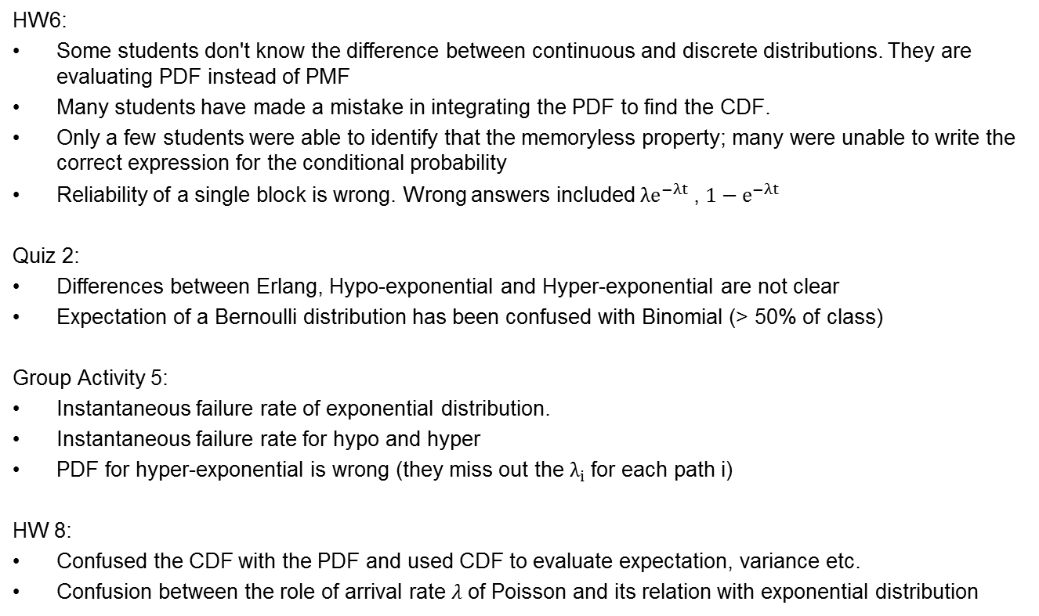
Insights from HWs and GAs
HW6:
Some students don't know the difference between continuous and discrete distributions. They are evaluating PDF instead of PMF
Many students have made a mistake in integrating the PDF to find the CDF.
Only a few students were able to identify that the memoryless property; many were unable to write the correct expression for the conditional probability
Reliability of a single block is wrong. Wrong answers included$λe^{−λt}$ , $1−e^{−λt}$
Quiz 2:
Differences between Erlang, Hypo-exponential and Hyper-exponential are not clear
Expectation of a Bernoulli distribution has been confused with Binomial (> 50% of class)
Group Activity 5:
Instantaneous failure rate of exponential distribution.
Instantaneous failure rate for hypo and hyper
PDF for hyper-exponential is wrong (they miss out the $λ_{i}$for each path i)
HW 8:
Confused the CDF with the PDF and used CDF to evaluate expectation, variance etc.
Confusion between the role of arrival rate $λ$of Poisson and its relation with exponential distribution

Slide 4
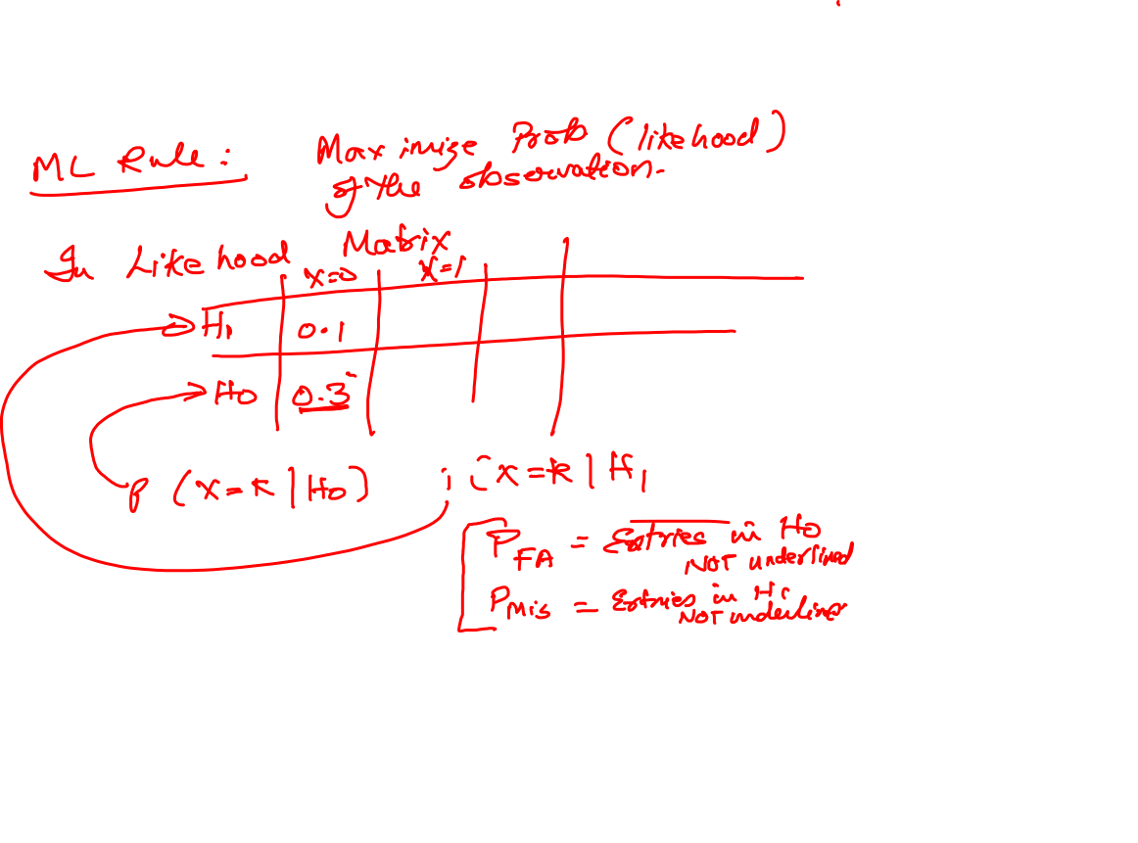

Slide 5
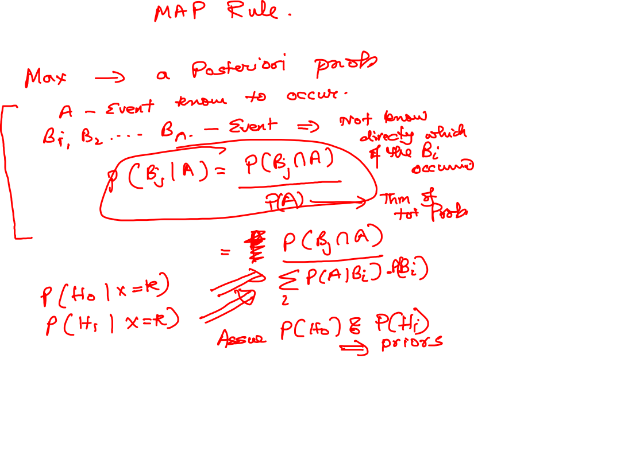

Slide 6
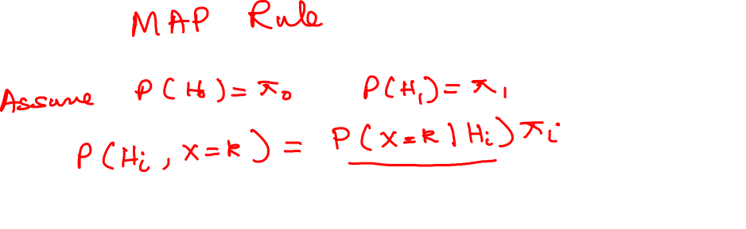

Slide 10
Likelihood Ratio Test (LRT)
A way to generalize the ML and MAP decision rules into a single framework is using LRT.
Define the likelihood ratio for each possible observation k as the ratio of the two conditional probabilities:
A decision rule can be expressed as an LRT with threshold :
If the threshold is increased, then there are fewer observations that lead to deciding is true.
As increases, decreases, and increases.

Slide 11
Likelihood Ratio Test (LRT) (Cont’d)
If the observation is X = k:
The ML rule declares hypothesis is true, if and otherwise it declares is true.
So the ML rule can be specified using an LRT with :
The MAP rule declares hypothesis is true, if and otherwise it declares is true.
So the MAP rule can be specified using an LRT with :
For uniform priors , MAP and ML decision rules are the same

Slide 12
Example 2: Discrete Case
Suppose you have a coin and you know that either:
  H1: the coin is biased, showing heads on each flip with probability 2/3; or
  H0: the coin is fair, showing heads and tails with probability 1/2
Suppose you flip the coin five times. Let X be the number of times heads shows.
Describe the ML and MAP decision rules using LRT.
Find , , and for both decision rules.
Use the prior probabilities .

Slide 13
Example 2 (Cont’d)
X (number of times that head shows up) has a binomial distribution with n = 5, and:
  p = 2/3 for (Coin is biased)
  p = 1/2 for (Coin is fair)
Remember for a binomial distribution:
So we have:
The rows of the likelihood matrix consist of the pmf of X:
 | X = 0 | X = 1 | X = 2 | X = 3 | X = 4 | X = 5

Slide 14
Example 2 (Cont’d)
In computing the likelihood ratio, the binomial coefficients cancel, so:
The ML decision rule is:
  Declare H₁ whenever , or equivalently
The MAP decision rule is:
  Declare H₁ whenever , or equivalently

Slide 15

Example 2 (Cont’d)
For the ML rule:
For the MAP rule:
As expected the probability of error ( ) for the MAP rule is smaller than
for the ML rule.
$$5$$

Slide 16

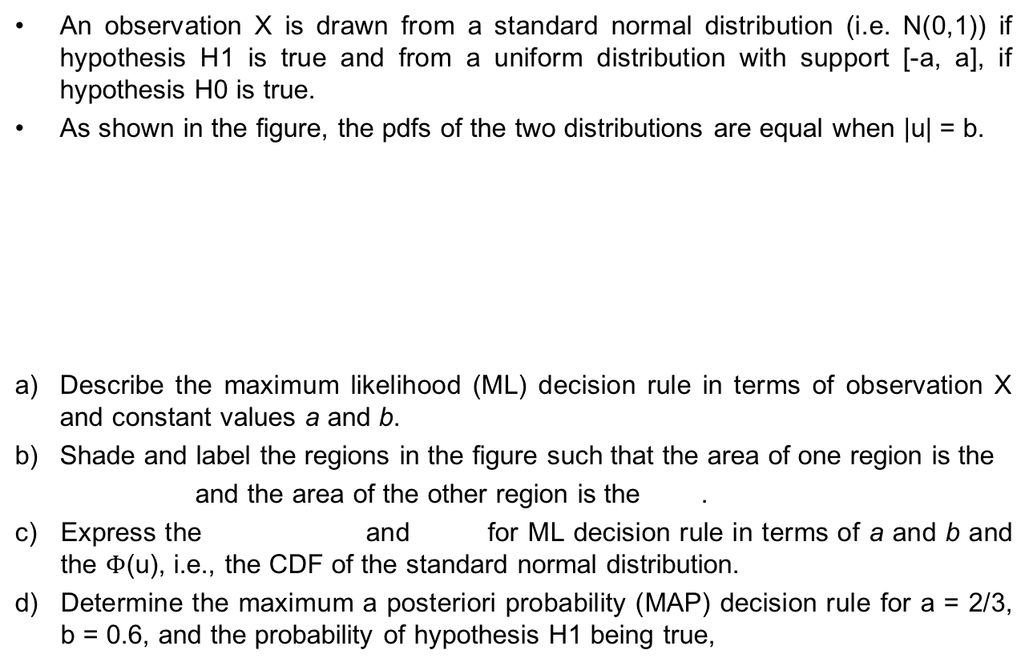
Example 3
An observation X is drawn from a standard normal distribution (i.e. N(0,1)) if hypothesis H1 is true and from a uniform distribution with support [-a, a], if hypothesis H0 is true.
As shown in the figure, the pdfs of the two distributions are equal when |u| = b.
Describe the maximum likelihood (ML) decision rule in terms of observation X and constant values a and b.
Shade and label the regions in the figure such that the area of one region is the
and the area of the other region is the .
Express the and for ML decision rule in terms of a and b and the $Φ$(u), i.e., the CDF of the standard normal distribution.
Determine the maximum a posteriori probability (MAP) decision rule for a = 2/3, b = 0.6, and the probability of hypothesis H1 being true,

Slide 17
Example 3 (Cont’d)

Slide 18
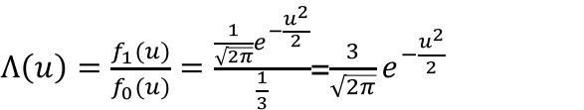
Example 3 (Cont’d)
$Λ\left(u\right)=\frac{f_{1}(u)}{f_{0}(u)}=\frac{\frac{1}{\sqrt{2π}}e^{−\frac{u^{2}}{2}}}{\frac{1}{3}}$=$\frac{3}{\sqrt{2π}}e^{−\frac{u^{2}}{2}}$

Slide 19
Conditional Probability Mass Function
Recall that for any two events E and F, the conditional probability of E given F is defined, as long as P(F) > 0, by:
Hence, if X and Y are discrete random variables, then the conditional probability mass function of X given that Y = y, is defined by:
for all values of y such that P{Y = y}>0.

Slide 20
Conditional CDF and Expectation
The conditional probability distribution function of X given Y =y is defined, for all y such that P{Y = y} > 0, by:
Finally, the conditional expectation of X given that Y = y is defined by:
All the definitions are exactly as before with the exception that everything is now conditional on the event that Y = y.
If X and Y are independent, then the conditional mass function, distribution, and expectation are the same as unconditional ones:

Slide 21
Conditional Probability Density Function
If X and Y have a joint probability density function f (x, y), then the conditional probability density function of X, given that Y = y, is defined for all values of y such that fY(y) > 0, by:
To motivate this definition, multiply the left side by dx and the right side by (dx dy)/dy to get:

