Slide 1
Binary Hypothesis Testing
ECE 313
Probability with Engineering Applications
Lecture 21
Professor Ravi K. Iyer
Dept. of Electrical and Computer Engineering
University of Illinois at Urbana Champaign

Slide 2
Today’s Topics
Introduction to Detection Rules
  Binary Hypothesis Testing:
    Maximum Likelihood (ML) Estimation
    Maximum a Posteriori Probability (MAP) Estimation
  Likelihood ratio tests
  Reference: ECE 313 Course Notes by Prof. Hajek, pages 59–65 and 138–143, available at:
  https://courses.engr.illinois.edu/ece313/fa2014/probabilityAug14.pdf
Announcements:
  Group activity on Hypothesis testing in class, next Wednesday April 19
    First progress meeting on the project coming up

Slide 6
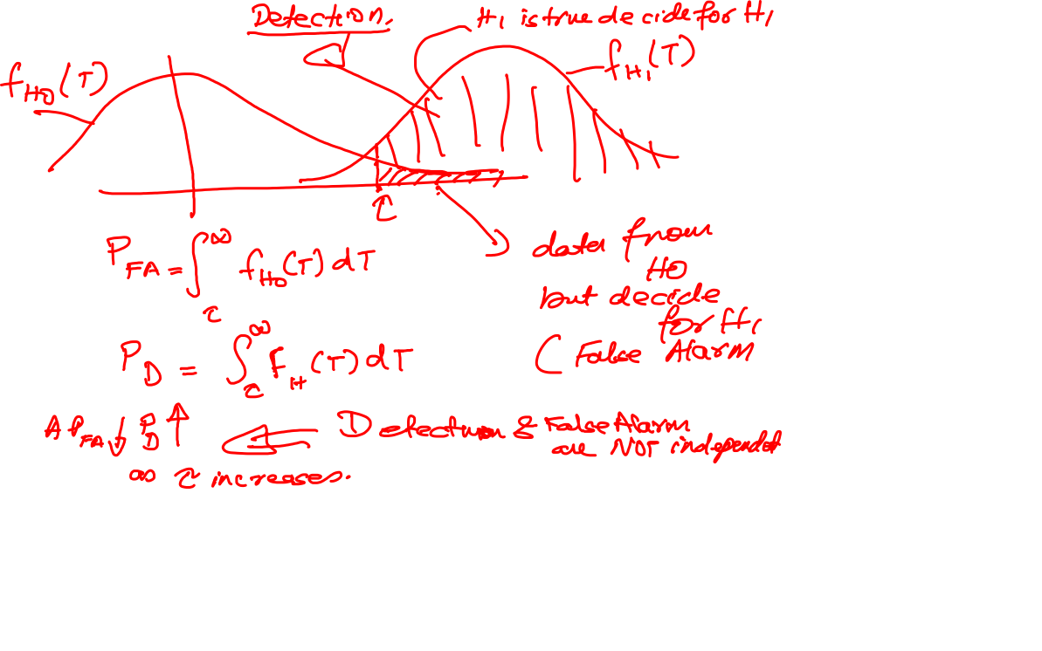

Slide 7
Binary Hypothesis Testing
In many practical problems we need to make decisions about on the basis of limited information contained in a sample.
For instance a system administrator may have to decide whether to upgrade the capacity of installation. The choice is binary in nature (e.g. an upgrade or not)
To arrive at a decision we often make assumptions or a guess (an assertion) about the nature of the underlying population or situation. Such an assertion which may or may not be valid is called a statistical hypothesis.
Procedures that enable us to decide whether to reject or accept hypotheses, based on the available information are called statistical tests.

Slide 8
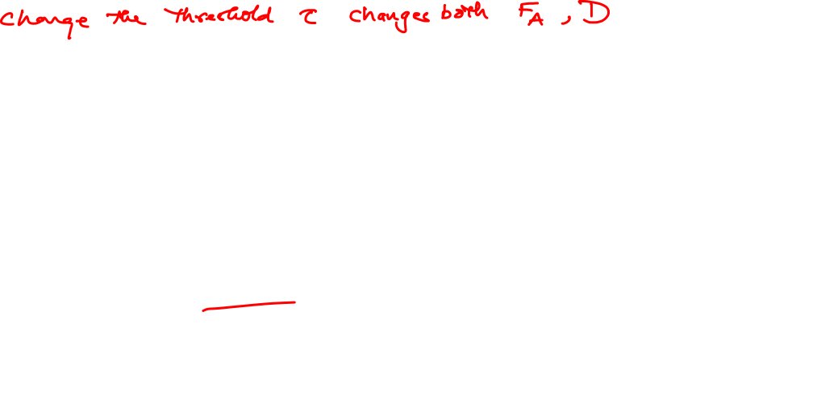
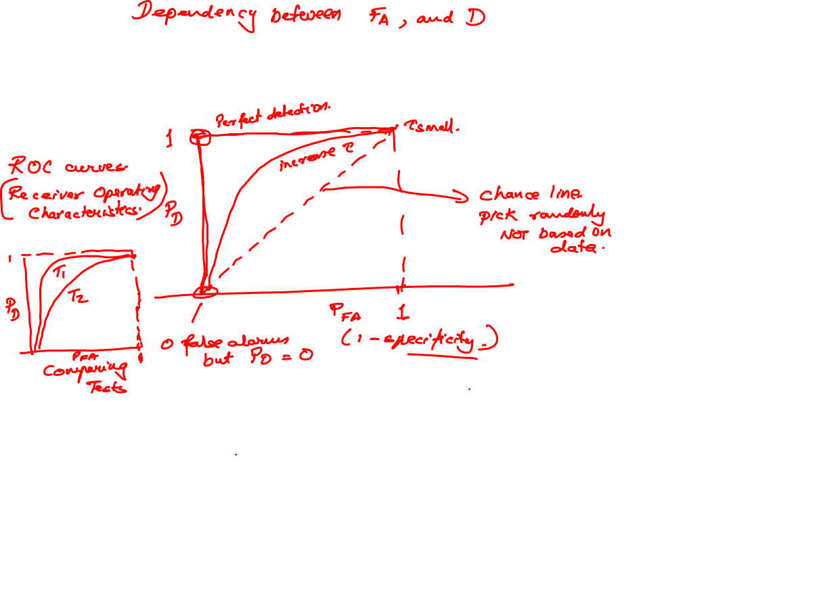

Slide 9
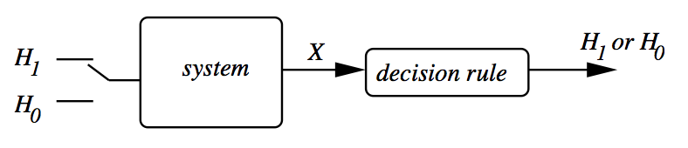
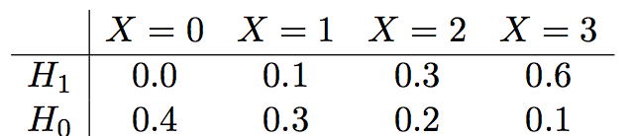
Binary Hypothesis Testing:
Basic Framework
Binary: Either hypothesis H₁ is true or hypothesis H₀ is true.
Based on which hypothesis is true, system generates a set of observations X.
We use the past observations and find the conditional probabilities of different patterns under each hypothesis:
  e.g. What is the probability of observing two abnormal spots (X = 2) given patient has a tumor (H1)?
Learning a decision rule
based on
past measurements
Previous Measurements
MRI Scan Machine
Images captured from brain when H1 or H0:
e.g. X = No. of abnormal spots in the image
H1: Patient has a tumor
H0: Patient doesn’t have a tumor

Slide 10
Binary Hypothesis Testing:
Basic Framework
Either hypothesis H₁ is true or hypothesis H₀ is true.
Based on which hypothesis is true, system generates a set of observations X.
We measure the past observations to learn the conditional probabilities of different patterns under each hypothesis:
  e.g. What is the probability of observing two abnormal spots (X = 2) if patient has a tumor (H1)?
Next we formulate a decision rule that is then used to determine whether H₁ or H₀ is true for new measurements.
Note that the system has uncertainty or the features are not the best, so the decision rule can sometimes declare a true hypothesis, or it can make an error
formulate a decision rule
based on
past measurements
Training
Previous Measurements
Testing
New Measurements

Slide 11
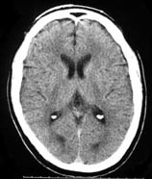



Example 1
Suppose the data is from a computer aided tomography (CAT) scan system, and the hypotheses are:
  H₁: A tumor is present
  H₀: No tumor is present
We model the number of abnormal spots observed
in the image by a discrete random variable X.
Suppose:
  If hypothesis H₁ is true (given), then X has pmf p₁
  If hypothesis H₀ is true (given), then X has pmf p₀
Note that p1 and p0 are conditional pmf’s, described by a likelihood Matrix
P (X = k | H1) =>
Given a tumor, what is the probability of observing 3 spots
P (X = k | H0) =>

Slide 12
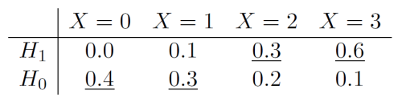
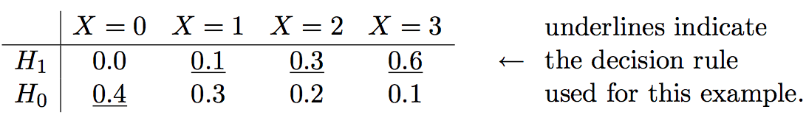
Example 1: Decision Rule
A decision rule specifies for each possible observation (each of the possible values of X), which hypothesis is declared.
Typically a decision rule is described using a likelihood matrix. Here we underline one entry in each column, to specify which hypothesis is to be declared for each possible value of X.
Exampl:e: A probability-based decision rule: H1 is declared when the probability of an observation given hypothesis H1 is higher than its probability given H0:
Example intuitive decision rule: H₁ is declared whenever X ≥ 1 :
If we observe X = 2,3 in the new measurements,
H1 (tumor) is declared, otherwise H0 (no tumor).
Declare H0
Declare H1

Slide 13
Binary Hypothesis Testing
In a binary hypothesis testing problem, there are two possibilities for which the hypothesis is true, and two possibilities for which hypothesis is declared:
    H₀ = Negative or null hypothesis,
    H₁ = Positive or alternative hypothesis
So there are four possible outcomes:
  H₁ is declared given Hypothesis H₁ is true. => True Positive
  H₁ is declared given Hypothesis H₀ is true. => False Positive
                (False Alarm)
  H₀ is declared given Hypothesis H₀ is true. => True Negative
  H₀ is declared given Hypothesis H₁ is true. => False Negative
  (Miss Detection)

Slide 14

Probability of False Alarm and Miss
Two conditional probabilities are defined:
is the sum of entries in the H₀ row of the likelihood matrix that are not underlined:
is the sum of entries in the H₁ row of the likelihood matrix that are not underlined:
=> Type I Error
=> Type II Error

Slide 15
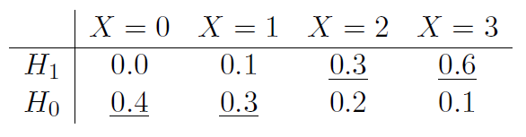
Decision Rule
If we modify the sample decision rule in the previous example to declare H₁ when X = 1:
Then the will decrease to:
The will increase to:
So what decision rule should be used?
  Trade-off between the two types of error probabilities
  Evaluate the pair of conditional error probabilities for multiple decision rules and then make a final selection

Slide 16
Maximum Likelihood (ML) Decision Rule
Maximum likelihood (ML) decision rule declares the hypothesis that maximizes the probability (likelihood) of the observation
ML decision rule is based on likelihood matrix, the matrix of conditional probabilities of
The sum of elements in each row of the likelihood matrix is one.
ML decision rule is specified by underlining the larger entry in each column of likelihood matrix.
If the entries in a column are identical, then either can be underlined.

Slide 17
Maximum a posteriori probability (MAP) Decision Rule
Maximum a-posteriori probability (MAP) decision rule declares the hypothesis which maximizes the posteriori probabilities
A Posteriori probability is a conditional probability that an observer would declare a hypothesis, given an observation k:
So given an observation X = k, the MAP decision rule chooses the hypothesis with the larger posteriori probability
The posteriori probabilities are unknown, so we use Bayes’ formula to calculate them.

Slide 18
Maximum a posteriori probability (MAP) Decision Rule (Cont’d)
So the MAP decision rule requires the computation of the joint probabilities:
But we have:
  from the likelihood matrix
  which are called the prior probabilities.
  The prior probabilities are determined independent of the experiment and prior to any observation is made.

Slide 19
Maximum a posteriori probability (MAP) Decision Rule (Cont’d)
Let’s assume,
We apply the Bayes rule to calculate the joint probabilities
as follows:

Slide 20
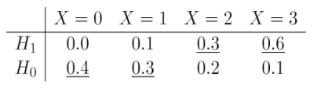
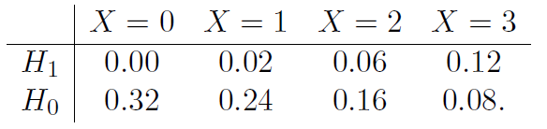
Maximum a posteriori probability (MAP) Decision Rule (Cont’d)
MAP decision rule creates a joint probability matrix: this is a matrix of the joint probabilities of , (just calculated).
Each row in the joint probability matrix is times the corresponding row of the likelihood matrix.
The sum of entries in row is , and the some of all the entries in the matrix is one.

Slide 21
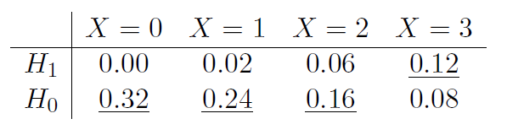
Maximum a posteriori probability (MAP) Decision Rule (Cont’d)
Remember : ,
So the posterior probability can be computed by dividing the value in the row , column , divided by the sum of entries in the column .
Since the denominators for both are the same (both equal to ), we only need to compare the numerator (joint probabilities of )
MAP decision rule is specified by underlying the larger entry in each column of the joint probability matrix.
If the entries in a column are identical, then either can be underlined.

Slide 22
Average Error Probability
Remember the conditional probabilities of:
The average error probability is defined as:
is the sum of entries in the H₀ row of the likelihood matrix, (joint probability matrix) that are not underlined (divided by )
is the sum of entries in the H₀ row of the likelihood matrix, (joint probability matrix) that are not underlined (divided by )
is the sum of all the entries in the joint probability matrix that are not underlined.
Among all decision rules, MAP is the one that minimizes =>Optimal

Slide 23
Likelihood Ratio Test (LRT)
A way to generalize the ML and MAP decision rules into a single framework is using LRT.
Define the likelihood ratio for each possible observation k as the ratio of the two conditional probabilities:
A decision rule can be expressed as an LRT with threshold :
If the threshold is increased, then there are fewer observations that lead to deciding is true.
As increases, decreases, and increases.

Slide 24
Likelihood Ratio Test (LRT) (Cont’d)
If the observation is X = k:
The ML rule declares hypothesis is true, if and otherwise it declares is true.
So the ML rule can be specified using an LRT with :
The MAP rule declares hypothesis is true, if and otherwise it declares is true.
So the MAP rule can be specified using an LRT with :
For uniform priors , MAP and ML decision rules are the same

Slide 25
Example 2: Discrete Case
Suppose you have a coin and you know that either:
  H1: the coin is biased, showing heads on each flip with probability 2/3; or
  H0: the coin is fair, showing heads and tails with probability 1/2
Suppose you flip the coin five times. Let X be the number of times heads shows.
Describe the ML and MAP decision rules using LRT.
Find , , and for both decision rules.
Use the prior probabilities of .

Slide 26
Example 2 (Cont’d)
X (number of times that head shows up) has a binomial distribution with n = 5, and:
  p = 2/3 for (Coin is biased)
  p = 1/2 for (Coin is fair)
Remember for a binomial distribution:
So we have:
The rows of the likelihood matrix consist of the pmf of X:
 | X = 0 | X = 1 | X = 2 | X = 3 | X = 4 | X = 5

Slide 27
Example 2 (Cont’d)
In computing the likelihood ratio, the binomial coefficients cancel, so:
The ML decision rule is:
  Declare H₁ whenever , or equivalently
The MAP decision rule is:
  Declare H₁ whenever , or equivalently

Slide 28
Example 2 (Cont’d)
For the ML rule:
For the MAP rule:
As expected the probability of error ( ) for the MAP rule is smaller than
for the ML rule.

Slide 29

Example 3
An observation X is drawn from a standard normal distribution (i.e. N(0,1)) if hypothesis H1 is true and from a uniform distribution with support [-a, a], if hypothesis H0 is true.
As shown in the figure, the pdfs of the two distributions are equal when |u| = b.
Describe the maximum likelihood (ML) decision rule in terms of observation X and constant values a and b.
Shade and label the regions in the figure such that the area of one region is the
and the area of the other region is the .
Express the and for ML decision rule in terms of a and b and the (u) function of the standard normal distribution.
Determine the maximum a posteriori probability (MAP) decision rule for a = 2/3, b = 0.6, and the probability of hypothesis H1 being true,

Slide 30
Example 3 (Cont’d)

Slide 31
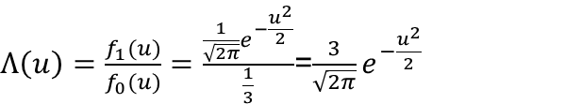
Example 3 (Cont’d)
$Λ\left(u\right)=\frac{f_{1}(u)}{f_{0}(u)}=\frac{\frac{1}{\sqrt{2π}}e^{−\frac{u^{2}}{2}}}{\frac{1}{3}}$=$\frac{3}{\sqrt{2π}}e^{−\frac{u^{2}}{2}}$

