Slide 1
Independence of Random Variables, Covariance, and Correlation
ECE 313
Probability with Engineering Applications
Lecture 20
Ravi K. Iyer
Dept. of Electrical and Computer Engineering
University of Illinois at Urbana Champaign

Slide 2
Today’s Topics and Announcements
Joint Distribution Functions review of concepts
Conditional Distributions
Independence of Random Variables
Covariance and Correlation
Announcements:
  Group activity in the class, next Week,.
  Final project will be released Monday
    Concepts: Hypothesis testing, Joint distributions, Independence, Covariance and correlation
    Project schedules on Compass and Piazza

Slide 3

Joint Distribution Functions
We have concerned ourselves with the probability distribution of a single random variable
Often interested in probability statements concerning two or more random variables
Define, for any two random variables X and Y, the joint cumulative probability distribution function of X and Y by
The distribution of X (Marginal Distribution)can be obtained from the joint distribution of X and Y as follows:

Slide 4

Joint Distribution Functions Cont’d
Similarly,
Where X and Y are both discrete random variables - define the joint probability mass function (joint pmf) of X and Y by
Probability mass function of X

Slide 5

Joint Distribution Functions Cont’d
If X and Y are jointly continuous defined for all real x and y, then
f(x,y) Called the joint probability density function of X and Y .
Marginal probability density of X:
is the probability density function of X.
The probability density function of Y is
because:

Slide 6
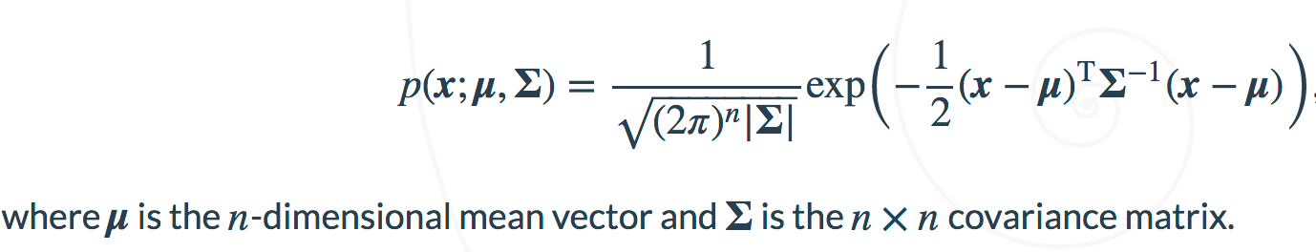

Example: Bivariate normal distribution
Visualizing multivariate normal distribution of an n-dimensional vector x
Example: bivariate normal distribution
  n = 2
  $μ=\left[−1, 1\right]$
  $Σ=\left[\begin{matrix}1 & −0.5 \\ −.5 & 1\end{matrix}\right]$

Slide 7
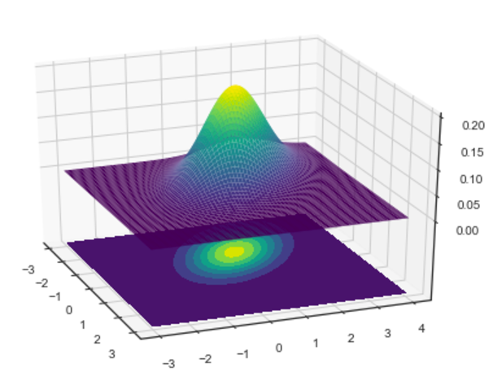
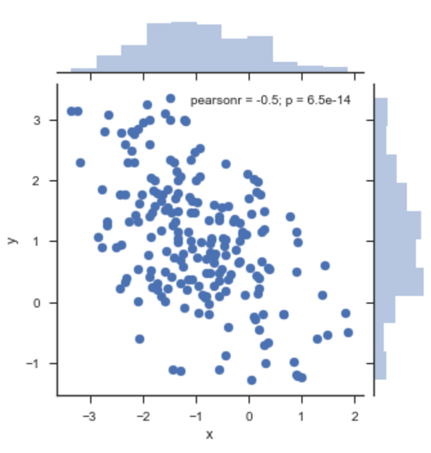

Example: Bivariate normal distribution
  n = 2
  $μ=\left[−1, 1\right]$
  $Σ=\left[\begin{matrix}1 & −0.5 \\ −.5 & 1\end{matrix}\right]$
2-D scatter plot of 200 samples
from the bivariate normal distribution
3-D plot of 200 samples
from the bivariate normal distribution
Notes:
http://seaborn.pydata.org/tutorial/distributions.html
http://scipython.com/blog/visualizing-the-bivariate-gaussian-distribution/

Slide 8
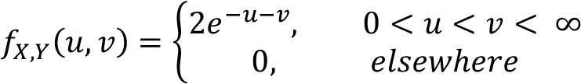
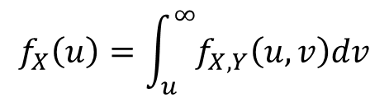
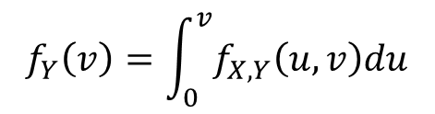
Example - Joint Distribution Functions
The jointly continuous random variable X and Y have joint pdf
v
v = u
u

Slide 9
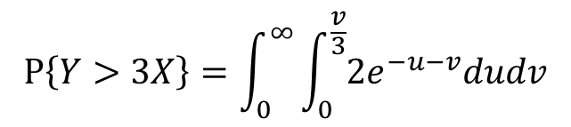

Example - Joint Distribution Functions
The jointly continuous random variable X and Y have joint pdf
Find P[Y > 3X]
v = 3u
v
v = u
u

Slide 10
Joint Distribution Functions Cont’d
Proposition: if X and Y are random variables and g is a function of two variables, then
For example, if g(X,Y)=X+Y, then, in the continuous case

Slide 11

Joint Distribution Functions Cont’d
Where the first integral is evaluated by using the foregoing Proposition with g(x,y)=x and the second with g(x,y)=y
In the discrete case
Joint probability distributions may also be defined for n random variables. If are n random variables, then for any n constants

Slide 12
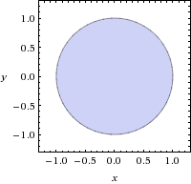
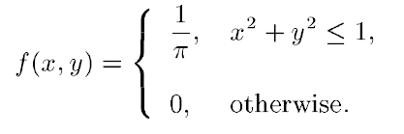
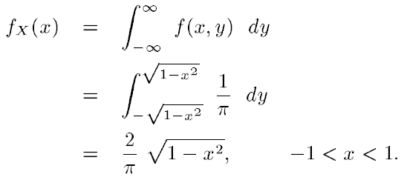

Example 2
Let X and Y have joint pdf
Determine the marginal pdfs of X and Y. Are X and Y independent?

Slide 13


Example 2 (Cont’d)
Similarly,
So clearly,

Slide 14
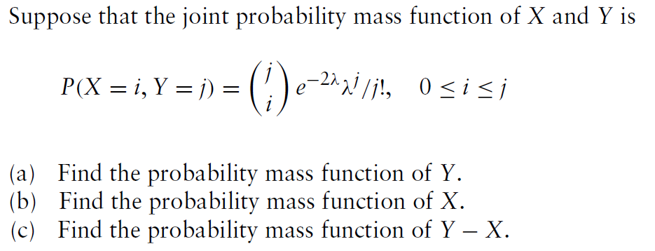

Example 3

Slide 15
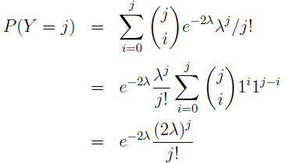
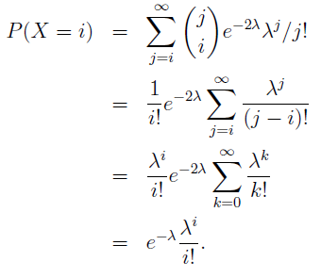
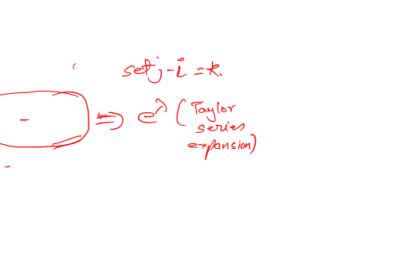
Example 3 (Cont’d)
Marginal PDF of Y:
Marginal PDF of X:

Slide 16
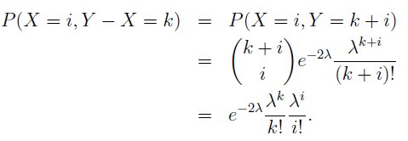
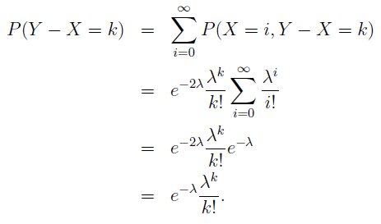
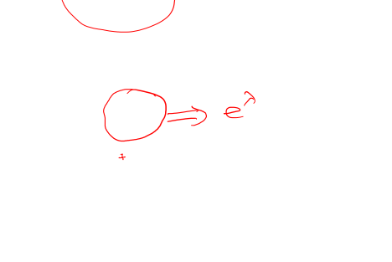
Example 3 (Cont’d)
We first calculate the joint density function of X and Y-X
Then summing up with respect to i, we get the marginal distribution of Y – X, which is for k:

Slide 17
Conditional Probability Mass Function
Recall that for any two events E and F, the conditional probability of E given F is defined, as long as P(F) > 0, by:
Hence, if X and Y are discrete random variables, then the conditional probability mass function of X given that Y = y, is defined by:
for all values of y such that P{Y = y}>0.

Slide 18

Conditional CDF and Expectation
The conditional probability distribution function of X given Y =y is defined, for all y such that P{Y = y} > 0, by:
Finally, the conditional expectation of X given that Y = y is defined by:
All the definitions are exactly as before with the exception that everything is now conditional on the event that Y = y.
If X and Y are independent, then the conditional mass function, distribution, and expectation are the same as unconditional ones:

Slide 19

Conditional Probability Density Function
If X and Y have a joint probability density function f (x, y), then the conditional probability density function of X, given that Y = y, is defined for all values of y such that fY(y) > 0, by:
To motivate this definition, multiply the left side by dx and the right side by (dx dy)/dy to get:

Slide 20
Binary Hypothesis Testing
In many practical problems we need to make decisions about on the basis of limited information contained in a sample.
For instance a system administrator may have to decide whether to upgrade the capacity of installation. The choice is binary in nature (e.g. an upgrade or not)
To arrive at a decision we often make assumptions or a guess (an assertion) about the nature of the underlying population or situation. Such an assertion which may or may not be valid is called a statistical hypothesis.
Procedures that enable us to decide whether to reject or accept hypotheses, based on the available information are called statistical tests.

Slide 21
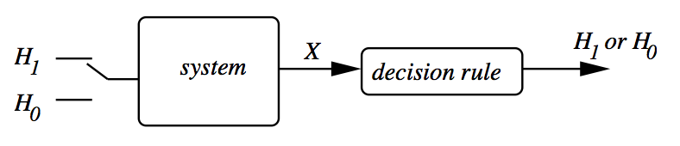
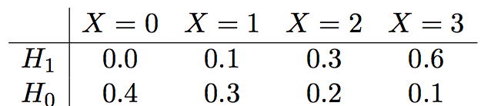
Binary Hypothesis Testing:
Basic Framework
Binary: Either hypothesis H₁ is true or hypothesis H₀ is true.
Based on which hypothesis is true, system generates a set of observations X.
We use the past observations and find the conditional probabilities of different patterns under each hypothesis:
  e.g. What is the probability of observing two abnormal spots (X = 2) given patient has a tumor (H1)?
Learning a decision rule
based on
past measurements
Previous Measurements
MRI Scan Machine
Images captured from brain when H1 or H0:
e.g. X = No. of abnormal spots in the image
H1: Patient has a tumor
H0: Patient doesn’t have a tumor

Slide 22
Binary Hypothesis Testing:
Basic Framework
Either hypothesis H₁ is true or hypothesis H₀ is true.
Based on which hypothesis is true, system generates a set of observations X.
We measure the past observations to learn the conditional probabilities of different patterns under each hypothesis:
  e.g. What is the probability of observing two abnormal spots (X = 2) if patient has a tumor (H1)?
Next we formulate a decision rule that is then used to determine whether H₁ or H₀ is true for new measurements.
Note that the system has uncertainty or the features are not the best, so the decision rule can sometimes declare a true hypothesis, or it can make an error
formulate a decision rule
based on
past measurements
Training
Previous Measurements
Testing
New Measurements

Slide 23
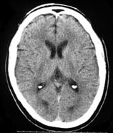
Example 1
Suppose the data is from a computer aided tomography (CAT) scan system, and the hypotheses are:
  H₁: A tumor is present
  H₀: No tumor is present
We model the number of abnormal spots observed
in the image by a discrete random variable X.
Suppose:
  If hypothesis H₁ is true (given), then X has pmf p₁
  If hypothesis H₀ is true (given), then X has pmf p₀
Note that p1 and p0 are conditional pmf’s, described by a likelihood Matrix
P (X = k | H1) =>
Given a tumor, what is the probability of observing 3 spots
P (X = k | H0) =>

Slide 24
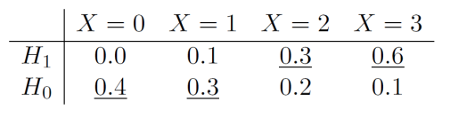
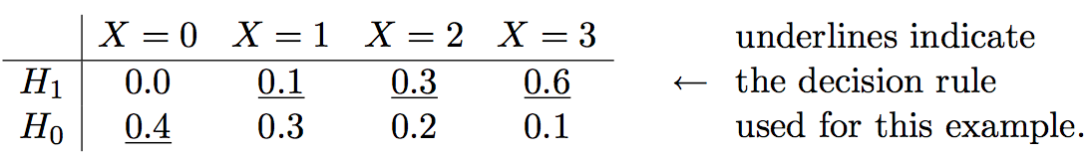
Example 1: Decision Rule
A decision rule specifies for each possible observation (each of the possible values of X), which hypothesis is declared.
Typically a decision rule is described using a likelihood matrix. Here we underline one entry in each column, to specify which hypothesis is to be declared for each possible value of X.
Exampl:e: A probability-based decision rule: H1 is declared when the probability of an observation given hypothesis H1 is higher than its probability given H0:
Example intuitive decision rule: H₁ is declared whenever X ≥ 1 :
If we observe X = 2,3 in the new measurements,
H1 (tumor) is declared, otherwise H0 (no tumor).
Declare H0
Declare H1

Slide 25
Binary Hypothesis Testing
In a binary hypothesis testing problem, there are two possibilities for which the hypothesis is true, and two possibilities for which hypothesis is declared:
    H₀ = Negative or null hypothesis,
    H₁ = Positive or alternative hypothesis
So there are four possible outcomes:
  H₁ is declared given Hypothesis H₁ is true. => True Positive
  H₁ is declared given Hypothesis H₀ is true. => False Positive
                (False Alarm)
  H₀ is declared given Hypothesis H₀ is true. => True Negative
  H₀ is declared given Hypothesis H₁ is true. => False Negative
  (Miss Detection)

Slide 26
Probability of False Alarm and Miss
Two conditional probabilities are defined:
is the sum of entries in the H₀ row of the likelihood matrix that are not underlined:
is the sum of entries in the H₁ row of the likelihood matrix that are not underlined:
=> Type I Error
=> Type II Error

Slide 27
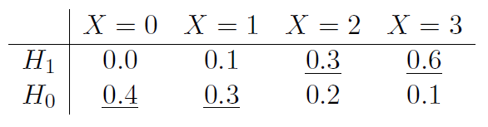
Decision Rule
If we modify the sample decision rule in the previous example to declare H₁ when X = 1:
Then the will decrease to:
The will increase to:
So what decision rule should be used?
  Trade-off between the two types of error probabilities
  Evaluate the pair of conditional error probabilities for multiple decision rules and then make a final selection

