Slide 1
Expectations of Random Variables,
Functions of Random Variables
ECE 313
Probability with Engineering Applications
Lecture 17
Ravi K. Iyer
Dept. of Electrical and Computer Engineering
University of Illinois at Urbana Champaign

Slide 2
Today’s Topics
Expectation and Variance
  Moments: Mean and Variance
  Functions of Random Variables
Reliability Function--- deriving the mean and varince
Announcements
  Homework 7 due Wednesday.
  Group activity on Hypo-exponentials, Erlang and Hyper-Exponentials, c Pl read the class notes and examples
  Mini Project 2 graded waiting for you to submit individual contributions
  Final mini-project will be announced next week

Slide 4
Moments of a Distribution
Let X be a random variable, and define another random variable Y as a function of X so that Suppose that we wish to compute E[Y]
(provided the sum or the integral on the right-hand side is absolutely convergent). A special case of interest is the power function
For k=1,2,3,…, is known as the kth moment of the random variable X. Note that the first moment is the ordinary expectation or the mean of X.
We define the kth central moment, of the random variable X by
Known as the variance of X, Var[X], often denoted by
The variance of a random variable X is
Var[X] is always a nonnegative number.

Slide 5
Variance: 2nd Central Moment
We define the kth central moment, of the random variable X by
σ known as the variance of X, Var[X], often denoted by
Definition (Variance). The variance of a random variable X is
It is clear that Var[X] is always a nonnegative number.

Slide 6
Variance of a Random Variable
Suppose that X is continuous with density f, let . Then,
So we obtain the useful identity:

Slide 7
Variance of Normal Random Variable
Let X be normally distributed with parameters and . Find Var(X).
Recalling that , we have that:
Substituting yields:
Integrating by parts ( ) gives:

Slide 8
Variance of Exponential Distribution
From this, we determine the following proof:
From this point, we need to use integration by parts to solve this equation:
Now we can use the integration by parts formula to continue solving:

Slide 9
Variance of Exponential Distribution (cont.)
Now, we need to determine E(x²) so we can calculate the variance:
Again, integration by parts again:
Note

Slide 10
Variance of Exponential Distribution (cont.)
Now that we have found and we can substitute
them into the equation to find the following

Slide 11
Variance of Exponential Distribution (cont.)
Now that we have found and we can substitute
them into the equation to find the following

Slide 12
Functions of a Random Variable
Let As an example, X could denote the measurement error in a certain physical experiment and Y would then be the square of the error (e.g. method of least squares).
Note that

Slide 13
Functions of a Random Variable (cont.)
Let X have the standard normal distribution [N(0,1)] so that
This is a chi-squared distribution with one degree of freedom

Slide 14
Functions of a Random Variable (cont.)
Generating Exponential Random Numbers
Let X be uniformly distributed on (0,1). We show that
has an exponential distribution with parameter Note: Y is a nonnegative random variable:
This fact can be used in a distribution-driven simulation. In simulation programs it is important to be able to generate values of variables with known distribution functions. Such values are known as random deviates or random variates. Most computer systems provide built-in functions to generate random deviates from the uniform distribution over (0,1), say u. Such random deviates are called random numbers.

Slide 15
Example 1
Let X be uniformly distributed on (0,1). We obtain the cumulative distribution function (CDF) of the random variable Y, defined by Y = X^{n} as follows: for
Now, the probability density function (PDF) of Y is given by

Slide 16
Expectation of a Function of a Random Variable
Given a random variable X and its probability distribution or its pmf/pdf
We are interested in calculating not the expected value of X, but the expected value of some function of X, say, g(X).
One way: since g(X) is itself a random variable, it must have a probability distribution, which should be computable from a knowledge of the distribution of X. Once we have obtained the distribution of g(X), we can then compute E[g(X)] by the definition of the expectation.
Example 1: Suppose X has the following probability mass function:
Calculate E[X²].
Letting Y=X²,we have that Y is a random variable that can take on one of the values, 0², 1², 2² with respective probabilities

Slide 17
Expectation of a Function of a Random Variable (cont.)
Proposition 2: (a) If X is a discrete random variable with probability mass function p(x), then for any real-valued function g,
(b) if X is a continuous random variable with probability density function f(x), then for any real-valued function g:
Example 3, Applying the proposition to Example 1 yields
Example 4, Applying the proposition to Example 2 yields

Slide 18
Corollary
If a and b are constants, then
The discrete case:
The continuous case:

Slide 19
The Reliability Function
Let the random variable X be the lifetime or the time to failure of a component. The probability that the component survives until some time t is called the reliability R(t) of the component:
where F is the CDF (Failure) of the component lifetime, X.
The component is assumed to be working properly at time t=0 and no component can work forever without failure:
i.e.
R(t) is a monotone non-increasing function of t.
For t less than zero, reliability has no meaning, but: sometimes we let R(t)=1 for t<0. F(t) is also called the unreliability.

Slide 20
The Reliability Function (Cont’d)
In the limit as N₀→∞ , we expect (survival) to approach R(t). As the test progresses, N_{s}(t) gets smaller and R(t) decreases.

Slide 21
The Reliability Function (Cont’d)
Consider a fixed number of identical components, N₀, under test.
After time t, N_{f}(t) components have failed and N_{s}(t) components have survived
The estimated probability of survival:

Slide 22
The Reliability Function (Cont’d)
(N₀ is constant, while the number of failed components N_{f} increases with time.)
Taking derivatives:
N’_{f}(t) is the rate at which components fail
As , the right hand side may be interpreted as the negative of the failure density function,
Note: is the (unconditional) probability that a component will fail in the interval

Slide 23
Time to Failure and Reliability Function
Let T denote the time to failure or lifetime of a component in the system, and f(t) and F(t) denote the probability density function and cumulative distribution function of T, respectively.
f(t) represents the y probability density of failure at time t
The probability that the component will fail at or before time t is given by:
And the reliability of the component is equal to the probability that it will survive at least until time t, given by:
So we have:
Note: is the (unconditional) probability that a component will fail in the interval

Slide 24
Mean Time to Failure (MTTF)
The expected life or the mean time to failure (MTTF) of the component is given by:
Integrating by parts we obtain:
Now, since R(t) approaches zero faster than t approaches ∞, we have:

Slide 25
Exponentially Distributed Lifetime
If the component lifetime is exponentially distributed, then:
And:

Slide 26
Standby Redundancy
A standby system is one in which two components are connected in parallel, but only one component is required to be operative for the system to function properly.
Initially the power is applied to only one component and the other component is kept in a powered-off state (de-energized).
When the energized component fails, it is de-energized and removed from operation, and the second component is energized and connected in the former’s place.
If we assume that the first component fails at some time τ, then the second component’s lifetime starts at time τ and assuming that it fails at time t, its lifetime will be t – τ:
t - τ
t = 0 τ t > τ

Slide 27
Standby Redundancy (Cont’d)
If we assume that the time to failure of the components is exponentially distributed with parameters λ₁ and λ_{2,} then the probability density function for the failure of the first component is:
Given that the first component must fail for the lifetime of the second component to start, the density function of the lifetime of the second component is conditional, given by:
Then we define the system failure as a function of t and , using the definition of conditional probability:

Slide 28
Standby Redundancy (Cont’d)
The associated marginal density function of is:
So the system failure will be:
And the reliability function will be:

Slide 29
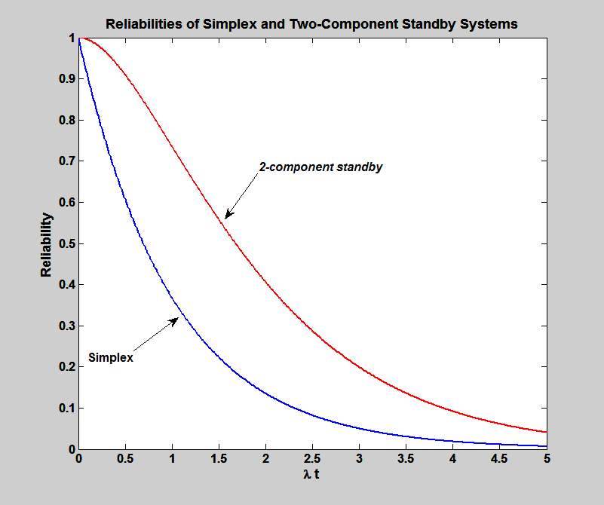
Standby Redundancy (Cont’d)

Slide 30
Instantaneous Failure Rate or Hazard Rate
Hazard measures the conditional probability of a failure given the system is currently working.
The failure density (pdf) measures the overall speed of failures
The Hazard/Instantaneous Failure Rate measures the dynamic (instantaneous) speed of failures.
To understand the hazard function we need to review conditional probability and conditional density functions (very similar concepts)

Slide 31
Review of Joint and Conditional Density Functions
We define the joint density function for two continuous random variables X and Y by:
The cumulative distribution function associated with this density function is given by:

Slide 32
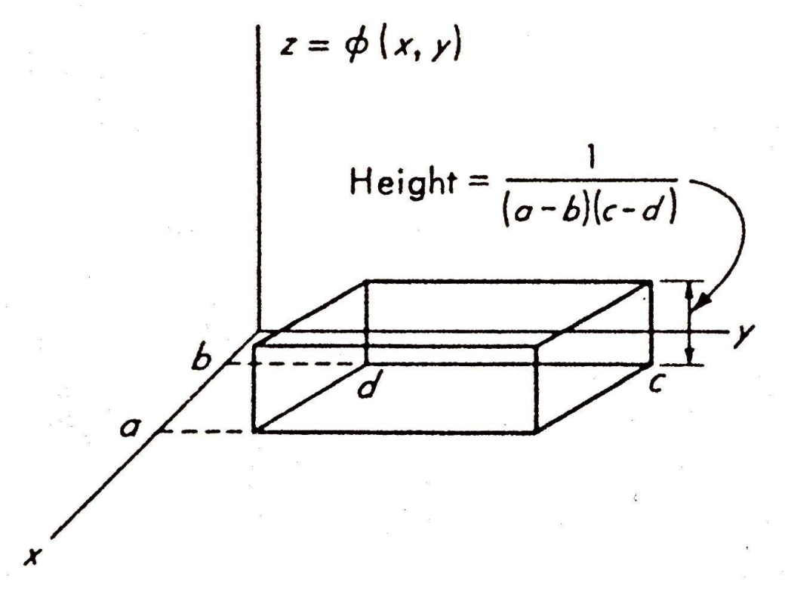
Parallelepiped Density Function
A parallelepiped density function is shown below:
The probability that
and is given by:

Slide 33
Review of Joint and Conditional
Density Functions (Cont’d)
Now if we associate random variable X with A and random variable Y with B then,
Thus joint probability
Remember random variables X and Y are independent if their joint density function is the product of the two marginal density functions.

Slide 34
Review of Joint and Conditional
Density Functions (Cont’d)
If events A and B are not independent, we must deal with dependent or conditional probabilities. Recall the following relations
We can express conditional probability in terms of the random variables X and Y
The left-hand side defines the conditional density function for y given x, which is written as

Slide 35
Review of Joint and Conditional
Density Functions (Cont’d)
Similarly, the conditional density function for x given y is
Now we use this to determine hazard function as a conditional density function

Slide 36
Hazard Function
The time to failure of a component is the random variable T. Therefore the failure density function is defined by
Sometimes it is more convenient to deal with the probability of failure between time t and t+dt, given that there were no failures up to time t. The probability expression becomes
(a)
where

Slide 37
Hazard Function
The conditional probability on the left side (a) gives rise to the conditional probability function z(t) defined by
(b)
The conditional function is generally called the hazard. Combining (a) and (b):
The main reason for defining the z(t) function is that it is often more convenient to work with than f(t).

Slide 38
Hazard Function
For example, suppose that f(t) is an exponential distribution, the most common failure density one deals with in reliability work.
Thus, an exponential failure density corresponds to a constant hazard function.
What are the implications of this result?

Slide 39
Instantaneous Failure Rate
If we know for certain that the component was functioning up to time t, the (conditional) probability of its failure in the interval will (in general) be different from
This leads to the notion of “Instantaneous failure rate.” the conditional probability that the component does not survive for an (additional) interval of duration x given that it has survived until time t can be written as:

Slide 40
Instantaneous Failure Rate (Cont’d)
Definition: The instantaneous failure rate h(t) at time t is defined to be:
so that:
h(t)∆t represents the conditional probability that a component surviving to age t will fail in the interval (t,t+∆t).
The exponential distribution is characterized by a constant instantaneous failure rate:

Slide 41
Instantaneous Failure Rate (Cont’d)
Integrating both sides of the equation:
(Using the boundary condition, R(0)=1) Hence:

Slide 42
Cumulative Hazard
The cumulative failure rate, , is referred to as the cumulative hazard.
gives a useful theoretical representation of reliability as a function of the failure rate.
An alternate representation gives the reliability in terms of cumulative hazard:
If the lifetime is exponentially distributed, then and we obtain the exponential reliability function.
(Using the boundary condition, R(0)=1) Hence:

Slide 43
f(t) and h(t)
f(t)∆t is the unconditional probability that the component will fail in the interval (t,t+ ∆t]
h(t) ∆t is the conditional probability that the component will fail in the same time interval, given that it has survived until time t.
h(t) is always greater than or equal to f(t), because R(t)≤1.
f(t) is a probability density. h(t) is not.
[h(t)] is the failure rate
[f(t)] is the failure density.
To further see the difference, we need the notion of conditional probability density.

Slide 44
Failure Rate as a Function of Time

Slide 45
Constraints on f(t) and z(t)

