Slide 1
Expectations of Random Variables,
Functions of Random Variables
ECE 313
Probability with Engineering Applications
Lecture 16
Ravi K. Iyer
Dept. of Electrical and Computer Engineering
University of Illinois at Urbana Champaign

Slide 2
Today’s Topics
review hypo, Erlang and Hyper Exponential distributions
Expectations
  Expectations of important random variables
  - Short quiz
Announcements
  Homework 7.
  Based on your Midterm exam, individual problems are assigned to you to solve. Checkout Compass.
  Midterm regrades. Submit today
  a brief concept quiz
  Mini Project 2 grades posted this week
  Final project dates will be announced soon

Slide 3
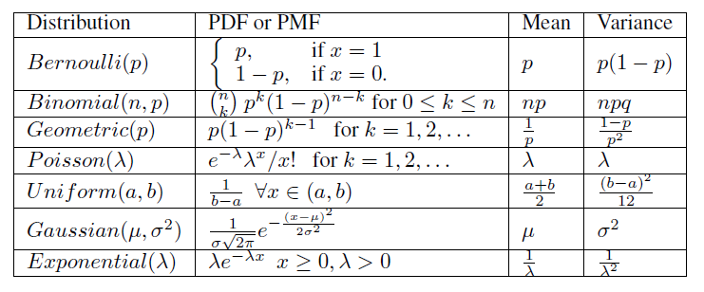




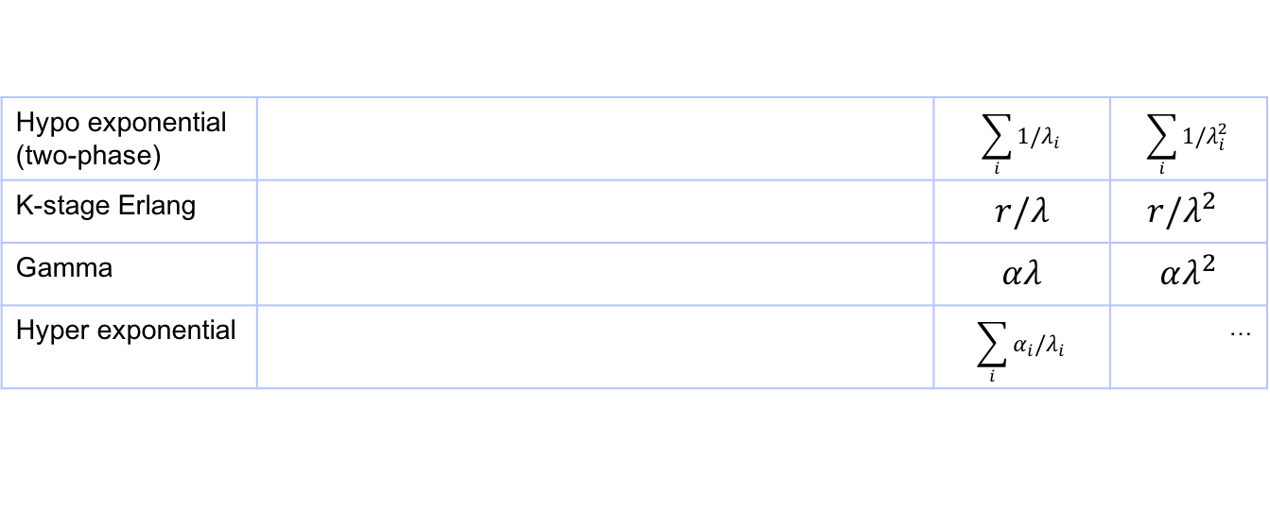
Summary of important distributions
Hypo exponential (two-phase) |  | $$\sum_{i}{1/λ_{i}}$$ | $$\sum_{i}{1/λ_{i}^{2}}$$
K-stage Erlang |  | $r/λ$ | $r/λ^{2}$
Gamma |  | $$αλ$$ | $$αλ^{2}$$
Hyper exponential |  | $$\sum_{i}{α_{i}/λ_{i}}$$ | …

Slide 4
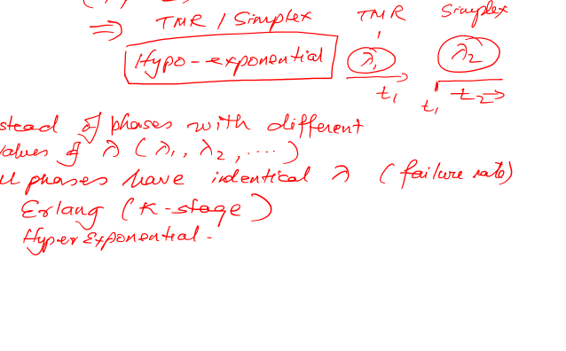
Exponential & related Distributions

Slide 5

Expectation of a Random Variable
The Discrete Case: If X is a discrete random variable having a probability mass function p(x), then the expected value of X is defined by
  The expected value of X is a weighted average of the possible values that X can take on, each value being weighted by the probability that X assumes that value. For example, if the probability mass function of X is given by
  then
  is just an ordinary average of the two possible values 1 and 2 that X can assume.

Slide 6
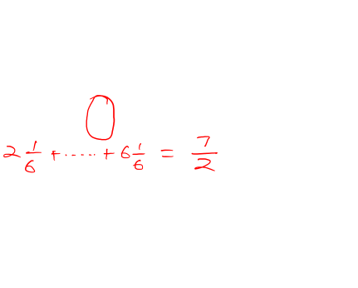
Expectation of a Random Variable (Cont.)
  Assume
  Then
  is a weighted average of the two possible values 1 and 2 where the value 2 is given twice as much weight as the value 1 since p(2) = 2p(1).
  Find E[X] where X is the outcome when we roll a fair die.
  Solution: Since

Slide 7

Expectation of a Random Variable (Cont.)
Expectation of a Bernoulli Random Variable: Calculate E[X] when X is a Bernoulli random variable with parameter p.
Since:
We have:

Slide 8
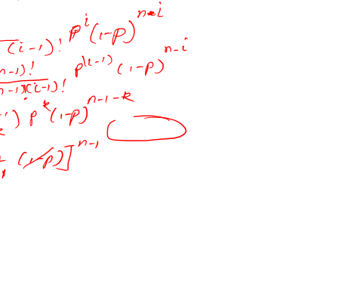
Expectation of a Random Variable (Cont.)
Expectation of a Binomial Random Variable: Calculate E[X] when X is a binomially distributed with parameters n and p.
Let k = i − 1..

Slide 9
Expectation of a Random Variable (Cont.)
Expectation of a Geometric Random Variable: Calculate the expectation of a geometric random variable having parameter p.
We have:
The expected number of independent trials
we need to perform until we get our first success
equals the reciprocal of the probability that any one
trial results in a success.

Slide 10
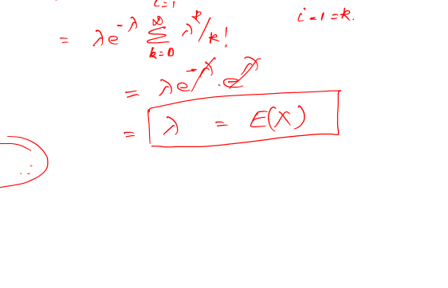
Expectation of a Random Variable (Cont.)
Expectation of a Poisson Random Variable: Calculate E[X] if X is a Poisson random variable with parameter λ.
where we have used the identity:

Slide 11

The Continuous Case
The expected value of a continuous random variable: If X is a continuous random variable having a density function f (x), then the expected value of X is defined by:
Example: Expectation of a Uniform Random Variable, Calculate the expectation of a random variable uniformly distributed over (α, β)

Slide 12
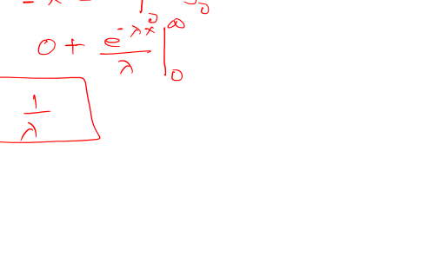
The Continuous Case (Cont.)
Expectation of an Exponential Random Variable: Let X be exponentially distributed with parameter λ. Calculate E[X].
Integrating by parts:

Slide 13
The Continuous Case Cont’d
Expectation of a Normal Random Variable): X is normally distributed with parameters μ and σ²:
Writing x as (x-μ) + μ yields
Letting y= x-μ leads to
Where f(x) is the normal density. By symmetry, the first integral must be 0, and so

Slide 14
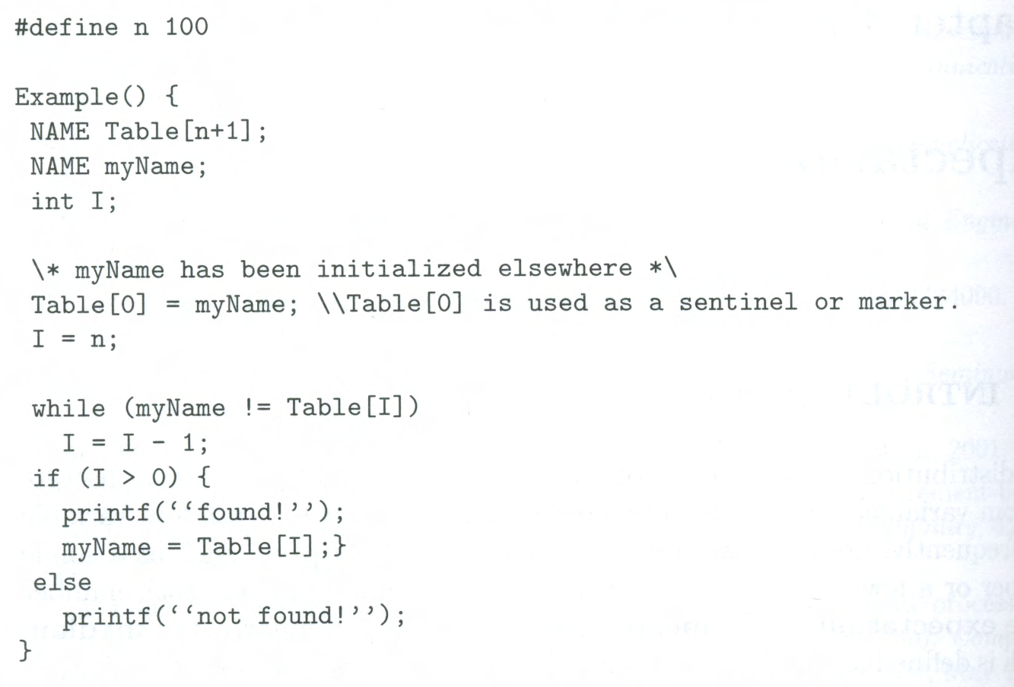
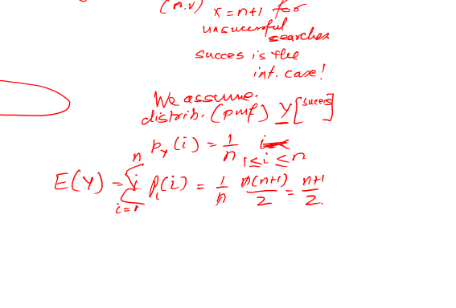
Example: Searching a table sequentially
Consider the problem of searching for a specific name in a table of names. A simple method is to scan the table sequentially, starting from one end, until we either find the name or reach the other end, indicating that the required name is missing from the table. The following is a C program fragment for sequential search:

Slide 15
Example Cont’d
In order to analyze the time required for sequential search, let X be the discrete random variable denoting the number of comparisons “myName≠Table[I]” made. The set of all possible values of X is {1,2,…,n+1}, and X=n+1 for unsuccessful searches.
More interesting to consider a random variable Y that denotes the number of comparisons for a successful search. The set of all possible values of Y is {1,2,…,n}. To compute the average search time for a successful search, we must specify the pmf of Y. In the absence of any specific information, let us assume that Y is uniform over its range:
Then
Thus, on the average, approximately half the table needs to be searched

Slide 16

Example Table ordered by non increasing access probabilities
If α_{i} denotes the access probability for name Table[i], then the average successful search time is E[Y] is minimized when names in the table are in the order of non-increasing access probabilities; that is, α₁ ≥ α₂ ≥ … ≥ α_{n}.
Where the constant c is determined from the normalization requirement
Thus,
Where H_{n} is the partial sum of a harmonic series; that is: and C(=0.577) is the Euler Constant.
Now, if the names in the table are ordered as above, then the average search time is
Which is considerably less than the previous value (n+1)/2, for large n

Slide 17
Example 3
Zipf’s law has been used to model the distribution of Web page requests [BRES 1999]. It has been found that the probability of a request for the ith most popular page is inversely proportional to i [ALME1996, WILL 1996],
Where n is the total number of Web pages in the universe.
We assume the Web page requests are independent and the cache can hold only m Web pages regardless of the size of each Web page. If we adopt a removal policy called “least frequently used”, which always keeps the m most popular pages, then the hit ratio h(m)- the probability that a request can find its page in cache- is given by

Slide 18





Slide 19
Example 4
Let X be a continuous random variable with an exponential density given by
Then
Let u=λx, then du= λdx, and
Thus, if a component obeys an exponential failure law with parameter λ (known as the failure rate), then its expected life, or its mean time to failure (MTTF), is 1/ λ. Finally, if the service time requirement of a job is an exponentially distributed random variable with parameter μ (known as the service rate), then the mean (average) service time is 1/μ.

Slide 20
Problem 1
Using integration by parts, show (assuming that and
are all finite) that for a continuous random variable X:
This result states that the expectation of a random variable X equals the difference of the areas of the right-hand and left-hand shaded regions.(This formula applies to the case of discrete and mixed random variables as well.)

Slide 21
Moments of a Distribution
Let X be a random variable, and define another random variable Y as a function of X so that To compute E[Y]
(provided the sum or the integral on the right-hand side is absolutely convergent). A special case of interest is the power function
For k=1,2,3,…, is known as the kth moment of the random variable X. Note that the first moment is the ordinary expectation or the mean of X.
We define the kth central moment, of the random variable X by
Known as the variance of X, Var[X], often denoted by
It is clear that Var[X] is always a nonnegative number.

Slide 22
Variance: 2nd Central Moment
We define the kth central moment, of the random variable X by
known as the variance of X, Var[X], often denoted by
Definition (Variance). The variance of a random variable X is
It is clear that Var[X] is always a nonnegative number.

Slide 23
Functions of a Random Variable
Let As an example, X could denote the measurement error in a certain physical experiment and Y would then be the square of the error (e.g. method of least squares).
Note that

Slide 24
Functions of a Random Variable (cont.)
Let X have the standard normal distribution [N(0,1)] so that
This is a chi-squared distribution with one degree of freedom

Slide 25
Functions of a Random Variable (cont.)
Generating Exponential Random Numbers
Let X be uniformly distributed on (0,1). We show that
has an exponential distribution with parameter Note: Y is a nonnegative random variable:
This fact can be used in a distribution-driven simulation. In simulation programs it is important to be able to generate values of variables with known distribution functions. Such values are known as random deviates or random variates. Most computer systems provide built-in functions to generate random deviates from the uniform distribution over (0,1), say u. Such random deviates are called random numbers.

Slide 26
Example
Let X be uniformly distributed on (0,1). We obtain the cumulative distribution function (CDF) of the random variable Y, defined by Y = X^{n} as follows: for
Now, the probability density function (PDF) of Y is given by

Slide 27
Expectation of a Function of a Random Variable
Given a random variable X and its probability distribution or its pmf/pdf
We are interested in calculating not the expected value of X, but the expected value of some function of X, say, g(X).
One way: since g(X) is itself a random variable, it must have a probability distribution, which should be computable from a knowledge of the distribution of X. Once we have obtained the distribution of g(X), we can then compute E[g(X)] by the definition of the expectation.
Example 1: Suppose X has the following probability mass function:
Calculate E[X²].
Letting Y=X²,we have that Y is a random variable that can take on one of the values, 0², 1², 2² with respective probabilities

Slide 28
Expectation of a Function of a Random Variable (cont.)
Proposition 2: (a) If X is a discrete random variable with probability mass function p(x), then for any real-valued function g,
(b) if X is a continuous random variable with probability density function f(x), then for any real-valued function g:
Example 3, Applying the proposition to Example 1 yields
Example 4, Applying the proposition to Example 2 yields

Slide 29
Corollary
If a and b are constants, then
The discrete case:
The continuous case:

Slide 30
Moments
The expected value of a random variable X, E[X], is also referred to as the mean or the first moment of X.
The quantity is called the nth moment of X. We have:
Another quantity of interest is the variance of a random variable X, denoted by Var(X), which is defined by:

