Slide 1
Gaussian, Exponential and Hypo Exponential Distributions
ECE 313
Probability with Engineering Applications
Lecture 12
Ravi K. Iyer
Department of Electrical and Computer Engineering
University of Illinois

Slide 2
Today’s topics
Gaussian examples
Exponential
Hypo Exponential
Announcements
  Mini project 2 due Saturday midnight (task 0,1 due march 7 10:00am)
  Midterm, March 15 in-class, 11:00am – 12:20pm
  Midterm review session March 13 5:30pm – 7:00pm Place TBD
  HW 5 released – not graded; HW 6 released today due Monday March 13 remember

Slide 3
Normal or Gaussian Distribution

Slide 4


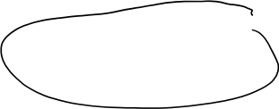
Normal or Gaussian Distribution
Extremely important in statistical application because of the central limit theorem:
  Under very general assumptions, the mean of a sample of n mutually independent random variables is normally distributed in the limit n → ∞.
Errors in measurement often follows this distribution.
During the wear-out phase, component lifetime follows a normal distribution.
The normal density is given by:
where are two parameters of the distribution.

Slide 5
Normal or Gaussian Distribution (cont.)
Normal density with parameters μ =2 and σ =1
σ =1
0.4
f_{x}(x)
0.2
μ = 2
-5.00
-2.00
1.00
4.00
7.00
x

Slide 6


Normal or Gaussian Distribution (cont.)
Since the standard normal density is clearly symmetric, it follows that for z > 0:
The tabulations of the normal distribution are made only for z ≥ 0 To find P(a ≤ Z ≤ b), use F(b) - F(a).

Slide 7







Normal or Gaussian Distribution (cont.)
The distribution function (CDF) F(x) has no closed form, so between every pair of limits a and b, probabilities relating to normal distributions are usually obtained numerically and recorded in special tables.
These tables apply to the standard normal distribution [Z ~ N(0,1)] --- a normal distribution with parameters μ = 0 , σ = 1 --- and their entries are the values of:

Slide 8



Normal or Gaussian Distribution (cont.)
For a particular value, x, of a normal random variable X, the corresponding value of the standardized variable Z is:
The Cumulative distribution function of X can be found by using:
alternatively:
Similarly, if X is normally distributed with parameters μ and σ2 then
Z = αX + β is normally distributed with parameters αμ + β and α²σ².

Slide 9





Normal or Gaussian Distribution Example 1
An analog signal received at a detector (measured in microvolts) may be modeled as a Gaussian random variable N(200, 256) at a fixed point in time. What is the probability that the signal will exceed 240 microvolts? What is the probability that the signal is larger than 240 microvolts, given that it is larger than 210 microvolts?

Slide 10
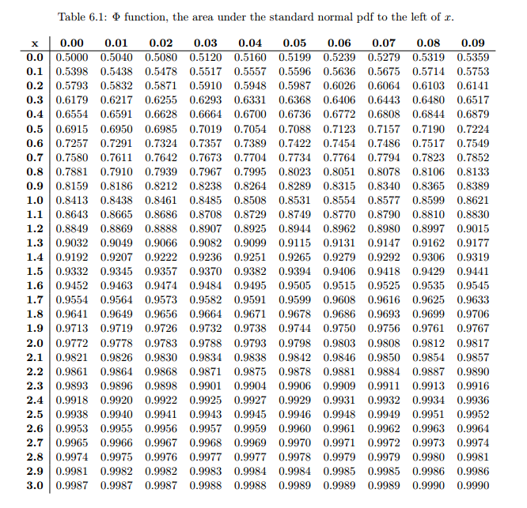
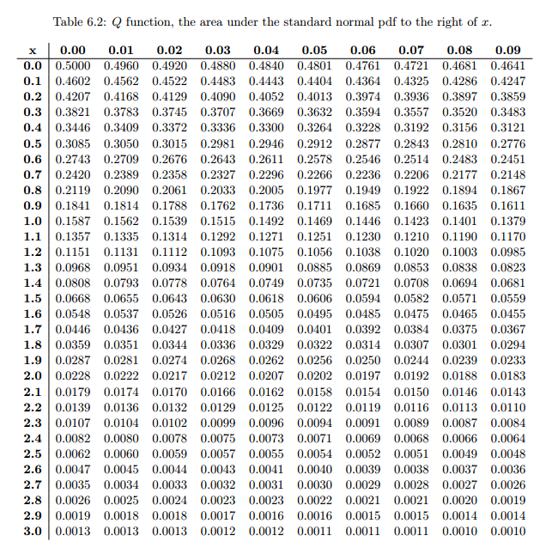
Normal or Gaussian Distribution (cont.)
The CDF of the N(0,1) distribution ( ) is denoted in the tables by , and its complementary CDF is denoted by , so:

Slide 11

Normal or Gaussian Distribution Example 1 (cont.)
Next:

Slide 12

Normal or Gaussian Distribution Example 2
Assuming that the life of a given subsystem, in the wear-out phase, is normally distributed with μ = 10,000 hours and σ = 1,000 hours, determine the reliability for an operating time of 500 hours given that
  (a) The age of the component is 9,000 hours,
  (b) The age of the component is 11,000.
The required quantity under (a) is R_{9,000}(500) and under (b) is R_{11,000}(500).

Slide 13
Normal or Gaussian Distribution Example 2
Assuming that the life of a given subsystem, in the wear-out phase, is normally distributed with μ = 10,000 hours and σ = 1,000 hours, determine the reliability for an operating time of 500 hours given that
  (a) The age of the component is 9,000 hours,
  (b) The age of the component is 11,000.
The required quantity under (a) is R_{9,000}(500) and under (b) is R_{11,000}(500).

Slide 14
Normal or Gaussian Distribution Example 2 (cont.)
Note that with the usual exponential assumption these two quantities will be identical.
But under a Normal assumption:

Slide 15
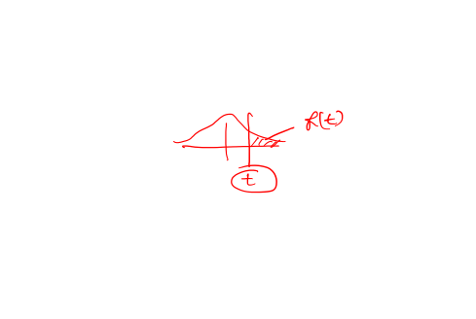
Normal or Gaussian Distribution Example 2 (cont.)

Slide 16

Normal or Gaussian Distribution Example 2 (cont.)

Slide 17
Exponential Distribution

Slide 18



The Exponential Distribution
The exponential distribution occurs in applications such as reliability theory and queuing theory. Reasons for its use include:
  Its memoryless (Markov) property
  Its relation to the (discrete) Poisson distribution
The following random variables will often be modeled as exponential:
  Time between two successive job arrivals to a computing center
  Service time at a server in a queuing network
  Time to failure (lifetime) of a component
  Time required to repair a component that has malfunctioned

Slide 19



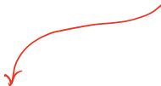
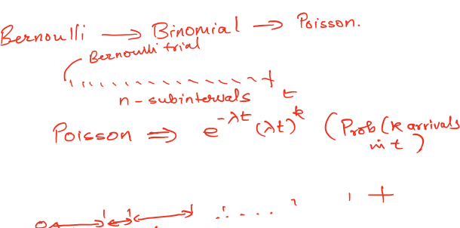

Slide 20




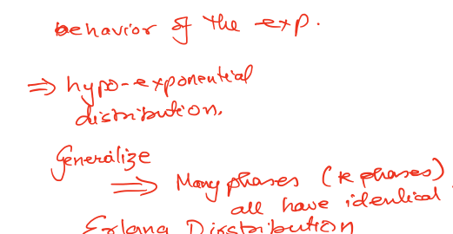

Slide 23





The Exponential Distribution Function
The CDF of the exponential distribution is given by:
If a random variable X possesses CDF given in the above equation, we use the notation X ~EXP(λ), for brevity. The pdf of X is given by:

Slide 24

The CDF of an Exponentially Distributed Random Variable
1.0
F(x)
0.5
0
0
1.25
2.50
3.75
5.00
x
The CDF of an exponentially distributed random variable with parameter λ = 1

Slide 25

Exponential pdf
5.00
λ = 5
F(x)
2.50
2
1
0
0
0.750
1.50
2.25
3.00
x

Slide 26

Specifying the pdf
While specifying the pdf, we usually state only the nonzero part.
It is understood that the pdf is zero over any unspecified region.
Since , the total area under the exponential pdf is unity.
Also:
and

Slide 27
Memoryless Property of the Exponential Distribution
1.0
F(x)
0.5
Conditional probability density function of
Y = X - t given X > t
t
y
0
0
1.25
2.50
3.75
5.00
x

Slide 28
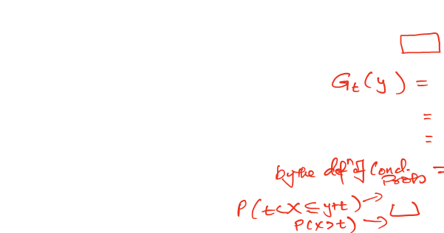

Memoryless Property of the Exponential Distribution
Assume that we know that X exceeds t (X > t). For example, X is the lifetime of a component.
Assume we have observed the component to have been operating for t hours.
We are then interested in the distribution of Y = X- t, which is the remaining (residual) lifetime of the component.
The conditional probability of Y ≤ y can be denoted by G_{t}(y).
Thus for y ≥ 0:

Slide 29



Memoryless Property (cont.)
Thus:

Slide 30

Memoryless Property (cont.)
Thus, G_{t}(y) is independent of t and identical to the original exponential distribution of X.
The distribution of the remaining life of the component does not depend on how long the component has been operating; the component does not “age.” Its eventual breakdown results from a suddenly appearing failure, not from gradual deterioration.
If inter-arrival times are exponentially distributed, the “memory-less” property (also known as the Markov property) says that “the wait time for a new arrival is statistically independent of how long we have already waited”!

Slide 31

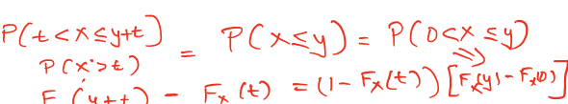
Memoryless Property (cont.)
If X is a nonnegative continuous random variable with the Markov property, then we can show that the distribution of X must be exponential:
Since F_{x}(0) = 0, we rearrange the above equation to get:
or

Slide 32





Memoryless Property (cont.)
Taking the limit as t approaches zero, we get:
where F’_{x} denotes the derivative of F_{x} Let R_{x}(y) = 1 - F_{x}(y); then the above equation reduces to:
The solution to this differential equation is given by:
where K is a constant of integration and -R’_{x} (0) = F’_{x}(0) = f_{x}(0), the pdf evaluated at 0.

Slide 33




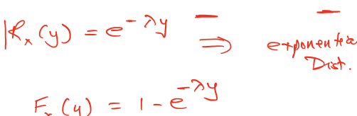


Memoryless Property (cont.)
Noting that the R_{x}(0) = 1, and denoting f_{x}(0) by the constant λ, we get:
and hence
Therefore X must have the exponential distribution.
The exponential distribution can be obtained from the Poisson distribution by considering the interarrival times rather than the number of arrivals.

Slide 34
Example 1 (TMR system)
Consider the triple modular redundant (TMR) system (n = 3 and m = 2).
Let assume that R denotes the reliability of a component then
  for the discrete time we assume that R = constant and then:
R_{TMR} = 3R² - 2R³
  for the continuous time we assume that the failure of components are exponentially distributed with parameter λ
    the reliability of a component can be expressed as:
R(t) = 1 - (1 - e^{-λt}) = e^{-λt} , and consequently
R_{TMR}(t) = 3R(t)² - 2R(t)³
R_{TMR}(t) = 3 e^{-2λt} - 2 e^{-3λt}

Slide 35
Comparison of TMR and Simplex

Slide 36
Example 1 (TMR system) cont.
From the plot R_{tmr}(t) against t as well as R(t) against t, note that:
and
Where t₀ is the solution to the equation:
which is:

Slide 37
Example 1 (TMR system) cont.
Thus if we define a “short” mission by the mission time t ≤ t₀, then it is clear that TMR type of redundancy improves reliability only for short missions.
For long missions, this type of redundancy actually degrades reliability.

Slide 38
Example 2 (TMR/Simplex system)
TMR system has higher reliability than simplex for short missions only.
To improve upon the performance of TMR, we observe that after one of the three units have failed, both of the two remaining units must function properly for the classical TMR configuration to function properly.
Thus, after one failure, the system reduces to a series system of two components, from the reliability point of view.

Slide 39
Example 2 (TMR/Simplex system) cont.
An improvement over this simple scheme, known as TMR/simplex
  detects a single component failure,
  discards the failed component, and
  reverts to one of the nonfailing simplex components.
In other words, not only the failed component but also one of the good components is discarded.

Slide 40
Example 2 (TMR/Simplex system) cont.
Let X, Y, Z, denote the times to failure of the three components.
Let W denote the residual time to failure of the chosen surviving component.
Let X, Y, Z be mutually independent and exponentially distributed with parameter λ.
Then, if L denotes the time to failure of TMR/simplex, then L can be expressed as:
L = min{X, Y, Z} + W

Slide 41
Hypoexponential Distribution
Many processes in nature can be divided into sequential phases.
If the time the process spends in each phase is:
  Independent
  Exponentially distributed
It can be shown that the overall time is hypoexponentially distributed.
For example: The service times for input-output operations in a computer system often possess this distribution.
The distribution has r parameters, one for each distinct phase.

Slide 42
Hypoexponential Distribution (cont.)
A two-stage hypoexponential random variable, X, with parameters λ₁ and λ₂ (λ₁ ≠λ₂ ), is denoted by X~HYPO(λ_{1,} λ₂ ).

Slide 43
The pdf of the Hypoexponential Distribution
0.669
f(t)
0.334
0
0
1.25
2.50
3.75
5.00
t

Slide 44
The CDF of the Hypoexponential Distribution
The corresponding distribution function is:
1.0
F(t)
0.5
0
0
1.25
2.50
3.75
5.00
t

Slide 45
Example 2 (TMR/Simplex system) cont.
We use two useful notions:
1. The lifetime distribution of a series system whose components have independent exponentially distributed lifetimes is itself exponentially distributed with parameter
2. If X´ and Y´are
  exponentially distributed with parameters λ₁ and λ₂, respectively,
  X´ and Y´ are independent , and
  λ₁ ≠ λ₂ then
Z = X´ + Y´
has a two-stage hypoexponential distribution with parameters λ₁ and λ₂,

Slide 46
Example 2 (TMR/Simplex system) cont.
Now:
  Since the exponential distribution is memoryless, the lifetime W of the surviving component is exponentially distributed with parameter λ.
  min {X, Y, Z} is exponentially distributed with parameter 3λ.
  Then L has a two-stage hypoexponential distribution with parameters 3λ and λ.

Slide 47
Example 2 (TMR/Simplex system) cont.
Therefore, we have:
The reliability expression of TMR/simplex is:
The TMR/simplex has a higher reliability than either a simplex or an ordinary TMR system for all t ≥ 0.

Slide 48
Comparison of Simplex, TMR, & TMR/Simplex

Slide 49
Erlang and Gamma Distribution
When r sequential phases have independent identical exponential distributions, the resulting density (pdf) is known as r-stage (or r-phase) Erlang:
The CDF (Cumulative distribution function is:
Also:

Slide 50
Erlang and Gamma Distribution (cont.)
The exponential distribution is a special case of the Erlang distribution with r = 1.
A component subjected to an environment so that N_{t}, the number of peak stresses in the interval (0, t], is Poisson distributed with parameter λ t.
The component can withstand (r -1) peak stresses and the rth occurrence of a peak stress causes a failure.
The component lifetime X is related to N_{t} so these two events are equivalent:

Slide 51
Erlang and Gamma Distribution (cont.)
Thus:
F(t) = 1 - R(t) yields the previous formula:
Conclusion is that the component lifetime has an r-stage Erlang distribution.

Slide 52
Gamma Function and Density
If r (call it α) take nonintegral values, then we get the gamma density:
where the gamma function is defined by the integral:

Slide 53
Gamma Function and Density (cont.)
The following properties of the gamma function will be useful in our workl. Integration by parts shows that for α > 1:
In particular, if α is a positive integer, denoted by n, then:
Other useful formulas related to the gamma function are:
and

Slide 54
Gamma Function and Density (cont.)

Slide 55
Hyperexponential Distribution
A process with sequential phases gives rise to a hypoexponential or an Erlang distribution, depending upon whether or not the phases have identical distributions.
If a process consists of alternate phases, i. e. during any single experiment the process experiences one and only one of the many alternate phases, and
If these phases have independent exponential distributions, then
The overall distribution is hyperexponential.

Slide 56
Hyperexponential Distribution (cont.)
The density function of a k-phase hyperexponential random variable is:
The distribution function is:
The failure rate is:
which is a decreasing failure rate from Σα_{i}λ_{i} down to min {λ₁, λ₂,…}

Slide 57
Hyperexponential Distribution (cont.)
The hyperexponential is a special case of mixture distributions that often arise in practice:
The hyperexponential distribution exhibits more variability than the exponential, e.g. CPU service-time distribution in a computer system often expresses this.
If a product is manufactured in several parallel assembly lines and the outputs are merged, then the failure density of the overall product is likely to be hyperexponential.

Slide 58
Hyperexponential Distribution (cont.)

Slide 59
Example 3 (On-line Fault Detector)
Consider a model consisting of a functional unit (e.g., an adder) together with an on-line fault detector
Let T and C denote the times to failure of the unit and the detector respectively
After the unit fails, a finite time D (called the detection latency) is required to detect the failure.
Failure of the detector, however, is detected instantaneously.

Slide 61
Example 3 (On-line Fault Detector) cont.
Let X denote the time to failure indication and Y denote the time to failure occurrence (of either the detector or the unit).
Then
X = min{T + D, C} and Y = min{T, C}.
If the detector fails before the unit, then a false alarm is said to have occurred.
If the unit fails before the detector, then the unit keeps producing erroneous output during the detection phase and thus propagates the effect of the failure.
The purpose of the detector is to reduce the detection time D.

Slide 62
Example 3 (On-line Fault Detector) cont.
We define:
Real reliability R_{r}(t) = P(Y ≥ t) and
Apparent reliability R_{a}(t) = P(X ≥ t).
A powerful detector will tend to narrow the gap between R_{r}(t) and R_{a}(t).
Assume that T, D, and C are mutually independent and exponentially distributed with parameters λ, δ, and α.

Slide 63
Example 3 (On-line Fault Detector) cont.
Then Y is exponentially distributed with parameter λ + α and:
T + D is hypoexponentially distributed so that:

Slide 64
Example 3 (On-line Fault Detector) cont.
And, the apparent reliability is:

Slide 65
Summary
Four special types of phase-type exponential distributions:
Hypoexponential Distribution:
  Exponential distributions at each phase have different λ
2) Examples

Slide 66
Phase-type Exponential Distributions
Exponential Distribution:
  Time to the event or Inter-arrivals => Poisson
  Phase-type Exponential Distributions:
  We have a process that is divided into k sequential phases, in which time that the process spends in each phase is:
    Independent
    Exponentially distributed
  The generalization of the phase-type exponential distributions is called Coxian Distribution
    Any distribution can be expressed as the sum of phase-type exponential distributions

