Slide 1
Important Discrete Distributions:
Poisson, Geometric, & Modified Geometric
ECE 313
Probability with Engineering Applications
Lecture 11
Ravi K. Iyer
Department of Electrical and Computer Engineering
University of Illinois

Slide 2
Today’s topics
Group Activity discrete distributions
Mini project 2
Announcements
  Mini project 2 will be posted today
  Midterm, March 15 in-class, 11:00am – 12:20pm

Slide 3
Group Activity: A probabilistic attack on an airline reservation website of ACME Corp
A hacker wants to attack an airline reservation website of ACME Corp in the months leading up to the Spring break. The hacker controls a botnet to flood the airline reservation website with malicious requests, i.e., launching Distributed Denial of Service (DDoS) attack.
Each execution of the botnet attack (a trial) involves exercising any of the four payloads:
  (A) TCP/IP flooding attack,
  (B) Domain Name Service (DNS) reflection attack,
  (C) Transport Layer Security (TLS) renegotiation attack, and
  (D) slow Hypertext Transfer Protocol (HTTP) POST attack.
The success of at least one of these payloads will make the airline reservation website inaccessible, i.e., the botnet attack (a trial) is successful.

Slide 4
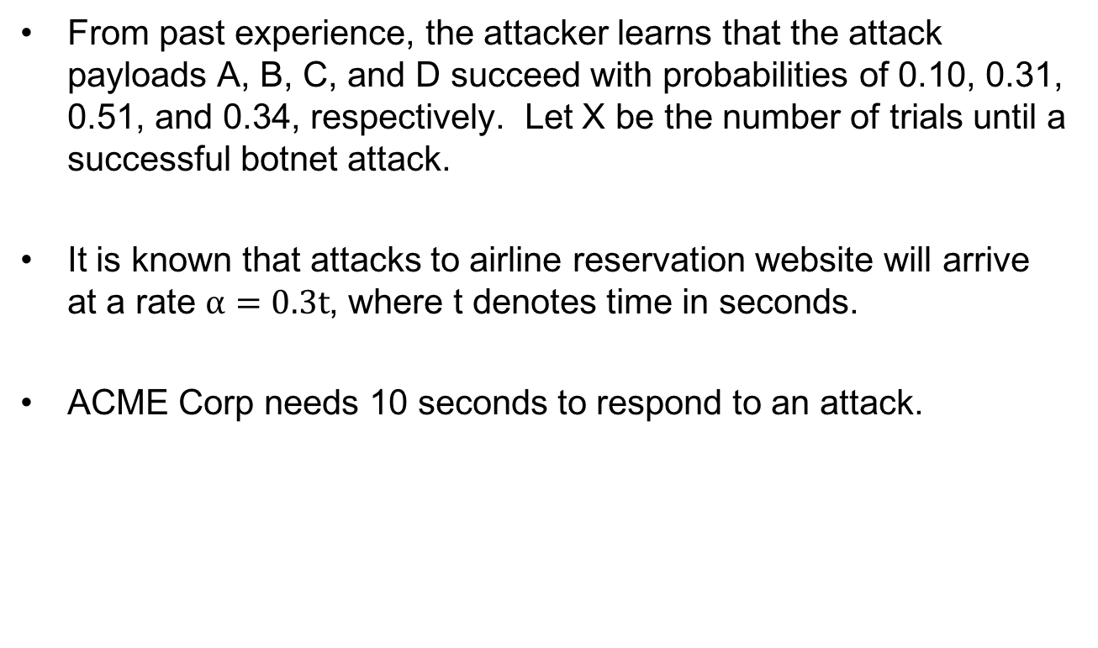
Group Activity: A probabilistic attack on an airline reservation website (cont.)
From past experience, the attacker learns that the attack payloads A, B, C, and D succeed with probabilities of 0.10, 0.31, 0.51, and 0.34, respectively. Let X be the number of trials until a successful botnet attack.
It is known that attacks to airline reservation website will arrive at a rate $α=0.3t$, where t denotes time in seconds.
ACME Corp needs 10 seconds to respond to an attack.

Slide 5
Group Activity: Solution

Slide 6
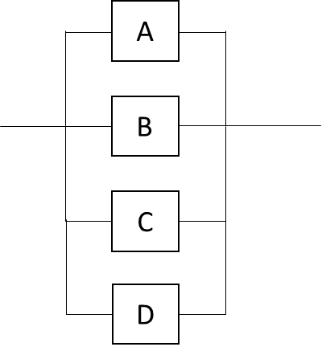
Group Activity Solution
Model the probability of a successful attack as a reliability block diagram
If any of the attack is successful, we can claim that the attack is successful. Hence, A, B, C and D are in parallel
Find the probability of a successful break-in to the system on an arbitrary single trial (with precision of one decimal point). Show your work.
The attacker fails to break-in only if all the four attacks fail.
i.e., P(Success) = 1 – P(Fail)
= 1 – (A fail & B fail & C fail & D fail)
1 – (1-0.10)(1-0.31)(1-0.51)(1-0.34) = 0.8

Slide 7
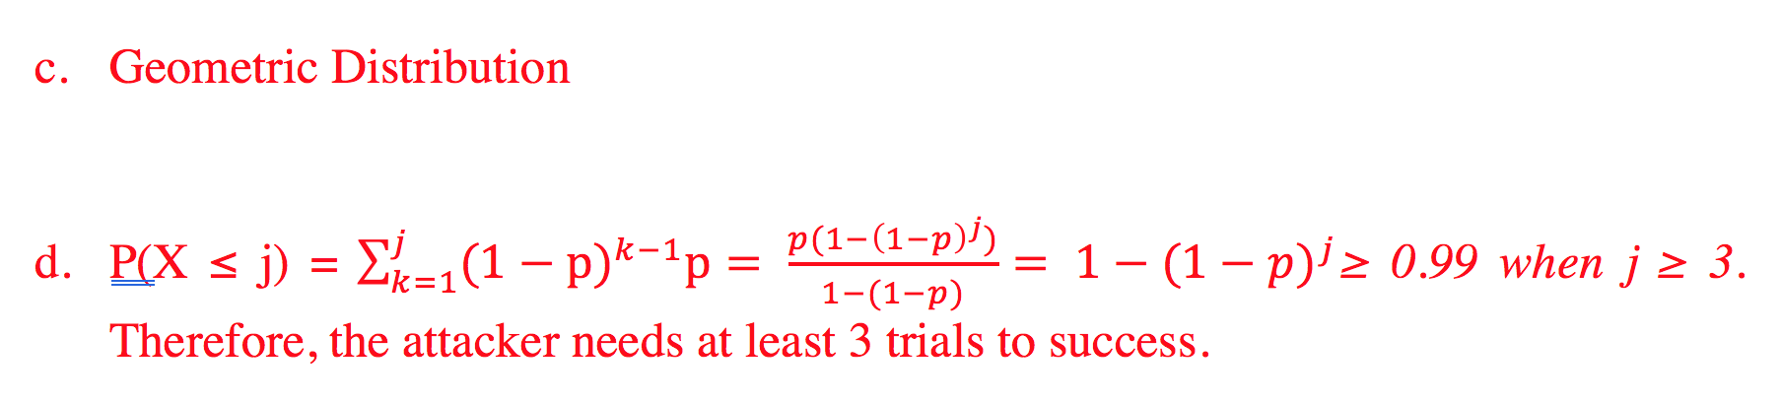
Group Activity Solution (cont.)

Slide 8
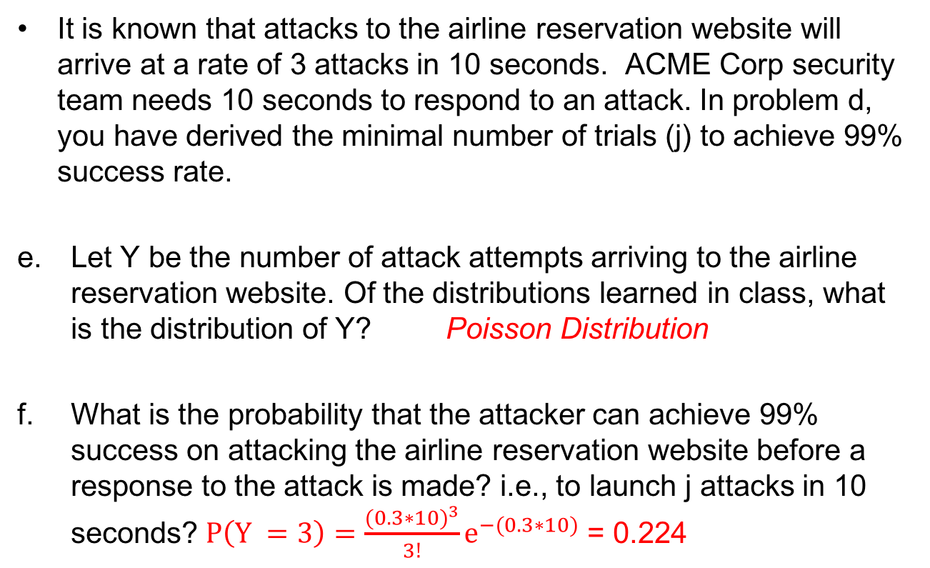
Group Activity Solution (cont.)
It is known that attacks to the airline reservation website will arrive at a rate of 3 attacks in 10 seconds. ACME Corp security team needs 10 seconds to respond to an attack. In problem d, you have derived the minimal number of trials (j) to achieve 99% success rate.
Let Y be the number of attack attempts arriving to the airline reservation website. Of the distributions learned in class, what is the distribution of Y? Poisson Distribution
What is the probability that the attacker can achieve 99% success on attacking the airline reservation website before a response to the attack is made? i.e., to launch j attacks in 10 seconds?$P\left(Y =3\right)=\frac{{(0.3∗10)}^{3}}{3!}e^{−(0.3∗10)}$ = 0.224

Slide 9
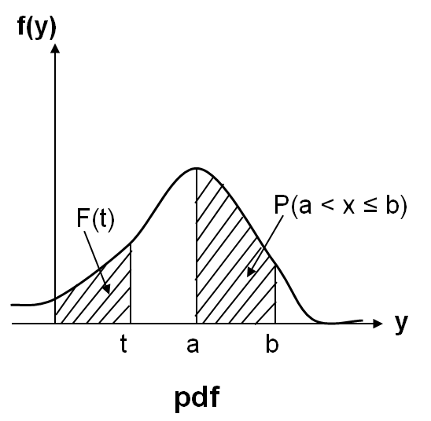
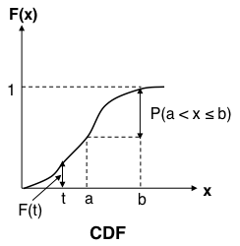
Review: Continuous Random Variables
Continuous Random Variables:
  Probability distribution function (pdf):
    Properties:
    All probability statements about X can be answered by f(x):
  Cumulative distribution function (CDF):
    Properties:
    A continuous function

Slide 10
Multi-parameter Signal Analysis for Patient Monitoring
Mini Project 2
ECE 313 – Section G

Slide 11
Multi-parameter Signal Analysis for Patient Monitoring
In this Project, you will do:
  Analyze data by calculating/plotting the empirical distributions using physiological monitoring data
  Compare an empirical distribution with an estimated normal distribution from estimated parameters (μ, σ)
  Determine a threshold to find abnormalities of each monitored signal
  Generate alarms for each signal
  Implement a voter that makes the final decision
  Perform an 3-fold cross validation
and you will learn:
  to calculate the pmf/pdf and cdf based on empirical data
  the characteristics of pmf and pdf
  the relationship between pmf, pdf, and cdf
  properties of the Normal distribution
  to evaluate the performance of a monitoring system which has false alarms and missed detections

Slide 12
Multi-parameter Signal Analysis for Patient Monitoring
Assume you are an engineer working at a medical device company ACME
You are assigned to design a reliable patient monitoring system which analyzes the correlated physiological signals collected from the patient’s body, and generates alarms for abnormalities.
You are given a set of three correlated physiological signals collected from the biomedical sensors attached to the patient’s body:
  S1: Heart Rate (HR)
  S2: Pulse Rate (PR)
  S3: Respiration Rate (RESP)

Slide 13
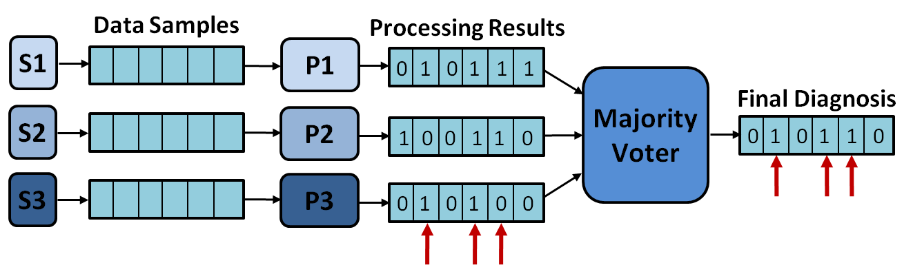
Mini Project 2: Description
You design a multi-parameter and fusion monitoring system where
The signals are passed through three processing units (P1, P2, and P3, respectively), called threshold functions, to detect patient abnormalities.
Each threshold function will generate an alarm whenever a data sample of the corresponding signal exceeds a pre-defined threshold. A “1” on the output of each function indicates an alarm and a “0” corresponds to absence of an alarm.
A majority voter function then generates the final output, based on the value that the majority of the threshold functions agreed upon.
Figure 1

Slide 14
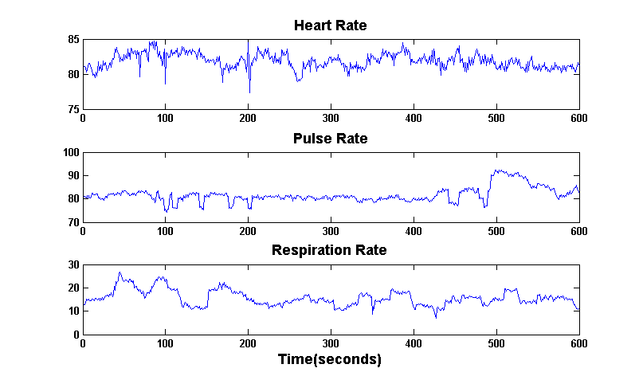
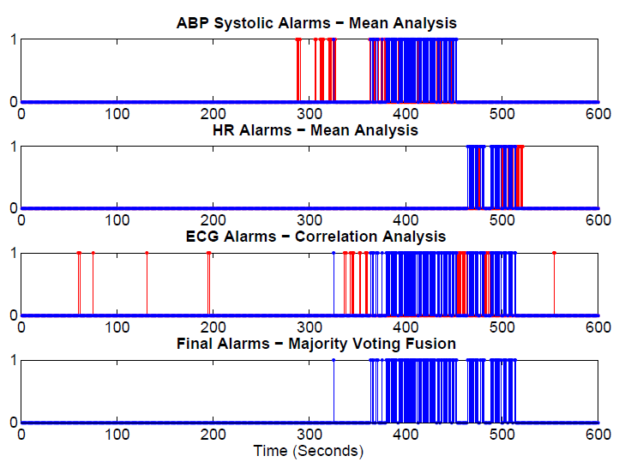
Majority Voter Example
Heart Rate Alarms
Pulse Rate Alarms
Respiration Rate Alarms
Figure 2
Notes:
Blood pressure and heart rate signals are monitored using a mean analysis technique where during the training period the mean and standard deviation of samples are calculated and is used in the monitoring phase as a patient-specific signature for detection of abnormalities.

Slide 15
Voter Success Examples
Assume that by talking to the physician, we know that in the time interval T the patient experiences an abnormality and an alarm should be raised (The output from the monitoring system should be “1”).
If P1 and P2 functions generate “1”, but P3 generates a “0”, then the majority voter will generate a “1” (an alarm) on the final output, indicating a patient abnormality.
  This means that P3 missed a true alarm, and voter fixed a missed detection on P3.
Assume that for another time interval we know the patient experienced no abnormality and no alarms should be raised (The output should be “0”).
If P1 generates a “1”, P2 and P3 functions generate “0”, then the majority voter will generate a “0” (no alarm) on the final output, indicating no patient abnormality.
  This means that P1 raised a false alarm, and the voter masked a false alarm on P1.

Slide 16
Voter Failure Examples
Again, assume that by talking to the physician, we know that in the time interval T the patient experienced an abnormality and an alarm should be raised (The output from the monitoring system should be “1”).
But both P1 and P2 functions generate “0”, while P3 generates a “1”, then the majority voter will generate a “0” (no alarm) on the final output, wrongly indicating that there is no patient abnormality.
  This means that P3 raised a true alarm, but because P1 and P2 had missed detection, the voter output was erroneous. We call this a missed detection.
Now assume that for another time interval we know the patient experienced no abnormality and no alarms should be raised (The output should be “0”).
If P1 generates a “0”, but P2 and P3 functions generate “1”, then the majority voter will generate a “1” (an alarm) on the final output, indicating a patient abnormality.
  This means that P1 raise a true alarm, P2 and P3 raised false alarms, and the voter output was erroneous. We call this a a false alarm.

Slide 17
Task 0: Data Import & Preparation
Task 0:
  You are provided with a dataset patient_data.mat, a main skeleton code, and two skeleton codes for functions pdf_cdf and threshold_func.
patient_data consists of 2 variables:
  data (physiological signals) and golden_alarms (physician annotations)
data is an array of 3 rows and 30,000 columns
  The first row corresponds to the Heart Rate (HR), the second row corresponds to the Pulse Rate(PR), and the third row corresponds to the Respiration Rate (RESP)
  Each column corresponds to a data sample (there are 30,000 data entries for each signal)
  Sampling rate is 1 sample/second and the whole period is 30,000 seconds.
golden_alarms is a single row of 3,000 columns, each entry is a binary value
  Each entry corresponds to an interval containing 10 samples.
  Any of the samples contain an alarm in a given interval, the entry is 1 if it contains alarms, 0 if there are no alarms.
Run the following parts provided in the skeleton code:
Load the provided data set into MATLAB: load patient_data.mat
In order to visualize the data, as in Figure 2, plot all three signals over time.

Slide 18
Task 1.1: Data Analytics
  For the Respiration Rate (RESP) signal:
The skeleton code generates three different sample sets of sizes 70, 1000, 30,000 sample points from each signal. You should now write function pdf_cdf to plot: i) the pmf using the discrete samples, ii) estimated pdf using the continuous data, and iii) the cdf. For each sample set X:
    Find the pmf of Y = floor(X), i.e., the distribution of sample points in different intervals of data (e.g. what is the percentage of samples in interval 3 ≤ RESP < 4). Hint: Use unique(floor(X)) to get the list of intervals and hist function to get the frequencies (Remember that 0 ≤ P(X) ≤ 1). Plot the pmf using bar function.
    Plot the estimated pdf* for the signal using the code provided to you in the skeleton. What differences do you see between the pmf plotted in part 1 above and the estimated pdf?
    Use the ecdf function in Matlab to calculate and plot the CDF in the same figure.
    Hint: The CDF of the whole data set (k = 30,000) is plotted for you as a reference point to compare with. Use hold on to plot all the graphs in the same figure.
What differences do you see as the sample sizes increase from 70 to 30000?
Notes:
Note that hist returns counts, but we should derive probabilities

Slide 19
Task 1.1 (Cont.)
  For the Respiration Rate (RESP) signal:
Use the tabulate function in MATLAB over X (sample size k = 30000) and Y(=floor(X)). tabulate(X) will give you the value of pdf for each sample point, while tabulate(Y) will give you a pmf. Find the minimum and maximum probability values found by the tabulate function in each case.
Explain why tabulate(X) gives a pdf while the other gives a pmf.
What difference do you find for the derived min, max for each distribution
Can you relate the difference to identify a distinct characteristics of a pdf?
(Hint: see class lecture notes
Related to part a.2: See the following links for more information on kernel density estimation based on data:
http://en.wikipedia.org/wiki/Kernel_density_estimation
http://www.mathworks.com/help/stats/kernel-distribution.html
Notes:
Note that hist returns counts, but we should derive probabilities

Slide 20
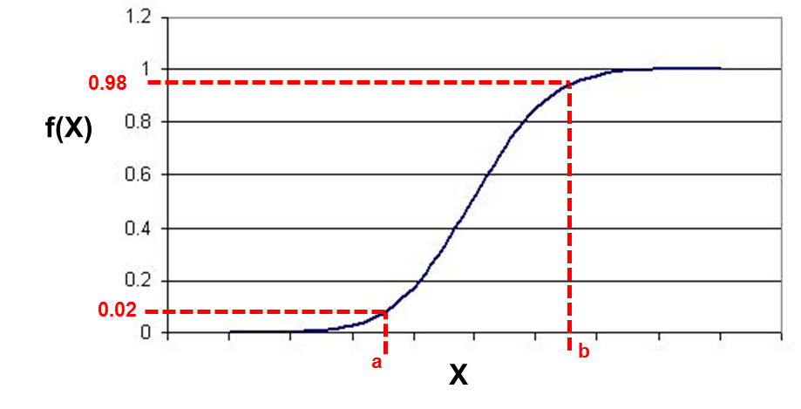
Task 1.1 (Cont.)
  (TRAINing) In order to design an efficient threshold function, you need to find an interval of X where 96% of probability for signal lies. Assume that an anomaly happens when the data sample falls outside of this range on any of the two tails of distribution.
  You will determine the thresholds in two ways, using the data (Task 1.1.c) and assuming a normal distribution (Task 1.2)
  These thresholds are subsequently used in task2.1.a to generate alarms from the given signals.
  Based on the CDF of the signal (sample size k = 30,000) that you calculated in part a, find values a and b such that P(X ≤ a) ≤ 0.02 and P(X ≤ b) ≥ 0.98.
Figure 3
Notes:
Note that hist returns counts, but we should derive probabilities

Slide 21
Task 1.2: Data Analytics
  For the Respiration Rate (RESP) signal:
  Calculate the mean and standard deviation of the signal over the whole period for the 30,000 samples
    Hint: You can use mean and std functions in MATLAB
  Use the normrnd function in MATLAB to generate a normally distributed random variable with the mean and standard deviation that you found for the signal in part (a) and plot the pdf and CDF of this normal random variable.
  Use the normplot function in MATLAB to estimate the difference between the distribution in Task 1.1 and the corresponding normal distribution here.
  What differences do you see between the distribution generated in this task and the plot from Task 1.1 for 30K sample size?
  Hint: See http://en.wikipedia.org/wiki/Skewness
  d) Write the equation for pdf and CDF of the normal distribution that you generated in part b. Use the normal distribution table (described in Lectures 11-12) to find values a and b such that P(X ≤ a) ≤ 0.02 and P(X ≤ b) ≥ 0.98.
  What differences do you see compared to the values of a and b in Task 1.1?

Slide 22
Task 2.1:Anomaly Detector
  (TESTing)
  Use the empirical thresholds (a and b) shown in Table 1 (Slide 15) and call the provided threshold functions to generate alarms for each of the HR, PR, and RESP variables. Remember that a “1” on the output from each threshold function indicates an alarm and “0” corresponds to absence of an alarm.
  Coalescing of alarms: The alarms generated for each of the variables HR, PR, and RESP are then coalesced separately over fixed intervals of 10 samples. For example, if for HR there is at least one alarm generated during an interval of 10 samples, then the output for that interval will be “1”, similarly for PR, and RESP.
  Write a majority voter function that takes as input each of the 10-sample windows and votes on the alarms generated from each threshold function in part (b). The output of the voter will then a sequence of alarms that the majority (at least 2 out of 3) of the functions agreed on.
  Use the bar function in MATLAB to plot the coalesced alarms generated for each variable (in part b) and the final alarms generated by the majority voter (in part c). (Hint: Each bar will represent an alarm (“1”) during a 10-sample window).

Slide 23
Task 2.2: Detector Evaluation
  You are given by the physician a vector of golden alarms (golden_alarms variable) which indicates for each 10-sample interval whether patient was diagnosed an actual abnormality (“1”) or not (“0”).
  - A false alarm corresponds to the case where an alarm (“1”) is generated based on processed input data for an interval, but no abnormalities (“0” in the golden alarms) are detected by the doctor for the same input data.
  A miss detection corresponds to the case where no alarm (“0”) is generated based on processed input data for an interval, but at least one abnormality (“1” in the golden alarms) is detected by the doctor for the same input data.
  Calculate the probabilities of false alarms and miss-detections for the whole system (Show all your work).
      Recall that the voter operates on coalesced alarms, generated in part (b).
      P(False Alarm) = P(Voter raises an alarm | Physician indicates no abnormality)
      P(Miss Detection) = P(Voter raises no alarms | Physician indicates an abnormality)
  Calculate the probability of error.
    P(Error) = P(Voter raises an alarm AND Physician indicates no abnormality)+
    P(Voter raises no alarm AND Physician indicates an abnormality)

Slide 24
Task 2.2 (Cont.)
c) Perform Tasks 2.1 and 2.2 again, this time with the theoretical thresholds (a and b) found in Task 1.2 - part d and Table 1. What differences did you see in the probabilities of miss-detection, false-alarm, and error for each signal?
What lessons did you learn by observing the results generated by the empirical approach vs. the theoretical approach?
Provide your explanations in at least three bullets.
Table1
Signal | Empirical Thresholds | Theoretical Thresholds
Heart Rate (HR) | a = 80.17, b = 98.52 | a = 78.84, b = 96.83
Pressure Rate (PR) | a = 79.00, b = 97.07 | a = 78.15, b = 96.09
Respiration Rate (RR) | To be calculated in Tasks 1.1.a and 1.1.b

Slide 25
Task 3: 3-fold Validation
In Task 1 and Task 2, we have designed a decision logic (TRAINing) and evaluated (TESTing) it on the same dataset. However, the testing data might not always be available at the point of training. Here we introduce you 3-fold validation for a more realistic evaluation.
Divide the data into three subsets of equal length.
Hint! d1 = data[:, 1:100000]; can be used for parsing the first 1/3 of the data
Divide the golden_alarms into three subsets of equal length.
Caution! Note that the length of golden_alarms is not the same as data
For each subset:
TRAIN the decision model using the remaining subsets and using the detector from the TRAIN step, TEST it on the subset (store the performance)
e.g., let d1, d2, d3 be the three subsets. Keep d1 for TESTing. Perform data analytics on d1+d3 and find the thresholds a, b(TRAIN). Using a, b and d1, TEST the performance of the detector implemented in Task 2. Same procedure repeated with d2, and d3 for testing
Hint! train_data = [d1 d3]; can be used for combining the two subsets
After repeating (b) over each of the three subsets, average the three sets of performances saved from the TEST procedures.
How do the averages (of P(false alarm), P(miss detection), P(error)) compare to the results from Task 2.2?
(Optional) Reading for your own interest:
n-fold cross validation
Overfitting

Slide 26
Project Timeline and Grading
Tasks 0-1: due on Friday, March 3rd, 11:59 PM.
  Submit your answers for Task 1 and a working MATAB script
All Tasks: due on Friday, Mar 10th, 11:59 PM.
  Submit your report and a working MATLAB script
Grading
  Task 1: 40%
  Task 2: 30%
  Task 3: 30%
Checkout the class website for description of the project, tasks, and data set, as well as your group assignments: http://courses.engr.illinois.edu/ece313/SectionG/projects.html
Contact your group members to start the project as soon as possible.

Slide 27
Project Submission
A report describing your work and results and your Matlab code must be delivered electronically to the TA by the due date: Submissions will be done through Compass
Matlab code Instructions:
  We provide you with a skeleton file to start from.
  Fill in the code related to each task in the sections indicated by comments.
  fprintf() functions are provided for structured results. Please replace the variables accordingly to report your results.
  TAs will execute your code & check the results. Non-executable code will not be graded.
Report Instructions (follow all steps):
  Format your report to separate different tasks in separate sections.
  Copy results generated by fprintf() functions into corresponding sections in report.
  Explain all your work and assumptions made for deriving your results.
  Incorrect final answers without any explanations or comments receive zero credit.
  Non-readable reports will be returned without a grade.
  Include your names, group name. Each group member must affirm that she/he has worked on the project and has read and agrees with the final report

Slide 28
MATLAB Tutorial
Files:
  Function and codes: .m
  Files: .mat
Import a data set into MATLAB workspace:
  load patient_data.mat
Export a data set from the MATLAB workspace:
  save result.mat
  save result.mat X, Y, Z
Clear all the workspace environment:
  clear all
Clear the command window:
  clc
You can repeat the previous commands by arrow keys or from the command history window

Slide 29
MATLAB Tutorial (Cont.)
Define variables in the command window:
  x = 1
  y = X + Z
  z = cos(1)
To define arrays:
  T = [1, 2, 3, 4, 5]
  T = 1:5
  W = [1, 1.1, 1.2, 1.3, 1.4, 1.5]
  W = 1:0.1:1.5
  Labels = {‘Heart Rate’, ‘Blood Pressure’, ‘Electrocardiogram’}
  T = [1, 2, 3; 4, 5, 6] (An array of 2 rows and 3 columns)
To see the values of variables, just type their name:
  x
  W(1)
  T(2:3)

Slide 30
MATLAB Tutorial (Cont.)
Define a vector of zeros or ones:
  zeros(1,10) (A vector of 10 columns, all initialized to 0)
  ones(2,3) (An array of 2 rows and 3 columns, all initialized to 1)
Find the size of a vector or array:
  size(T)
  size(W, 2)
Plotting a variable
  plot(x)
  plot(t, x)

Slide 31
MATLAB Resources
MATLAB Tutorials and Learning Resources:
  http://www.mathworks.com/academia/student_center/tutorials/launchpad.html
    Watch short videos and look at MATLAB examples.
    Read the user’s guide.
  MATLAB help:
    help hist
    doc hist

Slide 32
Normal or Gaussian Distribution

Slide 33
Normal or Gaussian Distribution
Extremely important in statistical application because of the central limit theorem:
  Under very general assumptions, the mean of a sample of n mutually independent random variables is normally distributed in the limit n → ∞.
Errors in measurement often follows this distribution.
During the wear-out phase, component lifetime follows a normal distribution.
The normal density is given by:
where are two parameters of the distribution.

Slide 34
Normal or Gaussian Distribution (cont.)
Normal density with parameters μ =2 and σ =1
σ =1
0.4
f_{x}(x)
0.2
μ = 2
-5.00
-2.00
1.00
4.00
7.00
x

Slide 35
Normal or Gaussian Distribution (cont.)
The distribution function (CDF) F(x) has no closed form, so between every pair of limits a and b, probabilities relating to normal distributions are usually obtained numerically and recorded in special tables.
These tables apply to the standard normal distribution [Z ~ N(0,1)] --- a normal distribution with parameters μ = 0 , σ = 1 --- and their entries are the values of:

Slide 36
Normal or Gaussian Distribution (cont.)
Since the standard normal density is clearly symmetric, it follows that for z > 0:
The tabulations of the normal distribution are made only for z ≥ 0 To find P(a ≤ Z ≤ b), use F(b) - F(a).

Slide 37
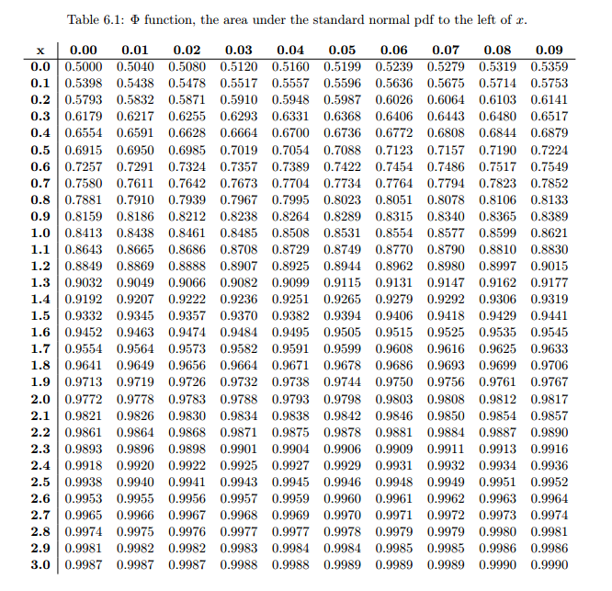
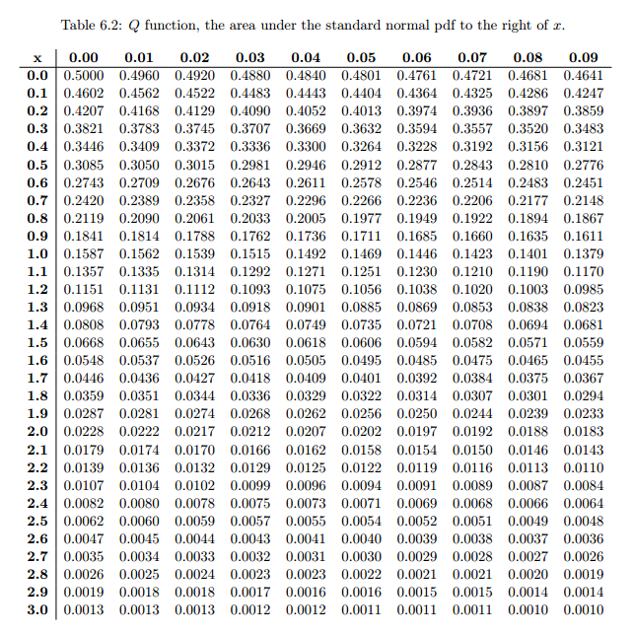
Normal or Gaussian Distribution (cont.)
The CDF of the N(0,1) distribution ( ) is denoted in the tables by , and its complementary CDF is denoted by , so:

Slide 38
Normal or Gaussian Distribution (cont.)
For a particular value, x, of a normal random variable X, the corresponding value of the standardized variable Z is:
The Cumulative distribution function of X can be found by using:
alternatively:
Similarly, if X is normally distributed with parameters μ and σ2 then
Z = αX + β is normally distributed with parameters αμ + β and α²σ².

Slide 39
Normal or Gaussian Distribution Example 1
An analog signal received at a detector (measured in microvolts) may be modeled as a Gaussian random variable N(200, 256) at a fixed point in time. What is the probability that the signal will exceed 240 microvolts? What is the probability that the signal is larger than 240 microvolts, given that it is larger than 210 microvolts?

Slide 40
Normal or Gaussian Distribution Example 1 (cont.)
Next:

Slide 41
Normal or Gaussian Distribution Example 2
Assuming that the life of a given subsystem, in the wear-out phase, is normally distributed with μ = 10,000 hours and σ = 1,000 hours, determine the reliability for an operating time of 500 hours given that
  (a) The age of the component is 9,000 hours,
  (b) The age of the component is 11,000.
The required quantity under (a) is R_{9,000}(500) and under (b) is R_{11,000}(500).

Slide 42
Normal or Gaussian Distribution (cont.)
For a particular value, x, of a normal random variable X, the corresponding value of the standardized variable Z is:
The Cumulative distribution function of X can be found by using:
alternatively:
Similarly, if X is normally distributed with parameters μ and σ2 then
Z = αX + β is normally distributed with parameters αμ + β and α²σ².

Slide 43



Normal or Gaussian Distribution (cont.)
Since the standard normal density is clearly symmetric, it follows that for z > 0:
The tabulations of the normal distribution are made only for z ≥ 0 To find P(a ≤ Z ≤ b), use F(b) - F(a).

Slide 44

Normal or Gaussian Distribution (cont.)
The CDF of the N(0,1) distribution ( ) is denoted in the tables by , and its complementary CDF is denoted by , so:

Slide 45
Normal or Gaussian Distribution Example 1
An analog signal received at a detector (measured in microvolts) may be modeled as a Gaussian random variable N(200, 256) at a fixed point in time. What is the probability that the signal will exceed 240 microvolts? What is the probability that the signal is larger than 240 microvolts, given that it is larger than 210 microvolts?

Slide 46
Normal or Gaussian Distribution Example 1 (cont.)
Next:

Slide 47
Normal or Gaussian Distribution Example 2
Assuming that the life of a given subsystem, in the wear-out phase, is normally distributed with μ = 10,000 hours and σ = 1,000 hours, determine the reliability for an operating time of 500 hours given that
  (a) The age of the component is 9,000 hours,
  (b) The age of the component is 11,000.
The required quantity under (a) is R_{9,000}(500) and under (b) is R_{11,000}(500).

Slide 48
Normal or Gaussian Distribution Example 2 (cont.)
Note that with the usual exponential assumption these two quantities will be identical.
But in the present case:

Slide 49
Normal or Gaussian Distribution Example 2 (cont.)

Slide 50
Normal or Gaussian Distribution Example 2 (cont.)

