Slide 1
Lecture 6: PPAD, related problems,
and other TFNP classes.
CS598
Ruta Mehta
Most slides are borrowed from C. Daskalakis’s presentations.

Slide 2
Menu
Existence Theorems: Nash, Brouwer, Sperner

Slide 3
Games and Equilibria
2/5
3/5
Kick Dive | Left | Right
Left | 2 , -1 | -1 , 1
Right | -1 , 1 | 1, -1
Equilibrium:
A pair of randomized strategies so that no player has incentive to deviate if the other stays put.
1/2
1/2
[Nash ’50]: An equilibrium exists in every game.
no poly-time algorithm known, despite intense effort

Slide 4
Menu
Existence Theorems: Nash, Brouwer, Sperner

Slide 5
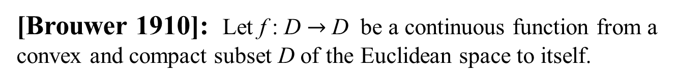
Brouwer’s Fixed Point Theorem
[Brouwer 1910]: Let f : D $→$ D be a continuous function from a convex and compact subset D of the Euclidean space to itself.
Then there exists an x $∈D$ s.t. x = f (x) .
closed and bounded
Below we show a few examples, when D is the 2-dimensional disk.
f
D
D

Slide 6
Brouwer’s Fixed Point Theorem
fixed point

Slide 7
Brouwer’s Fixed Point Theorem
fixed point

Slide 8
Brouwer’s Fixed Point Theorem
fixed point

Slide 9
Brouwer ⇒ Nash

Slide 10
Visualizing Nash’s Proof
Kick Dive | Left | Right
Left | 1 , -1 | -1 , 1
Right | -1 , 1 | 1, -1
ƒ: [0,1]² →[0,1]², continuous
such that
fixed points ≡ Nash eq.
Penalty Shot Game

Slide 11

Visualizing Nash’s Proof
0
Pr[Right]
1
0
Kick Dive | Left | Right
Left | 1 , -1 | -1 , 1
Right | -1 , 1 | 1, -1
Pr[Right]
Penalty Shot Game
1

Slide 12
Visualizing Nash’s Proof
0
Pr[Right]
1
0
Kick Dive | Left | Right
Left | 1 , -1 | -1 , 1
Right | -1 , 1 | 1, -1
Pr[Right]
Penalty Shot Game
1

Slide 13
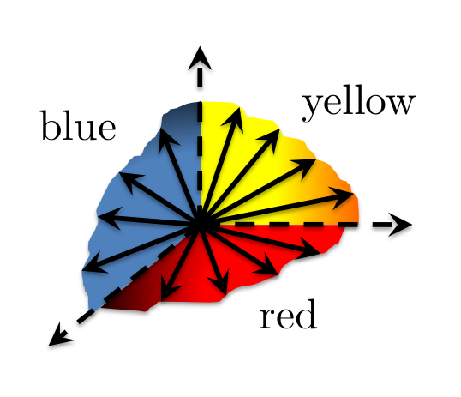
Visualizing Nash’s Proof
0
Pr[Right]
1
0
Kick Dive | Left | Right
Left | 1 , -1 | -1 , 1
Right | -1 , 1 | 1, -1
Pr[Right]
Penalty Shot Game
1

Slide 14
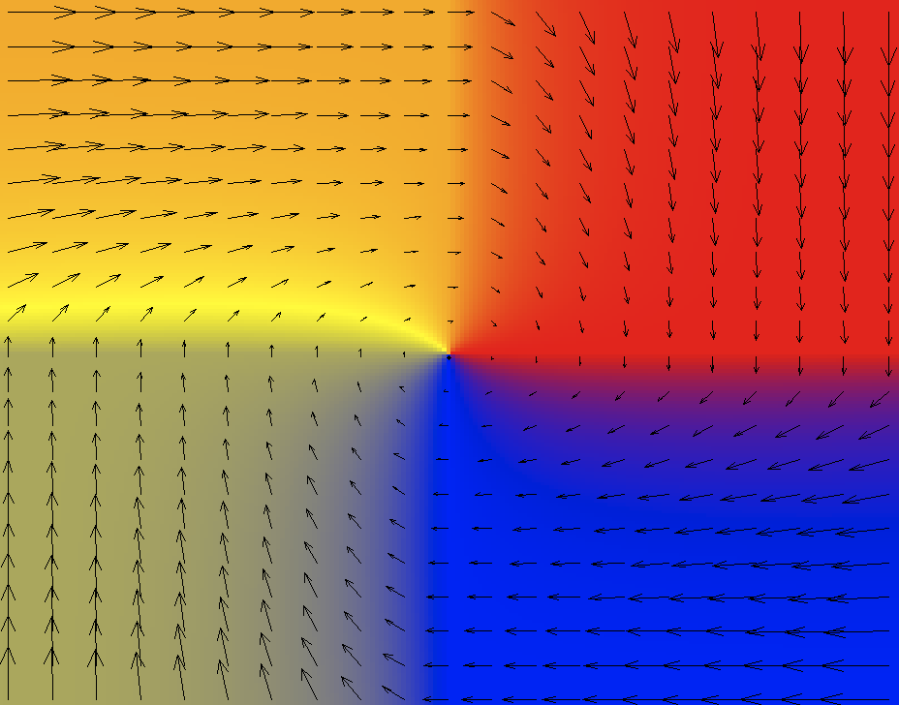
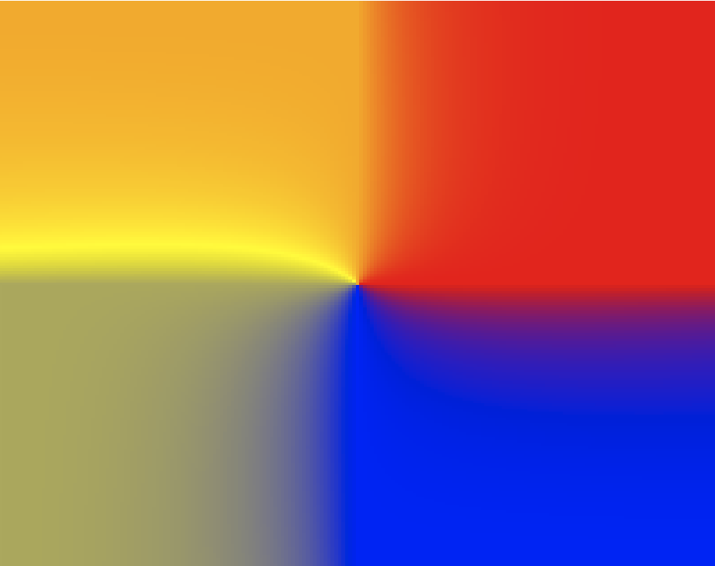
Visualizing Nash’s Proof
0
Pr[Right]
1
½
½
0
Kick Dive | Left | Right
Left | 1 , -1 | -1 , 1
Right | -1 , 1 | 1, -1
ƒ: [0,1]² →[0,1]², cont.
such that
fixed point ≡ Nash eq.
Pr[Right]
½
½
Penalty Shot Game
1
fixed point

Slide 15
Menu
Existence Theorems: Nash, Brouwer, Sperner

Slide 16
Sperner’s Lemma (2-d)

Slide 17
Sperner’s Lemma (2-d)
no yellow
legal boundary coloring
no blue
no red
[Sperner 1928]: Color the boundary using three colors in a legal way.

Slide 18
Sperner’s Lemma (2-d)
no yellow
legal boundary coloring
no blue
no red
[Sperner 1928]: Color the boundary using three colors in a legal way. No matter how the internal nodes are colored, there exists a tri-chromatic triangle. In fact an odd number of those.

Slide 19
Sperner’s Lemma (2-d)
[Sperner 1928]: Color the boundary using three colors in a legal way. No matter how the internal nodes are colored, there exists a tri-chromatic triangle. In fact an odd number of those.

Slide 20
Sperner ⇒ Brouwer

Slide 21
Sperner ⇒ Brouwer (High-Level)
Given f : [0,1]² → [0,1]²
1. For all ε, existence of approximate fixed point |f(x)-x| < ε, can be shown via Sperner’s lemma.
2. Then use compactness.
For 1: Triangulate [0,1]²;

Slide 22
Sperner ⇒ Brouwer (High-Level)
Given f : [0,1]² → [0,1]²
1. For all ε, existence of approximate fixed point |f(x)-x| < ε, can be shown via Sperner’s lemma.
2. Then use compactness.
For 1: Triangulate [0,1]²;
then color points according
to the direction of f (x)-x;

Slide 23
Sperner ⇒ Brouwer (High-Level)
Given f : [0,1]² → [0,1]²
1. For all ε, existence of approximate fixed point |f(x)-x| < ε, can be shown via Sperner’s lemma.
2. Then use compactness.
For 1: Triangulate [0,1]²;
then color points according
to the direction of f (x)-x;

Slide 24
Sperner ⇒ Brouwer (High-Level)
Given f : [0,1]² → [0,1]²
1. For all ε, existence of approximate fixed point |f(x)-x| < ε, can be shown via Sperner’s lemma.
2. Then use compactness.
For 1: Triangulate [0,1]²;
then color points according
to the direction of f (x)-x;
then apply Sperner.

Slide 25
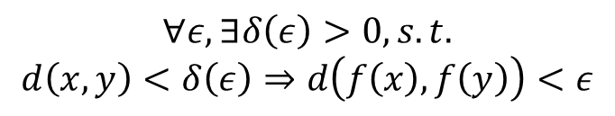
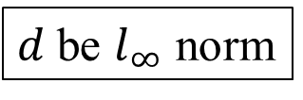
2D-Brouwer on the Square
$d$ be $l_{∞}$ norm
Suppose ƒ: [0,1]² →[0,1]², continuous
(by the Heine-Cantor theorem)
$$∀ε, ∃δ\left(ε\right)>0, s.t.$$
$$d\left(x,y\right)<δ\left(ε\right)⇒d\left(f\left(x\right), f\left(y\right)\right)<ε$$
1
0
0
1

Slide 26

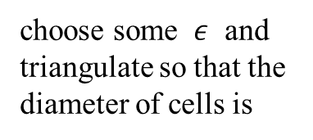
2D-Brouwer on the Square
$d$ be $l_{∞}$ norm
Suppose ƒ: [0,1]² →[0,1]², continuous
(by the Heine-Cantor theorem)
$$∀ε, ∃δ\left(ε\right)>0, s.t.$$
$$d\left(x,y\right)<δ\left(ε\right)⇒d\left(f\left(x\right), f\left(y\right)\right)<ε$$
1
choose some $ε$ and
triangulate so that the diameter of cells is
$$δ<δ(ε)$$
0
0
1

Slide 27

2D-Brouwer on the Square
$d$ be $l_{∞}$ norm
Suppose ƒ: [0,1]² →[0,1]², continuous
(by the Heine-Cantor theorem)
$$∀ε, ∃δ\left(ε\right)>0, s.t.$$
$$d\left(x,y\right)<δ\left(ε\right)⇒d\left(f\left(x\right), f\left(y\right)\right)<ε$$
color the nodes of the triangulation according to the direction of
1
$$f\left(x\right)−x$$
choose some $ε$ and
triangulate so that the diameter of cells is
$$δ<δ(ε)$$
0
0
1

Slide 28
2D-Brouwer on the Square
$d$ be $l_{∞}$ norm
Suppose ƒ: [0,1]² →[0,1]², continuous
(by the Heine-Cantor theorem)
$$∀ε, ∃δ\left(ε\right)>0, s.t.$$
$$d\left(x,y\right)<δ\left(ε\right)⇒d\left(f\left(x\right), f\left(y\right)\right)<ε$$
color the nodes of the triangulation according to the direction of
color the nodes of the triangulation according to the direction of
1
$$f\left(x\right)−x$$
choose some $ε$ and
triangulate so that the diameter of cells is
$$δ<δ(ε)$$
(tie-break at the boundary angles, so that the resulting coloring respects the boundary conditions required by Sperner’s lemma)
find a trichromatic triangle, guaranteed by Sperner
0
0
1

Slide 29
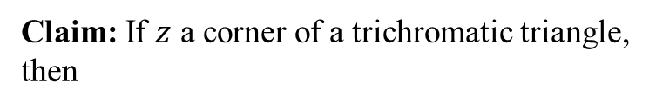


2D-Brouwer on the Square
$d$ be $l_{∞}$ norm
Suppose ƒ: [0,1]² →[0,1]², continuous
(by the Heine-Cantor theorem)
$$∀ε, ∃δ\left(ε\right)>0, s.t.$$
$$d\left(x,y\right)<δ\left(ε\right)⇒d\left(f\left(x\right), f\left(y\right)\right)<ε$$
1
Claim: If $z$ a corner of a trichromatic triangle, then
Choosing $δ=min⁡\{δ\left(ε\right),ε\}$
$${\left|f\left(z\right)−z\right|}_{∞}<cε, c>0$$
0
0
1

Slide 30




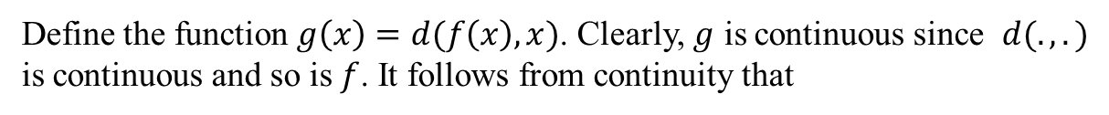
2D-Brouwer on the Square
Finishing the proof of Brouwer’s Theorem (Compactness):
- pick a sequence of epsilons: $ε_{i}=2^{−i}, i=1, 2, …$
- define a sequence of triangulations of diameter: $δ_{i}=\min\left\{δ\left(ε_{i}\right),ε_{i}\right\}, i=1,2,…$
- pick a trichromatic triangle in each triangulation. Its corner be $z_{i}, i=1,2,…$
- by compactness, this sequence has a converging subsequence $w_{i}, i=1,2,…$
with limit point $w^{∗}$
Claim: $f\left(w^{∗}\right)=w^{∗}$
Proof:
Define the function $g\left(x\right)=d(f\left(x\right),x)$. Clearly, $g$ is continuous since $d(.,.)$ is continuous and so is $f$. It follows from continuity that
$$g\left(w_{i}\right)→g\left(w^{∗}\right), as i→∞$$
But $0≤g\left(w^{i}\right)≤c2^{−i}$. Hence, $g\left(w_{i}\right)→0$. It follows that $g\left(w^{∗}\right)=0$.
Therefore, $d\left(f\left(w^{∗}\right),w^{∗}\right)=0⇒f\left(w^{∗}\right)=w^{∗}$

Slide 31
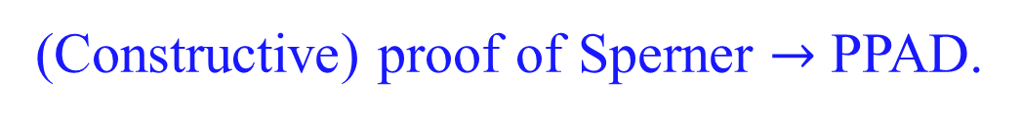
Menu
Existence Theorems: Nash, Brouwer, Sperner
(Constructive) proof of Sperner $→$ PPAD.

Slide 32
Proof of Sperner’s Lemma
[Sperner 1928]: Color the boundary using three colors in a legal way. No matter how the internal nodes are colored, there exists a tri-chromatic triangle. In fact an odd number of those.

Slide 33
Proof of Sperner’s Lemma
For convenience we introduce an outer boundary, that does not create new tri-chromatic triangles.
We also introduce an artificial tri-chromatic triangle.
Next we define a directed walk starting from the artificial tri-chromatic triangle.
[Sperner 1928]: Color the boundary using three colors in a legal way. No matter how the internal nodes are colored, there exists a tri-chromatic triangle. In fact an odd number of those.

Slide 34
Proof of Sperner’s Lemma
Space of Triangles
Transition Rule:
If ∃ red - yellow door cross it with red on your left hand.
?
₂
₁
[Sperner 1928]: Color the boundary using three colors in a legal way. No matter how the internal nodes are colored, there exists a tri-chromatic triangle. In fact an odd number of those.

Slide 35
Proof of Sperner’s Lemma
Claim: The walk cannot exit the square, nor can it loop into itself.
Hence, it must stop somewhere inside. This can only happen at tri-chromatic triangle…
For convenience we introduce an outer boundary, that does not create new tri-chromatic triangles.
We also introduce an artificial tri-chromatic triangle.
!
Next we define a directed walk starting from the artificial tri-chromatic triangle.
Starting from other triangles we do the same going forward or backward.
[Sperner 1928]: Color the boundary using three colors in a legal way. No matter how the internal nodes are colored, there exists a tri-chromatic triangle. In fact an odd number of those.

Slide 36
Proof Structure: A directed parity argument
Vertices of Graph ≡ Triangles
all vertices have in-degree, out-degree ≤ 1
Artificial Trichromatic
...
degree 1 vertices: trichromatic triangles
degree 2 vertices: no blue, non-trichromatic
degree 0 vertices: all other triangles
Proof: ∃ at least one trichromatic (artificial one)
➔ ∃ another trichromatic

Slide 37
Recall: Lemke-Howson Structure for 2-Nash
Vertices of Graph ≡ vertices of the polyhedron.
0
...
degree 1 vertices: fully-labeled
degree 2 vertices: no label 1, 1-almost labeled
degree 0 vertices: all other vertices of the polytope
Proof: 0 fully-labeled
➔ ∃ another fully-labeled

Slide 38




The PPAD Class [Papadimitriou ’94]
(Polynomial Parity Argument for Directed Graph)
Suppose that an exponentially large graph with vertex set {0,1}^{n} is defined by two circuits:
possible previous
node id
node id
$${P(v}_{2})=v_{1} \& N\left(v_{1}\right)=v_{2}$$
P
$$v_{2}$$
node id
N
node id
$$v_{1}$$
possible next
END OF THE LINE:
Given P and N: If 0^{n} is an unbalanced node, find another unbalanced node. Otherwise output 0^{n}.
PPAD =
{ Problems reducible to END OF A LINE }

Slide 39



END OF A LINE
{0,1}^{n}
0^{n}
...
= solution
$$v_{2}$$
$$⇔P\left(v_{2}\right)=v_{1} \& N\left(v_{1}\right)=v_{2}$$
$$v_{1}$$

Slide 40
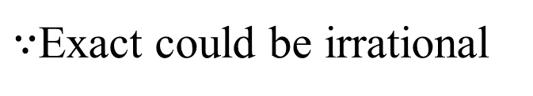
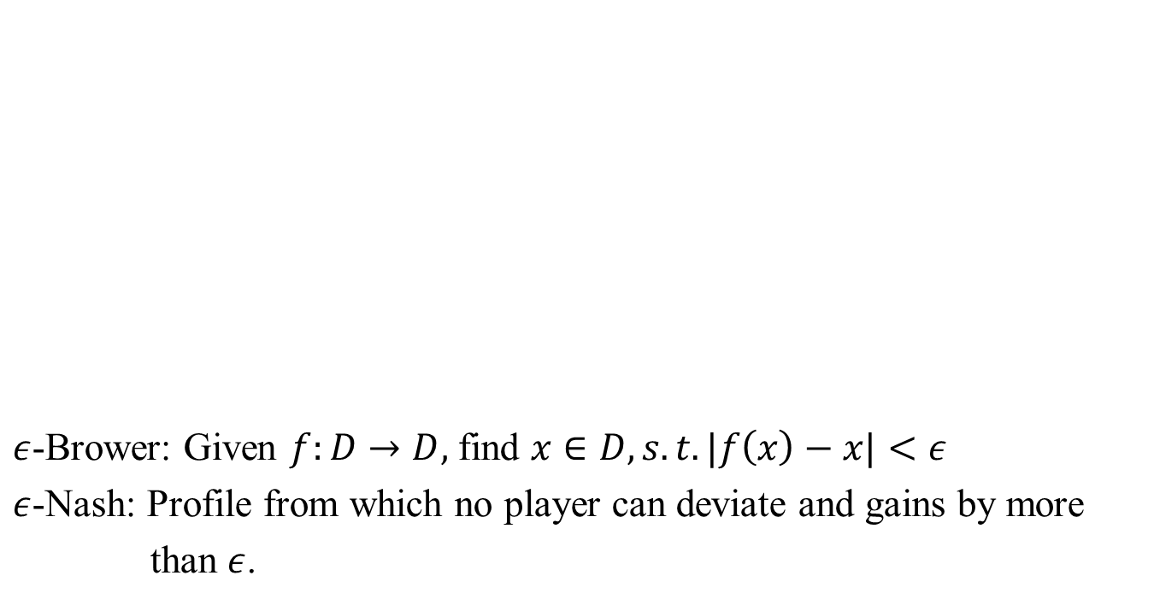
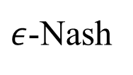
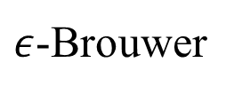
[Papadimitriou ’94]
PPAD
$ε$-Brower: Given $f:D→D,$ find $x∈D, s.t. |f\left(x\right)−x|<ε$
$ε$-Nash: Profile from which no player can deviate and gains by more
than $ε$.
Sperner
$ε$-Brouwer
$ε$-Nash
$∵$Exact could be irrational

Slide 41
Menu
Existence Theorems: Nash, Brouwer, Sperner
(Constructive) proof of Sperner, and PPAD
Why not use NP?
Total Search problems.

Slide 42
NP vs PPAD
NP
Poly-time
verifier
PPAD
NO!
Can they be NP-hard?
Because,
NP: If there exists a solution. Yes/No?
Here the answer is always YES!
  The problem is to find a solution.
Sperner
$ε$-Brouwer
$ε$-Nash

Slide 43



Function NP (FNP): Search problems
Either find a solution or say there is none!
Problem L$∈$ FNP has a poly-time verifier$A_{L}$ s.t. $A_{L}\left(x,y\right)=1$ if $y$ is a soln. of $x∈L$
It is poly-time (Karp) reducible to another problem L’ $∈$ FNP, associated with A_{L’}, iff there exist poly-time functions f, g such that
(i) f : {0,1}* → {0,1}* maps inputs x to L into inputs f(x) to L’
can’t reduce SAT to SPERNER, NASH or BROUWER
(ii)
$∀$ x,y: A_{L’} (f(x), y)=1 ⇒ A_{L}(x, g(y))=1
$∀$ x: A_{L’} (f(x), y)=0, ∀ y ⇒ A_{L}(x, y)=0, ∀ y
A search problem L’ is FNP-complete iff
L’ $∈$ FNP
e.g. SAT
$∀L∈$ FNP, L is poly-time reducible to L’.
SPERNER, NASH, BROUWER $∈$ FNP.

Slide 44


Total FNP
A search problem L is called total iff $∀$x $∃$y such that $A_{L}$(x, y)=1
Guaranteed solution!
TFNP = {L $∈$ FNP | L is total}
PPAD $⊆$ TFNP
Complexity Theory of TFNP:
1. identify the combinatorial argument of existence, responsible for making these problems total;
2. define a complexity class inspired by the argument of existence;
3. make sure that the complexity of the problem was captured as tightly as possible (via completeness results).

Slide 45
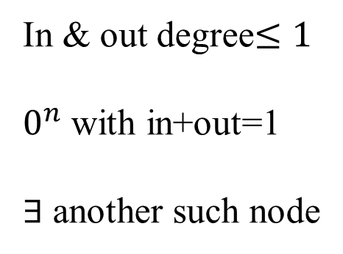
PPAD:
{0,1}^{n}
In & out degree$≤1$
$0^{n}$ with in+out=1
$∃$ another such node
0^{n}
...
= solution

Slide 46
Other arguments of existence, and resulting complexity classes
“If a graph has a node of odd degree, then it must have another.”
PPA
“Every directed acyclic graph must has a sink.”
PLS
“If a function maps n elements to n-1 elements, then there is a collision.”
PPP
Formally?

Slide 47



PPA: Polynomial Parity Argument [Papadimitriou ’94]
“If a graph has a node of odd degree, then it must have another.”
Suppose that an exponentially large graph with vertex set {0,1}^{n} is defined by one circuit:
possible adjacent nodes
$$v_{1}∈A\left(v_{2}\right) \& v_{2}∈A(v_{1})$$
node id
A
{ node id₁ , node id₂}
$$v_{2}$$
$$v_{1}$$
ODD DEGREE NODE:
Given C, if 0^{n} has odd degree, find another node
with odd degree. Otherwise say “yes”.
PPA =
{ Search problems in FNP reducible to ODD DEGREE NODE}

Slide 48
The Undirected Graph
{0,1}^{n}
0^{n}
...
= solution

Slide 49





PLS: Polynomial Local Search
[Johnson, Papadimitriou, Yannakakis ’89]
“Every DAG has a sink.”
Suppose that a DAG with vertex set {0,1}^{n} is defined by two circuits:
node id
A
{node id₁, …, node id_{k}}
$$v_{2}∈A\left(v_{1}\right) \& F\left(v_{2}\right)>F\left(v_{1}\right)$$
$$v_{2}$$
node id
F
$$ℝ$$
$$v_{1}$$
FIND SINK:
Given C, F: Find x s.t. F(x) ≥ F(y), for all y ∈ C(x).
PLS =
{ Search problems in FNP reducible to FIND SINK}

Slide 50
The DAG
{0,1}^{n}
= solution

Slide 51
PPP: Polynomial Pigeonhole Principle [Papadimitriou ’94]
“If a function maps n elements to n-1 elements, then there is a collision.”
Suppose that an exponentially large graph with vertex set {0,1}^{n} is defined by one circuit:
node id
C
node id
COLLISION:
Given C: Find x s.t. C( x )= 0^{n}; or find x ≠ y s.t. C(x)=C(y).
PPP =
{ Search problems in FNP reducible to COLLISION }

Slide 52
TFNP
PLS
PPP
PPA
PPAD
P
Notes:
Exercise: Show that PPAD is a subset of PPP.

