Slide 1
Lecture 6: Other Game Models and
Solution Concepts
CS598
Ruta Mehta
Some slides are borrowed from V. Conitzer’s presentations.

Slide 2
So far
Normal-form games
  Multiple rational players, single shot, simultaneous move
Nash equilibrium
  Existence
  Computation in two-player games.

Slide 3
Today:
Dominance and Iterated Elimination
Solution concepts
  Correlated equilibria
  Coarse-correlated equilibria
  Stackelberg equilibria
Other Games
  Extensive-form Games
  Bayesian Games
  Poly-matrix Games

Slide 4
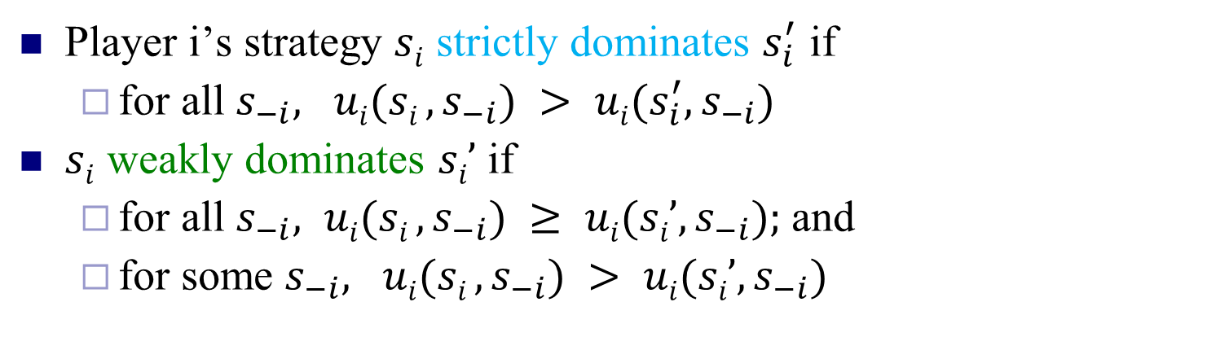
Dominance
Player i’s strategy $si$ strictly dominates $s_{i}^{′}$ if
  for all $s_{−i}, ui(si , s_{−i}) > ui{(s_{i}^{′}, s}_{−i})$
$si$ weakly dominates $si’$ if
  for all $s_{−i}, ui(si , s_{−i}) ≥ ui(si’, s_{−i});$and
  for some $s_{−i}, ui(si , s_{−i}) > ui(si’, s_{−i})$
-i = “the player(s) other than i”
L
M
R
U
0, 0 | 1, -1 | 1, -1
-1, 1 | 0, 0 | -1, 1
-1, 1 | 1, -1 | 0, 0
strict dominance
G
weak dominance
B

Slide 5
Prisoner’s Dilemma
Pair of criminals has been caught
They have two choices: {confess, don’t confess}
Attorney offers them a deal:
  If both confess to the major crime, they each get a 1 year reduction
  If only one confesses, that one gets 3 years reduction
confess
don’t confess
confess
-2, -2 | 0, -3
-3, 0 | -1, -1
don’t confess

Slide 6
“Should I buy an SUV?”
purchasing cost
accident cost
cost: 5
cost: 5
cost: 5
cost: 8
cost: 2
cost: 3
cost: 5
cost: 5
-10, -10 | -7, -11
-11, -7 | -8, -8

Slide 7
Dominance by Mixed strategies
Example of dominance by a mixed strategy:
3, 1 | 0, 0
0, 0 | 3, 2
1, 0 | 1, 1
1/2
1/2

Slide 8


Alice
Bob
m choices
n choices
$$A_{m×n}$$
$$B_{m×n}$$

Slide 9
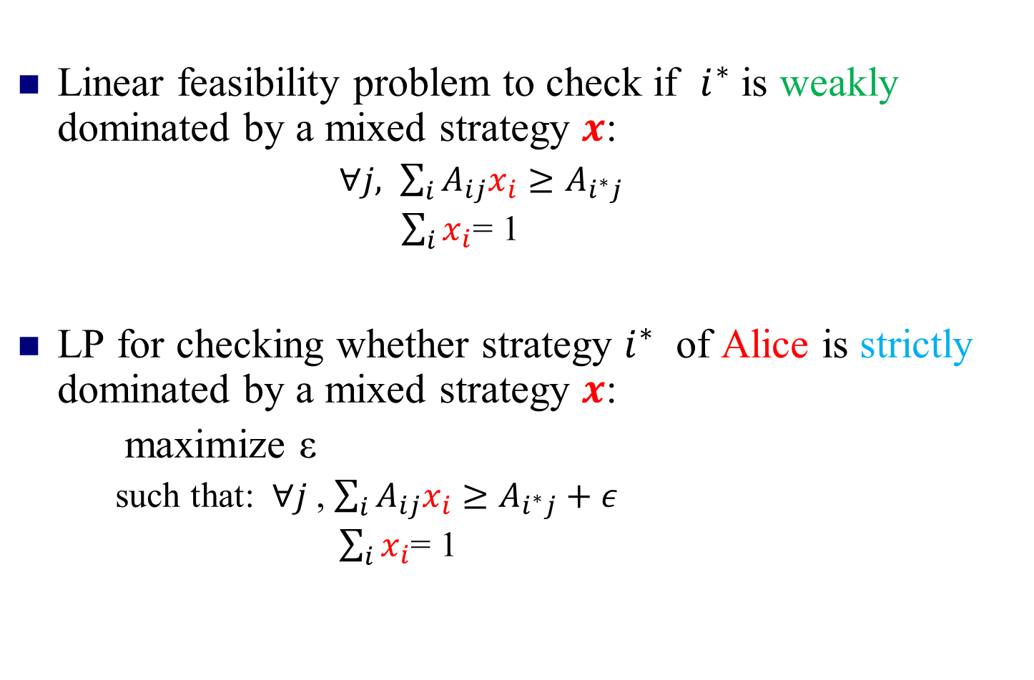
Checking for dominance by mixed strategies in two-player games
Linear feasibility problem to check if $i^{∗}$ is weakly dominated by a mixed strategy $x$:
  $∀j, \sum_{i}{A_{ij}x_{i}}≥A_{i^{∗}j}$
  $\sum_{i}{x_{i}}$= 1
LP for checking whether strategy $i^{∗}$ of Alice is strictly dominated by a mixed strategy $x$:
maximize ε
  such that: $∀j$ , $\sum_{i}{A_{ij}x_{i}}≥A_{i^{∗}j}+ε$
  $\sum_{i}{x_{i}}$= 1
Holds for n-player games too!

Slide 10
Iterated dominance
Iterated dominance: remove (strictly/weakly) dominated strategy, repeat.
L
M
R
U
0, 0 | 1, -1 | 1, -1
-1, 1 | 0, 0 | -1, 1
-1, 1 | 1, -1 | 0, 0
L
R
G
U
0, 0 | 1, -1
-1, 1 | 0, 0
B
B

Slide 11
Iterated dominance: path (in)dependence
Iterated weak dominance is path-dependent: sequence of eliminations may determine which solution we get (if any)
(whether or not dominance by mixed strategies allowed)
0, 1 | 0, 0
1, 0 | 1, 0
0, 0 | 0, 1
0, 1 | 0, 0
1, 0 | 1, 0
0, 0 | 0, 1
0, 1 | 0, 0
1, 0 | 1, 0
0, 0 | 0, 1
Iterated strict dominance is path-independent: elimination process will always terminate at the same point
(whether or not dominance by mixed strategies allowed)

Slide 12
Computational questions for n-player games.
1. Can a given strategy be eliminated using iterated dominance?
2. Is there some path of elimination by iterated dominance such that only one strategy per player remains?
For strict dominance both can be solved in polynomial time due to path-independence
  Check if any strategy is dominated, remove it, repeat
For weak dominance, both questions are NP-hard (even when all utilities are 0 or 1), with or without dominance by mixed strategies [Conitzer, Sandholm 05]
  Weaker version proved by [Gilboa, Kalai, Zemel 93]

Slide 13




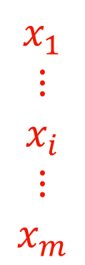
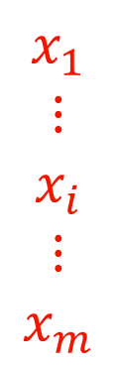
$$y_{1} … y_{j} … y_{n}$$
$$y_{1} … y_{j} … y_{n}$$
$$x_{1}$$
$$⋮$$
$$x_{i}$$
$$⋮$$
$$x_{m}$$
$$x_{1}$$
$$⋮$$
$$x_{i}$$
$$⋮$$
$$x_{m}$$
A
B
NE:
$x^{T}Ay≥{x^{′}}^{T}Ay,$ $∀x′$
$x^{T}By≥x^{T}By′,$ $∀y′$
No one plays
dominated
strategies.
Why this?
What if they can discuss beforehand?

Slide 14


Players: {Alice, Bob}
Two options: {Football, Shopping}
$$2/3 1/3$$
F
S
At Mixed NE
both get 2/3 < 1
$$1/3$$
$$2/3$$
F
1 2
0 0
0.5
S
0 0
2 1
0.5
Instead they agree on ½(F, S), ½(S, F)
Payoffs are (1.5, 1.5)
Fair!
Needs a common coin toss!

Slide 15
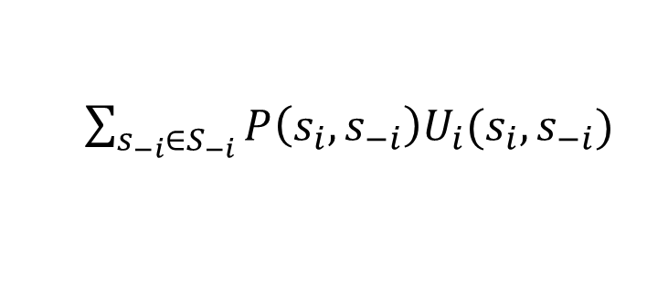
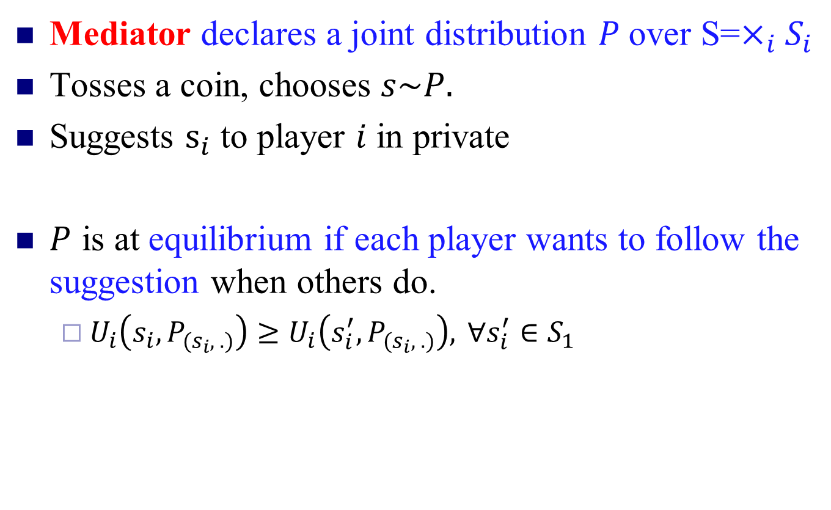
Correlated Equilibrium – (CE) (Aumann’74)
Mediator declares a joint distribution $P$over S=$×_{i}S_{i}$
Tosses a coin, chooses $s\sim P.$
Suggests $s_{i}$ to player $i$ in private
$P$ is at equilibrium if each player wants to follow the suggestion when others do.
  $U_{i}\left(s_{i}, P_{(s_{i}, .)}\right)≥U_{i}\left(s_{i}^{′}, P_{(s_{i}, .)}\right), ∀s_{i}^{′}∈S_{1}$
$\sum_{s_{−i}∈S_{−i}}{P\left({s_{i}, s}_{−i}\right)U_{i}(s_{i},s_{−i})}$
Linear in P variables!

Slide 16

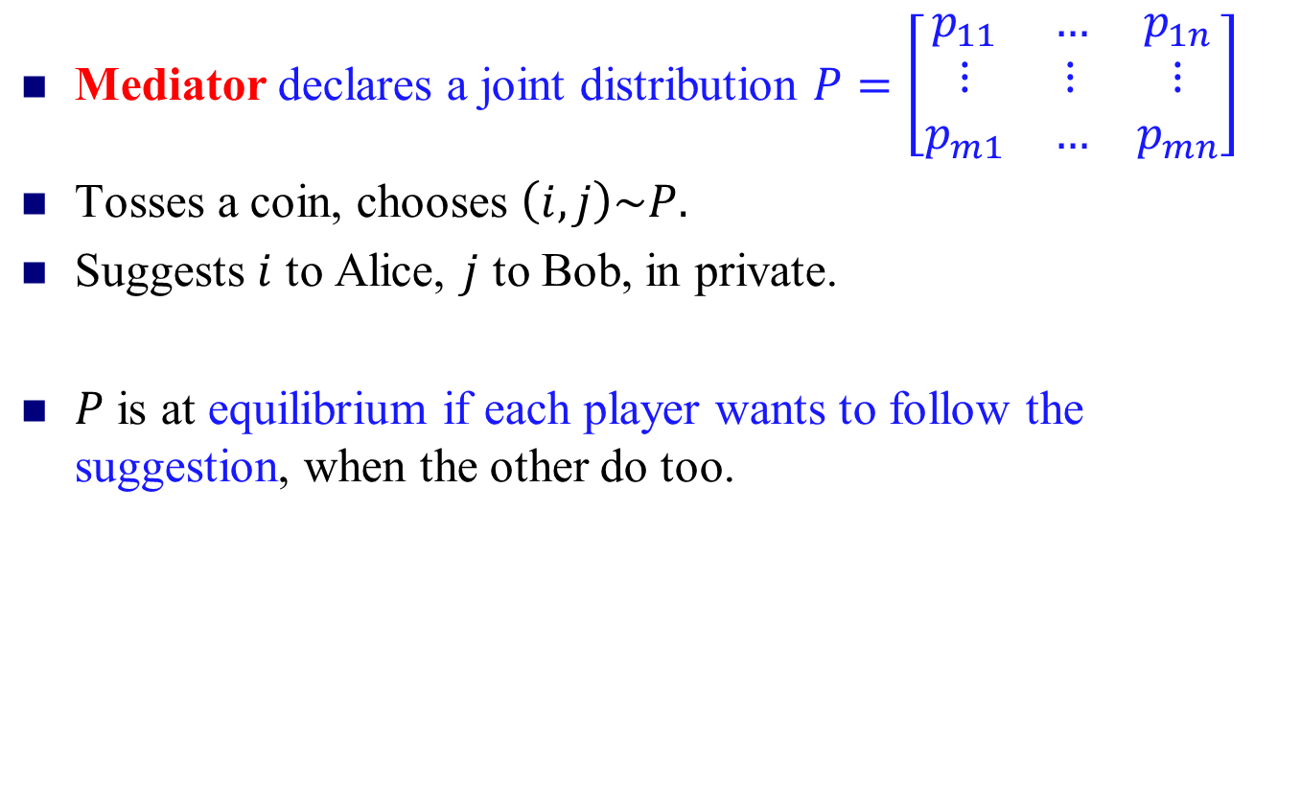

CE for 2-Player Case
Mediator declares a joint distribution $P=\left[\begin{matrix}p_{11} & … & p_{1n} \\ ⋮ & ⋮ & ⋮ \\ p_{m1} & … & p_{mn}\end{matrix}\right]$
Tosses a coin, chooses $\left(i,j\right)\sim P.$
Suggests $i$ to Alice, $j$ to Bob, in private.
$P$ is at equilibrium if each player wants to follow the suggestion, when the other do too.
Given Alice is suggested $i,$ she knows Bob is suggested $j\sim P_{(i, .)}$
$$e_{i}AP_{(i, .)}≥e_{i^{′}}AP_{\left(i, .\right)} :∀i^{′}∈S_{1}$$
$$P_{(. ,j)}Be_{j}≥P_{\left(. ,j\right)}Be_{j^{′}} :∀j^{′}∈S_{2}$$

Slide 17
Players: {Alice, Bob}
Two options: {Football, Shopping}
F
S
F
1 2
0 0
0.5
S
0 0
2 1
0.5
Instead they agree on ½(F, S), ½(S, F)
Payoffs are (1.5, 1.5)
CE!
Fair!

Slide 18
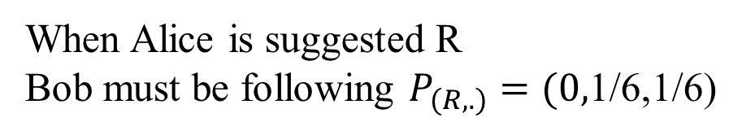
Rock-Paper-Scissors
(Aumann)
Prisoner’s Dilemma
C
NC
R
P
S
C
-2, -2 | 0, -3
-3, 0 | -1, -1
R
0, 0 | 0, 1 | 1, 0
1, 0 | 0, 0 | 0, 1
0, 1 | 1, 0 | 0, 0
1
0
0
1/6
1/6
NC
0
0
P
1/6
0
1/6
NC is dominated
S
1/6
1/6
0
When Alice is suggested R
Bob must be following $P_{(R,.)}=(0,$1/6,1/6)
Following the suggestion gives her 1/6
While P gives 0, and S gives 1/6.

Slide 19
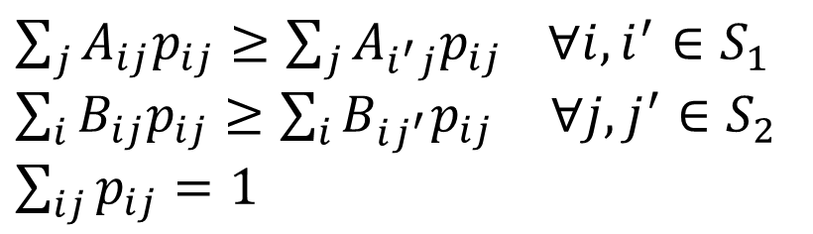
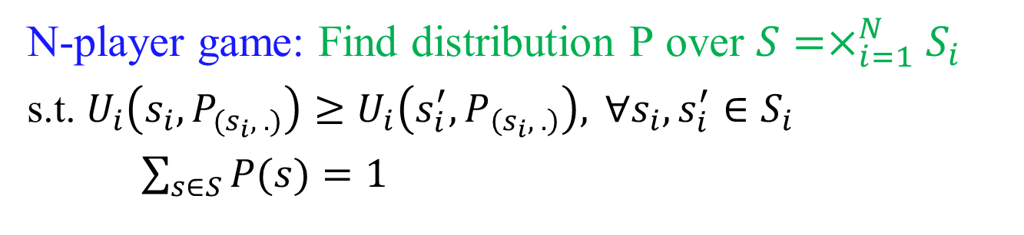
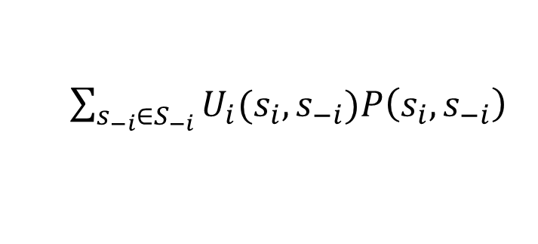
Computation: Linear Feasibility Problem
N-player game: Find distribution P over $S=×_{i=1}^{N}S_{i}$
s.t. $U_{i}\left(s_{i}, P_{(s_{i}, .)}\right)≥U_{i}\left(s_{i}^{′}, P_{\left(s_{i}, .\right)}\right), ∀s_{i}, s_{i}^{′}∈S_{i}$
$\sum_{s∈S}{P(s)}=1$
$\sum_{s_{−i}∈S_{−i}}{U_{i}(s_{i},s_{−i})P\left({s_{i}, s}_{−i}\right)}$
Linear in P variables!
Two-player Game (A, B):
$\sum_{j}{A_{ij}p_{ij}}≥\sum_{j}{A_{i^{′}j}p_{ij}} ∀i, i^{′}∈S_{1}$
$\sum_{i}{B_{ij}p_{ij}}≥\sum_{i}{B_{ij^{′}}p_{ij}} ∀j, j^{′}∈S_{2}$
$\sum_{ij}{p_{ij}}=1$

Slide 20

Computation: Linear Feasibility Problem
N-player game: Find distribution P over $S=×_{i=1}^{N}S_{i}$
s.t. $U_{i}\left(s_{i}, P_{(i,.)}\right)≥U_{i}\left(s_{i}^{′}, P_{\left(s_{i},.\right)}\right), ∀s_{i}, s_{i}^{′}∈S_{i}$
$\sum_{s∈S}{P(s)}=1$
$\sum_{s_{−i}∈S_{−i}}{U_{i}(s_{i},s_{−i})P\left({s_{i}, s}_{−i}\right)}$
Linear in P variables!
Can optimize convex function as well!

Slide 21
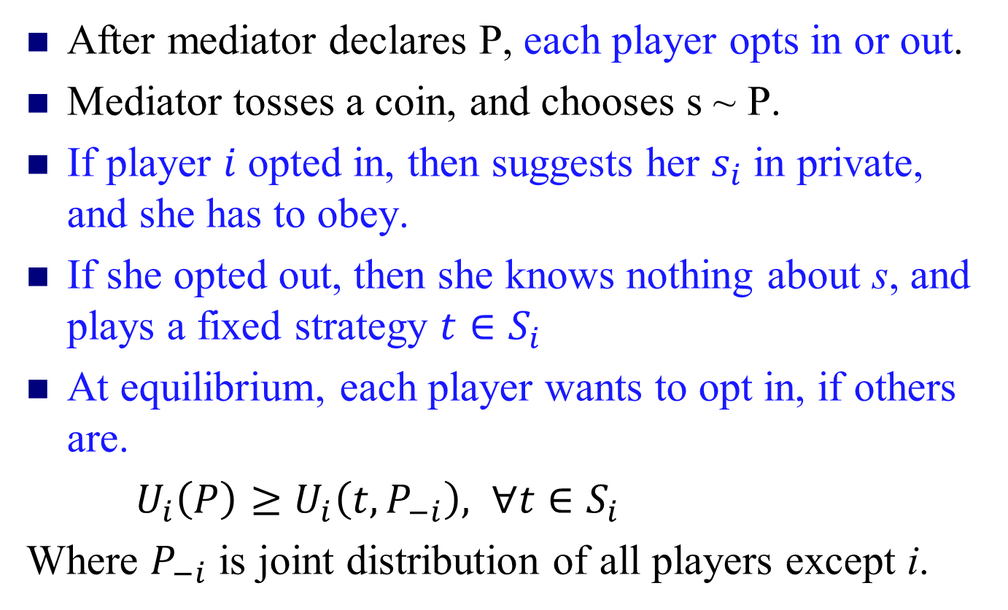
Coarse- Correlated Equilibrium
After mediator declares P, each player opts in or out.
Mediator tosses a coin, and chooses s ~ P.
If player $i$ opted in, then suggests her $s_{i}$ in private, and she has to obey.
If she opted out, then she knows nothing about s, and plays a fixed strategy $t∈S_{i}$
At equilibrium, each player wants to opt in, if others are.
$U_{i}\left(P\right)≥U_{i}\left(t,P_{−i}\right), ∀t∈S_{i}$
Where $P_{−i}$ is joint distribution of all players except i.

Slide 22
Importance of (Coarse) CE
Natural dynamics quickly arrive at approximation of such equilibria.
  No-regret, MWU
Poly-time computable in the size of the game.
  Can optimize a convex function too.

Slide 23
Show the following
CCE
CE
NE
PNE

Slide 24
Extensive-form Game
Players move one after another
  Chess, Poker, etc.
  Tree representation.
Firm 2
Strategy of a player:
What to play at each of its node.
out
in
Firm 1
2,0
I
O
fight
accommodate
-1, 1 | 2, 0
1, 1 | 2, 0
F
-1,1
1,1
A
Entry game

Slide 25
A poker-like game
Both players put 1 chip in the pot
Player 1 gets a card (King is a winning card, Jack a losing card)
Player 1 decides to raise (add one to the pot) or check
Player 2 decides to call
(match) or fold (P1 wins)
If player 2 called, player
1’s card determines
pot winner

Slide 26
Poker-like game in normal form
“nature”
1 gets King
1 gets Jack
cc
cf
fc
ff
player 1
player 1
rr
0, 0 | 0, 0 | 1, -1 | 1, -1
.5, -.5 | 1.5, -1.5 | 0, 0 | 1, -1
-.5, .5 | -.5, .5 | 1, -1 | 1, -1
0, 0 | 1, -1 | 0, 0 | 1, -1
raise
check
raise
check
rc
player 2
player 2
cr
call
fold
call
fold
call
fold
call
fold
cc
2
1
1
1
-2
1
-1
1
Can be exponentially big!

Slide 27
Sub-Game Perfect Equilibrium
Every sub-tree is at equilibrium
Computation when perfect information (no nature/chance move): Backward induction
Firm 2
out
in
Firm 1
2,0
Firm 2
fight
accommodate
out
in
-1,1
1,1
2,0
1,1
accommodate
Entry game

Slide 28
Sub-Game Perfect Equilibrium
Every sub-tree is at equilibrium
Computation when perfect information (no nature/chance move): Backward induction
Firm 2
out
in
Firm 1
(accommodate, in)
2,0
Firm 2
fight
accommodate
out
in
-1,1
1,1
2,0
1,1
accommodate
Entry game

Slide 29
Corr. Eq. in Extensive form Game
How to define?
  CE in its normal-form representation.
Is it computable?
  Recall: exponential blow up in size.
Can there be other notions?
See “Extensive-Form Correlated Equilibrium: Definition and Computational Complexity” by von Stengel and Forges, 2008.

Slide 30
Commitment (Stackelberg strategies)

Slide 31
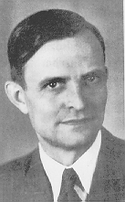
Commitment
1, 1 | 3, 0
0, 0 | 2, 1
Unique Nash equilibrium (iterated strict dominance solution)
von Stackelberg
Suppose the game is played as follows:
  Player 1 commits to playing one of the rows,
  Player 2 observes the commitment and then chooses a column
Optimal strategy for player 1: commit to Down

Slide 32
Commitment: an extensive-form game
For the case of committing to a pure strategy:
Player 1
Up
Down
Player 2
Player 2
Left
Right
Left
Right
1, 1
3, 0
0, 0
2, 1

Slide 33
Commitment to mixed strategies
0
1
.49
1, 1 | 3, 0
0, 0 | 2, 1
.51
Also called a Stackelberg (mixed) strategy

Slide 34
Commitment: an extensive-form game
… for the case of committing to a mixed strategy:
Player 1
(1,0) (=Up)
(.5,.5)
(0,1) (=Down)
…
…
Player 2
Left
Right
Left
Right
Left
Right
1, 1
3, 0
.5, .5
2.5, .5
0, 0
2, 1
Economist: Just an extensive-form game, nothing new here
Computer scientist: Infinite-size game! Representation matters

Slide 35
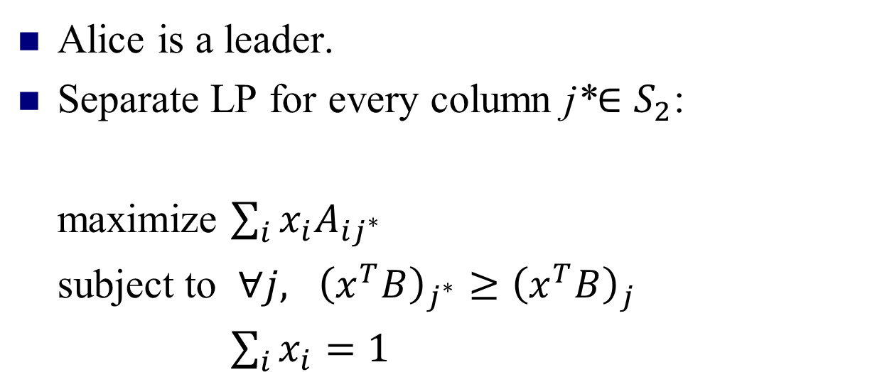
Computing the optimal mixed strategy to commit to
[Conitzer & Sandholm EC’06]
Alice is a leader.
Separate LP for every column j*$∈S_{2}$:
maximize $\sum_{i}{x_{i}A_{ij^{∗}}}$
subject to $∀j, {\left(x^{T}B\right)}_{j^{∗}}≥{\left(x^{T}B\right)}_{j}$
$\sum_{i}{x_{i}}=1$
Row utility
Column optimality
distributional constraint
Pick the one that gives max utility.

Slide 36
On the game we saw before
x
1, 1 | 3, 0
0, 0 | 2, 1
y
maximize 1x + 0y
subject to
1x + 0y ≥ 0x + 1y
x + y = 1
x ≥ 0, y ≥ 0
maximize 3x + 2y
subject to
0x + 1y ≥ 1x + 0y
x + y = 1
x ≥ 0, y ≥ 0

Slide 37
Visualization
 | L | C | R
U | 0,1 | 1,0 | 0,0
M | 4,0 | 0,1 | 0,0
D | 0,0 | 1,0 | 1,1
(0,1,0) = M
C
L
R
(1,0,0) = U
(0,0,1) = D

Slide 38


Generalizing beyond zero-sum games
Minimax, Nash, Stackelberg all agree in zero-sum games
0, 0 | -1, 1
-1, 1 | 0, 0
zero-sum games
minimax strategies
zero-sum games
general-sum games
Nash equilibrium
zero-sum games
general-sum games
Stackelberg mixed strategies

Slide 39
Other nice properties of commitment to mixed strategies
0, 0 | -1, 1
1, -1 | -5, -5
No equilibrium selection problem
Leader’s payoff at least as good as any Nash eq. or even correlated eq. (von Stengel & Zamir [GEB ‘10])
≥

Slide 40
Previous Lecture
Dominance and Iterated Elimination
Solution concepts
  Correlated equilibria
  Coarse-correlated equilibria
  Stackelberg equilibria
Other Games
  Extensive-form Games
  Bayesian Games
  Succinct multi-player games: Poly-matrix

Slide 41
Bayesian Games
So far in Games,
Complete information (each player has perfect information
regarding the element of the game).
Bayesian Game
A game with incomplete information
Each player has initial private information, type.
- Bayesian equilibrium: solution of the Bayesian game

Slide 42
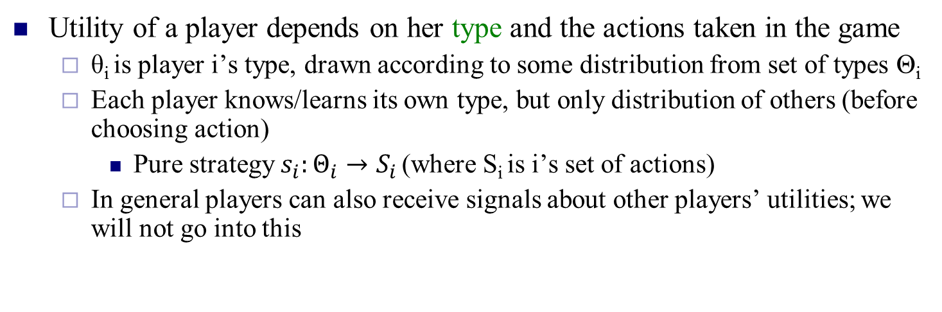
Bayesian game
Utility of a player depends on her type and the actions taken in the game
  θ_{i} is player i’s type, drawn according to some distribution from set of types Θ_{i}
  Each player knows/learns its own type, but only distribution of others (before choosing action)
    Pure strategy $s_{i}:Θ_{i}→S_{i}$ (where S_{i} is i’s set of actions)
  In general players can also receive signals about other players’ utilities; we will not go into this
L
R
L
R
row player
type 1 (prob. 0.5)
U
4 | 6
2 | 4
column player
type 1 (prob. 0.5)
U
4 | 6
4 | 6
D
D
L
R
L
R
row player
type 2 (prob. 0.5)
U
2 | 4
4 | 2
column player
type 2 (prob. 0.5)
U
2 | 2
4 | 2
D
D

Slide 43
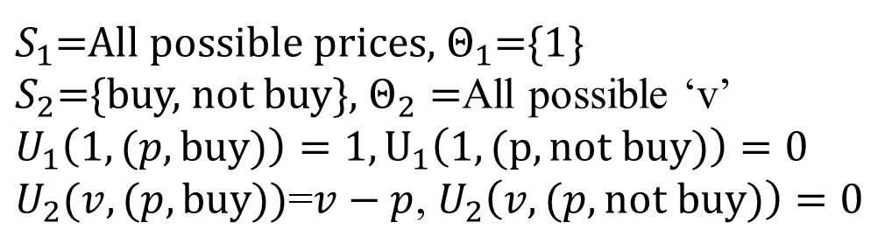
Car Selling Game
A seller wants to sell a car
A buyer has private value ‘v’ for the car w.p. P(v)
Sellers knows P, but not v
Seller sets a price ‘p’, and buyer decides to buy or not buy.
If sell happens then the seller is happy, and buyer gets v-p.
$S_{1}$=All possible prices, $Θ_{1}$={1}
$S_{2}$={buy, not buy}, $Θ_{2}=$All possible ‘v’
$U_{1}\left(1,(p, buy)\right)=1, U_{1}\left(1, (p, not buy)\right)=0$
$U_{2}(v,(p,buy))$=$v−p$, $U_{2}\left(v,(p, not buy)\right)=0$

Slide 44
Converting Bayesian games to normal form
L
R
L
R
row player
type 1 (prob. 0.5)
U
4 | 6
2 | 4
column player
type 1 (prob. 0.5)
U
4 | 6
4 | 6
D
D
L
R
L
R
row player
type 2 (prob. 0.5)
U
2 | 4
4 | 2
column player
type 2 (prob. 0.5)
U
2 | 2
4 | 2
D
D
type 1: L
type 2: L
type 1: L
type 2: R
type 1: R
type 2: L
type 1: R
type 2: R
type 1: U
type 2: U
3, 3 | 4, 3 | 4, 4 | 5, 4
4, 3.5 | 4, 3 | 4, 4.5 | 4, 4
2, 3.5 | 3, 3 | 3, 4.5 | 4, 4
3, 4 | 3, 3 | 3, 5 | 3, 4
type 1: U
type 2: D
exponential blowup in size
type 1: D
type 2: U
type 1: D
type 2: D

Slide 45
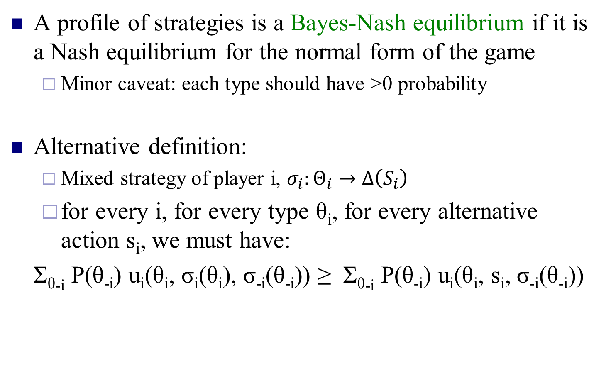

Bayes-Nash equilibrium
A profile of strategies is a Bayes-Nash equilibrium if it is a Nash equilibrium for the normal form of the game
  Minor caveat: each type should have >0 probability
Alternative definition:
  Mixed strategy of player i, $σ_{i}:Θ_{i}→Δ\left(S_{i}\right)$
  for every i, for every type θ_{i}, for every alternative action s_{i}, we must have:
Σ_{θ-i} P(θ_{-i}) u_{i}(θ_{i}, σ_{i}(θ_{i}), σ_{-i}(θ_{-i})) ≥ Σ_{θ-i} P(θ_{-i}) u_{i}(θ_{i}, s_{i}, σ_{-i}(θ_{-i}))
$$Π_{p≠i}P(θ_{p})$$

Slide 46
Again what about corr. eq. in Bayesian games?
Notion of signaling.
Look up the literature.

Slide 47
Multi-player games
Some slides from C. Papadimitriou’s presentation.

Slide 48
Many player Games
With games we are supposed to model markets and the Internet
These have many players
To describe a game with n players and s strategies per player you need ns^{n} numbers

Slide 49
Recall: Corr. Eq. in n-player game
Linear programming!
n players, s strategies each
ns² inequalites
s^{n} variables!
Nice for 2 or 3 players
But many players?

Slide 50
Many players (cont.)
These important games cannot require astronomically long descriptions
“if your problem is important, then its input cannot be astronomically long…”
Conclusion: Many interesting games are
  multi-player
  succinctly representable

Slide 51
e.g., Graphical Games
[Kearns et al. 2002] Players are vertices of a graph, each player is affected only by his/her neighbors
If degrees are bounded by d, ns^{d} numbers suffice to describe the game
Also: polymatrix, congestion, anonymous, hypergraphical, …

Slide 52
Theorem: A correlated equilibrium in a succinct game can be found in polynomial time provided the utility expectation over mixed strategies can be computed in polynomial time.
[Papadimitriou & Roughgarden ‘08, Jiang & Leyton-Brown ’10]

Slide 53
But, Optimization?
Theorem: Computing exact optimal (maximizing sum of utilities) is NP-hard.
Theorem: Even approximation is NP-hard [Barman & Ligett ‘15]
[Papadimitriou & Roughgarden ‘08]

Slide 54
Polymatrix/Network Games

Slide 55
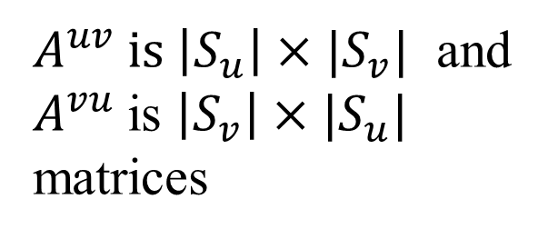
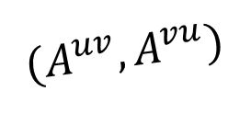
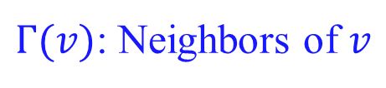
Polymatrix/network Games
Game on graph
  Nodes are players, playing with their neighbors.
v
$$(A^{uv}, A^{vu})$$
$A^{uv} is \left|S_{u}\right|×|S_{v}|$ and
$A^{vu}$is $\left|S_{v}\right|×|S_{u}|$
matrices
u
$Γ(v)$: Neighbors of $v$

Slide 56
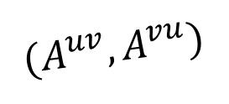
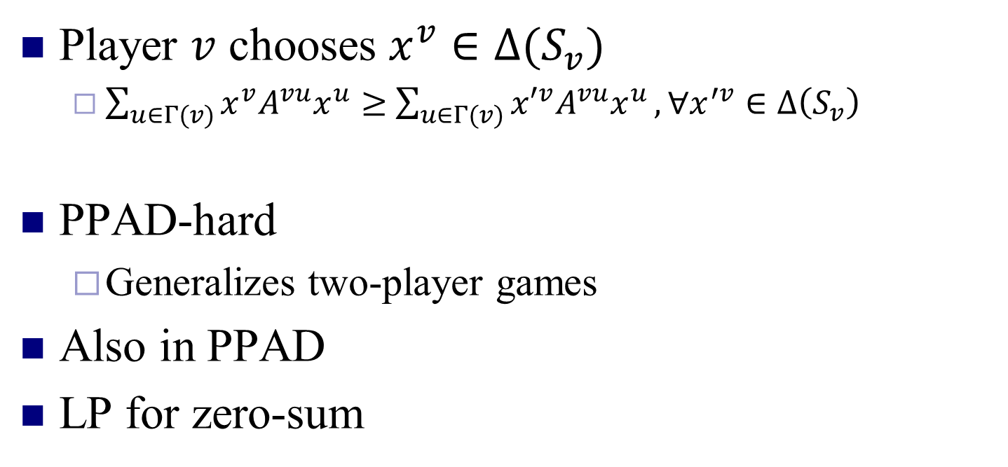
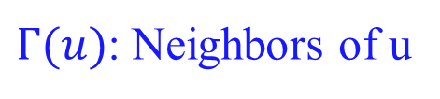
NE in Polymatrix/network Games
Player $v$ chooses $x^{v}∈Δ(S_{v})$
  $\sum_{u∈Γ(v)}{x^{v}A^{vu}x^{u}}≥$ $\sum_{u∈Γ(v)}{{x′}^{v}A^{vu}x^{u}},∀x^{′v}∈Δ\left(S_{v}\right)$
PPAD-hard
  Generalizes two-player games
Also in PPAD
LP for zero-sum
$Γ(u)$: Neighbors of u
v
$$(A^{uv}, A^{vu})$$
u

Slide 57

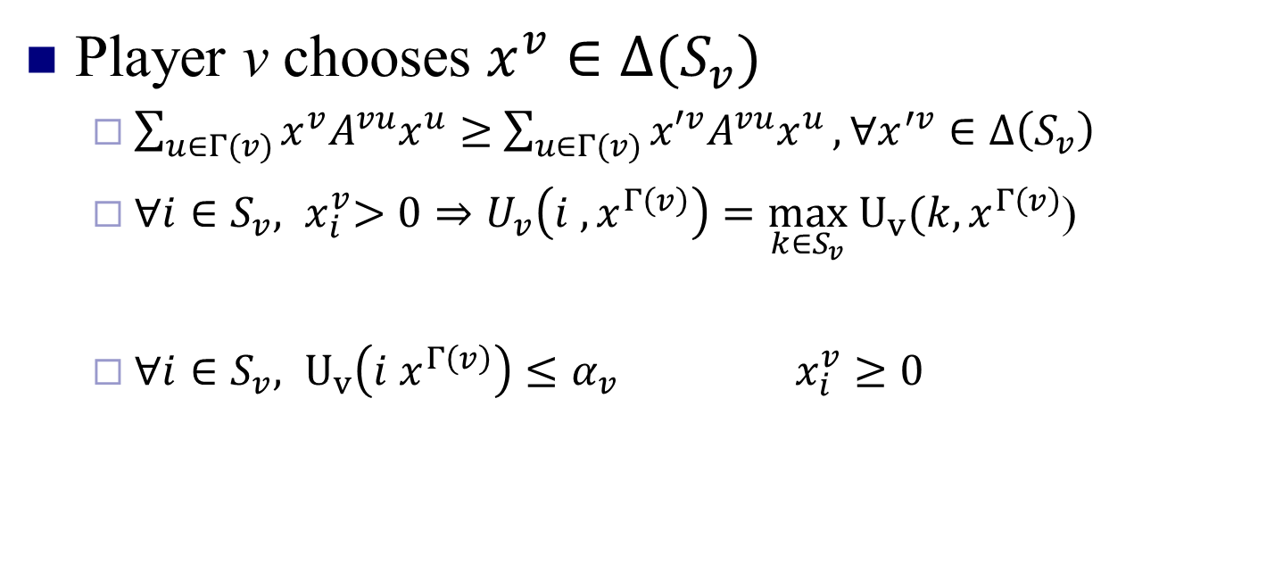
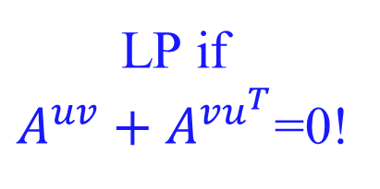
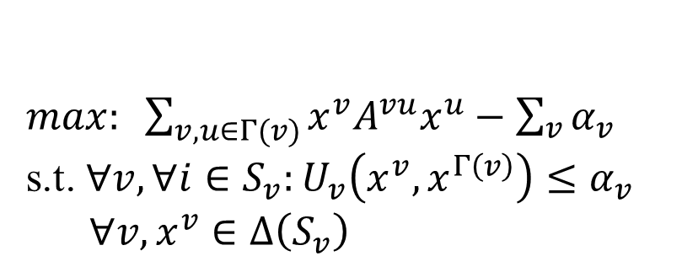
NE in Polymatrix
Player v chooses $x^{v}∈Δ(S_{v})$
  $\sum_{u∈Γ(v)}{x^{v}A^{vu}x^{u}}≥$ $\sum_{u∈Γ(v)}{{x′}^{v}A^{vu}x^{u}},∀x^{′v}∈Δ\left(S_{v}\right)$
  ${∀i∈S_{v}, x}_{i}^{v}>0⇒U_{v}\left(i ,x^{Γ\left(v\right)}\right)=\max_{k∈S_{v}} U_{v}(k, x^{Γ\left(v\right)}$)
  ${∀i∈S_{v}, U}_{v}\left(i x^{Γ\left(v\right)}\right)≤α_{v} x_{i}^{v}≥0$
$$α_{v}$$
$max: \sum_{v, u∈Γ(v)}{x^{v}A^{vu}x^{u}}−\sum_{v}{α_{v}}$
s.t. $∀v, ∀i∈S_{v}:U_{v}\left(x^{v}, x^{Γ\left(v\right)}\right)≤α_{v}$
$∀v, x^{v}∈Δ\left(S_{v}\right)$
LP if
$A^{uv}+A^{vu^{T}}$=0!
What if total all is zero?

Slide 58
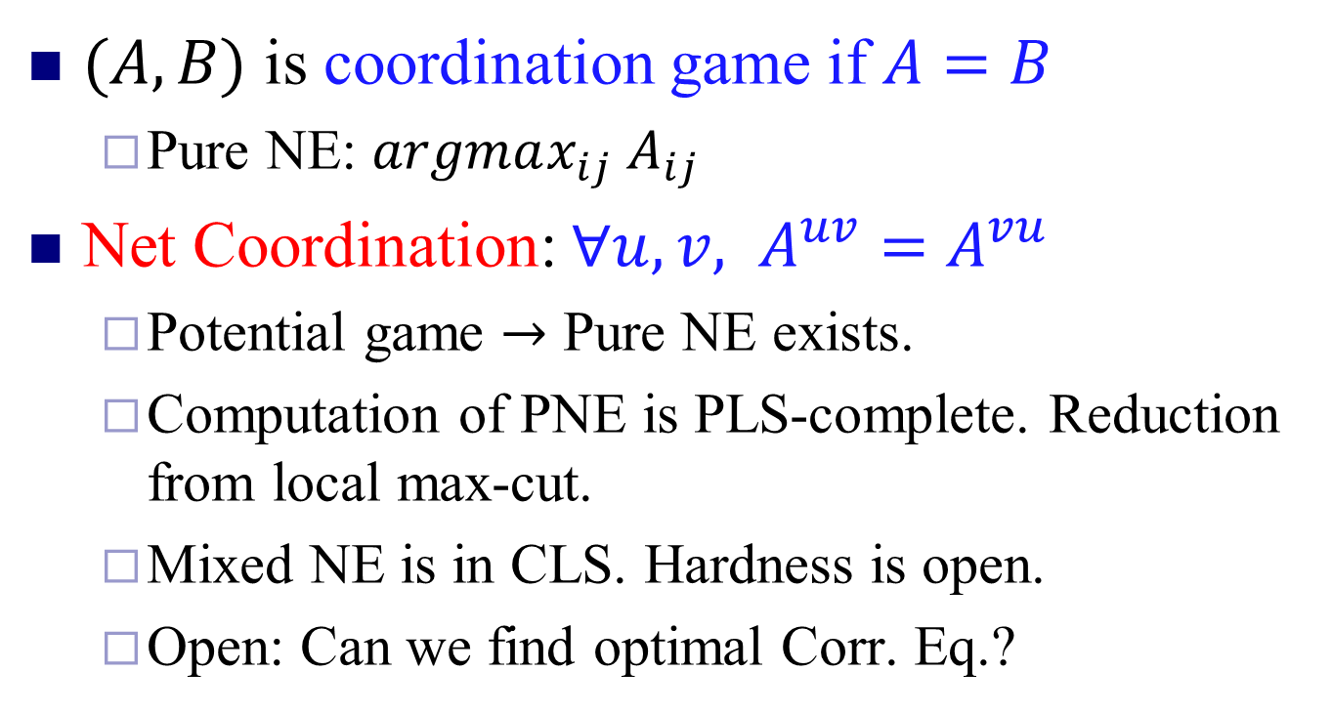
Net Coordination Game
$(A,B)$ is coordination game if $A=B$
  Pure NE: $argmax_{ij} A_{ij}$
Net Coordination: $∀u,v, A^{uv}=A^{vu}$
  Potential game $→$ Pure NE exists.
  Computation of PNE is PLS-complete. Reduction from local max-cut.
  Mixed NE is in CLS. Hardness is open.
  Open: Can we find optimal Corr. Eq.?

