Slide 1
CS 598 RM
Review Session
May 3rd, 2017

Slide 2
Topics Covered
Equilibrium in two player games: Nash, Correlated, Stackelberg
  Computation and hardness. Complexity classes PPAD, PPA, PLS, and PPP
Selfish Routing
  Non-atomic and Atomic. Potential Games. PoA and Smoothness framework
  Cost-sharing games
Auctions
  Truthful Auction, Myerson’s Lemma
  Myerson’s optimal Auction. Bulow-Kempler Theorem
  Without money: Voting, House Allocation, Stable Matching
Markets: Fisher and Exchange model
  Equilibrium Characterization and Computation

Slide 3

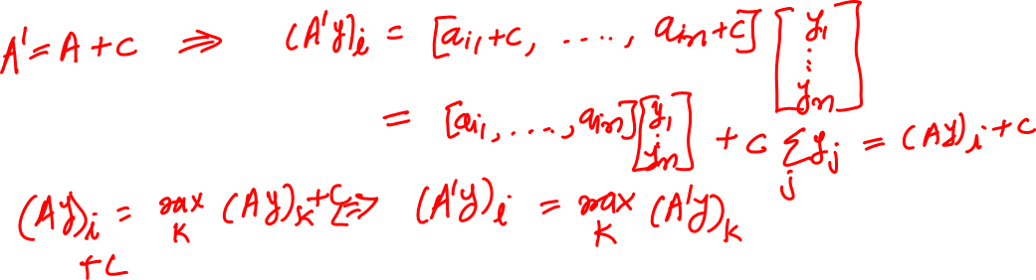
Nash Equilibrium
Game (A,B)$∈R^{m×n}×R^{m×n}. \left(x,y\right)∈Δ_{m}×Δ_{n}$ is a NE
$x_{i}>0⇒{\left(Ay\right)}_{i}=\max_{k}{{\left(Ay\right)}_{k}}$
$y_{j}>0⇒{\left(x^{T}B\right)}_{j}=\max_{k}{{\left(x^{T}B\right)}_{k}}$

Slide 4

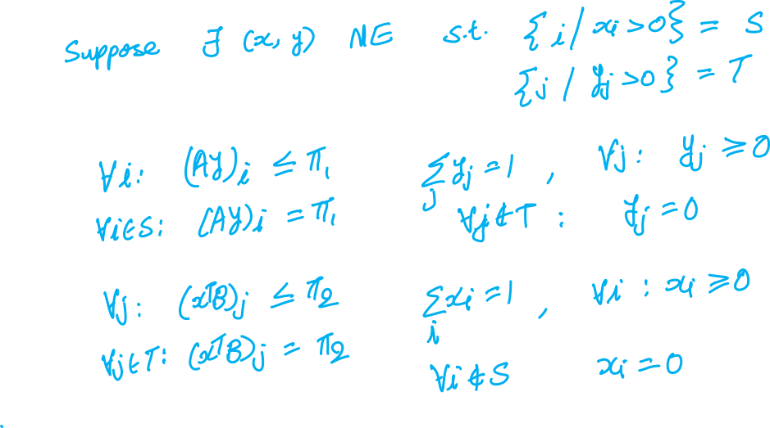
1. Given a subsets $S$ and $T$ of pure actions of players one and two respectively, we can check in polynomial time if there is a NE with support $(S,T)$.

Slide 5
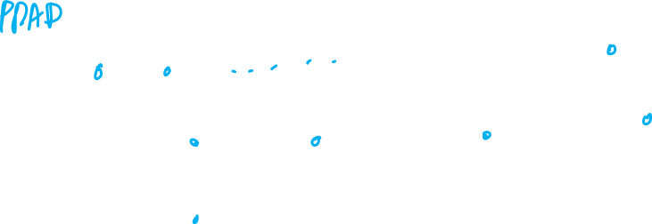
Complexity Classes PPAD and PLS

Slide 6
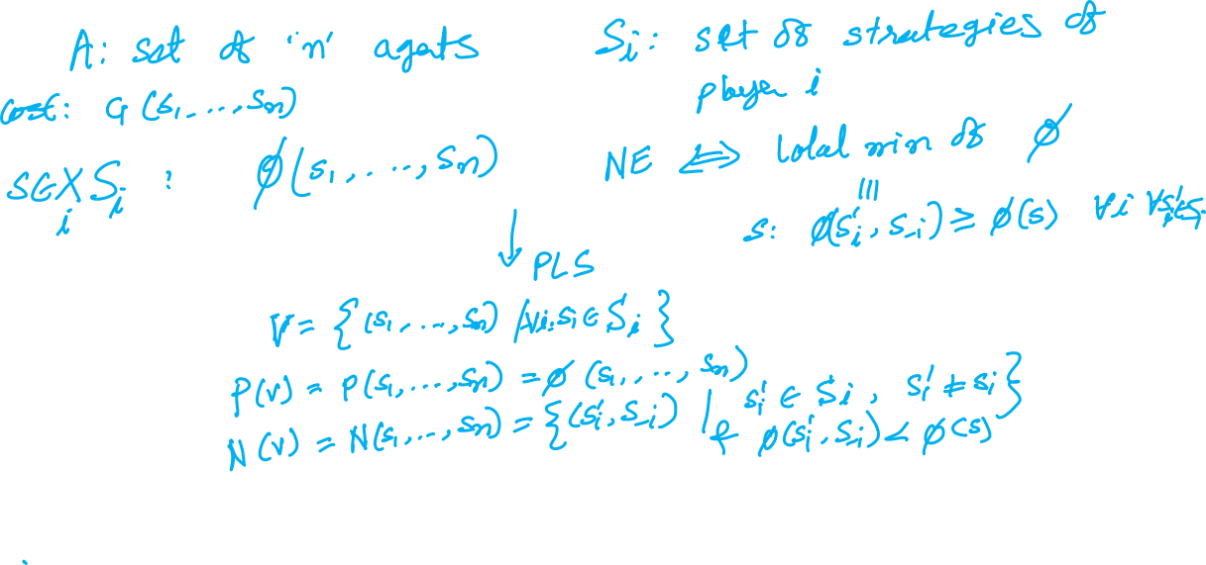
2. Show that finding pure NE of a potential game is in PLS

Slide 7
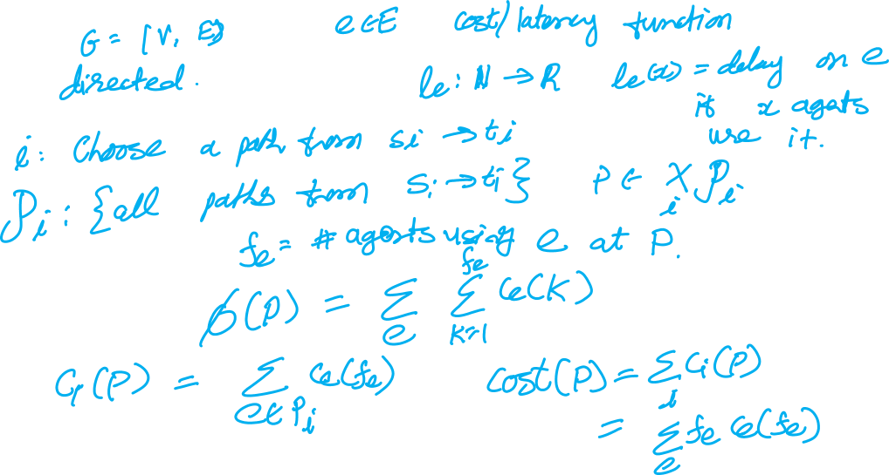
Selfish Routing and Potential Function

Slide 8

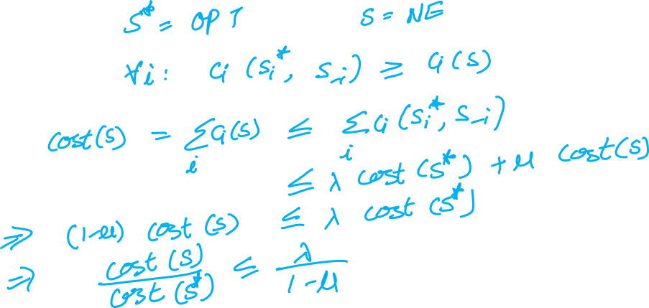
Smooth Games and PoA
$\left(λ,μ\right) smooth: \sum_{i}{c_{i}\left(s_{i}^{∗},s_{−i}\right)≤}λ cost\left(s^{∗}\right)+μ cost\left(s\right)$

Slide 9
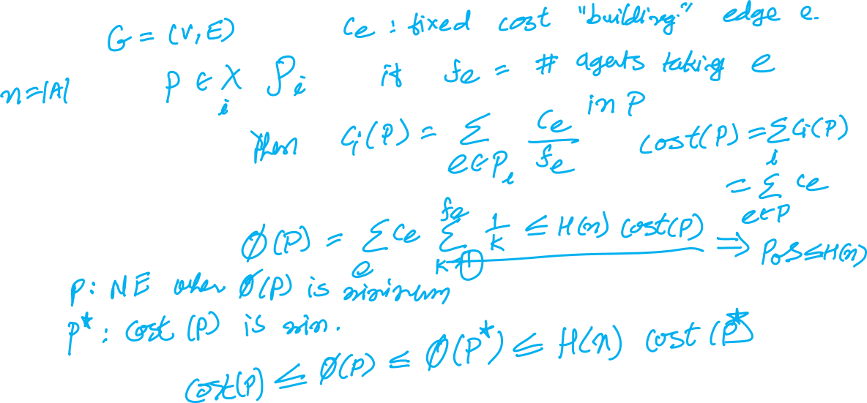
Cost Sharing Games and PoS

Slide 10

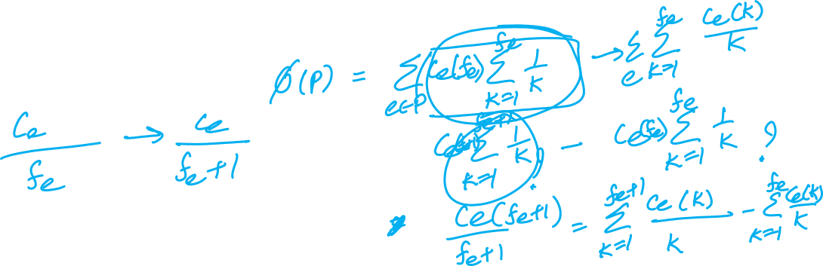
3. Suppose the cost on each edge $e$ is not a constant but a non-decreasing concave function of the number of agents using it, i.e., $c_{e}\left(0\right)=0,$ $c_{e}(x)$ is non-decreasing, and $(c_{e}\left(k+1\right)−c_{e}\left(k\right))$ is decreasing. PoS $≤H(n)$

Slide 11
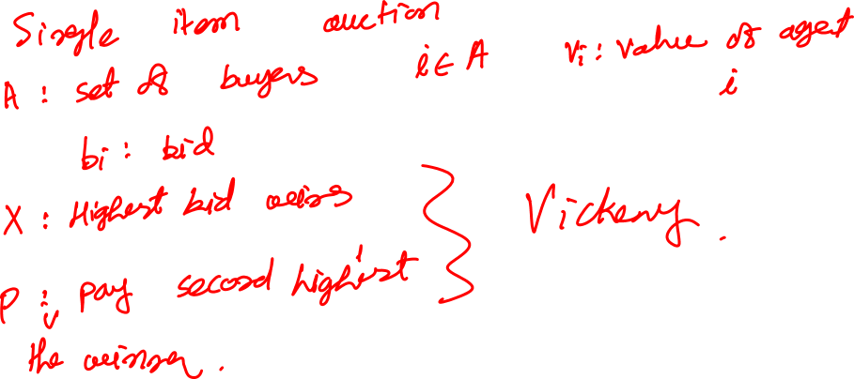
Auctions and DSIC

Slide 12

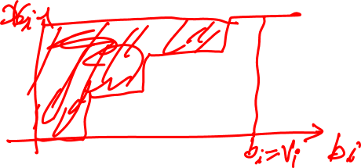
Myerson’s Lemma
For single parameter setting, an allocation and a payment rule is DSIC iff
Allocation rule $x_{i}(.,b_{−i})$ is monotone for each $i$ and $b_{−i}$
$p_{i}\left(b_{i},b_{−i}\right)=\sum_{j}{z_{j} . jump in x_{i}\left(.,b_{−i}\right) at z_{j}}$

Slide 13

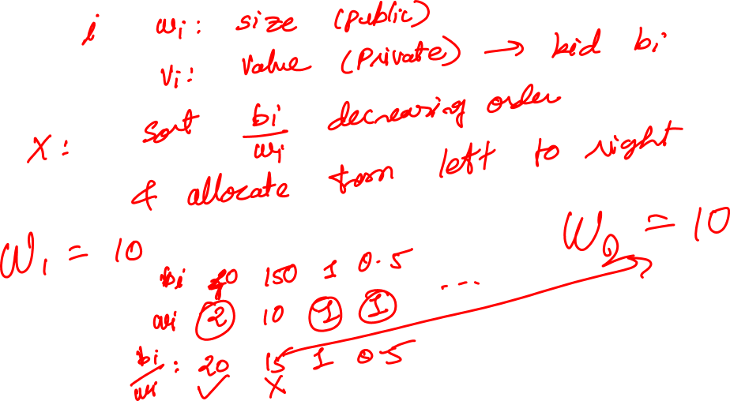
4. Knapsack auction with two sacks of size $W_{1}$ and $W_{2}$

Slide 14
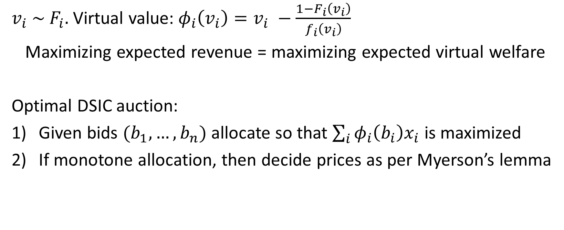
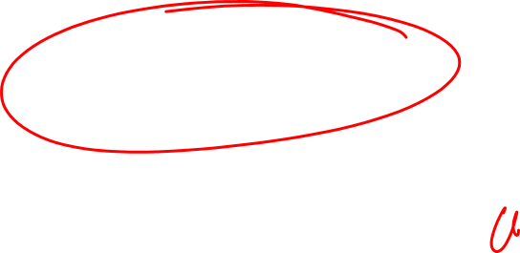
Myerson’s Optimal Auction
$v_{i} \sim F_{i}.$ Virtual value:$φ_{i}\left(v_{i}\right)=v_{i} −\frac{1−F_{i}\left(v_{i}\right)}{f_{i}\left(v_{i}\right)}$
Maximizing expected revenue = maximizing expected virtual welfare
Optimal DSIC auction:
Given bids $(b_{1},…, b_{n})$ allocate so that $\sum_{i}{φ_{i}\left(b_{i}\right)x_{i}}$is maximized
If monotone allocation, then decide prices as per Myerson’s lemma

Slide 15

$v_{1}\sim$ uniform over $\left[0, 1\right] ⇒f\left(x\right)=1, F\left(x\right)=x$
$v_{2}\sim$ e$xponential distribution with rate 3⇒f\left(x\right)=3 e^{−3x}, F\left(x\right)=1 −e^{−3x}$
5. Allocation:

Slide 16
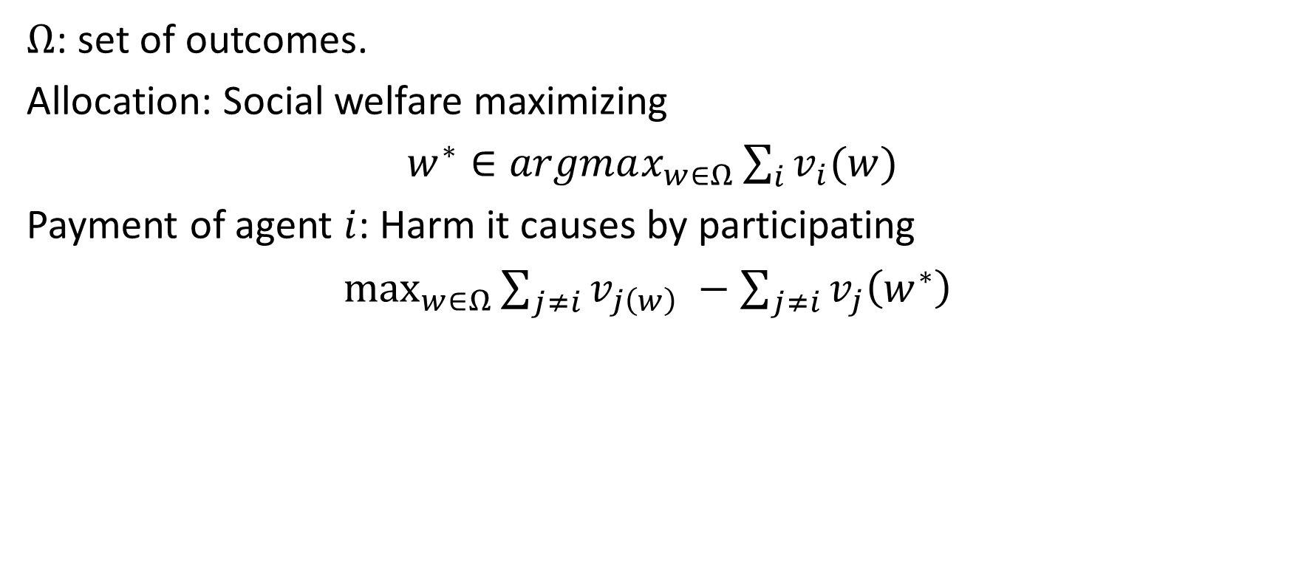
VCG
$Ω$: set of outcomes.
Allocation: Social welfare maximizing
$w^{∗}∈argmax_{w∈Ω}\sum_{i}{v_{i}(w)}$
Payment of agent $i$: Harm it causes by participating
$\max_{w∈Ω}{\sum_{j≠i}{v_{j\left(w\right)}} −\sum_{j≠i}{v_{j}\left(w^{∗}\right)}}$

Slide 17

6. Procurement Auction: Auctioneer needs to buy out a house. There is a set A of sellers, and seller $a∈A$ has a house with cost $c_{a}$. Design a VCG mechanism.

Slide 18
7. Auction with unit demand agents.

Slide 19

Multi Item Procurement: Auctioneer wants to buy a bandwidth block of size at least $W$. A set $A$ of channel operators are willing to sell. Operator $a∈A$ has block of size $w_{i},$ and values it at cost $c_{i}$.
Greedy allocation rule: sort by $\frac{c_{i}}{w_{i}}$ in increasing order and buy in order until filled.

Slide 20
Fisher Market and Equilibrium

Slide 21

8. Compute equilibrium for the following market: two buyers, 3 goods
$$e_{1}=2, e_{2}=6,$$
$$U_{1}\left(x_{1}\right)=x_{11}+x_{12}+x_{13}, U_{2}\left(x_{2}\right)=x_{22}+2x_{23}$$

Slide 22
Exchange Market

Slide 23
9. Computing equilibrium of exchange market with Leontief utilities and pairing economy is PPAD-hard.

