Slide 1
Prophet Inequalities
A Crash Course
Brendan Lucier, Microsoft Research
EC18: ACM Conference on Economics and Computation
Mentoring Workshop, June 18, 2018

Slide 2
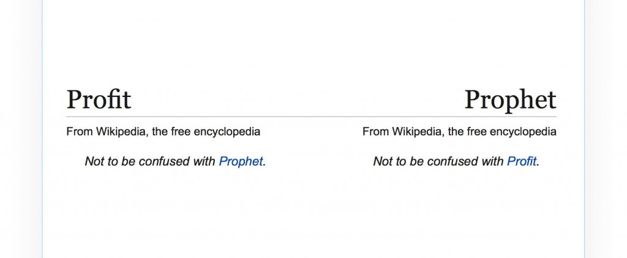

Slide 3
The Plan
Introduction to Prophet Inequalities
Connections to Pricing and Mechanism Design
Variations I: Secretaries and Prophet Secretaries
Variations II: Multiple Prizes

Slide 4
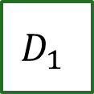




Prophet Inequality
The gambler’s problem:
$$D_{1}$$
$$D_{2}$$
$$D_{3}$$
$$D_{4}$$
$$D_{5}$$
Notes:
Describing prophet inequality as a game

Slide 5
Prophet Inequality
The gambler’s problem:
$20
$$D_{1}$$
$$D_{2}$$
$$D_{3}$$
$$D_{4}$$
$$D_{5}$$
Keep: win $20, game stops.
Discard: prize is lost, game
continues with next box.
Notes:
Boxes arrive and are opened one by one.
Gambler chooses whether to keep the prize (end game), or move on.
The distributions from which prizes are drawn are known in advance. Independent across boxes.

Slide 6
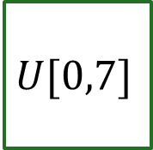
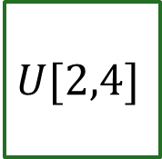

Let’s Play…
3.16
2.87
1.14
2.67
$$U[2,4]$$
$$U[2,4]$$
$$U[1,5]$$
$$U[0,7]$$

Slide 7
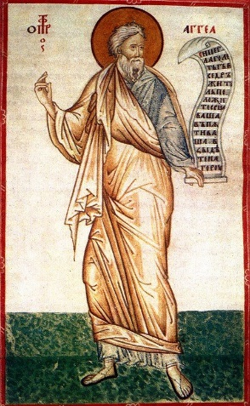
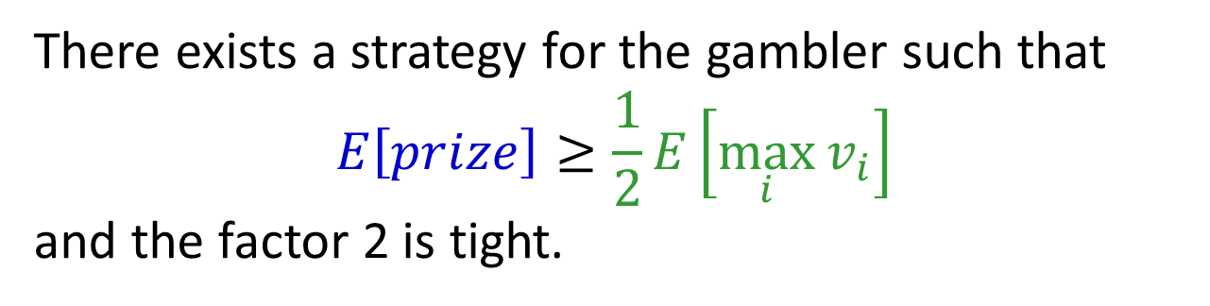
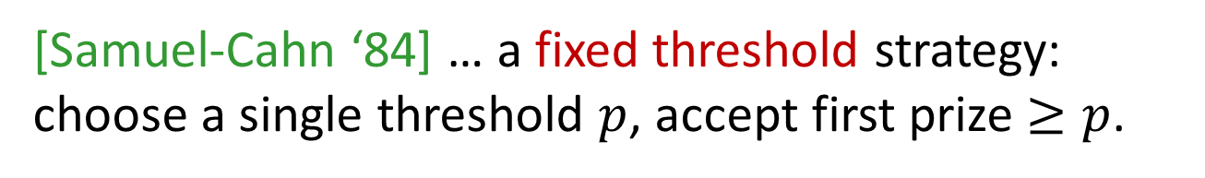
Prophet Inequality
Theorem: [Krengel, Sucheston, Garling ‘77]
There exists a strategy for the gambler such that
$$E\left[prize\right]≥\frac{1}{2}E\left[\max_{i}{v_{i}}\right]$$
and the factor 2 is tight.
[Samuel-Cahn ‘84] … a fixed threshold strategy:
choose a single threshold $p$, accept first prize $≥p$.
Notes:
Prophet Haggai

Slide 8

Lower Bound: 2 is Tight
$\frac{1}{ε}$ w.p. $ε$
0 otherwise
1

Slide 9
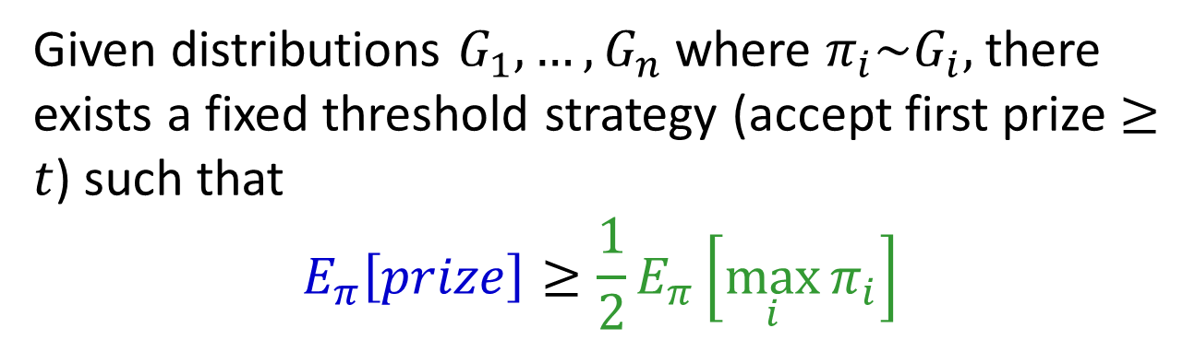
Theorem: [Samuel-Cahn ‘84]
Given distributions $G_{1},…,G_{n}$ where $π_{i}\sim G_{i},$there exists a fixed threshold strategy (accept first prize $≥t$) such that
$$E_{π}\left[prize\right]≥\frac{1}{2}E_{π}\left[\max_{i}{π_{i}}\right]$$
Proof: On the board.
Notes:
Prophet Haggai

Slide 10


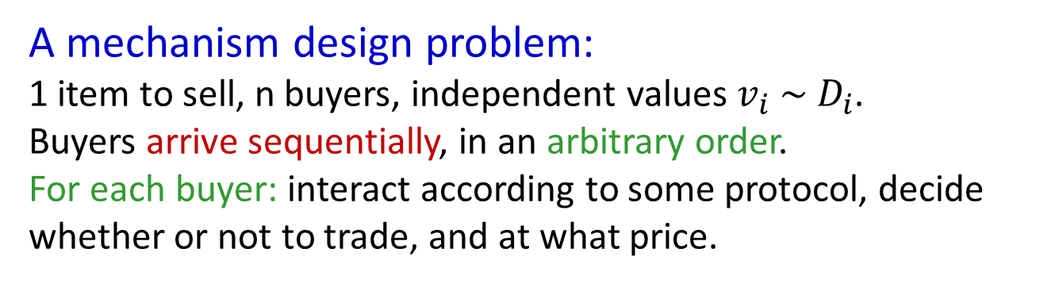



Application: Posted Pricing
A mechanism design problem:
1 item to sell, n buyers, independent values $v_{i} \sim D_{i}$.
Buyers arrive sequentially, in an arbitrary order.
For each buyer: interact according to some protocol, decide whether or not to trade, and at what price.
$$v_{1} \sim D_{1}$$
$$v_{2} \sim D_{2}$$
$$v_{3} \sim D_{3}$$
$$v_{4} \sim D_{4}$$
Corollary of Prophet Inequality:
Posting an appropriate take-it-or-leave-it price yields at least half of the expected optimal social welfare.
[Hajiaghayi Kleinberg Sandholm ’07]
Notes:
An immediate corollary

Slide 11
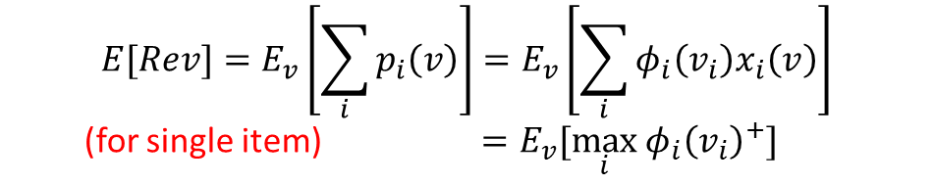
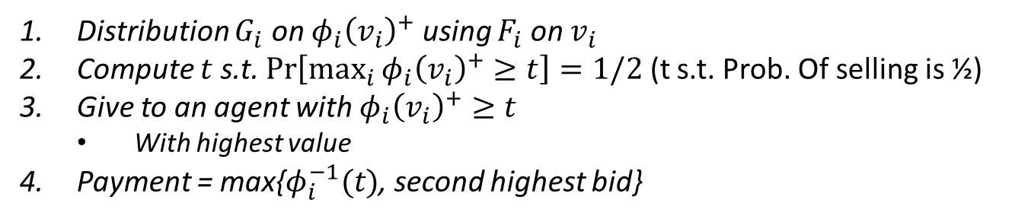
Applications
What about revenue?
[Chawla Hartline Malec Sivan ’10]: Can apply prophet inequality to virtual values to achieve half of optimal revenue.
$$E[Rev]=E_{v}\left[\sum_{i}{p_{i}\left(v\right)}\right]=E_{v}\left[\sum_{i}{φ_{i}\left(v_{i}\right)x_{i}\left(v\right)}\right]$$
(for single item) $=E_{v}[\max_{i} φ_{i}{\left(v_{i}\right)}^{+}]$
Auction w/ E[Rev]$≥\frac{1}{2}OPT$
Distribution $G_{i}$ on $φ_{i}{\left(v_{i}\right)}^{+}$ using $F_{i}$ on $v_{i}$
Compute $t$ s.t. $\operatorname{Pr}\left[\max_{i}{φ_{i}{\left(v_{i}\right)}^{+}}≥t\right]=1/2$ (t s.t. Prob. Of selling is ½)
Give to an agent with $φ_{i}{\left(v_{i}\right)}^{+}≥t$
  With highest value
Payment = max{$φ_{i}^{−1}(t)$, second highest bid}
Notes:
We won’t go into detail here about the connections between virtual value and revenue. See Matt’s tutorial for more.

Slide 12

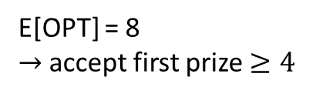
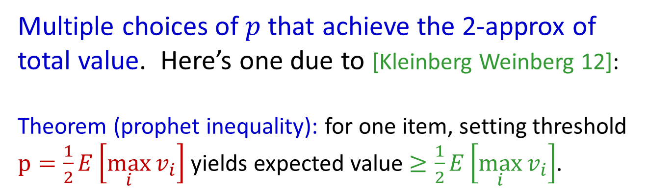
Prophet Inequality
Multiple choices of $p$ that achieve the 2-approx of total value. Here’s one due to [Kleinberg Weinberg 12]:
Theorem (prophet inequality): for one item, setting threshold $p=\frac{1}{2}E\left[\max_{i}{v_{i}}\right]$ yields expected value $≥\frac{1}{2}E\left[\max_{i}{v_{i}}\right]$.
Example:
10 w.p. 1/2
8 w.p. 1/4
6 w.p. 1/8
2 w.p. 1/8
OPT =
1 or 6
0 or 8
2 or 10
E[OPT] = 8
$→$accept first prize $≥4$
(each box: prizes equally likely)
Notes:
Note: not optimal! (Price 2 is better)
Also: comparison with optimal ex-post, not with the optimal price!
Also note: threshold p depends on the set of distributions, but not the arrival order!

Slide 13

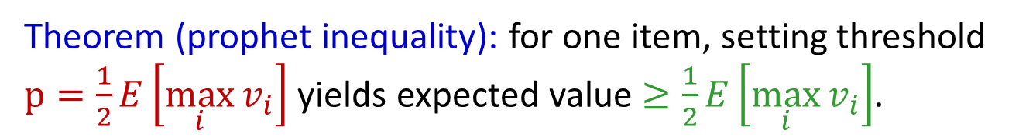
Prophet Inequality: Proof
Theorem (prophet inequality): for one item, setting threshold $p=\frac{1}{2}E\left[\max_{i}{v_{i}}\right]$ yields expected value $≥\frac{1}{2}E\left[\max_{i}{v_{i}}\right]$.
What can go wrong?
If threshold is
Too low: we might accept a small prize, preventing us from taking a larger prize in a later round.
Too high: we don’t accept any prize.

Slide 14

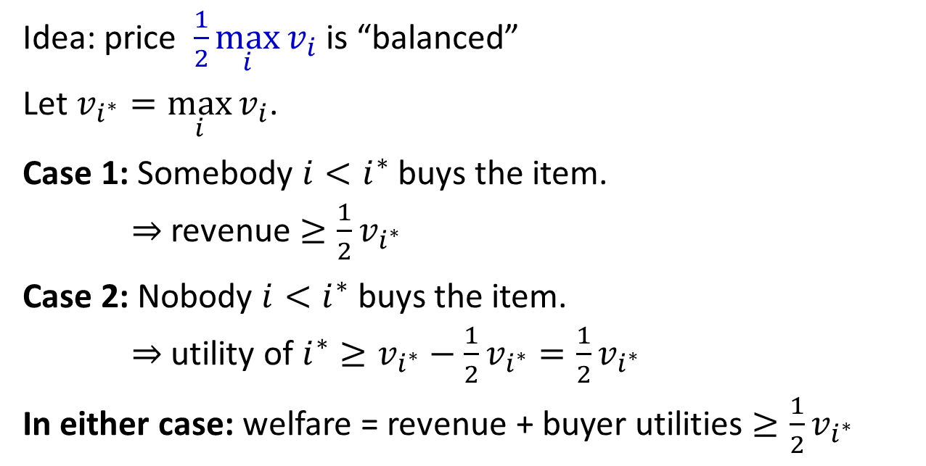



A Proof for Full Information
$$v_{1}=10$$
$$v_{2}=50$$
$$v_{3}=80$$
$$v_{4}=15$$
Idea: price $\frac{1}{2}\max_{i}{v_{i}}$ is “balanced”
Let $v_{i^{∗}}=\max_{i}{v_{i}}$.
Case 1: Somebody $i<i^{∗}$ buys the item.
$⇒$revenue $≥\frac{1}{2}v_{i^{∗}}$
Case 2: Nobody $i<i^{∗}$ buys the item.
$⇒$ utility of $i^{∗}≥v_{i^{∗}}−\frac{1}{2}v_{i^{∗}}=\frac{1}{2}v_{i^{∗}}$
In either case: welfare = revenue + buyer utilities $≥\frac{1}{2}v_{i^{∗}}$
Notes:
Again, this price of 40 is not optimal (80 is better). But we present this argument because it extends directly to the probabilistic case on the next slide

Slide 15
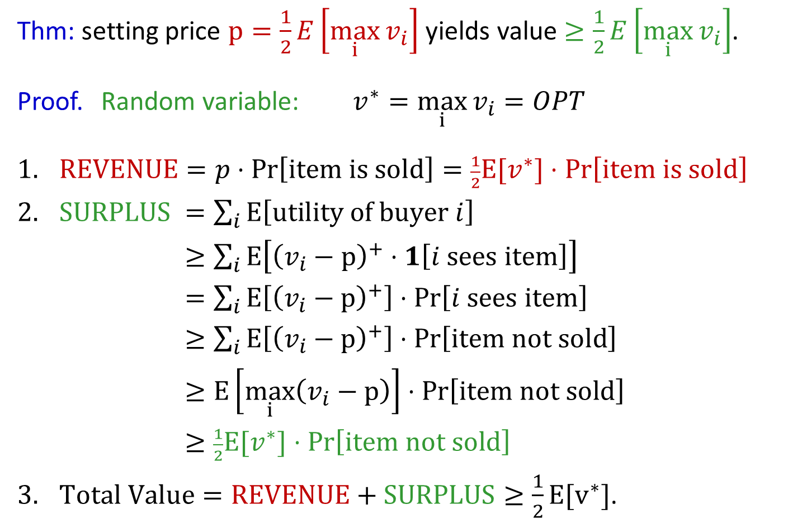
Extending to Stochastic Setting
Thm: setting price $p=\frac{1}{2}E\left[\max_{i}{v_{i}}\right]$ yields value $≥\frac{1}{2}E\left[\max_{i}{v_{i}}\right]$.
Proof. Random variable: $v^{∗}=\max_{i}{v_{i}}=OPT$
$REVENUE=p⋅\operatorname{Pr}\left[\text{item} \text{is} \text{sold}\right]=\frac{1}{2}E[v^{∗}]⋅\operatorname{Pr}\left[\text{i}\text{tem} \text{is} \text{sold}\right]$
$SURPLUS$ $=\sum_{i}{E\left[\text{utility} \text{of} \text{buyer} i\right]}$
$≥\sum_{i}{E\left[{\left(v_{i}−p\right)}^{+}⋅1\left[i \text{sees} \text{item}\right]\right]}$
$=\sum_{i}{E\left[{\left(v_{i}−p\right)}^{+}\right]⋅Pr\left[i \text{sees} \text{item}\right]}$
$≥\sum_{i}{E\left[{\left(v_{i}−p\right)}^{+}\right]⋅Pr\left[\text{item} \text{not} \text{sold}\right]}$
$≥E\left[\max_{i}\left(v_{i}−p\right)\right]⋅Pr\left[\text{item} \text{not} \text{sold}\right]$
$≥\frac{1}{2}E[v^{∗}]⋅Pr\left[\text{ite}\text{m} \text{not} \text{sold}\right]$
$Total Value=REVENUE+SURPLUS≥\frac{1}{2}E[v^{∗}]$.
Notes:
Important: linearity of expectation trick.
-> Idea: if prob of not selling is high, then prob. that max-valued player can buy is high. Since expected value of max-valued player is high, and price is low, surplus must be high!
[ equality: independence, and doesn’t depend on value. Next line: dominance. Then just take the sum. ]
Note: x^+ == max{x, 0}

Slide 16

Prophet Inequality: Proof
Thm: for one item, price $p=\frac{1}{2}E\left[OPT\right]$ yields value $≥\frac{1}{2}E\left[OPT\right]$.
Summary:
Price is high enough that expected revenue offsets the
opportunity cost of selling the item.
Price is low enough that expected buyer surplus offsets the value left on the table due to the item going unsold.

Slide 17
Secretaries and Prophet Secretaries

Slide 18
A Variation
Prophet Inequality:
Prizes drawn from distributions, order is arbitrary
A Related Problem:
Prizes are arbitrary, order is uniformly random

Slide 19


Let’s Play…
5.21
0.003
682,918
10⁹⁹
$$?$$
$$?$$
$$?$$
$$?$$
The game of googol [Gardner ‘60]

Slide 20
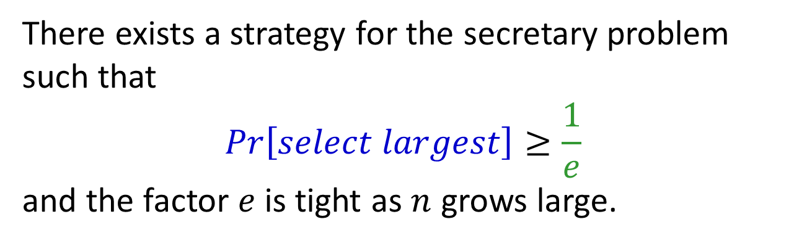
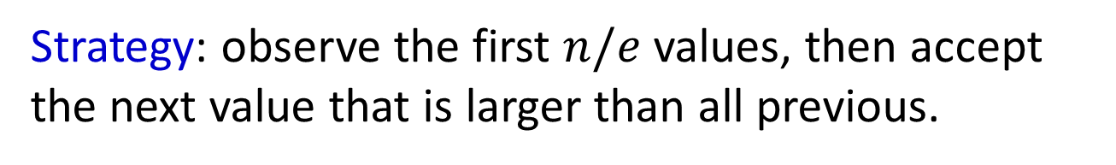
Secretary Problem
Theorem: [Lindley ’61, Dynkin ‘63, Gilbert and Mosteller ‘66]
There exists a strategy for the secretary problem such that
$$Pr\left[select largest\right]≥\frac{1}{e}$$
and the factor $e$ is tight as $n$ grows large.
Strategy: observe the first $n/e$ values, then accept the next value that is larger than all previous.

Slide 21
Prophets vs Secretaries
Prophet Inequality:
Prizes drawn from distributions, order is arbitrary
Secretary Problem / Game of Googol:
Prizes are arbitrary, order is uniformly random
Prophet Secretary:
Prizes drawn from distributions, order is uniformly random
known
and revealed online
[Esfandiari, Hajiaghayi, Liaghat, Monemizadeh ‘15]

Slide 22
Recall:
$$U[2,4]$$
$$U[2,4]$$
$$U[1,5]$$
$$U[0,7]$$
Notes:
Why can random order help? Intuition: some orders are easier than others. E.g., higher-variance boxes first.

Slide 23



Recall:
$$U[0,7]$$
$$U[1,5]$$
$$U[2,4]$$
$$U[2,4]$$

Slide 24
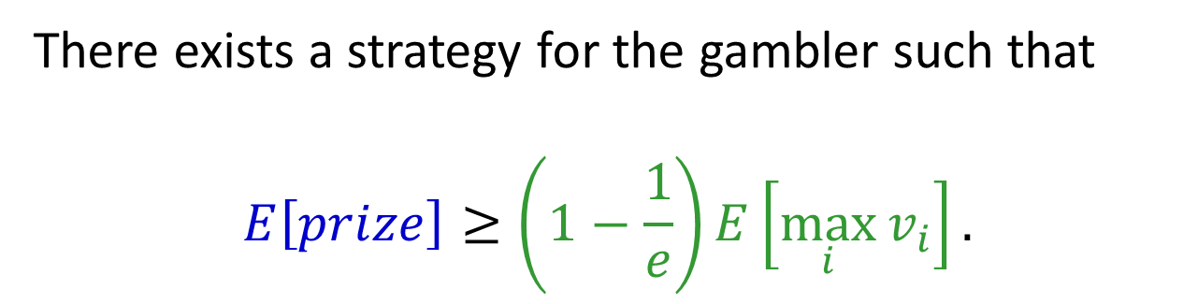
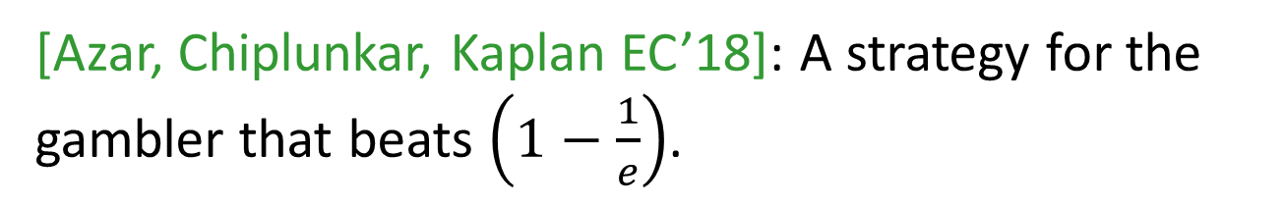
Prophet Secretary
Theorem: [Esfandiari, Hajiaghayi, Liaghat, Monemizadeh ‘15]
There exists a strategy for the gambler such that
$$E\left[prize\right]≥\left(1−\frac{1}{e}\right)E\left[\max_{i}{v_{i}}\right].$$
[Azar, Chiplunkar, Kaplan EC’18]: A strategy for the gambler that beats $\left(1−\frac{1}{e}\right)$.
Notes:
Note: better than 1/2

Slide 25
Prophet Secretary
threshold
value
prize
round
1
2
3
4
5
6
7
8
Notes:
A way to visualize

Slide 26

Prophet Secretary
Higher threshold:
more revenue when we
sell the item to this buyer.
value
Lower threshold:
More surplus for this buyer.
round
1
2
3
4
5
6
7
8
Notes:
Can imagine optimizing for one particular buyer. Same forces at play.
How is randomization useful? Adversary can’t force buyer 4 to have a very poor draw. So giving buyer-specific bounds makes sense.

Slide 27
Extension: Multiple Prizes

Slide 28
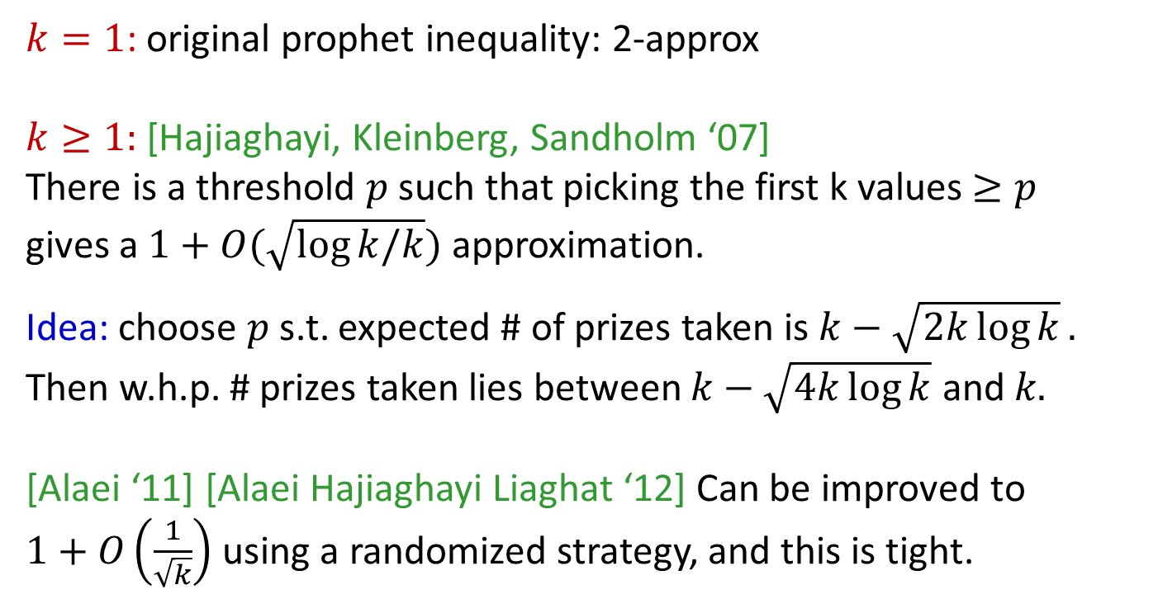
Multiple-Prize Prophet Inequality
Prophet inequality, but gambler can keep up to $k$ prizes
$k=1$: original prophet inequality: 2-approx
$k≥1:$ [Hajiaghayi, Kleinberg, Sandholm ‘07]
There is a threshold $p$ such that picking the first k values $≥p$
gives a $1+O(\sqrt{log⁡k/k})$approximation.
Idea: choose $p$ s.t. expected # of prizes taken is $k−\sqrt{2k\log{k}}.$
Then w.h.p. # prizes taken lies between $k−\sqrt{4k\log{k}}$ and 𝑘.
[Alaei ‘11] [Alaei Hajiaghayi Liaghat ‘12] Can be improved to
$1+O\left(\frac{1}{\sqrt{k}}\right)$ using a randomized strategy, and this is tight.
Notes:
If k is greater than 1, the problem gets EASIER. Why? Concentration (Hoeffding inequality). Get tight bound up to logs.
Can interpret as: come up with right threshold for a fractional relaxation of the problem, and the canonical rounding doesn’t do too badly.
Note: revenue is at least p * (k – blah), and buyer surplus is at least (OPT – kp).
Idea of Alaei improvement: same approach, but do the randomized rounding more carefully.

Slide 29
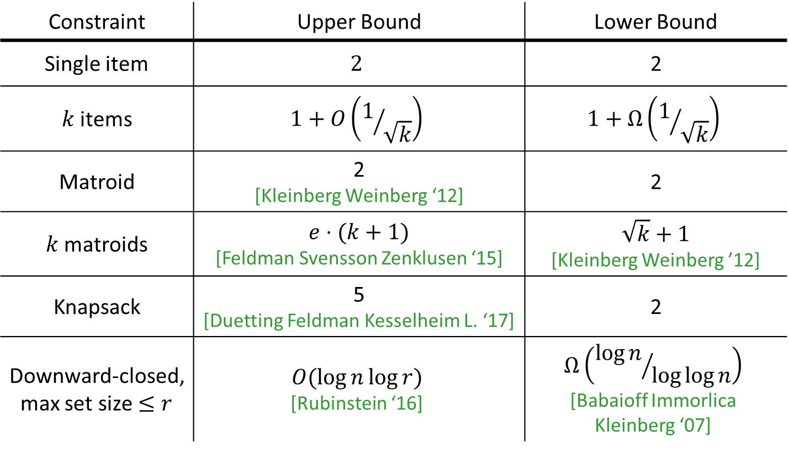
Aside: Beyond Cardinality
Constraint | Upper Bound | Lower Bound
Single item | $$2$$ | 2
$k$ items | $$1+O\left(1/{\sqrt{k}}\right)$$ | $$1+Ω\left(1/{\sqrt{k}}\right)$$
Matroid | 2 [Kleinberg Weinberg ‘12] | 2
$k$ matroids | $e⋅(k+1)$ [Feldman Svensson Zenklusen ‘15] | $$\sqrt{k}+1$$ [Kleinberg Weinberg ’12]
Knapsack | 5 [Duetting Feldman Kesselheim L. ‘17] | 2
Downward-closed, max set size $≤r$ | $$O(\log{n\log{r}})$$ [Rubinstein ‘16] | $$Ω\left({\log{n}}/{\log{\log{n}}}\right)$$ [Babaioff Immorlica Kleinberg ‘07]
Directly imply posted-price mechanisms for welfare, revenue
Notes:
Lots of literature on this…

Slide 30
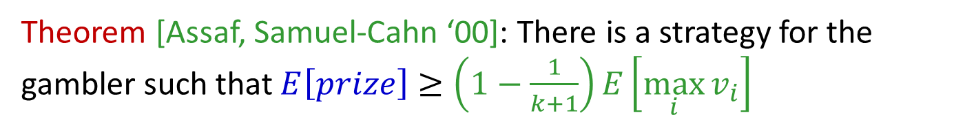
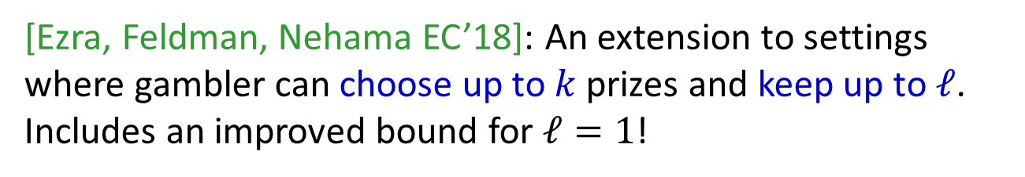
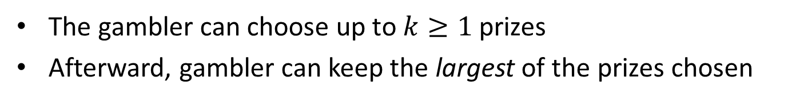
Multiple-Prize Prophet Inequality
A different variation on cardinality:
The gambler can choose up to $k≥1$ prizes
Afterward, gambler can keep the largest of the prizes chosen
Theorem [Assaf, Samuel-Cahn ‘00]: There is a strategy for the gambler such that $E\left[prize\right]≥\left(1−\frac{1}{k+1}\right)E\left[\max_{i}{v_{i}}\right]$
[Ezra, Feldman, Nehama EC’18]: An extension to settings where gambler can choose up to $k$ prizes and keep up to $ℓ$. Includes an improved bound for $ℓ=1$!

Slide 31
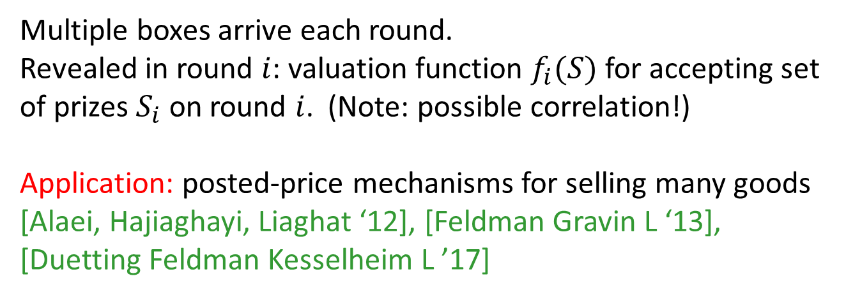
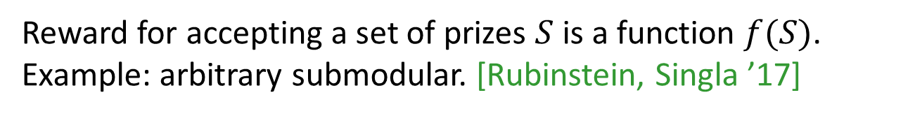
Combinatorial Variants
More general valuation functions:
Reward for accepting a set of prizes $S$ is a function $f(S)$. Example: arbitrary submodular. [Rubinstein, Singla ’17]
Multiple prizes per round:
Multiple boxes arrive each round.
Revealed in round $i$: valuation function $f_{i}(S)$ for accepting set of prizes $S_{i}$ on round $i$. (Note: possible correlation!)
Application: posted-price mechanisms for selling many goods
[Alaei, Hajiaghayi, Liaghat ‘12], [Feldman Gravin L ‘13], [Duetting Feldman Kesselheim L ’17]
Notes:
Related to mechanisms for combinatorial auctions. Can use posted prices to get a good approximation to the efficient outcome!

Slide 32
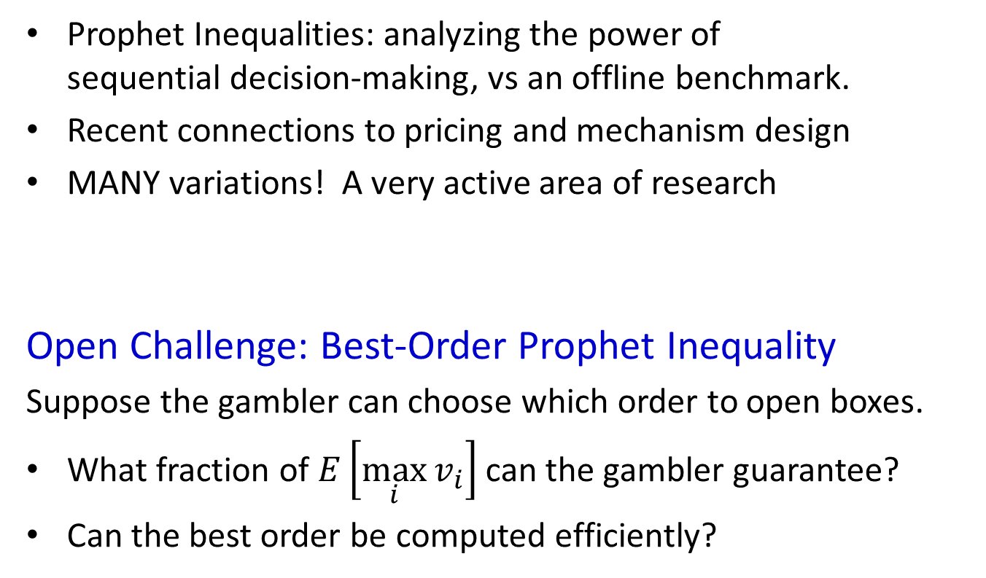
Summary
Prophet Inequalities: analyzing the power of
sequential decision-making, vs an offline benchmark.
Recent connections to pricing and mechanism design
MANY variations! A very active area of research
Open Challenge: Best-Order Prophet Inequality
Suppose the gambler can choose which order to open boxes.
What fraction of $E\left[\max_{i}{v_{i}}\right]$ can the gambler guarantee?
Can the best order be computed efficiently?
Thanks!

Slide 33
Bonus: Multi-Dimensional Prophets
Notes:
More information on the “combinatorial variants” slide

Slide 34
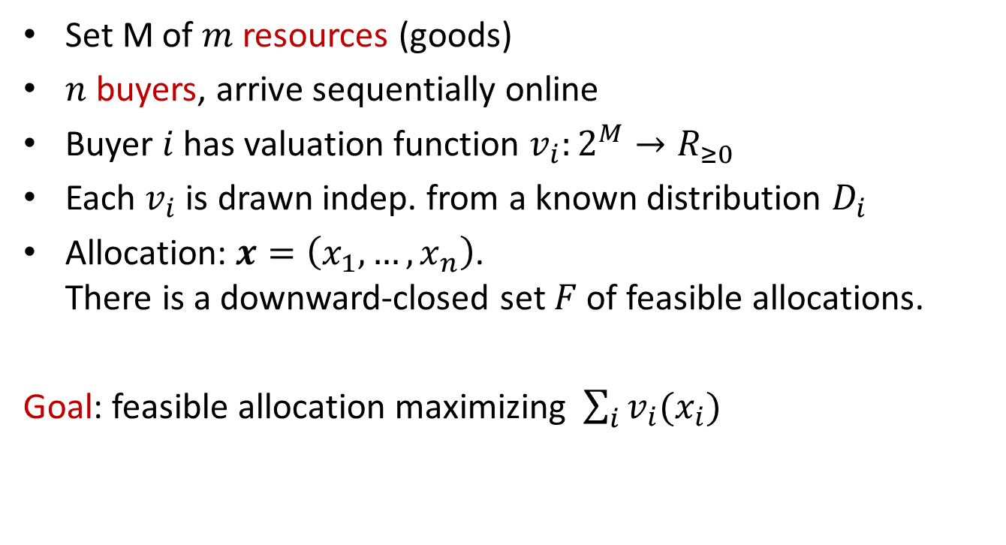
Buyers:
Goods:
A General Model
1
1
Combinatorial allocation
2
2
Set M of $m$ resources (goods)
$n$ buyers, arrive sequentially online
Buyer $i$ has valuation function $v_{i}:2^{M}→R_{≥0}$
Each $v_{i}$ is drawn indep. from a known distribution $D_{i}$
Allocation: $x=\left(x_{1},…,x_{n}\right)$.
There is a downward-closed set $F$ of feasible allocations.
Goal: feasible allocation maximizing $\sum_{i}{v_{i}(x_{i})}$
n
m
Notes:
A theoretical abstraction --- the combinatorial auction problem

Slide 35
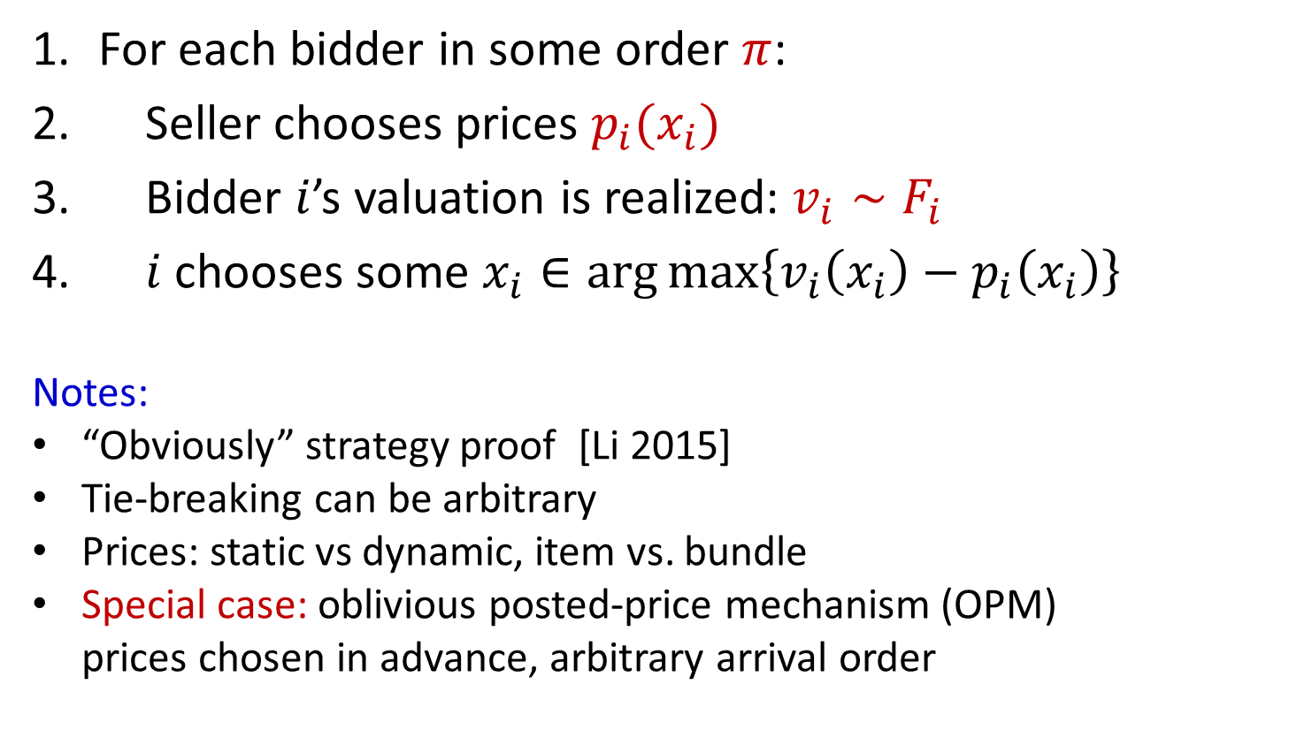
Posted Price Mechanism
For each bidder in some order $π$:
Seller chooses prices $p_{i}(x_{i})$
Bidder $i$’s valuation is realized: $v_{i}∼F_{i}$
$i$chooses some $x_{i}∈\arg{\max\left\{v_{i}\left(x_{i}\right)−p_{i}\left(x_{i}\right)\right\}}$
Notes:
“Obviously” strategy proof [Li 2015]
Tie-breaking can be arbitrary
Prices: static vs dynamic, item vs. bundle
Special case: oblivious posted-price mechanism (OPM)
prices chosen in advance, arbitrary arrival order
Notes:
Note: a single price vector, fixed for all time, used for all buyers. Supermarket model!

Slide 36
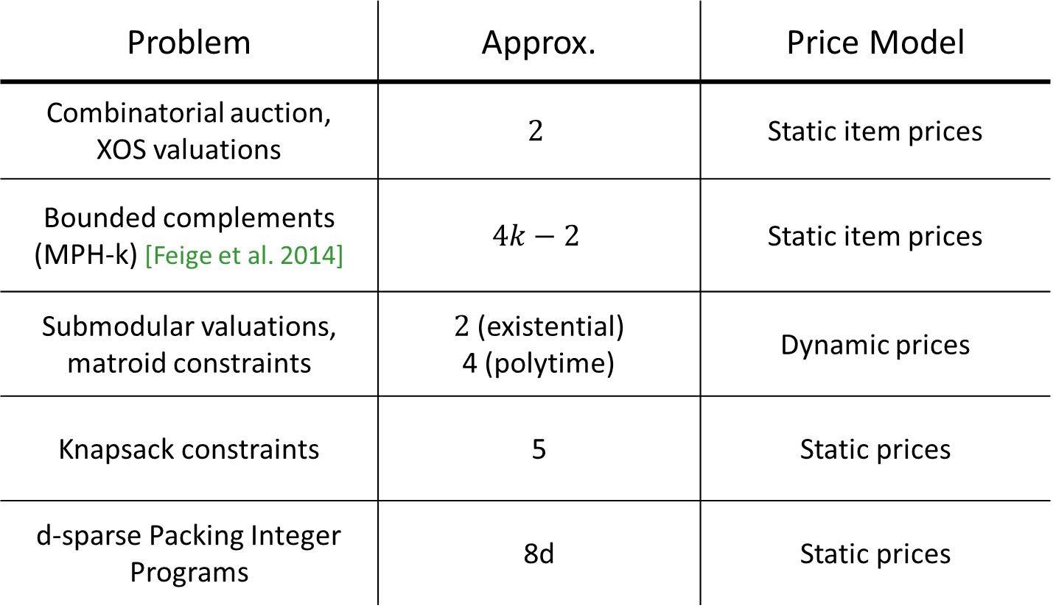
Applications
Problem | Approx. | Price Model
Combinatorial auction, XOS valuations | $$2$$ | Static item prices
Bounded complements (MPH-k) [Feige et al. 2014] | $$4k−2$$ | Static item prices
Submodular valuations, matroid constraints | $2$ (existential) 4 (polytime) | Dynamic prices
Knapsack constraints | 5 | Static prices
d-sparse Packing Integer Programs | 8d | Static prices
[Feldman Gravin L ‘13], [Duetting Feldman Kesselheim L ’17]
Notes:
Can use multi-dimensional prophet inequalities to bound the performance of pricing rules for combinatorial auction variants.
Sometimes useful to use dynamic prices: update prices after each buyer, depending on what they purchase.

