Slide 1
Other Solution Concepts and
Game Models
CS598
Ruta Mehta
Some slides are borrowed from V. Conitzer’s presentations.

Slide 2
So far
Normal-form games
  Multiple rational players, single shot, simultaneous move
Nash equilibrium
  Existence
  Computation in two-player games.

Slide 3
Today:
Issues with NE
  Multiplicity
  Selection: How players decide/reach any particular NE
Possible Solutions
  Dominance: Dominant Strategy equilibria
  Arbitrator/Mediator: Correlated equilibria, Coarse-correlated equilibria
  Communication/Contract: Stackelberg equilibria, Nash bargaining
Other Games
  Extensive-form Games, Bayesian Games

Slide 4
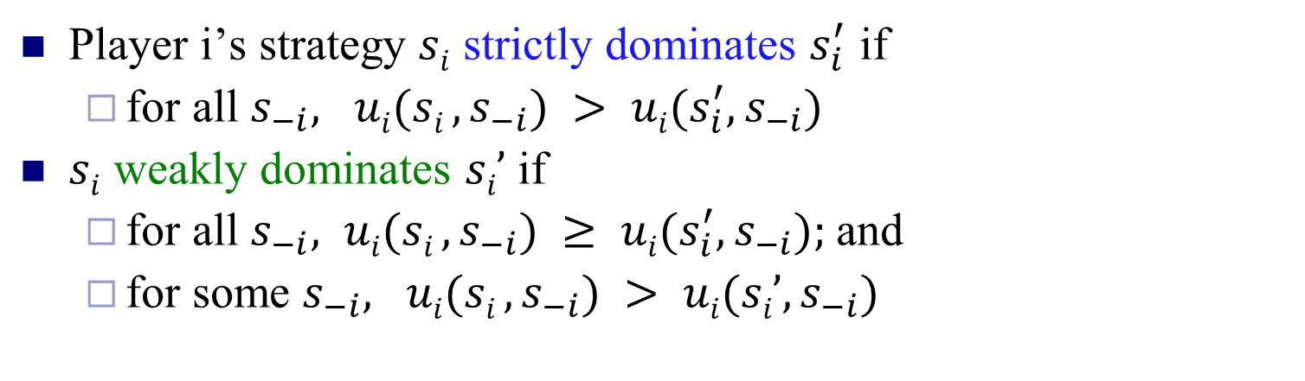
Dominance
Player i’s strategy $si$ strictly dominates $s_{i}^{′}$ if
  for all $s_{−i}, ui(si , s_{−i}) > ui{(s_{i}^{′}, s}_{−i})$
$si$ weakly dominates $si’$ if
  for all $s_{−i}, ui(si , s_{−i}) ≥ ui(s_{i}^{′}, s_{−i});$and
  for some $s_{−i}, ui(si , s_{−i}) > ui(si’, s_{−i})$
-i = “the player(s) other than i”
L
M
R
U
0, 0 | 1, -1 | 1, -1
-1, 1 | 0, 0 | -1, 1
-1, 1 | 1, -1 | 0, 0
strict dominance
G
weak dominance
B

Slide 5
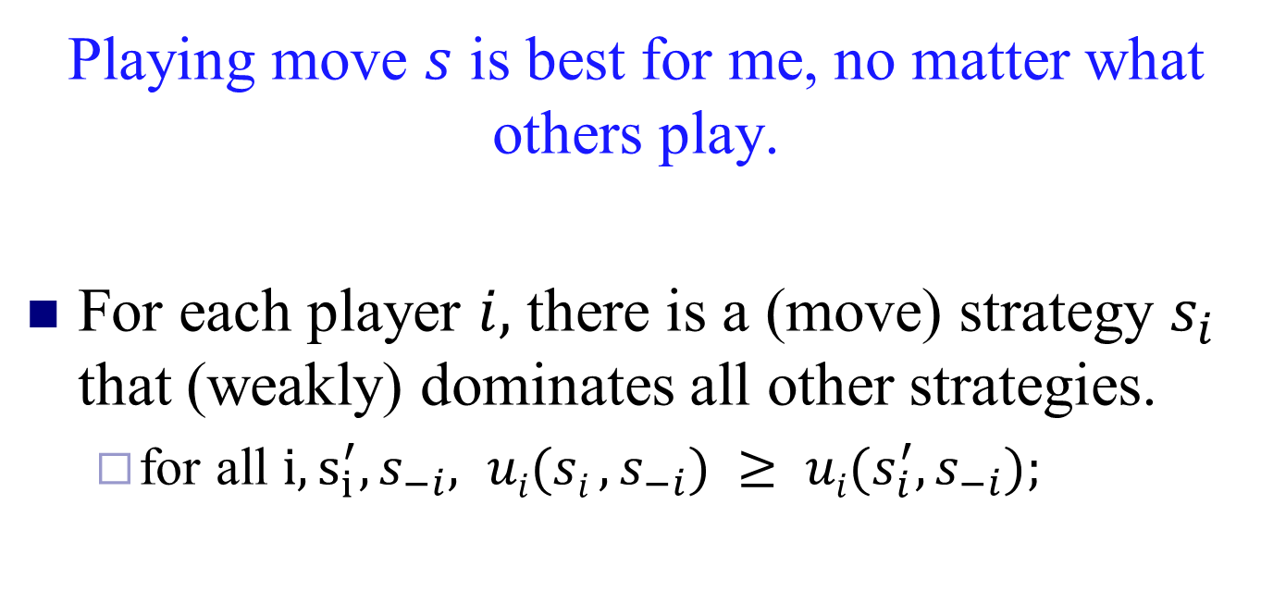
Dominant Strategy Equilibrium
Playing move $s$ is best for me, no matter what others play.
For each player $i,$ there is a (move) strategy $s_{i}$ that (weakly) dominates all other strategies.
  for all $i,s_{i}^{′},s_{−i}, ui(si , s_{−i}) ≥ ui(s_{i}^{′}, s_{−i});$
Example?

Slide 6
Prisoner’s Dilemma
Pair of criminals has been caught
They have two choices: {confess, don’t confess}
Attorney offers them a deal:
  If both confess to the major crime, they each get a 1 year reduction
  If only one confesses, that one gets 3 years reduction
confess
don’t confess
confess
-2, -2 | 0, -3
-3, 0 | -1, -1
don’t confess

Slide 7
“Should I buy an SUV?”
purchasing cost
accident cost
cost: 5
cost: 5
cost: 5
cost: 8
cost: 2
cost: 3
cost: 5
cost: 5
-10, -10 | -7, -11
-11, -7 | -8, -8

Slide 8
Dominance by Mixed strategies
Example of dominance by a mixed strategy:
3, 1 | 0, 0
0, 0 | 3, 2
1, 0 | 1, 1
1/2
1/2

Slide 9
Iterated dominance: path (in)dependence
Iterated weak dominance is path-dependent: sequence of eliminations may determine which solution we get (if any)
(whether or not dominance by mixed strategies allowed)
0, 1 | 0, 0
1, 0 | 1, 0
0, 0 | 0, 1
0, 1 | 0, 0
1, 0 | 1, 0
0, 0 | 0, 1
0, 1 | 0, 0
1, 0 | 1, 0
0, 0 | 0, 1
Iterated strict dominance is path-independent: elimination process will always terminate at the same point
(whether or not dominance by mixed strategies allowed)

Slide 10




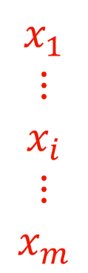
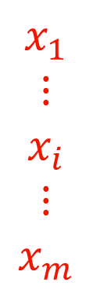
$$y_{1} … y_{j} … y_{n}$$
$$y_{1} … y_{j} … y_{n}$$
$$x_{1}$$
$$⋮$$
$$x_{i}$$
$$⋮$$
$$x_{m}$$
$$x_{1}$$
$$⋮$$
$$x_{i}$$
$$⋮$$
$$x_{m}$$
A
B
NE:
$x^{T}Ay≥{x^{′}}^{T}Ay,$ $∀x′$
$x^{T}By≥x^{T}By′,$ $∀y′$
No one plays
dominated
strategies.
Why?
What if they can discuss beforehand?

Slide 11


Players: {Alice, Bob}
Two options: {Football, Shopping}
$$2/3 1/3$$
F
S
At Mixed NE
both get 2/3 < 1
$$1/3$$
$$2/3$$
F
1 2
0 0
0.5
S
0 0
2 1
0.5
Instead they agree on ½(F, S), ½(S, F)
Payoffs are (1.5, 1.5)
Fair!
Needs a common coin toss!

Slide 12
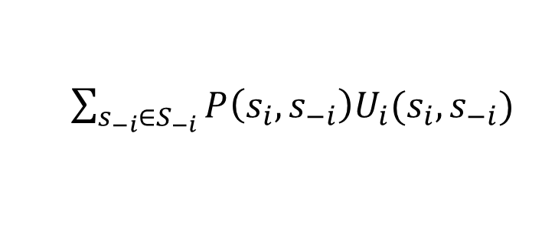
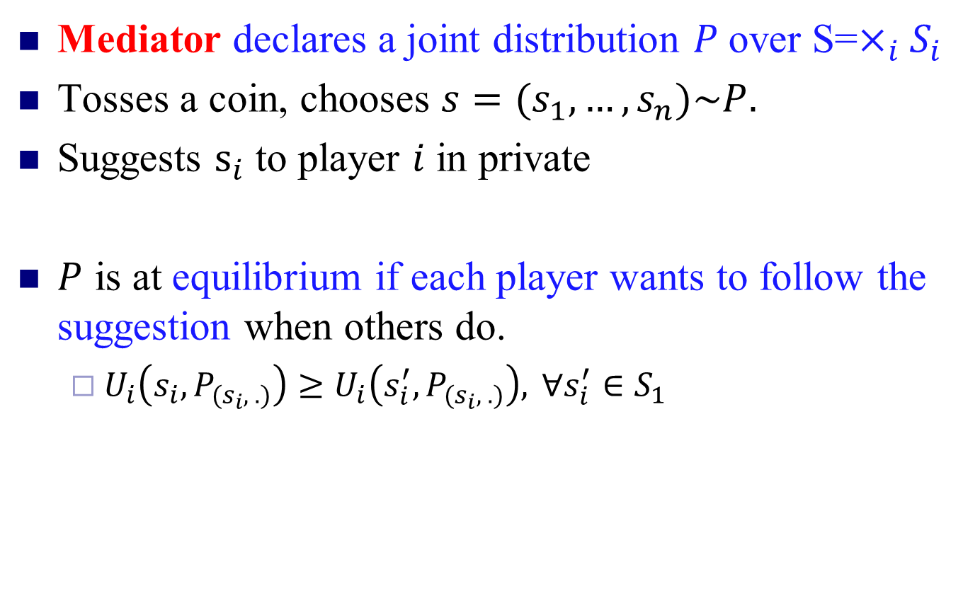
Correlated Equilibrium – (CE) (Aumann’74)
Mediator declares a joint distribution $P$over S=$×_{i}S_{i}$
Tosses a coin, chooses $s=(s_{1},…, s_{n})\sim P.$
Suggests $s_{i}$ to player $i$ in private
$P$ is at equilibrium if each player wants to follow the suggestion when others do.
  $U_{i}\left(s_{i}, P_{(s_{i}, .)}\right)≥U_{i}\left(s_{i}^{′}, P_{(s_{i}, .)}\right), ∀s_{i}^{′}∈S_{1}$
$\sum_{s_{−i}∈S_{−i}}{P\left({s_{i}, s}_{−i}\right)U_{i}(s_{i},s_{−i})}$
Linear in P variables!

Slide 13
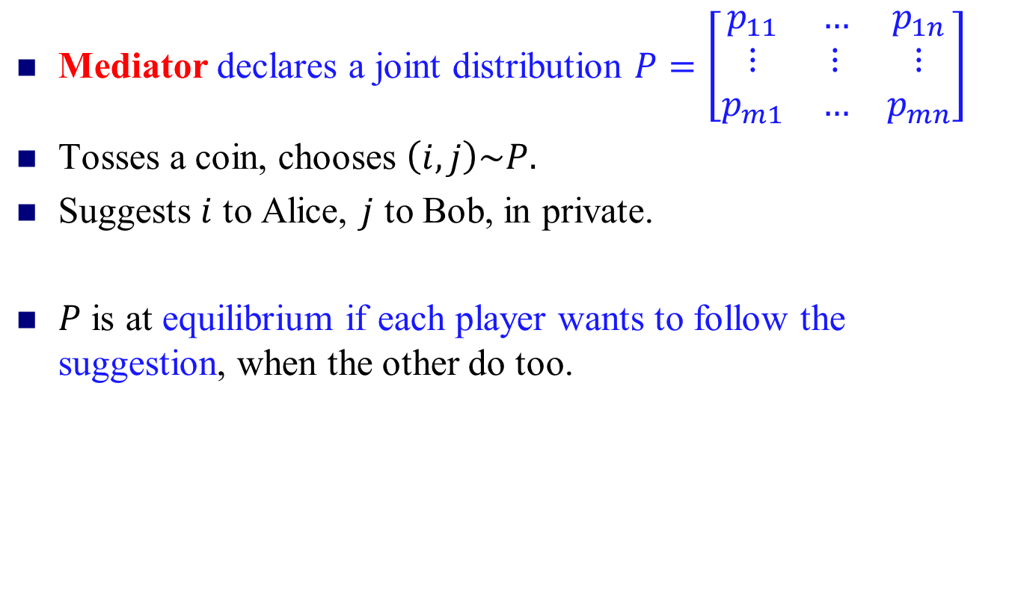
CE for 2-Player Case
Mediator declares a joint distribution $P=\left[\begin{matrix}p_{11} & … & p_{1n} \\ ⋮ & ⋮ & ⋮ \\ p_{m1} & … & p_{mn}\end{matrix}\right]$
Tosses a coin, chooses $\left(i,j\right)\sim P.$
Suggests $i$ to Alice, $j$ to Bob, in private.
$P$ is at equilibrium if each player wants to follow the suggestion, when the other do too.
Given Alice is suggested $i,$ she knows Bob is suggested $j \sim P(i,.)$
$\left\langle A\left(i,.\right), P\left(i,.\right)\right\rangle ≥\left\langle A\left(i^{′},.\right), P\left(i,.\right)\right\rangle :∀i^{′}∈S_{1}$
$\left\langle B\left(.,j\right),P\left(.,j\right)\right\rangle ≥\left\langle B\left(.,j^{′}\right),P\left(.,j\right)\right\rangle :∀j^{′}∈S_{2}$

Slide 14
Players: {Alice, Bob}
Two options: {Football, Shopping}
F
S
F
1 2
0 0
0.5
S
0 0
2 1
0.5
Instead they agree on ½(F, S), ½(S, F)
Payoffs are (1.5, 1.5)
CE!
Fair!

Slide 15
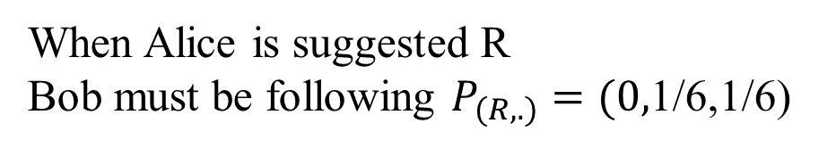
Rock-Paper-Scissors
(Aumann)
Prisoner’s Dilemma
C
NC
R
P
S
C
-5, -5 | 0, -6
-6, 0 | -1, -1
R
0, 0 | 0, 1 | 1, 0
1, 0 | 0, 0 | 0, 1
0, 1 | 1, 0 | 0, 0
1
0
0
1/6
1/6
NC
0
0
P
1/6
0
1/6
NC is dominated
S
1/6
1/6
0
When Alice is suggested R
Bob must be following $P_{(R,.)}=(0,$1/6,1/6)
Following the suggestion gives her 1/6
While P gives 0, and S gives 1/6.

Slide 16
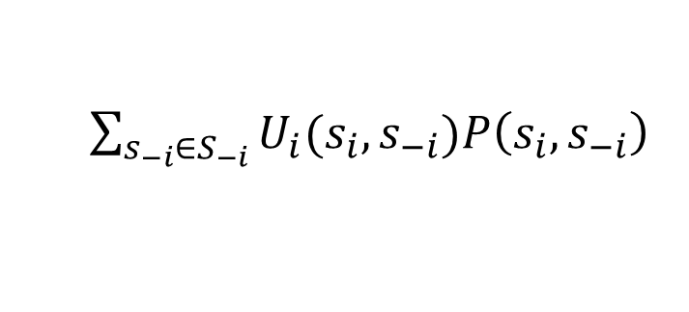
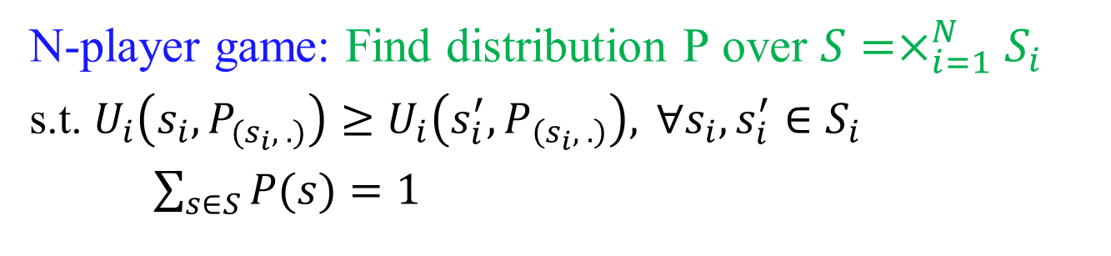
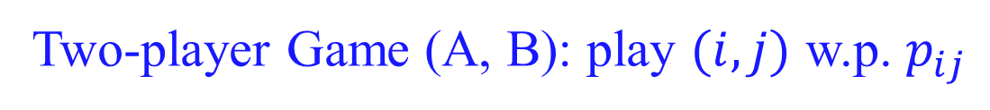
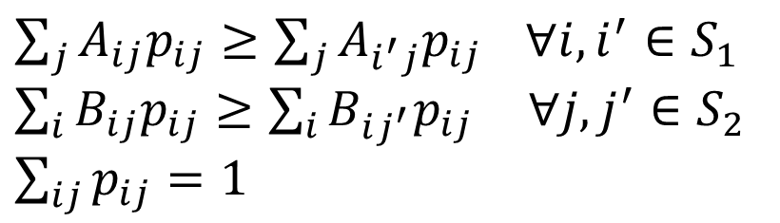
Computation: Linear Feasibility Problem
Two-player Game (A, B): play $(i,j)$ w.p. $p_{ij}$
$\sum_{j}{A_{ij}p_{ij}}≥\sum_{j}{A_{i^{′}j}p_{ij}} ∀i, i^{′}∈S_{1}$
$\sum_{i}{B_{ij}p_{ij}}≥\sum_{i}{B_{ij^{′}}p_{ij}} ∀j, j^{′}∈S_{2}$
$\sum_{ij}{p_{ij}}=1$
N-player game: Find distribution P over $S=×_{i=1}^{N}S_{i}$
s.t. $U_{i}\left(s_{i}, P_{(s_{i}, .)}\right)≥U_{i}\left(s_{i}^{′}, P_{\left(s_{i}, .\right)}\right), ∀s_{i}, s_{i}^{′}∈S_{i}$
$\sum_{s∈S}{P(s)}=1$
$\sum_{s_{−i}∈S_{−i}}{U_{i}(s_{i},s_{−i})P\left({s_{i}, s}_{−i}\right)}$
Linear in P variables!

Slide 17
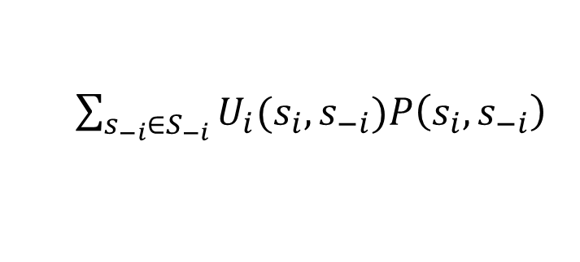
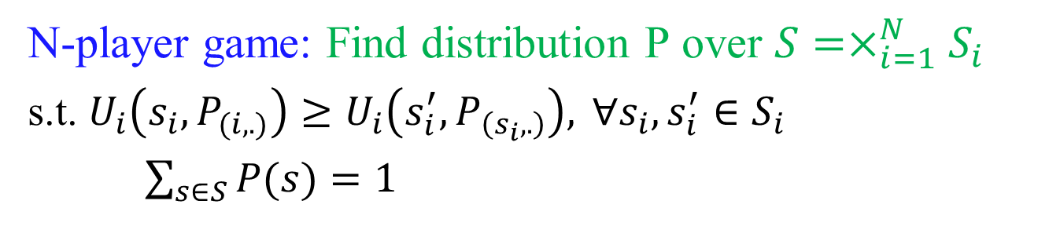
Computation: Linear Feasibility Problem
N-player game: Find distribution P over $S=×_{i=1}^{N}S_{i}$
s.t. $U_{i}\left(s_{i}, P_{(i,.)}\right)≥U_{i}\left(s_{i}^{′}, P_{\left(s_{i},.\right)}\right), ∀s_{i}, s_{i}^{′}∈S_{i}$
$\sum_{s∈S}{P(s)}=1$
$\sum_{s_{−i}∈S_{−i}}{U_{i}(s_{i},s_{−i})P\left({s_{i}, s}_{−i}\right)}$
Linear in P variables!
Can optimize convex function as well!

Slide 18
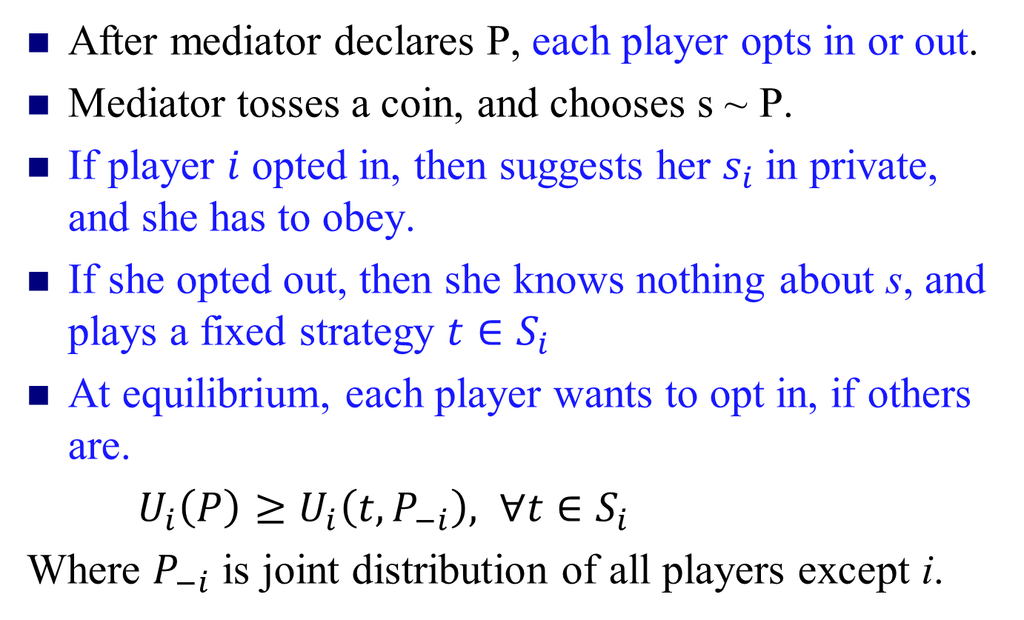
Coarse- Correlated Equilibrium
After mediator declares P, each player opts in or out.
Mediator tosses a coin, and chooses s ~ P.
If player $i$ opted in, then suggests her $s_{i}$ in private, and she has to obey.
If she opted out, then she knows nothing about s, and plays a fixed strategy $t∈S_{i}$
At equilibrium, each player wants to opt in, if others are.
$U_{i}\left(P\right)≥U_{i}\left(t,P_{−i}\right), ∀t∈S_{i}$
Where $P_{−i}$ is joint distribution of all players except i.

Slide 19
Importance of (Coarse) CE
Natural dynamics quickly arrive at approximation of such equilibria.
  No-regret, Multiplicative Weight Update (MWU)
Poly-time computable in the size of the game.
  Can optimize a convex function too.

Slide 20
Show the following
CCE
CE
NE
PNE
DSE

Slide 21
Extensive-form Game
Players move one after another
  Chess, Poker, etc.
  Tree representation.
Firm 2
Strategy of a player:
What to play at each of its node.
out
in
Firm 1
2,0
I
O
fight
accommodate
-1, 1 | 2, 0
1, 1 | 2, 0
F
-1,1
1,1
A
Entry game

Slide 22
A poker-like game
Both players put 1 chip in the pot
Player 1 gets a card (King is a winning card, Jack a losing card)
Player 1 decides to raise (add one to the pot) or check
Player 2 decides to call
(match) or fold (P1 wins)
If player 2 called, player
1’s card determines
pot winner

Slide 23
Poker-like game in normal form
“nature”
1 gets King
1 gets Jack
cc
cf
fc
ff
player 1
player 1
rr
0, 0 | 0, 0 | 1, -1 | 1, -1
.5, -.5 | 1.5, -1.5 | 0, 0 | 1, -1
-.5, .5 | -.5, .5 | 1, -1 | 1, -1
0, 0 | 1, -1 | 0, 0 | 1, -1
raise
check
raise
check
rc
player 2
player 2
cr
call
fold
call
fold
call
fold
call
fold
cc
2
1
1
1
-2
1
-1
1
Can be exponentially big!

Slide 24
Sub-Game Perfect Equilibrium
Every sub-tree is at equilibrium
Computation when perfect information (no nature/chance move): Backward induction
Firm 2
out
in
Firm 1
2,0
Firm 2
fight
accommodate
out
in
-1,1
1,1
2,0
1,1
accommodate
Entry game

Slide 25
Sub-Game Perfect Equilibrium
Every sub-tree is at equilibrium
Computation when perfect information (no nature/chance move): Backward induction
Firm 2
out
in
Firm 1
(accommodate, in)
2,0
Firm 2
fight
accommodate
out
in
-1,1
1,1
2,0
1,1
accommodate
Entry game

Slide 26
Corr. Eq. in Extensive form Game
How to define?
  CE in its normal-form representation.
Is it computable?
  Recall: exponential blow up in size.
Can there be other notions?
See “Extensive-Form Correlated Equilibrium: Definition and Computational Complexity” by von Stengel and Forges, 2008.

Slide 27
Commitment (Stackelberg strategies)

Slide 28
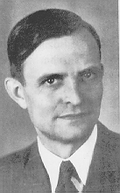
Commitment
1, 1 | 3, 0
0, 0 | 2, 1
Unique Nash equilibrium (iterated strict dominance solution)
von Stackelberg
Suppose the game is played as follows:
  Player 1 commits to playing one of the rows,
  Player 2 observes the commitment and then chooses a column
Optimal strategy for player 1: commit to Down

Slide 29
Commitment: an extensive-form game
For the case of committing to a pure strategy:
Player 1
Up
Down
Player 2
Player 2
Left
Right
Left
Right
1, 1
3, 0
0, 0
2, 1

Slide 30
Commitment to mixed strategies
0
1
.49
1, 1 | 3, 0
0, 0 | 2, 1
.51
Also called a Stackelberg (mixed) strategy

Slide 31
Commitment: an extensive-form game
… for the case of committing to a mixed strategy:
Player 1
(1,0) (=Up)
(.5,.5)
(0,1) (=Down)
…
…
Player 2
Left
Right
Left
Right
Left
Right
1, 1
3, 0
.5, .5
2.5, .5
0, 0
2, 1
Economist: Just an extensive-form game, nothing new here
Computer scientist: Infinite-size game! Representation matters

Slide 32
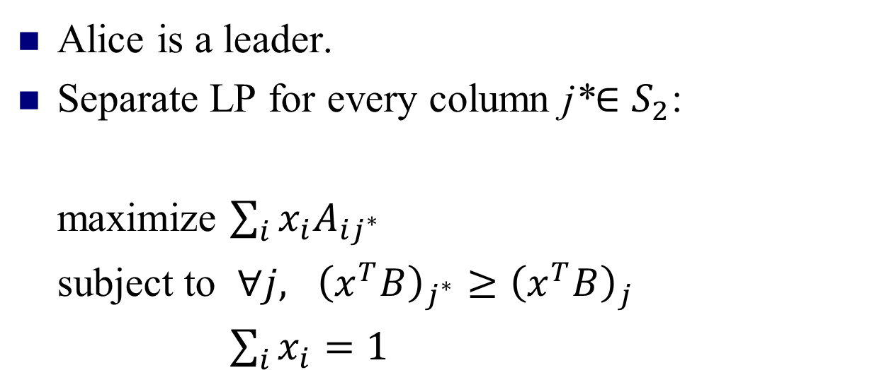
Computing the optimal mixed strategy to commit to
[Conitzer & Sandholm EC’06]
Alice is a leader.
Separate LP for every column j*$∈S_{2}$:
maximize $\sum_{i}{x_{i}A_{ij^{∗}}}$
subject to $∀j, {\left(x^{T}B\right)}_{j^{∗}}≥{\left(x^{T}B\right)}_{j}$
$\sum_{i}{x_{i}}=1$
Row utility
Column optimality
distributional constraint
Pick the one that gives max utility.

Slide 33
On the game we saw before
x
1, 1 | 3, 0
0, 0 | 2, 1
y
maximize 1x + 0y
subject to
1x + 0y ≥ 0x + 1y
x + y = 1
x ≥ 0, y ≥ 0
maximize 3x + 2y
subject to
0x + 1y ≥ 1x + 0y
x + y = 1
x ≥ 0, y ≥ 0

Slide 34
Visualization
 | L | C | R
U | 0,1 | 1,0 | 0,0
M | 4,0 | 0,1 | 0,0
D | 0,0 | 1,0 | 1,1
(0,1,0) = M
C
L
R
(1,0,0) = U
(0,0,1) = D

Slide 35
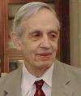

Generalizing beyond zero-sum games
Minimax, Nash, Stackelberg all agree in zero-sum games
0, 0 | -1, 1
-1, 1 | 0, 0
zero-sum games
minimax strategies
zero-sum games
general-sum games
Nash equilibrium
zero-sum games
general-sum games
Stackelberg mixed strategies

Slide 36
Other nice properties of commitment to mixed strategies
0, 0 | -1, 1
1, -1 | -5, -5
No equilibrium selection problem
Leader’s payoff at least as good as any Nash eq. or even correlated eq. (von Stengel & Zamir [GEB ‘10])
≥

Slide 37
Bayesian Games
So far in Games,
Complete information (each player has perfect information
regarding the element of the game).
Bayesian Game
A game with incomplete information
Each player has initial private information, type.
- Bayesian equilibrium: solution of the Bayesian game

Slide 38
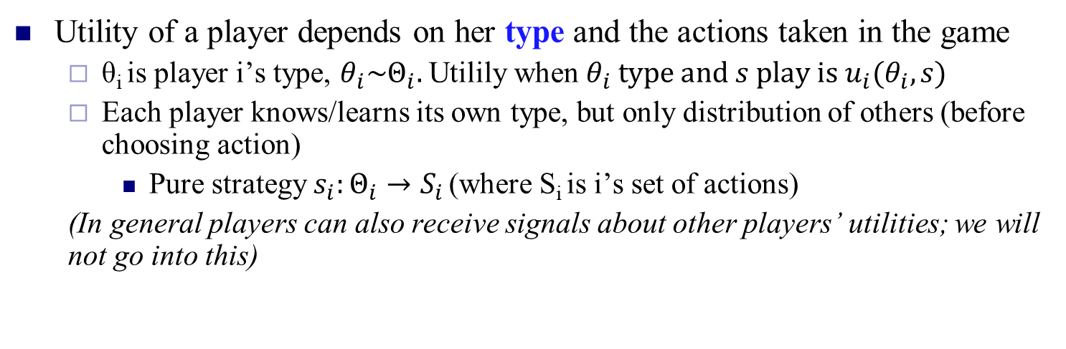
Bayesian game
Utility of a player depends on her type and the actions taken in the game
  θ_{i} is player i’s type, $θ_{i}\sim Θ_{i}.$ Utilily when $θ_{i} type and s play is u_{i}(θ_{i},s)$
  Each player knows/learns its own type, but only distribution of others (before choosing action)
    Pure strategy $s_{i}:Θ_{i}→S_{i}$ (where S_{i} is i’s set of actions)
  (In general players can also receive signals about other players’ utilities; we will not go into this)
L
R
L
R
row player
type 1 (prob. 0.5)
U
4 | 6
2 | 4
column player
type 1 (prob. 0.5)
U
4 | 6
4 | 6
D
D
L
R
L
R
row player
type 2 (prob. 0.5)
U
2 | 4
4 | 2
column player
type 2 (prob. 0.5)
U
2 | 2
4 | 2
D
D

Slide 39
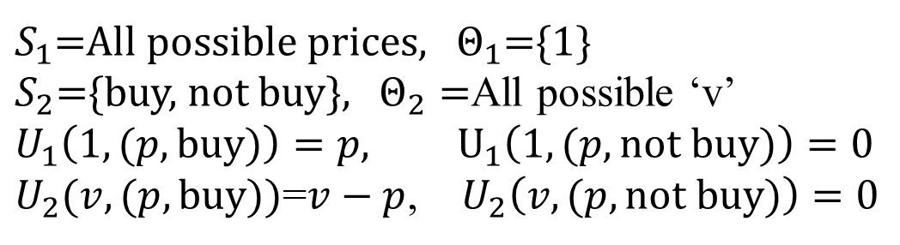
Car Selling Game
A seller wants to sell a car
A buyer has private value ‘v’ for the car w.p. P(v)
Sellers knows P, but not v
Seller sets a price ‘p’, and buyer decides to buy or not buy.
If sell happens then the seller gets p, and buyer gets (v-p).
$S_{1}$=All possible prices, $Θ_{1}$={1}
$S_{2}$={buy, not buy}, $Θ_{2}=$All possible ‘v’
$U_{1}\left(1,(p, buy)\right)=p, U_{1}\left(1, (p, not buy)\right)=0$
$U_{2}(v,(p,buy))$=$v−p$, $U_{2}\left(v,(p, not buy)\right)=0$

Slide 40
Converting Bayesian games to normal form
L
R
L
R
row player
type 1 (prob. 0.5)
U
4 | 6
2 | 4
column player
type 1 (prob. 0.5)
U
4 | 6
4 | 6
D
D
L
R
L
R
row player
type 2 (prob. 0.5)
U
2 | 4
4 | 2
column player
type 2 (prob. 0.5)
U
2 | 2
4 | 2
D
D
type 1: L
type 2: L
type 1: L
type 2: R
type 1: R
type 2: L
type 1: R
type 2: R
type 1: U
type 2: U
3, 3 | 4, 3 | 4, 4 | 5, 4
4, 3.5 | 4, 3 | 4, 4.5 | 4, 4
2, 3.5 | 3, 3 | 3, 4.5 | 4, 4
3, 4 | 3, 3 | 3, 5 | 3, 4
type 1: U
type 2: D
exponential blowup in size
type 1: D
type 2: U
type 1: D
type 2: D

Slide 41
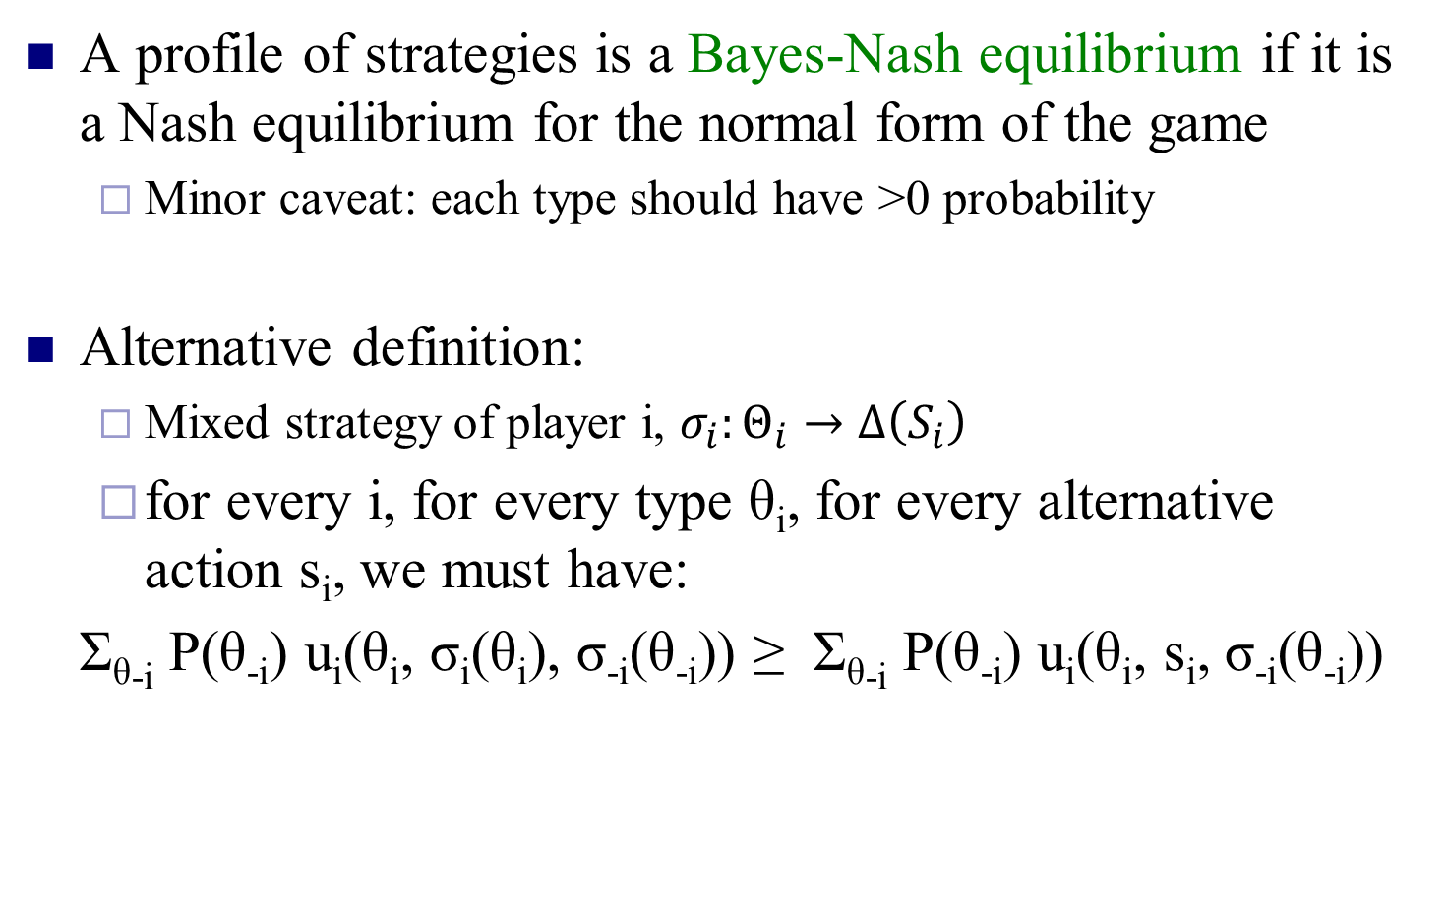

Bayes-Nash equilibrium
A profile of strategies is a Bayes-Nash equilibrium if it is a Nash equilibrium for the normal form of the game
  Minor caveat: each type should have >0 probability
Alternative definition:
  Mixed strategy of player i, $σ_{i}:Θ_{i}→Δ\left(S_{i}\right)$
  for every i, for every type θ_{i}, for every alternative action s_{i}, we must have:
Σ_{θ-i} P(θ_{-i}) u_{i}(θ_{i}, σ_{i}(θ_{i}), σ_{-i}(θ_{-i})) ≥ Σ_{θ-i} P(θ_{-i}) u_{i}(θ_{i}, s_{i}, σ_{-i}(θ_{-i}))
$$Π_{p≠i}P(θ_{p})$$

Slide 42
Again what about corr. eq. in Bayesian games?
Notion of signaling.
Look up the literature.

