Slide 1


Slide 2
Algorithmic Game Theory
Instructor: Ruta Mehta
TA: TBA

Slide 3
Multiple self-interested agents interacting in the same environment
Deciding what to do.
Q:
What to expect? How good is it? Can it be controlled?

Slide 4
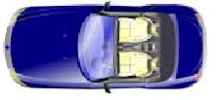
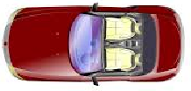

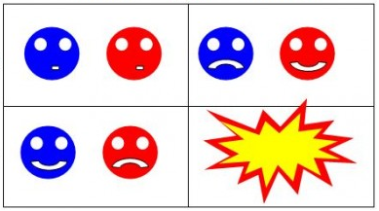
Chicken (Traffic Light)
C
S
C
S
C
S
C
S

Slide 5
AGT, in addition, focuses on designing efficient algorithms to compute solutions necessary to make accurate prediction.
Algorithmic Game Theory

Slide 6
What to expect
Research-oriented Course
  Exposure to key concepts and proof techniques from AGT
  Explore research problems and novel questions
What is expected from you
  Pre-req: Basic knowledge of linear-algebra, linear programming, probability, algorithms.
  Energetic participation in class
  Research/Survey Project (individually or in groups of two).

Slide 7
Instructor: Ruta Mehta (Me)
TA: TBA
Office hours:
  Ruta: Wed 1-2pm (tentative)
Webpage: https://courses.engr.illinois.edu/cs598rm
Check webpage for the updates

Slide 8
Grading:
  3 homeworks, one every month – 30%
  Final exam – 25%
  Research/Survey Project – 40%
    Work – 20%
    Presentation – 10%
    Report – 10%
  Class participation – 5%

Slide 9
References
T. Roughgarden, Twenty Lectures on Algorithmic Game Theory, 2016.
N. Nisan, T. Roughgarden, E. Tardos, and V. Vazirani (editors), Algorithmic Game Theory, 2007. (Book available online for free.)
M. Osborne and A. Rubinstein, A Course in Game Theory, 1994.
R. Myerson, Game Theory: Analysis of conflict, 1991.
Recent papers, and lecture notes from other similar course

Slide 10
Useful links
Webpage: https://courses.engr.illinois.edu/cs598rm/
Piazza Page: piazza.com/illinois/fall2018/cs598rm

Slide 11
3 Broad Goals

Slide 12
Goal #1
Understand outcomes arising from
interaction of intelligent and self-interested agents.
Games and Equilibria

Slide 13
Prisoner’s Dilemma
Two thieves caught for burglary.
Two options: {confess, not confess}
N
C
N
-1 -1
-6 0
C
0 -6
-5 -5

Slide 14
Prisoner’s Dilemma
Two thieves caught for burglary.
Two options: {confess, not confess}
N
C
N
-1 -1
-6 0
C
0 -6
-5 -5
Only stable state

Slide 15
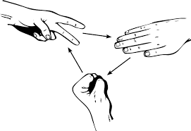
Rock-Paper-Scissors
R
P
S
R
0 0
-1 1
1 -1
P
1 -1
0 0
-1 1
S
-1 1
1 -1
0 0
Both playing (1/3,1/3,1/3)
is the only NE.
No pure stable state!
Nash Eq.: No player gains by
deviating individually
Why?

Slide 16
Normal form games and Nash equilibrium existence
Computation:
  Zero-sum: minmax theorem,
  General: (may be) Lemke-Howson algorithm
Complexity: PPAD-complete
Other equilibrium notions – markets, security games
Incomplete information, Bayesian Nash
Collusion, Core, Nash bargaining

Slide 17
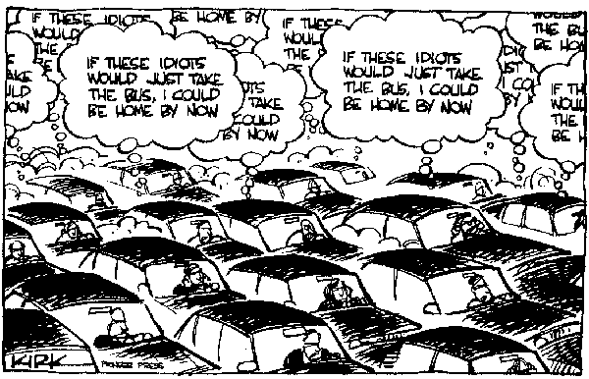
Tragedy of commons
Limited but open resource shared by many.
Bad outcome!
Stable: Over use => Disaster

Slide 18
Goal #2
Analyze quality of the outcome arising from
strategic interaction, i.e. OPT vs NE.
Price of Anarchy

Slide 19




Braess’ Paradox
60 commuters
30
$x$ minutes
$1$ hour
s
t
$1$ hour
$x$ minutes
30
Commute time: 1.5 hours

Slide 20
Braess’ Paradox
60 commuters
30
$x$ minutes
$1$ hour
s
t
0 hours
~1 hour
$1$ hour
$x$ minutes
30
Commute time: 1.5 hours

Slide 21

Braess’ Paradox
60 commuters
$x$ minutes
$1$ hour
60
s
t
0 hours
$1$ hour
$x$ minutes
Commute time: 2 hours

Slide 22


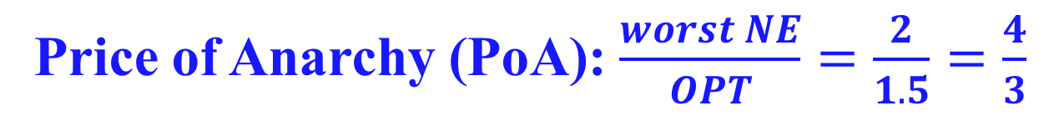


Braess’ Paradox
60 commuters
$x$ minutes
$1$ hour
60
s
t
0 hours
$1$ hour
$x$ minutes
Price of Anarchy (PoA): $\frac{worst NE}{OPT}=\frac{2}{1.5}=\frac{4}{3}$
Can not be worse!

Slide 23
Network routing games
Congestion (potential) games
PoA in linear congestion games
  Smoothness framework
Iterative play and convergence

Slide 24
Goal #3
Designing rules to ensure “good” outcome
under strategic interaction among selfish agents.
Mechanism Design

Slide 25
At the core of large industries
Search auction – primary revenue for google!
Spectrum auction – distribution of public good.
enables variety of mobile/cable services.
Kidney exchange – critical decision making

Slide 26
At the core of large industries
Online markets – eBay, Uber/Lyft, TaskRabbit
Voting, review, coupon systems.
So on …

Slide 27
MD without money
  Arrow’s theorem (voting), stable matching, fair division
MD with money
  First price auction, second price auction, VCG
  Generalized second price auction for search (Google)
  Optimal auctions: Myerson auction and extensions

Slide 28
Fun Fact!
Olympics 2012 Scandal
Check out Women’s doubles badminton
tournament
Video of the fist controversial match

Slide 29
Food for Thought
You and your friend choose a number …
2
3
97
98
99
100

Slide 30
Food for Thought
You and your friend choose a number …
2
3
96
97
98
99
100
-2
+2
What will you choose?
What if +/- 50?
What are Nash equilibria?

