Slide 1
Single view 3D Scene Layout
3D Vision
University of Illinois
Derek Hoiem

Slide 2
Agenda
Scene representations
Outdoor scene layout
  Photo popup, WorldSheet
Indoor scene layout
  Room as box
  360-based layout
  Complete scene parsing

Slide 3
Geometric Pixel Labeling
Scene Layout
Structured by pixels
View-dependent: depth, normals, boundaries are relative to current view
Translation between two measurable things (e.g. intensity to depth)
Structured with objects and surfaces
View-independent: same representation applies to many perspectives
Interpretation of models from measurement

Slide 4



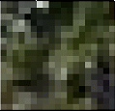
Uses of scene layout
Context for recognition

Slide 5
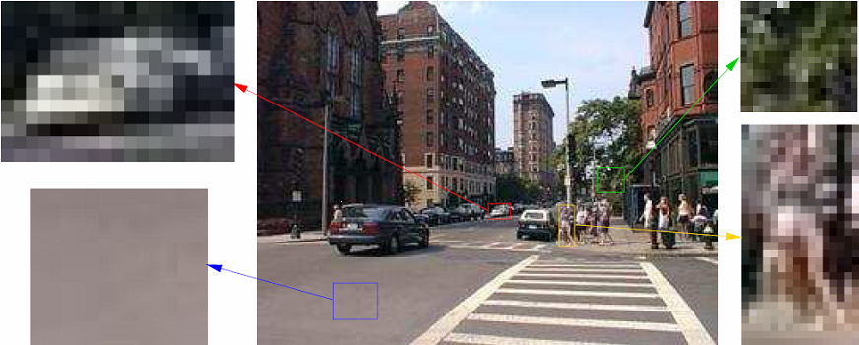
Uses of scene layout
Context for recognition

Slide 6
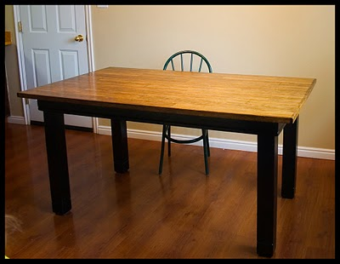
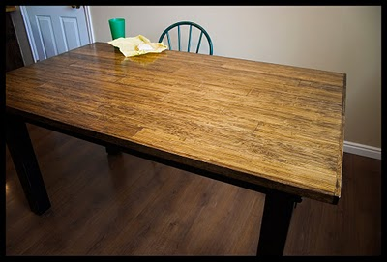
Physical space helpful for recognition
Apparent shape depends strongly on viewpoint

Slide 7
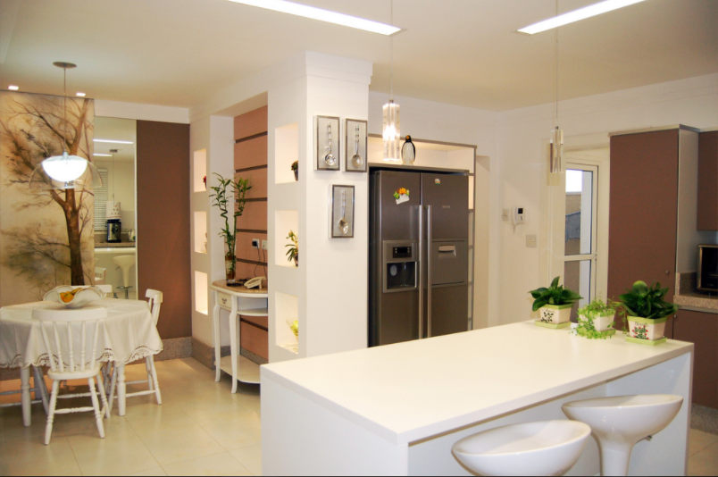
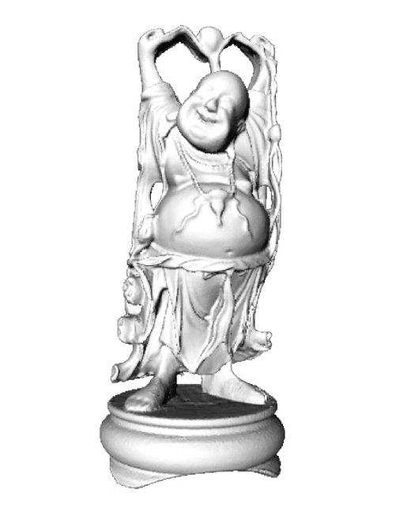
Physical space needed to predict appearance

Slide 8
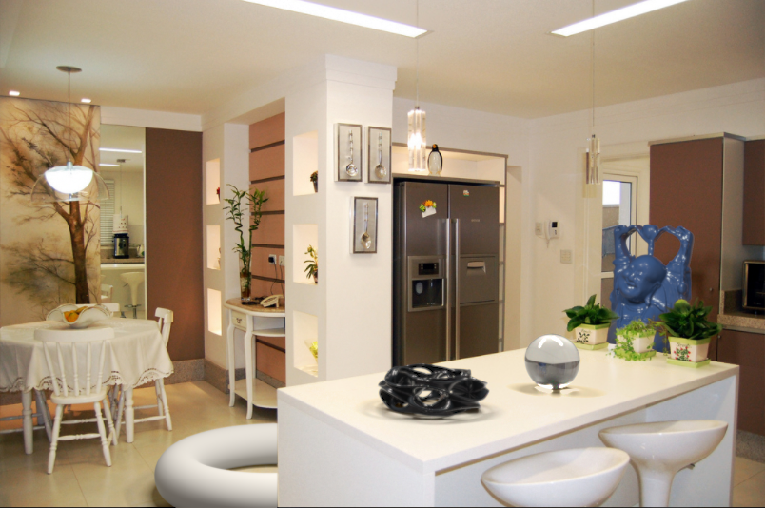
Physical space needed to predict appearance

Slide 9
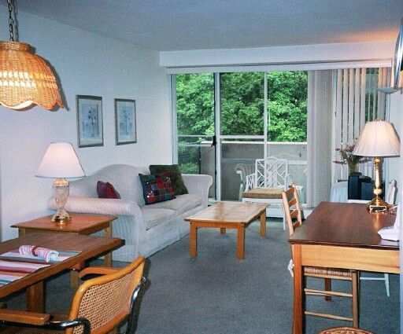
Scene understanding

Slide 10
Do pixel labels provide scene understanding?
Lamp
Wall
Sofa
Table
Floor
Floor

Slide 11
Interpreting scene layout in a physical space
Wall
Sofa
Table
Floor

Slide 12
Physical space needed for affordance
Could I stand over here?
Is this a good place to sit?
Can I put my cup here?
Walkable path

Slide 13
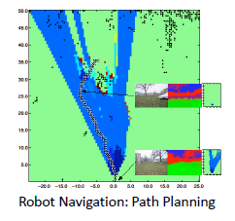
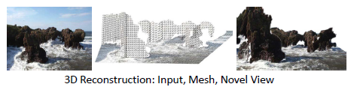
Uses of scene layout
Other direct applications
  Assisted driving
  Robot navigation/interaction
  Object insertion

Slide 14
How to represent scene space?
Wide variety of possible representations

Slide 15
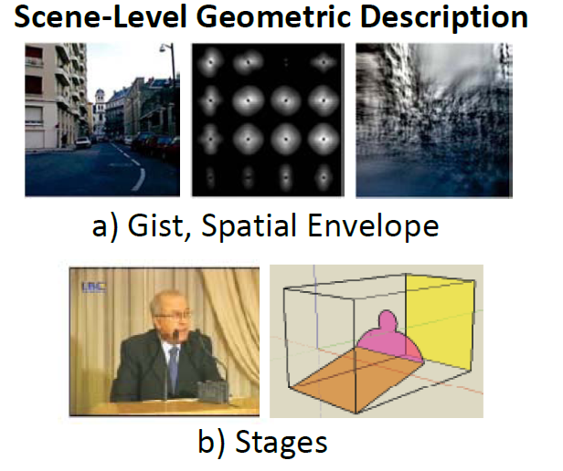
Figs from Hoiem - Savarese 2011 book

Slide 16
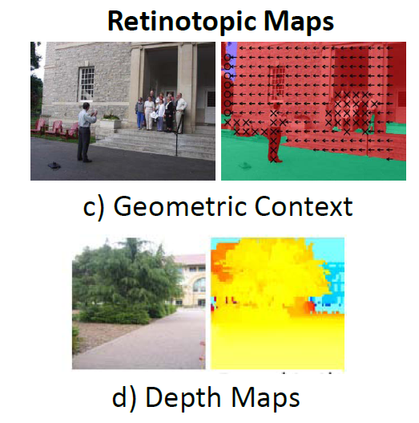
Figs from Hoiem - Savarese 2011 book

Slide 17
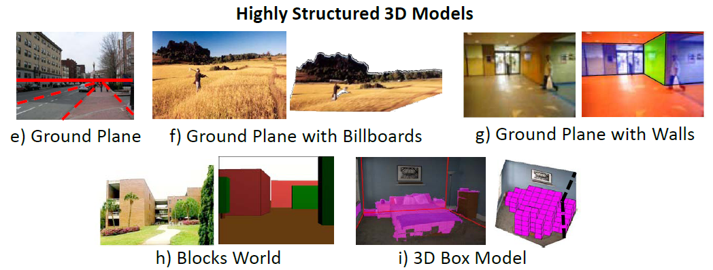
CAD-like: layout + objects
Figs from Hoiem - Savarese 2011 book

Slide 18
Key Trade-offs
Level of detail: rough “gist”, or detailed point cloud?
  Precision vs. accuracy
  Difficulty of inference
Abstraction: depth at each pixel, or ground planes and walls?
  What is it for: e.g., metric reconstruction vs. interaction

Slide 19
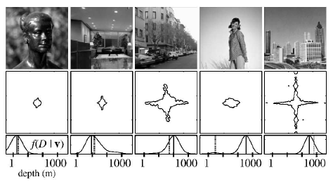
Low detail, Low/Med abstraction
Holistic Scene Space: “Gist”
Torralba & Oliva 2002
Oliva & Torralba 2001

Slide 20
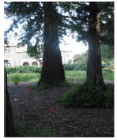
High detail, Low abstraction
Depth Map
Saxena, Chung & Ng 2005, 2007

Slide 21
Low detail, High abstraction
Room as a Box
Hedau Hoiem Forsyth 2009

Slide 22
Med-High detail, High abstraction
Complete 3D Layout
Guo Zou Hoiem 2015

Slide 23
Depth (Saxena et al. 2007)
CAD-like (Guo et al 2015)
Detail
Room as Box (Hedau et al. 2009)
Gist (Oliva Torralba 2002)
Abstraction

Slide 24
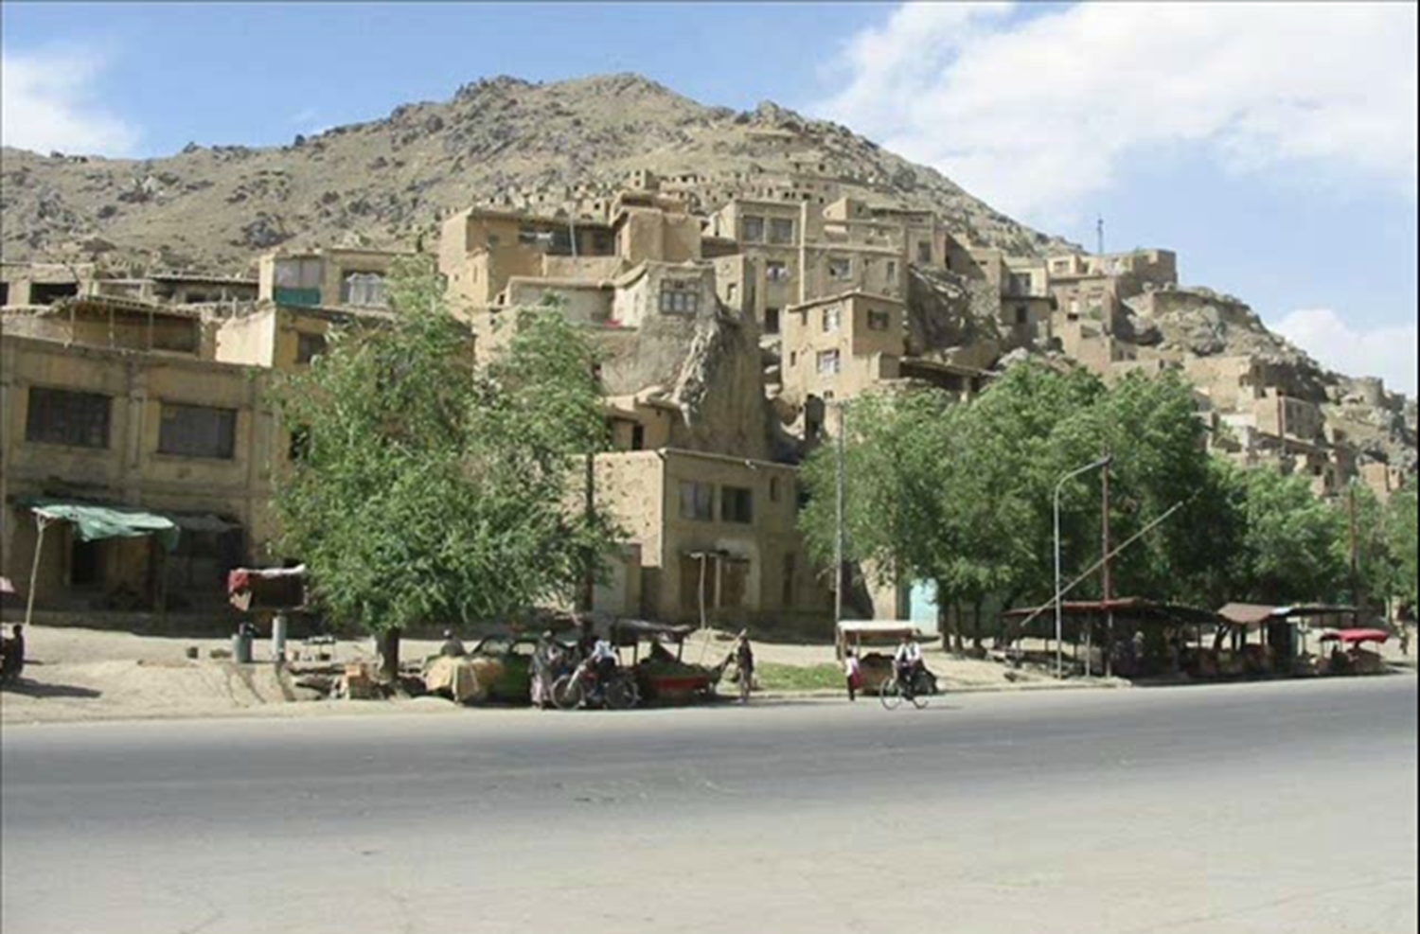
Outdoor Scenes
Highly irregular
~ Things sitting on the ground
Ground-object boundary informs distance

Slide 25
Surface Layout (“Geometric Context”)
Hoiem Efros Hebert 2005,2007
Slide from Sanja Fidler

Slide 26
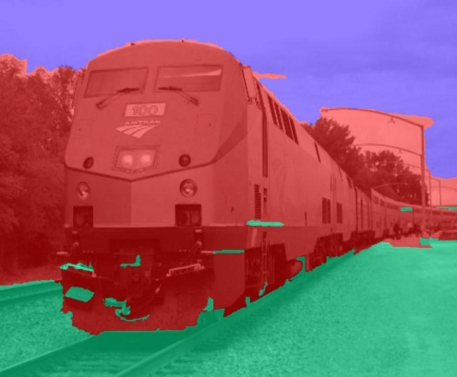
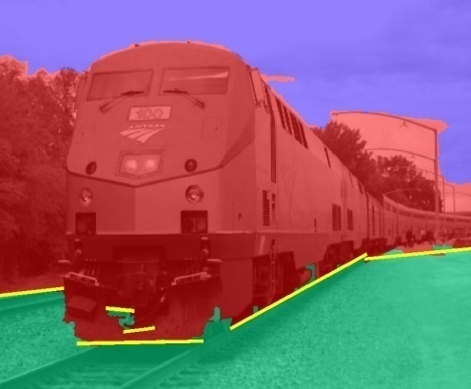

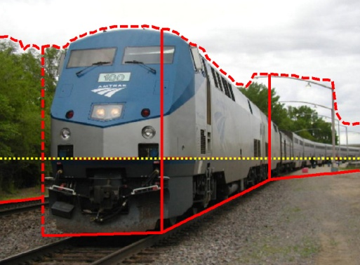
Automatic Photo Popup
Labeled Image
Fit Ground-Vertical Boundary with Line Segments
Form Segments into Polylines
Cut and Fold
Final Pop-up Model
[Hoiem Efros Hebert 2005]
Notes:
Note that horizon estimate is often poor

Slide 27
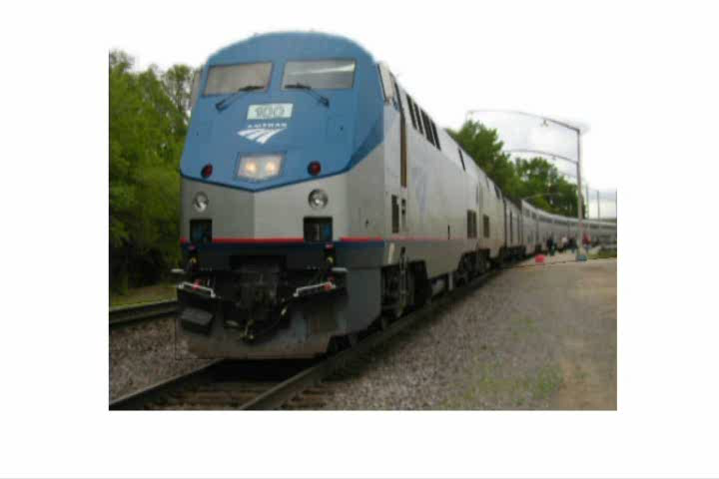
Automatic Photo Popup

Slide 28
Surface Layout + Boundaries + Viewpoint
[Hoiem et al. 2008]

Slide 29

Notes:
Explain holes

Slide 30
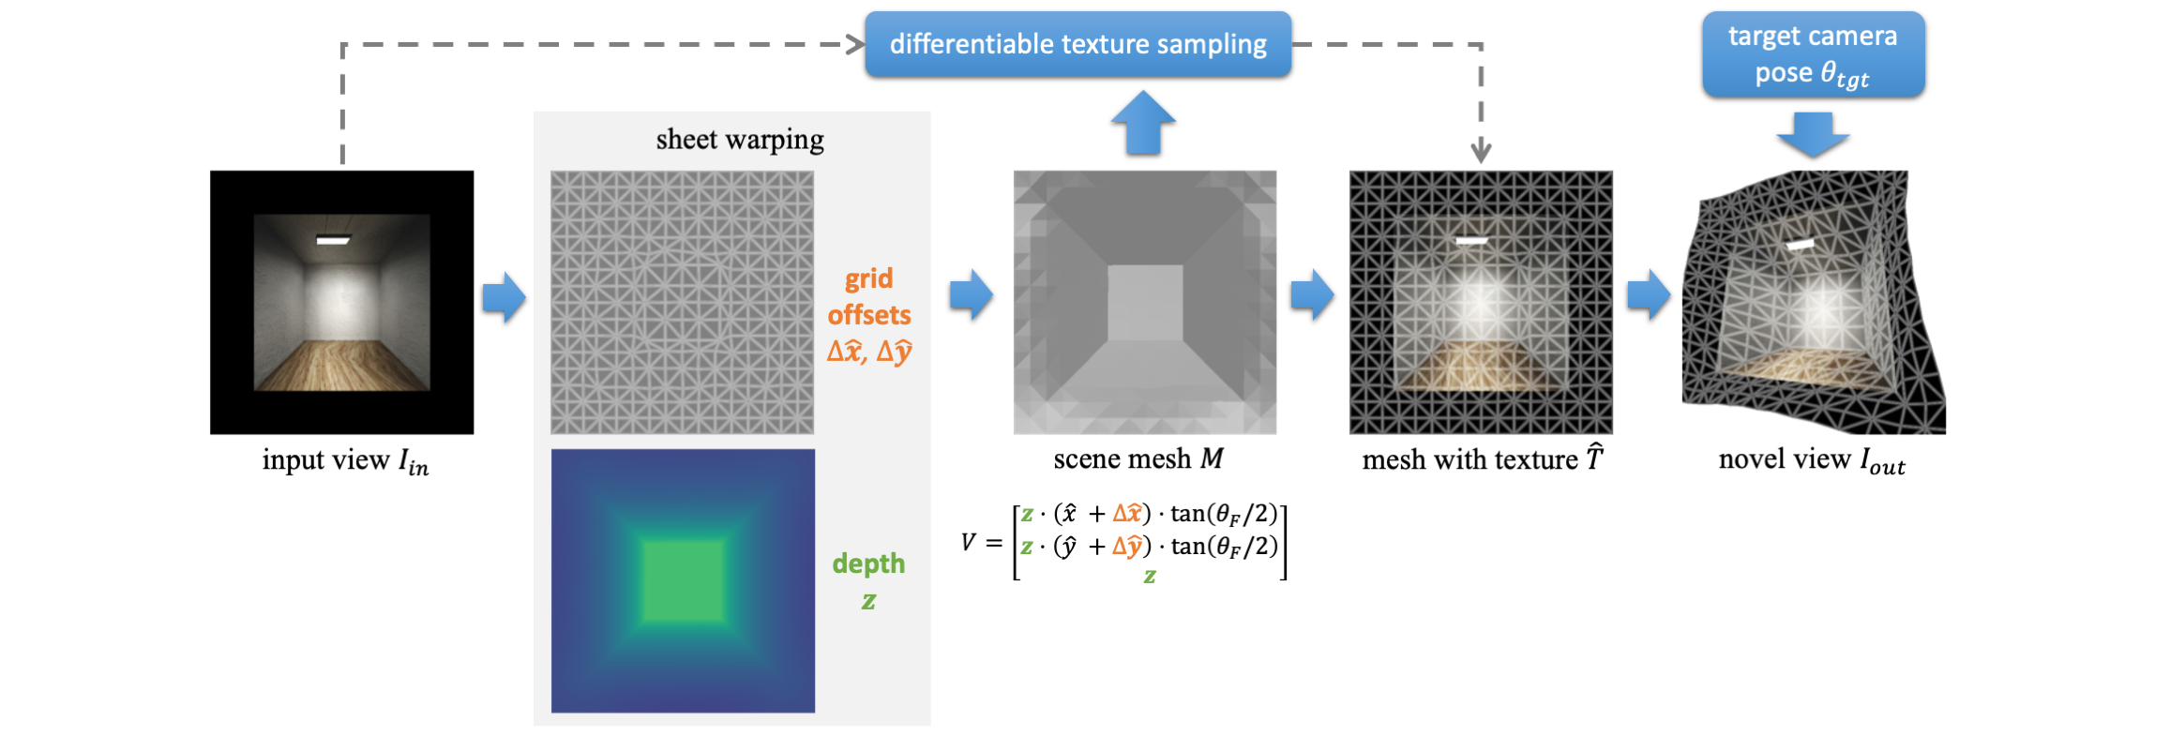
Worldsheet (Hu et al. ICCV 2021)
https://worldsheet.github.io/
https://www.youtube.com/watch?v=j5aT3zRxFlk

Slide 31
Key challenges
How to represent the physical space?
  Requires seeing beyond the visible
How to estimate the physical space?
  Requires simplified models
  Requires learning from examples

Slide 32
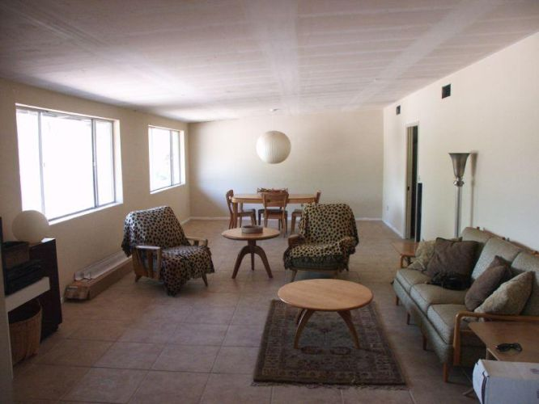
Indoor scenes
Highly regular
Lots of things close to each other
Things on other things
Ground contact often not visible

Slide 33
Simplest Model: Box Layout
Hedau Hoiem Forsyth, ICCV 2009
Room is an oriented 3D box
  Three vanishing points specify orientation
  Two pairs of sampled rays specify position/size

Slide 34
Simplest Model: Box Layout
Room is an oriented 3D box
  Three vanishing points (VPs) specify orientation
  Two pairs of sampled rays specify position/size
Another box consistent with the same vanishing points

Slide 35
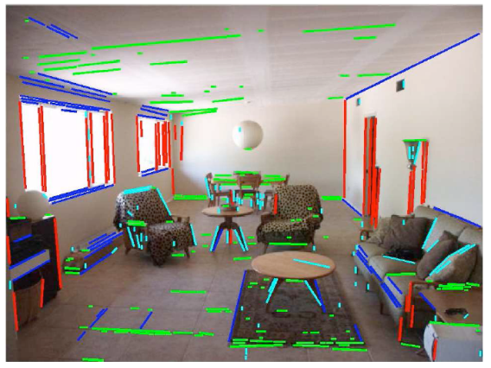
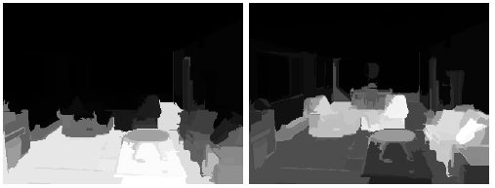
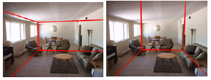
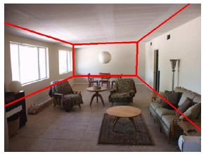
Box Layout Algorithm
Detect edges
Estimate 3 orthogonal vanishing points
Apply region classifier to label pixels with visible surfaces
  Boosted decision trees on region based on color, texture, edges, position
Generate box candidates by sampling pairs of rays from VPs
Score each box based on edges and pixel labels
  Learn score via structured learning
Jointly refine box layout and pixel labels to get final estimate
+

Slide 36
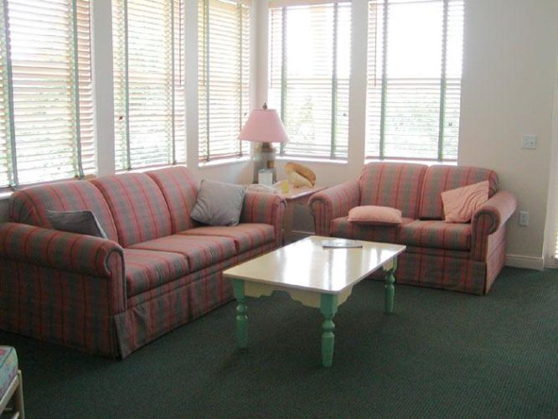
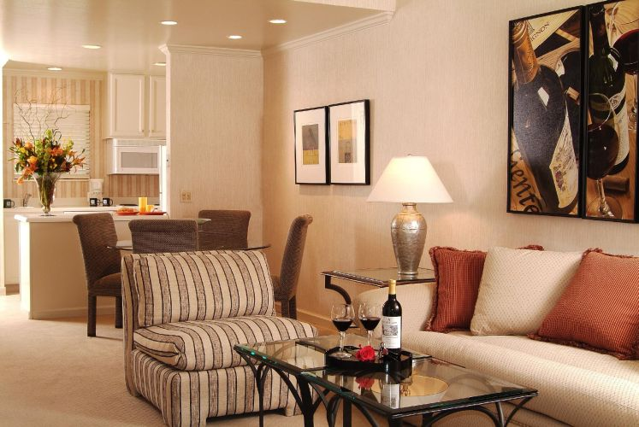
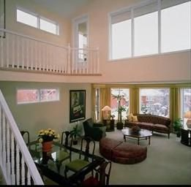
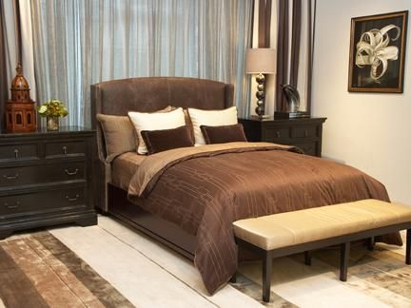
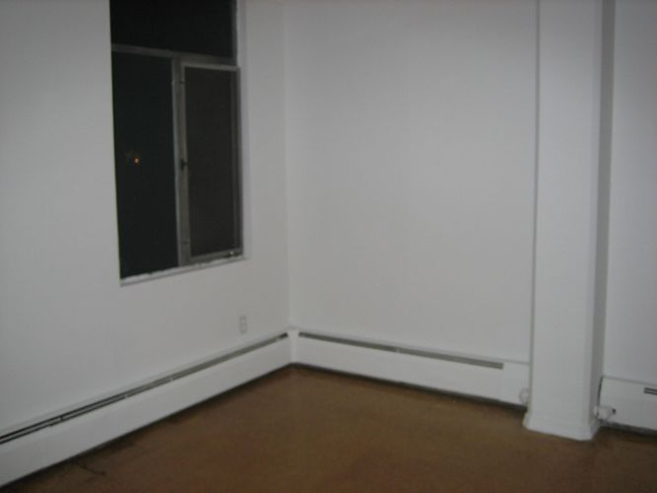
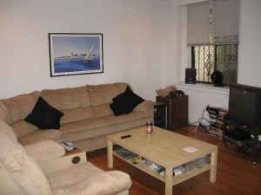
Evaluation
Dataset: 308 indoor images
  Train with 204 images, test with 104 images

Slide 37
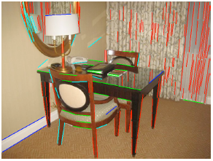
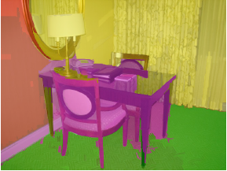
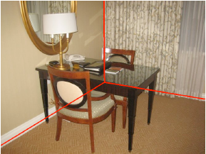
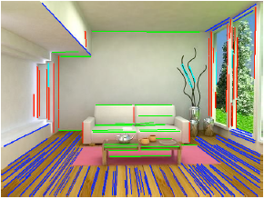
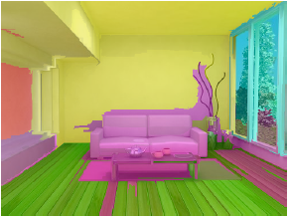
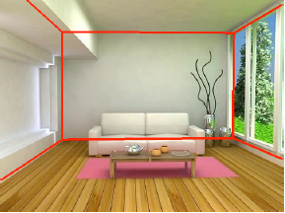
Experimental results
Detected Edges
Surface Labels
Box Layout
Detected Edges
Surface Labels
Box Layout

Slide 38
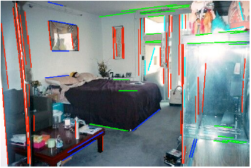
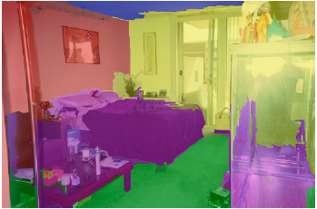
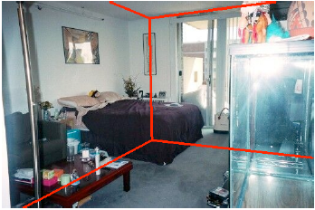
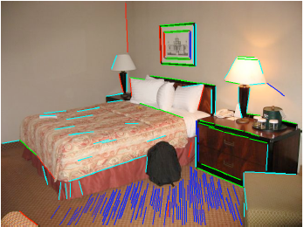
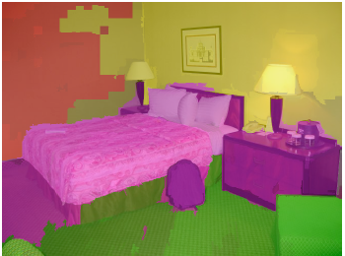
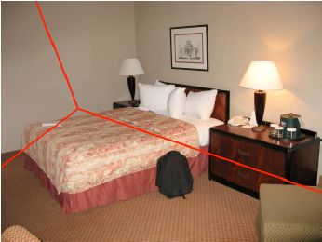
Experimental results
Detected Edges
Surface Labels
Box Layout
Detected Edges
Surface Labels
Box Layout

Slide 39
Experimental results
Joint reasoning of surface label / box layout helps
  Pixel error: 26.5% → 21.2%
  Corner error: 7.4% → 6.3%
Similar performance for cluttered and uncluttered rooms

Slide 40
Similar idea for 360 images: “recognize” features of geometry, and fit simple model
“LayoutNet”: Zou Colburn Shan Hoiem 2018 (collaboration with Zillow)

Slide 41
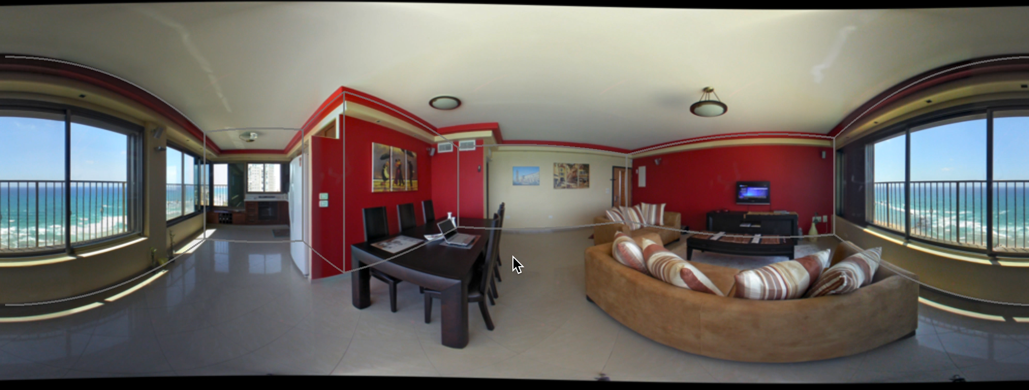
LayoutNet example

Slide 42
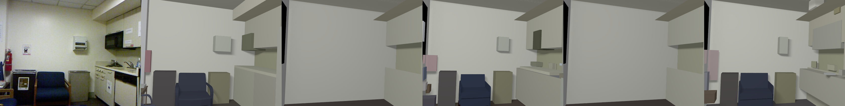
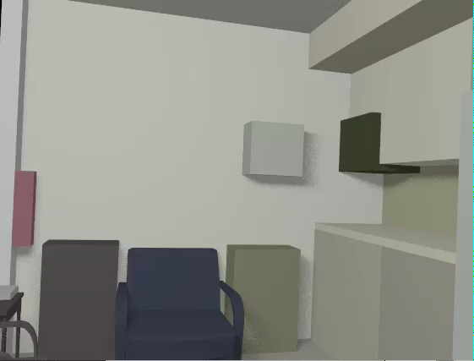
Predicting complete models from RGBD
Key idea: create complete 3D scene hypothesis that is consistent with observed depth and appearance
Guo Zou Hoiem 2015, 2016
Notes:
We think the most natural way

Slide 43
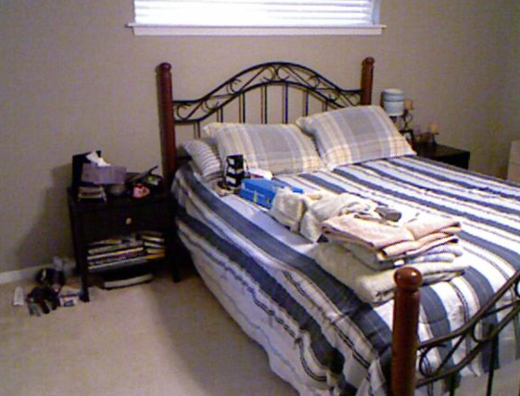
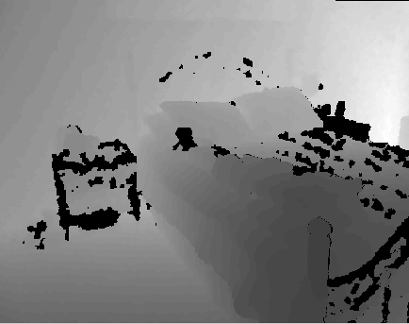

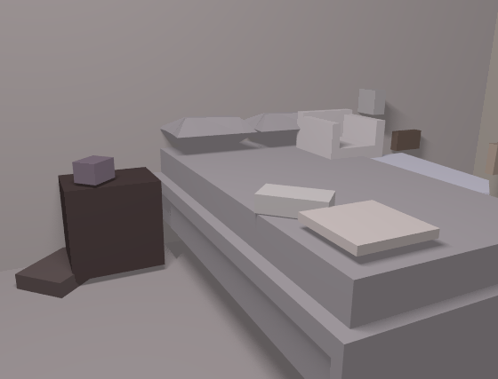









Overview of approach
RGB-D Input
Layout Proposals
Composing
Object Proposals
Exemplar Region Retrieval
3D Model Fitting
Annotated Scene
...
Retrieved Region
Source 3D Model
Transferred Model
Retrieved Region
Source 3D Model
Transferred Model
Notes:
3D Layout: Detection. 3D Object: transfer. Composition: integer programming

Slide 44



Example result
Notes:
We think the most natural way

Slide 45


Manual
Segmentation
Composition with
Manual Segmentation
Original Image
Ground Truth
Annotation
Composition with
Auto Proposal
Auto Proposal

Slide 46

Manual
Segmentation
Composition w.
Manual Segmentation
Original Image
Ground Truth
Annotation
Composition w.
Auto Proposal
Auto Proposal

Slide 47

Scene parsing via rendering consistency
“Holistic 3D Scene Parsing”: Huang et al. 2018

Slide 48
CVPR 2018
Input Image
Layout + Object Shape/Pose
Layout Only

Slide 49
Image
Ground Truth
Prediction
Image
Ground Truth
Prediction

Slide 50
Ultimate goal of 3D scene layout
Recover layout surfaces (walls, floor, counters, etc.)
Recognize objects where possible
Estimate pose and shape of object(s) of interest
Estimate space occupancy of all other objects (for movement)

Slide 51

Can we combine representations of detail and structure?
Detailed Geometry
from Multiview
Structure and Semantics from Single View

Slide 52
Things to remember
Most vision tasks are about representing the image, but 3D scene layout is about representing the world
Difficult to maintain both precision and abstraction in a single representation – maybe best to maintain separate representations
  Viewer-centric depth, normals, boundaries
  Viewer-independent 3D layout of surfaces and shapes/positions of objects
Biggest barrier to progress is complexity and challenge of evaluating, given that a central aim is to produce useful representations for unspecified downstream tasks

