Slide 1
Structure from Motion
3D Vision
University of Illinois
Derek Hoiem

Slide 2
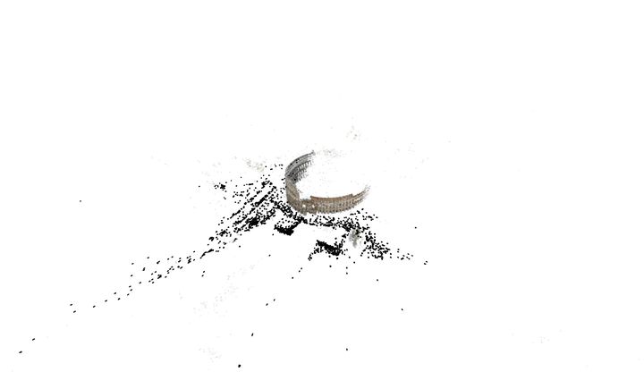
Structure from Motion (SfM)
Goal: Solve for camera poses and 3D points in scene
Notes:
Shows positions of cameras when photos were taken (i.e. camera poses or frustra) and the 3D points that are reconstructed based on matched features

Slide 3
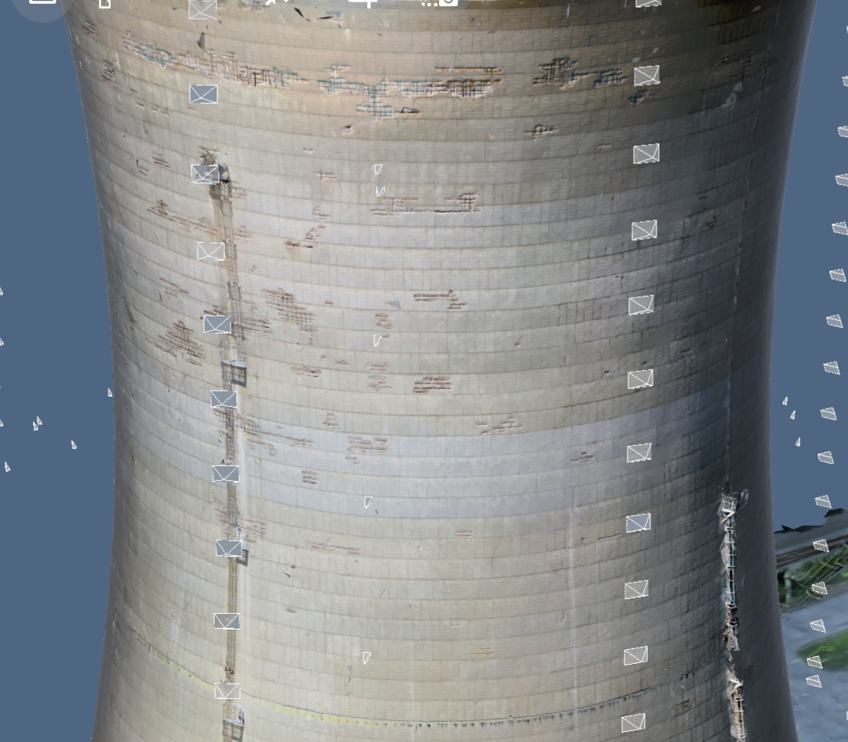
Example Application:
Inspection
Enable inspection in hard to reach areas with drone photos and 3D reconstruction
Create 3D model from images
Provide tools to inspect on images and map interactions to 3D

Slide 4
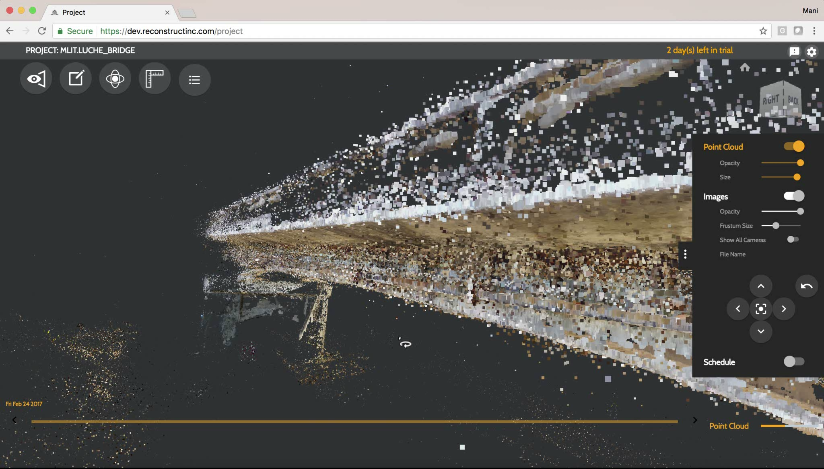

Slide 5
Incremental SfM
Compute features
Match images
Reconstruct
  Solve for poses and 3D points in two cameras
  Solve for pose of additional camera(s) that observe reconstructed 3D points
  Solve for new 3D points that are viewed in at least two cameras
  Bundle adjust to minimize reprojection error

Slide 6
Incremental SFM: detect features
Feature types: SIFT, ORB, Hessian-Laplacian, …
im 1
im 2
im 3
im n
…
Each circle represents a set of detected features
Notes:
Features are representations of image patches at “interest point” locations. Interest points are positions in images that are local maxima of some property, such as “cornerness” or “blobness”, such that the same scene point is likely to be detected as an interest point in another image of the same scene.

Slide 7
Incremental SFM: match features and images
For each pair of images:
Match feature descriptors via approximate nearest neighbor
Solve for F or E and find inlier feature correspondences
…
Points of same color have been matched to each other

Slide 8
Incremental SFM: create tracks graph
…
…
im 1
im 2
im 3
im n
tracks graph: bipartite graph between observed 3D points and images
Notes:
The tracks graph organizes and records which images see the same features. A “track” is a set of features across 2 or more images that are thought to correspond to the same scene point. In the tracks graph, there is a node for each scene point, and a node for each image. There is an edge between a scene point and image if it is thought that the image observes that scene point. The edge between the point and image stores the feature information.

Slide 9
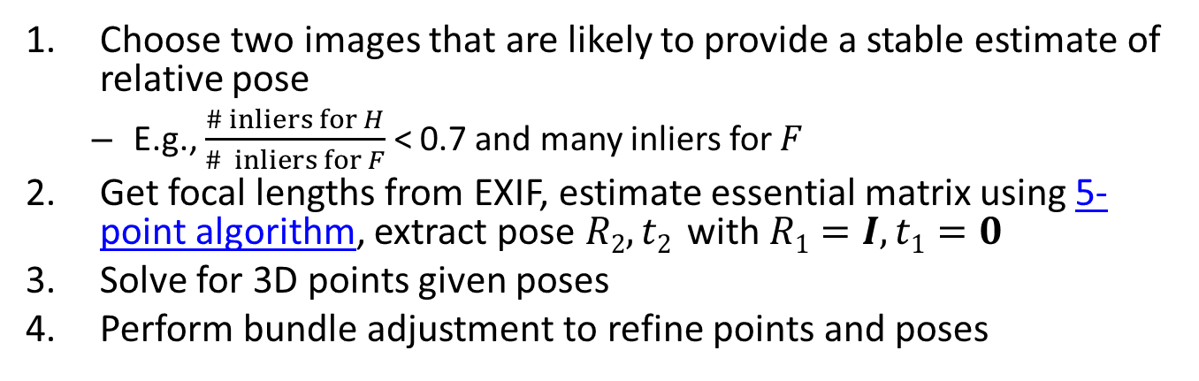
Incremental SFM: initialize reconstruction
Choose two images that are likely to provide a stable estimate of relative pose
  E.g., $\frac{\# inliers for H}{\# inliers for F}$ < 0.7 and many inliers for $F$
Get focal lengths from EXIF, estimate essential matrix using 5-point algorithm, extract pose $R2, t2$ with $R1=I, t1=0$
Solve for 3D points given poses
Perform bundle adjustment to refine points and poses
…
im 1
im 2
im 3
im n
filled circles = “triangulated” points
filled rectangles = “resectioned” images (solved pose)

Slide 10
Bundle adjustment
Non-linear method for refining structure and pose
Minimizing reprojection error
X_{j}
Ceres Solver
P₁X_{j}
x_{1j}
x_{3j}
P₃X_{j}
P₂X_{j}
x_{2j}
P₁
P₃
P₂

Slide 11
Incremental SFM: grow reconstruction
Resection: solve pose for image(s) that have the most triangulated points
Triangulate: solve for any new points that have at least two cameras
Bundle adjust
Optionally, align with GPS from EXIF or ground control points (GCP)
…
im 1
im 2
im 3
im n
filled circles = “triangulated” points
filled rectangles = “resectioned” images (solved pose)

Slide 12
Incremental SFM: grow reconstruction
Resection: solve pose for image(s) that have the most triangulated points
Triangulate: solve for any new points that have at least two cameras
Bundle adjust
Optionally, align with GPS from EXIF or ground control points (GCP)
…
im 1
im 2
im 3
im n
filled circles = “triangulated” points
filled rectangles = “resectioned” images (solved pose)

Slide 13
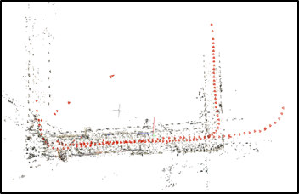
Why SfM is hard
Slow
  Matching N² pairs of images takes too long (~1-4s per pair)
  Bundle adjustment takes longer with more images and needs to be repeated as images are added: up to O(N³)
  Grow reconstruction phase is not easy to parallelize
Bad feature matches are very common and cause misregistrations
Insufficient feature matches cause incomplete reconstructions
from COLMAP SfM (Schonberger et al. 2016)
Bad matches in low texture, repetitive hallway cause COLMAP to fail to reconstruct loop (Kataria et al. 2020)

Slide 14
Incremental SfM, Take 2: improvements in green
Compute features
Match images
Reconstruct
  Solve for poses and 3D points in two cameras
  Solve for pose of additional camera(s) that observe reconstructed 3D points
  Solve for new 3D points that are viewed in at least two cameras
  Bundle adjust to minimize reprojection error

Slide 15
Incremental SFM: detect features
Feature types: SIFT, ORB, Hessian-Laplacian, …
Use GPU for fast feature computation
im 1
im 2
im 3
im n
…
Each circle represents a set of detected features
Notes:
Features are representations of image patches at “interest point” locations. Interest points are positions in images that are local maxima of some property, such as “cornerness” or “blobness”, such that the same scene point is likely to be detected as an interest point in another image of the same scene.

Slide 16
Incremental SFM: match features and images
Find match candidates:
Match K closest images in GPS distance or time
Use vocab tree on features to find K most similar images
Potentially, add new candidates based on candidates that are already found
For each pair of candidate images:
Match feature descriptors via approximate nearest neighbor
  GPU can be used for fast feature matching
  Lowe’s ratio test used to reject some potentially bad matches
Solve for F or E and find inlier feature correspondences
  Remove feature matches that have above threshold reprojection error according to F or E
  Discard image pairs that have below threshold number of geometrically verified matches
…
Points of same color have been matched to each other

Slide 17
Incremental SFM: create tracks graph
…
…
im 1
im 2
im 3
im n
tracks graph: bipartite graph between observed 3D points and images
Notes:
The tracks graph organizes and records which images see the same features. A “track” is a set of features across 2 or more images that are thought to correspond to the same scene point. In the tracks graph, there is a node for each scene point, and a node for each image. There is an edge between a scene point and image if it is thought that the image observes that scene point. The edge between the point and image stores the feature information.

Slide 18
Incremental SFM: initialize reconstruction
Choose two images that are likely to provide a stable estimate of relative pose
  E.g., $\frac{\# inliers for H}{\# inliers for F}$ < 0.7 and many inliers for $F$
Get focal lengths from EXIF, estimate essential matrix using 5-point algorithm, extract pose $R2, t2$ with $R1=I, t1=0$
Solve for 3D points given poses
Perform bundle adjustment to refine points and poses
…
im 1
im 2
im 3
im n
filled circles = “triangulated” points
filled rectangles = “resectioned” images (solved pose)

Slide 19
Triangulation: Linear Solution
Given P, P’, x, x’
Precondition points and projection matrices
Create matrix A
[U, S, V] = svd(A)
X = V(:, end)
Pros and Cons
Works for any number of corresponding images
Not projectively invariant
Code: http://www.robots.ox.ac.uk/~vgg/hzbook/code/vgg_multiview/vgg_X_from_xP_lin.m

Slide 20
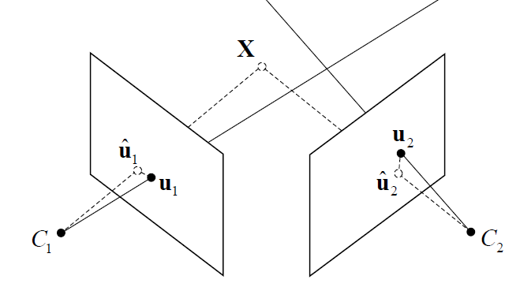




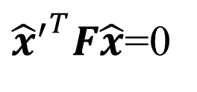
Triangulation: Non-linear Solution
Minimize projected error while satisfying
${{\hat{x}}^{′}}^{T}F\hat{x}$=0
$$cost\left(X\right)=dist{\left(x,\hat{x}\right)}^{2}+dist{\left(x′,\hat{x}′\right)}^{2}$$
$$x′$$
$$\hat{x}$$
$$x$$
$${\hat{x}}^{′}$$
Figure source: Robertson and Cipolla (Chpt 13 of Practical Image Processing and Computer Vision)
Notes:
This is what is optimized in bundle adjustment – solving for the 3D points X and the camera poses C such that each point X_i projects close to where it is observed in each image.

Slide 21
Bundle adjustment
Non-linear method for refining structure and motion
Minimizing reprojection error
X_{j}
Ceres Solver
Use robust loss for reprojection error, such as Huber
P₁X_{j}
x_{1j}
x_{3j}
P₃X_{j}
P₂X_{j}
x_{2j}
P₁
P₃
P₂

Slide 22
Incremental SFM: grow reconstruction
Sort images, e.g. by number of triangulated points
  Resection: solve pose for image(s) that have the most triangulated points
  Triangulate: solve for any new points viewed by at least two reconstructed cameras
  Remove 3D points that do not have enough baseline or too high reprojection error in any camera (optionally, split into multiple tracks)
  Bundle adjust
    Only do full bundle adjust after some percent of new images are resectioned (huge time savings for large reconstructions)
Optionally, align with GPS from EXIF or ground control points (GCP)
…
im 1
im 2
im 3
im n
filled circles = “triangulated” points
filled rectangles = “resectioned” images (solved pose)

Slide 23
Incremental SFM: grow reconstruction
Sort images, e.g. by number of triangulated points
  Resection: solve pose for image(s) that have the most triangulated points
  Triangulate: solve for any new points viewed by at least two reconstructed cameras
  Remove 3D points that do not have enough baseline or too high reprojection error in any camera (optionally, split into multiple tracks)
  Bundle adjust
    Only do full bundle adjust after some percent of new images are resectioned (huge time savings for large reconstructions)
Optionally, align with GPS from EXIF or ground control points (GCP)
…
im 1
im 2
im 3
im n
filled circles = “triangulated” points
filled rectangles = “resectioned” images (solved pose)

Slide 24
Where does SfM fail?
Not enough images with enough overlap
  Disconnected reconstructions
Featureless or reflecting surfaces
  No matches or bad matches
Images with pure rotations
  Recovery of “F” can fail or bad pose reconstruction
Repeated structures (buildings or bridges)
  Many consistent bad matches results in inconsistent reconstructions

Slide 25



Improving Structure from Motion with Reliable Resectioning
Rajbir Kataria​
University of Illinois Urbana-Champaign​
Joseph DeGol
Microsoft
Derek Hoiem
University of Illinois Urbana-Champaign​
3DV 2000
Notes:
Hi I’m Rajbir Kataria and I’ll be presenting our work, “Improving Structure from Motion with Reliable Resectioning”

Slide 26
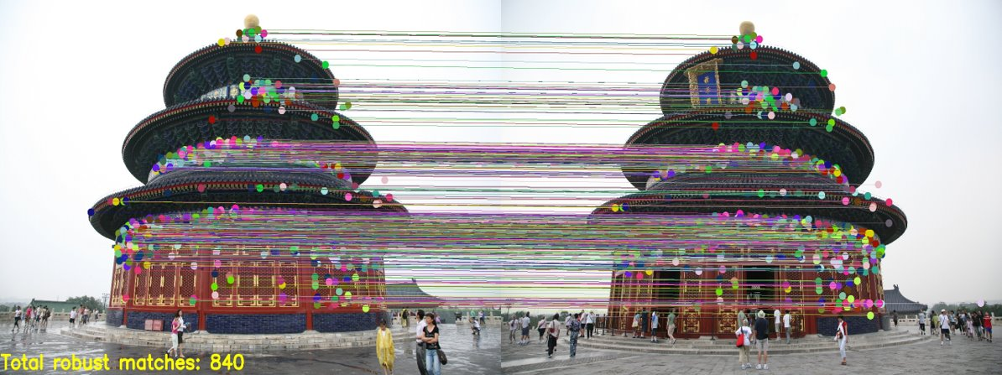
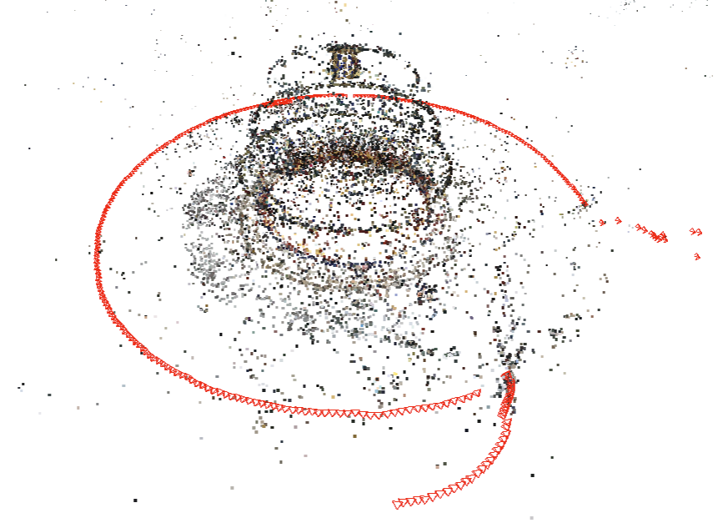
False matches on repeated structures cause catastrophic failures
Notes:
A common cause of failure in structure-from-motion is misregistration of images due to repeated structures. Here, we observe 840 matches on two different sides of the temple which leads to a catastrophic failure. To understand this problem, let’s briefly discuss resectioning.

Slide 27
Resectioning is a critical step
1. Select image that views the most triangulated points
2. Estimate pose of image using all the triangulated points
(PnP algorithm using RANSAC)
✖
✖
✖
✖
✖
Notes:
Resectioning is the process of adding images and points to an existing reconstruction. It involves [CLICK] selecting the image to reconstruct, [CLICK], estimating it’s pose[CLICK], and triangulating additional points. Our method proposes alternatives to the accepted standard for the first two steps. The pose estimation step employs RANSAC making it somewhat robust to outliers, however this does not overcome the problem caused by duplicate structures.

Slide 28
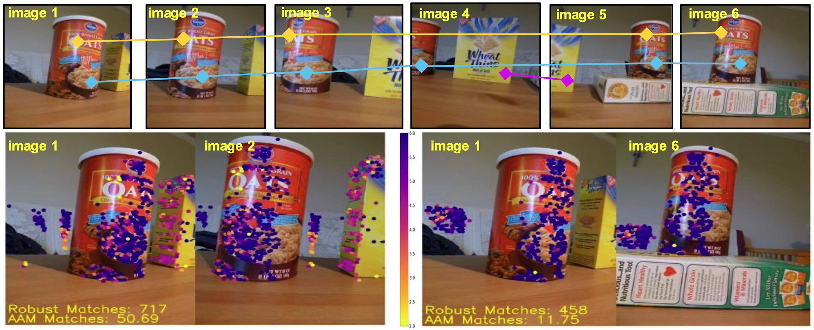
Ambiguity-adjusted match score (AAM): Discount longer tracks that are more likely to correspond to duplicate structures
Notes:
To address this, we introduce ambiguity-adjusted matches, or AAM for short. In uniform capture patterns, repeated structures contain longer tracks than non-repeated ones, as shown in the images at the top. In AAM, we give longer tracks less importance by discounting matches based on their track length. This is analogous to how tf-idf downweights common features in retrieval.
In the bottom image pairs, matches are colored based on their weight where purple matches have the lowest weight, followed by pink and then yellow. Our measure gives more weight to matches on the “Wheat thins” box compared to matches on the Oats container, since the container occurs more frequently in the scene.

Slide 29
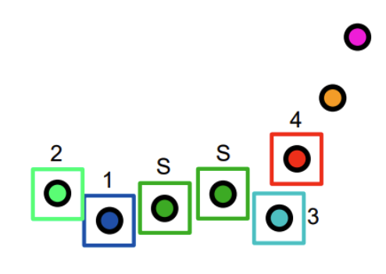
Local resectioning order uses most similar image
We use points from a smaller set of reliable images to determine resectioning order and pose estimation
Notes:
To improve SfM, we use the AAM measure to represent similarity in the resectioning process. For resectioning order, we simply add the most similar image to any reconstructed image. In this example, the distance between images represents dissimilarity, “S” specifies the starting images, and the numbers represent the order in which the image is resectioned.

Slide 30
Local pose estimation uses reliable images only
We use points from a smaller set of reliable images to determine resectioning order and pose estimation
s_{max}
Notes:
To estimate the pose of the newly resectioned red image, we first determine the similarity value between itself and the most similar reconstructed image. We label this value as s_{max}

Slide 31
Local pose estimation uses reliable images only
Use points from a smaller set of reliable images to determine resectioning order and pose estimation
τ*s_{max}
s_{max}
Notes:
Then, we use s_{max} and the pre-set parameter tau to determine the set of reliable reconstructed images. Only points viewed by these images are used to estimate the initial pose of the red image.

Slide 32
Our method improves standard pipelines
Local resectioning using ambiguity-adjusted matches compared against baselines (standard OpenSfM and COLMAP pipelines)
OpenSfM
OpenSfM w/ Our Resectioning
COLMAP
COLMAP w/ Our Resectioning
Duplicate Structures Dataset
6 Failures
6 Successes
6 Failures
2 Failures
4 Successes
UIUCTag Dataset
9 Failures
3 Failures
7 Failures
5 Failures
13 Successes
3 Partial Successes
2 Partial Successes
8 Successes
3 Partial Successes
7 Successes
4 Successes
TanksAndTemples Dataset
4 Failures
1 Failure
1 Failure
7 Successes
6 Successes
6 Successes
3 Successes
Notes:
Our method is simple and easily integrated into OpenSfM and COLMAP. We show improvements over the standard pipelines across 3 different datasets. This figure illustrates our results where green indicates successes, yellow indicates partial successes, and red indicates catastrophic failures.

Slide 33
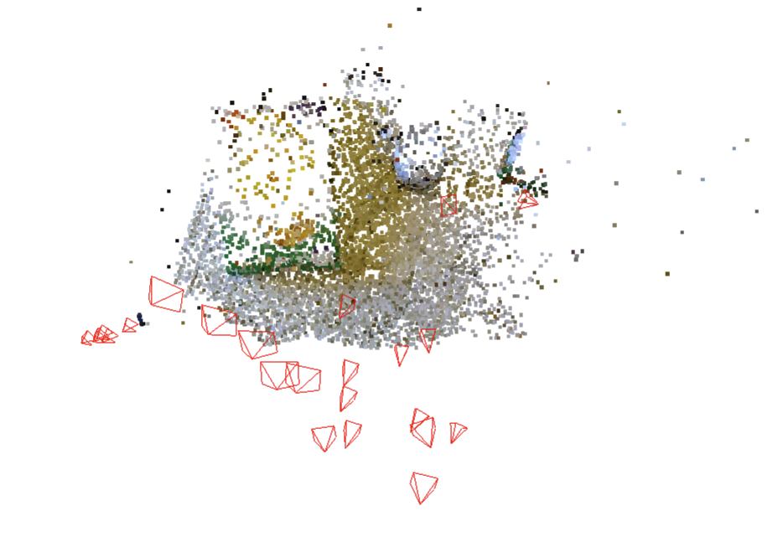
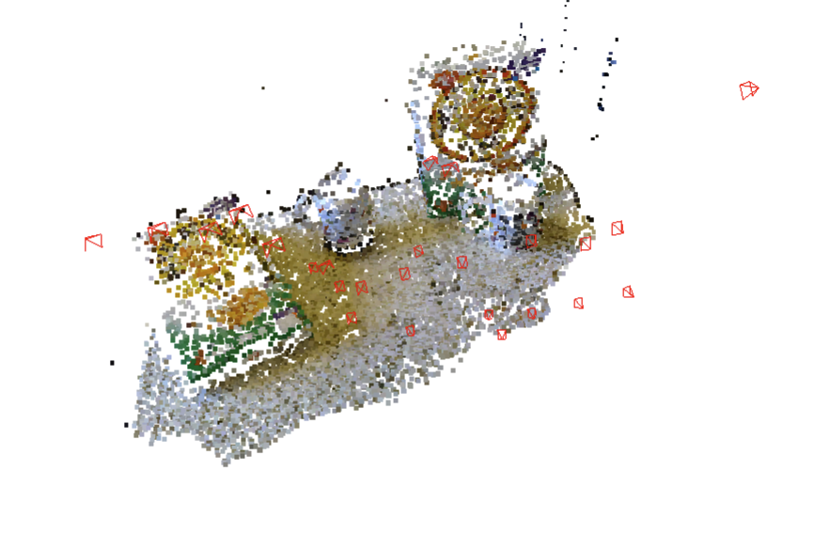
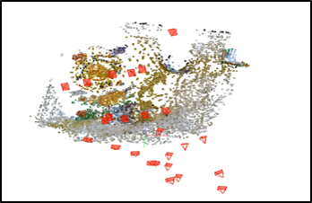
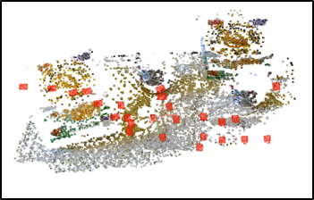
Successful reconstruction of Cereal (DuplicateStructures)
OpenSfM
OpenSfM (OURS)
COLMAP
COLMAP (OURS)
Notes:
For example, on the Cereal scene our method, shown on the right, reconstructs both cereal boxes despite them looking identical.

Slide 34
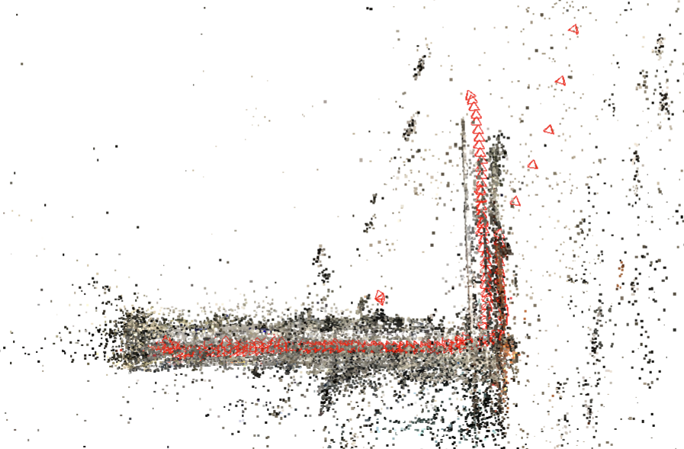
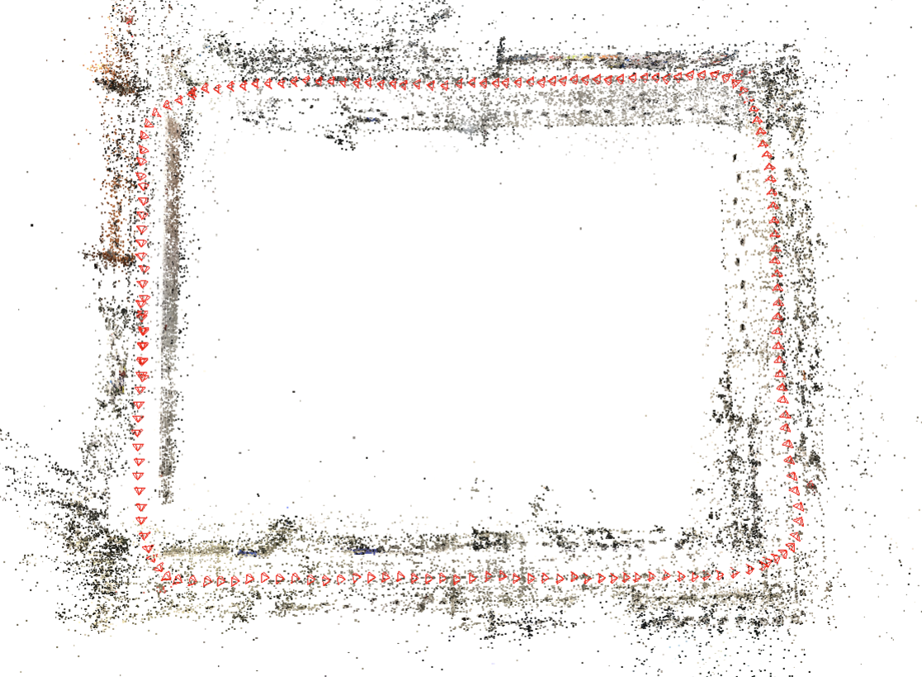
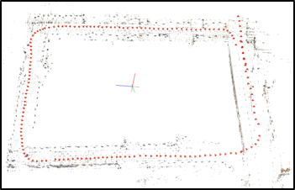
Successful reconstruction of ece_floor3_loop_cw (UIUCTag)
OpenSfM
OpenSfM (OURS)
COLMAP
COLMAP (OURS)
Notes:
For this building floor scene, our method is able to disambiguate the repeated structures on the ceiling.

Slide 35
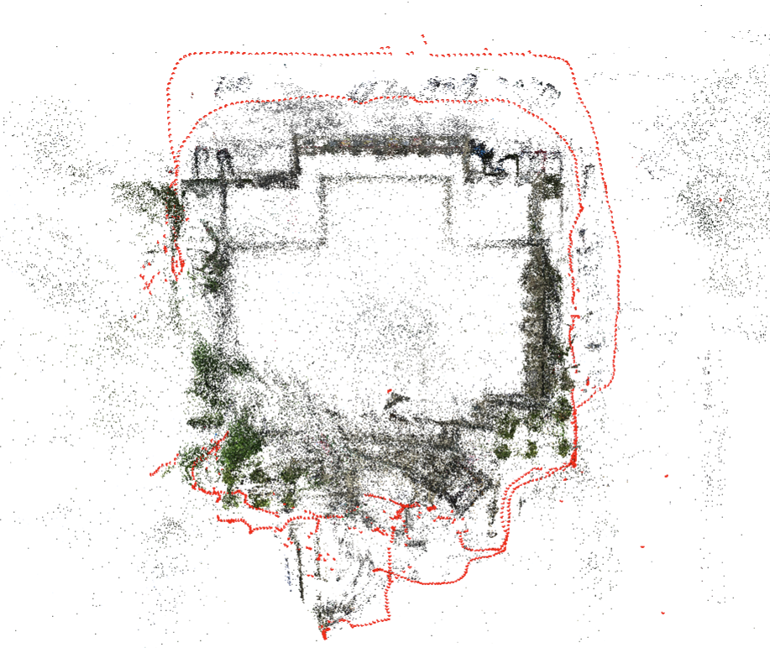
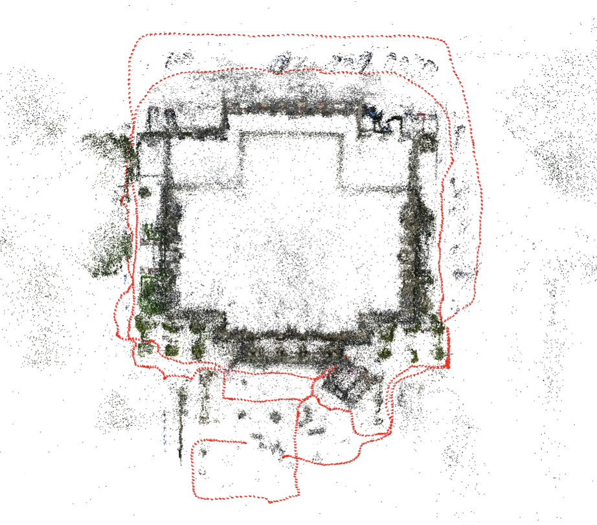
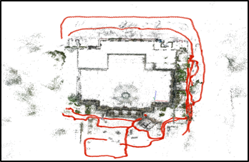
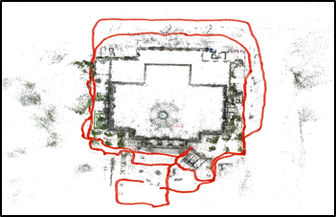
Successful reconstruction of Courthouse (TanksAndTemples)
OpenSfM
OpenSfM (OURS)
COLMAP
COLMAP (OURS)
Notes:
Similarly, our method successfully disambiguates the sides and dome of the Courthouse building in this scene.

Slide 36
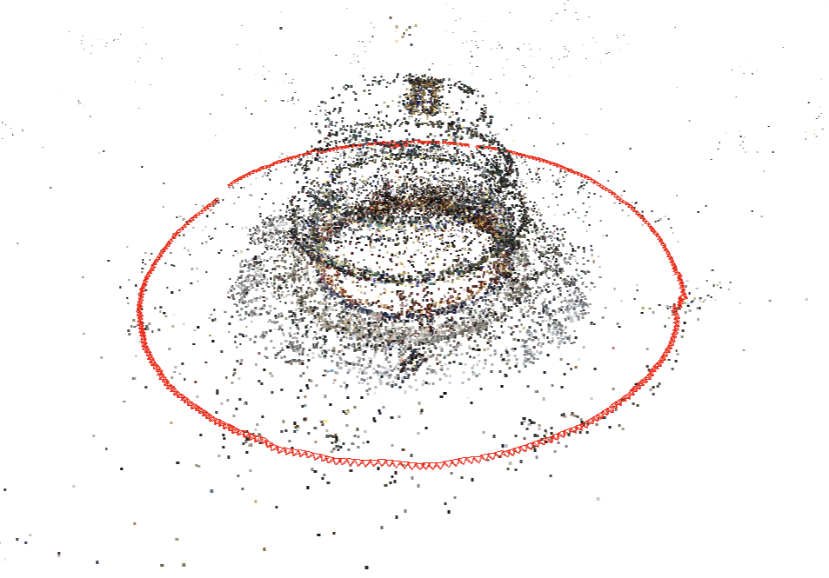
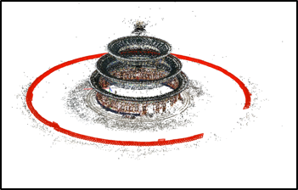
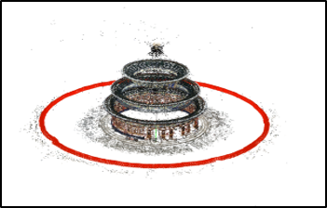
Successful reconstruction of TempleOfHeaven (Internet)
OpenSfM
OpenSfM (OURS)
COLMAP
COLMAP (OURS)
Notes:
The same applies for the TempleOfHeaven internet scene.

Slide 37
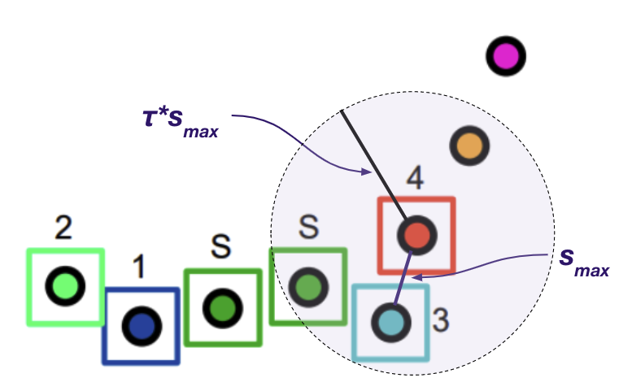
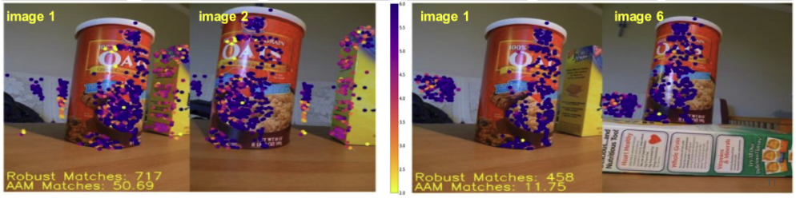
Summary
Ordering and Local Resectioning
Ambiguity-adjusted matches
Results
Notes:
In conclusion, we propose a new resectioning order with an ambiguity-adjusted match score, and perform initial pose estimation using only the most trusted image matches. This easy-to-implement change leads to major improvements in two state-of-the-art SfM systems for a wide variety of scenes.

Slide 43
Incremental vs. Global SfM
Incremental includes more outlier checks and generates more precise results but take much longer
Global is much faster but does not as effectively remove outliers and provides an approximate solution that is not precise enough (in my experience) for MVS

Slide 44
Important recent papers and methods for SfM
COLMAP SfM
OpenSfM (software only): https://github.com/mapillary/OpenSfM
Visual SfM: Visual SfM (Wu 2013)
  Used to be the best incremental SfM software (but not anymore and closed source); paper still very good

Slide 45
Open problems / research ideas
Improved matching
  Learned features, especially for handling large viewpoint, scale, or time differences, or features for low-texture regions
Improved outlier rejection
  Perhaps global SfM outlier checks can benefit incremental SfM
Improved speed
  Hybrid global/incremental and hierarchical systems
  Online SfM / MVS
Improved standard evaluations
  More real-world scenarios like inspection instead of internet collections

Slide 46
Summary
Structure-from-Motion usually works (95% of the time)
  But it matters when it doesn’t work
Incremental SfM is most precise, but Global SfM is faster
Main practical challenges (beyond speed) stem from feature matching in poor light environments, textureless surfaces, and large baselines and scale differences

