Slide 1
Learning to Speak Your Ideas

Slide 2
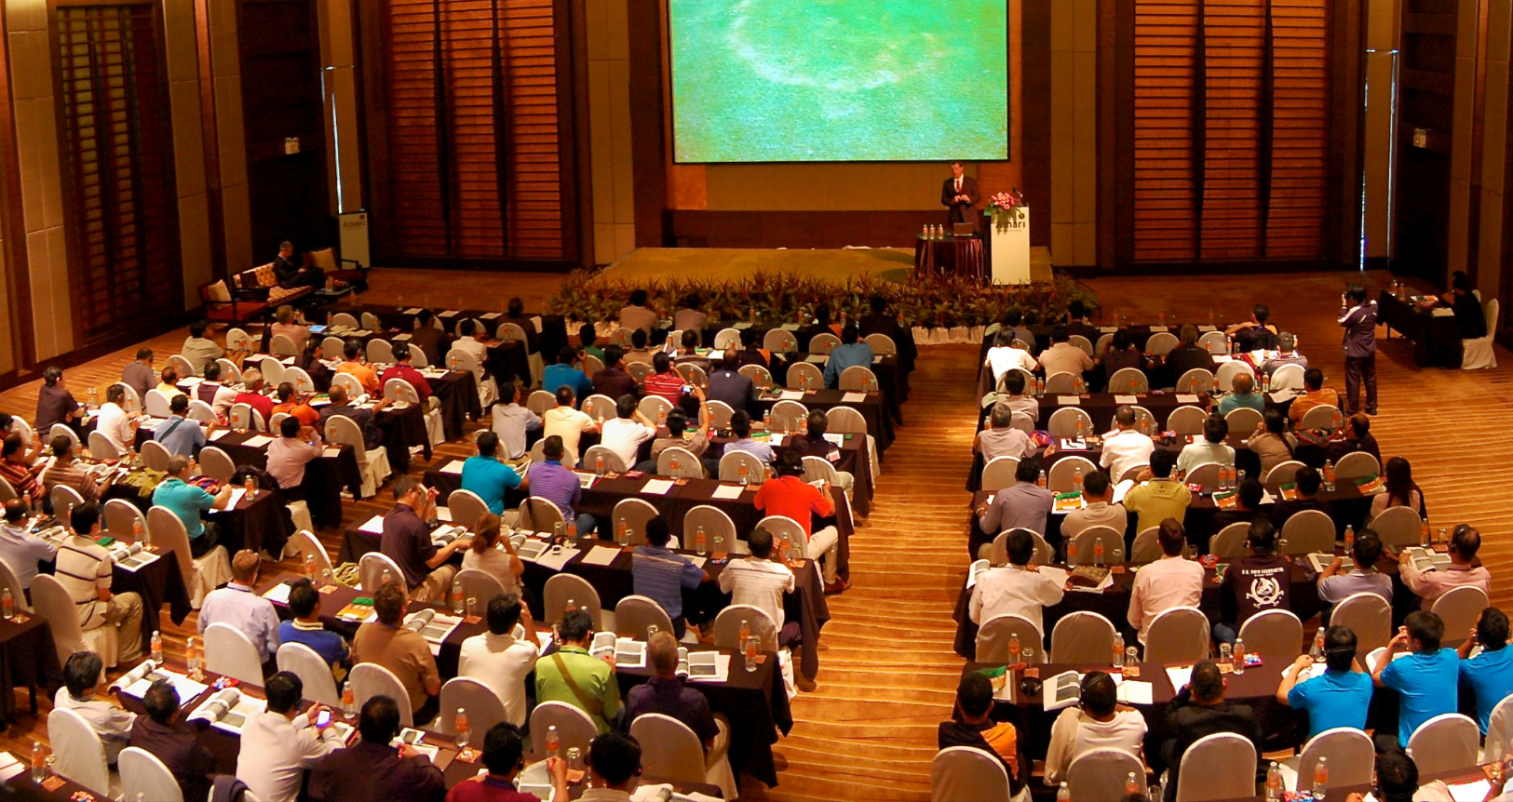
Public speaking is critical to your career
I want this to
be you!
Notes:
Learning to effectively talk about your work is as important as your ability to write about that work.
Effective speaking skills generalize to research presentations, job talks, classroom teaching, product meetings, and student interactions, among others

Slide 3
Public speaking is critical to your career
I want this to
be you!
The talk is as important as the paper
Notes:
Learning to effectively talk about your work is as important as your ability to write about that work.
Effective speaking skills generalize to research presentations, job talks, classroom teaching, product meetings, and student interactions, among others

Slide 4
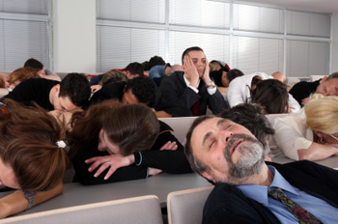

Slide 5
Minimum elements for a presentation
Problem statement
Your innovation
Key decisions
Reflections on the work
Summary of take away messages
Notes:
Implies organization

Slide 6
Minimum elements for a presentation
Problem statement
Your innovation
Key decisions
Reflections on the work
Summary of take away messages
To bring this all together, you need a story!
Notes:
Implies organization

Slide 7
How to Tell Your Story
Transitions between main points
Repetition of main ideas
Good aesthetics
Resonate with the audience
Consumable amount of content

Slide 8
How to Tell Your Story
Transitions between main points
Repetition of main ideas
Good aesthetics
Resonate with the audience
Consumable amount of content
“the speaker was too hard to follow”
“I wasn’t sure how anything the speaker said related to anything else”

Slide 9
Know Your Audience
You want to be here
Rambling
Audience comprehension
Number of words used to explain the concept
Notes:
Rambling leads to frustration and boredom
Wastes time you don’t have.

Slide 10
Know Your Audience
About two minutes per slide
A 20 minute talk should have 10 to 15 slides
You want to be here
Rambling
Audience comprehension
Number of words used to explain the concept
Notes:
Rambling leads to frustration and boredom
Wastes time you don’t have.

Slide 11
What to Say and How to Say It
Presentation styles
  Read from notes
  Speak from memory
  Impromptu speaking
  Extemporaneous speaking

Slide 12
What to Say and How to Say It
Presentation styles
  Read from notes
  Speak from memory
  Impromptu speaking
  Extemporaneous speaking
Novice speakers tend to memorize or read notes
  hard to memorize a long talk
  the audience notices prolonged reading
  if you lose your place, can lead to awkward pauses or worse

Slide 13
Can you hear me now?
Volume
  Speak loud enough so the furthest audience member can hear you
  Should not speak so loudly that the audience is annoyed
  Maintain volume level throughout your talk
  Vary to emphasize certain points
Tone
  How do you actually sound to your audience?
  Ex: Do you care about your project? Professional? Too excited?

Slide 14
Am I talking too fast?
Stay between these endpoints, but vary the pace for emphasis
Too slow. Audience becomes bored
Too fast. Audience cannot absorb content.
  Novices tend to speak too fast due to anxiety
Notes:
Novices tend to speak too fast due to anxiety

Slide 15
Project Confidence!
Good posture
  Face the audience, shoulders back, hands out of pockets, and smile
Eye Contact
  Talk to the audience, and with the entire audience
  Make eye contact for 70-80 percent of your presentation
Gestures
  Emphasize specific points
Movement
  Move around to help maintain audience interest
Notes:
How you present yourself to your audience matters!

Slide 16
Tips for Aesthetics
Minimize the amount of content on each slide
  Set font size to at least 18 points for text
  Use at most three main bullets
  List short phrases (start with verb)
Give dominance to visual content, remove most text and speak it
Refrain from extensive mathematical equations

Slide 17
How to give a bad presentation …
Robin’s 12+ Commandments
(adapted from David Patterson’s “How to give a bad talk”)

Slide 18
How to Give a Bad Talk
Thou shalt not be prepared
  Why waste research time preparing slides?
  There are billions of people in the world. Who cares what 20 people think?
  Caveat: Though shalt not be neat
    Ignore speling and grammmar
    Use illegible fonts

Slide 19

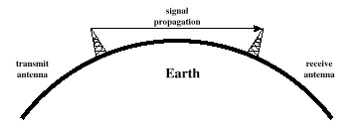
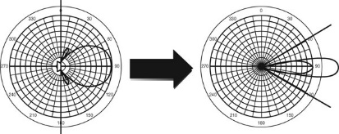
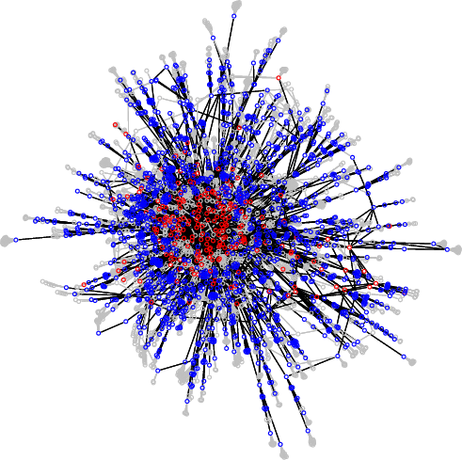
How to Give a Bad Talk
Thou shalt not waste space
  No one likes white space
  Fill in any extra space you may have on a slide with unrelated informaiton
Physical ⇨ How to transmit bits
Data Link ⇨ How to transmit frames
Network ⇨ How to route packets
Transport ⇨ How to send packets
Session ⇨ How to group data
Presentation ⇨ How to format data
Application ⇨ Everything else!
0
8
16
Host 1
Host 2
version
hdr len
TOS
31
ident
length
flags
offset
DHCP Server
TTL
protocol
Higher-level protocol (TCP)
Higher-level protocol (TCP)
Host A
checksum
Service interface
DHCP Relay
source address
Host A broadcasts DHCPDISCOVER message
destination address
options (variable)
pad (variable)
Host A broadcasts DHCP request
Relay unicasts DHCP request to server
Lower-level Protocol (IP)
Peer-to-peer interface
Lower-level Protocol (IP)
Server responds with host’s IP address
Host B
Other Networks
DHCP Server

Slide 20
How to Give a Bad Talk
Thou shalt not covet brevity
  Read every word on your slide
  Always use complete sentences, never just key words
    Sentence fragments make you look illiterate
  Caveat: Avoid moving content to “backup slides”
    You probably won’t get a chance to show them

Slide 21


How to Give a Bad Talk
Thou shalt use annoying animations
  Caveat: Thou shalt blind and nauseate your audience with a laser pointer
Powerpoint is cool
Use it to its full potential!

Slide 22
How to Give a Bad Talk
Thou shalt not write large
  Be humble -- use a small font
  Important people sit in front
  Who cares about the riff-raff?

Slide 23
How to Give a Bad Talk
Thou shalt not use color
  Flagrant use of color indicates uncareful research
  It's also unfair to emphasize some words over others
Thou shalt not use a good color scheme
  Make every word a different color
  Use colors that can’t be seen on the screen

Slide 24
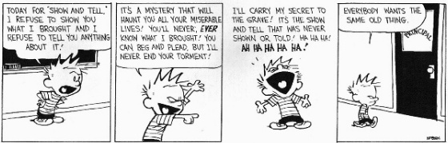
How to Give a Bad Talk
Thou shalt not illustrate
  Confucius says “A picture = 10K words,”
  Dijkstra says “Pictures are a crutch for weak minds.”
  If you must use illustrations, don’t explain them.
  Caveat: Thou shalt not draw on your slides
    Slides are a work of art, do not deface them!

Slide 25
How to Give a Bad Talk
Thou shalt not make eye contact
  You should avert eyes to show respect
  Blocking screen can also add mystery
  You should read from your computer
  You should turn your back on the audience
  Caveat: Thou shalt point to your computer
    Everyone knows what you are pointing to

Slide 26
How to Give a Bad Talk
Thou shalt not skip slides in a long talk
  You prepared the slides; people came for your whole talk; so just talk faster
  Skip summary and conclusions if necessary
  Caveat: Thou shalt not plan for Q&A
    Don’t repeat questions
    Start talking quickly
    Don’t cut discussion short
    When in doubt, bluff
    Universal answer
      Dismiss question as irrelevant/naïve

Slide 27
How to Give a Bad Talk
Thou shalt speak neither clearly nor loudly
  Important people sit in front
  Don’t use a microphone
  Let the people in the back read the slides
  Caveat: Thou shalt not distract your audience
    Do not distract with motion
    Keep voice level
    Do not ask rhetorical questions
    Do not use humor

Slide 28
How to Give a Bad Talk
Thou shalt not practice
  Why waste research time practicing a talk?
  It could take several hours out of your semester
  How can you appear spontaneous if you practice?
  If you do practice, argue with any suggestions you get and make sure your talk is longer than the time you have to present it

Slide 29
Discussion
Most talks are imperfect, but NEVER give a talk that is memorably bad
Practice 2-3 times yourself, then twice in front of a live audience
  Focus on the beginning and end of a talk
  Never apologize!
Q&A is critical
  Limit responses to 30 seconds (anticipate in advance)
  May concede the work is imperfect
  Respond to aggressive questioners with empathy

