Slide 1
Desirable Fair Cake-Cutting Algorithm in Practice

Slide 2

Cake-cutting Problem
cake: [0, 1]
agents: N = {1, …, n}
allocation: A = {A₁, …, A_{n}}
valuation function of agent i: v_{i}(I), I is union of subintervals in [0,1]
social welfare: $Σv_{i}(A_{i})$

Slide 3
Assumptions
additive valuation functions: v_{i}(I)+v_{i}(I’) = v_{i}(I∪I’)
v_{i}(I)>=0
normalize: v_{i}([0, 1]) = 1, for every agent I
non-atomic: v_{i}([x, x]) = 0

Slide 4
Equitability (EQ)
interpersonal comparisons of utility among agents
EQ allocation: A s.t. v_{i}(A_{i}) = v_{j}(A_{j}), for all i, j

Slide 5
2 Agents
An interval I is strictly/weakly desired by agent 1 if v₁(I) >(=) v₂(I)
Claim: for 2 agents, every maxsum EQ allocation (largest possible social welfare that EQ allocations can get) is Pareto Optimal (PO)

Slide 6
Ratio-based Allocation
Y_{1 op 2} = {x: v₁(x) op v₂(x)}
e.g. Y_{1 > 2} represents all intervals that are strictly desired by agent 1
Ratio of valuation functions: R₁(x) = v₁(x) / v₂(x)

Slide 7
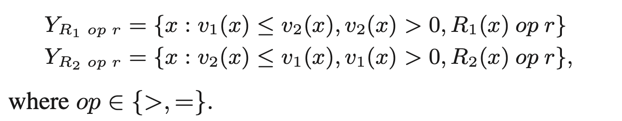
Ratio-based Allocation
Y_{R1 = 0.5}
Y_{1 > 2}
Y_{R1 > 0.5}
v
agent 2
agent 1
R₁(x) =1
R₁(x)=0.5
x
R₁(x) =1
Reference: "On maxsum fair cake divisions."

Slide 8
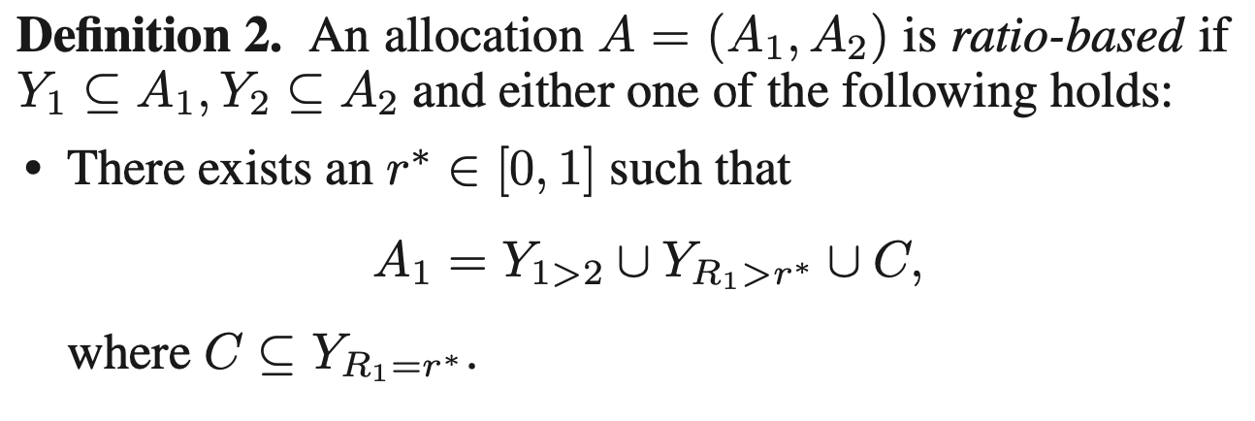
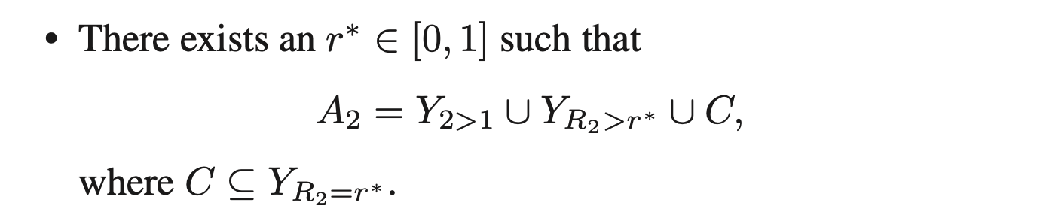
Ratio-based Allocation
Reference: "On maxsum fair cake divisions."

Slide 9
Every Ratio-based Allocation is PO
Case 1: r* = 1
All intervals are allocated to the agent who weakly desires the interval

Slide 10
Every Ratio-based Allocation is PO
Case 2: r* < 1
Without loss of generality, let agent 1 receive all her weakly desired intervals (red) plus some of agent 2’s strictly desired intervals (yellow)
v₁(A₁) >= v₁(Y_{1 >= 2})
Y_{R1 = r*}
Y_{1 > 2}
Y_{R1 > r*}
v
agent 2
agent 1
R₁(x) =1
R₁(x)=r*
x
R₁(x) =1

Slide 11
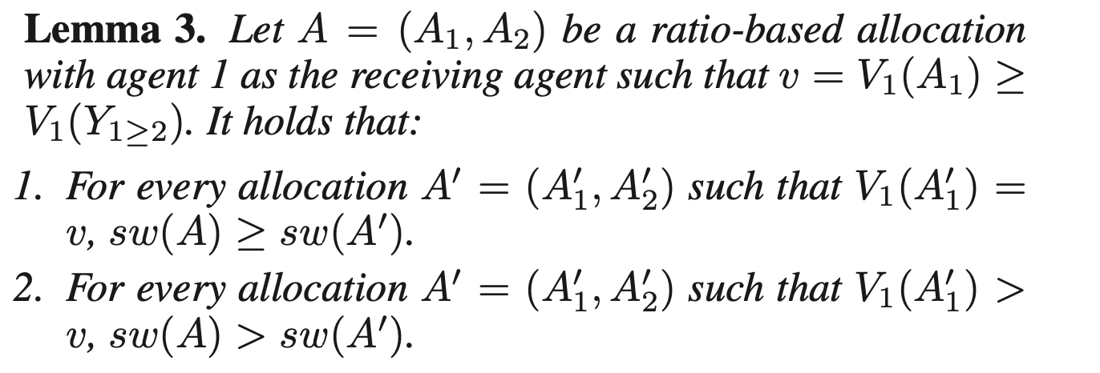
Every Ratio-based Allocation is PO
Reference: "On maxsum fair cake divisions."

Slide 12
Every Maxsum EQ Allocation is PO
Case 1: v₁(Y_{1 >= 2}) >= v₂(Y_{2 > 1}) and v₂(Y_{2 >= 1}) >= v₁(Y_{1 > 2})
Allocate Y_{1 > 2} to agent 1, Y_{2 > 1} to agent 2; split Y₁ ₌ ₂ to satisfy EQ
Always feasible
Maxsum allocation implies PO
Y_{1 > 2}
Y₁ ₌ ₂
Y_{2 > 1}
v
agent 2
agent 1
R₁(x) =1
x
R₁(x) =1

Slide 13
Every Maxsum EQ Allocation is PO
Case 2: without loss of generality, v₁(Y_{1 >= 2}) < v₂(Y_{2 > 1})
Consider R₁(x) from 1 to 0:
v₁: from v₁(Y_{1 >= 2}) to 1
v₂: from v₂(Y_{2 > 1}) to 0
There exists a ratio-based allocation that is maxsum EQ
v
1
agent 1
agent 2
R₁(x)
0
r*

Slide 14
Every Maxsum EQ Allocation is PO
Case 2: without loss of generality, v₁(Y_{1 >= 2}) < v₂(Y_{2 > 1})
Since every ratio-based allocation is PO, maxsum PO allocation is not Pareto-dominated by any other allocation ; thus, it is PO

Slide 15
More theorems…
For 2 agents, maxsum EF and EF+EQ allocations are also PO
For 3 or more agents, both maxsum EF and EQ allocations may not be PO
For piecewise linear valuation functions, the max social welfare of EF allocations >= that of EQ allocations

Slide 16
Fair-cake Cutting Protocols
Robertson-Webb Model:
2 Types of queries (to avoid trivial protocols):
Cut(p, a): player p returns x s.t. v([0, x]) = a, v([x, 1]) = 1-a
Eval(p, x): player p returns a = v([0, x])
Assign operation: assign disjoint interval (x, y) to player p
Complexity is measured by the number of cuts in the worst case

Slide 17
Knaster–Banach Last Diminisher Protocol
For n agents, given a cake [y, 1], agent 1 chooses a cut x1 so that v1(y, x1) = v1(y, 1)/n. Agent 2 now has the right, but is not obliged, to choose x2 < x1. Whatever she does, agent 3 has the right, without obligation, to further diminish the already diminished (or not diminished) piece too, and so on up to n.
The rule obliges the last diminisher (say agent i) who chose the cut xi to take as her allocation Ai = [y, xi). Agent i is disposed of, and the remaining n − 1 persons start the same game with the remainder of the cake [xi, 1]. When there is only one agent left, she receives the unclaimed piece of cake.
O(n²)
agent 3
agent 1
remaining cake

Slide 18
Even-Paz Algorithm
For n agents, given a cake [y, z], all agents choose cuts xi such that vi(y, xi) = vi(y,z)/2. We let x∗ be the median cut, i.e. the ⌊n/2⌋th cut. Then the procedure breaks the cake-cutting problem into two: all agents who choose cuts xi ≤ x∗ are to divide the cake [y, x∗), whereas all agents who chose cuts above x∗ are to divide the cake [x∗, z]. Each half is divided recursively among the n/2 partners assigned to it. When the procedure is called with a singleton set of agents {i} and an interval I it assigns Ai = I.
O(nlog(n))
medium cut
agent 1
agent 2
agent 3
agent 4
remaining cake

Slide 19
"On the complexity of cake cutting.” provides a lower bound of O(nlog(n)) on a restricted version of Robertson-Webb Model (assign only once for each agent; count number of queries+cuts)
"Fair cake-cutting in practice.” gives examples to demonstrate that most well-known protocols are not strategy-proof. In fact, an agent can get a max social welfare of 1 if she knows other agents’ valuation functions.

Slide 20
References
Brams, Steven J., Michal Feldman, John K. Lai, Jamie Morgenstern, and Ariel D. Procaccia. "On maxsum fair cake divisions." In Twenty-sixth AAAI Conference on Artificial Intelligence. 2012.
Woeginger, Gerhard J., and Jiří Sgall. "On the complexity of cake cutting." Discrete Optimization 4, no. 2 (2007): 213-220.
Kyropoulou, Maria, Josué Ortega, and Erel Segal-Halevi. "Fair cake-cutting in practice." In Proceedings of the 2019 ACM conference on economics and computation, pp. 547-548. 2019.

