Slide 1
Part Models and Pixel Labeling
04/13/17
Computer Vision
CS 543 / ECE 549
University of Illinois
Derek Hoiem

Slide 2
Influential Works in Detection
Sung-Poggio (1994, 1998) : ~2412 citations
  Basic idea of statistical template detection, bootstrapping to get “face-like” negative examples, multiple whole-face prototypes (in 1994)
Rowley-Baluja-Kanade (1996-1998) : ~4953
  “Parts” at fixed position, neural network based detector, non-maxima suppression, simple cascade, rotation, pretty good accuracy, fast
Viola-Jones (2001, 2004) : ~27,000
  Haar-like features, Adaboost as feature selection, hyper-cascade, very fast, easy to implement
Dalal-Triggs (2005) : ~18000
  Careful feature engineering, excellent results, HOG feature, online code
Felzenszwalb-Huttenlocher (2000): ~2100
  Efficient way to solve part-based detectors
Felzenszwalb-McAllester-Ramanan DPM (2008,2010): ~7200
  Excellent template/parts-based blend
Girshick-Donahue-Darrell-Malik R-CNN (2014- ): ~4700
  Region proposals + fine-tuned CNN features (marks significant advance in accuracy over hog-based methods)

Slide 3
CNN (Deep Learning) for Classification
Operations
  Convolution with learned filters, ReLU
    Note: after first layer, filters operate on high dimensional feature maps, not intensities
  Spatial pooling and downsample 2x
  “Bottlenecks” to limit parameters
  “Skip connections” to simplify optimization, enable ensemble behavior
  Classification (with multilabel or softmax loss)
Tricks to train
  Batchnorm
  ADAM / momentum
  Data augmentation
  Set parameters appropriately (weight initialization, learning rate schedule, momentum, weight decay)
Each filter: 3x3x512
Final feature map: 7x7x512
Fig: Deep Residual Learning for Image Recognition
He et al. CVPR 2006
Notes:
Go through this slowly. Make sure to emphasize that convolutional layers operate on high dimensional feature maps, and that the feature maps eventually get very low res, so they are kind of like a spatial pyramids model

Slide 4
CNN for Detection
Classifier network produces a set of feature maps
Each cell proposes bounding boxes that might be objects
Features are pooled into bbox regions and classified into object categories or background
Faster R-CNN (Ren et al. 2016)

Slide 5
Object bounding box detections
Faster RCNN detections

Slide 6
Today’s class
Object part models
Pixel labeling

Slide 7
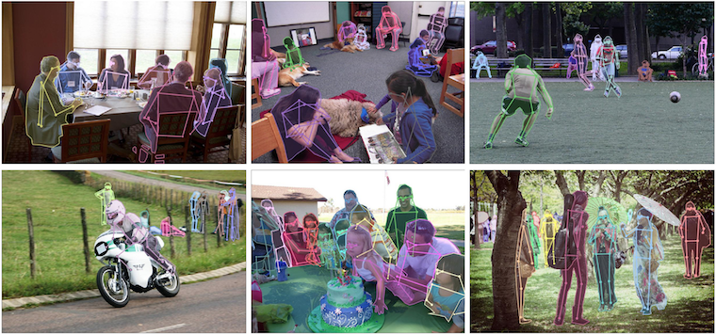
Part/keypoint Prediction
http://mscoco.org/dataset/#keypoints-challenge2016

Slide 8
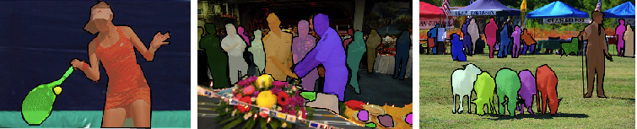
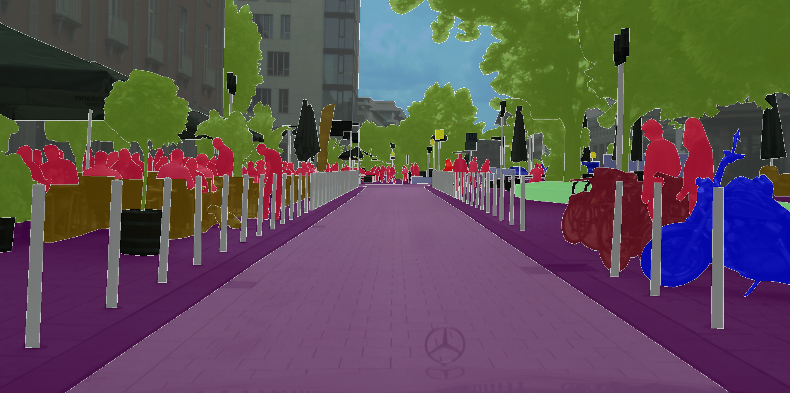
Semantic Segmentation
http://mscoco.org/dataset/#detections-challenge2016
https://www.cityscapes-dataset.com/examples/#fine-annotations

Slide 9
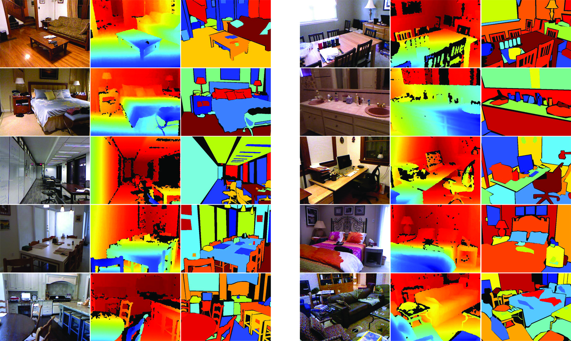
Semantic Segmentation
http://cs.nyu.edu/~silberman/datasets/nyu_depth_v2.html

Slide 10
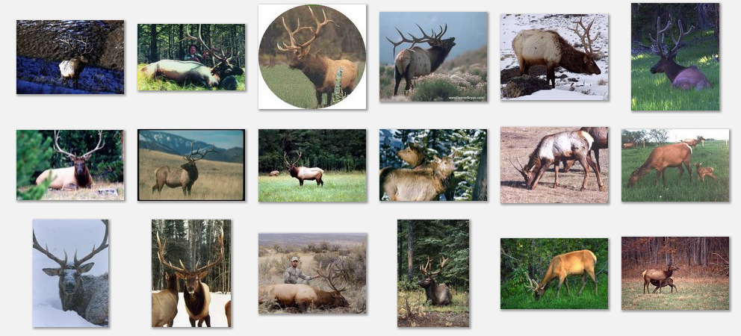
Deformable objects
Images from Caltech-256
Slide Credit: Duan Tran

Slide 11
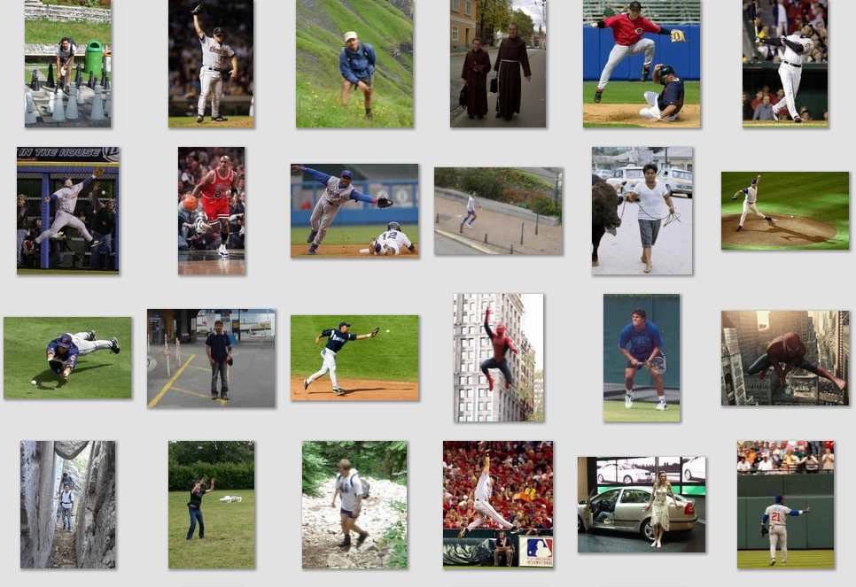
Deformable objects
Images from D. Ramanan’s dataset
Slide Credit: Duan Tran

Slide 12
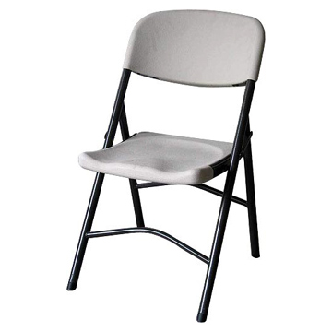
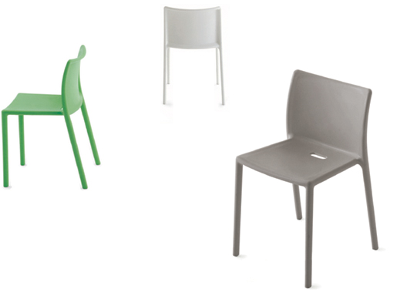
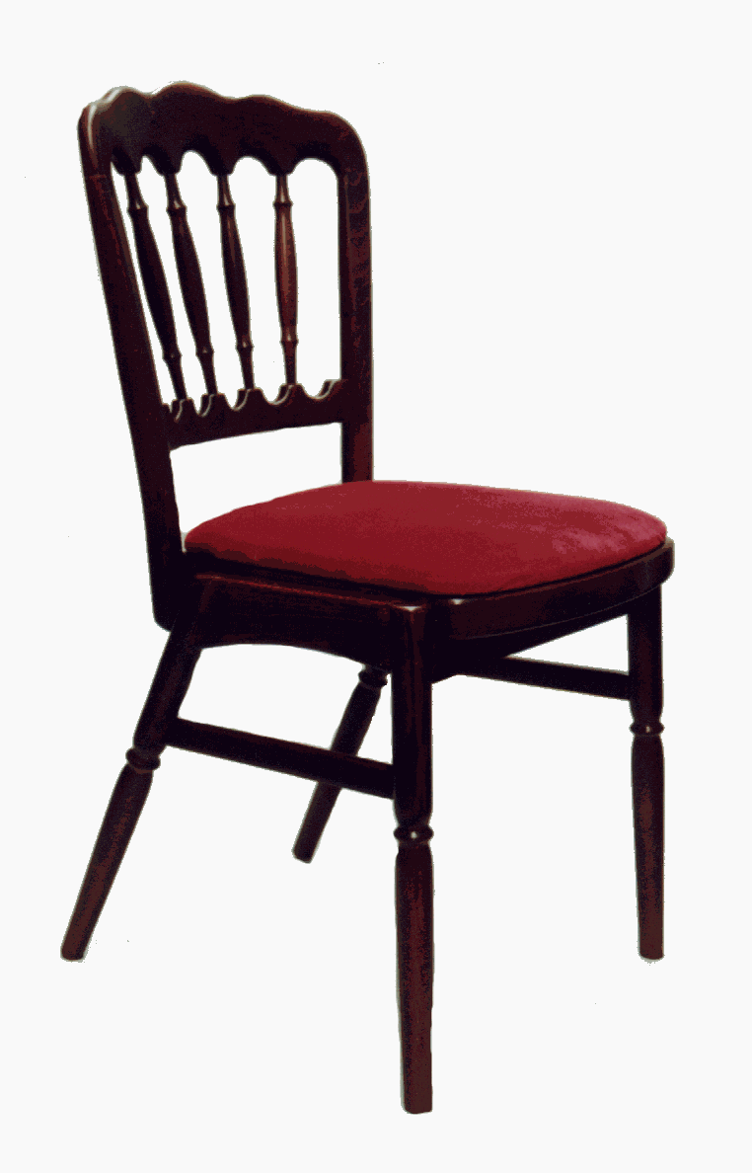

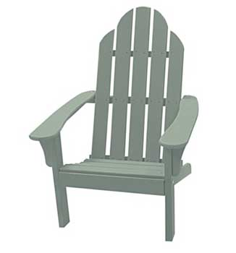
Compositional objects

Slide 13
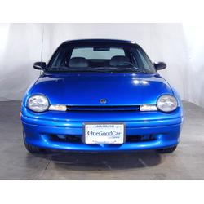

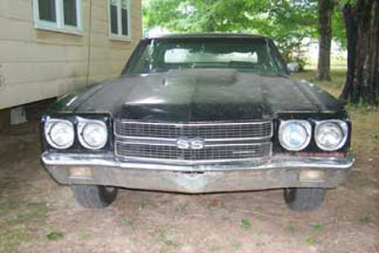
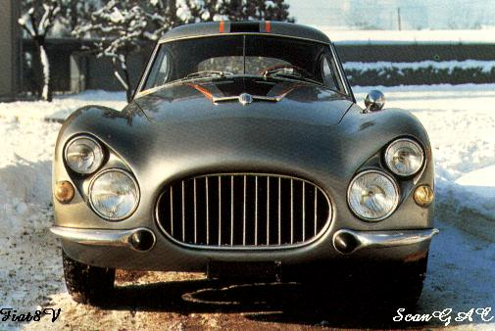
Parts-based Models
Define object by collection of parts modeled by
  Appearance
  Spatial configuration
Slide credit: Rob Fergus

Slide 14
How to model spatial relations?
One extreme: fixed template

Slide 15
How to model spatial relations?
Another extreme: bag of words
=

Slide 16
How to model spatial relations?
CNNs have flexible models through spatial pooling
=

Slide 17
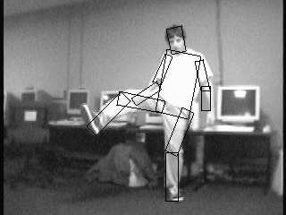
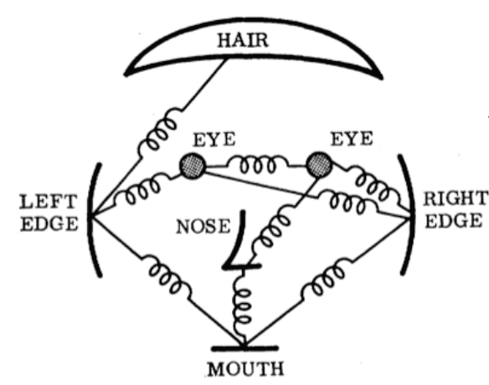
How to model spatial relations?
Articulated parts model
  Object is configuration of parts
  Each part is detectable
Images from Felzenszwalb

Slide 18
How to model spatial relations?
Tree-shaped model

Slide 19
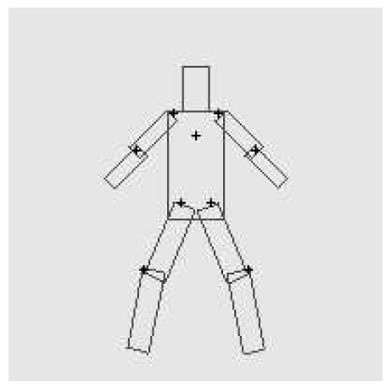
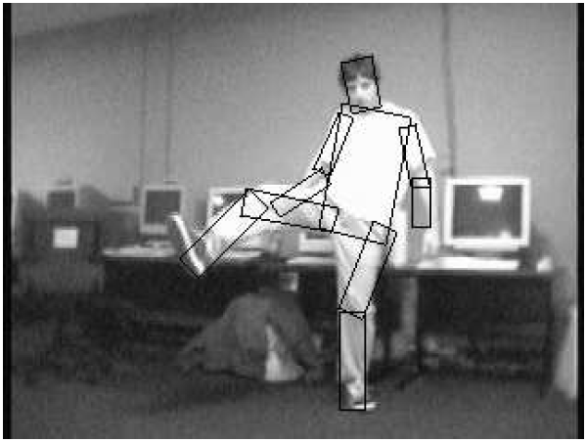
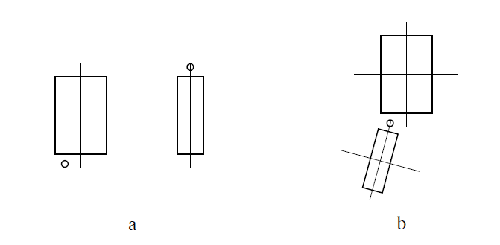
Pictorial Structures Model
Part = oriented rectangle
Spatial model = relative size/orientation
Felzenszwalb and Huttenlocher 2005
Notes:
What is the root of the tree?

Slide 20
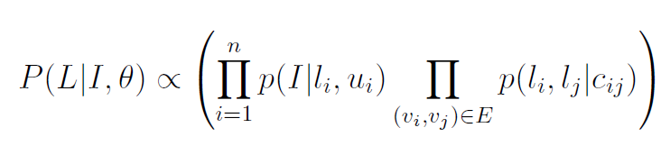
Pictorial Structures Model
Appearance likelihood
Geometry likelihood

Slide 21
Modeling the Appearance
Any appearance model could be used
  HOG Templates, etc.
  Here: rectangles fit to background subtracted binary map
Can train appearance models independently (easy, not as good) or jointly (more complicated but better)
Appearance likelihood
Geometry likelihood

Slide 22
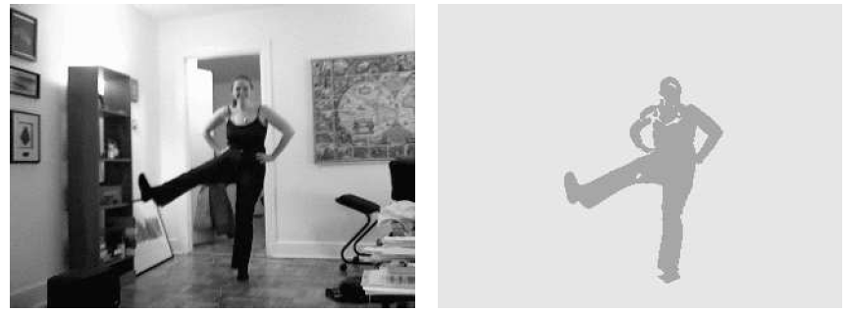

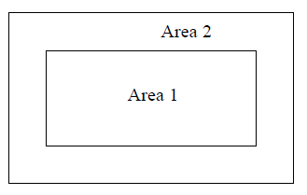
Part representation
Background subtraction

Slide 23
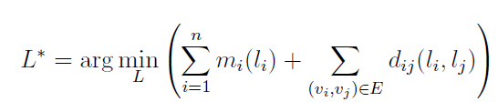
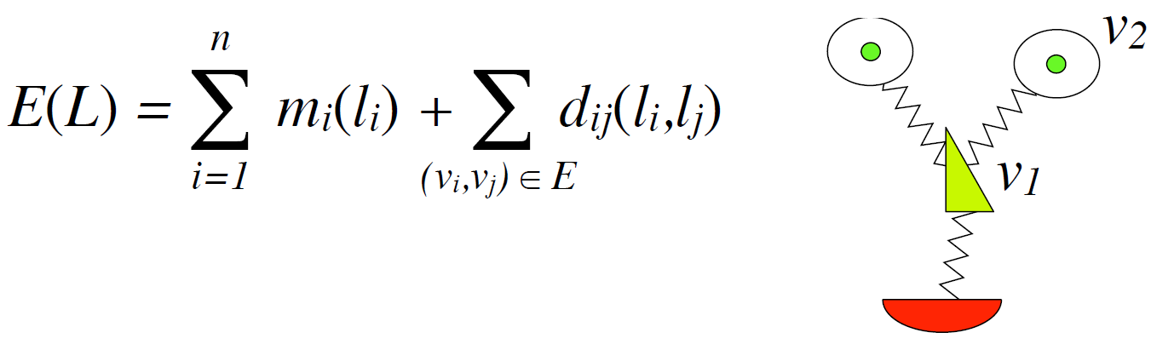
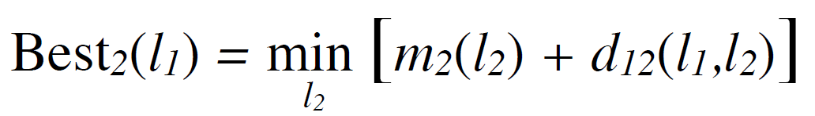
Pictorial structures model
Optimization is tricky but can be efficient
For each l₁, find best l₂:
Remove v₂, and repeat with smaller tree, until only a single part
For k parts, n locations per part, this has complexity of O(kn²), but can be solved in ~O(kn) using generalized distance transform

Slide 24
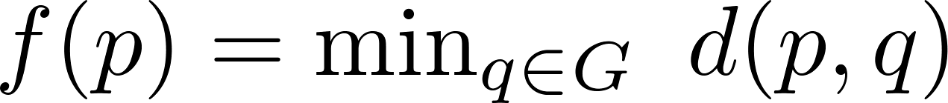
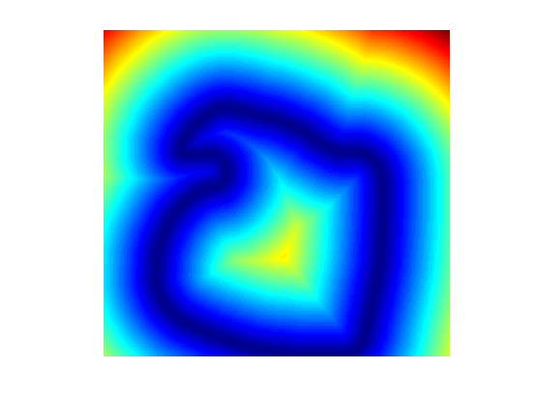
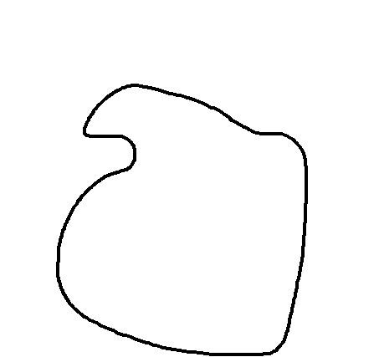
Distance Transform
For each pixel p, how far away is the nearest pixel q of set G
  G is often the set of edge pixels
G: black pixels
p₁
q₁
q₂
p₂

Slide 25
Distance Transform - Applications
Set distances – e.g. Hausdorff Distance
Image processing – e.g. Blurring
Robotics – Motion Planning
Alignment
  Edge images
  Motion tracks
  Audio warping
Deformable Part Models

Slide 26

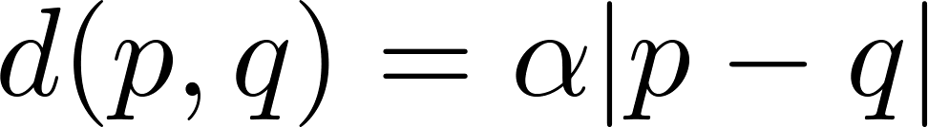
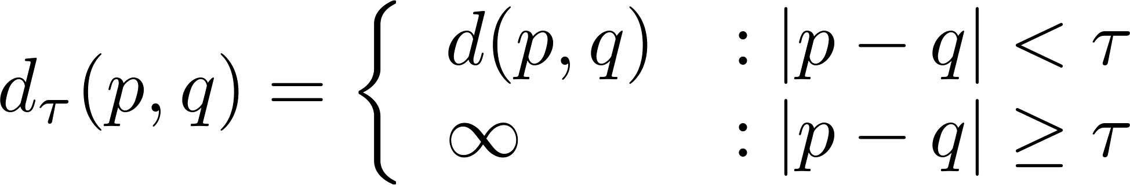
Generalized Distance Transform
Original form:
General form:
For many deformation costs,
Quadratic
Abs Diff
Min Composition
Bounded

Slide 27
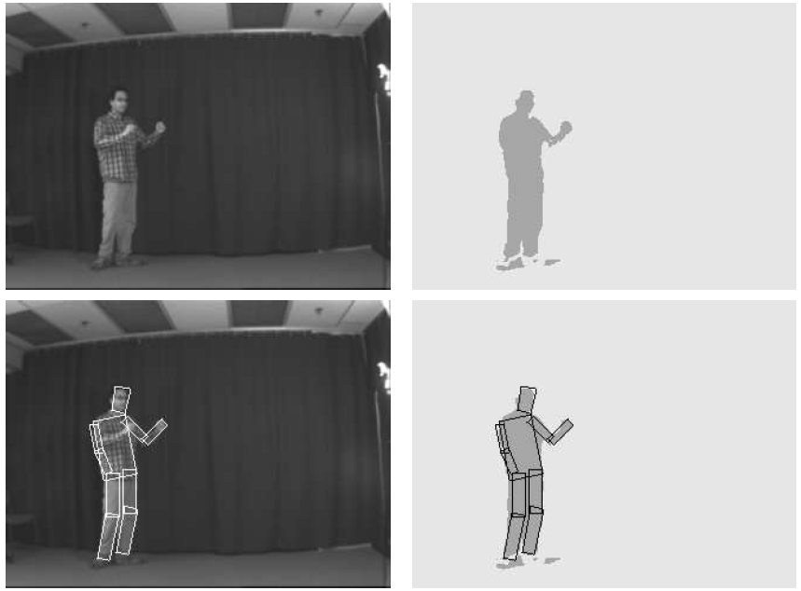
Results for person matching

Slide 28
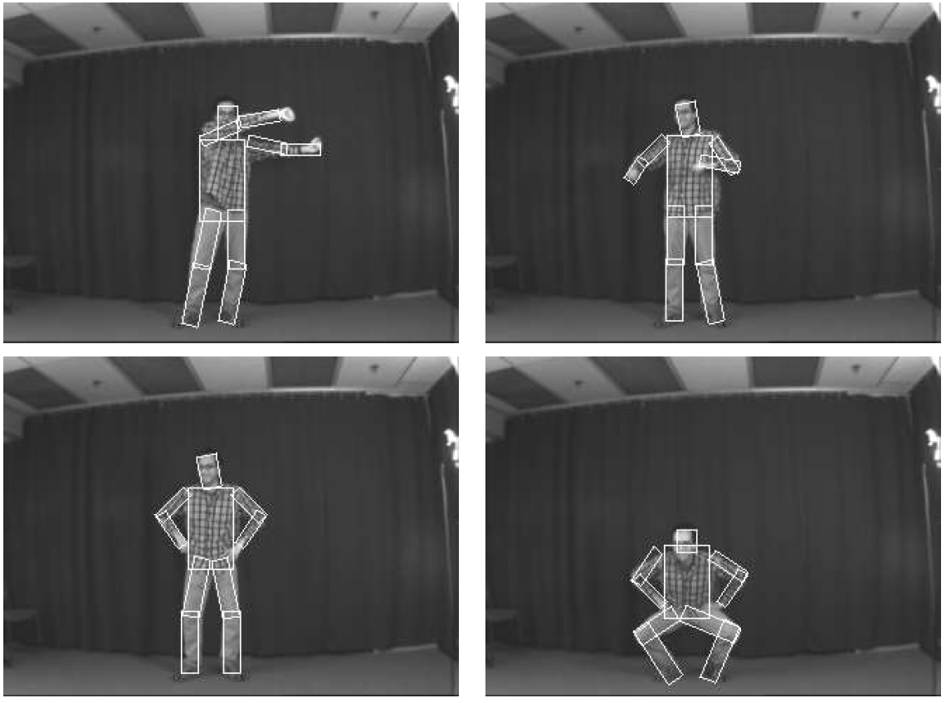
Results for person matching

Slide 29
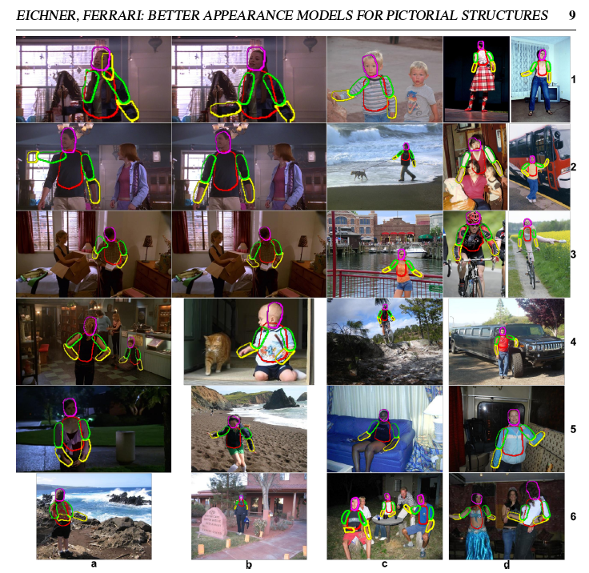
Enhanced pictorial structures
Learn spatial prior
Color models from soft segmentation
(initialized by location priors of each part)
BMVC 2009

Slide 30
Parts can be hard to find on their own

Slide 31
Example from Ramakrishna

Slide 32
Sequential structured prediction
Can consider pose estimation as predicting a set of related variables (called structured prediction)
  Some parts easy to find (head), some are hard (wrists)
One solution: jointly solve for most likely variables (DPM, pictorial structures)
Another solution: iteratively predict each variable based in part on previous predictions

Slide 33
Pose machines
Ramakrishna et al. ECCV 2014

Slide 34
Example results

Slide 35
General principle
“Auto-context” (Tu CVPR 2008): instead of fancy graphical models, create feature from past predictions and repredict
Can view this as an “unrolled belief propagation” (Ross et al. 2011)
Tu Bai 2010: Auto-context
Ross Munoz Hebert Bagnell 2011: Message-Passing Inference Machines

Slide 36
One more approach: parallel structured prediction
Back to CNNs
  CNN model is a sequence of iterative feature processing
  Last feature layer stores features that encode key information for all predictions
  In parallel, predict bounding boxes, category, parts, and keypoints from last feature layer

Slide 37
Mask R-CNN – He Gxioxari Dollar Girshick
Same network as Faster R-CNN, except
  Bilinearly interpolate when extracting 7x7 cells of ROI features for better alignment of features to image
  Instance segmentation: produce a 28x28 mask for each object category
  Keypoint prediction: produce a 56x56 mask for each keypoint (aim is to label single pixel as correct keypoint)
Example ROI and predicted mask
Example ROI and predicted mask and keypoints

Slide 38
Top performing object detector, keypoint segmenter, instance segmenter

Slide 39
Example detections and instance segmentations

Slide 40
Example detections and instance segmentations

Slide 41
Example keypoint detections

Slide 42
What if you want to label every pixel?
“Stuff” can be hard to capture with bounding boxes
https://www.cityscapes-dataset.com/examples/#fine-annotations

Slide 43
Fully convolutional networks for semantic segmentation – Long Shelhamer Darrel 2015
Use network trained for classification as pre-trained network for pixel labeling
Convert fully connected layers into convolutions
Add features from earlier conv layers to improve resolution
Fine-tune for pixel labeling task
224x224
500x500

Slide 44
“Fully convolutional” results
Takes advantage of pre-training from classification
Applied to objects and scenes (NYUd v2)
But feature pooling reduces spatial sensitivity and resolution

Slide 45
Dilated Convolutions – Yu Kolton 2016
Replacing last two pooling layers with “dilated convolution” that filters a sparse 3x3 grid of pixels
Enables large receptive field with few parameters
Improves resolution

Slide 46
Dilated Convolutions results

Slide 47
Graphical models vs. sequential/parallel prediction
Advantages of BP/graphcut/etc
  Elegant
  Relations are explicitly modeled
  Exact inference in some cases
Advantages of sequential/parallel prediction
  Simple procedures for training and inference
  Learns how much to rely on each prediction
  Can model very complex relations

Slide 48
Things to remember
Models can be broken down into part appearance and spatial configuration
  Wide variety of models
Efficient optimization can be tricky but usually possible
  Generalized distance transform is a useful trick
Rather than explicitly modeling contextual relations, can encode through features/classifiers

Slide 49
Next classes
Tues: Object tracking with Kalman Filters
Thurs: Action Recognition

