Slide 1
Convolutional Neural Networks
04/06/17
Computer Vision
CS 543 / ECE 549
University of Illinois
Derek Hoiem
Many slides from Lana Lazebnik, and some from Jia-bin Huang

Slide 2
Deep convolutional neural networks (CNNs)
  Shock and awe
  Architecture (Alexnet, VGG, Inception, Resnet)
  Optimizer (stochastic gradient descent, Adam)
  Transfer
  Why it works

Slide 3
History of deep convolutional nets
1950’s: neural nets (perceptron) invented by Rosenblatt
1980’s/1990’s: Neural nets are popularized and then abandoned as being interesting idea but impossible to optimize or “unprincipled”
1990’s: LeCun achieves state-of-art performance on character recognition with convolutional network (main ideas of today’s networks)
2000’s: Hinton, Bottou, Bengio, LeCun, Ng, and others keep trying stuff with deep networks but without much traction/acclaim in vision
2010-2011: Substantial progress in some areas, but vision community still unconvinced
  Some neural net researchers get ANGRY at being ignored/rejected
2012: shock at ECCV 2012 with ImageNet challenge

Slide 4
2012 ImageNet 1K
(Fall 2012)
Slide: Jia-bin Huang

Slide 5

2012 ImageNet 1K (Fall 2012)
Slide: Jia-bin Huang

Slide 6
R-CNN demonstrates major detection improvement by pre-training on ImageNet and fine-tuning on PASCAL
R-CNN
Regionlets
Deformable Parts Model (v1-v5)
HOG Template
Key Advance: Learn effective features from massive amounts of labeled data and
adapt to new tasks with less data
Better Features
HOG: Dalal-Triggs 2005 DPM: Felzenszwalb et al. 2008-2012 Regionlets: Wang et al. 2013 R-CNN: Girshick et al. 2014

Slide 7
“CNN Features off-the-shelf: an Astounding Baseline for Recognition”
Razavian et al. CVPR 2014

Slide 8
How it felt to be an object recognition researcher
https://youtu.be/XCtuZ-fDL2E?t=140

Slide 9
Rewind…
Slide: Lazebnik
The Perceptron
Input
Weights
x₁
w₁
x₂
w₂
Output: sgn(w⋅x + b)
x₃
w₃
.
.
.
w_{D}
x_{D}
Rosenblatt, Frank (1958), The Perceptron: A Probabilistic Model for Information Storage and Organization in the Brain, Cornell Aeronautical Laboratory, Psychological Review, v65, No. 6, pp. 386–408.

Slide 10
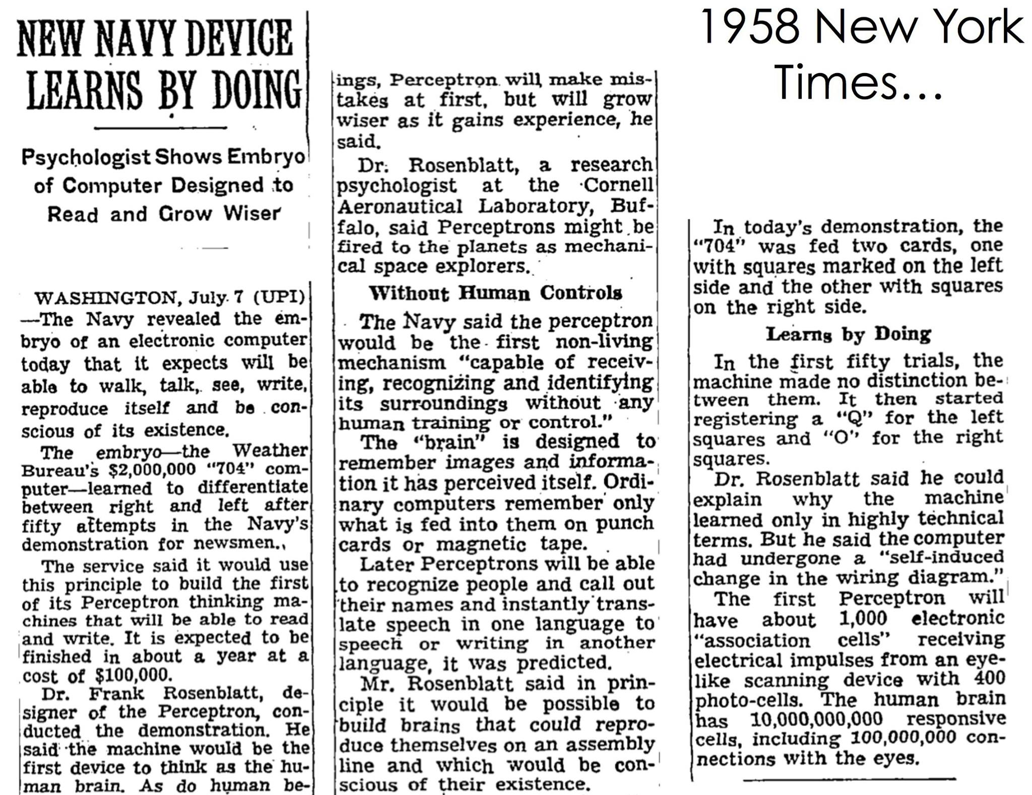
Slide: Lazebnik

Slide 11
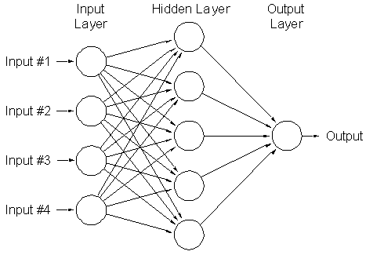
Two-layer neural network
Can learn nonlinear functions provided each perceptron has a differentiable nonlinearity
Sigmoid:
Slide: Lazebnik

Slide 12
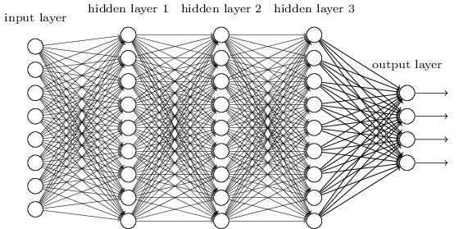
Multi-layer neural network
Slide: Lazebnik

Slide 13
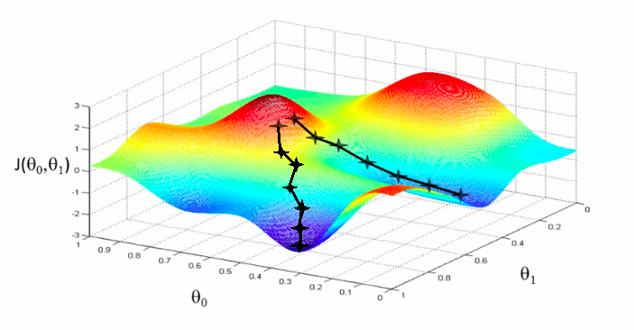
Training of multi-layer networks
Find network weights to minimize the training error between true and estimated labels of training examples, e.g.:
Update weights by gradient descent:
w₂
w₁
Slide: Lazebnik

Slide 14
Training of multi-layer networks
Find network weights to minimize the training error between true and estimated labels of training examples, e.g.:
Update weights by gradient descent:
Back-propagation: gradients are computed in the direction from output to input layers and combined using chain rule
Stochastic gradient descent: compute the weight update w.r.t. a small batch of examples at a time, cycle through training examples in random order in multiple epochs
Slide: Lazebnik

Slide 15
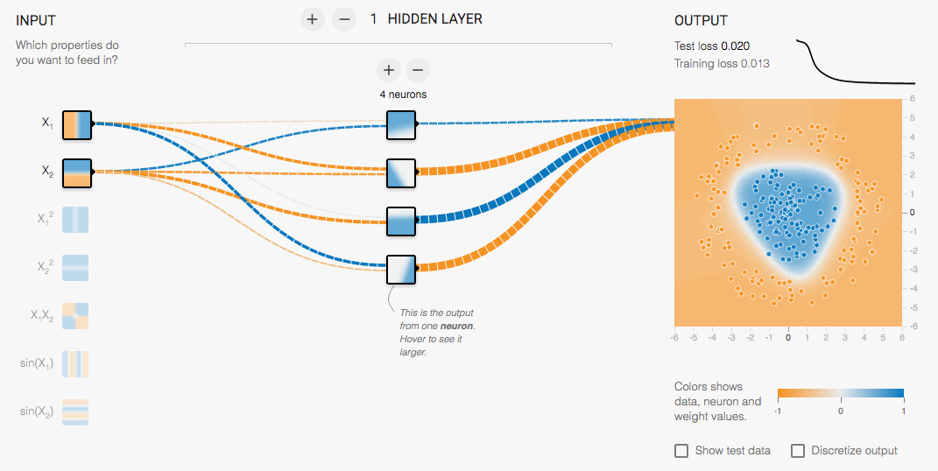
Multi-Layer Network Demo
http://playground.tensorflow.org/
Slide: Lazebnik

Slide 16
From fully connected to convolutional networks
image
Fully connected layer
Slide: Lazebnik

Slide 17
From fully connected to convolutional networks
image
Convolutional layer
Slide: Lazebnik

Slide 18
From fully connected to convolutional networks
feature map
learned weights
image
Convolutional layer
Slide: Lazebnik

Slide 19
From fully connected to convolutional networks
feature map
learned weights
image
Convolutional layer
Slide: Lazebnik

Slide 20
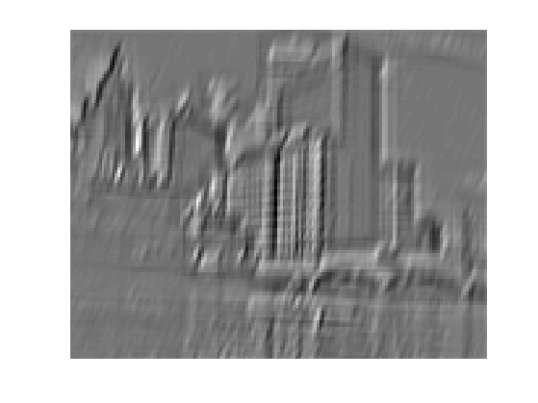
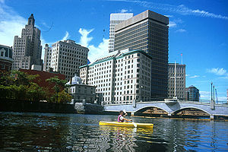
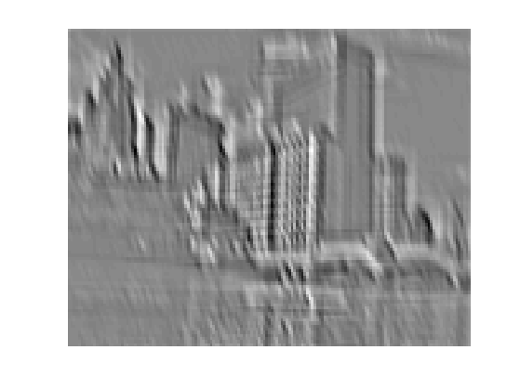
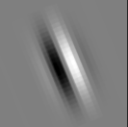
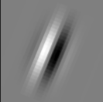
Convolution as feature extraction
...
Input
Feature Map
Slide: Lazebnik

Slide 21
From fully connected to convolutional networks
feature map
learned weights
image
Convolutional layer
Slide: Lazebnik

Slide 22
From fully connected to convolutional networks
next layer
image
Convolutional layer
Slide: Lazebnik

Slide 23
Key operations in a CNN
Feature maps
Spatial pooling
Non-linearity
Convolution (Learned)
...
Input Image
Input
Feature Map
Source: R. Fergus, Y. LeCun
Slide: Lazebnik

Slide 24
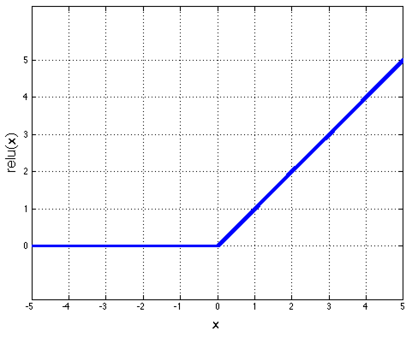
Key operations
Feature maps
Spatial pooling
Rectified Linear Unit (ReLU)
Non-linearity
Convolution (Learned)
Input Image
Source: R. Fergus, Y. LeCun
Slide: Lazebnik

Slide 25
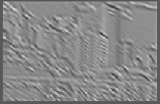
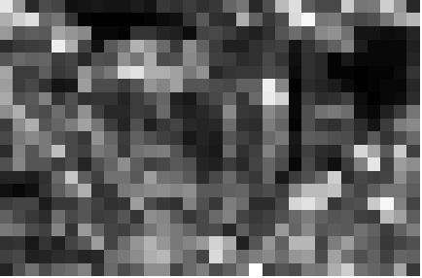
Key operations
Feature maps
Spatial pooling
  Max
Non-linearity
Convolution (Learned)
Input Image
Source: R. Fergus, Y. LeCun
Slide: Lazebnik

Slide 26
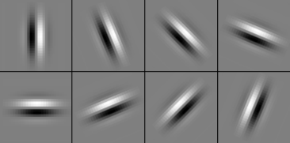
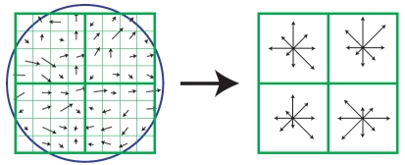
Comparison to Pyramids with SIFT
Lowe [IJCV 2004]
Image
Pixels
Apply
oriented filters
Spatial pool
(Sum)
Feature
Vector
Normalize to unit length
slide credit: R. Fergus

Slide 27




Comparison to Pyramids with SIFT
Lazebnik,
Schmid,
Ponce
[CVPR 2006]
SIFT
Features
Filter with
Visual Words
Max
Multi-scale
spatial pool
(Sum)
Classifier
slide credit: R. Fergus

Slide 28
Key idea: learn features and classifier that work well together (“end-to-end training”)
Label
Dense
Dense
Dense
Convolution/pool
Convolution/pool
Convolution/pool
Convolution/pool
Convolution/pool
Image

Slide 29
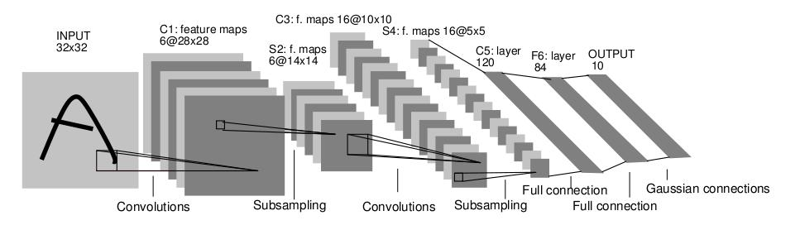
LeNet-5
Average pooling
Sigmoid or tanh nonlinearity
Fully connected layers at the end
Trained on MNIST digit dataset with 60K training examples
Y. LeCun, L. Bottou, Y. Bengio, and P. Haffner, Gradient-based learning applied to document recognition, Proc. IEEE 86(11): 2278–2324, 1998.

Slide 30
Fast forward to the arrival of big visual data…
~14 million labeled images, 20k classes
Images gathered from Internet
Human labels via Amazon MTurk
ImageNet Large-Scale Visual Recognition Challenge (ILSVRC):
1.2 million training images, 1000 classes
www.image-net.org/challenges/LSVRC/
Slide: Lazebnik

Slide 31
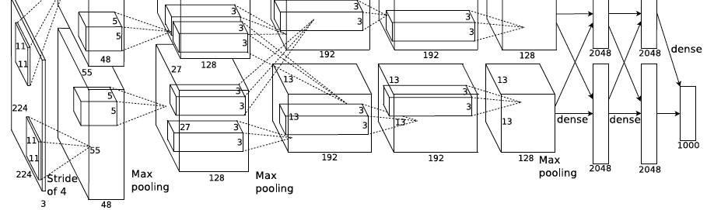
AlexNet: ILSVRC 2012 winner
Similar framework to LeNet but:
  Max pooling, ReLU nonlinearity
  More data and bigger model (7 hidden layers, 650K units, 60M params)
  GPU implementation (50x speedup over CPU)
    Trained on two GPUs for a week
  Dropout regularization
A. Krizhevsky, I. Sutskever, and G. Hinton, ImageNet Classification with Deep Convolutional Neural Networks, NIPS 2012
Notes:
Two-GPU architecture

Slide 32
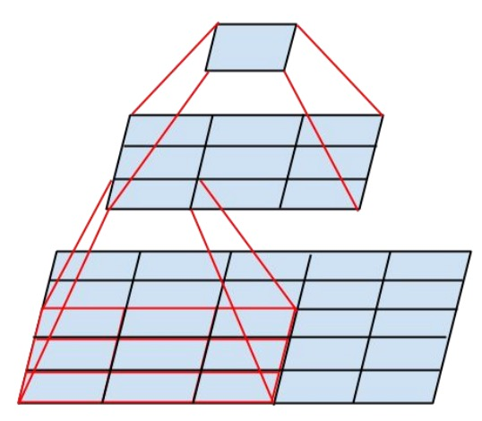
VGGNet
Sequence of deeper networks trained progressively
Large receptive fields replaced by successive layers of 3x3 convolutions (with ReLU in between)
  One 7x7 conv layer with C feature maps needs 49C² weights, three 3x3 conv layers need only 27C² weights
K. Simonyan and A. Zisserman, Very Deep Convolutional Networks for Large-Scale Image Recognition, ICLR 2015

Slide 33
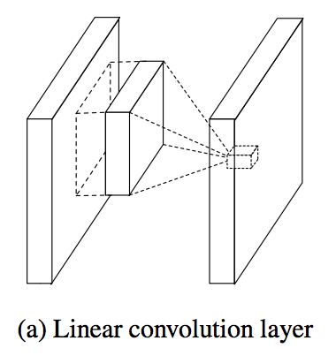
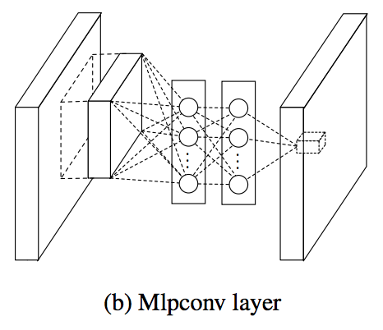
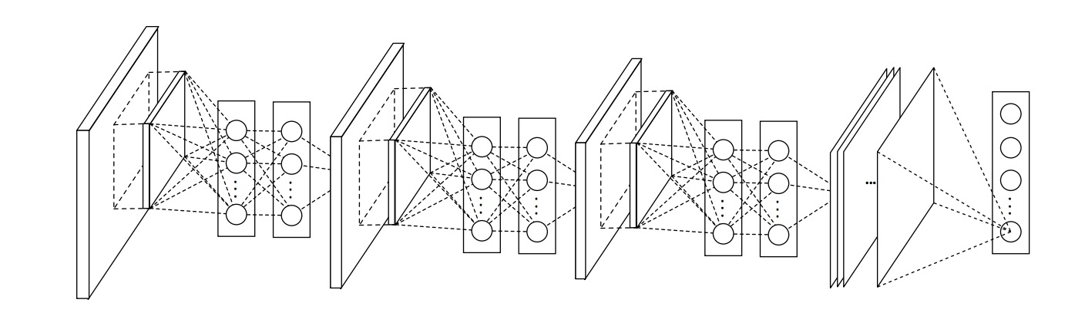
Network in network
M. Lin, Q. Chen, and S. Yan, Network in network, ICLR 2014
Slide: Lazebnik

Slide 34
1x1 convolutions
conv layer
Slide: Lazebnik

Slide 35
1x1 convolutions
1x1 conv layer
Slide: Lazebnik

Slide 36
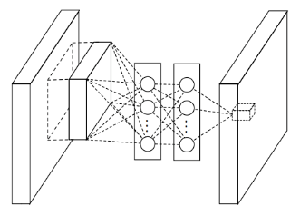
1x1 convolutions
1x1 conv layer
Slide: Lazebnik

Slide 37
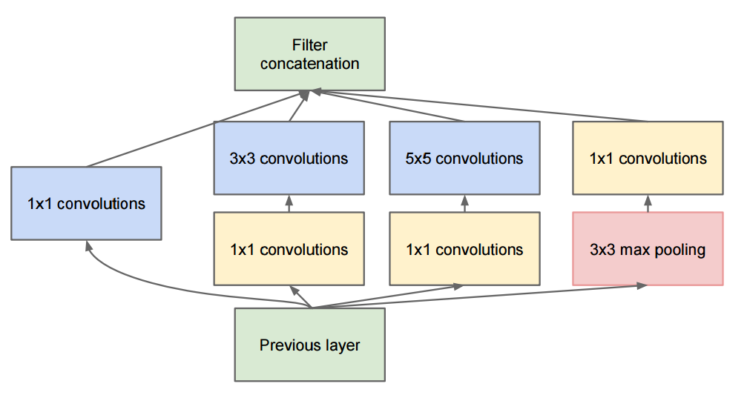
GoogLeNet: Inception module
  Parallel paths with different receptive field sizes and operations to capture sparse patterns of correlations
  1x1 convolutions for dimensionality reduction before expensive convolutions
C. Szegedy et al., Going deeper with convolutions, CVPR 2015

Slide 38
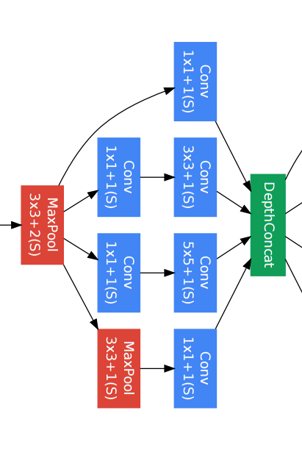
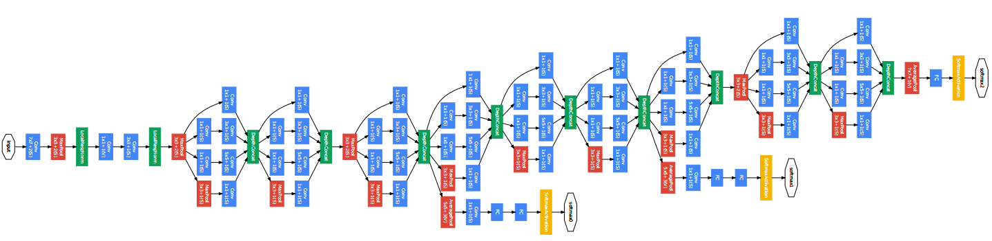
GoogLeNet
Inception module
C. Szegedy et al., Going deeper with convolutions, CVPR 2015

Slide 39
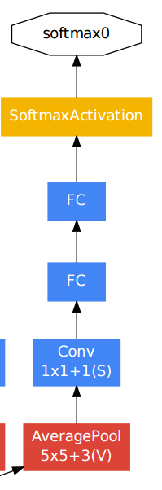
GoogLeNet
Auxiliary classifier
C. Szegedy et al., Going deeper with convolutions, CVPR 2015

Slide 40
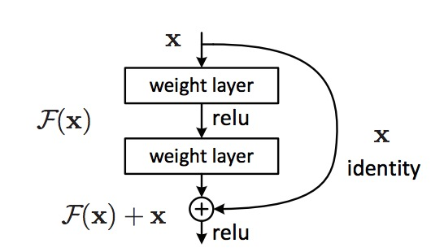
ResNet: the residual module
Introduce skip or shortcut connections (existing before in various forms in literature)
Make it easy for network layers to represent the identity mapping
For some reason, need to skip at least two layers
Kaiming He, Xiangyu Zhang, Shaoqing Ren, and Jian Sun, Deep Residual Learning for Image Recognition, CVPR 2016 (Best Paper)

Slide 41
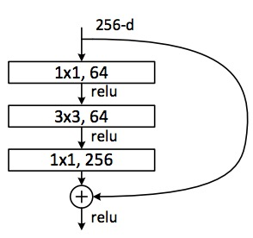
ResNet
Deeper residual module (bottleneck)
  Directly performing 3x3 convolutions with 256 feature maps at input and output:
  256 x 256 x 3 x 3 ~ 600K operations
  Using 1x1 convolutions to reduce 256 to 64 feature maps, followed by 3x3 convolutions, followed by 1x1 convolutions to expand back to 256 maps:
  256 x 64 x 1 x 1 ~ 16K
  64 x 64 x 3 x 3 ~ 36K
  64 x 256 x 1 x 1 ~ 16K
  Total: ~70K
Kaiming He, Xiangyu Zhang, Shaoqing Ren, and Jian Sun, Deep Residual Learning for Image Recognition, CVPR 2016 (Best Paper)
Slide: Lazebnik

Slide 42
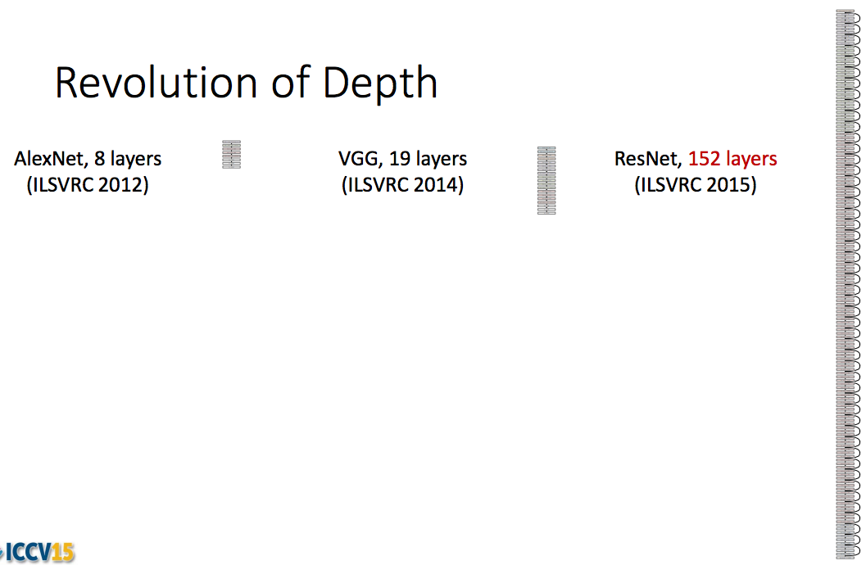
ResNet: going real deep
Kaiming He, Xiangyu Zhang, Shaoqing Ren, and Jian Sun, Deep Residual Learning for Image Recognition, CVPR 2016

Slide 43
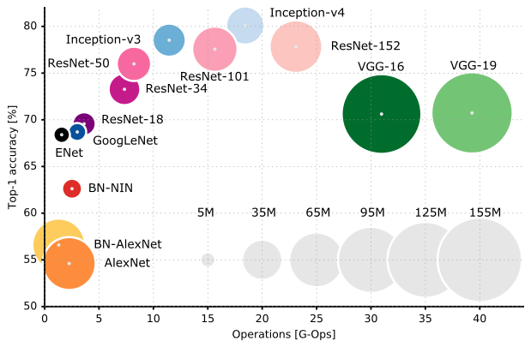
Bigger not better: innovations typically reduce parameters, despite deeper nets

Slide 44
Key ideas of CNN Architectures
Convolutional layers
  Same local functions evaluated everywhere → much fewer parameters
Pooling
  Larger receptive field and translational invariance
ReLU: maintain a gradient signal over large portion of domain
Limit parameters
  Sequence of 3x3 filters instead of large filters (also encodes that local pixels are more relevant)
  1x1 convs to reduce feature dimensions
Skip network
  Prevents having to maintain early layers (just add residual)
  Acts as ensemble

Slide 45
Optimization

Slide 46
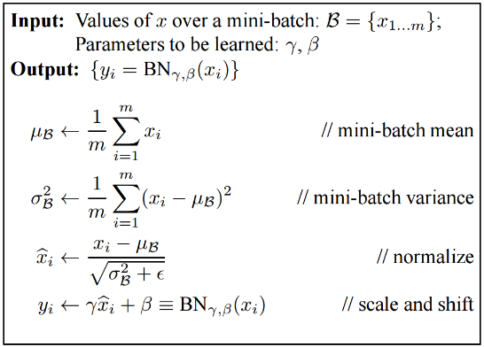
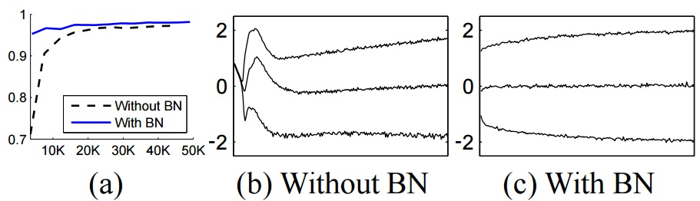
Batch Normalization
Batch Normalization: Accelerating Deep Network Training by
Reducing Internal Covariate Shift [Ioffe and Szegedy 2015]

Slide 47
Key ideas of optimization
Stochastic gradient descent (SGD) in batches
  Batch size 128 or 256 recommended
  Use ADAM for gradient/momentum
Normalize inputs/features (similar idea to whitening)
  Batchnorm normalizes inputs to each layer by estimate (e.g. moving average) of mean/std
Crazy optimization problem (so many local minima), but
  Model capacity is larger than needed to help ensure that important patterns are discovered
  Many solutions are similarly good (e.g. can permute layers without effect)
Good discussion post on local minima

Slide 48
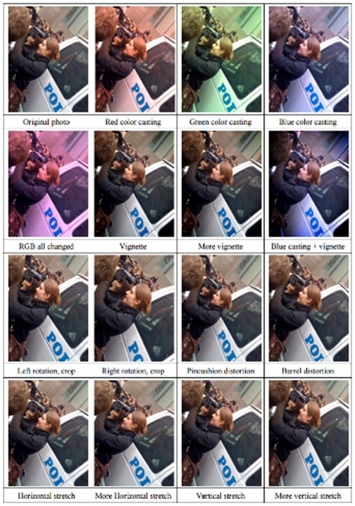
Data Augmentation (Jittering)
Slide: Jiabin Huang
Create virtual training samples
  Horizontal flip
  Random crop
  Color casting
  Geometric distortion
Idea goes back to Pomerleau 1995 at least (neural net for car driving)
Deep Image [Wu et al. 2015]

Slide 49
What does the CNN learn?

Slide 50
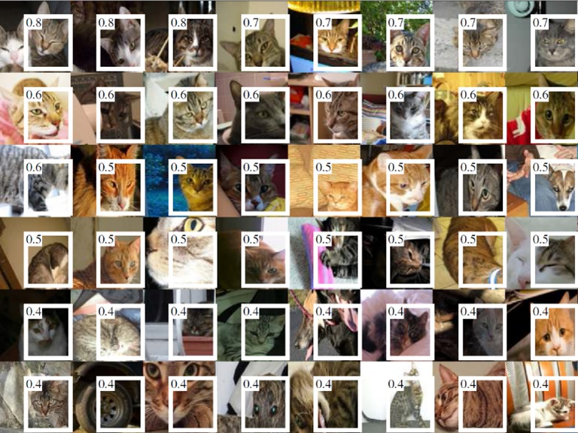
Individual Neuron Activation
RCNN [Girshick et al. CVPR 2014]

Slide 51
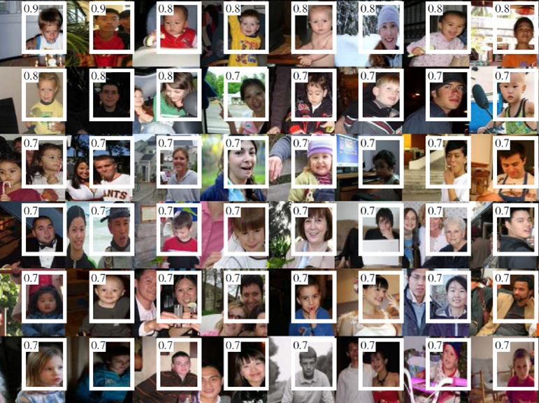
Individual Neuron Activation
RCNN [Girshick et al. CVPR 2014]

Slide 52
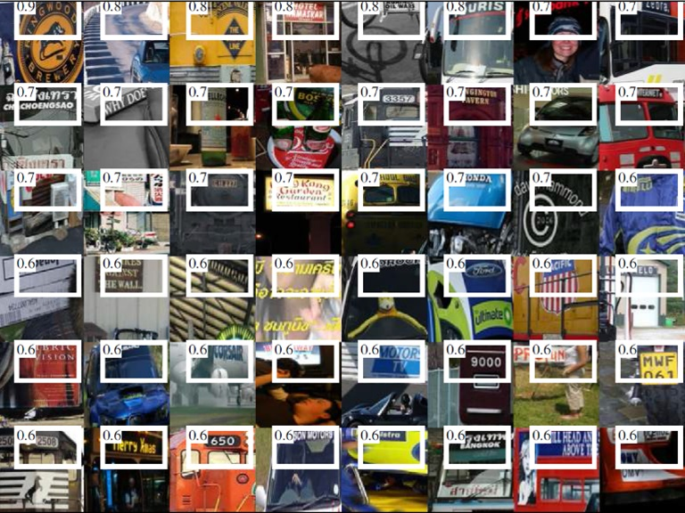
Individual Neuron Activation
RCNN [Girshick et al. CVPR 2014]

Slide 53
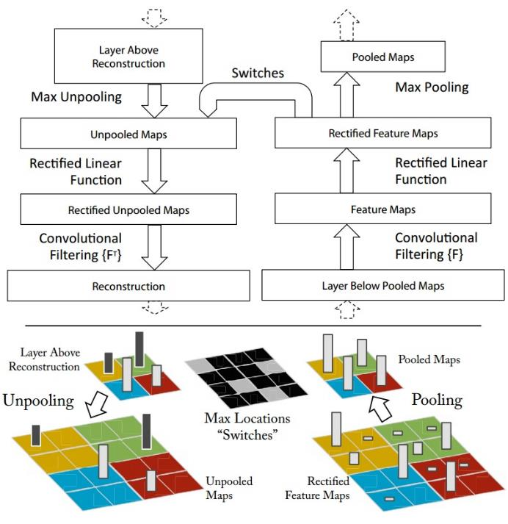
Map activation back to the input pixel space
What input pattern originally caused a given activation in the feature maps?
Visualizing and Understanding Convolutional Networks [Zeiler and Fergus, ECCV 2014]

Slide 54
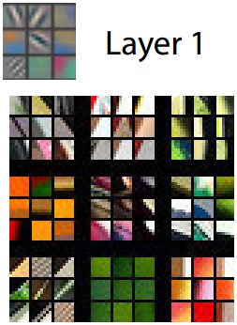
Layer 1
Visualizing and Understanding Convolutional Networks [Zeiler and Fergus, ECCV 2014]

Slide 55
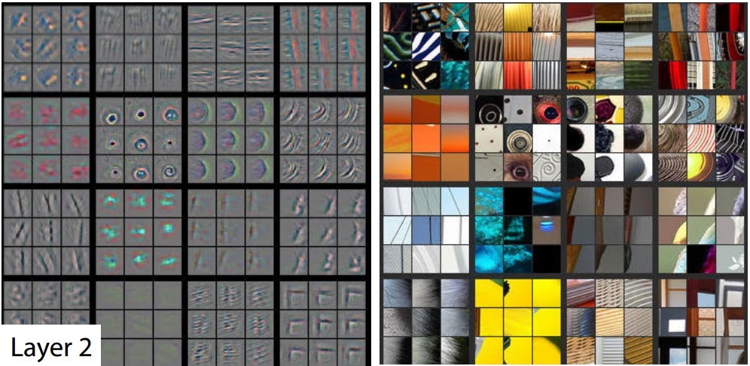
Layer 2
Visualizing and Understanding Convolutional Networks [Zeiler and Fergus, ECCV 2014]

Slide 56
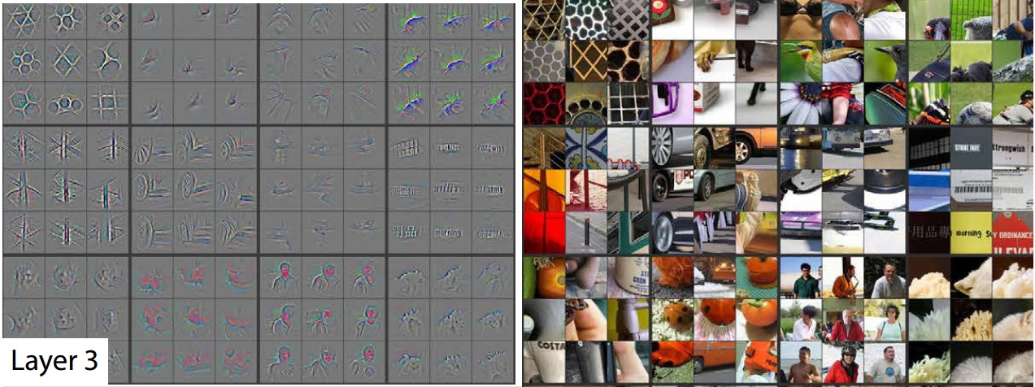
Layer 3
Visualizing and Understanding Convolutional Networks [Zeiler and Fergus, ECCV 2014]

Slide 57
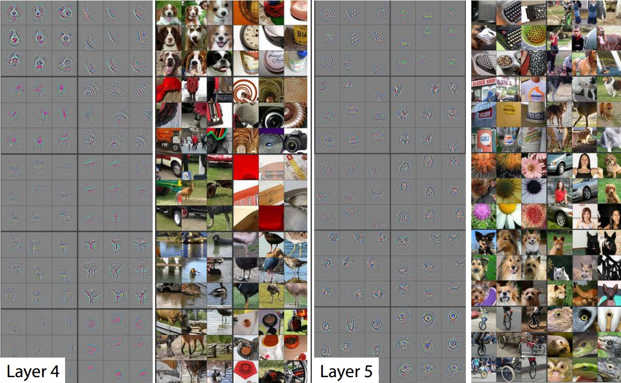
Layer 4 and 5
Visualizing and Understanding Convolutional Networks [Zeiler and Fergus, ECCV 2014]

Slide 58
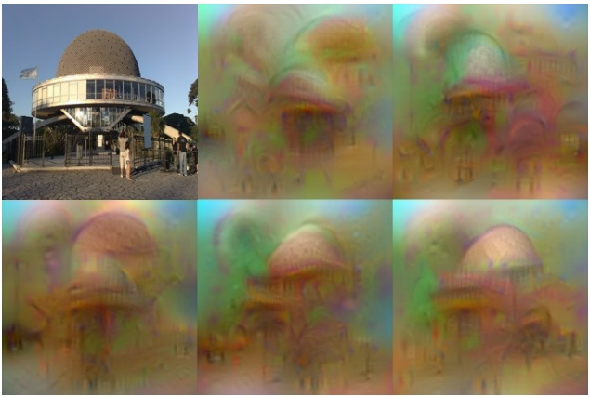
Invert CNN features
Reconstruct an image from CNN features
Understanding deep image representations by inverting them
[Mahendran and Vedaldi CVPR 2015]

Slide 59
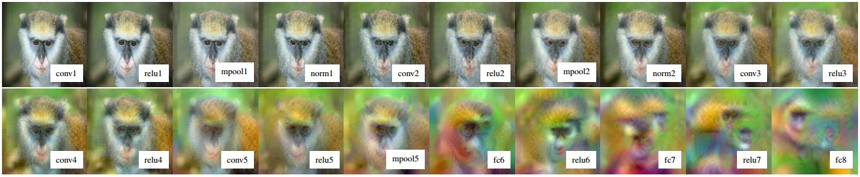
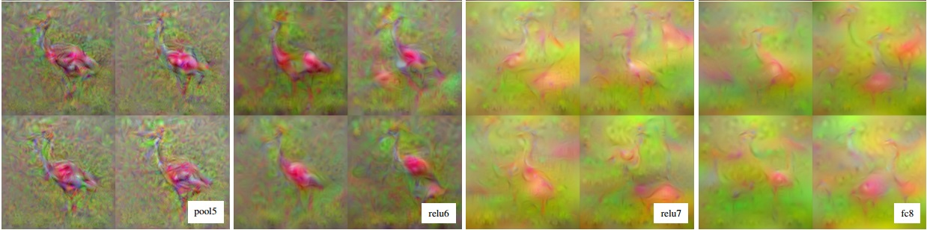
CNN Reconstruction
Reconstruction from different layers
Multiple reconstructions
Understanding deep image representations by inverting them
[Mahendran and Vedaldi CVPR 2015]

Slide 60
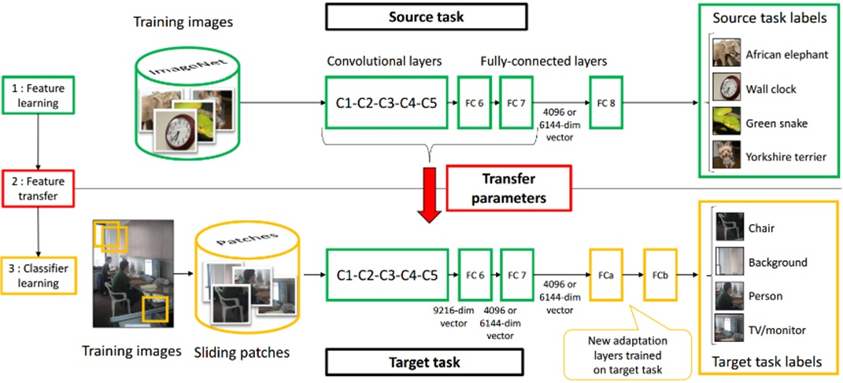
Transfer Learning
Slide: Jiabin Huang
Improvement of learning in a new task through the transfer of knowledge from a related task that has already been learned.
Weight initialization for CNN
Learning and Transferring Mid-Level Image Representations using
Convolutional Neural Networks [Oquab et al. CVPR 2014]

Slide 61
Tools
Caffe
cuda-convnet2
Torch
MatConvNet
Pylearn2
TensorFlow

Slide 62
Reading list
https://culurciello.github.io/tech/2016/06/04/nets.html
Y. LeCun, L. Bottou, Y. Bengio, and P. Haffner, Gradient-based learning applied to document recognition, Proc. IEEE 86(11):
2278–2324, 1998.
A. Krizhevsky, I. Sutskever, and G. Hinton, ImageNet Classification with Deep Convolutional Neural Networks, NIPS 2012
D. Kingma and J. Ba, Adam: A Method for Stochastic Optimization, ICLR 2015
M. Zeiler and R. Fergus, Visualizing and Understanding Convolutional Networks,
ECCV 2014 (best paper award)
K. Simonyan and A. Zisserman, Very Deep Convolutional Networks for Large-Scale Image Recognition, ICLR 2015
M. Lin, Q. Chen, and S. Yan, Network in network, ICLR 2014
C. Szegedy et al., Going deeper with convolutions, CVPR 2015
C. Szegedy et al., Rethinking the inception architecture for computer vision,
CVPR 2016
K. He, X. Zhang, S. Ren, and J. Sun, Deep Residual Learning for Image Recognition, CVPR 2016 (best paper award)

Slide 63
Next week
Object detection and pixel labeling

