Slide 1
Image and Region Categorization
04/04/17
Computer Vision
CS 543 / ECE 549
University of Illinois
Derek Hoiem
Notes:
Afternoon
Image and region categorization
Use one image , what do you see
Can see different, transfer knowledge
Can know a lot of things by seeing it a dog
Type of categorization

Slide 2
Classification problems
  Image Categorization: classify an image S
  Object Detection: classify a region
  Semantic Segmentation: classify a pixel
  Structured Problems: estimate pose as a set of related landmarks
  Others: attributes, actions, materials, …
Example: bag of words image classifier
  Histogram of visual words, spatial binning / pooling
  Linear classifier
General framework: pixels->features->scorer
    Features can be learned: clustering, pooling
    Scorer can be linear combination of features or based on similarity to training samples
Key principles of machine learning
  Bias-variance trade-off
  Overfitting
Deep convolutional neural nets
  Architecture (Alexnet, VGG, Inception, Resnet)
  Optimizer (Adam)
  Transfer
  Why it works

Slide 3
Last classes
Object instance recognition: localizing an object instance in an image
Face recognition: matching one face image to another
This week and next: mapping images and regions to categories
Notes:
In the previous classes covered vision tasks involving recognition of particular instance
Object instance recognition is localizing particular object instance in an image
The other related task is face recognition, match one face to a particular person
Today, talking about another task, mapping images and regions to categories.
What is the difference? For example for face images, finding if the image contains John is a instance recognition task, but john is not a category.
Recognizing a face images is a male or a female is categorization task.

Slide 4
This week: image categorization
Overview of image and region categorization
  Task description
  What is a category
Example of spatial pyramids bag-of-words scene categorizer
Key concepts: features and classification
Deep convolutional neural networks (CNNs)

Slide 5
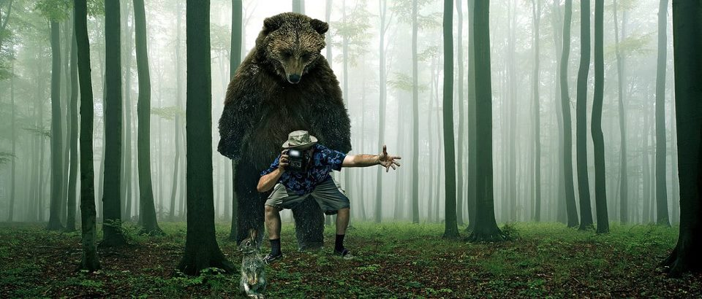
What do you see in this image?
Trees
Bear
Camera
Man
Can I put stuff in it?
Rabbit
Grass
Forest
Notes:
What do you say about this image?
So this is a forest scene, and there is a lot trees, grass on the ground, man and holding a camera looking rabbit, bear behind.
Giving out category names, doing categorization

Slide 6
Categorization lets us describe, predict, or interact with the object based on visual cues
Is it dangerous?
Is it alive?
How fast does it run?
Is it soft?
Does it have a tail?
Can I poke with it?

Slide 7
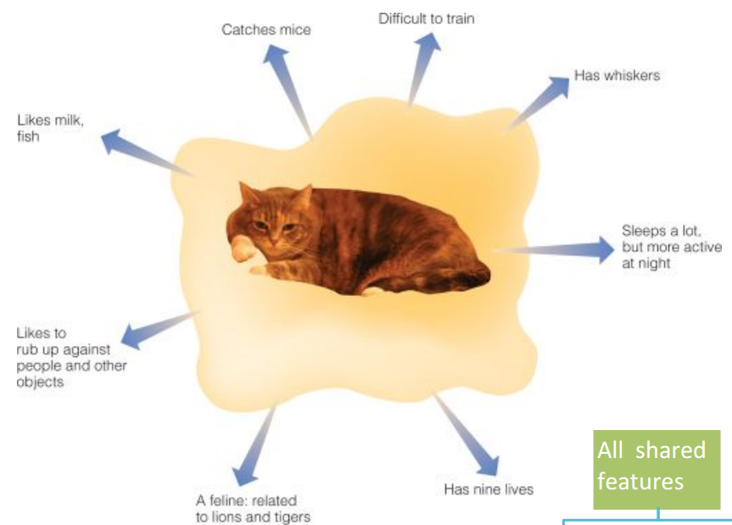
Why do we care about categories?
Predict behavior, beyond of what is immediately perceived
Pointers to knowledge
  Help to understand individual cases not previously encountered
Communication
Notes:
I think about things in categories because there are many benefit to it.
Mainly the benefit is, from categories, we can go beyond what we see and make prediction

Slide 8
Theory of categorization
How do we determine if something is a member of a particular category?
Definitional approach
Prototype approach
Exemplar approach

Slide 9
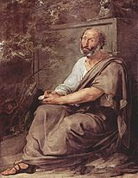
Definitional approach: classical view of categories
Plato & Aristotle
  Categories are defined by a list of properties shared by all elements in a category
  Category membership is binary
  Every member in the category is equal
  The Categories (Aristotle)
Aristotle by Francesco Hayez
Slide Credit: A. A. Efros

Slide 10
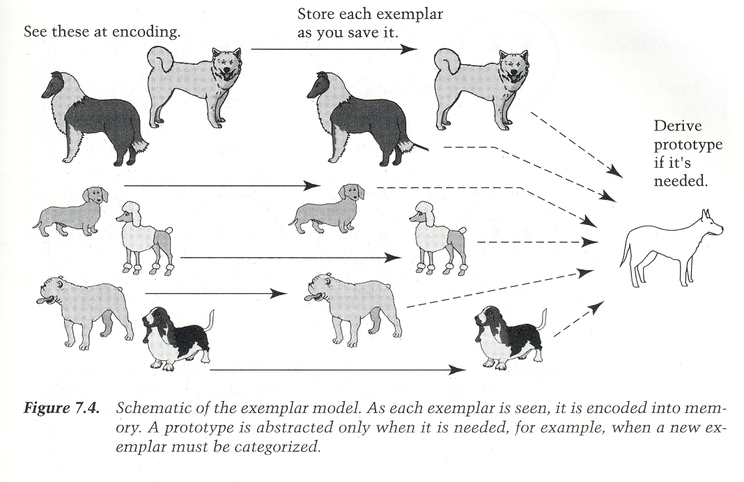
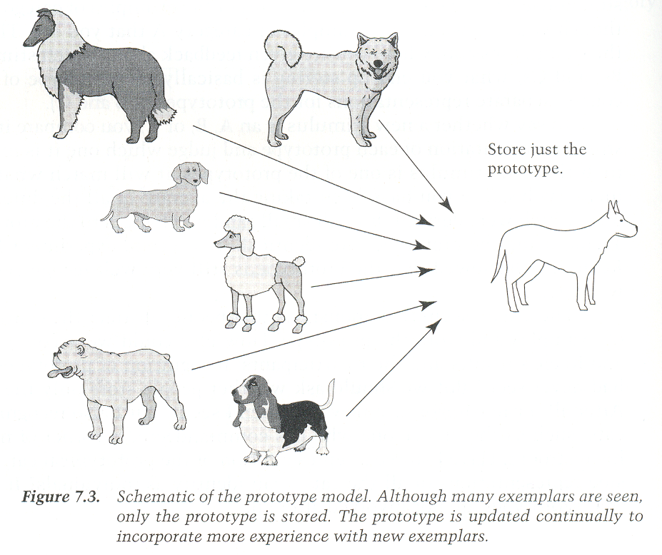
Prototype Model
Exemplars Model
Category judgments are made
by comparing a new exemplar
to all the old exemplars of a category
or to the exemplar that is the most
appropriate
Category judgments are made
by comparing a new exemplar
to the prototype.
Slide Credit: Torralba
Notes:
Knowing what a category is, how do we recognize them?
One way to think about it is that I have a generic prototype of something say dog, and I compare everything to the prototype to make this decision.
The other way to think about it is I have kept in my memory a number of exemplars and I compare new things to those exemplars and make the prediction

Slide 11

Levels of categorization [Rosch 70s]
Definition of Basic Level:
Similar shape: Basic level categories are the highest-level category for which their members have similar shapes.
Similar motor interactions: … for which people interact with its members using similar motor sequences.
Common attributes: … there are a significant number
of attributes in common between pairs of members.
…
animal
Superordinate
levels
…
…
similarity
quadruped
…
Basic level
dog
cat
cow
German
shepherd
Doberman
Sub Basic Superordinate
Subordinate
level
…
“Fido”
…
Rosch et a. Principle of categorization, 1978
Notes:
So category is important but what kind of categories do we what to work with?
It turns out that philosophers have been thinking about it over thousands of years and some of recent theories about categorization is made by a research Elenor Rosch in 1976.
They found that first categories can be put into taxonomies. Dog is subcategory of animal, and German shepherd is subcategory of dog.
At higher level things share very little in common, and at lower level, things share a lot in common. a fly is very different from a dog, but german shepherd is very similar to a greyhound, but the boundary may be less clear.
So in the taxonomy tree, there is level called basic level where people are very comfortable to work with, they are like dog, cat, cow.
In this level categories still share a lot in common and the boundaries of categories are very clear.

Slide 12
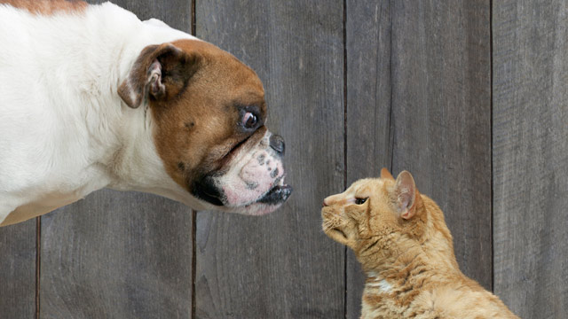
Image categorization
Cat vs Dog

Slide 13
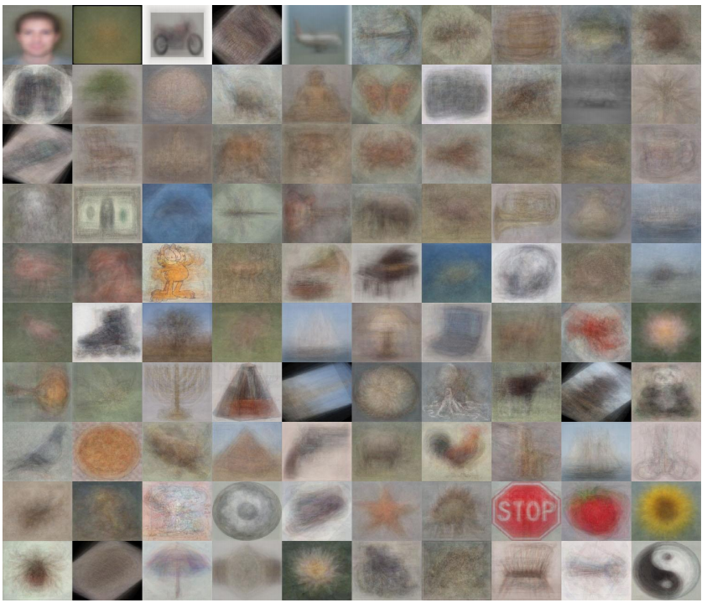
Image categorization
Object recognition
Caltech 101 Average Object Images

Slide 14
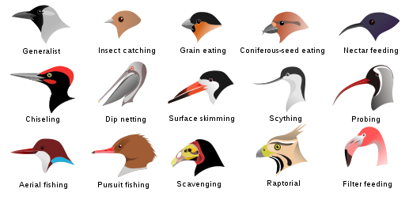
Image categorization
Fine-grained recognition
Visipedia Project

Slide 15
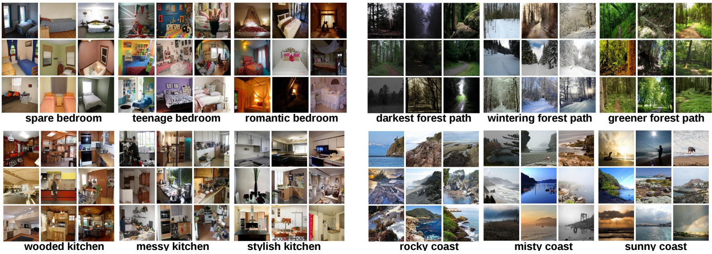
Image categorization
Place recognition
Places Database [Zhou et al. NIPS 2014]

Slide 16
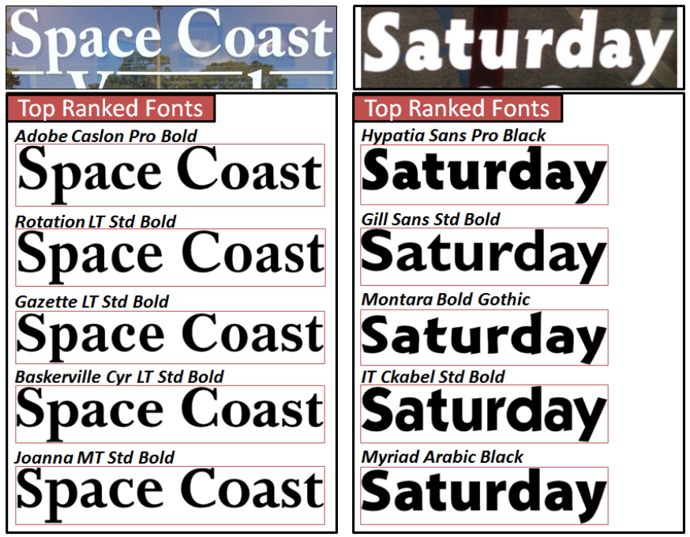
Image categorization
Visual font recognition
[Chen et al. CVPR 2014]

Slide 17
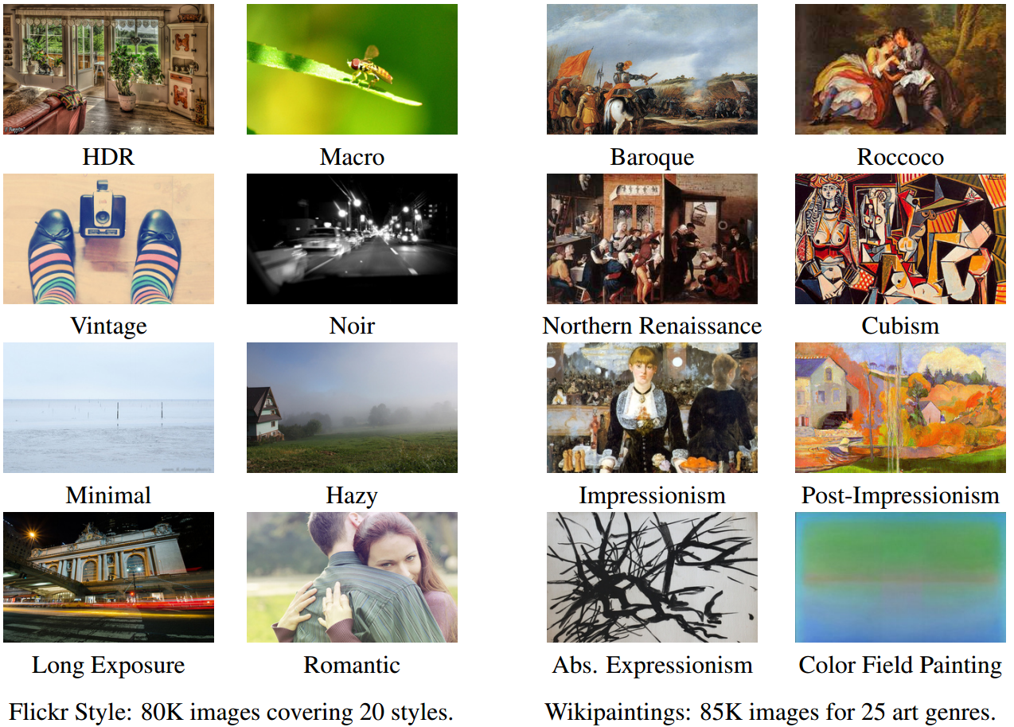
Image categorization
Image style recognition
[Karayev et al. BMVC 2014]

Slide 18
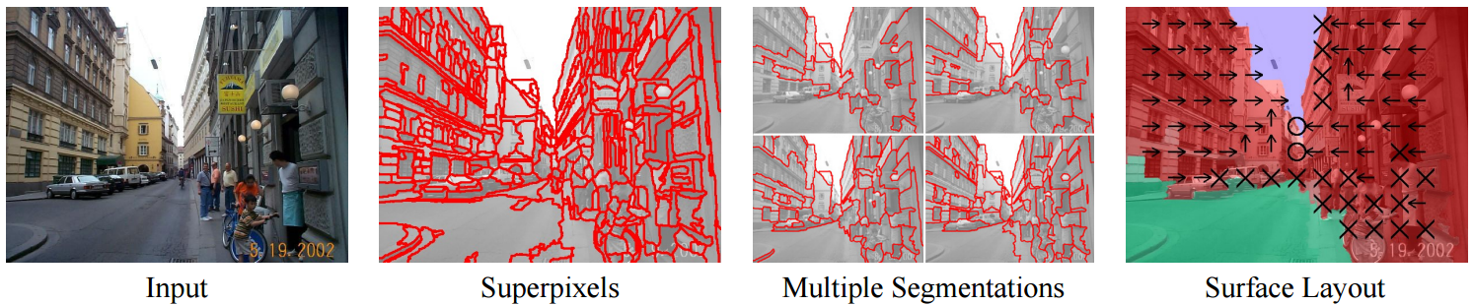
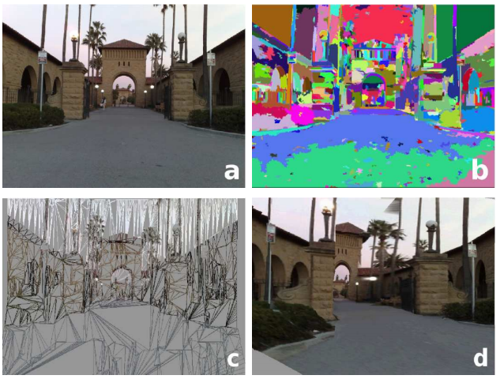
Region categorization
Layout prediction
Assign regions to orientation
Geometric context [Hoiem et al. IJCV 2007]
Assign regions to depth
Make3D [Saxena et al. PAMI 2008]

Slide 19
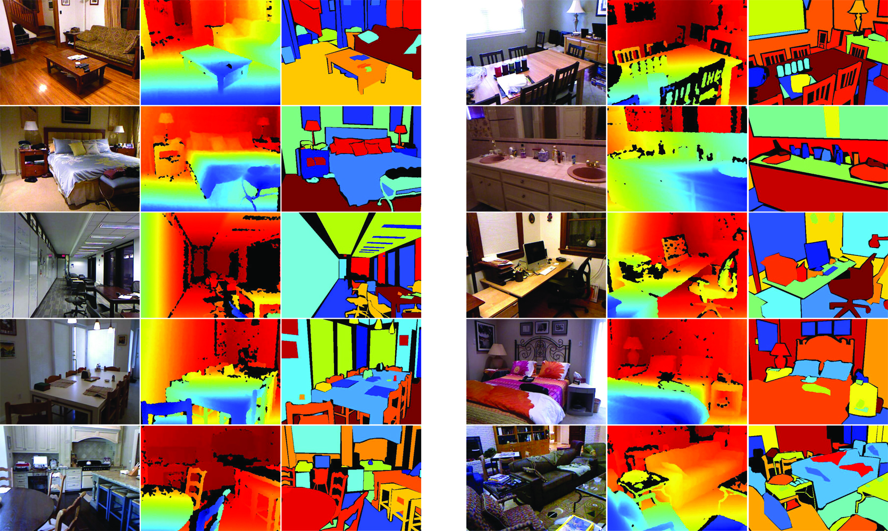
Region categorization
Semantic segmentation from RGBD images
[Silberman et al. ECCV 2012]

Slide 20
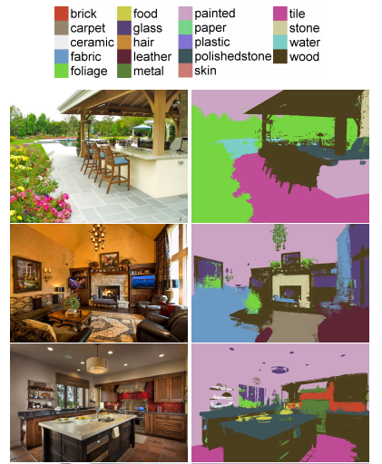
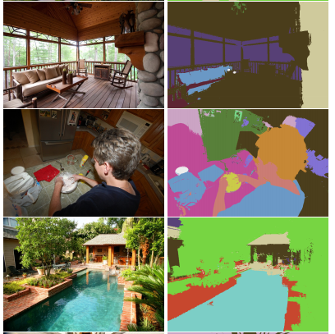
Region categorization
Material recognition
[Bell et al. CVPR 2015]

Slide 21
Many vision problems involve categorization
Image: Classify as indoor/outdoor, which room, what objects are there, etc.
Object Detection: classify location (bounding box or region) as object or non-object
Semantic Segmentation: classify pixel into an object, material, part, etc.
Action Recognition: classify a frame or sequence into an action type
…

Slide 22
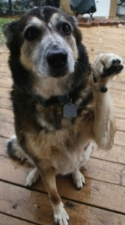
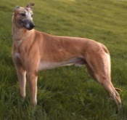
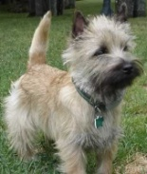
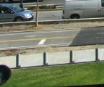

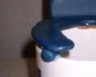
Categorization from supervised learning
LAB Histogram
x
x
x
x
x
Textons
o
x
o
x
= Category
label
o
o
HOG
o
x
Bag of SIFT
x
Examples
+
+
Image Features
Classifier
Notes:
Supervised learning
First we represent the visual appearance of our examples using some image features, we want the features to capture important visual characteristics
Then, we will build models to separate the examples from the same category from the examples that do not belong to this category

Slide 23
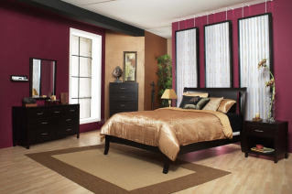

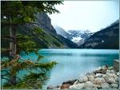

Training phase
Training
Training Labels
Training Images
Image Features
Classifier Training
Trained Classifier
Notes:
Remember that we used sift matching in object instance recognition. It doesn’t usually work for categorization mainly because there are too much variance in appearance of difference instances of object within the same category. So we usually need a different framework for it.
We start with a bunch of training images with their training label, we extract some image features that summarize their visual cues and use put the label and features
into a classifier to learn a model to characterize its visual cues.

Slide 24
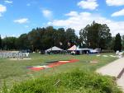
Testing phase
Training
Training Labels
Training Images
Image Features
Classifier Training
Trained Classifier
Testing
Image Features
Trained Classifier
Prediction
Outdoor
Test Image
Notes:
At testing time, we are given a new image, we also represent it in terms of image features and apply the trained model to obtain the prediction

Slide 25
Example: Spatial Pyramid BoW Classifier
Features: spatially binned histograms of clustered SIFT descriptors
Classifier: SVM
Lazebnik et al. CVPR 2006

Slide 26
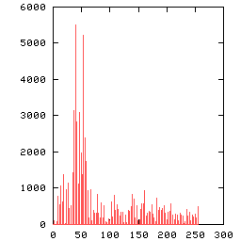
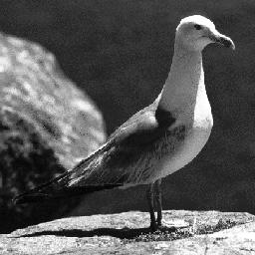
A little background on histograms…
Global histogram
- Represent distribution of features
  Color, texture, depth, …
Space Shuttle Cargo Bay
Images from Dave Kauchak
Notes:
Histograms, measure feature distribution. General representation, The feature maybe color text, depth

Slide 27
2D histogram
Feature 2
Feature 1

Slide 28
Histogram with marginal binning
Probability or count of data in each bin
Marginal histogram on feature 1
Feature 2
Feature 1
bin

Slide 29
Histogram with marginal binning
Marginal histogram on feature 2
bin
Feature 2
Feature 1

Slide 30
Histogram with joint binning
bin
Feature 2
Feature 1

Slide 31
Joint vs marginal binning
Feature 2
Feature 2
Feature 1
Feature 1
Feature 2
Feature 1
Joint histogram
Requires lots of data
Loss of resolution to
avoid empty bins
Marginal histogram
  Requires independent features
  More data/bin than
  joint histogram

Slide 32
Histogram with clustering
Cluster data (or partition) into K clusters, count how many samples appear in each cluster to get K-dim histogram
Use the same cluster centers (or partitioning) for all images
bin
Feature 2
Feature 1

Slide 33
Computing histogram distance
Cosine similarity (dot product of normalized counts)
Histogram intersection
Chi-squared Histogram matching distance
Earth mover’s distance
(Cross-bin similarity measure)
  minimal cost paid to transform one distribution into the other
[Rubner et al. The Earth Mover's Distance as a Metric for Image Retrieval, IJCV 2000]

Slide 34
Histograms: implementation issues
Quantization
  Grids: fast but applicable only with few dimensions
  Clustering: slower but can quantize data in higher dimensions
Matching
  Histogram intersection or Euclidean/Cosine may be faster
  Chi-squared often works better
  Earth mover’s distance is good for when nearby bins represent similar values
Few Bins
Need less data
Coarser representation
Many Bins
Need more data
Finer representation
Notes:
Recap on histogram
Design issue histogram how many bin grids. Fewer loss more information compact
More bins data points fine
Euclidean

Slide 35
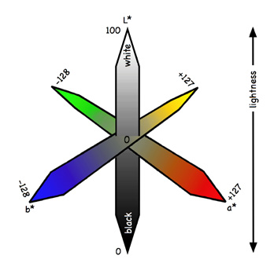
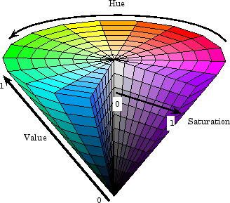
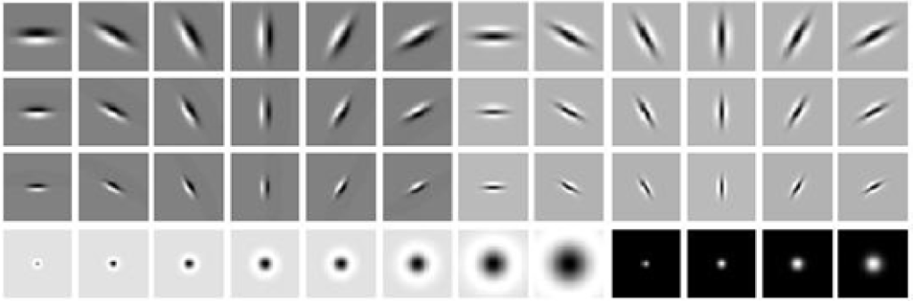
What kind of things do we compute histograms of?
Color
Texture (filter banks or HOG over regions)
L*a*b* color space
HSV color space
Notes:
Histogram of what.
Color, RGB values LAB approximate human perception, HSV hue staturation and illumination.
Textures: texture filter response

Slide 36
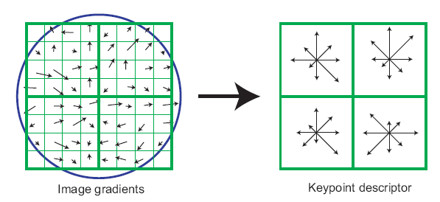
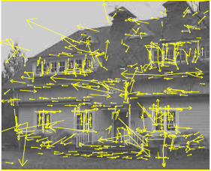
What kind of things do we compute histograms of?
Histograms of descriptors
“Bag of visual words”
SIFT – [Lowe IJCV 2004]
Notes:
Histogram of distinctive interesting points.
Detect and describe, interesting point descriptor, histogram of descriptors
Bag of visual words

Slide 37
Image categorization with bag of words
Training
Extract keypoints and descriptors for all training images
Cluster descriptors
Quantize descriptors using cluster centers to get “visual words”
Represent each image by normalized counts of “visual words”
Train classifier on labeled examples using histogram values as features
Testing
Extract keypoints/descriptors and quantize into visual words
Compute visual word histogram
Compute label or confidence using classifier

Slide 38
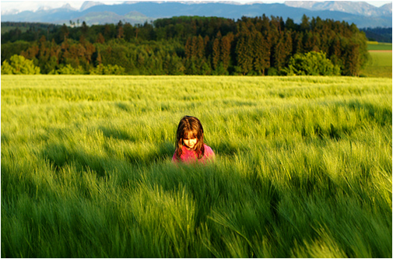
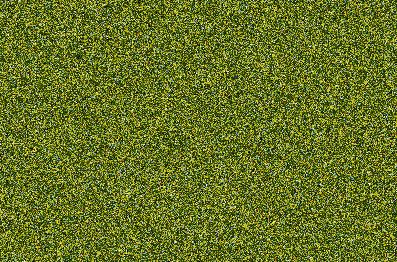
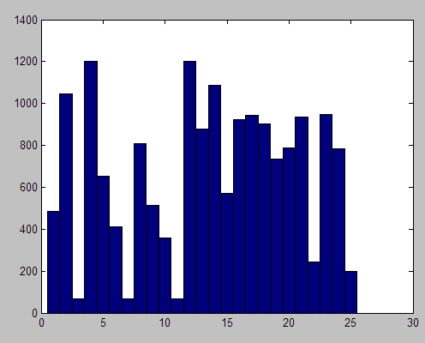
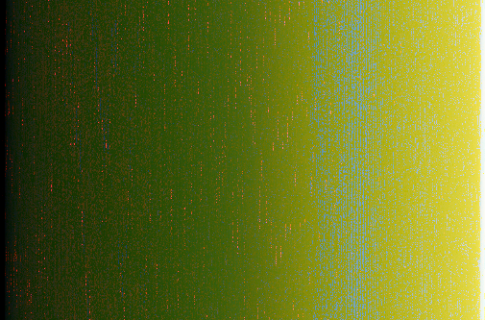
But what about spatial layout?
All of these images have the same color histogram
Notes:
So far, global histogram over the whole image discard spatial information
Images contain structures and looking at a scene spatial distribution of feature we want to capture but we throw them away
Result in the fact that I can construct a very different image and still get the same histogram
This image is obvious a scene on grassland but with the noisy and gradient image on the bottom, color histogram

Slide 39
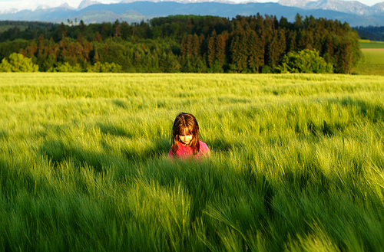
Spatial pyramid
Compute histogram in each spatial bin
Notes:
Overcome this, global, pyramid of histogram
Split into spatial bins at several levels and compute the histogram in each of them

Slide 40
Spatial pyramid
[Lazebnik et al. CVPR 2006]
Notes:
In more details, we still have the global histogram, but then I also have histograms computed in this 2x2 grid and histogram computed in 4x4 grid
Each of the histograms are individual normalized. They are weighted because you want each level to have equal weights, and combined together.
This spatial pyramid bag of bow is often considered as the goto feature to image categorization, works best for scenes, also works for most object.

Slide 41
Training
Training Labels
Training Images
Spatial Pyramid BoW
Classifier Training
Trained Classifier
Testing
Spatial Pyramid BoW
Trained Classifier
Prediction
Outdoor
Test Image
Notes:
At testing time, we are given a new image, we also represent it in terms of image features and apply the trained model to obtain the prediction

Slide 42
Linear SVM classifier
Find the hyperplane that separate examples of different categories
f(x) = w^{T}x + b
x
x
f( )>0
x
x
x
x
o
x
x
o
o
f( )>0
o
o
x2
f( )<0
x1
Notes:
Learning a linear classifier implies finding a hyperplane
Fall on to one side of plane
indoor/outdoor, discriminant function, f of indoor images, f of outdoor iamges

Slide 43
Linear Separators
Which of the linear separators is best?
http://www.cs.utexas.edu/~mooney/cs391L/slides/svm.ppt
http://www1.cs.columbia.edu/~belhumeur/courses/biometrics/2010/svm.ppt
Notes:
There can be infinite

Slide 44
Classification Margin
Distance from example x_{i} to the separator is
Examples closest to the hyperplane are support vectors.
Margin ρ of the separator is the distance between support vectors.
ρ
r
Notes:
Examples are x, the discriminant function is f =
It would be the linear separator that separate examples with most confidence
Can be expressed by maximizing the distance between examples and the plane, closest are called support vectors
The distance is called margin

Slide 45
Maximum Margin Classification
Implies that only support vectors matter; other training examples are ignorable.
Notes:
Finding the that maximizes this margin
Support vectors, other are ignored

Slide 46
Linear SVM Formulation
Find weights that try to get all examples right with a confidence margin while limiting the L2 norm of the weight vector
Loss and regularization
such that
Parameter C trades off between cost of hard examples and penalty on having large feature weights

Slide 47
Linear SVM Dual Formulation
such that

Slide 48
Spatial Pyramids Results

Slide 49
Recap: Spatial Pyramid BoW Classifier
Features
  Extract dense SIFT (spatially pooled and normalized histograms of gradients)
  Assign each SIFT vector to a cluster number
  Compute histograms of spatially pooled clustered SIFT vectors
  Variations like Fisher vectors and 2nd order pooling shown to improve performance
Classifier
  Linear SVM (or slightly better performance with chi-squared or histint SVMs)

Slide 50
Now let’s go back to the core concepts of image categorization in general

Slide 51
Categorization involves features and a classifier
Training Images
Training
Training Labels
Image Features
Classifier Training
Trained Classifier
Testing
Image Features
Trained Classifier
Prediction
Outdoor
Test Image
Notes:
At testing time, we are given with an new image, we also represent it in terms of image features and apply the trained model to obtain the prediction

Slide 52






Q: What are good features for…
recognizing a beach?

Slide 53
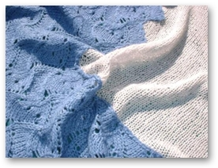
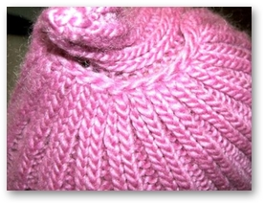
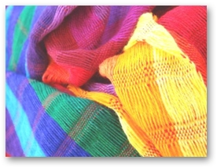
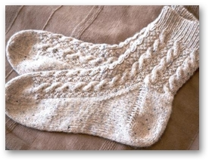

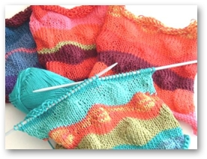
Q: What are good features for…
recognizing cloth fabric?

Slide 54
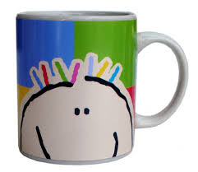

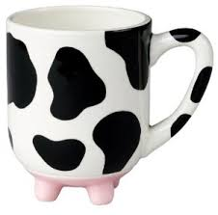
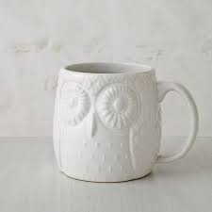


Q: What are good features for…
recognizing a mug?

Slide 55
What are the right features?
Depend on what you want to know!
Object: shape
  Local shape info, shading, shadows, texture
Scene : geometric layout
  linear perspective, gradients, line segments
Material properties: albedo, feel, hardness
  Color, texture
Action: motion
  Optical flow, tracked points
Notes:
Object: shape, shadows

Slide 56
General principles of features
Coverage
  Ensure that all relevant info is captured
Concision
  Minimize number of features without sacrificing coverage
Directness
  Ideal features are independently useful for prediction
Notes:
To represent images using features, there is not a certain best way to represent an image.
However, there are a few guidelines that apply: 1. we want our features to capture what is relveant to our categorization task.
For example, we want to focus on material category, look at color and texture categorize the scene category, then we want to use some feature that can capture the overall layout.
2. Features to be simple, less complicated model. In the extreme case, we can directly use raw image intensity as features. But the problem is, structured, correlated and classifier would not be able to learn. Learned by classifiers
3. Correlated features, each predict different things. RGB, LAB, color. RGB and texture, different perspective.

Slide 57
It’s hard to design good features for a specific problem
Many machine learning algorithms solve for both feature and classifier parameters, such as
Decision trees
Random forests
Multilayer neural networks (including CNNs)

Slide 58
Classifiers
Goal: From labeled training samples, learn parameters of a scoring/decision function that is likely to predict the correct label on test samples
Typical assumptions:
Training and test samples drawn from same distribution (i.i.d.)
Training labels are correct

Slide 59
Many classifiers to choose from
SVM
Neural networks
Naïve Bayes
Bayesian network
Logistic regression
Randomized Forests
Boosted Decision Trees
K-nearest neighbor
RBMs
Deep networks
Etc.
Which is the best one?

Slide 60
Classifiers: three main options
Nearest neighbor: take a vote from K closest neighbors
  Can learn features or distance measure
Linear: score is linear combination of features
  SVM, perceptron, naïve bayes, logistic regression
  Others learn features and then apply linear classifier (e.g. deep network, random forest)
Structured prediction: score an interdependent set of labels
  E.g. label body part positions
  Structured SVM, CNN, graphical model algorithms

Slide 61
Generalization Theory
It’s not enough to do well on the training set: also should make good predictions for new examples

Slide 62
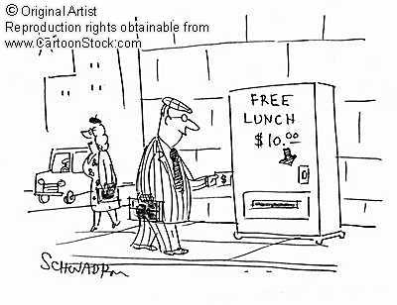
No Free Lunch Theorem
Notes:
You can only get generalization through assumptions.

Slide 63
Bias-Variance Trade-off
E(MSE) = noise² + bias² + variance
Error due to variance parameter estimates from training samples
Unavoidable error
Error due to incorrect assumptions
See the following for explanation of bias-variance (also Bishop’s “Neural Networks” book):
http://www.inf.ed.ac.uk/teaching/courses/mlsc/Notes/Lecture4/BiasVariance.pdf

Slide 64
Bias and Variance
Error = noise² + bias² + variance
Few training examples
Test Error
Many training examples
High Bias
Low Variance
Complexity
Low Bias
High Variance
Notes:
Note: these figures don’t work in pdf

Slide 65
Choosing the trade-off
Need validation set
Validation set is separate from the test set
Test error
Error
Training error
High Bias
Low Variance
Complexity
Low Bias
High Variance

Slide 66
Effect of Training Size
Fixed classifier
Error
Testing
Generalization Error
Training
Number of Training Examples

Slide 67

How to measure complexity?
VC dimension
Number of parameters
What is the VC dimension of a linear classifier for N-dimensional features? For a nearest neighbor classifier?
Upper bound on generalization error
Test error <=
Training error +
N: size of training set
h: VC dimension
η: 1-probability that bound holds

Slide 68
How to reduce variance?
Choose a simpler classifier
Regularize the parameters
Use fewer features
Get more training data
Which of these could actually lead to greater test error?
Notes:
The simpler classifier or regularization could increase bias and lead to more error.

Slide 69
Maximizing Margin Reduces Risk of Error
Key idea behind SVM
x
x
x
x
x
x
o
x
x
o
o
o
o
x2
x1

Slide 70
Characteristics of vision learning problems
Lots of continuous features
  E.g., HOG template may have 1000 features
  Spatial pyramid may have ~15,000 features
Imbalanced classes
  often limited positive examples, practically infinite negative examples
Difficult prediction tasks

Slide 71
When a massive training set is available
Relatively new phenomenon
  MNIST (handwritten letters) in 1990s, LabelMe in 2000s, ImageNet (object images) in 2009, …
Want classifiers with low bias (high variance ok) and reasonably efficient training
Very complex classifiers with simple features are often effective
  Random forests
  Deep convolutional networks

Slide 72
New training setup with moderate sized datasets
Training Labels
Training Images
Tune CNN features and
Neural Network classifier
Trained Classifier
Initialize CNN Features
Dataset similar to task with millions of labeled examples

Slide 73
Practical tips
Preparing features for linear classifiers
  Often helps to make zero-mean, unit-dev
  For non-ordinal features, convert to a set of binary features
Selecting classifier meta-parameters (e.g., regularization weight)
  Cross-validation: split data into subsets; train on all but one subset, test on remaining; repeat holding out each subset
    Leave-one-out, 5-fold, etc.
Most popular classifiers in vision
  SVM: linear for when fast training/classification is needed; performs well with lots of weak features
  Logistic Regression: outputs a probability; easy to train and apply
  Nearest neighbor: hard to beat if there is tons of data (e.g., character recognition)
  Boosted stumps or decision trees: applies to flexible features, incorporates feature selection, powerful classifiers
  Random forests: outputs probability; good for simple features, tons of data
  Deep networks / CNNs: flexible output; learns features; adapt existing network (which is trained with tons of data) or train new with tons of data
Always try at least two types of classifiers

Slide 74
Next class
Deep convolutional neural networks (CNNs)
  Architecture (Alexnet, VGG, Inception, Resnet)
  Optimizer (stochastic gradient descent, Adam)
  Transfer
  Why it works

