Slide 1
MRFs and Segmentation with Graph Cuts
03/28/17
Computer Vision
CS 543 / ECE 549
University of Illinois
Derek Hoiem

Slide 2
Logistics
Most HW 3 grades released
HW 4 due in 2 weeks (April 10)
Final project proposals due Friday

Slide 3
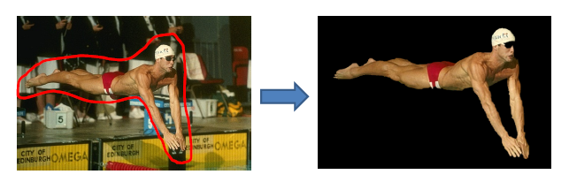
Today’s class
Review/Finish EM
MRFs
Segmentation with Graph Cuts
i
w_{ij}
j

Slide 4

Missing Data Problems: Segmentation
Challenge: Segment the image into figure and ground without knowing what the foreground looks like in advance.
Three subproblems:
If we had labels, how could we model the appearance of foreground and background? MLE: maximum likelihood estimation
Once we have modeled the fg/bg appearance, how do we compute the likelihood that a pixel is foreground? Probabilistic inference
How can we get both labels and appearance models at once? Hidden data problem: Expectation Maximization
Background
Foreground

Slide 5
EM: Mixture of Gaussians
Initialize parameters
Compute likelihood of hidden variables for current parameters
Estimate new parameters for each component, weighted by likelihood
Given by normal distribution

Slide 6
Gaussian Mixture Models: Practical Tips
Design decisions
  Number of components
    Select by hand based on knowledge of problem
    Select using cross-validation or sample data
    Usually, not too sensitive and safer to use more components
  Variance
    “Spherical covariance”: dimensions within each component are independent with equal variance (1 parameter but usually too restrictive)
    “Diagonal covariance”: dimensions within each component are not independent with difference variances (N parameters for N-D data)
    “Full covariance”: no assumptions (N*(N+1)/2 parameters); for high N might be expensive to do EM, to evaluate, and may overfit
    Typically use “Full” if lots of data, few dimensions; Use “Diagonal” otherwise
Can get stuck in local minima
  Use multiple restarts
  Choose solution with greatest data likelihood

Slide 7
“Hard EM”
Same as EM except compute z* as most likely values for hidden variables
K-means is an example
Advantages
  Simpler: can be applied when cannot derive EM
  Sometimes works better if you want to make hard predictions at the end
But
  Generally, pdf parameters are not as accurate as EM

Slide 8
EM Demo
GMM with images demos

Slide 9

What’s wrong with this prediction?
P(foreground | image)

Slide 10
Solution: encode dependencies between pixels
P(foreground | image)
Normalizing constant called “partition function”
Labels to be predicted
Individual predictions
Pairwise predictions

Slide 11
Writing Likelihood as an “Energy”
-log
Cost of assignment y_{i}
Cost of pairwise assignment y_{i ,}y_{j}

Slide 12
Notes on energy-based formulation
Primarily used when you only care about the most likely solution (not the confidences)
Can think of it as a general cost function
Can have larger “cliques” than 2
  Clique is the set of variables that go into a potential function

Slide 13
Markov Random Fields
Node y_{i}: pixel label
Edge: constrained pairs
Cost to assign a label to each pixel
Cost to assign a pair of labels to connected pixels

Slide 14
Markov Random Fields
Unary potential
Example: “label smoothing” grid
0: -logP(y_{i} = 0 | data)
1: -logP(y_{i} = 1 | data)
Pairwise Potential
0 1
0 0 K
1 K 0
K>0

Slide 15
Solving MRFs with graph cuts
Source (Label 0)
Cost to assign to 1
Cost to split nodes
Cost to assign to 0
Sink (Label 1)

Slide 16
Solving MRFs with graph cuts
Source (Label 0)
Cost to assign to 1
Cost to split nodes
Cost to assign to 0
Sink (Label 1)

Slide 17
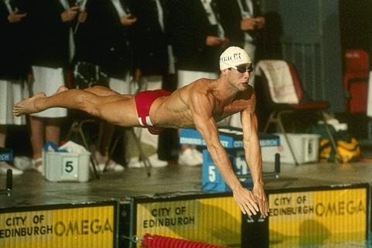
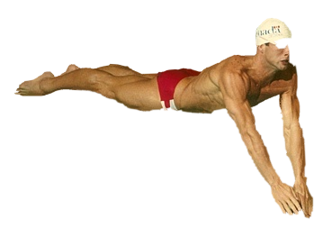
GrabCut segmentation
User provides rough indication of foreground region.
Goal: Automatically provide a pixel-level segmentation.

Slide 18
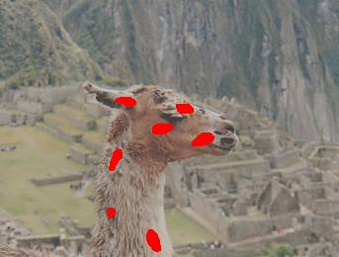
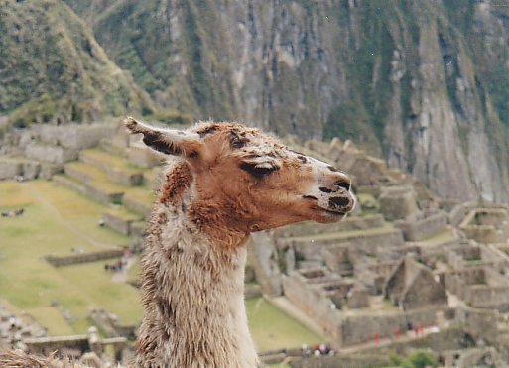
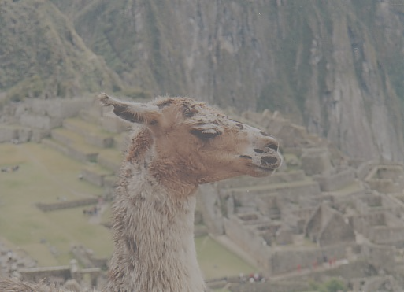
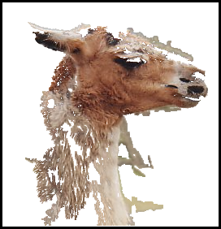
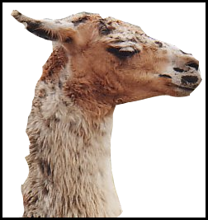
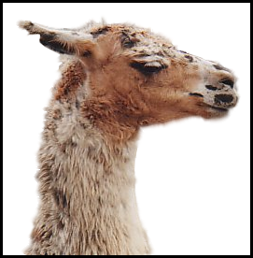
Grab cuts and graph cuts
Magic Wand
(198?)
Intelligent Scissors
Mortensen and Barrett (1995)
GrabCut
User
Input
Result
Regions
Boundary
Regions & Boundary
Source: Rother
Notes:
Basic idea is to combine the information which was used in the 2 well known tools: MW and IS.
MS select a region of similar colour according to your input. Fat pen and the boundary snapps to high contrast edges.
Grabcut combines it. And this allows us to simplify the user interface considerably by …

Slide 19
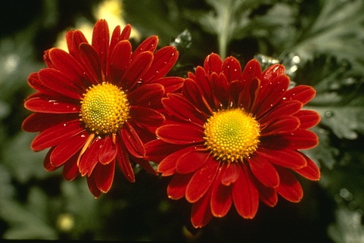
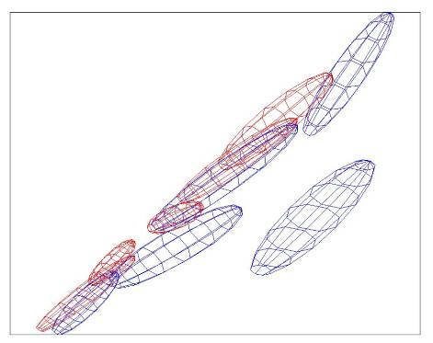
Color Model
R
Foreground &
Background
Background
G
Gaussian Mixture Model (typically 5-8 components)
Source: Rother
Notes:
Color enbergy.
Iterations have the effect of pulling them away;
D is – log likelyhood of the GMM.

Slide 20

Graph cuts
Boykov and Jolly (2001)
Foreground (source)
Image
Min Cut
Background
(sink)
Cut: separating source and sink; Energy: collection of edges
Min Cut: Global minimal energy in polynomial time
Source: Rother
Notes:
Optimization engine we use Graph Cuts. By now everybody should know what graph cut is. IN case you missed it here is a very brief introduction.
To image. 3D view. First task to construct a graph.
All pixels on a certain scanline. Just a few of them.
Next step introduce artificial nodes. fgd and background.
Edges – contrast. Boundary is quite likely between black and white.
Min Cut - Minimum edge strength.

Slide 21

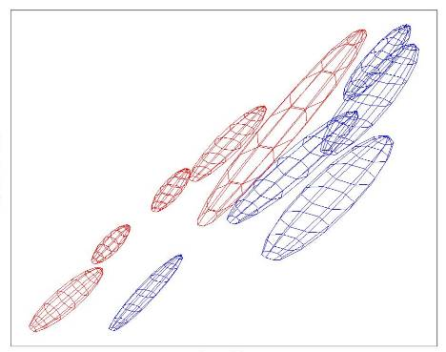
Color Model
R
R
Foreground &
Background
Iterated graph cut
Foreground
Background
G
Background
G
Gaussian Mixture Model (typically 5-8 components)
Source: Rother
Notes:
Color energy.
Iterations have the effect of pulling them away;
D is – log likelihood of the GMM.

Slide 22
GrabCut segmentation
Define graph
  usually 4-connected or 8-connected
    Divide diagonal potentials by sqrt(2)
Define unary potentials
  Color histogram or mixture of Gaussians for background and foreground
Define pairwise potentials
Apply graph cuts
Return to 2, using current labels to compute foreground, background models

Slide 23
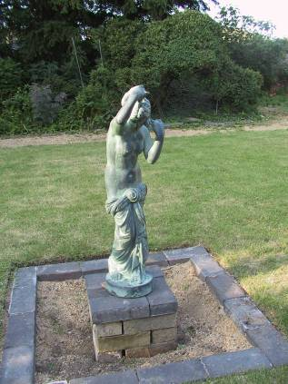
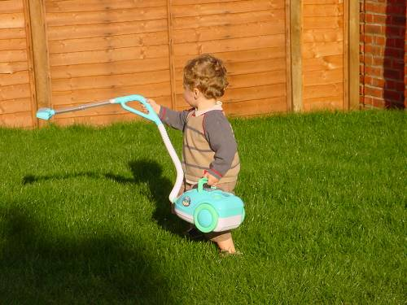
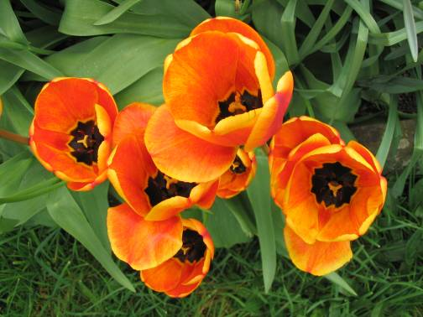
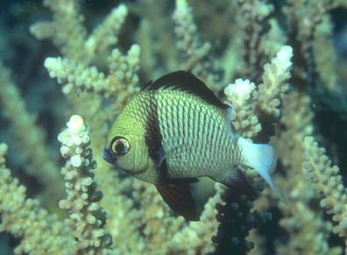
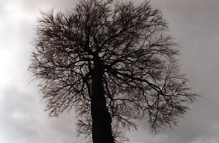
What is easy or hard about these cases for graphcut-based segmentation?

Slide 24
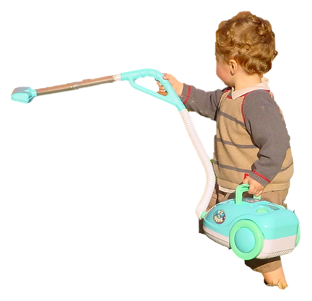
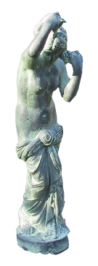


Easier examples
GrabCut – Interactive Foreground Extraction 10
Notes:
Moderately straightforward examples- after the user input automnatically

Slide 25
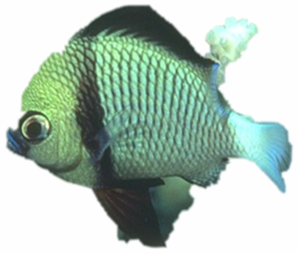

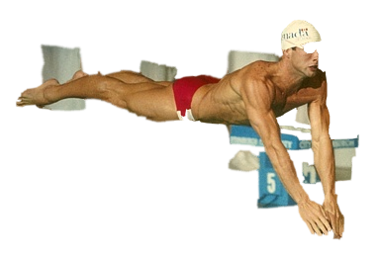
More difficult Examples
Camouflage &
Low Contrast
Fine structure
Harder Case
Initial Rectangle
Initial
Result
GrabCut – Interactive Foreground Extraction 11
Notes:
You might wonder when does it fail. 4 cases. Low contrats – an edge not good visible

Slide 26
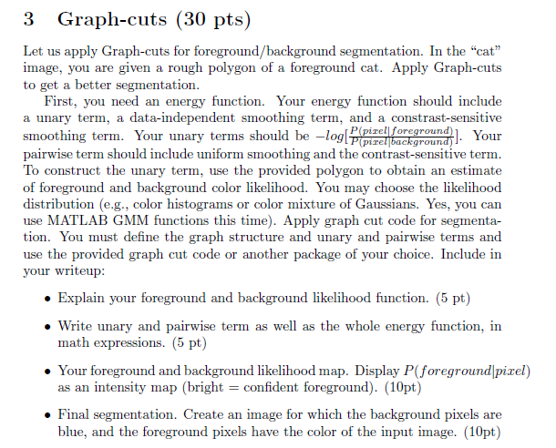
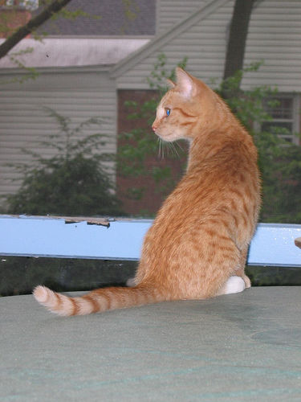
Notes
look at GraphCut.m in provided code (skip README) – if you have trouble using package get help from TA
Use poly2mask to convert the polygon to a foreground mask

Slide 27
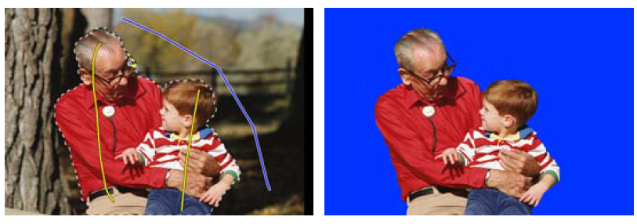
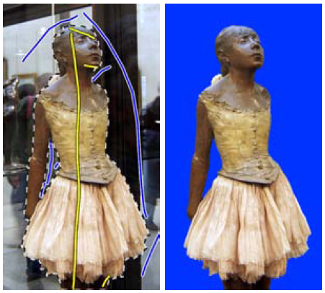
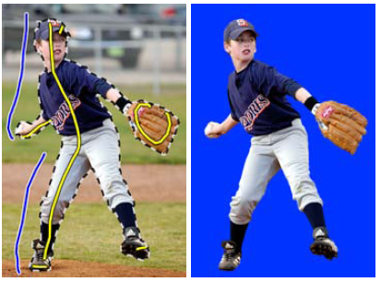
Lazy Snapping (Li et al. SG 2004)

Slide 28
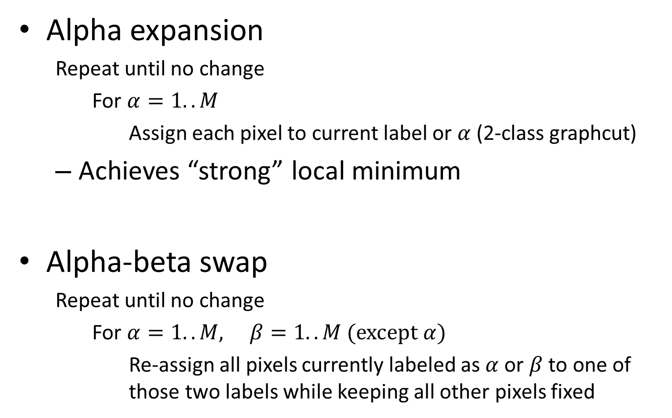
Graph cuts with multiple labels
Alpha expansion
  Repeat until no change
    For $α=1..M$
      Assign each pixel to current label or $α$ (2-class graphcut)
  Achieves “strong” local minimum
Alpha-beta swap
  Repeat until no change
    For $α=1..M, β=1..M (except α)$
      Re-assign all pixels currently labeled as $α$or $β$ to one of those two labels while keeping all other pixels fixed

Slide 29
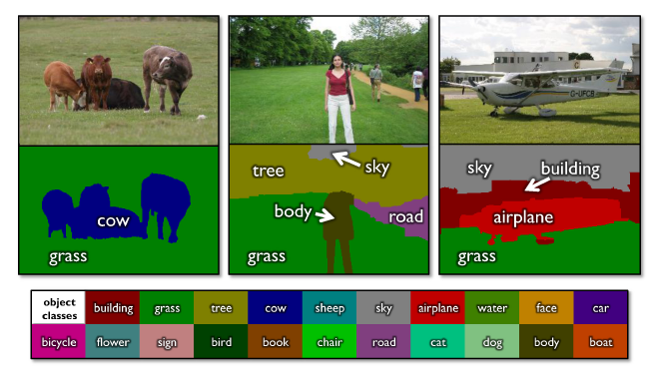
Using graph cuts for recognition
TextonBoost (Shotton et al. 2009 IJCV)

Slide 30
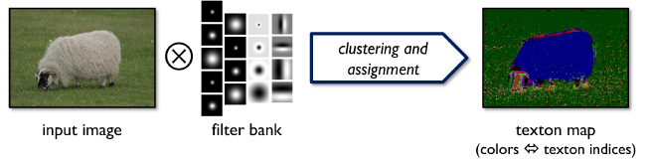
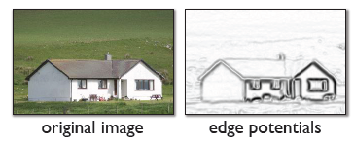
Using graph cuts for recognition
Unary Potentials
from classifier
(note: edge potentials are from input image also; this is illustration from paper)
Alpha Expansion Graph Cuts
TextonBoost (Shotton et al. 2009 IJCV)

Slide 31
Limitations of graph cuts
Associative: edge potentials penalize different labels
If not associative, can sometimes clip potentials
Graph cut algorithm applies to only 2-label problems
  Multi-label extensions are not globally optimal (but still usually provide very good solutions)
Must satisfy

Slide 32
Graph cuts: Pros and Cons
Pros
  Very fast inference
  Can incorporate data likelihoods and priors
  Applies to a wide range of problems (stereo, image labeling, recognition)
Cons
  Not always applicable (associative only)
  Need unary terms (not used for bottom-up segmentation, for example)
Use whenever applicable

Slide 33
More about MRFs/CRFs
Other common uses
  Graph structure on regions
  Encoding relations between multiple scene elements
Inference methods
  Loopy BP or BP-TRW
    Exact for tree-shaped structures
    Approximate solutions for general graphs
    More widely applicable and can produce marginals but often slower

Slide 34
Further reading and resources
Graph cuts
  http://www.cs.cornell.edu/~rdz/graphcuts.html
  Classic paper: What Energy Functions can be Minimized via Graph Cuts? (Kolmogorov and Zabih, ECCV '02/PAMI '04)
Belief propagation
  Yedidia, J.S.; Freeman, W.T.; Weiss, Y., "Understanding Belief Propagation and Its Generalizations”, Technical Report, 2001: http://www.merl.com/publications/TR2001-022/

Slide 35
Next section: Object Recognition
Face recognition
Categorization, classifiers, and features
CNNs and object category recognition
Tracking objects

