Slide 1
Structure from Motion
03/07/17
Computer Vision
CS 543 / ECE 549
University of Illinois
Derek Hoiem
Affine SfM slides adapted from Martial Hebert

Slide 2
This class: structure from motion
Incremental perspective structure from motion
Global affine structure from motion

Slide 3
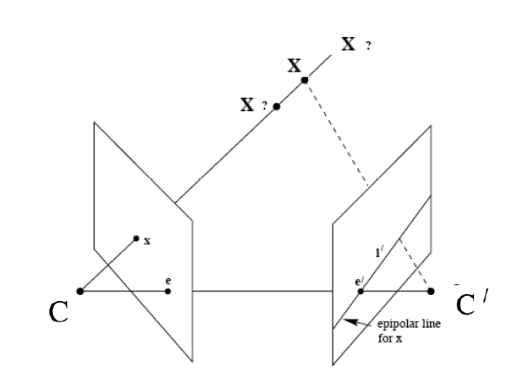
Last Class: Epipolar Geometry
Point x in left image corresponds to epipolar line l’ in right image
Epipolar line passes through the epipole (the intersection of the cameras’ baseline with the image plane

Slide 4



Last Class: Fundamental Matrix
Fundamental matrix maps from a point in one image to a line in the other
If x and x’ correspond to the same 3d point X:

Slide 5
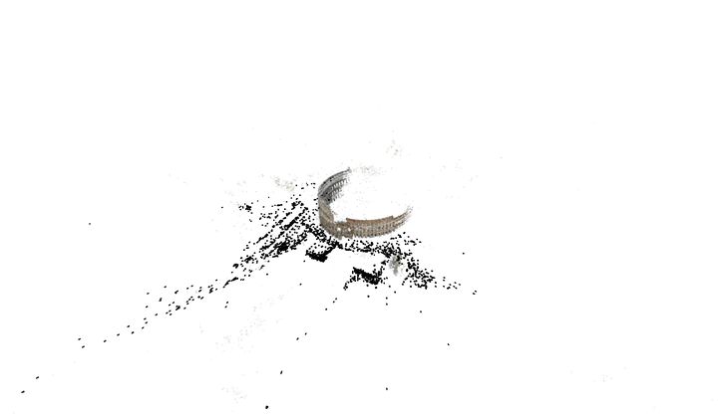
Incremental Structure from Motion (SfM)
Goal: Solve for camera poses and 3D points in scene

Slide 6
Incremental SfM
Compute features
Match images
Reconstruct
  Solve for pose and 3D points in two cameras
  Solve for pose of additional camera(s) that observe reconstructed 3D points
  Solve for new 3D points that are viewed in at least two cameras
  Bundle adjust to minimize reprojection error

Slide 7
Incremental SFM: detect features
Feature types: SIFT, ORB, Hessian-Laplacian, …
im 1
im 2
im 3
im n
…
Each circle represents a set of detected features

Slide 8
Incremental SFM: match features and images
For each pair of images:
Match feature descriptors via approximate nearest neighbor
Solve for F and find inlier feature correspondences
Speed tricks
  Match only 100 largest features first
  Use a bag-of-words method to find candidate matches
  Perform initial filtering based on GPS coordinates, if available
  Use known matches to predict new ones
…
Points of same color have been matched to each other

Slide 9
Incremental SFM: create tracks graph
…
…
im 1
im 2
im 3
im n
tracks graph: bipartite graph between observed 3D points and images

Slide 10
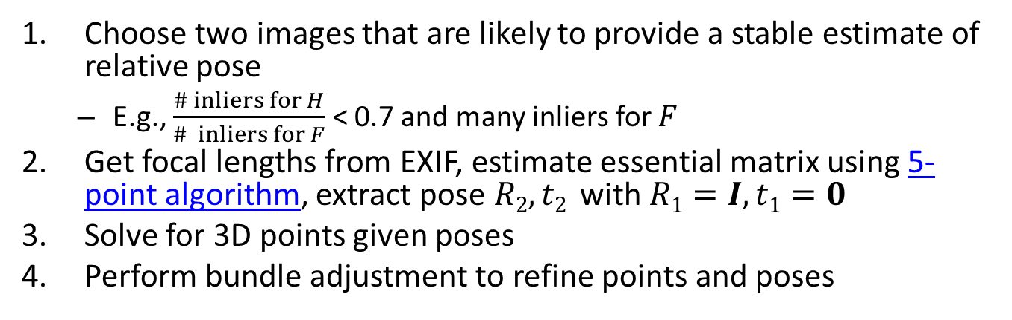
Incremental SFM: initialize reconstruction
Choose two images that are likely to provide a stable estimate of relative pose
  E.g., $\frac{\# inliers for H}{\# inliers for F}$ < 0.7 and many inliers for $F$
Get focal lengths from EXIF, estimate essential matrix using 5-point algorithm, extract pose $R2, t2$ with $R1=I, t1=0$
Solve for 3D points given poses
Perform bundle adjustment to refine points and poses
…
im 1
im 2
im 3
im n
filled circles = “triangulated” points
filled rectangles = “resectioned” images (solved pose)

Slide 11
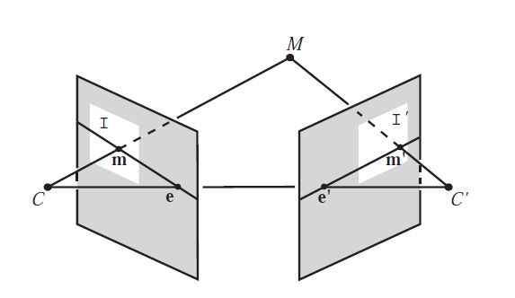
Triangulation: Linear Solution
Generally, rays C→x and C’→x’ will not exactly intersect
Can solve via SVD, finding a least squares solution to a system of equations
X
x
x'
Further reading: HZ p. 312-313

Slide 12
Triangulation: Linear Solution
Given P, P’, x, x’
Precondition points and projection matrices
Create matrix A
[U, S, V] = svd(A)
X = V(:, end)
Pros and Cons
Works for any number of corresponding images
Not projectively invariant
Code: http://www.robots.ox.ac.uk/~vgg/hzbook/code/vgg_multiview/vgg_X_from_xP_lin.m

Slide 13
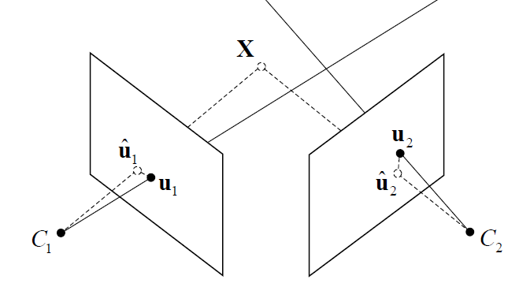
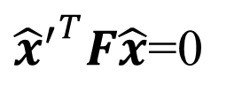




Triangulation: Non-linear Solution
Minimize projected error while satisfying
${{\hat{x}}^{′}}^{T}F\hat{x}$=0
$$cost\left(X\right)=dist{\left(x,\hat{x}\right)}^{2}+dist{\left(x′,\hat{x}′\right)}^{2}$$
$$x′$$
$$\hat{x}$$
$$x$$
$${\hat{x}}^{′}$$
Figure source: Robertson and Cipolla (Chpt 13 of Practical Image Processing and Computer Vision)

Slide 14
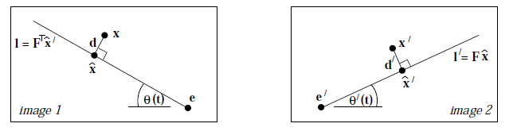

Triangulation: Non-linear Solution
Minimize projected error while satisfying
Solution is a 6-degree polynomial of t, minimizing
${{\hat{x}}^{′}}^{T}F\hat{x}$=0
$$cost\left(X\right)=dist{\left(x,\hat{x}\right)}^{2}+dist{\left(x′,\hat{x}′\right)}^{2}$$
Further reading: HZ p. 318

Slide 15
Bundle adjustment
Non-linear method for refining structure and motion
Minimizing reprojection error
X_{j}
P₁X_{j}
x_{1j}
x_{3j}
P₃X_{j}
P₂X_{j}
x_{2j}
P₁
P₃
P₂

Slide 16
Incremental SFM: grow reconstruction
Resection: solve pose for image(s) that have the most triangulated points
Triangulate: solve for any new points that have at least two cameras
Remove 3D points that are outliers
Bundle adjust
  For speed, only do full bundle adjust after some percent of new images are resectioned
Optionally, align with GPS from EXIF or ground control points (GCP)
…
im 1
im 2
im 3
im n
filled circles = “triangulated” points
filled rectangles = “resectioned” images (solved pose)

Slide 17
Incremental SFM: grow reconstruction
Resection: solve pose for image(s) that have the most triangulated points
Triangulate: solve for any new points that have at least two cameras
Remove 3D points that are outliers
Bundle adjust
  For speed, only do full bundle adjust after some percent of new images are resectioned
Optionally, align with GPS from EXIF or ground control points (GCP)
…
im 1
im 2
im 3
im n
filled circles = “triangulated” points
filled rectangles = “resectioned” images (solved pose)

Slide 18
Projective structure from motion
Given: m images of n fixed 3D points
x_{ij} = P_{i} X_{j} , i = 1,… , m, j = 1, … , n
Problem: estimate m projection matrices P_{i} and n 3D points X_{j} from the mn corresponding 2D points x_{ij}
X_{j}
x_{1j}
x_{3j}
x_{2j}
P₁
P₃
Slides from Lana Lazebnik
P₂

Slide 19
Projective structure from motion
Given: m images of n fixed 3D points
x_{ij} = P_{i} X_{j} , i = 1,… , m, j = 1, … , n
Problem: estimate m projection matrices P_{i} and n 3D points X_{j} from the mn corresponding points x_{ij}
With no calibration info, cameras and points can only be recovered up to a 4x4 projective transformation Q:
X → QX, P → PQ⁻¹
We can solve for structure and motion when
2mn >= 11m +3n – 15
For two cameras, at least 7 points are needed

Slide 20
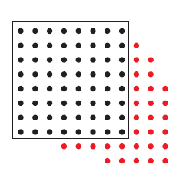
Sequential structure from motion
Initialize motion (calibration) from two images using fundamental matrix
Initialize structure by triangulation
For each additional view:
  Determine projection matrix of new camera using all the known 3D points that are visible in its image – calibration/resectioning
points
cameras

Slide 21
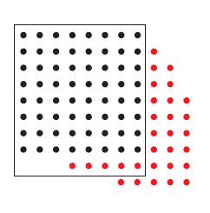
Sequential structure from motion
Initialize motion from two images using fundamental matrix
Initialize structure by triangulation
For each additional view:
  Determine projection matrix of new camera using all the known 3D points that are visible in its image – calibration
  Refine and extend structure: compute new 3D points,
  re-optimize existing points that are also seen by this camera – triangulation
points
cameras

Slide 22
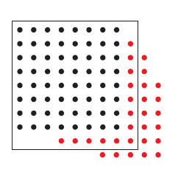
Sequential structure from motion
Initialize motion from two images using fundamental matrix
Initialize structure by triangulation
For each additional view:
  Determine projection matrix of new camera using all the known 3D points that are visible in its image – calibration
  Refine and extend structure: compute new 3D points, re-optimize existing points that are also seen by this camera – triangulation
Refine structure and motion: bundle adjustment
points
cameras

Slide 23
Auto-calibration
Auto-calibration: determining intrinsic camera parameters directly from uncalibrated images
For example, we can use the constraint that a moving camera has a fixed intrinsic matrix
  Compute initial projective reconstruction and find 3D projective transformation matrix Q such that all camera matrices are in the form P_{i} = K [R_{i} | t_{i}]
Can use constraints on the form of the calibration matrix, such as zero skew

Slide 24
Summary so far
From two images, we can:
  Recover fundamental matrix F
  Recover canonical cameras P and P’ from F
  Estimate 3D positions (if K is known) that correspond to each pixel
For a moving camera, we can:
  Initialize by computing F, P, X for two images
  Sequentially add new images, computing new P, refining X, and adding points
  Auto-calibrate assuming fixed calibration matrix to upgrade to similarity transform

Slide 25
Important recent papers and methods for SfM
OpenMVG
  https://github.com/openMVG/openMVG
  http://imagine.enpc.fr/~moulonp/publis/iccv2013/index.html (Moulin et al. ICCV 2013)
  Software has global and incremental methods
OpenSfM (software only): https://github.com/mapillary/OpenSfM
  Basis for my description of incremental SfM
Visual SfM: Visual SfM (Wu 2013)
  Used to be the best incremental SfM software (but not anymore and closed source); paper still very good
Reconstruction of Cornell (Crandall et al. ECCV 2011)

Slide 26
Multiview Stereo (MVS)
“Multiview Stereo: a tutorial” by Yasu Furukawa
http://www.cse.wustl.edu/~furukawa/papers/fnt_mvs.pdf
Software:
  MVE: https://github.com/simonfuhrmann/mve
Main ideas:
  Initialize with SfM
  MVS: For each image, find 2+ other images with similar viewpoints but substantial baselines
    Grow regions from sparse points in SfM
    Create a patch around each pixel and solve for depth, surface normal, and relative intensity that is consistent with all images

Slide 27
Surface Reconstruction
Floating scale surface reconstruction:
http://www.gcc.tu-darmstadt.de/home/proj/fssr/
Software:
  MVE: https://github.com/simonfuhrmann/mve
Main ideas:
  Initialize with MVS
  Merge 3D points from all depth images
  Estimate implicit surface function in octree and find zero crossings
Implicit Surface Example

Slide 28
Where does SfM fail?
Not enough images with enough overlap
  Disconnected reconstructions
Featureless or reflecting surfaces
  No matches or bad matches
Images with pure rotations
  Recovery of “F” can fail or bad pose reconstruction
Repeated structures (buildings or bridges)
  Many consistent bad matches results in inconsistent reconstructions

Slide 29
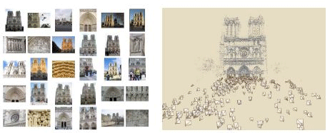
Photo synth
Noah Snavely, Steven M. Seitz, Richard Szeliski, "Photo tourism: Exploring photo collections in 3D," SIGGRAPH 2006
http://photosynth.net/

Slide 30
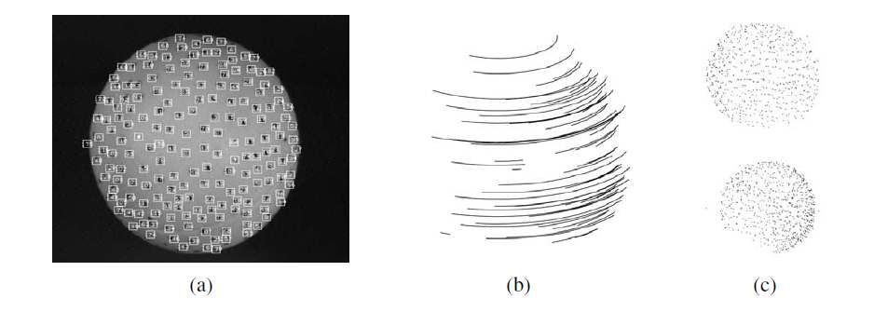
Structure from motion under orthographic projection
3D Reconstruction of a Rotating Ping-Pong Ball
Reasonable choice when
  Change in depth of points in scene is much smaller than distance to camera
  Cameras do not move towards or away from the scene
C. Tomasi and T. Kanade. Shape and motion from image streams under orthography:
A factorization method. IJCV, 9(2):137-154, November 1992.

Slide 31

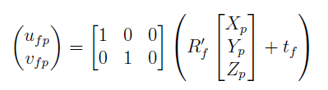
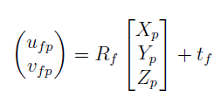

Orthographic projection for rotated/translated camera
x
a₂
a₁
X

Slide 32
Affine structure from motion
Affine projection is a linear mapping + translation in inhomogeneous coordinates
We are given corresponding 2D points (x) in several frames
We want to estimate the 3D points (X) and the affine parameters of each camera (A)
x
a₂
X
Projection of
world origin
a₁

Slide 33
Step 1: Simplify by getting rid of t: shift to centroid of points for each camera
2d normalized point
(observed)
3d normalized point
Linear (affine) mapping
Notes:
Makes our world coordinates at the center of the object

Slide 34
Suppose we know 3D points and affine camera parameters …
then, we can compute the observed 2d positions of each point
3D Points (3xn)
Camera Parameters (2mx3)
2D Image Points (2mxn)

Slide 35
Affine structure from motion
Centering: subtract the centroid of the image points
For simplicity, assume that the origin of the world coordinate system is at the centroid of the 3D points
After centering, each normalized point x_{ij} is related to the 3D point X_{i} by
Notes:
Center to get rid of the “b” in “x = AX + b”

Slide 36
Affine structure from motion
Given: m images of n fixed 3D points:
x_{ij} = A_{i} X_{j} + b_{i} , i = 1,… , m, j = 1, … , n
Problem: use the mn correspondences x_{ij} to estimate m projection matrices A_{i} and translation vectors b_{i},
and n points X_{j}
The reconstruction is defined up to an arbitrary affine transformation Q (12 degrees of freedom):
We have 2mn knowns and 8m + 3n unknowns (minus 12 dof for affine ambiguity)
Thus, we must have 2mn >= 8m + 3n – 12
For two views, we need four point correspondences

Slide 37
What if we instead observe corresponding 2d image points?
Can we recover the camera parameters and 3d points?
cameras (2 m)
points (n)
What rank is the matrix of 2D points?
Notes:
The measurement matrix D = MS must have rank 3!

Slide 38
Affine structure from motion
Let’s create a 2m × n data (measurement) matrix:
points (3 × n)
cameras
(2 m × 3)
The measurement matrix D = MS must have rank 3!
C. Tomasi and T. Kanade. Shape and motion from image streams under orthography:
A factorization method. IJCV, 9(2):137-154, November 1992.

Slide 39
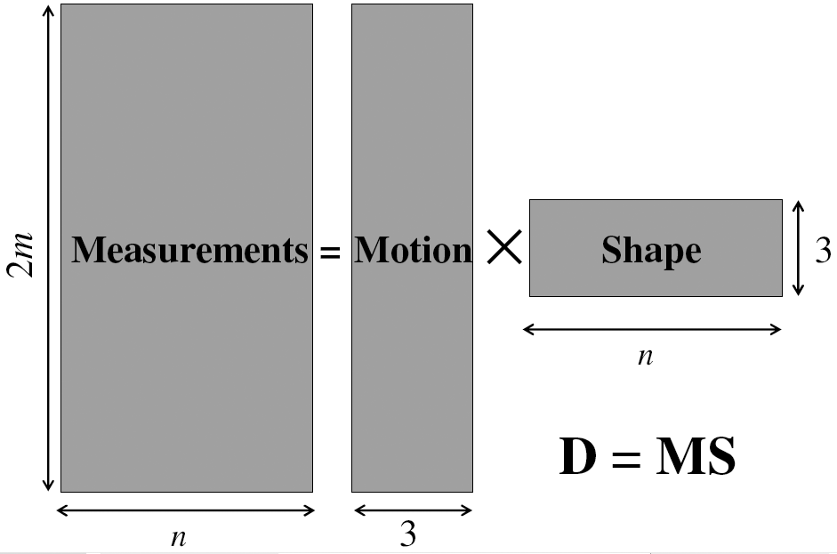
Factorizing the measurement matrix
AX
Source: M. Hebert

Slide 40
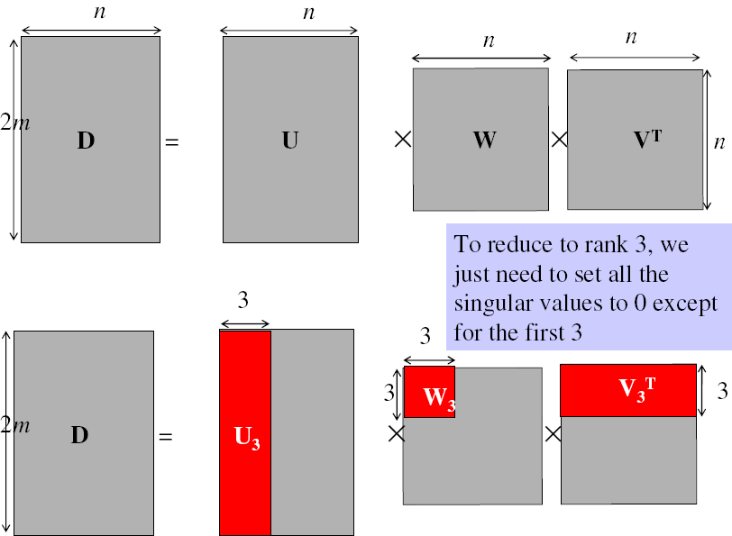
Factorizing the measurement matrix
Singular value decomposition of D:
Source: M. Hebert

Slide 41
Factorizing the measurement matrix
Singular value decomposition of D:
Source: M. Hebert

Slide 42
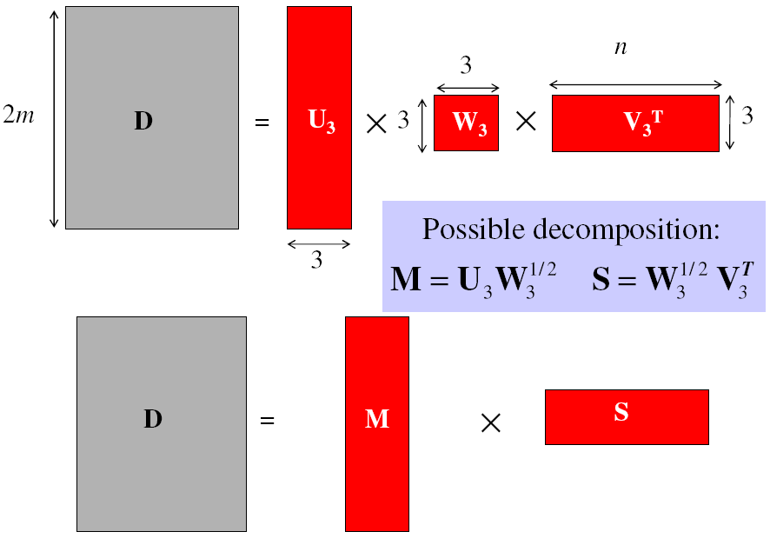
Factorizing the measurement matrix
Obtaining a factorization from SVD:
Source: M. Hebert

Slide 43
Factorizing the measurement matrix
Obtaining a factorization from SVD:
Source: M. Hebert

Slide 44
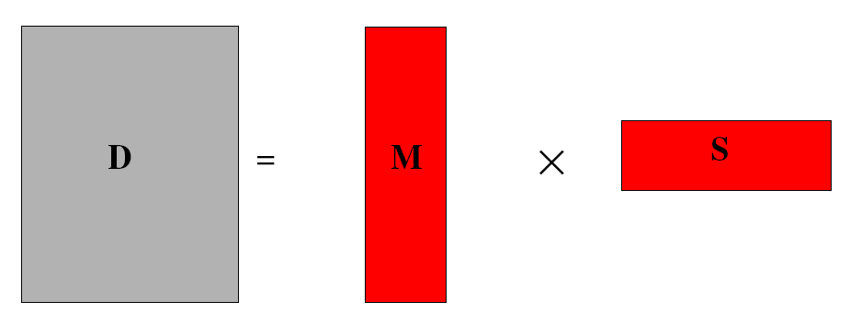
Affine ambiguity
The decomposition is not unique. We get the same D by using any 3×3 matrix C and applying the transformations A → AC, X →C⁻¹X
That is because we have only an affine transformation and we have not enforced any Euclidean constraints (like forcing the image axes to be perpendicular, for example)
Source: M. Hebert

Slide 45
Eliminating the affine ambiguity
Orthographic: image axes are perpendicular and of unit length
a₁ · a₂ = 0
x
|a₁|² = |a₂|² = 1
a₂
a₁
X
Source: M. Hebert

Slide 46
Solve for orthographic constraints
Solve for L = CC^{T}
Recover C from L by Cholesky decomposition: L = CC^{T}
Update A and X: A = AC, X = C⁻¹X
Three equations for each image i
where
~
~

Slide 47
Algorithm summary
Given: m images and n tracked features x_{ij}
For each image i, center the feature coordinates
Construct a 2m × n measurement matrix D:
  Column j contains the projection of point j in all views
  Row i contains one coordinate of the projections of all the n points in image i
Factorize D:
  Compute SVD: D = U W V^{T}
  Create U₃ by taking the first 3 columns of U
  Create V₃ by taking the first 3 columns of V
  Create W₃ by taking the upper left 3 × 3 block of W
Create the motion (affine) and shape (3D) matrices:
  A = U₃W₃^{½} and X = W₃^{½} V₃^{T}
Eliminate affine ambiguity
Source: M. Hebert

Slide 48
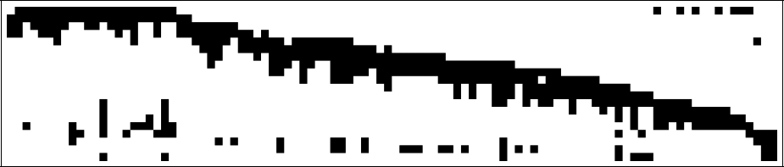
Dealing with missing data
So far, we have assumed that all points are visible in all views
In reality, the measurement matrix typically looks something like this:
One solution:
  solve using a dense submatrix of visible points
  Iteratively add new cameras
cameras
points

Slide 49
Reconstruction results (your HW 3.4)
C. Tomasi and T. Kanade. Shape and motion from image streams under orthography:
A factorization method. IJCV, 9(2):137-154, November 1992.

Slide 50
Further reading
Short explanation of Affine SfM: class notes from Lischinksi and Gruber
http://www.cs.huji.ac.il/~csip/sfm.pdf
Clear explanation of epipolar geometry and projective SfM
  http://mi.eng.cam.ac.uk/~cipolla/publications/contributionToEditedBook/2008-SFM-chapters.pdf

Slide 51
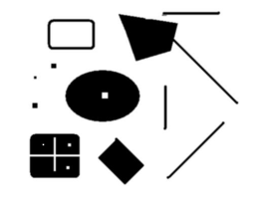
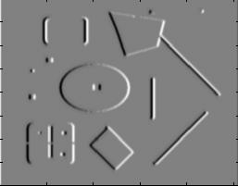
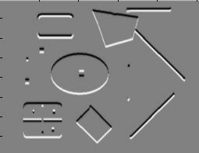
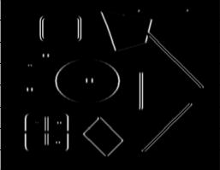
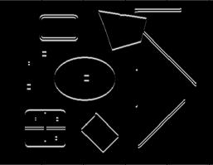
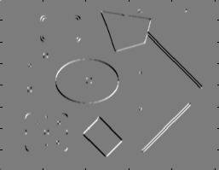
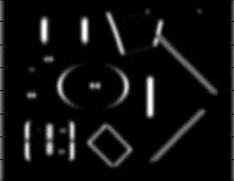
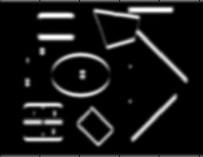
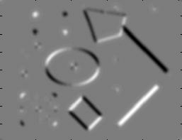
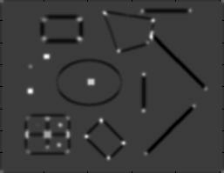
Review of Affine SfM from Interest Points
Detect interest points (e.g., Harris)
I_{x}
I_{y}
1. Image derivatives
I_{x}²
I_{y}²
I_{x}I_{y}
2. Square of derivatives
3. Gaussian
filter g(σ_{I})
g(I_{x}²)
g(I_{y}²)
g(I_{x}I_{y})
4. Cornerness function – both eigenvalues are strong
5. Non-maxima suppression
har

Slide 52
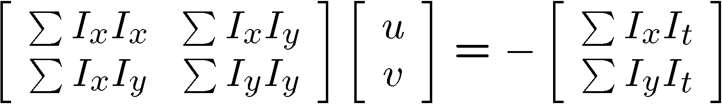
Review of Affine SfM from Interest Points
2. Correspondence via Lucas-Kanade tracking
Original (x,y) position
  Initialize (x’,y’) = (x,y)
  Compute (u,v) by
  Shift window by (u, v): x’=x’+u; y’=y’+v;
  Recalculate I_{t}
  Repeat steps 2-4 until small change
    Use interpolation for subpixel values
I_{t} = I(x’, y’, t+1) - I(x, y, t)
2nd moment matrix for feature patch in first image
displacement

Slide 53
Review of Affine SfM from Interest Points
3. Get Affine camera matrix and 3D points using Tomasi-Kanade factorization
Solve for orthographic constraints

Slide 54
HW 3: Problem 4 summary
Tips
  Helpful matlab functions: interp2, meshgrid, ordfilt2 (for getting local maximum), svd, chol
  When selecting interest points, must choose appropriate threshold on Harris criteria or the smaller eigenvalue, or choose top N points
  Vectorize to make tracking fast (interp2 will be the bottleneck)
  If you get stuck on one part, can use the included intermediate results
  Get tracking working on one point for a few frames before trying to get it working for all points
Extra optional problems
  Affine verification
  Missing track completion
  Optical flow
  Coarse-to-fine tracking

Slide 55
Tips for HW 3
Problem 1: vanishing points
  Use lots of lines to estimate vanishing points
  For estimation of VP from lots of lines, see single-view geometry chapter, or use robust estimator of a central intersection point
  For obtaining intrinsic camera matrix, numerical solver (e.g., fsolve in matlab) may be helpful
Problem 3: epipolar geometry
  Use reprojection distance for inlier check (make sure to compute line to point distance correctly)
Problem 4: structure from motion
  Use Matlab’s chol and svd
  If you weren’t able to get tracking to work from HW2 can use provided points

Slide 56
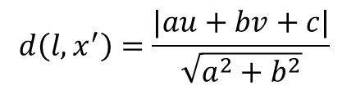
Distance of point to epipolar line
l=Fx=[a b c]
.
x
.
x‘=[u v 1]
$$d\left(l,x^{′}\right)=\frac{|au+bv+c|}{\sqrt{a^{2}+b^{2}}}$$

Slide 57
The Reading List
“A computer algorithm for reconstructing a scene from two images”, Longuet-Higgins, Nature 1981
“Shape and motion from image streams under orthography:
A factorization method.” C. Tomasi and T. Kanade, IJCV, 9(2):137-154, November 1992
“In defense of the eight-point algorithm”, Hartley, PAMI 1997
“An efficient solution to the five-point relative pose problem”, Nister, PAMI 2004
“Accurate, dense, and robust multiview stereopsis”, Furukawa and Ponce, CVPR 2007
“Photo tourism: exploring image collections in 3d”, ACM SIGGRAPH 2006
“Building Rome in a day”, Agarwal et al., ICCV 2009
(also see reading from earlier slides)

Slide 58
Next class
Clustering and using clustered interest points for matching images in a large database

