Slide 1
Photo Stitching Panoramas from Multiple Images
03/3/15
Computer Vision
CS 543 / ECE 549
University of Illinois
Derek Hoiem
Notes:
How does image stitching in a camera work?

Slide 2
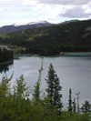
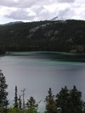
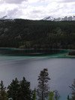
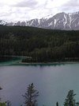
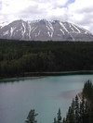
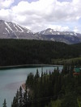
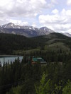
Image Stitching
Combine two or more overlapping images to make one larger image
Add example
Slide credit: Vaibhav Vaish

Slide 3
Concepts introduced/reviewed in today’s lecture
Camera model
Homographies
Solving homogeneous systems of linear equations
Keypoint-based alignment
RANSAC
Blending
How the iphone stitcher works

Slide 4
Photo stitching
P
Q
Camera Center

Slide 5
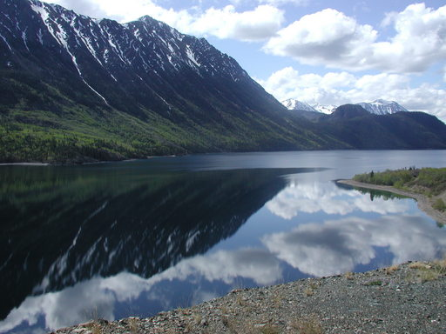
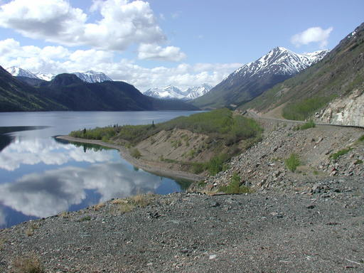
Illustration
Camera Center

Slide 6
Problem set-up
x = K [R t] X
x' = K' [R' t'] X
t=t'=0
x'=Hx where H = K' R' R⁻¹ K⁻¹
Typically only R and f will change (4 parameters), but, in general, H has 8 parameters
.
X
x
x'
f
f'

Slide 7
Homography
Definition
General mathematics:
homography = projective linear transformation
Vision (most common usage):
homography = linear transformation between two image planes
Examples
Project 3D surface into frontal view
Relate two views that differ only by rotation

Slide 8
Homography example: Image rectification
p’
p
To unwarp (rectify) an image solve for homography H given p and p’: wp’=Hp
Notes:
15 min

Slide 9
Image Stitching Algorithm Overview
Detect keypoints (e.g., SIFT)
Match keypoints (e.g., 1st/2nd NN < thresh)
Estimate homography with four matched keypoints (using RANSAC)
Combine images

Slide 10
Computing homography
Assume we have four matched points: How do we compute homography H?
Direct Linear Transformation (DLT)

Slide 11
Computing homography
Direct Linear Transform
Apply SVD: UDV^{T} = A
h = V_{smallest} (column of V corr. to smallest singular value)
Matlab
[U, S, V] = svd(A);
h = V(:, end);
Explanations of SVD and solving homogeneous linear systems
Notes:
SVD gives the homogeneous least squares solution constrained to have a norm of 1

Slide 12
Computing homography
Assume we have four matched points: How do we compute homography H?
Normalized DLT
Normalize coordinates for each image
Translate for zero mean
Scale so that average distance to origin is ~sqrt(2)
This makes problem better behaved numerically (see HZ p. 107-108)
Compute using DLT in normalized coordinates
Unnormalize:

Slide 13
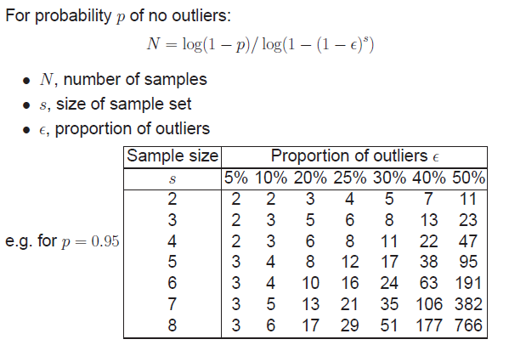
Computing homography
Assume we have matched points with outliers: How do we compute homography H?
Automatic Homography Estimation with RANSAC
Choose number of samples N
HZ Tutorial ‘99

Slide 14
Computing homography
Assume we have matched points with outliers: How do we compute homography H?
Automatic Homography Estimation with RANSAC
Choose number of samples N
Choose 4 random potential matches
Compute H using normalized DLT
Project points from x to x’ for each potentially matching pair:
Count points with projected distance < t
E.g., t = 3 pixels
Repeat steps 2-5 N times
Choose H with most inliers
HZ Tutorial ‘99

Slide 15
Automatic Image Stitching
Compute interest points on each image
Find candidate matches
Estimate homography H using matched points and RANSAC with normalized DLT
Project each image onto the same surface and blend
Matlab: maketform, imtransform

Slide 16
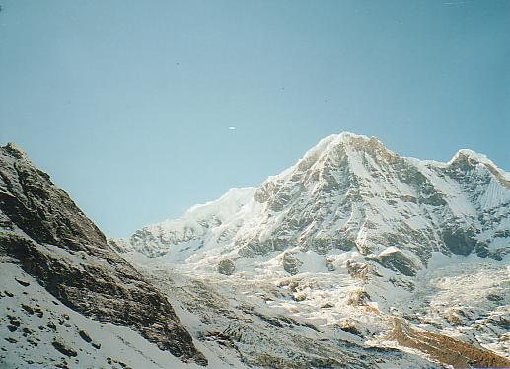
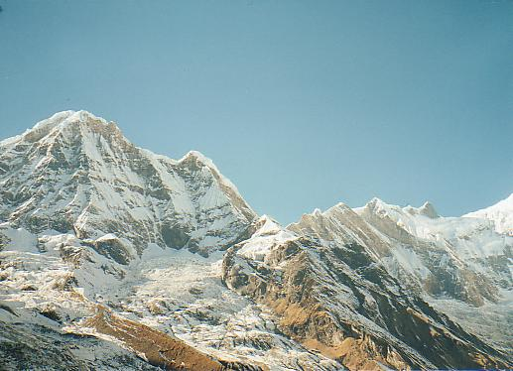
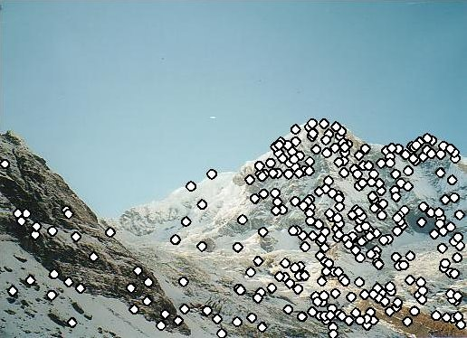
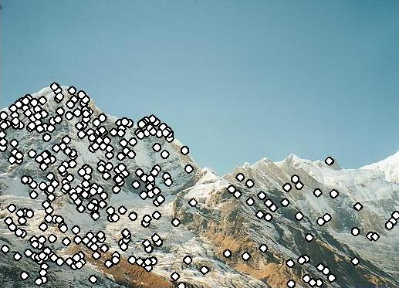
RANSAC for Homography
Initial Matched Points

Slide 17
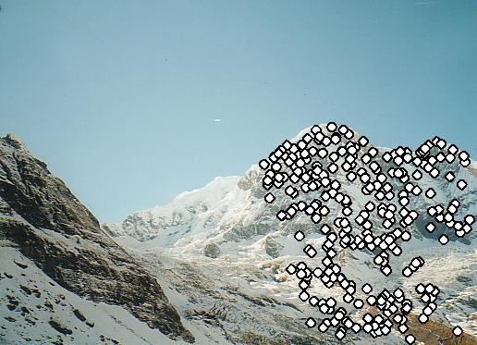
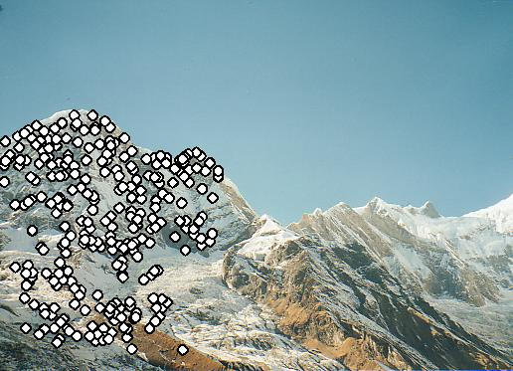
RANSAC for Homography
Final Matched Points

Slide 18
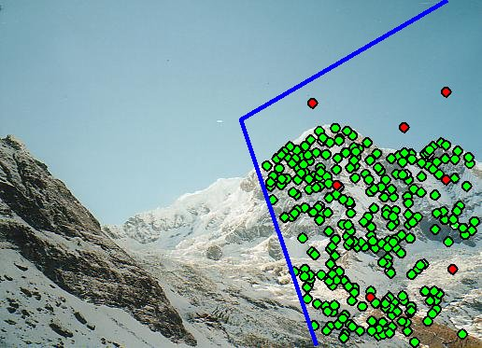
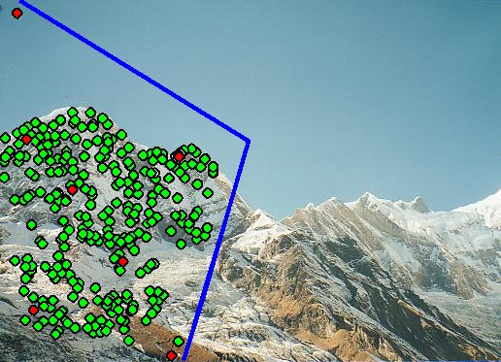
Verification

Slide 19
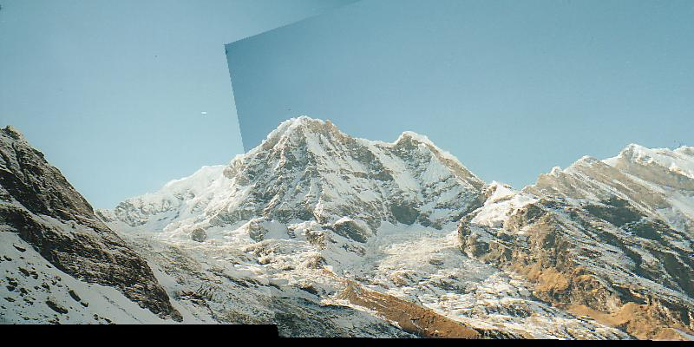
RANSAC for Homography

Slide 20
Choosing a Projection Surface
Many to choose: planar, cylindrical, spherical, cubic, etc.

Slide 21
Planar Mapping
x
x
f
f
For red image: pixels are already on the planar surface
For green image: map to first image plane

Slide 22
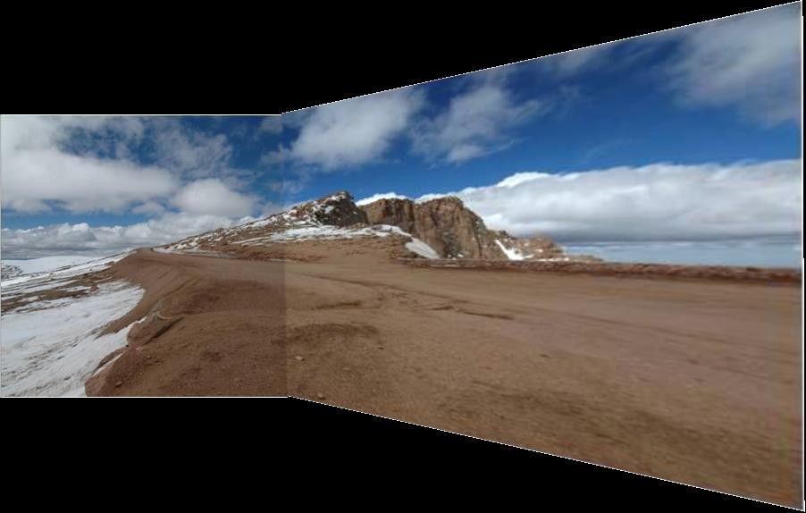
Planar Projection
Planar
Photos by Russ Hewett

Slide 23
Planar Projection
Planar

Slide 24
Cylindrical Mapping
x
x
f
f
For red image: compute h, theta on cylindrical surface from (u, v)
For green image: map to first image plane, than map to cylindrical surface

Slide 25
Cylindrical Projection
Cylindrical

Slide 26
Cylindrical Projection
Cylindrical

Slide 27
Planar
Cylindrical

Slide 28
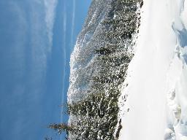
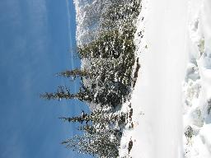
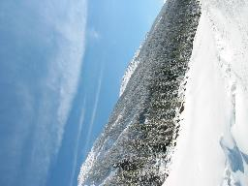
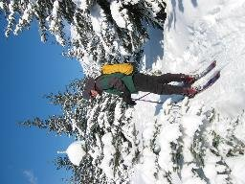
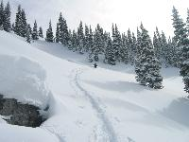
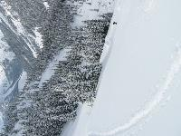
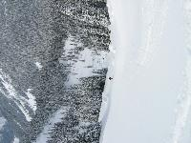
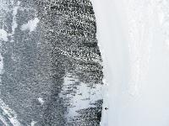
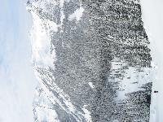
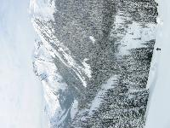
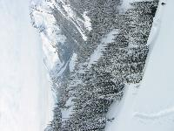
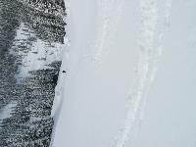
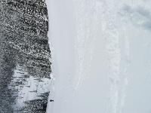
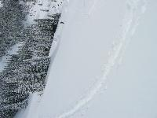
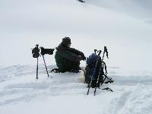
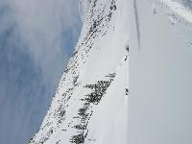
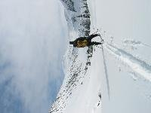
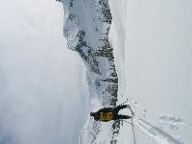
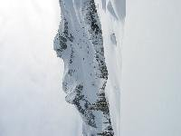
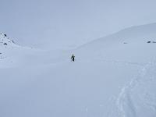
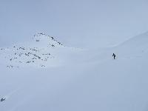
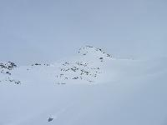
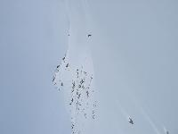
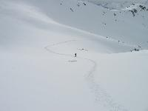
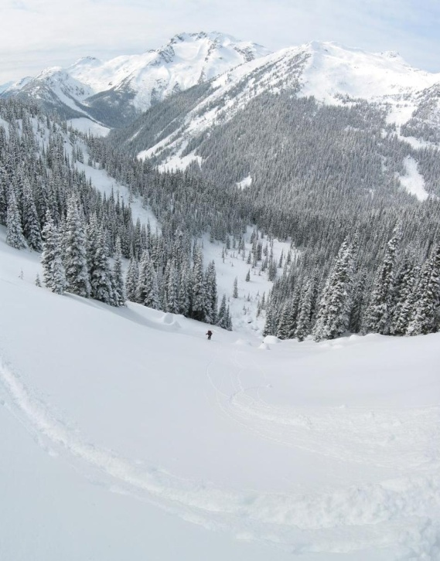
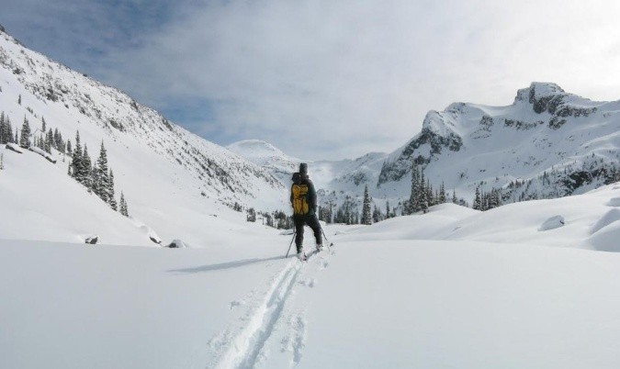
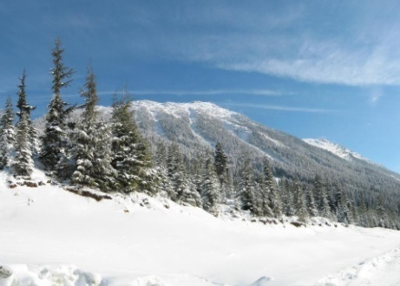
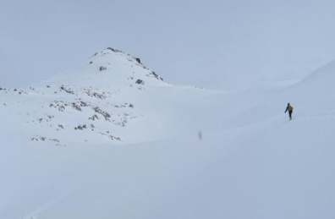
Recognizing Panoramas
Some of following material from Brown and Lowe 2003 talk
Brown and Lowe 2003, 2007

Slide 29
Recognizing Panoramas
Input: N images
Extract SIFT points, descriptors from all images
Find K-nearest neighbors for each point (K=4)
For each image
Select M candidate matching images by counting matched keypoints (m=6)
Solve homography H_{ij} for each matched image

Slide 30
Recognizing Panoramas
Input: N images
Extract SIFT points, descriptors from all images
Find K-nearest neighbors for each point (K=4)
For each image
Select M candidate matching images by counting matched keypoints (m=6)
Solve homography H_{ij} for each matched image
Decide if match is valid (n_{i} > 8 + 0.3 n_{f} )
# inliers
# keypoints in overlapping area

Slide 31
Recognizing Panoramas (cont.)
(now we have matched pairs of images)
Find connected components

Slide 32
Finding the panoramas

Slide 33
Finding the panoramas

Slide 34
Finding the panoramas

Slide 35
Recognizing Panoramas (cont.)
(now we have matched pairs of images)
Find connected components
For each connected component
Perform bundle adjustment to solve for rotation (θ₁, θ₂, θ₃) and focal length f of all cameras
Project to a surface (plane, cylinder, or sphere)
Render with multiband blending

Slide 36
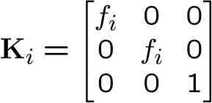
Bundle adjustment for stitching
Non-linear minimization of re-projection error
where H = K’ R’ R⁻¹ K⁻¹
Solve non-linear least squares (Levenberg-Marquardt algorithm)
See paper for details

Slide 37
Bundle Adjustment
New images initialised with rotation, focal length of best matching image

Slide 38
Bundle Adjustment
New images initialised with rotation, focal length of best matching image

Slide 39
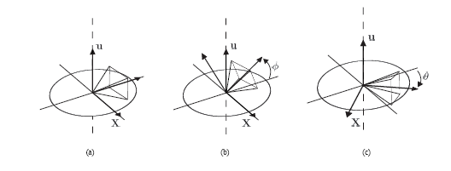
Straightening
Rectify images so that “up” is vertical

Slide 40
Details to make it look good
Choosing seams
Blending

Slide 41
Choosing seams
Easy method
Assign each pixel to image with nearest center
im1
im2
x
x
Image 2
Image 1

Slide 42
Choosing seams
Easy method
Assign each pixel to image with nearest center
Create a mask:
mask(y, x) = 1 iff pixel should come from im1
Smooth boundaries (called “feathering”):
mask_sm = imfilter(mask, gausfil);
Composite
imblend = im1_c.*mask + im2_c.*(1-mask);
im1
im2
x
x
Image 2
Image 1

Slide 43
Choosing seams
Better method: dynamic program to find seam along well-matched regions
Illustration: http://en.wikipedia.org/wiki/File:Rochester_NY.jpg

Slide 44
Gain compensation
Simple gain adjustment
Compute average RGB intensity of each image in overlapping region
Normalize intensities by ratio of averages

Slide 45
Multi-band Blending
Burt & Adelson 1983
Blend frequency bands over range ∝ λ

Slide 46
Multiband Blending with Laplacian Pyramid
At low frequencies, blend slowly
At high frequencies, blend quickly
1
0
1
0
1
0
Left pyramid
blend
Right pyramid

Slide 47
Multiband blending
Laplacian pyramids
Compute Laplacian pyramid of images and mask
Create blended image at each level of pyramid
Reconstruct complete image

Slide 48
Blending comparison (IJCV 2007)

Slide 49
Blending Comparison

Slide 50
Further reading
DLT algorithm: HZ p. 91 (alg 4.2), p. 585
Normalization: HZ p. 107-109 (alg 4.2)
RANSAC: HZ Sec 4.7, p. 123, alg 4.6
Rick Szeliski’s alignment/stitching tutorial
Recognising Panoramas: Brown and Lowe, IJCV 2007 (also bundle adjustment)

Slide 51
How does iphone panoramic stitching work?
Capture images at 30 fps
Stitch the central 1/8 of a selection of images
Select which images to stitch using the accelerometer and frame-to-frame matching
Faster and avoids radial distortion that often occurs towards corners of images
Alignment
Initially, perform cross-correlation of small patches aided by accelerometer to find good regions for matching
Register by matching points (KLT tracking or RANSAC with FAST (similar to SIFT) points) or correlational matching
Blending
Linear (or similar) blending, using a face detector to avoid blurring face regions and choose good face shots (not blinking, etc)
http://www.patentlyapple.com/patently-apple/2012/11/apples-cool-iphone-5-panorama-app-revealed-in-5-patents.html

Slide 52
Things to remember
Homography relates rotating cameras
Recover homography using RANSAC and normalized DLT
Bundle adjustment minimizes reprojection error for set of related images
Details to make it look nice (e.g., blending)

Slide 53
Next class
Stereo and epipolar geometry

