Slide 1
Alignment and Object Instance Recognition
02/16/17
Computer Vision
CS 543 / ECE 549
University of Illinois
Derek Hoiem

Slide 2
Today’s class
Fitting/Alignment (continued)
Object instance recognition
Example of alignment-based category recognition

Slide 3
Methods discussed last class
Global optimization / Search for parameters
  Least squares fit
  Robust least squares
  Iterative closest point (ICP)
Hypothesize and test
  Generalized Hough transform
  RANSAC

Slide 4
RANSAC
_{(RANdom SAmple Consensus) :}
Fischler & Bolles in ‘81.
Algorithm:
Sample (randomly) the number of points required to fit the model
Solve for model parameters using samples
Score by the fraction of inliers within a preset threshold of the model
Repeat 1-3 until the best model is found with high confidence
Notes:
Let me give you an intuition of what is going on. Suppose we have the standard line fitting problem in presence of outliers.
We can formulate this problem as follows: want to find the best partition of points in inlier set and outlier set such that…
The objective consists of adjusting the parameters of a model function so as to best fit a data set.
"best" is defined by a function f that needs to be minimized.
Such that the best parameter of fitting the line give rise to a residual error lower that delta
as when the sum, S, of squared residuals

Slide 5
RANSAC
Line fitting example
Algorithm:
Sample (randomly) the number of points required to fit the model (#=2)
Solve for model parameters using samples
Score by the fraction of inliers within a preset threshold of the model
Repeat 1-3 until the best model is found with high confidence
Illustration by Savarese
Notes:
Let me give you an intuition of what is going on. Suppose we have the standard line fitting problem in presence of outliers.
We can formulate this problem as follows: want to find the best partition of points in inlier set and outlier set such that…
The objective consists of adjusting the parameters of a model function so as to best fit a data set.
"best" is defined by a function f that needs to be minimized.
Such that the best parameter of fitting the line give rise to a residual error lower that delta
as when the sum, S, of squared residuals

Slide 6
RANSAC
Line fitting example
Algorithm:
Sample (randomly) the number of points required to fit the model (#=2)
Solve for model parameters using samples
Score by the fraction of inliers within a preset threshold of the model
Repeat 1-3 until the best model is found with high confidence
Notes:
Let me give you an intuition of what is going on. Suppose we have the standard line fitting problem in presence of outliers.
We can formulate this problem as follows: want to find the best partition of points in inlier set and outlier set such that…
The objective consists of adjusting the parameters of a model function so as to best fit a data set.
"best" is defined by a function f that needs to be minimized.
Such that the best parameter of fitting the line give rise to a residual error lower that delta
as when the sum, S, of squared residuals

Slide 7
RANSAC
Line fitting example
Algorithm:
Sample (randomly) the number of points required to fit the model (#=2)
Solve for model parameters using samples
Score by the fraction of inliers within a preset threshold of the model
Repeat 1-3 until the best model is found with high confidence
Notes:
Let me give you an intuition of what is going on. Suppose we have the standard line fitting problem in presence of outliers.
We can formulate this problem as follows: want to find the best partition of points in inlier set and outlier set such that…
The objective consists of adjusting the parameters of a model function so as to best fit a data set.
"best" is defined by a function f that needs to be minimized.
Such that the best parameter of fitting the line give rise to a residual error lower that delta
as when the sum, S, of squared residuals

Slide 8
RANSAC
Algorithm:
Sample (randomly) the number of points required to fit the model (#=2)
Solve for model parameters using samples
Score by the fraction of inliers within a preset threshold of the model
Repeat 1-3 until the best model is found with high confidence
Notes:
Let me give you an intuition of what is going on. Suppose we have the standard line fitting problem in presence of outliers.
We can formulate this problem as follows: want to find the best partition of points in inlier set and outlier set such that…
The objective consists of adjusting the parameters of a model function so as to best fit a data set.
"best" is defined by a function f that needs to be minimized.
Such that the best parameter of fitting the line give rise to a residual error lower that delta
as when the sum, S, of squared residuals

Slide 9
How to choose parameters?
Number of sampled points s
  Minimum number needed to fit the model
Number of samples N
  Choose N so that, with probability p, at least one random sample is free from outliers (e.g. p=0.99) (outlier ratio: e )
Distance threshold δ
  Choose δ so that a good point with noise is likely (e.g., prob=0.95) within threshold
  Zero-mean Gaussian noise with std. dev. σ: t²=3.84σ²
 | proportion of outliers e
s | 5% | 10% | 20% | 25% | 30% | 40% | 50%
2 | 2 | 3 | 5 | 6 | 7 | 11 | 17
3 | 3 | 4 | 7 | 9 | 11 | 19 | 35
4 | 3 | 5 | 9 | 13 | 17 | 34 | 72
5 | 4 | 6 | 12 | 17 | 26 | 57 | 146
6 | 4 | 7 | 16 | 24 | 37 | 97 | 293
7 | 4 | 8 | 20 | 33 | 54 | 163 | 588
8 | 5 | 9 | 26 | 44 | 78 | 272 | 1177
modified from M. Pollefeys

Slide 10
RANSAC conclusions
Good
Robust to outliers
Applicable for larger number of objective function parameters than Hough transform
Optimization parameters are easier to choose than Hough transform
Bad
Computational time grows quickly with fraction of outliers and number of parameters
Sensitive to noise (with high noise might not be able to estimate parameters from any sample)
Not as good for getting multiple fits (though one solution is to remove inliers after each fit and repeat)
Common applications
Computing a homography (e.g., image stitching)
Estimating fundamental matrix (relating two views)

Slide 11
Line Fitting Demo (Part 2)

Slide 12
Alignment
Alignment: find parameters of model that maps one set of points to another
Typically want to solve for a global transformation that accounts for most true correspondences
Difficulties
  Noise (typically 1-3 pixels)
  Outliers (often 30-50%)
  Many-to-one matches or multiple objects

Slide 13
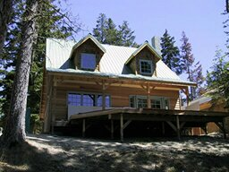
Parametric (global) warping
T
p = (x,y)
p’ = (x’,y’)
Transformation T is a coordinate-changing machine:
p’ = T(p)
What does it mean that T is global?
  Is the same for any point p
  can be described by just a few numbers (parameters)
For linear transformations, we can represent T as a matrix
p’ = Tp

Slide 14
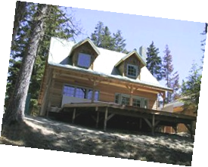
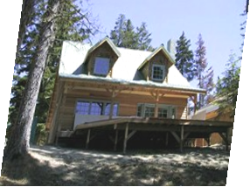
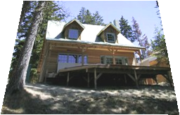
Common transformations
original
Transformed
translation
rotation
aspect
affine
perspective
Slide credit (next few slides): A. Efros and/or S. Seitz

Slide 15
Scaling
Scaling a coordinate means multiplying each of its components by a scalar
Uniform scaling means this scalar is the same for all components:
× 2

Slide 16
Scaling
Non-uniform scaling: different scalars per component:
X × 2,
Y × 0.5

Slide 17
Scaling
Scaling operation:
Or, in matrix form:
scaling matrix S

Slide 18
2-D Rotation
(x’, y’)
(x, y)
x’ = x cos(θ) - y sin(θ)
y’ = x sin(θ) + y cos(θ)
θ

Slide 19
2-D Rotation
Polar coordinates…
x = r cos (φ)
y = r sin (φ)
x’ = r cos (φ + θ)
y’ = r sin (φ + θ)
Trig Identity…
x’ = r cos(φ) cos(θ) – r sin(φ) sin(θ)
y’ = r sin(φ) cos(θ) + r cos(φ) sin(θ)
Substitute…
x’ = x cos(θ) - y sin(θ)
y’ = x sin(θ) + y cos(θ)
(x’, y’)
(x, y)
θ
φ

Slide 20
2-D Rotation
This is easy to capture in matrix form:
Even though sin(θ) and cos(θ) are nonlinear functions of θ,
  x’ is a linear combination of x and y
  y’ is a linear combination of x and y
What is the inverse transformation?
  Rotation by –θ
  For rotation matrices
R

Slide 21
Basic 2D transformations
Scale
Shear
Rotate
Translate
Affine is any combination of translation, scale, rotation, shear
Affine

Slide 22
Affine Transformations
Affine transformations are combinations of
  Linear transformations, and
  Translations
Properties of affine transformations:
  Lines map to lines
  Parallel lines remain parallel
  Ratios are preserved
  Closed under composition
or

Slide 23
Projective Transformations
Projective transformations are combos of
  Affine transformations, and
  Projective warps
Properties of projective transformations:
  Lines map to lines
  Parallel lines do not necessarily remain parallel
  Ratios are not preserved
  Closed under composition
  Models change of basis
  Projective matrix is defined up to a scale (8 DOF)

Slide 24
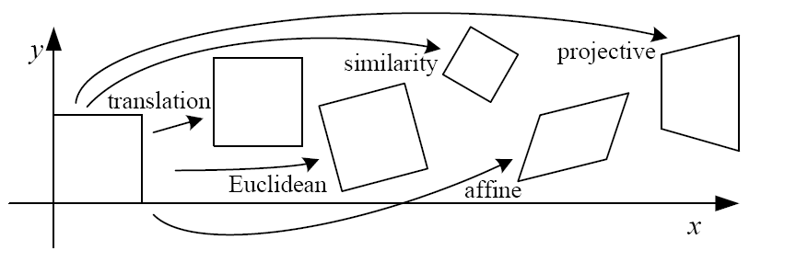
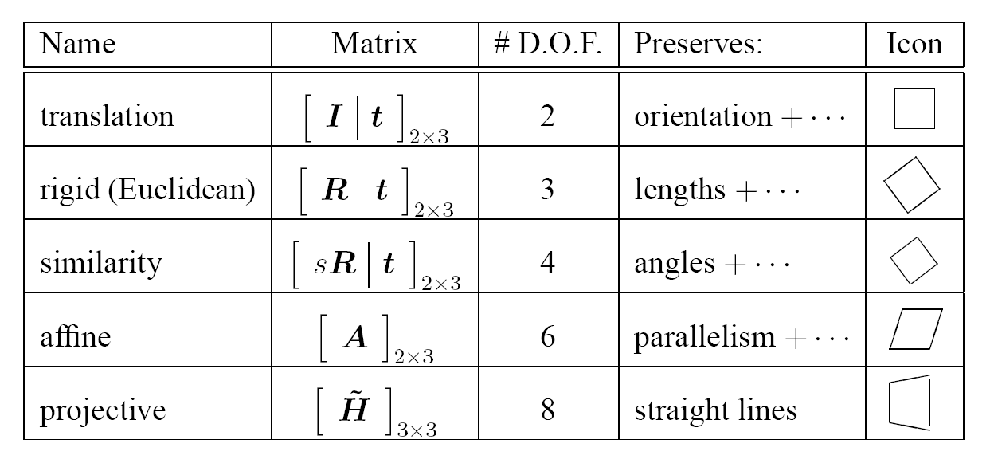
2D image transformations (reference table)

Slide 25

Example: solving for translation
A₁
A₂
A₃
B₁
B₂
B₃
Given matched points in {A} and {B}, estimate the translation of the object

Slide 26
Example: solving for translation
A₁
A₂
A₃
(t_{x}, t_{y})
B₁
B₂
B₃
Least squares solution
Write down objective function
Derived solution
  Compute derivative
  Compute solution
Computational solution
  Write in form Ax=b
  Solve using pseudo-inverse or eigenvalue decomposition

Slide 27
Example: solving for translation
A₁
A₅
B₄
A₂
A₃
(t_{x}, t_{y})
B₁
A₄
B₂
B₃
B₅
Problem: outliers
RANSAC solution
Sample a set of matching points (1 pair)
Solve for transformation parameters
Score parameters with number of inliers
Repeat steps 1-3 N times

Slide 28
Example: solving for translation
B₄
A₁
B₅
B₆
A₂
A₃
(t_{x}, t_{y})
B₁
A₄
B₂
B₃
A₅
A₆
Problem: outliers, multiple objects, and/or many-to-one matches
Hough transform solution
Initialize a grid of parameter values
Each matched pair casts a vote for consistent values
Find the parameters with the most votes
Solve using least squares with inliers

Slide 29
Example: solving for translation
(t_{x}, t_{y})
Problem: no initial guesses for correspondence

Slide 30
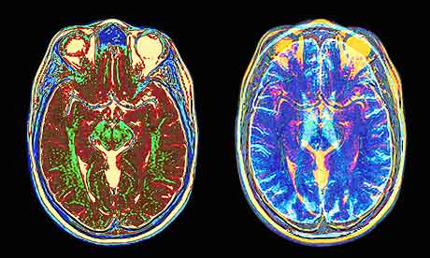
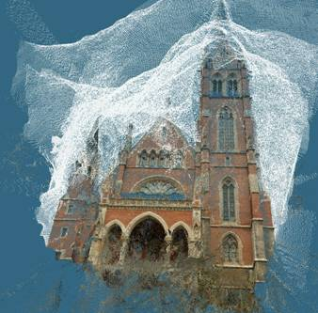
What if you want to align but have no prior matched pairs?
Hough transform and RANSAC not applicable
Important applications
Medical imaging: match brain scans or contours
Robotics: match point clouds

Slide 31
Iterative Closest Points (ICP) Algorithm
Goal: estimate transform between two dense sets of points (from {Set 1} to {Set 2})
Initialize transformation (e.g., compute difference in means and scale)
Assign each point in {Set 1} to its nearest neighbor in {Set 2}
Estimate transformation parameters
  e.g., least squares or robust least squares
Transform the points in {Set 1} using estimated parameters
Repeat steps 2-4 until change is very small

Slide 32
Example: solving for translation
(t_{x}, t_{y})
Problem: no initial guesses for correspondence
ICP solution
Find nearest neighbors for each point
Compute transform using matches
Move points using transform
Repeat steps 1-3 until convergence

Slide 33
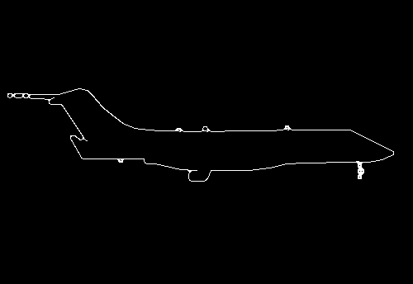
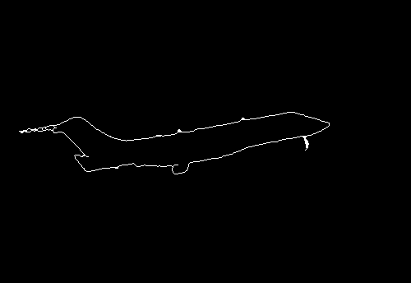

Example: aligning boundaries
Extract edge pixels $p1..pn$ and $q1..qm$
Compute initial transformation (e.g., compute translation and scaling by center of mass, variance within each image)
Get nearest neighbors: for each point $pi$ find corresponding $match(i)=\underset{j}{argmin}{dist(pi,qj)}$
Compute transformation T based on matches
Warp points p according to T
Repeat 3-5 until convergence
p
q

Slide 34
ICP: Good and Bad
Good
  Very simple
  Does not require correspondences
Bad
  May require dense points (so that there are good matches across sets)
  Subject to local minima from initialization, though there are methods to address this (see below) http://www.cv-foundation.org/openaccess/content_iccv_2013/papers/Yang_Go-ICP_Solving_3D_2013_ICCV_paper.pdf
Fig from paper linked below

Slide 35
Algorithm Summary
Least Squares Fit
  closed form solution
  robust to noise
  not robust to outliers
Robust Least Squares
  improves robustness to noise
  requires iterative optimization
Hough transform
  robust to noise and outliers
  can fit multiple models
  only works for a few parameters (1-4 typically)
RANSAC
  robust to noise and outliers
  works with a moderate number of parameters (e.g, 1-8)
Iterative Closest Point (ICP)
  For local alignment only: does not require initial correspondences

Slide 36

Object Instance Recognition
Match keypoints to object model
Solve for affine transformation parameters
Score by inliers and choose solutions with score above threshold
A₁
B₃
A₃
A₂
Matched keypoints
B₁
B₂
Affine Parameters
This Class
# Inliers
Choose hypothesis with max score above threshold

Slide 37


Overview of Keypoint Matching
1. Find a set of
distinctive key-
points
A₁
B₃
2. Define a region
around each
keypoint
A₂
A₃
B₁
B₂
3. Extract and
normalize the
region content
4. Compute a local
descriptor from the
normalized region
N pixels
e.g. color
e.g. color
N pixels
5. Match local
descriptors

Slide 38
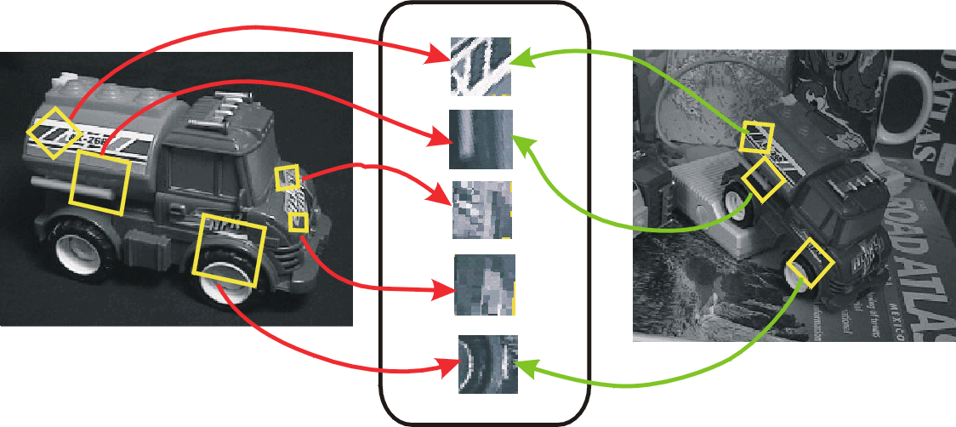
Keypoint-based instance recognition
Given two images and their keypoints (position, scale, orientation, descriptor)
Goal: Verify if they belong to a consistent configuration
Local Features,
e.g. SIFT
Slide credit: David Lowe

Slide 39
Finding the objects (overview)
Input Image
Stored Image
Match interest points from input image to database image
Matched points vote for rough position/orientation/scale of object
Find position/orientation/scales that have at least three votes
Compute affine registration and matches using iterative least squares with outlier check
Report object if there are at least T matched points

Slide 40
Matching Keypoints
Want to match keypoints between:
  Query image
  Stored image containing the object
Given descriptor x₀, find two nearest neighbors x₁, x₂ with distances d₁, d₂
x₁ matches x₀ if d₁/d₂ < 0.7
  This gets rid of 90% false matches, 5% of true matches in Lowe’s study

Slide 41
Affine Object Model
Accounts for 3D rotation of a surface under orthographic projection

Slide 42

Affine Object Model
What is the minimum number of matched points that we need?

Slide 43
Finding the objects (in detail)
Match interest points from input image to database image
Get location/scale/orientation using Hough voting
  In training, each point has known position/scale/orientation wrt whole object
  Matched points vote for the position, scale, and orientation of the entire object
  Bins for x, y, scale, orientation
    Wide bins (0.25 object length in position, 2x scale, 30 degrees orientation)
    Vote for two closest bin centers in each direction (16 votes total)
Geometric verification
  For each bin with at least 3 keypoints
  Iterate between least squares fit and checking for inliers and outliers
Report object if > T inliers (T is typically 3, can be computed to match some probabilistic threshold)

Slide 44
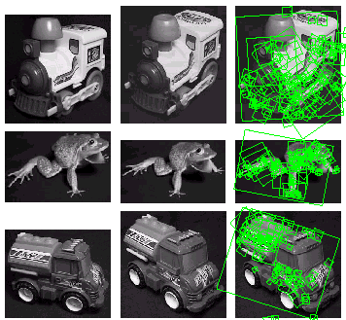
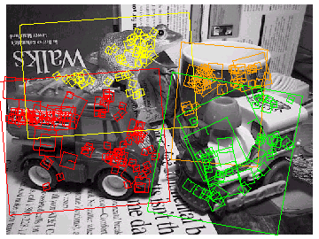
Examples of recognized objects

Slide 45
View interpolation
Training
  Given images of different viewpoints
  Cluster similar viewpoints using feature matches
  Link features in adjacent views
Recognition
  Feature matches may be
  spread over several
  training viewpoints
  ⇒ Use the known links to “transfer votes” to other viewpoints
[Lowe01]
Slide credit: David Lowe

Slide 46
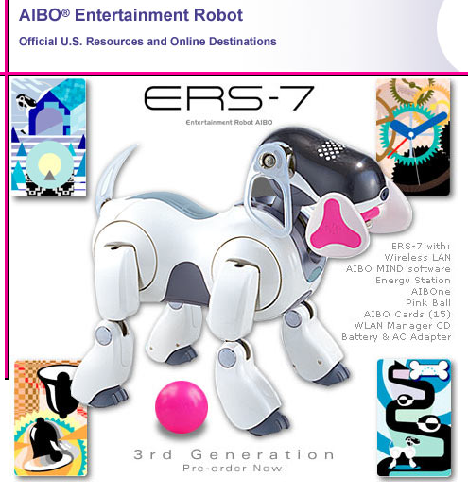
Applications
Sony Aibo
(Evolution Robotics)
SIFT usage
  Recognize
  docking station
  Communicate
  with visual cards
Other uses
  Place recognition
  Loop closure in SLAM
Slide credit: David Lowe

Slide 47
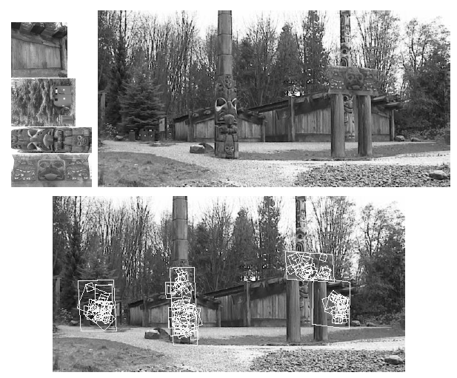
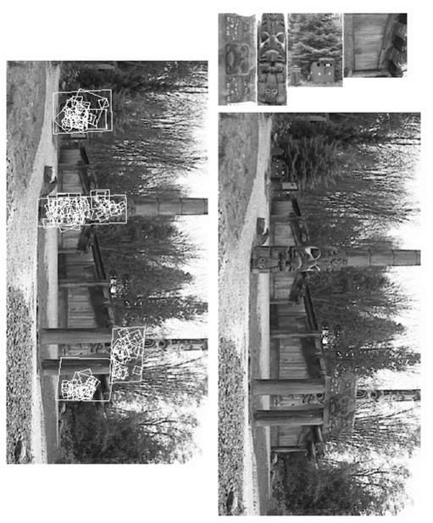
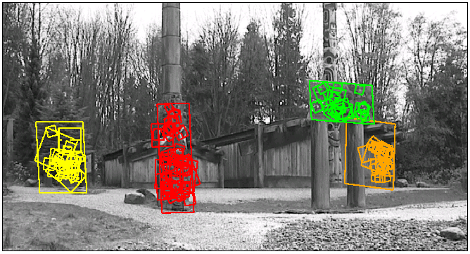
Location Recognition
Training
[Lowe04]
Slide credit: David Lowe

Slide 48
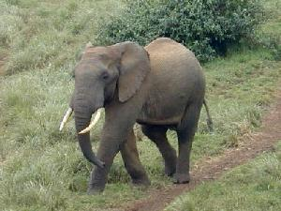
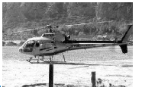
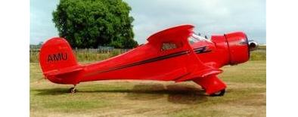
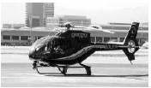
Another application: category recognition
Goal: identify what type of object is in the image
Approach: align to known objects and choose category with best match
?
“Shape matching and object recognition using low distortion correspondence”, Berg et al., CVPR 2005: http://www.cnbc.cmu.edu/cns/papers/berg-cvpr05.pdf

Slide 49
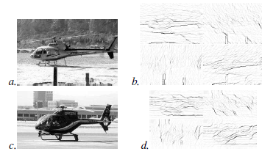
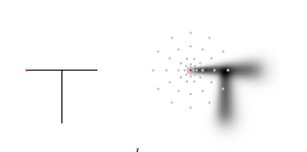
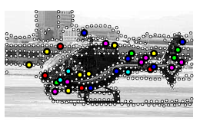
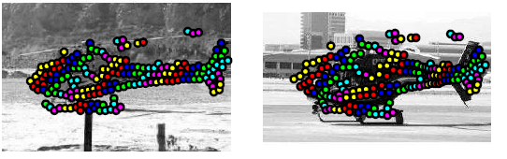
Summary of algorithm
Input: query q and exemplar e
For each: sample edge points and create “geometric blur” descriptor
Compute match cost c to match points in q to each point in e
Compute deformation cost H that penalizes change in orientation and scale for pairs of matched points
Solve a binary quadratic program to get correspondence that minimizes c and H, using thin-plate spline deformation
Record total cost for e, repeat for all exemplars, choose exemplar with minimum cost
Input, Edge Maps
Geometric Blur
Feature Points
Correspondences

Slide 50
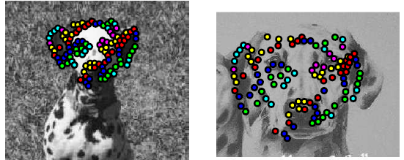
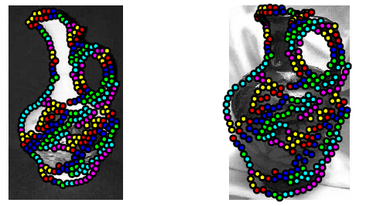
Examples of Matches

Slide 51
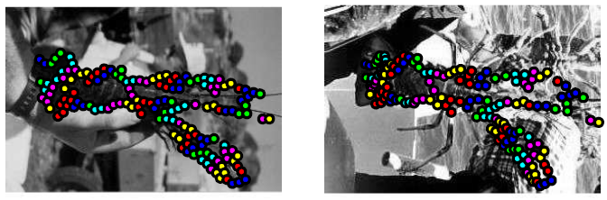
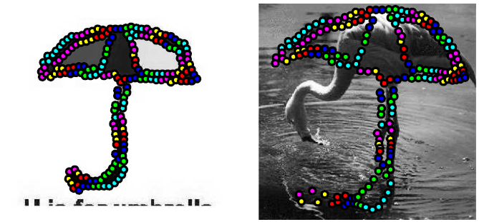
Examples of Matches

Slide 52
Other ideas worth being aware of
Thin-plate splines: combines global affine warp with smooth local deformation
Robust non-rigid point matching: http://noodle.med.yale.edu/~chui/tps-rpm.html (includes code, demo, paper)

Slide 53
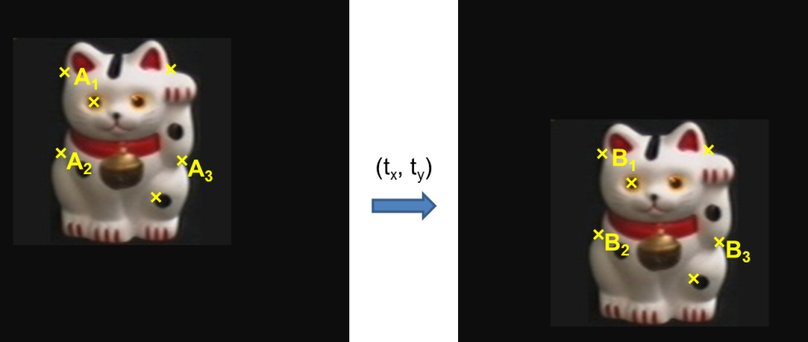
Key concepts
Alignment
  Hough transform
  RANSAC
  ICP
Object instance recognition
  Find keypoints, compute descriptors
  Match descriptors
  Vote for / fit affine parameters
  Return object if # inliers > T

