Slide 1
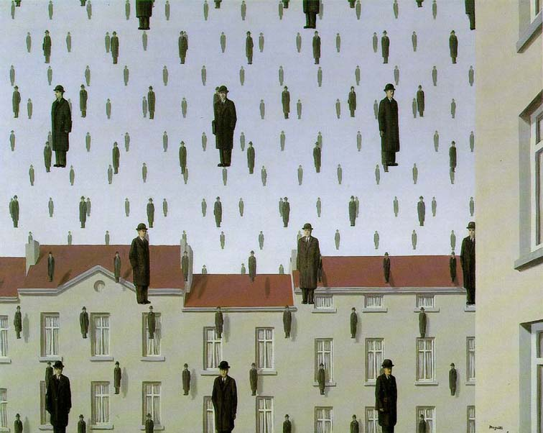
Templates, Image Pyramids, and Filter Banks
01/31/17
Computer Vision
Derek Hoiem, University of Illinois

Slide 2
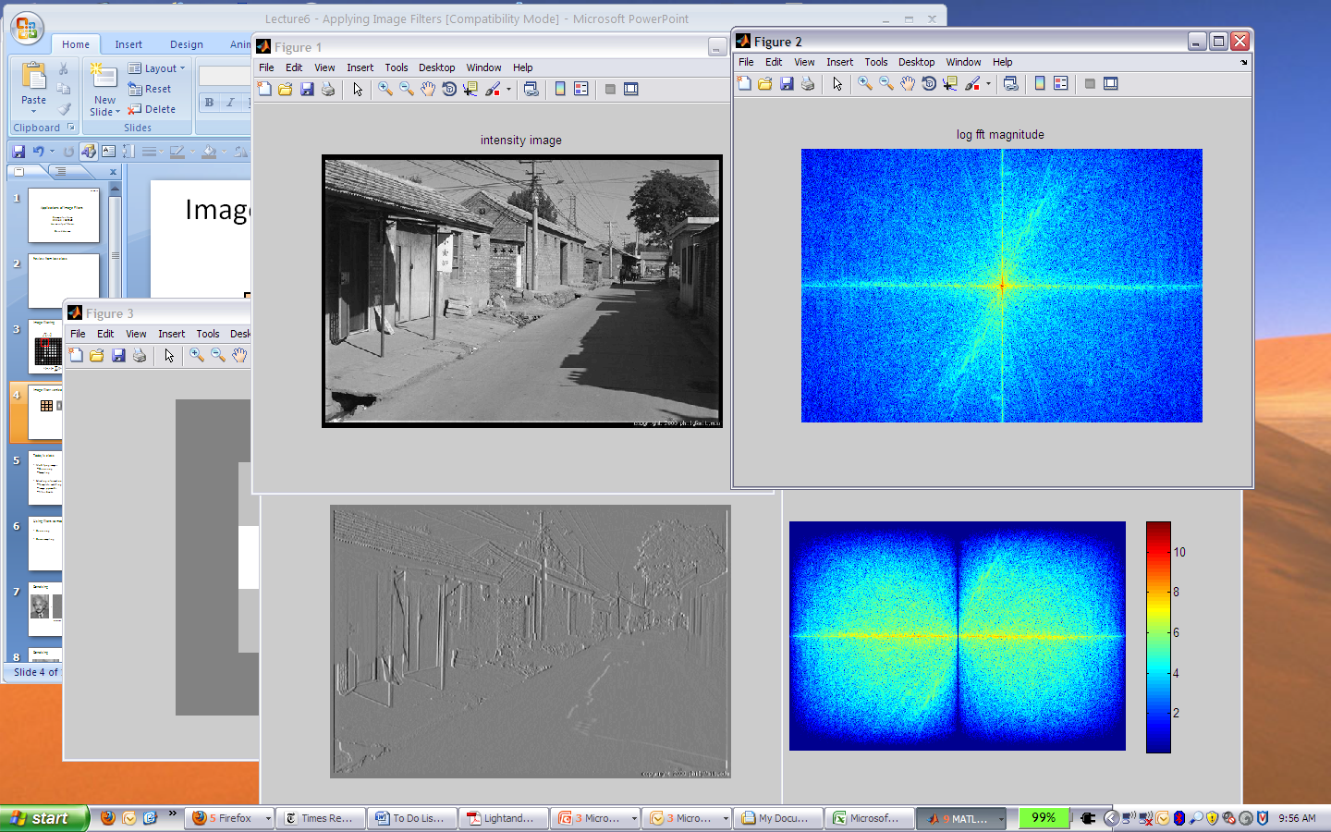
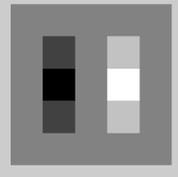
Review: filtering in spatial domain
1
0
-1
2
0
-2
1
0
-1
*
=

Slide 3
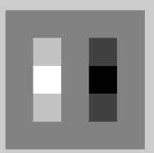

Review: filtering in frequency domain
FFT
FFT
=
Inverse FFT

Slide 4
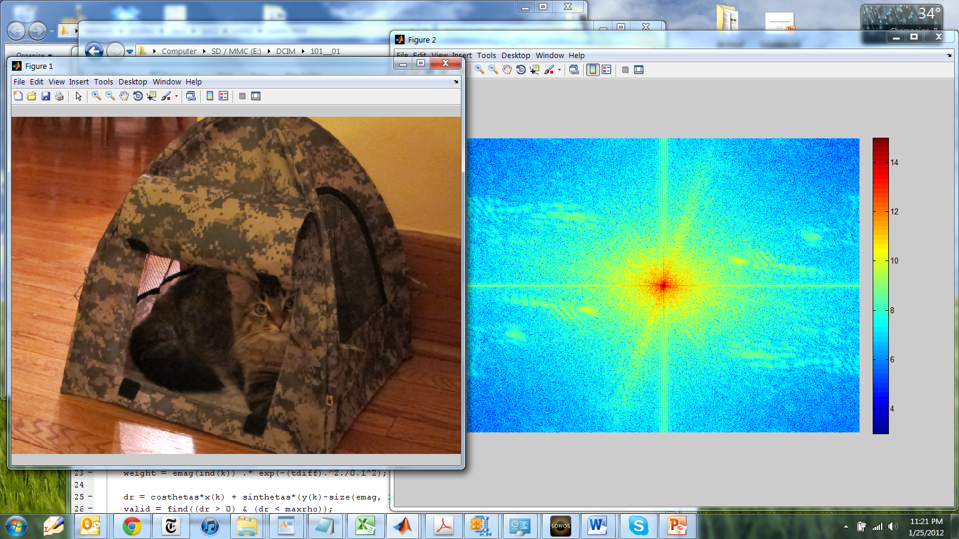
Review
Strong Vertical Frequency
(Sharp Horizontal Edge)
Diagonal Frequencies
Strong Horz. Frequency
(Sharp Vert. Edge)
Log Magnitude
Low Frequencies

Slide 5
Today’s class
Template matching
Image Pyramids
Filter banks and texture
Denoising, Compression

Slide 6
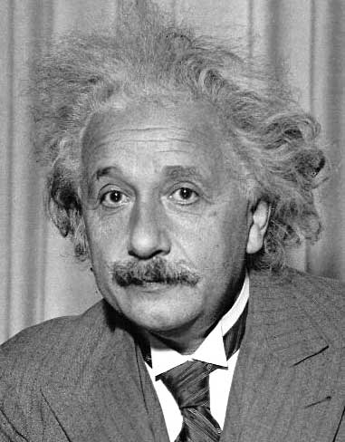
Template matching
Goal: find in image
Main challenge: What is a good similarity or distance measure between two patches?
  Correlation
  Zero-mean correlation
  Sum Square Difference
  Normalized Cross Correlation

Slide 7
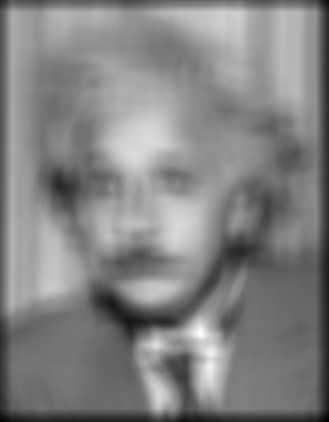
Matching with filters
Goal: find in image
Method 0: filter the image with eye patch
f = image
g = filter
What went wrong?
Input
Filtered Image
Notes:
Problem: response is stronger for higher intensity

Slide 8
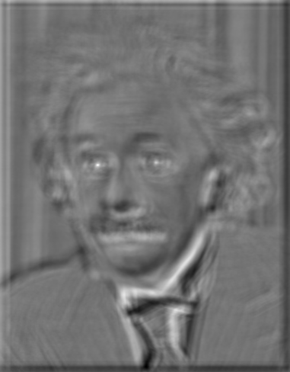
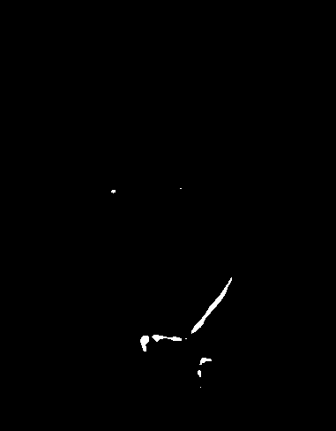
Matching with filters
Goal: find in image
Method 1: filter the image with zero-mean eye
mean of template g
True detections
False detections
Input
Filtered Image (scaled)
Thresholded Image
Notes:
Likes bright pixels where filters are above average, dark pixels where filters are below average. Problems: response is sensitive to gain/contrast, pixels in filter that are near the mean have little effect, does not require pixel values in image to be near or proportional to values in filter.

Slide 9
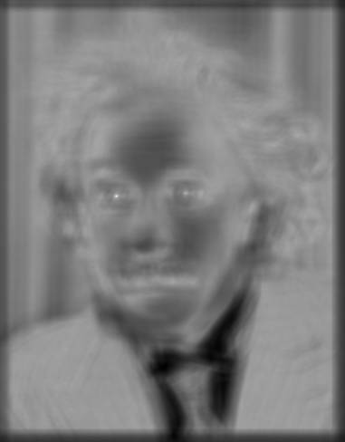

Matching with filters
Goal: find in image
Method 2: SSD
True detections
Input
1- sqrt(SSD)
Thresholded Image
Notes:
Problem: SSD sensitive to average intensity

Slide 10
Matching with filters
Can SSD be implemented with linear filters?

Slide 11
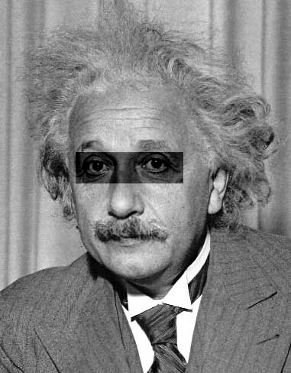
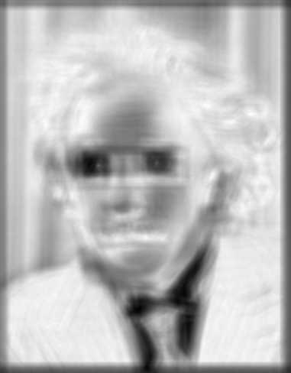
Matching with filters
Goal: find in image
Method 2: SSD
What’s the potential downside of SSD?
Input
1- sqrt(SSD)
Notes:
Problem: SSD sensitive to average intensity

Slide 12
Matching with filters
Goal: find in image
Method 3: Normalized cross-correlation
mean template
mean image patch
Matlab: normxcorr2(template, im)
Notes:
Invariant to mean and scale of intensity

Slide 13
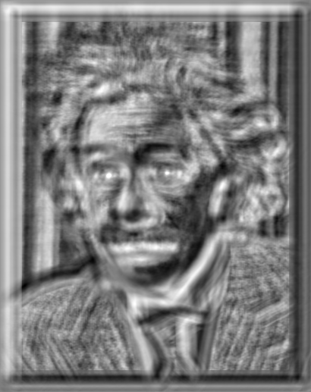

Matching with filters
Goal: find in image
Method 3: Normalized cross-correlation
True detections
Input
Normalized X-Correlation
Thresholded Image

Slide 14
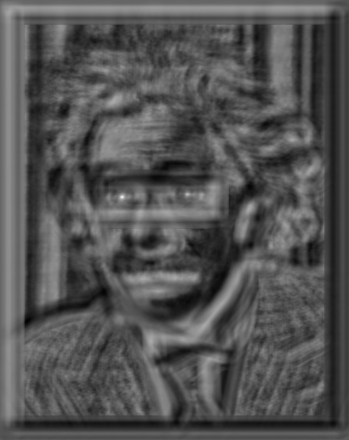
Matching with filters
Goal: find in image
Method 3: Normalized cross-correlation
True detections
Input
Normalized X-Correlation
Thresholded Image

Slide 15
Q: What is the best method to use?
A: Depends
Zero-mean filter: fastest but not a great matcher
SSD: next fastest, sensitive to overall intensity
Normalized cross-correlation: slowest, invariant to local average intensity and contrast

Slide 16
Q: What if we want to find larger or smaller eyes?
A: Image Pyramid

Slide 17
Review of Sampling
Gaussian
Filter
Image
Low-Pass Filtered Image
Sample
Low-Res Image

Slide 18
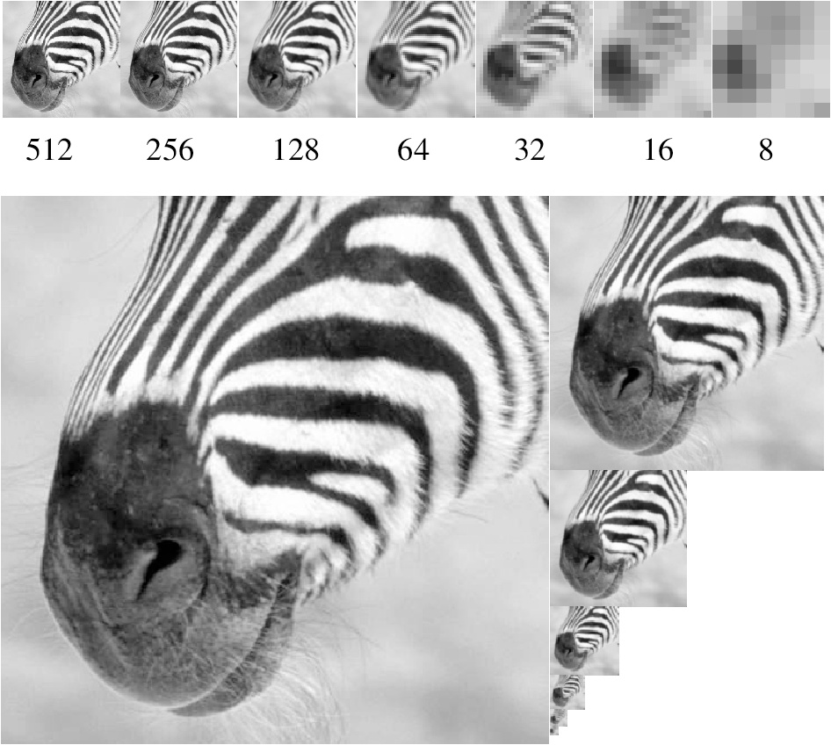
Gaussian pyramid
Source: Forsyth

Slide 19
Template Matching with Image Pyramids
Input: Image, Template
Match template at current scale
Downsample image
  In practice, scale step of 1.1 to 1.2
Repeat 1-2 until image is very small
Take responses above some threshold, perhaps with non-maxima suppression

Slide 20
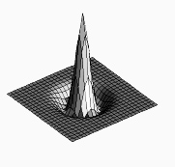

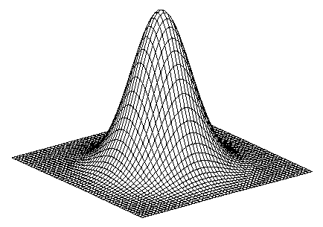
Laplacian filter
unit impulse
Gaussian
Laplacian of Gaussian
Source: Lazebnik

Slide 21
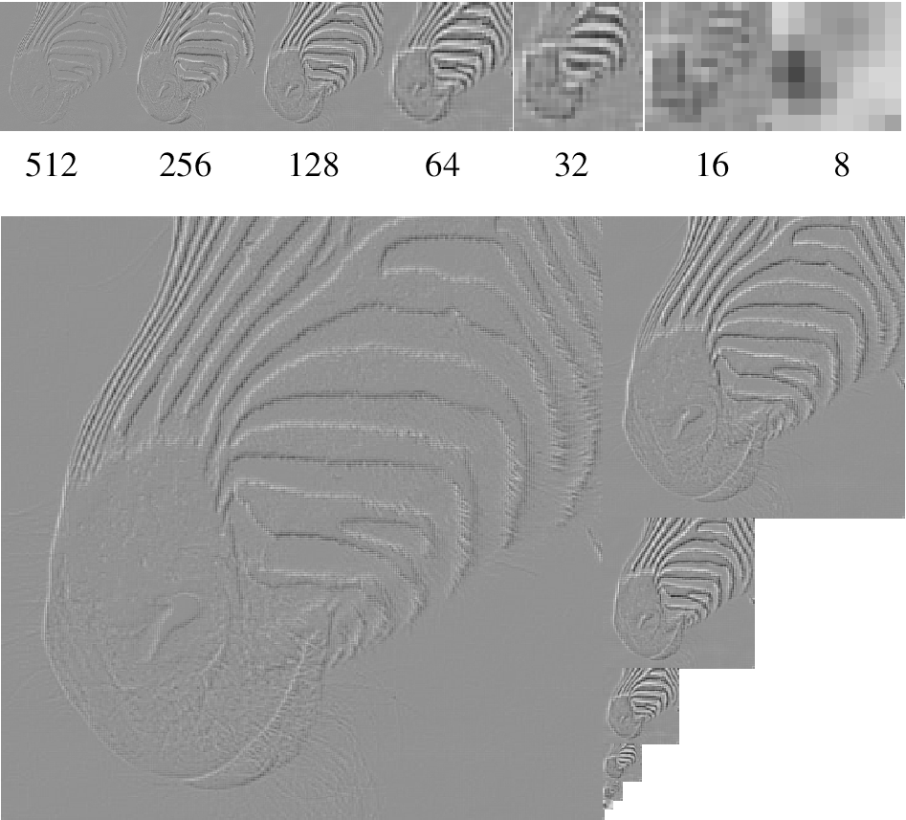
Laplacian pyramid
Source: Forsyth

Slide 22
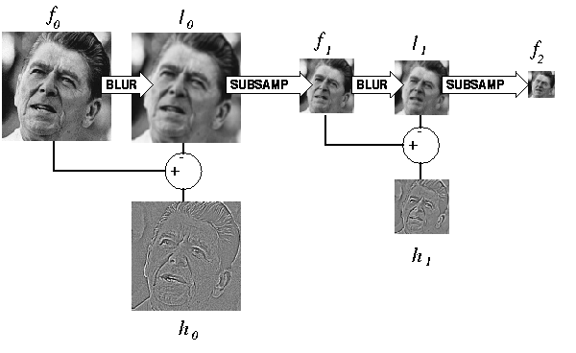
Computing Gaussian/Laplacian Pyramid
Can we reconstruct the original from the laplacian pyramid?
http://sepwww.stanford.edu/~morgan/texturematch/paper_html/node3.html

Slide 23



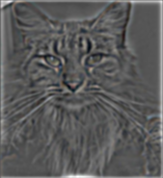


Creating the Gaussian/Laplacian Pyramid
Image = G₁
Smooth, then downsample
G₂
Downsample (Smooth(G₁))
Downsample (Smooth(G₂))
G₃
…
G_{N} = L_{N}
G₁ - Smooth(Upsample(G₂))
L₁
L₂
L₃
G₃ - Smooth(Upsample(G₄))
G₂ - Smooth(Upsample(G₃))
Use same filter for smoothing in each step (e.g., Gaussian with $σ=2$)
Downsample/upsample with “nearest” interpolation

Slide 24
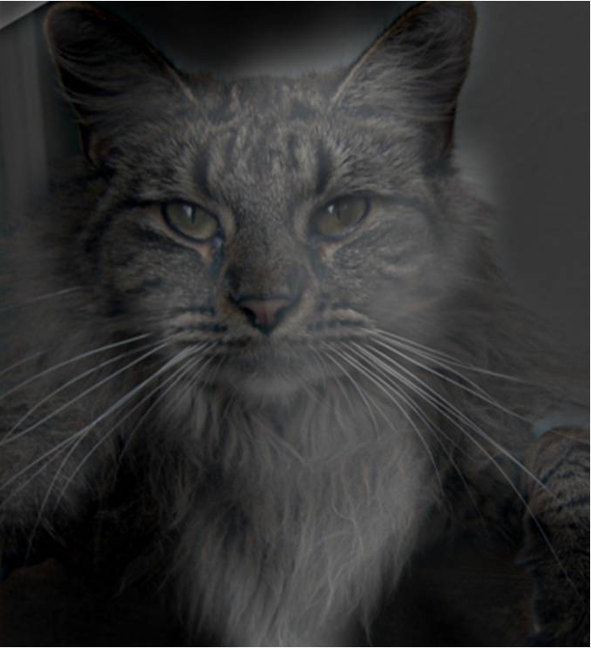
Hybrid Image

Slide 25
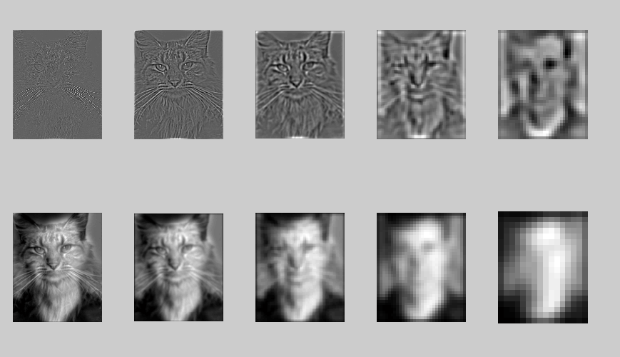
Hybrid Image in Laplacian Pyramid
High frequency → Low frequency

Slide 26
Reconstructing image from Laplacian pyramid
Image =
L₁ + Smooth(Upsample(G₂))
G₂ = L₂ + Smooth(Upsample(G₃))
G₃ = L₃ + Smooth(Upsample(L₄))
L₄
L₁
L₂
L₃
Use same filter for smoothing as in deconstruction
Upsample with “nearest” interpolation
Reconstruction will be nearly lossless

Slide 27
Major uses of image pyramids
Compression
Object detection
  Scale search
  Features
Detecting stable interest points
Registration
  Course-to-fine

Slide 28
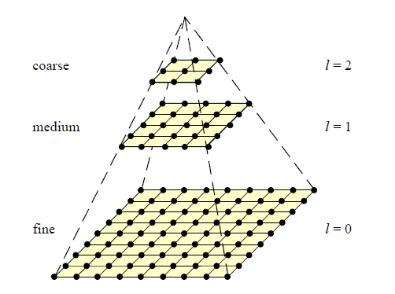
Coarse-to-fine Image Registration
Compute Gaussian pyramid
Align with coarse pyramid
Successively align with finer pyramids
  Search smaller range
Why is this faster?
Are we guaranteed to get the same result?

Slide 29
Image representation
Pixels: great for spatial resolution, poor access to frequency
Fourier transform: great for frequency, not for spatial info
Pyramids/filter banks: balance between spatial and frequency information

Slide 30
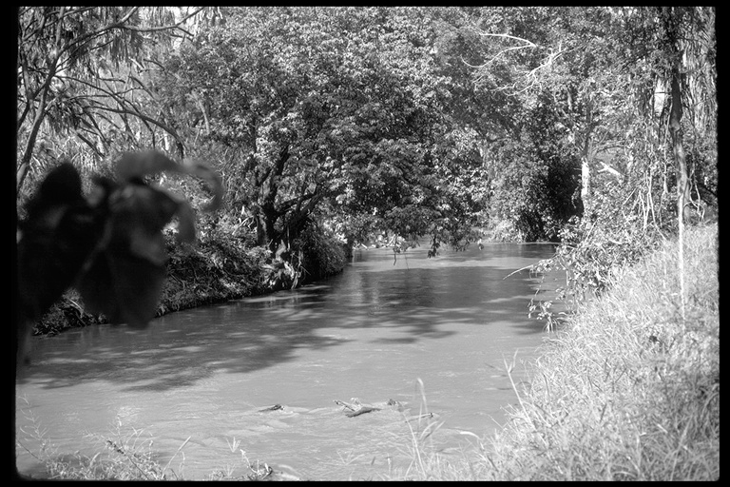
Application: Representing Texture
Source: Forsyth

Slide 31
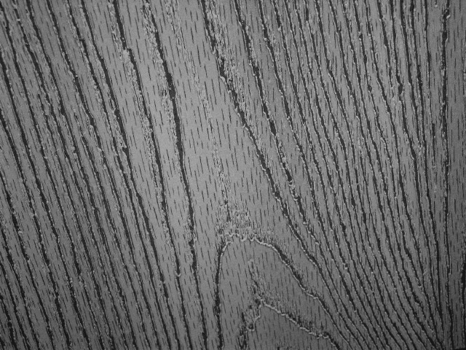
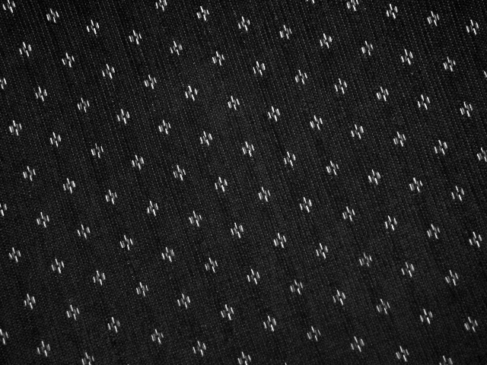
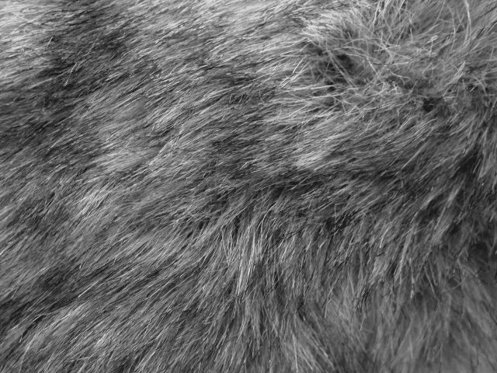
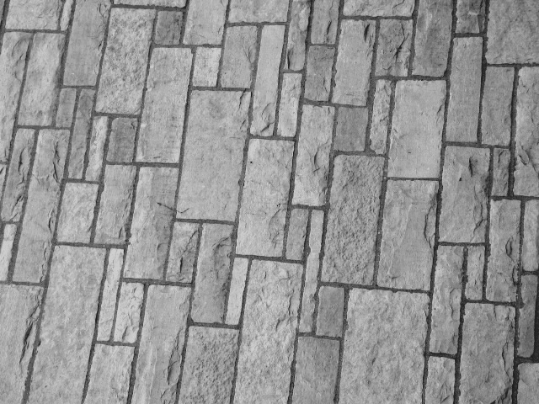
Texture and Material
http://www-cvr.ai.uiuc.edu/ponce_grp/data/texture_database/samples/

Slide 32
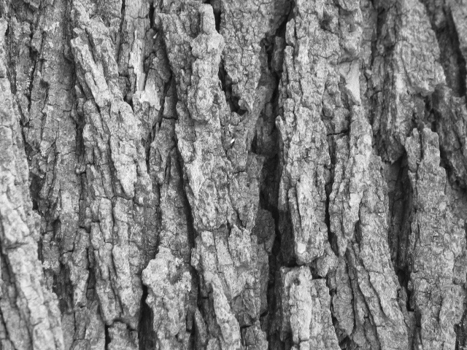
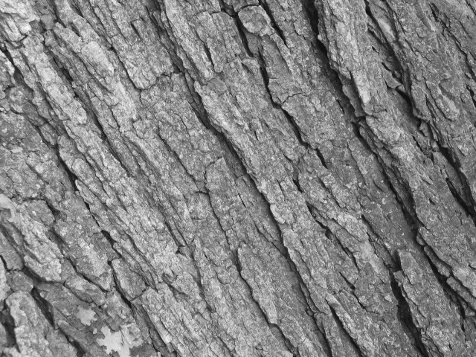
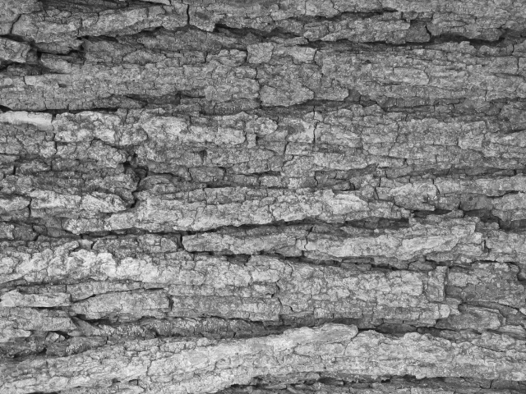
Texture and Orientation
http://www-cvr.ai.uiuc.edu/ponce_grp/data/texture_database/samples/

Slide 33
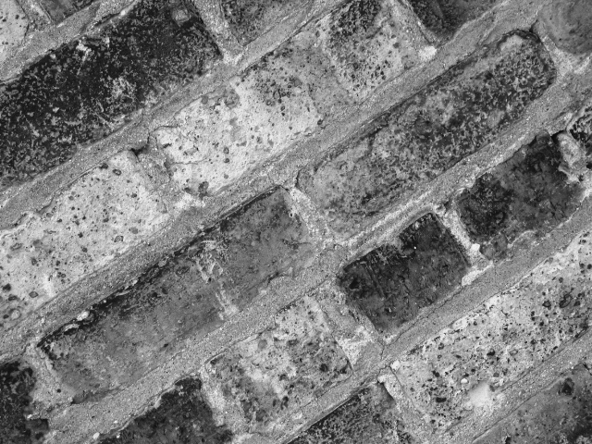
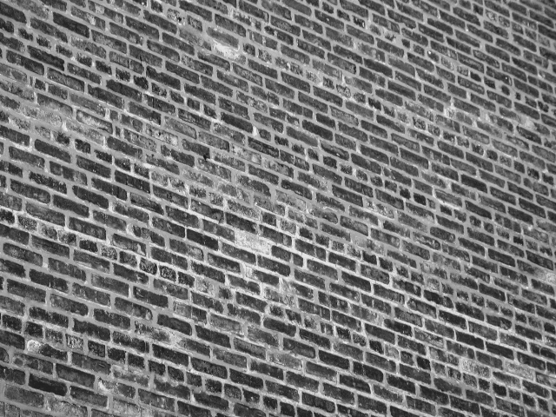
Texture and Scale
http://www-cvr.ai.uiuc.edu/ponce_grp/data/texture_database/samples/

Slide 34
What is texture?
Regular or stochastic patterns caused by bumps, grooves, and/or markings

Slide 35
How can we represent texture?
Compute responses of blobs and edges at various orientations and scales

Slide 36
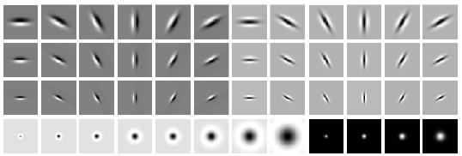
Overcomplete representation: filter banks
LM Filter Bank
Code for filter banks: www.robots.ox.ac.uk/~vgg/research/texclass/filters.html

Slide 37
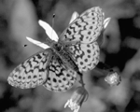
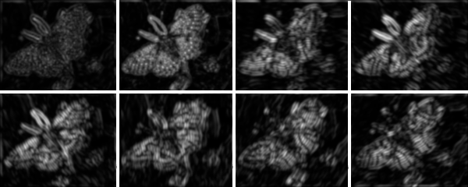
Filter banks
Process image with each filter and keep responses (or squared/abs responses)

Slide 38
How can we represent texture?
Measure responses of blobs and edges at various orientations and scales
Idea 1: Record simple statistics (e.g., mean, std.) of absolute filter responses

Slide 39
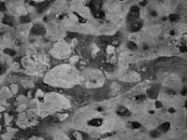
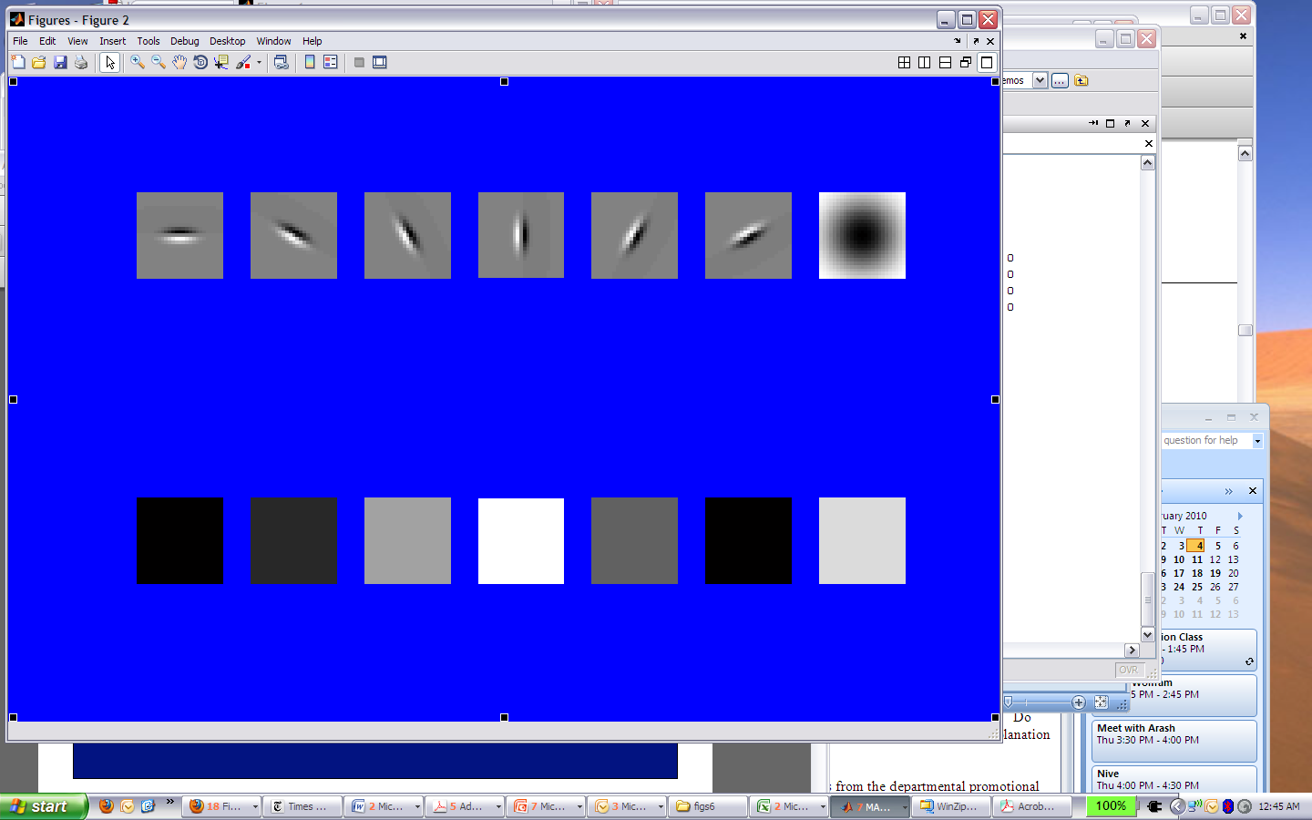
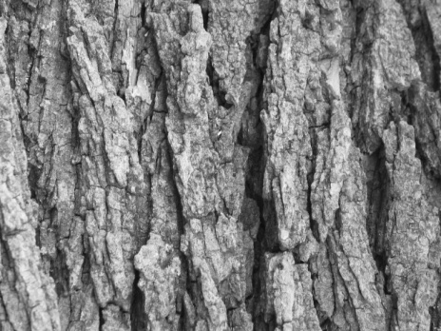
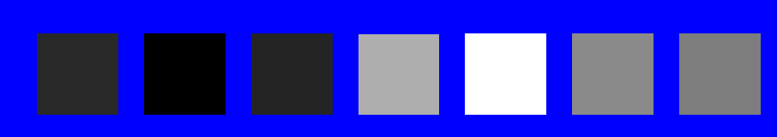
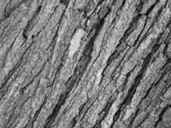
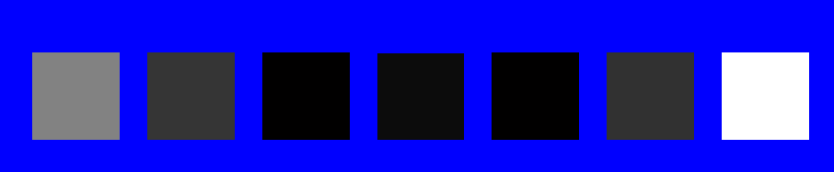
Can you match the texture to the response?
Filters
A
B
1
2
C
3
Mean abs responses

Slide 40

Representing texture by mean abs response
Filters
Mean abs responses

Slide 41
Representing texture
Idea 2: take vectors of filter responses at each pixel and cluster them, then take histograms (more on this in coming weeks)

Slide 42
Compression
How is it that a 4MP image (12000KB) can be compressed to 400KB without a noticeable change?

Slide 43
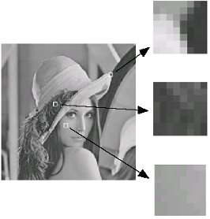
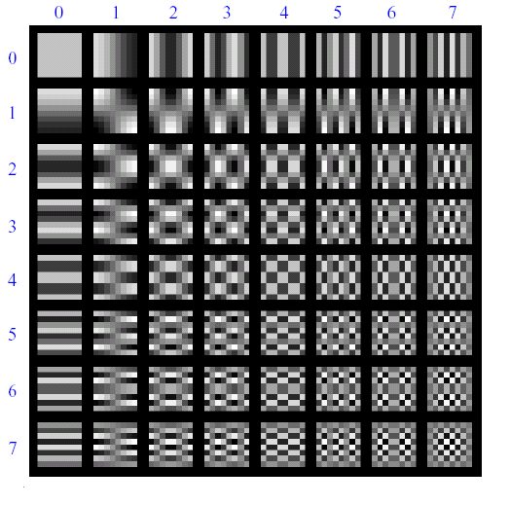
Lossy Image Compression (JPEG)
Block-based Discrete Cosine Transform (DCT)
Slides: Efros

Slide 44
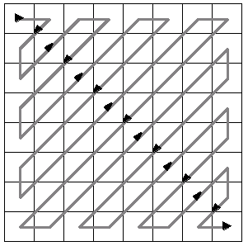
Using DCT in JPEG
The first coefficient B(0,0) is the DC component, the average intensity
The top-left coeffs represent low frequencies, the bottom right – high frequencies

Slide 45
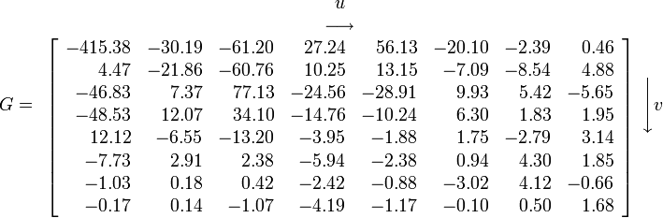
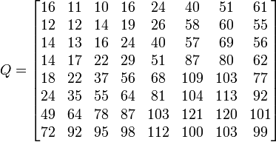
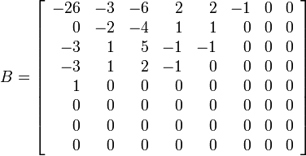
Image compression using DCT
Quantize
  More coarsely for high frequencies (which also tend to have smaller values)
  Many quantized high frequency values will be zero
Encode
  Can decode with inverse dct
Filter responses
Quantization table
Quantized values

Slide 46
JPEG Compression Summary
Convert image to YCrCb
Subsample color by factor of 2
  Color is interpolated anyway, and people have bad resolution for color
Split into blocks (8x8, typically), subtract 128
For each block
  Compute DCT coefficients
  Coarsely quantize
    Many high frequency components will become zero
  Encode (e.g., with Huffman coding)
http://en.wikipedia.org/wiki/YCbCr
http://en.wikipedia.org/wiki/JPEG

Slide 47
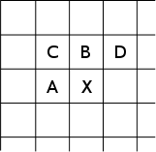
Lossless compression (PNG)
Predict that a pixel’s value based on its upper-left neighborhood
Store difference of predicted and actual value
Pkzip it (DEFLATE algorithm)

Slide 48

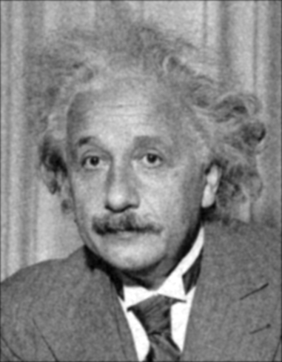
Denoising
Gaussian Filter
Additive Gaussian Noise

Slide 49


Reducing Gaussian noise
Smoothing with larger standard deviations suppresses noise, but also blurs the image
Source: S. Lazebnik

Slide 50

Reducing salt-and-pepper noise by Gaussian smoothing
3x3
5x5
7x7
Notes:
What’s wrong with these results?

Slide 51

Alternative idea: Median filtering
A median filter operates over a window by selecting the median intensity in the window
Is median filtering linear?
Source: K. Grauman
Notes:
Better at salt’n’pepper noise
Not convolution: try a region with 1’s and a 2, and then 1’s and a 3

Slide 52

Median filter
What advantage does median filtering have over Gaussian filtering?
  Robustness to outliers
Source: K. Grauman

Slide 53

Median filter
Salt-and-pepper noise
Median filtered
MATLAB: medfilt2(image, [h w])
Source: M. Hebert

Slide 54

Median vs. Gaussian filtering
3x3
5x5
7x7
Gaussian
Median

Slide 55

Other non-linear filters
Weighted median (pixels further from center count less)
Clipped mean (average, ignoring few brightest and darkest pixels)
Bilateral filtering (weight by spatial distance and intensity difference)
Bilateral filtering
Image:
http://vision.ai.uiuc.edu/?p=1455

Slide 56


Bilateral filters
Edge preserving: weights similar pixels more
Original
Gaussian
Bilateral
spatial
similarity (e.g., intensity)
Carlo Tomasi, Roberto Manduchi, Bilateral Filtering for Gray and Color Images, ICCV, 1998.

Slide 57
Review of last three days

Slide 58

Review: Image filtering
1
1
1
1
1
1
1
1
1
0 | 0 | 0 | 0 | 0 | 0 | 0 | 0 | 0 | 0
0 | 0 | 0 | 0 | 0 | 0 | 0 | 0 | 0 | 0
0 | 0 | 0 | 90 | 90 | 90 | 90 | 90 | 0 | 0
0 | 0 | 0 | 90 | 90 | 90 | 90 | 90 | 0 | 0
0 | 0 | 0 | 90 | 90 | 90 | 90 | 90 | 0 | 0
0 | 0 | 0 | 90 | 0 | 90 | 90 | 90 | 0 | 0
0 | 0 | 0 | 90 | 90 | 90 | 90 | 90 | 0 | 0
0 | 0 | 0 | 0 | 0 | 0 | 0 | 0 | 0 | 0
0 | 0 | 90 | 0 | 0 | 0 | 0 | 0 | 0 | 0
0 | 0 | 0 | 0 | 0 | 0 | 0 | 0 | 0 | 0
 | 0
0 | 0 | 0 | 0 | 0 | 0 | 0 | 0 | 0 | 0
0 | 0 | 0 | 0 | 0 | 0 | 0 | 0 | 0 | 0
0 | 0 | 0 | 90 | 90 | 90 | 90 | 90 | 0 | 0
0 | 0 | 0 | 90 | 90 | 90 | 90 | 90 | 0 | 0
0 | 0 | 0 | 90 | 90 | 90 | 90 | 90 | 0 | 0
0 | 0 | 0 | 90 | 0 | 90 | 90 | 90 | 0 | 0
0 | 0 | 0 | 90 | 90 | 90 | 90 | 90 | 0 | 0
0 | 0 | 0 | 0 | 0 | 0 | 0 | 0 | 0 | 0
0 | 0 | 90 | 0 | 0 | 0 | 0 | 0 | 0 | 0
0 | 0 | 0 | 0 | 0 | 0 | 0 | 0 | 0 | 0
Credit: S. Seitz
Notes:
ones, divide by 9

Slide 59
Image filtering
1
1
1
1
1
1
1
1
1
0 | 0 | 0 | 0 | 0 | 0 | 0 | 0 | 0 | 0
0 | 0 | 0 | 0 | 0 | 0 | 0 | 0 | 0 | 0
0 | 0 | 0 | 90 | 90 | 90 | 90 | 90 | 0 | 0
0 | 0 | 0 | 90 | 90 | 90 | 90 | 90 | 0 | 0
0 | 0 | 0 | 90 | 90 | 90 | 90 | 90 | 0 | 0
0 | 0 | 0 | 90 | 0 | 90 | 90 | 90 | 0 | 0
0 | 0 | 0 | 90 | 90 | 90 | 90 | 90 | 0 | 0
0 | 0 | 0 | 0 | 0 | 0 | 0 | 0 | 0 | 0
0 | 0 | 90 | 0 | 0 | 0 | 0 | 0 | 0 | 0
0 | 0 | 0 | 0 | 0 | 0 | 0 | 0 | 0 | 0
 | 0 | 10
0 | 0 | 0 | 0 | 0 | 0 | 0 | 0 | 0 | 0
0 | 0 | 0 | 0 | 0 | 0 | 0 | 0 | 0 | 0
0 | 0 | 0 | 90 | 90 | 90 | 90 | 90 | 0 | 0
0 | 0 | 0 | 90 | 90 | 90 | 90 | 90 | 0 | 0
0 | 0 | 0 | 90 | 90 | 90 | 90 | 90 | 0 | 0
0 | 0 | 0 | 90 | 0 | 90 | 90 | 90 | 0 | 0
0 | 0 | 0 | 90 | 90 | 90 | 90 | 90 | 0 | 0
0 | 0 | 0 | 0 | 0 | 0 | 0 | 0 | 0 | 0
0 | 0 | 90 | 0 | 0 | 0 | 0 | 0 | 0 | 0
0 | 0 | 0 | 0 | 0 | 0 | 0 | 0 | 0 | 0
Credit: S. Seitz
Notes:
ones, divide by 9

Slide 60
Image filtering
1
1
1
1
1
1
1
1
1
0 | 0 | 0 | 0 | 0 | 0 | 0 | 0 | 0 | 0
0 | 0 | 0 | 0 | 0 | 0 | 0 | 0 | 0 | 0
0 | 0 | 0 | 90 | 90 | 90 | 90 | 90 | 0 | 0
0 | 0 | 0 | 90 | 90 | 90 | 90 | 90 | 0 | 0
0 | 0 | 0 | 90 | 90 | 90 | 90 | 90 | 0 | 0
0 | 0 | 0 | 90 | 0 | 90 | 90 | 90 | 0 | 0
0 | 0 | 0 | 90 | 90 | 90 | 90 | 90 | 0 | 0
0 | 0 | 0 | 0 | 0 | 0 | 0 | 0 | 0 | 0
0 | 0 | 90 | 0 | 0 | 0 | 0 | 0 | 0 | 0
0 | 0 | 0 | 0 | 0 | 0 | 0 | 0 | 0 | 0
 | 0 | 10 | 20
0 | 0 | 0 | 0 | 0 | 0 | 0 | 0 | 0 | 0
0 | 0 | 0 | 0 | 0 | 0 | 0 | 0 | 0 | 0
0 | 0 | 0 | 90 | 90 | 90 | 90 | 90 | 0 | 0
0 | 0 | 0 | 90 | 90 | 90 | 90 | 90 | 0 | 0
0 | 0 | 0 | 90 | 90 | 90 | 90 | 90 | 0 | 0
0 | 0 | 0 | 90 | 0 | 90 | 90 | 90 | 0 | 0
0 | 0 | 0 | 90 | 90 | 90 | 90 | 90 | 0 | 0
0 | 0 | 0 | 0 | 0 | 0 | 0 | 0 | 0 | 0
0 | 0 | 90 | 0 | 0 | 0 | 0 | 0 | 0 | 0
0 | 0 | 0 | 0 | 0 | 0 | 0 | 0 | 0 | 0
Credit: S. Seitz
Notes:
ones, divide by 9

Slide 61
Filtering in spatial domain
1
0
-1
2
0
-2
1
0
-1
*
=

Slide 62
Filtering in frequency domain
FFT
FFT
=
Inverse FFT

Slide 63


Review of Last 3 Days
Linear filters for basic processing
  Edge filter (high-pass)
  Gaussian filter (low-pass)
[-1 1]
Gaussian
FFT of Gradient Filter
FFT of Gaussian

Slide 64

Review of Last 3 Days
Derivative of Gaussian

Slide 65
Review of Last 3 Days
Applications of filters
  Template matching (SSD or Normxcorr2)
    SSD can be done with linear filters, is sensitive to overall intensity
  Gaussian pyramid
    Coarse-to-fine search, multi-scale detection
  Laplacian pyramid
    More compact image representation
    Can be used for compositing in graphics

Slide 66
Review of Last 3 Days
Applications of filters
  Downsampling
    Need to sufficiently low-pass before downsampling
  Compression
    In JPEG, coarsely quantize high frequencies

Slide 67
Summary
Applications of filters
  Template matching (SSD or Normxcorr2)
    SSD can be done with linear filters, is sensitive to overall intensity
  Gaussian pyramid
    Coarse-to-fine search, multi-scale detection
  Laplacian pyramid
    More compact image representation
    Can be used for compositing in graphics
  Compression
    In JPEG, coarsely quantize high frequencies
  Filter banks for representing texture
  Denoising

Slide 68

Next class: edge detection

