Slide 1
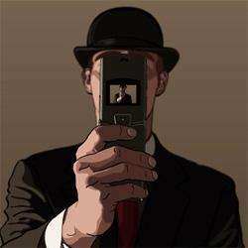
Pixels and Image Filtering
01/24/17
Computer Vision
Derek Hoiem, University of Illinois
Graphic: http://www.notcot.org/post/4068/

Slide 2
Today’s Class: Pixels and Linear Filters
Review of lighting
  Reflection and absorption
What is image filtering and how do we do it?
Color models

Slide 3
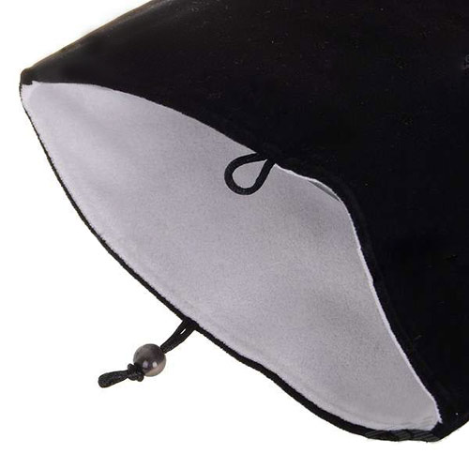
Reflection models
Albedo: fraction of light that is reflected
  Determines color (amount reflected at each wavelength)
Very low albedo (hard to see shape)
Higher albedo

Slide 4
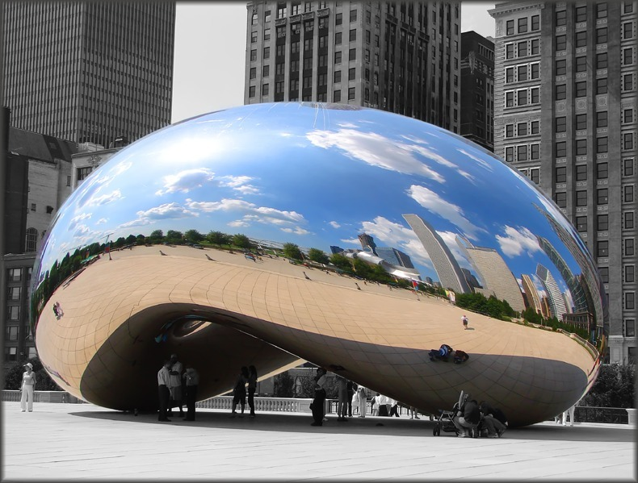
Reflection models
Specular reflection: mirror-like
  Light reflects at incident angle
  Reflection color = incoming light color

Slide 5
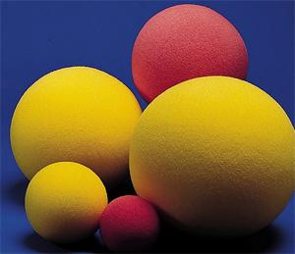
Reflection models
Diffuse reflection
  Light scatters in all directions (proportional to cosine between light source and surface normal)
  Observed intensity is independent of viewing direction
  Reflection color depends on light color and albedo

Slide 6
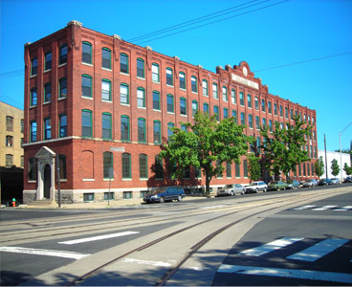
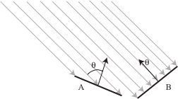

Surface orientation and light intensity
Amount of light that hits surface from distant point source depends on angle between surface normal and source
1
2
$$I\left(x\right)=ρ\left(x\right)\left(S⋅N(x)\right)$$
proportional to cosine of relative angle

Slide 7
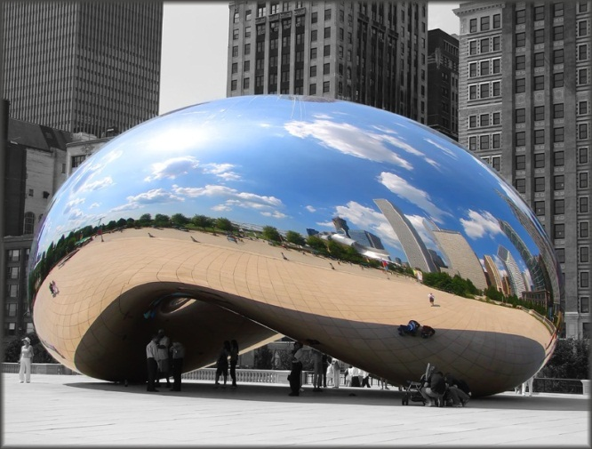
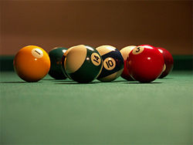
Reflection models
Lambertian: reflection all diffuse
Mirrored: reflection all specular
Glossy: reflection mostly diffuse, some specular
Specularities

Slide 8
Questions
How many light sources are in the scene?
How could I estimate the color of the camera’s flash?
Notes:
im = imread('billiards.png');
figure(1), imagesc(im), axis image, axis off
figure(1), hold on, plot([0 size(im, 2)], [76 76], 'k', 'linewidth', 1.5)
figure(2), hold off, subplot(3, 1, 1), plot(1:size(im, 2), squeeze(im(76, :, 1)), 'r', 'linewidth', 1.5)
figure(2), hold off, subplot(3, 1, 2), plot(1:size(im, 2), squeeze(im(76, :, 2)), 'g', 'linewidth', 1.5)
figure(2), hold off, subplot(3, 1, 3), plot(1:size(im, 2), squeeze(im(76, :, 3)), 'b', 'linewidth', 1.5)

Slide 9
The plight of the poor pixel
A pixel’s brightness is determined by
  Light source (strength, direction, color)
  Surface orientation
  Surface material and albedo
  Reflected light and shadows from surrounding surfaces
  Gain on the sensor
A pixel’s brightness tells us nothing by itself

Slide 10
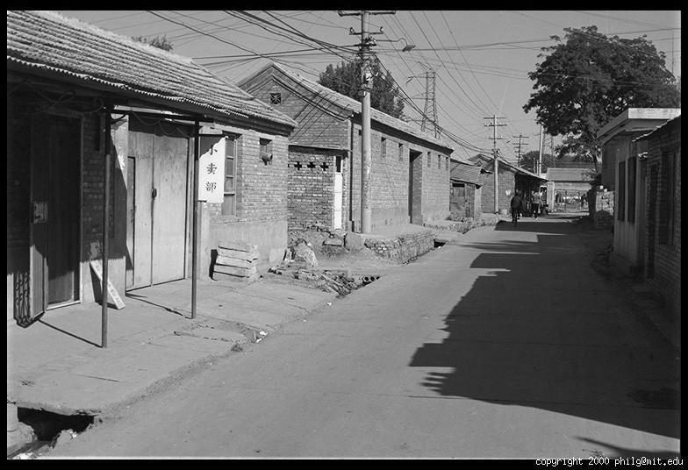
Basis for interpreting intensity images
Key idea: for nearby scene points, most factors do not change much
The information is mainly contained in local differences of brightness

Slide 11
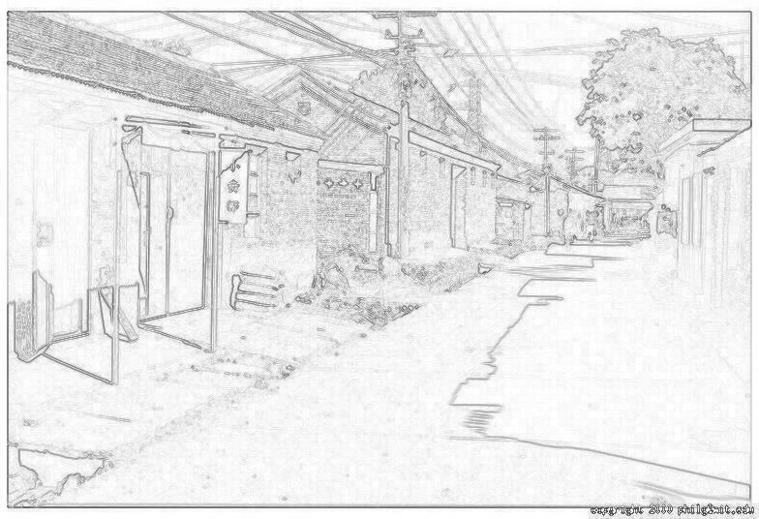
Darkness = Large Difference in Neighboring Pixels

Slide 12
Next three classes: three views of filtering
Image filters in spatial domain
  Filter is a mathematical operation on values of each patch
  Smoothing, sharpening, measuring texture
Image filters in the frequency domain
  Filtering is a way to modify the frequencies of images
  Denoising, sampling, image compression
Templates and Image Pyramids
  Filtering is a way to match a template to the image
  Detection, coarse-to-fine registration

Slide 13
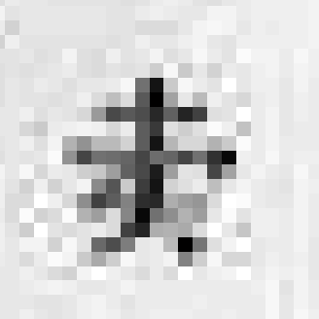
The raster image (pixel matrix)
0.92 | 0.93 | 0.94 | 0.97 | 0.62 | 0.37 | 0.85 | 0.97 | 0.93 | 0.92 | 0.99
0.95 | 0.89 | 0.82 | 0.89 | 0.56 | 0.31 | 0.75 | 0.92 | 0.81 | 0.95 | 0.91
0.89 | 0.72 | 0.51 | 0.55 | 0.51 | 0.42 | 0.57 | 0.41 | 0.49 | 0.91 | 0.92
0.96 | 0.95 | 0.88 | 0.94 | 0.56 | 0.46 | 0.91 | 0.87 | 0.90 | 0.97 | 0.95
0.71 | 0.81 | 0.81 | 0.87 | 0.57 | 0.37 | 0.80 | 0.88 | 0.89 | 0.79 | 0.85
0.49 | 0.62 | 0.60 | 0.58 | 0.50 | 0.60 | 0.58 | 0.50 | 0.61 | 0.45 | 0.33
0.86 | 0.84 | 0.74 | 0.58 | 0.51 | 0.39 | 0.73 | 0.92 | 0.91 | 0.49 | 0.74
0.96 | 0.67 | 0.54 | 0.85 | 0.48 | 0.37 | 0.88 | 0.90 | 0.94 | 0.82 | 0.93
0.69 | 0.49 | 0.56 | 0.66 | 0.43 | 0.42 | 0.77 | 0.73 | 0.71 | 0.90 | 0.99
0.79 | 0.73 | 0.90 | 0.67 | 0.33 | 0.61 | 0.69 | 0.79 | 0.73 | 0.93 | 0.97
0.91 | 0.94 | 0.89 | 0.49 | 0.41 | 0.78 | 0.78 | 0.77 | 0.89 | 0.99 | 0.93

Slide 14
Image filtering
Image filtering: for each pixel, compute function of local neighborhood and output a new value
  Same function applied at each position
  Output and input image are typically the same size

Slide 15
Image filtering
Linear filtering: function is a weighted sum/difference of pixel values
Really important!
  Enhance images
    Denoise, smooth, increase contrast, etc.
  Extract information from images
    Texture, edges, distinctive points, etc.
  Detect patterns
    Template matching

Slide 16

Example: box filter
1
1
1
1
1
1
1
1
1
Slide credit: David Lowe (UBC)

Slide 17
Image filtering
1
1
1
1
1
1
1
1
1
0 | 0 | 0 | 0 | 0 | 0 | 0 | 0 | 0 | 0
0 | 0 | 0 | 0 | 0 | 0 | 0 | 0 | 0 | 0
0 | 0 | 0 | 90 | 90 | 90 | 90 | 90 | 0 | 0
0 | 0 | 0 | 90 | 90 | 90 | 90 | 90 | 0 | 0
0 | 0 | 0 | 90 | 90 | 90 | 90 | 90 | 0 | 0
0 | 0 | 0 | 90 | 0 | 90 | 90 | 90 | 0 | 0
0 | 0 | 0 | 90 | 90 | 90 | 90 | 90 | 0 | 0
0 | 0 | 0 | 0 | 0 | 0 | 0 | 0 | 0 | 0
0 | 0 | 90 | 0 | 0 | 0 | 0 | 0 | 0 | 0
0 | 0 | 0 | 0 | 0 | 0 | 0 | 0 | 0 | 0
 | 0
Credit: S. Seitz
Notes:
ones, divide by 9

Slide 18
Image filtering
1
1
1
1
1
1
1
1
1
0 | 0 | 0 | 0 | 0 | 0 | 0 | 0 | 0 | 0
0 | 0 | 0 | 0 | 0 | 0 | 0 | 0 | 0 | 0
0 | 0 | 0 | 90 | 90 | 90 | 90 | 90 | 0 | 0
0 | 0 | 0 | 90 | 90 | 90 | 90 | 90 | 0 | 0
0 | 0 | 0 | 90 | 90 | 90 | 90 | 90 | 0 | 0
0 | 0 | 0 | 90 | 0 | 90 | 90 | 90 | 0 | 0
0 | 0 | 0 | 90 | 90 | 90 | 90 | 90 | 0 | 0
0 | 0 | 0 | 0 | 0 | 0 | 0 | 0 | 0 | 0
0 | 0 | 90 | 0 | 0 | 0 | 0 | 0 | 0 | 0
0 | 0 | 0 | 0 | 0 | 0 | 0 | 0 | 0 | 0
 | 0 | 10
0 | 0 | 0 | 0 | 0 | 0 | 0 | 0 | 0 | 0
0 | 0 | 0 | 0 | 0 | 0 | 0 | 0 | 0 | 0
0 | 0 | 0 | 90 | 90 | 90 | 90 | 90 | 0 | 0
0 | 0 | 0 | 90 | 90 | 90 | 90 | 90 | 0 | 0
0 | 0 | 0 | 90 | 90 | 90 | 90 | 90 | 0 | 0
0 | 0 | 0 | 90 | 0 | 90 | 90 | 90 | 0 | 0
0 | 0 | 0 | 90 | 90 | 90 | 90 | 90 | 0 | 0
0 | 0 | 0 | 0 | 0 | 0 | 0 | 0 | 0 | 0
0 | 0 | 90 | 0 | 0 | 0 | 0 | 0 | 0 | 0
0 | 0 | 0 | 0 | 0 | 0 | 0 | 0 | 0 | 0
Credit: S. Seitz
Notes:
ones, divide by 9

Slide 19
Image filtering
1
1
1
1
1
1
1
1
1
0 | 0 | 0 | 0 | 0 | 0 | 0 | 0 | 0 | 0
0 | 0 | 0 | 0 | 0 | 0 | 0 | 0 | 0 | 0
0 | 0 | 0 | 90 | 90 | 90 | 90 | 90 | 0 | 0
0 | 0 | 0 | 90 | 90 | 90 | 90 | 90 | 0 | 0
0 | 0 | 0 | 90 | 90 | 90 | 90 | 90 | 0 | 0
0 | 0 | 0 | 90 | 0 | 90 | 90 | 90 | 0 | 0
0 | 0 | 0 | 90 | 90 | 90 | 90 | 90 | 0 | 0
0 | 0 | 0 | 0 | 0 | 0 | 0 | 0 | 0 | 0
0 | 0 | 90 | 0 | 0 | 0 | 0 | 0 | 0 | 0
0 | 0 | 0 | 0 | 0 | 0 | 0 | 0 | 0 | 0
 | 0 | 10 | 20
0 | 0 | 0 | 0 | 0 | 0 | 0 | 0 | 0 | 0
0 | 0 | 0 | 0 | 0 | 0 | 0 | 0 | 0 | 0
0 | 0 | 0 | 90 | 90 | 90 | 90 | 90 | 0 | 0
0 | 0 | 0 | 90 | 90 | 90 | 90 | 90 | 0 | 0
0 | 0 | 0 | 90 | 90 | 90 | 90 | 90 | 0 | 0
0 | 0 | 0 | 90 | 0 | 90 | 90 | 90 | 0 | 0
0 | 0 | 0 | 90 | 90 | 90 | 90 | 90 | 0 | 0
0 | 0 | 0 | 0 | 0 | 0 | 0 | 0 | 0 | 0
0 | 0 | 90 | 0 | 0 | 0 | 0 | 0 | 0 | 0
0 | 0 | 0 | 0 | 0 | 0 | 0 | 0 | 0 | 0
Credit: S. Seitz
Notes:
ones, divide by 9

Slide 20
Image filtering
1
1
1
1
1
1
1
1
1
0 | 0 | 0 | 0 | 0 | 0 | 0 | 0 | 0 | 0
0 | 0 | 0 | 0 | 0 | 0 | 0 | 0 | 0 | 0
0 | 0 | 0 | 90 | 90 | 90 | 90 | 90 | 0 | 0
0 | 0 | 0 | 90 | 90 | 90 | 90 | 90 | 0 | 0
0 | 0 | 0 | 90 | 90 | 90 | 90 | 90 | 0 | 0
0 | 0 | 0 | 90 | 0 | 90 | 90 | 90 | 0 | 0
0 | 0 | 0 | 90 | 90 | 90 | 90 | 90 | 0 | 0
0 | 0 | 0 | 0 | 0 | 0 | 0 | 0 | 0 | 0
0 | 0 | 90 | 0 | 0 | 0 | 0 | 0 | 0 | 0
0 | 0 | 0 | 0 | 0 | 0 | 0 | 0 | 0 | 0
 | 0 | 10 | 20 | 30
0 | 0 | 0 | 0 | 0 | 0 | 0 | 0 | 0 | 0
0 | 0 | 0 | 0 | 0 | 0 | 0 | 0 | 0 | 0
0 | 0 | 0 | 90 | 90 | 90 | 90 | 90 | 0 | 0
0 | 0 | 0 | 90 | 90 | 90 | 90 | 90 | 0 | 0
0 | 0 | 0 | 90 | 90 | 90 | 90 | 90 | 0 | 0
0 | 0 | 0 | 90 | 0 | 90 | 90 | 90 | 0 | 0
0 | 0 | 0 | 90 | 90 | 90 | 90 | 90 | 0 | 0
0 | 0 | 0 | 0 | 0 | 0 | 0 | 0 | 0 | 0
0 | 0 | 90 | 0 | 0 | 0 | 0 | 0 | 0 | 0
0 | 0 | 0 | 0 | 0 | 0 | 0 | 0 | 0 | 0
Credit: S. Seitz
Notes:
ones, divide by 9

Slide 21
Image filtering
1
1
1
1
1
1
1
1
1
0 | 0 | 0 | 0 | 0 | 0 | 0 | 0 | 0 | 0
0 | 0 | 0 | 0 | 0 | 0 | 0 | 0 | 0 | 0
0 | 0 | 0 | 90 | 90 | 90 | 90 | 90 | 0 | 0
0 | 0 | 0 | 90 | 90 | 90 | 90 | 90 | 0 | 0
0 | 0 | 0 | 90 | 90 | 90 | 90 | 90 | 0 | 0
0 | 0 | 0 | 90 | 0 | 90 | 90 | 90 | 0 | 0
0 | 0 | 0 | 90 | 90 | 90 | 90 | 90 | 0 | 0
0 | 0 | 0 | 0 | 0 | 0 | 0 | 0 | 0 | 0
0 | 0 | 90 | 0 | 0 | 0 | 0 | 0 | 0 | 0
0 | 0 | 0 | 0 | 0 | 0 | 0 | 0 | 0 | 0
 | 0 | 10 | 20 | 30 | 30
Credit: S. Seitz
Notes:
ones, divide by 9

Slide 22
Image filtering
1
1
1
1
1
1
1
1
1
0 | 0 | 0 | 0 | 0 | 0 | 0 | 0 | 0 | 0
0 | 0 | 0 | 0 | 0 | 0 | 0 | 0 | 0 | 0
0 | 0 | 0 | 90 | 90 | 90 | 90 | 90 | 0 | 0
0 | 0 | 0 | 90 | 90 | 90 | 90 | 90 | 0 | 0
0 | 0 | 0 | 90 | 90 | 90 | 90 | 90 | 0 | 0
0 | 0 | 0 | 90 | 0 | 90 | 90 | 90 | 0 | 0
0 | 0 | 0 | 90 | 90 | 90 | 90 | 90 | 0 | 0
0 | 0 | 0 | 0 | 0 | 0 | 0 | 0 | 0 | 0
0 | 0 | 90 | 0 | 0 | 0 | 0 | 0 | 0 | 0
0 | 0 | 0 | 0 | 0 | 0 | 0 | 0 | 0 | 0
 | 0 | 10 | 20 | 30 | 30
?
Credit: S. Seitz
Notes:
ones, divide by 9

Slide 23
Image filtering
1
1
1
1
1
1
1
1
1
0 | 0 | 0 | 0 | 0 | 0 | 0 | 0 | 0 | 0
0 | 0 | 0 | 0 | 0 | 0 | 0 | 0 | 0 | 0
0 | 0 | 0 | 90 | 90 | 90 | 90 | 90 | 0 | 0
0 | 0 | 0 | 90 | 90 | 90 | 90 | 90 | 0 | 0
0 | 0 | 0 | 90 | 90 | 90 | 90 | 90 | 0 | 0
0 | 0 | 0 | 90 | 0 | 90 | 90 | 90 | 0 | 0
0 | 0 | 0 | 90 | 90 | 90 | 90 | 90 | 0 | 0
0 | 0 | 0 | 0 | 0 | 0 | 0 | 0 | 0 | 0
0 | 0 | 90 | 0 | 0 | 0 | 0 | 0 | 0 | 0
0 | 0 | 0 | 0 | 0 | 0 | 0 | 0 | 0 | 0
 | 0 | 10 | 20 | 30 | 30
 |  |  |  | 50
?
Credit: S. Seitz
Notes:
ones, divide by 9

Slide 24
Image filtering
1
1
1
1
1
1
1
1
1
0 | 0 | 0 | 0 | 0 | 0 | 0 | 0 | 0 | 0
0 | 0 | 0 | 0 | 0 | 0 | 0 | 0 | 0 | 0
0 | 0 | 0 | 90 | 90 | 90 | 90 | 90 | 0 | 0
0 | 0 | 0 | 90 | 90 | 90 | 90 | 90 | 0 | 0
0 | 0 | 0 | 90 | 90 | 90 | 90 | 90 | 0 | 0
0 | 0 | 0 | 90 | 0 | 90 | 90 | 90 | 0 | 0
0 | 0 | 0 | 90 | 90 | 90 | 90 | 90 | 0 | 0
0 | 0 | 0 | 0 | 0 | 0 | 0 | 0 | 0 | 0
0 | 0 | 90 | 0 | 0 | 0 | 0 | 0 | 0 | 0
0 | 0 | 0 | 0 | 0 | 0 | 0 | 0 | 0 | 0
 | 0 | 10 | 20 | 30 | 30 | 30 | 20 | 10
 | 0 | 20 | 40 | 60 | 60 | 60 | 40 | 20
 | 0 | 30 | 60 | 90 | 90 | 90 | 60 | 30
 | 0 | 30 | 50 | 80 | 80 | 90 | 60 | 30
 | 0 | 30 | 50 | 80 | 80 | 90 | 60 | 30
 | 0 | 20 | 30 | 50 | 50 | 60 | 40 | 20
 | 10 | 20 | 30 | 30 | 30 | 30 | 20 | 10
 | 10 | 10 | 10 | 0 | 0 | 0 | 0 | 0
Credit: S. Seitz

Slide 25
Box Filter
What does it do?
Replaces each pixel with an average of its neighborhood
Achieve smoothing effect (remove sharp features)
1
1
1
1
1
1
1
1
1
Slide credit: David Lowe (UBC)

Slide 26
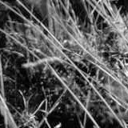
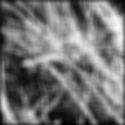
Smoothing with box filter

Slide 27
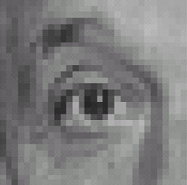
Practice with linear filters
0
0
0
?
0
1
0
0
0
0
Original
Source: D. Lowe

Slide 28
Practice with linear filters
0
0
0
0
1
0
0
0
0
Original
Filtered
(no change)
Source: D. Lowe

Slide 29
Practice with linear filters
0
0
0
?
0
0
1
0
0
0
Original
Source: D. Lowe

Slide 30
Practice with linear filters
0
0
0
0
0
1
0
0
0
Original
Shifted left
By 1 pixel
Source: D. Lowe

Slide 31
Practice with linear filters
0
0
0
-
1
1
1
?
0
2
0
1
1
1
0
0
0
1
1
1
(Note that filter sums to 1)
Original
Source: D. Lowe

Slide 32
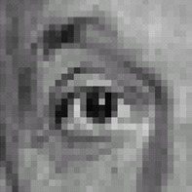
Practice with linear filters
0
0
0
-
1
1
1
0
2
0
1
1
1
0
0
0
1
1
1
Original
Sharpening filter
  Accentuates differences with local average
Source: D. Lowe

Slide 33
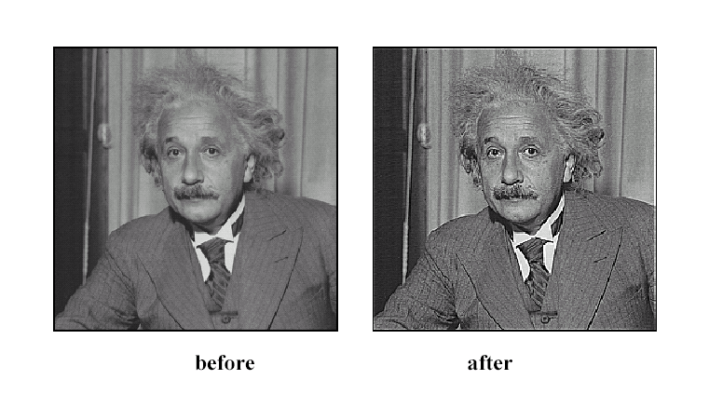
Sharpening
Source: D. Lowe

Slide 34
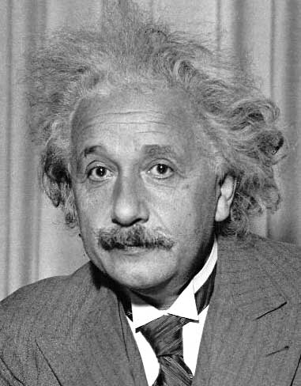
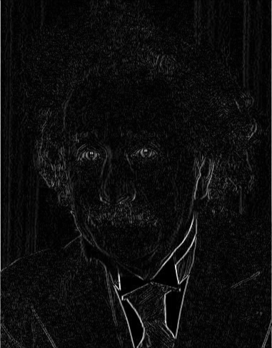
Other filters
1
0
-1
2
0
-2
1
0
-1
Sobel
Vertical Edge
(absolute value)

Slide 35
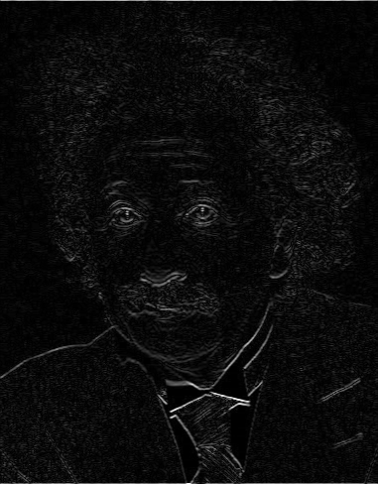
Other filters
1
2
1
0
0
0
-1
-2
-1
Sobel
Horizontal Edge
(absolute value)

Slide 36
Basic gradient filters
Horizontal Gradient
Vertical Gradient
0
0
0
0
-1
0
-1
0
1
-1
0
1
0
0
0
or
0
0
0
0
1
0
or
-1
0
1

Slide 37
Examples
Write as filtering operations, plus some elementwise operations: +, -, .*,>
Sum of four adjacent neighbors plus 1
Sum of squared values of 3x3 windows around each pixel:
Center pixel value is larger than the average of the pixel values to the left and right:

Slide 38
How could we synthesize motion blur?
theta = 30; len = 20;
fil = imrotate(ones(1, len), theta, 'bilinear');
fil = fil / sum(fil(:));
figure(2), imshow(imfilter(im, fil));

Slide 39
Filtering vs. Convolution
g=filter
f=image
2d filtering
  h=filter2(g,f); or h=imfilter(f,g);
2d convolution
  h=conv2(g,f);

Slide 40
Key properties of linear filters
Linearity:
filter(f₁ + f₂) = filter(f₁) + filter(f₂)
Shift invariance: same behavior regardless of pixel location
filter(shift(f)) = shift(filter(f))
Any linear, shift-invariant operator can be represented as a convolution
Source: S. Lazebnik

Slide 41
More properties
Commutative: a * b = b * a
  Conceptually no difference between filter and signal
Associative: a * (b * c) = (a * b) * c
  Often apply several filters one after another: (((a * b₁) * b₂) * b₃)
  This is equivalent to applying one filter: a * (b₁ * b₂ * b₃)
Distributes over addition: a * (b + c) = (a * b) + (a * c)
Scalars factor out: ka * b = a * kb = k (a * b)
Identity: unit impulse e = [0, 0, 1, 0, 0],
a * e = a
Source: S. Lazebnik

Slide 42
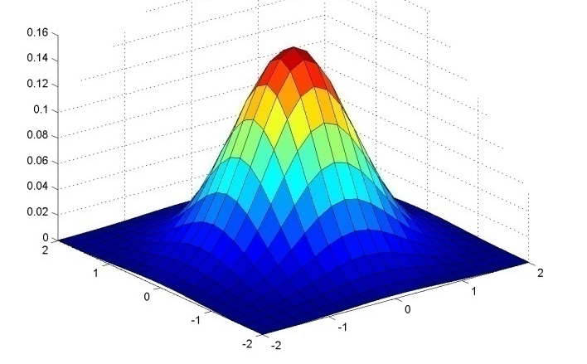
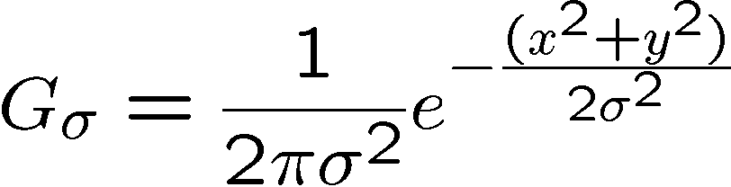
Important filter: Gaussian
Spatially-weighted average
0.003 0.013 0.022 0.013 0.003
0.013 0.059 0.097 0.059 0.013
0.022 0.097 0.159 0.097 0.022
0.013 0.059 0.097 0.059 0.013
0.003 0.013 0.022 0.013 0.003
5 x 5, σ = 1
Slide credit: Christopher Rasmussen

Slide 43

Smoothing with Gaussian filter

Slide 44
Smoothing with box filter

Slide 45
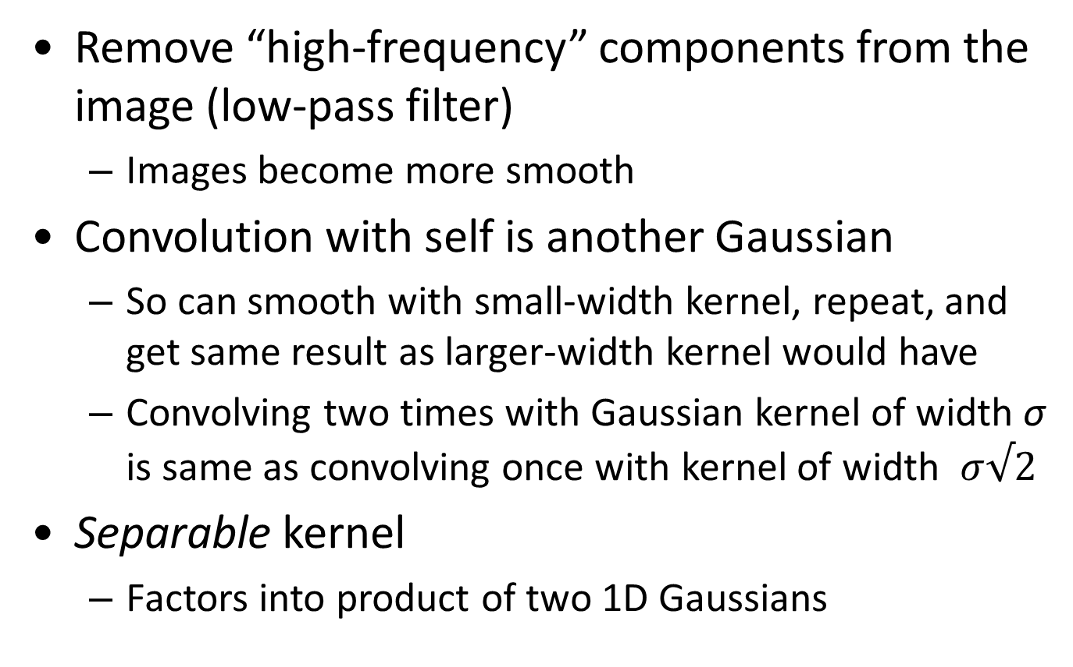
Gaussian filters
Remove “high-frequency” components from the image (low-pass filter)
  Images become more smooth
Convolution with self is another Gaussian
  So can smooth with small-width kernel, repeat, and get same result as larger-width kernel would have
  Convolving two times with Gaussian kernel of width σ is same as convolving once with kernel of width $σ√2$
Separable kernel
  Factors into product of two 1D Gaussians
Source: K. Grauman
Notes:
Linear vs. quadratic in mask size

Slide 46
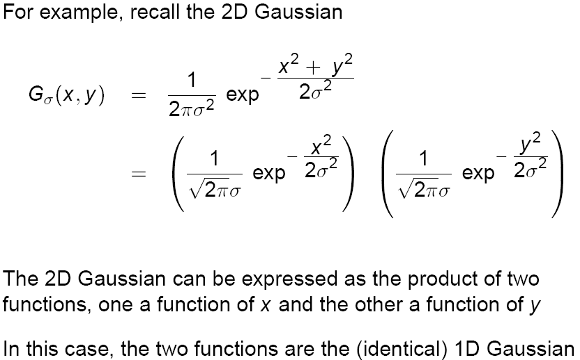
Separability of the Gaussian filter
Source: D. Lowe

Slide 47
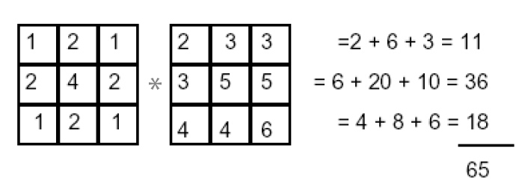
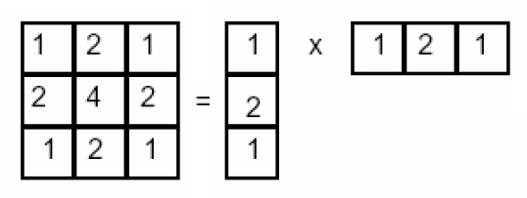
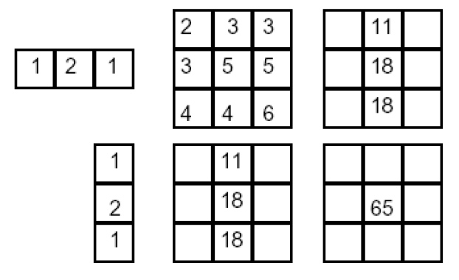
Separability example
2D filtering
(center location only)
The filter factors
into a product of 1D
filters:
Perform filtering
along rows:
*
=
Followed by filtering
along the remaining column:
*
=
Source: K. Grauman

Slide 48
Separability
Why is separability useful in practice?

Slide 49
Some practical matters

Slide 50
Practical matters
How big should the filter be?
Values at edges should be near zero ← important!
Rule of thumb for Gaussian: set filter half-width to about 3 σ

Slide 51
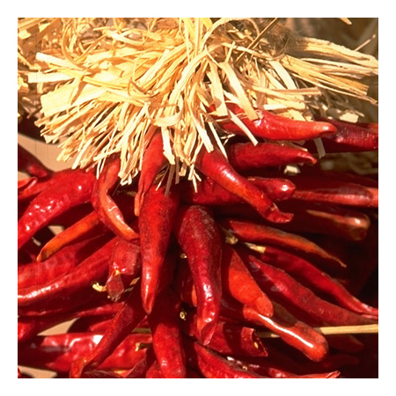
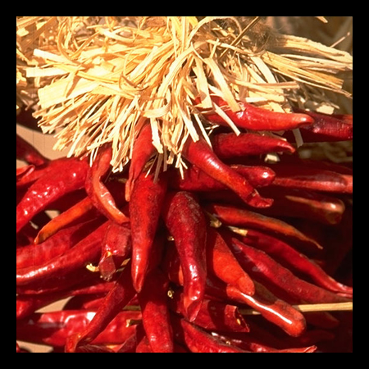

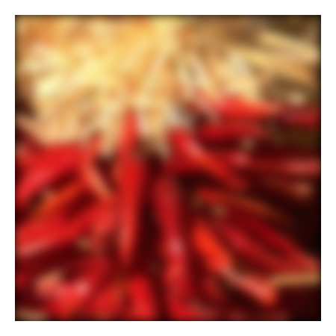
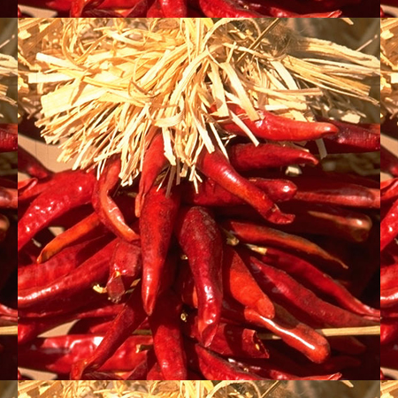

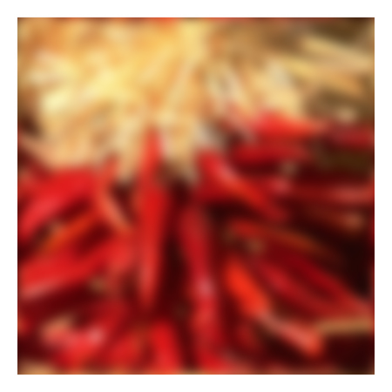



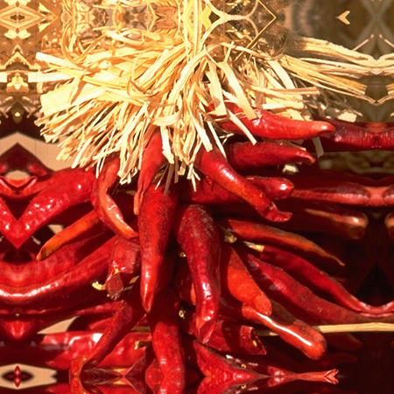


Practical matters
What about near the edge?
  the filter window falls off the edge of the image
  need to extrapolate
  methods:
    clip filter (black)
    wrap around
    copy edge
    reflect across edge
Source: S. Marschner

Slide 52
Practical matters
  methods (MATLAB):
    clip filter (black): imfilter(f, g, 0)
    wrap around: imfilter(f, g, ‘circular’)
    copy edge: imfilter(f, g, ‘replicate’)
    reflect across edge: imfilter(f, g, ‘symmetric’)
Source: S. Marschner

Slide 53
Practical matters
What is the size of the output?
MATLAB: filter2(g, f, shape)
  shape = ‘full’: output size is sum of sizes of f and g
  shape = ‘same’: output size is same as f
  shape = ‘valid’: output size is difference of sizes of f and g
full
same
valid
g
g
g
g
f
f
f
g
g
g
g
g
g
g
g
Source: S. Lazebnik

Slide 54
A little more about color…

Slide 55
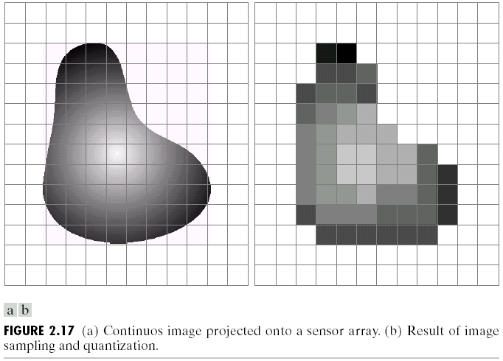
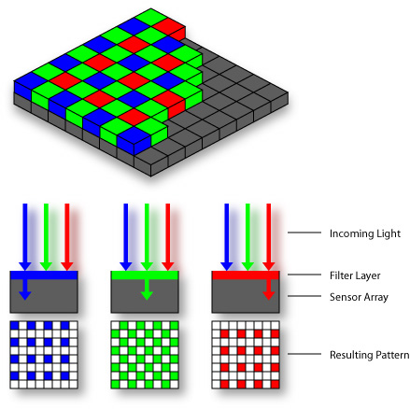
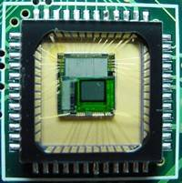
Digital Color Images
Bayer Filter
CMOS sensor

Slide 56
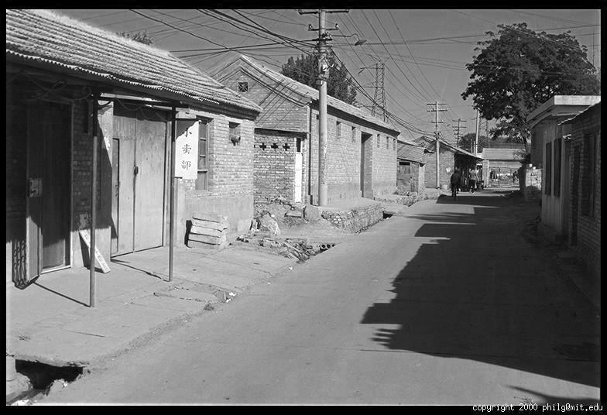
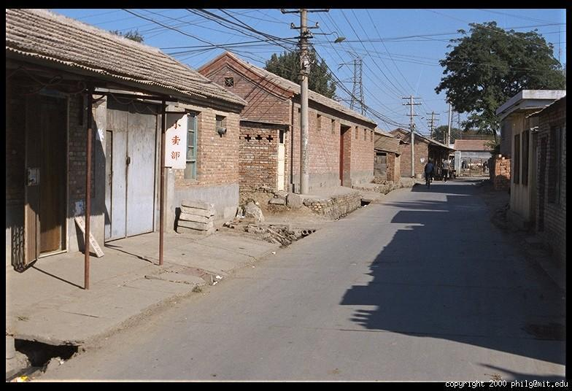
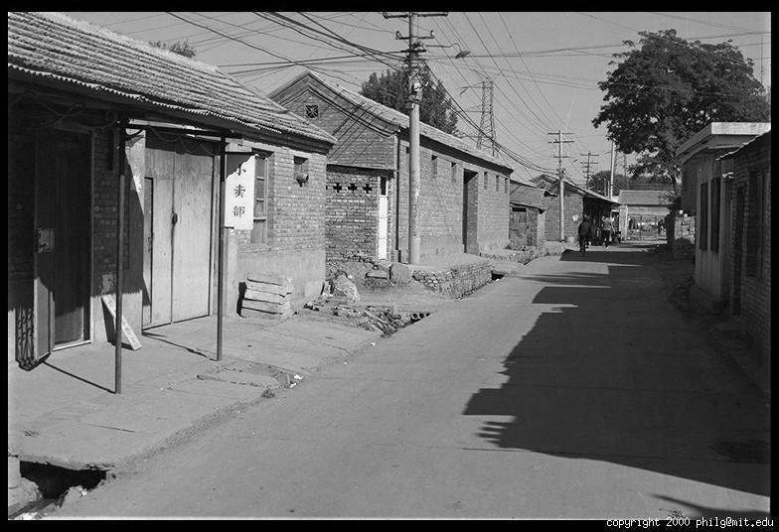
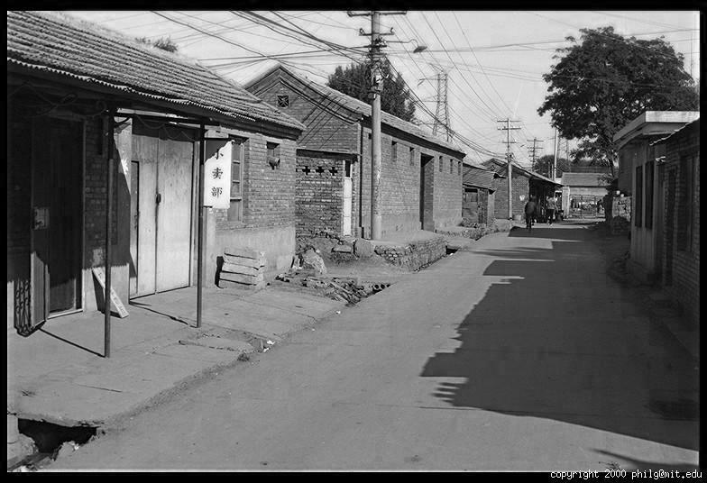
Color Image
R
G
B

Slide 57
Images in Matlab
Images represented as a matrix
Suppose we have a NxM RGB image called “im”
  im(1,1,1) = top-left pixel value in R-channel
  im(y, x, b) = y pixels down, x pixels to right in the b^{th} channel
  im(N, M, 3) = bottom-right pixel in B-channel
imread(filename) returns a uint8 image (values 0 to 255)
  Convert to double format (values 0 to 1) with im2double
column
row
R
0.92 | 0.93 | 0.94 | 0.97 | 0.62 | 0.37 | 0.85 | 0.97 | 0.93 | 0.92 | 0.99
0.95 | 0.89 | 0.82 | 0.89 | 0.56 | 0.31 | 0.75 | 0.92 | 0.81 | 0.95 | 0.91
0.89 | 0.72 | 0.51 | 0.55 | 0.51 | 0.42 | 0.57 | 0.41 | 0.49 | 0.91 | 0.92
0.96 | 0.95 | 0.88 | 0.94 | 0.56 | 0.46 | 0.91 | 0.87 | 0.90 | 0.97 | 0.95
0.71 | 0.81 | 0.81 | 0.87 | 0.57 | 0.37 | 0.80 | 0.88 | 0.89 | 0.79 | 0.85
0.49 | 0.62 | 0.60 | 0.58 | 0.50 | 0.60 | 0.58 | 0.50 | 0.61 | 0.45 | 0.33
0.86 | 0.84 | 0.74 | 0.58 | 0.51 | 0.39 | 0.73 | 0.92 | 0.91 | 0.49 | 0.74
0.96 | 0.67 | 0.54 | 0.85 | 0.48 | 0.37 | 0.88 | 0.90 | 0.94 | 0.82 | 0.93
0.69 | 0.49 | 0.56 | 0.66 | 0.43 | 0.42 | 0.77 | 0.73 | 0.71 | 0.90 | 0.99
0.79 | 0.73 | 0.90 | 0.67 | 0.33 | 0.61 | 0.69 | 0.79 | 0.73 | 0.93 | 0.97
0.91 | 0.94 | 0.89 | 0.49 | 0.41 | 0.78 | 0.78 | 0.77 | 0.89 | 0.99 | 0.93
G
0.92 | 0.93 | 0.94 | 0.97 | 0.62 | 0.37 | 0.85 | 0.97 | 0.93 | 0.92 | 0.99
0.95 | 0.89 | 0.82 | 0.89 | 0.56 | 0.31 | 0.75 | 0.92 | 0.81 | 0.95 | 0.91
0.89 | 0.72 | 0.51 | 0.55 | 0.51 | 0.42 | 0.57 | 0.41 | 0.49 | 0.91 | 0.92
0.96 | 0.95 | 0.88 | 0.94 | 0.56 | 0.46 | 0.91 | 0.87 | 0.90 | 0.97 | 0.95
0.71 | 0.81 | 0.81 | 0.87 | 0.57 | 0.37 | 0.80 | 0.88 | 0.89 | 0.79 | 0.85
0.49 | 0.62 | 0.60 | 0.58 | 0.50 | 0.60 | 0.58 | 0.50 | 0.61 | 0.45 | 0.33
0.86 | 0.84 | 0.74 | 0.58 | 0.51 | 0.39 | 0.73 | 0.92 | 0.91 | 0.49 | 0.74
0.96 | 0.67 | 0.54 | 0.85 | 0.48 | 0.37 | 0.88 | 0.90 | 0.94 | 0.82 | 0.93
0.69 | 0.49 | 0.56 | 0.66 | 0.43 | 0.42 | 0.77 | 0.73 | 0.71 | 0.90 | 0.99
0.79 | 0.73 | 0.90 | 0.67 | 0.33 | 0.61 | 0.69 | 0.79 | 0.73 | 0.93 | 0.97
0.91 | 0.94 | 0.89 | 0.49 | 0.41 | 0.78 | 0.78 | 0.77 | 0.89 | 0.99 | 0.93
B
0.92 | 0.93 | 0.94 | 0.97 | 0.62 | 0.37 | 0.85 | 0.97 | 0.93 | 0.92 | 0.99
0.95 | 0.89 | 0.82 | 0.89 | 0.56 | 0.31 | 0.75 | 0.92 | 0.81 | 0.95 | 0.91
0.89 | 0.72 | 0.51 | 0.55 | 0.51 | 0.42 | 0.57 | 0.41 | 0.49 | 0.91 | 0.92
0.96 | 0.95 | 0.88 | 0.94 | 0.56 | 0.46 | 0.91 | 0.87 | 0.90 | 0.97 | 0.95
0.71 | 0.81 | 0.81 | 0.87 | 0.57 | 0.37 | 0.80 | 0.88 | 0.89 | 0.79 | 0.85
0.49 | 0.62 | 0.60 | 0.58 | 0.50 | 0.60 | 0.58 | 0.50 | 0.61 | 0.45 | 0.33
0.86 | 0.84 | 0.74 | 0.58 | 0.51 | 0.39 | 0.73 | 0.92 | 0.91 | 0.49 | 0.74
0.96 | 0.67 | 0.54 | 0.85 | 0.48 | 0.37 | 0.88 | 0.90 | 0.94 | 0.82 | 0.93
0.69 | 0.49 | 0.56 | 0.66 | 0.43 | 0.42 | 0.77 | 0.73 | 0.71 | 0.90 | 0.99
0.79 | 0.73 | 0.90 | 0.67 | 0.33 | 0.61 | 0.69 | 0.79 | 0.73 | 0.93 | 0.97
0.91 | 0.94 | 0.89 | 0.49 | 0.41 | 0.78 | 0.78 | 0.77 | 0.89 | 0.99 | 0.93

Slide 58
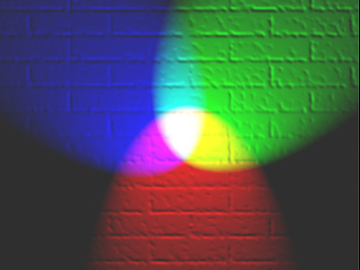
Color spaces
How can we represent color?
http://en.wikipedia.org/wiki/File:RGB_illumination.jpg

Slide 59

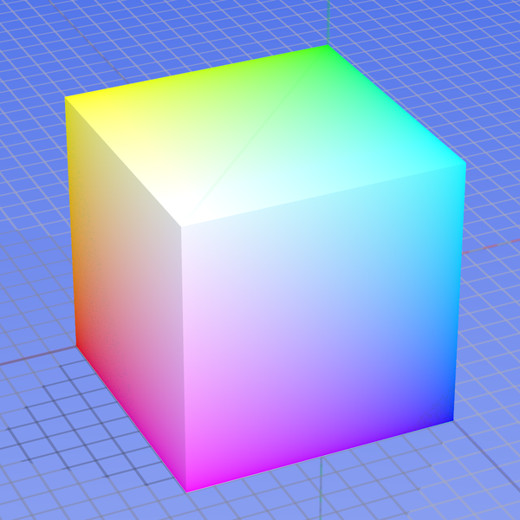
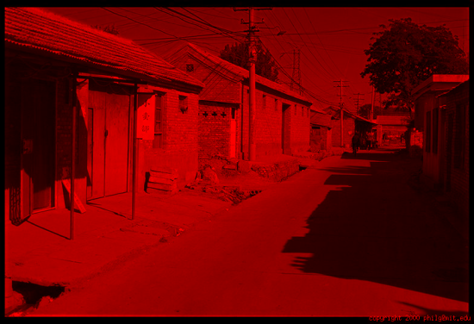
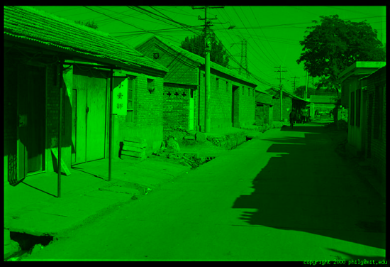
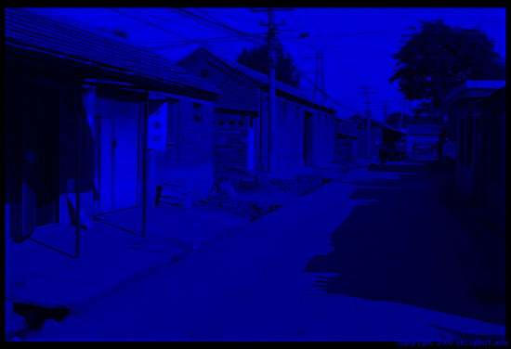
Color spaces: RGB
Default color space
0,1,0
R
(G=0,B=0)
1,0,0
G
(R=0,B=0)
0,0,1
B
(R=0,G=0)
Some drawbacks
Strongly correlated channels
Non-perceptual
Image from: http://en.wikipedia.org/wiki/File:RGB_color_solid_cube.png

Slide 60
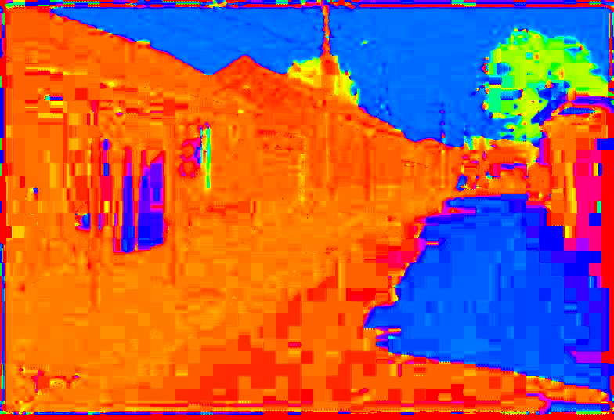
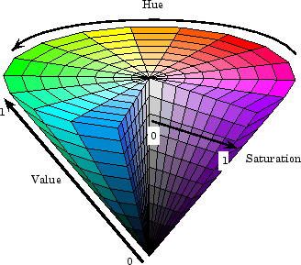
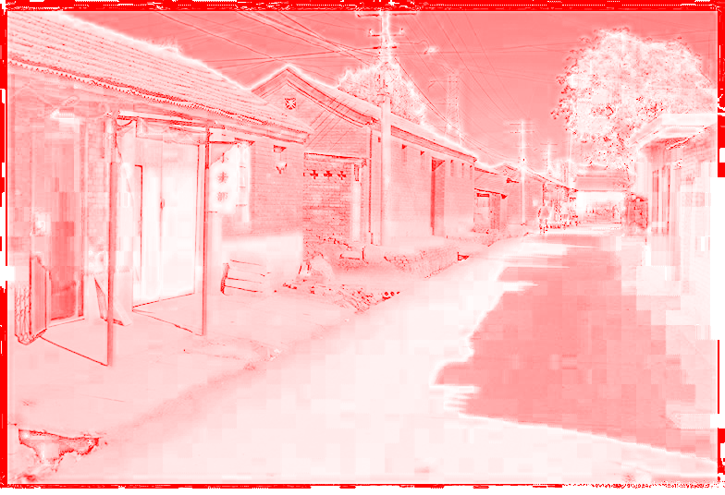
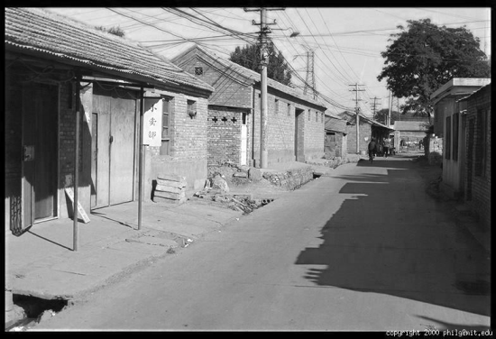
Color spaces: HSV
Intuitive color space
H
(S=1,V=1)
S
(H=1,V=1)
V
(H=1,S=0)

Slide 61
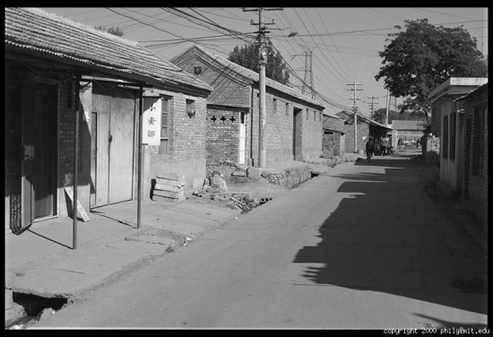





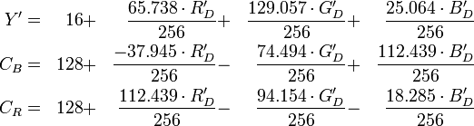
Color spaces: YCbCr
Fast to compute, good for compression, used by TV
Y=0
Y=0.5
Y
(Cb=0.5,Cr=0.5)
Cr
Cb
(Y=0.5,Cr=0.5)
Cb
Y=1
Cr
(Y=0.5,Cb=05)

Slide 62




Color spaces: CIE L*a*b*
“Perceptually uniform” color space
L
(a=0,b=0)
a
(L=65,b=0)
b
(L=65,a=0)
Luminance = brightness
Chrominance = color

Slide 63
Which contains more information?
(a) intensity (1 channel)
(b) chrominance (2 channels)

Slide 64
If you had to choose, would you rather go without luminance or chrominance?

Slide 65

Most information in intensity
Only color shown – constant intensity

Slide 66
Most information in intensity
Only intensity shown – constant color

Slide 67
Most information in intensity
Original image

Slide 68


Take-home messages
Image is a matrix of numbers (light intensities at different orientations)
  Interpreted mainly through local comparisons
Linear filtering is sum of dot product at each position
  Can smooth, sharpen, translate (among many other uses)
Attend to details: filter size, extrapolation, cropping
Color spaces beyond RGB sometimes useful
=
0.92 | 0.93 | 0.94 | 0.97 | 0.62 | 0.37 | 0.85 | 0.97 | 0.93 | 0.92 | 0.99
0.95 | 0.89 | 0.82 | 0.89 | 0.56 | 0.31 | 0.75 | 0.92 | 0.81 | 0.95 | 0.91
0.89 | 0.72 | 0.51 | 0.55 | 0.51 | 0.42 | 0.57 | 0.41 | 0.49 | 0.91 | 0.92
0.96 | 0.95 | 0.88 | 0.94 | 0.56 | 0.46 | 0.91 | 0.87 | 0.90 | 0.97 | 0.95
0.71 | 0.81 | 0.81 | 0.87 | 0.57 | 0.37 | 0.80 | 0.88 | 0.89 | 0.79 | 0.85
0.49 | 0.62 | 0.60 | 0.58 | 0.50 | 0.60 | 0.58 | 0.50 | 0.61 | 0.45 | 0.33
0.86 | 0.84 | 0.74 | 0.58 | 0.51 | 0.39 | 0.73 | 0.92 | 0.91 | 0.49 | 0.74
0.96 | 0.67 | 0.54 | 0.85 | 0.48 | 0.37 | 0.88 | 0.90 | 0.94 | 0.82 | 0.93
0.69 | 0.49 | 0.56 | 0.66 | 0.43 | 0.42 | 0.77 | 0.73 | 0.71 | 0.90 | 0.99
0.79 | 0.73 | 0.90 | 0.67 | 0.33 | 0.61 | 0.69 | 0.79 | 0.73 | 0.93 | 0.97
0.91 | 0.94 | 0.89 | 0.49 | 0.41 | 0.78 | 0.78 | 0.77 | 0.89 | 0.99 | 0.93
1
1
1
1
1
1
1
1
1

