Slide 1
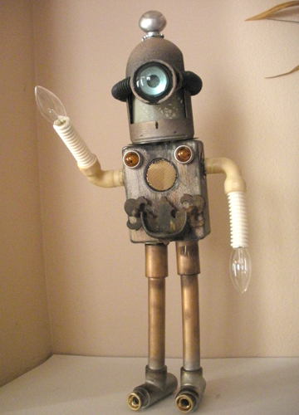
Computer Vision
1/17/2017
CS 543 / ECE 549
University of Illinois
Instructor: Derek Hoiem
TAs: Tanmay Gupta
Bryan Plummer
Chuhang Zou
photo source

Slide 2
Today’s class
A little about me and TAS
Intro to computer vision
Course logistics
Questions

Slide 3
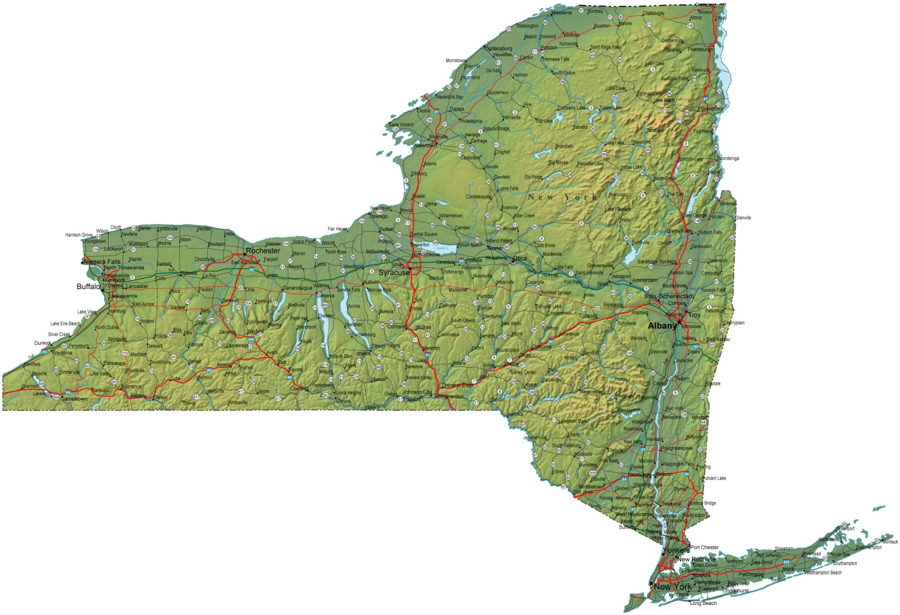
About me
Raised in “upstate” NY

Slide 4
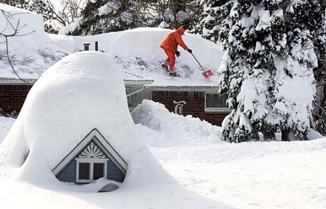
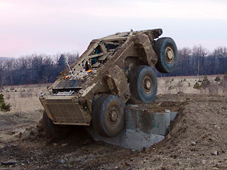
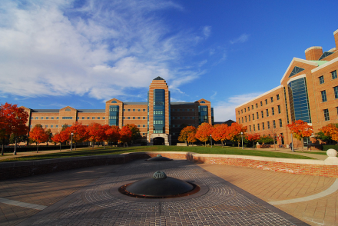
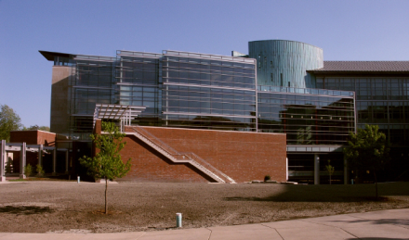
About me
1998-2002
Undergrad at SUNY Buffalo
B.S., EE and CSE
2002-2007
Grad at Carnegie Mellon
Ph.D. in Robotics
2007-2008
Postdoc at Beckman Institute
2009-
Prof in CS at UIUC

Slide 5
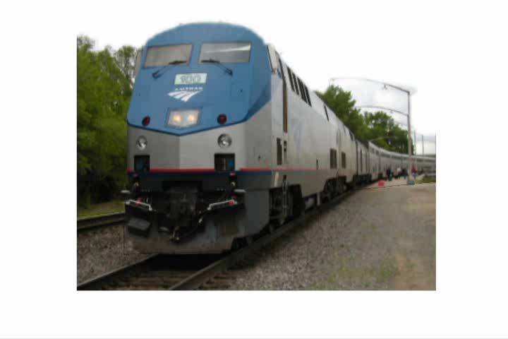
My research: single-view 3D reconstruction
with Efros, Hebert

Slide 6
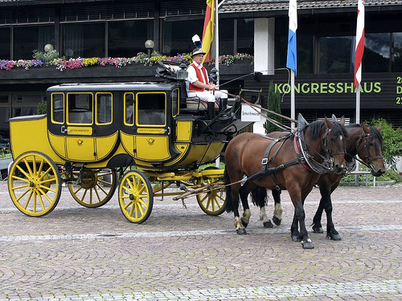
My Research: objects and attributes
Animal
Vehicle
head
Four-legged
Mammal
wheel
leg
Can run, jump
Is herbivorous
Facing right
Move on road
Facing right
with Farhadi, Endres
Notes:
Example of a detection result of our system, which has not seen carriages or horses during training. The red box is a detected location of a vehicle; the green box indicates a detected location of an animal. The shown categories and parts are those that served as evidence for the detections.

Slide 7

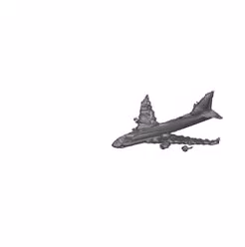
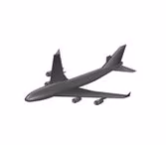
My Research: full 3D shape from depth
Match to exemplar,
Predict complete shape
Input Depth Image
Estimated Shape
True Shape
with Rock, Shin, et al.

Slide 8
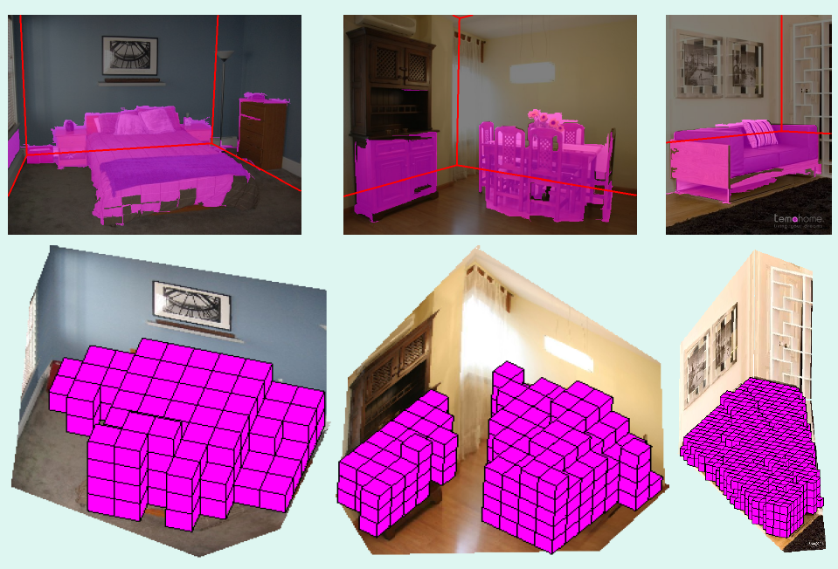
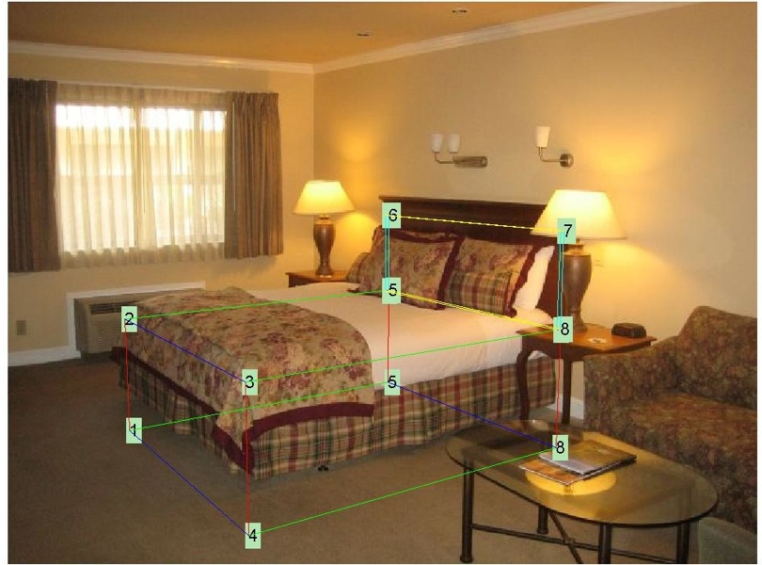
My Research
Recovering 3D layout and context
BED
with Hedau, Forsyth
Notes:
Left: Pink regions are estimated as pixels or 3D voxels that are occupied by objects. Red lines indicate estimated floor-wall boundaries. Right: An example of correct localization and identification of a bed, using spatial layout information.

Slide 9
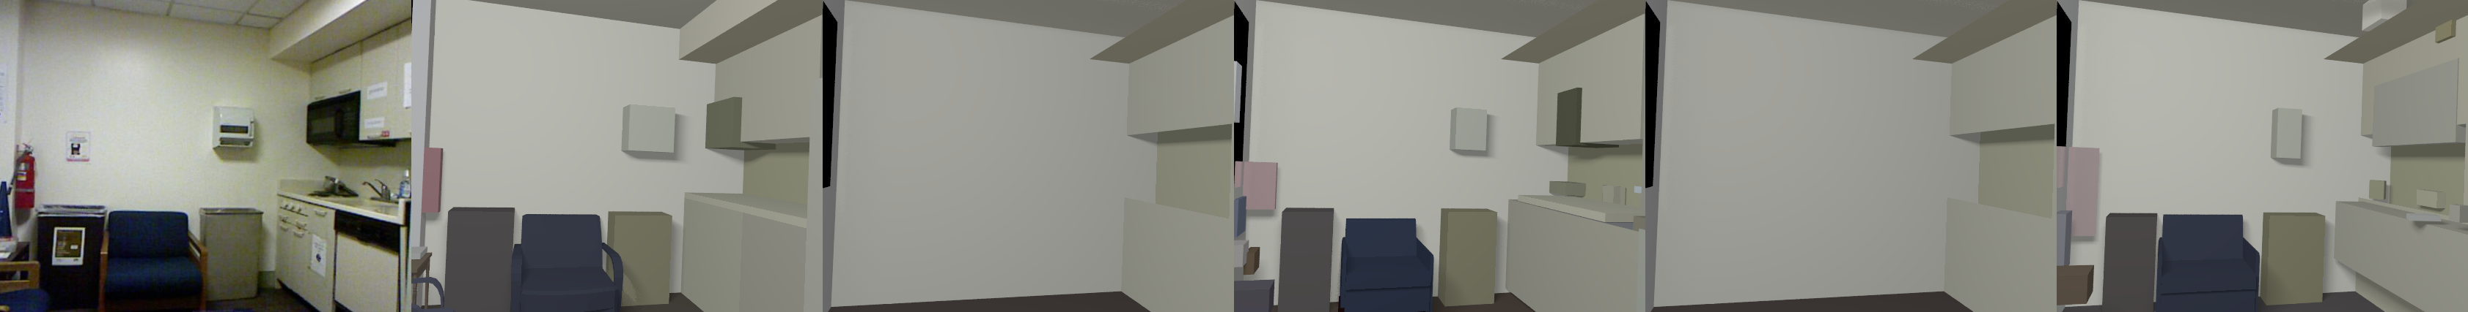
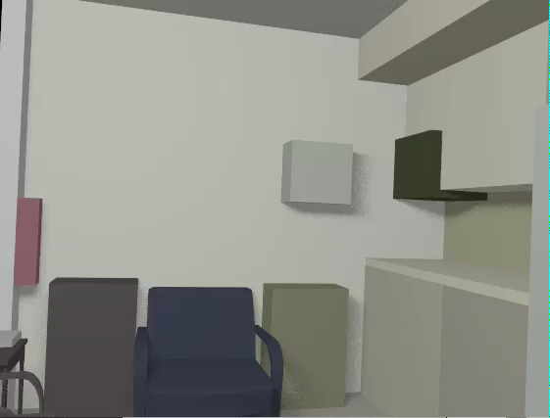
My Research
3D scene model from RGB+D image
RGBD Image
3D Model
with Zou, Guo

Slide 10
My Research

Slide 11
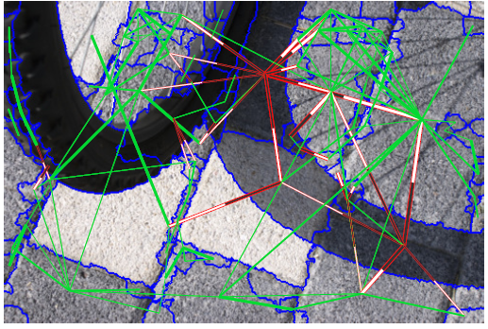
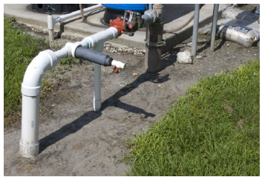
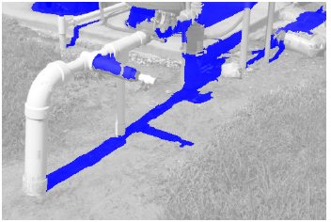
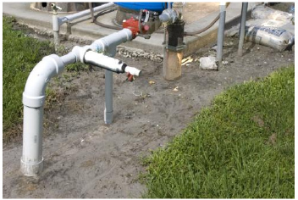
My Research
Shadow detection and removal
Detection by Comparing Pairs of Regions
Input
Detected Shadows
Removed Shadows
with Ruiqi Guo and Qieyun Dai

Slide 12
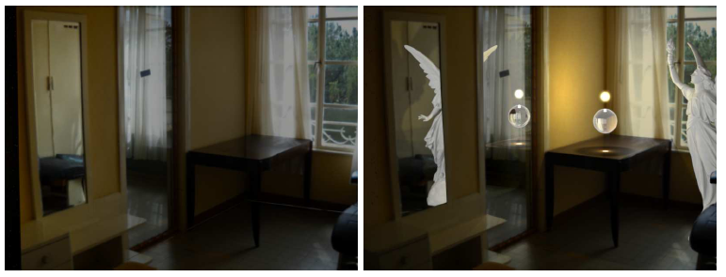
My Research
Editing images as if they were 3D scenes
(video)
with Karsch, Hedau, Forsyth

Slide 13
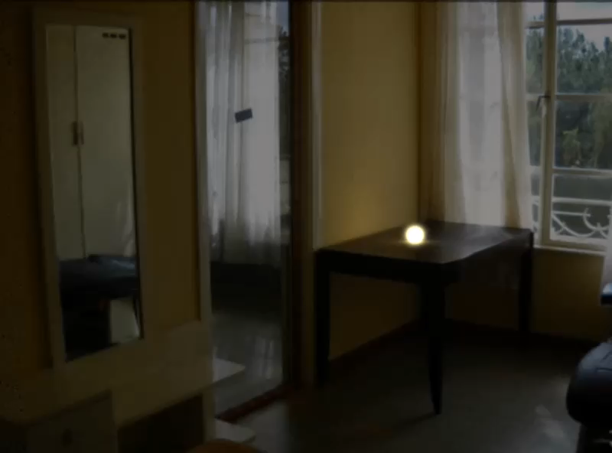

Slide 14
My Research: visual question answering
with Shih, Gupta, Singh

Slide 15
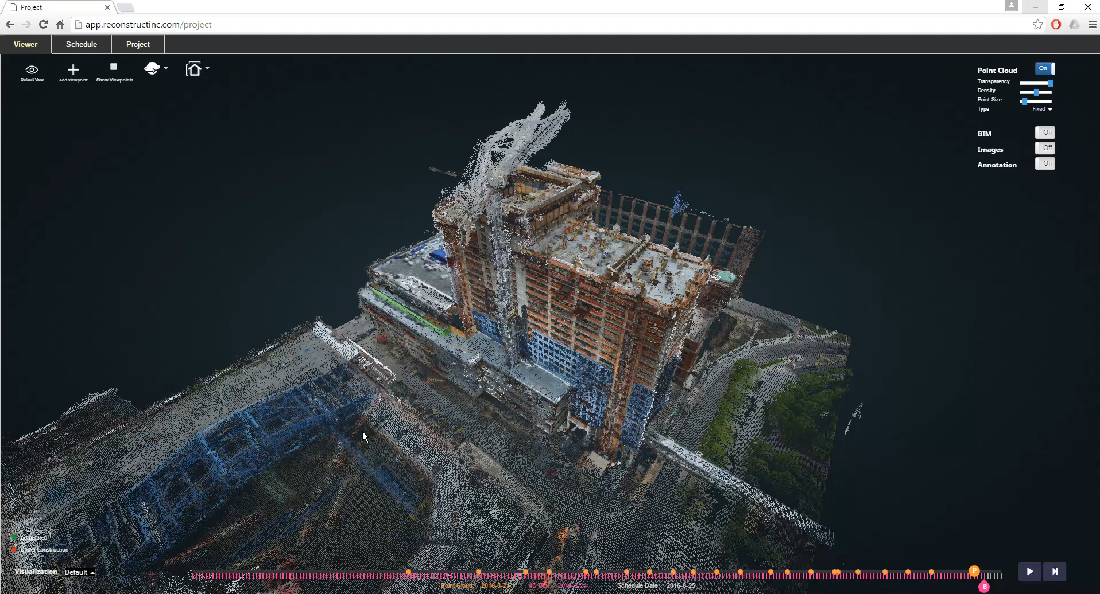
Reconstruct, Inc: vision for construction
https://www.reconstructinc.com/

Slide 16
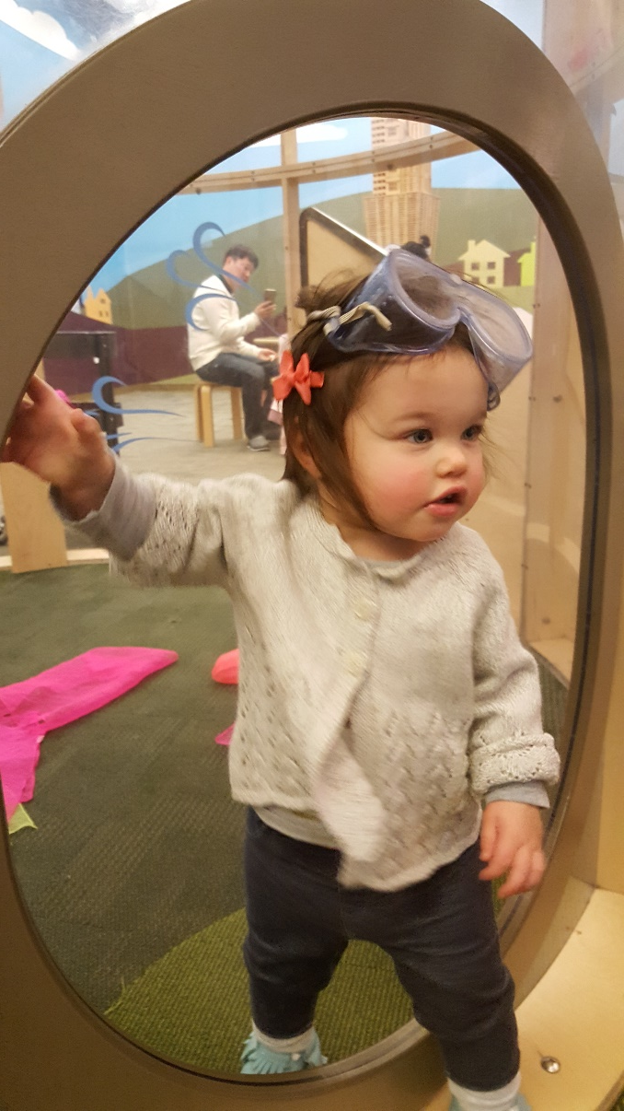
My daughter :)
Isla

Slide 17
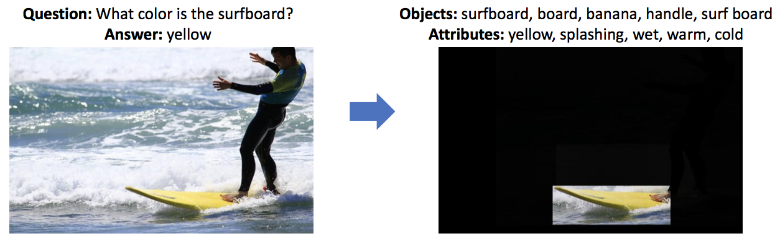
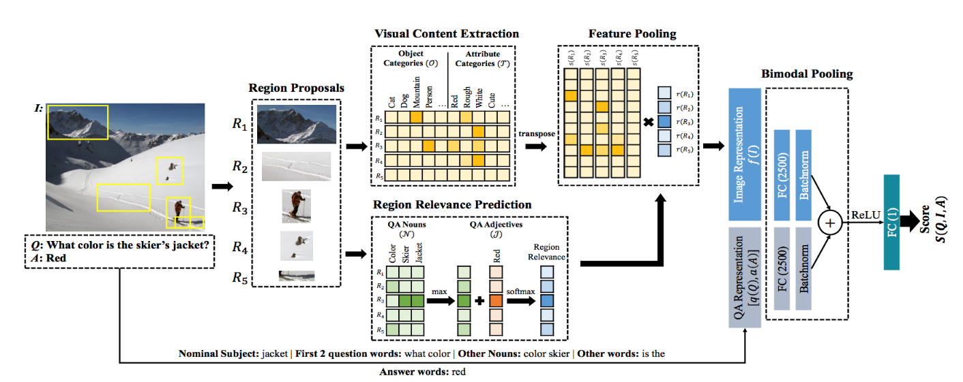
Tanmay Gupta (TA)
Hometown
Bokaro Steel City, India
Undergrad
IIT Kanpur, India
Research
Understanding the Visual World through Language
Visual Question Answering
Visual Relationships and their role in Vision-Language Tasks

Slide 18
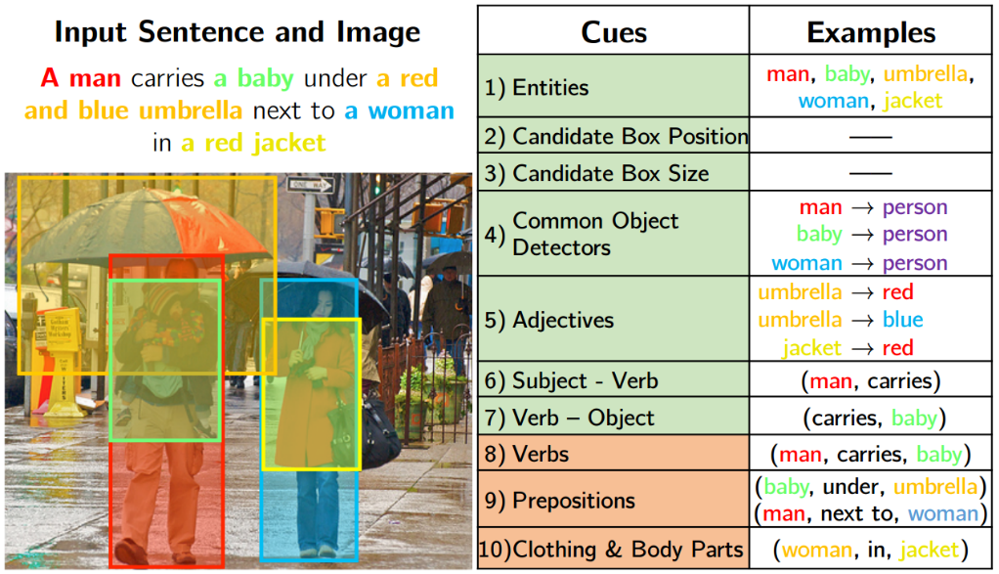
Bryan Plummer (TA)
Grew up in Angeles National Forest in Southern California
Undergrad: 2 years at Mesa Community College, 2 years at UIUC
Current Research: vision-language (language grounding, bidirectional retrieval, caption generation), video summarization

Slide 19
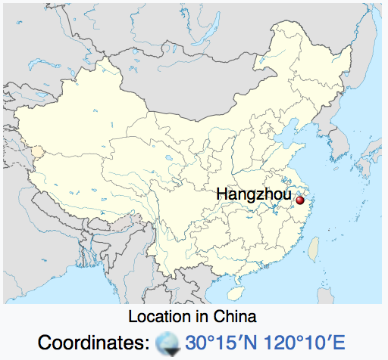
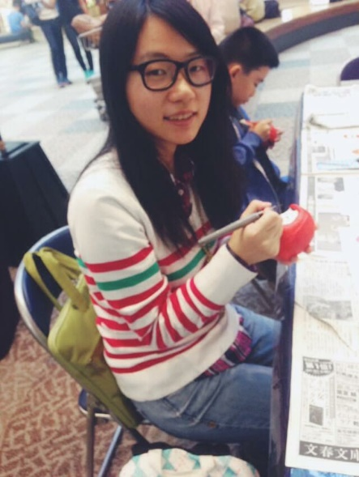
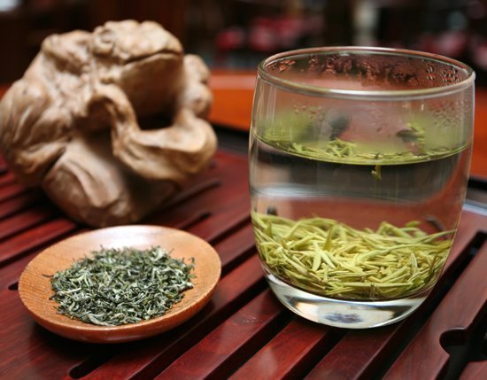
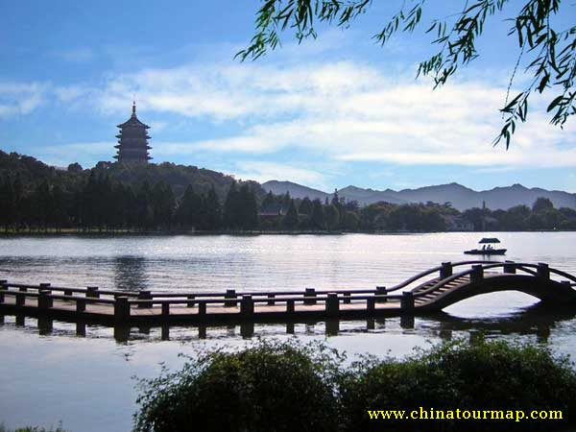
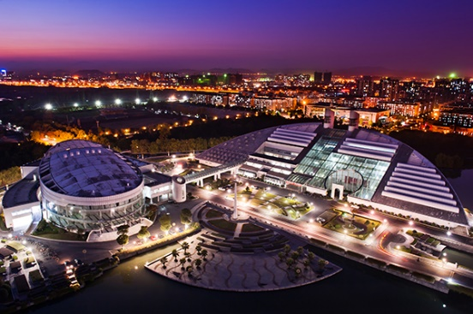
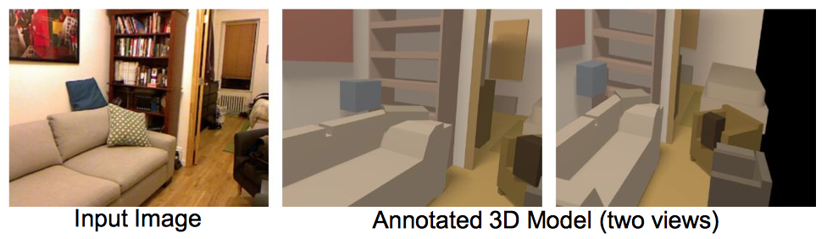
Chuhang Zou (TA)
Grew up in Hangzhou, China
2010-2014 CS Undergrad at Zhejiang University, China
2014- CS PhD at UIUC
Research: 3D scene understanding, 3D shape & deep
learning

Slide 20
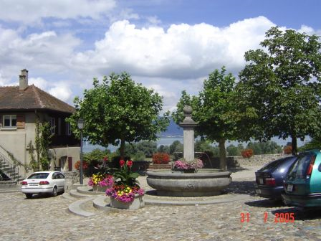
Computer Vision
Make computers understand images and video.
What kind of scene?
Where are the cars?
How far is the building?
…

Slide 21
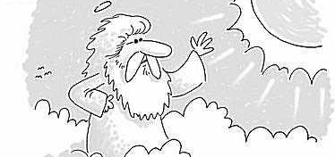
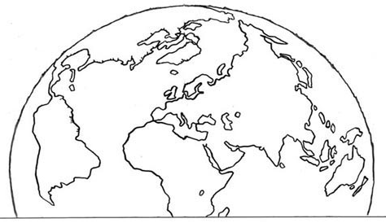
The miracle of vision
Let there be light!
Let there be light!
Doh! I was hoping for LIDAR.

Slide 22
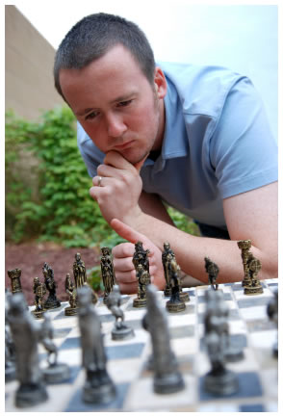
Vision is really hard
Vision is an amazing feat of natural intelligence
  More human brain devoted to vision than anything else
Is that a queen or a bishop?

Slide 23
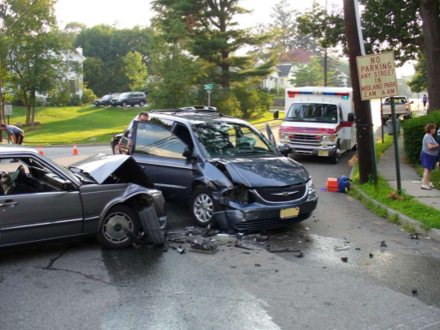
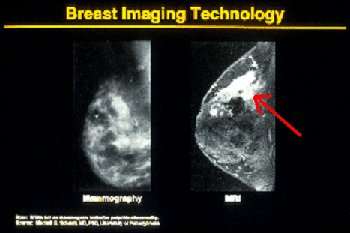
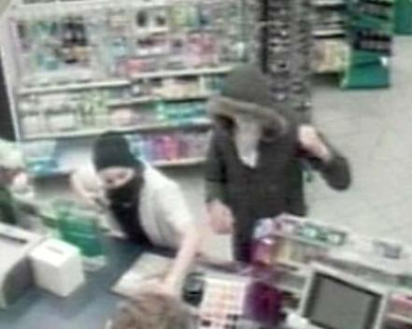
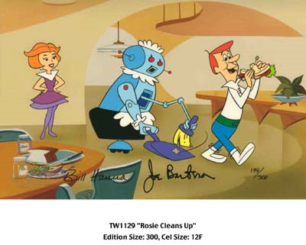
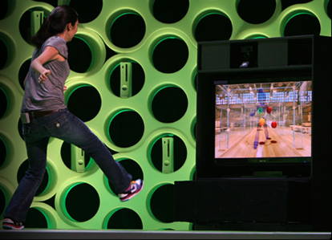
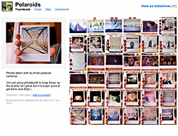
Computer vision matters
Safety
Health
Security
Comfort
Fun
Access

Slide 24

Two reasons for computer vision
Household Robots
Assisted Driving
Notes:
During my talk: 4 million hours spent doing housework in US; 4 deaths by automobile.

Slide 25
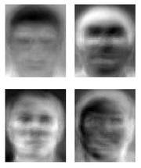
Ridiculously brief history of computer vision
1966: Minsky assigns computer vision as an undergrad summer project
1960’s: interpretation of synthetic worlds
1970’s: some progress on interpreting selected images
1980’s: ANNs come and go; shift toward geometry and increased mathematical rigor
1990’s: face recognition; statistical analysis in vogue
2000’s: broader recognition; large annotated datasets available; video processing starts
2010’s: ANNs are back for big improvements in recognition; likely large increase in deployed vision systems
2020’s: autonomous vehicles, the great robot rebellion?
Guzman ‘68
Ohta Kanade ‘78
Turk and Pentland ‘91

Slide 26
How vision is used now
Examples of state-of-the-art
Some of the following slides by Steve Seitz

Slide 27
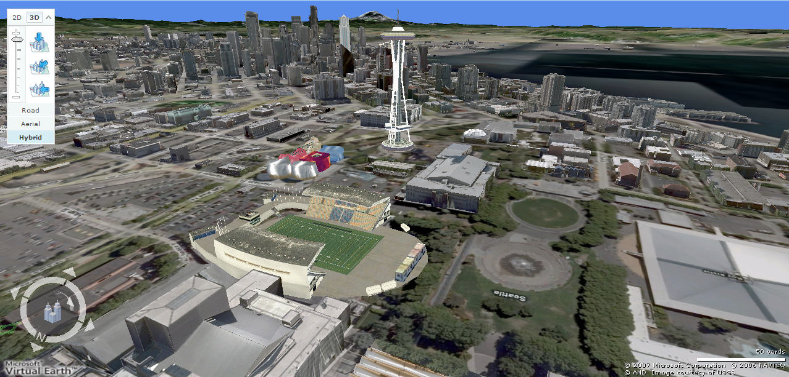
Earth viewers (3D modeling)
Image from Microsoft’s Virtual Earth
(see also: Google Earth)

Slide 28
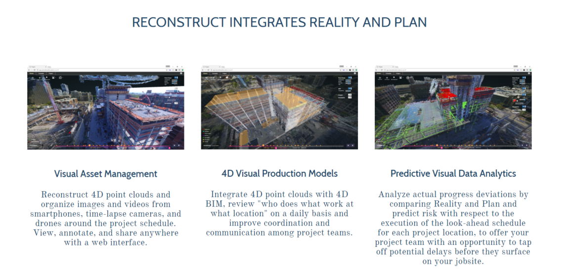
Vision in construction
reconstructinc.com

Slide 29
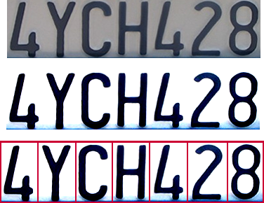
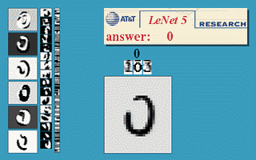
Optical character recognition (OCR)
Technology to convert scanned docs to text
  If you have a scanner, it probably came with OCR software
Digit recognition, AT&T labs
http://www.research.att.com/~yann/
License plate readers
http://en.wikipedia.org/wiki/Automatic_number_plate_recognition

Slide 30
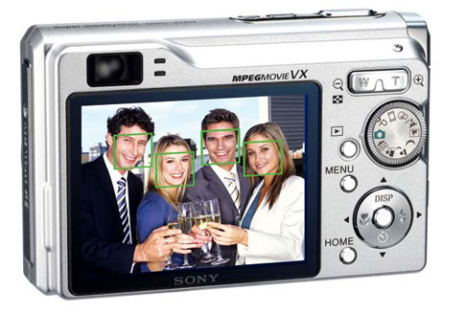
Face detection
Most digital cameras detect faces (and more)
  Canon, Sony, Fuji, …
Notes:
Why would this be useful? Main reason is focus. Also enables “smart” cropping.

Slide 31
Smile detection
Sony Cyber-shot® T70 Digital Still Camera

Slide 32
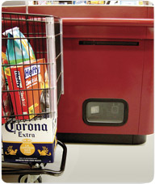
Object recognition (in supermarkets)
LaneHawk by EvolutionRobotics
“A smart camera is flush-mounted in the checkout lane, continuously watching for items. When an item is detected and recognized, the cashier verifies the quantity of items that were found under the basket, and continues to close the transaction. The item can remain under the basket, and with LaneHawk,you are assured to get paid for it… “

Slide 33

Shopping without checkout

Slide 34
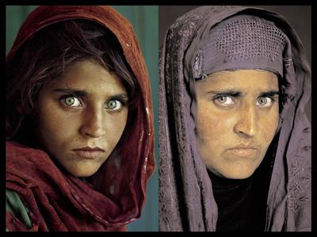
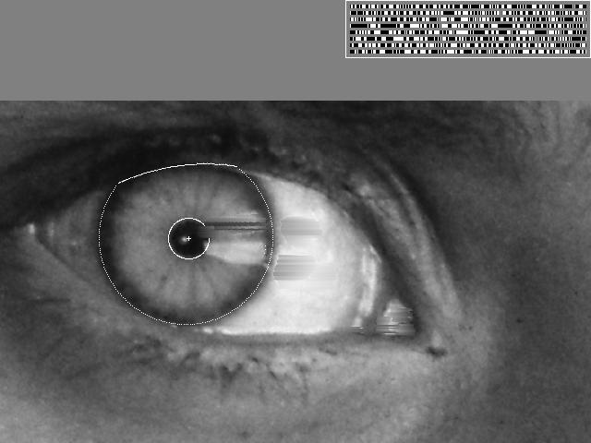

Vision-based biometrics
“How the Afghan Girl was Identified by Her Iris Patterns” Read the story
wikipedia
Notes:
Age 12, Age 30

Slide 35

Object recognition (in mobile phones)
  Point & Find, Nokia
  Google Goggles

Slide 36


Special effects: shape capture
The Matrix movies, ESC Entertainment, XYZRGB, NRC

Slide 37


Special effects: motion capture
Pirates of the Carribean, Industrial Light and Magic

Slide 38

Sports
Sportvision first down line
Nice explanation on www.howstuffworks.com
http://www.sportvision.com/video.html

Slide 39

Smart Cars: Tesla

Slide 40

Smart cars
Mobileye: vision systems currently in many cars
http://mobileye.com/technology/applications/vehicle-detection/forward-colision-warning/
http://mobileye.com/technology/applications/pedestrian-detection/pedestrian-collision-warning/
“Subaru thinks cameras are better than radar cruise”
http://www.roadandtrack.com/new-cars/news/a6852/subaru-camera-controlled-cruise/

Slide 41

Google cars
Google in talks with Ford, Toyota and Volkswagen to realise driverless cars
http://www.theatlantic.com/technology/archive/2014/05/all-the-world-a-track-the-trick-that-makes-googles-self-driving-cars-work/370871/

Slide 42


Interactive Games: Kinect
Object Recognition: http://www.youtube.com/watch?feature=iv&v=fQ59dXOo63o
Mario: http://www.youtube.com/watch?v=8CTJL5lUjHg
3D: http://www.youtube.com/watch?v=7QrnwoO1-8A
Robot: http://www.youtube.com/watch?v=w8BmgtMKFbY

Slide 43

Vision in space
NASA'S Mars Exploration Rover Spirit captured this westward view from atop
a low plateau where Spirit spent the closing months of 2007.
Vision systems (JPL) used for several tasks
  Panorama stitching
  3D terrain modeling
  Obstacle detection, position tracking
  For more, read “Computer Vision on Mars” by Matthies et al.

Slide 44


Industrial robots
Vision-guided robots position nut runners on wheels
http://www.automationworld.com/computer-vision-opportunity-or-threat

Slide 45




Mobile robots
NASA’s Mars Spirit Rover
http://en.wikipedia.org/wiki/Spirit_rover
http://www.robocup.org/
Saxena et al. 2008
STAIR at Stanford
http://www.youtube.com/watch?v=DF39Ygp53mQ

Slide 46


Medical imaging
3D imaging
MRI, CT
Image guided surgery
Grimson et al., MIT

Slide 47
Current state of the art
You just saw examples of current systems
  Many of these are less than 5 years old
This is a very active research area, and rapidly changing
  Many new apps in the next 5 years
To learn more about vision applications and companies
  David Lowe maintains an excellent overview of vision companies
    http://www.cs.ubc.ca/spider/lowe/vision.html

Slide 48
Course outline
Prof: Derek Hoiem (dhoiem@illinois.edu ), SC3312
TAs: Tanmay Gupta, tgupta6
Bryan Plummer, bplumme2
Chuhang Zou, czou4
Web page:
https://courses.engr.illinois.edu/cs543/

Slide 49
Waitlist
Fill out this form and keep coming to class
  https://goo.gl/forms/p3jQZ4CX3exc5QNm2
Will create priority list for 25 overflow seats and any drops by early next week
I don’t know what ECE 549 ADD is ¯\_(ツ)_/¯

Slide 50
Grades
Homeworks (75%)
Final project (25%)
Attendance
Late policy
10 points per day
5 late days forgiven

Slide 51
Academic Integrity
Can discuss hw with peers, but don’t copy
Carefully document any sources within hw hand-in
Don’t use code from Internet unless you have permission
  If you’re not sure, ask
Minimum penalty for any violation is zero on full assignment (15% of total grade)

Slide 52
Getting help outside of class
Office hours
  Time, see website
Otherwise, just stop by. If I’m not there, send me an e-mail.
Discussion board:
https://piazza.com/class/i4ohqjpy49s6ga
TAs: Tanmay Gupta (tgupta6@illinois.edu)
  Bryan Plummer (bplumme2@illinois.edu)
  Chuhang Zou (czou4@illinois.edu)
Readings/Textbook
Computer Vision: A Modern Approach (2nd edition) by David Forsyth and Jean Ponce (2011)
See syllabus for other useful books

Slide 53
What to expect from this course
Broad coverage (geometry, image processing, recognition, multiview, video)
Background to delve deeper into any computer vision-related topic
Practical experience
Lots of work, tough material, fast pace, but hopefully lots of learning too!

Slide 54
Topics
Interpreting Intensities
  What determines the brightness and color of a pixel?
  How can we use image filters to extract meaningful information from the image?
Correspondence and Alignment
  How can we find corresponding points in objects or scenes?
  How can we estimate the transformation between them?
Perspective and 3D Geometry
  How can we map between the 3D world and the 2D image?
  How can we recover 3D coordinates from images or video?
Grouping and Segmentation
  How can we group pixels into meaningful regions?
Categorization and Object Recognition
  How can we represent images and categorize them?
  How can we recognize categories of objects?
Advanced Topics
  Action recognition, 3D scenes and context, VQA, …

Slide 55
Prerequisites
Linear algebra, basic calculus, and probability
Programming will mostly be in Matlab, may be some Python
Experience with image processing or Matlab will help but is not necessary

Slide 56
Goals and Expectations
My goal: maximize the learning effectiveness of your time
What I expect from you
  Attend and participate, when possible
  Start assignments well before deadline
  Tell me what’s working and suggest improvements

Slide 57

Final comments
To do
  Sign up for newsgroup:
  https://piazza.com/class/i4ohqjpy49s6ga
  Sign up for Matlab tutorial with Bryan (if interested):
  http://doodle.com/poll/cwg3qeiuh2yq89hs
  Read syllabus, etc.
Next class: light and color
Questions?

