Slide 1
Object Category Detection: Statistical Templates
04/14/15
Computer Vision
CS 543 / ECE 549
University of Illinois
Derek Hoiem

Slide 2
Logistics
HW 5 due next Monday
Final project
  Posters on May 8, 7-10pm (final exam period)
  Papers due following Monday (one per group)
Remaining classes
  Object detection/tracking: next three classes
  Action recognition
  3D scenes/context
  Summary lecture and feedback (2nd to last day)
  I need to miss last class – Jiabin will teach convolutional neural networks

Slide 3
Today’s class: Object Category Detection
Overview of object category detection
Statistical template matching
  Dalal-Triggs pedestrian detector (basic concept)
  Viola-Jones detector (cascades, integral images)
  R-CNN detector (object proposals/CNN)

Slide 4
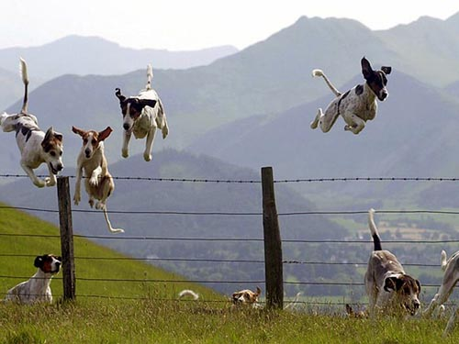
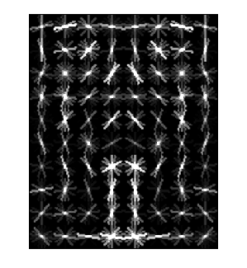
Object Category Detection
Focus on object search: “Where is it?”
Build templates that quickly differentiate object patch from background patch
Dog Model
…
Object or
Non-Object?

Slide 5
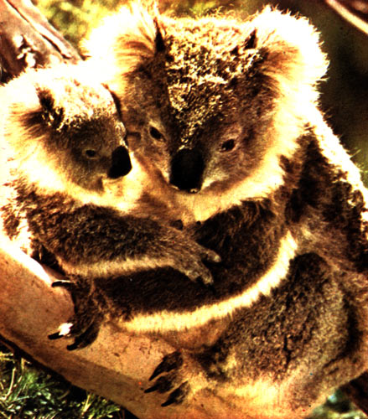
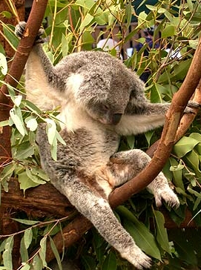
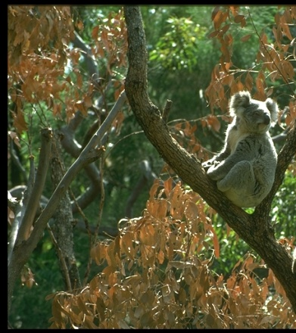
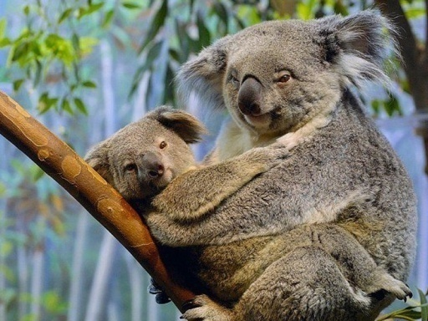
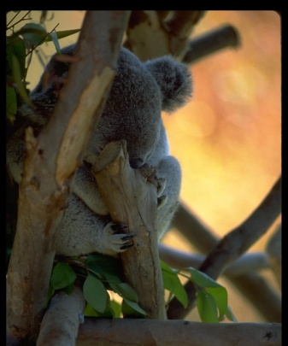
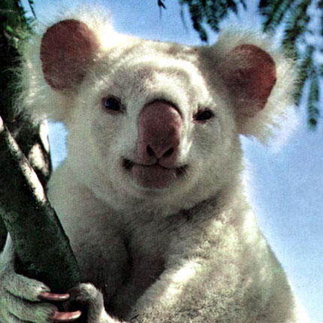
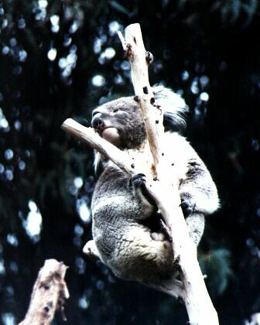
Challenges in modeling the object class
Illumination
Object pose
Clutter
Occlusions
Intra-class appearance
Viewpoint
Slide from K. Grauman, B. Leibe

Slide 6
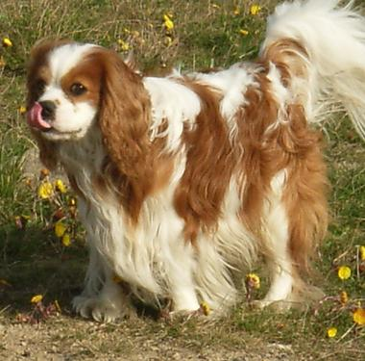
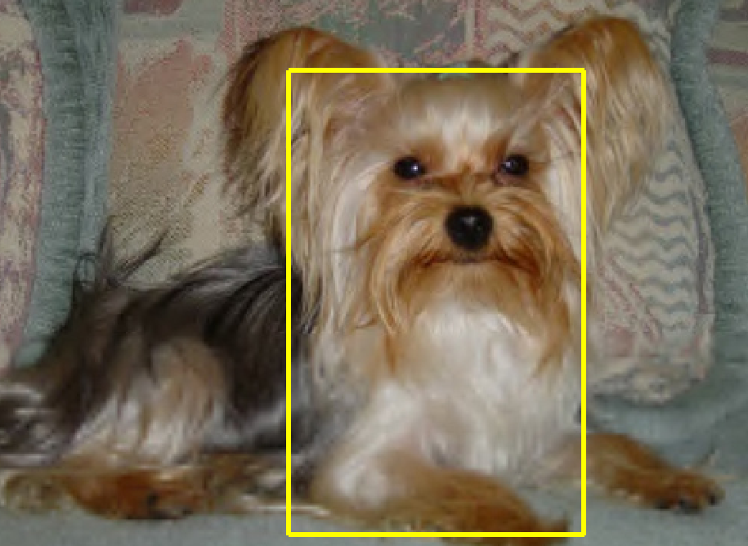
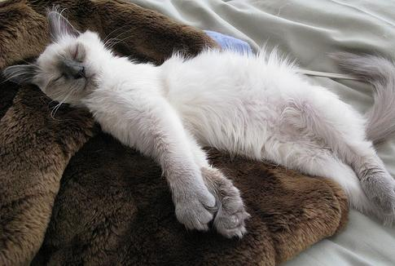
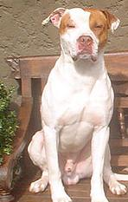
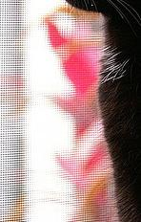

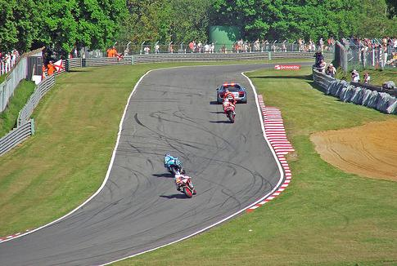

Challenges in modeling the non-object class
True Detections
Bad Localization
Confused with Similar Object
Confused with Dissimilar Objects
Misc. Background

Slide 7
General Process of Object Recognition
Specify Object Model
What are the object parameters?
Generate Hypotheses
Score Hypotheses
Resolve Detections

Slide 8
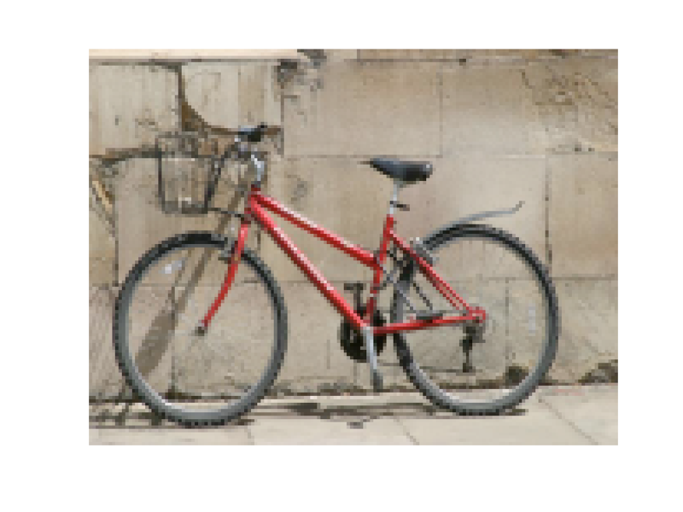
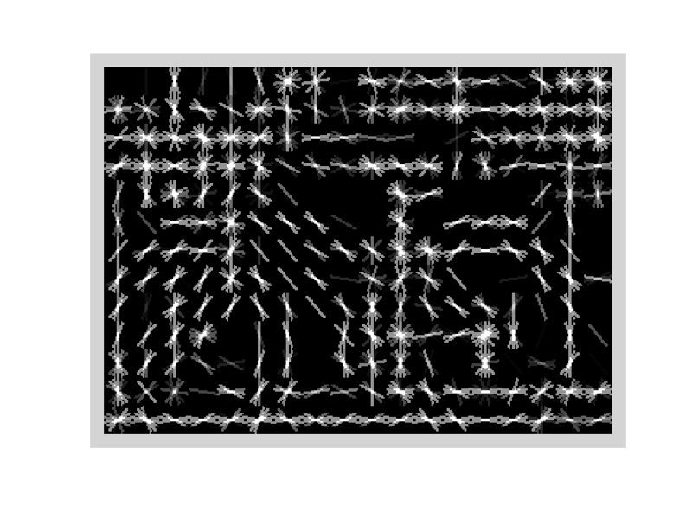
Specifying an object model
Statistical Template in Bounding Box
  Object is some (x,y,w,h) in image
  Features defined wrt bounding box coordinates
Image
Template Visualization
Images from Felzenszwalb

Slide 9
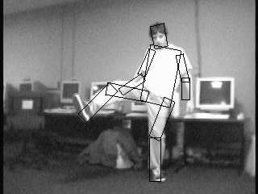

Specifying an object model
2. Articulated parts model
  Object is configuration of parts
  Each part is detectable
Images from Felzenszwalb

Slide 10

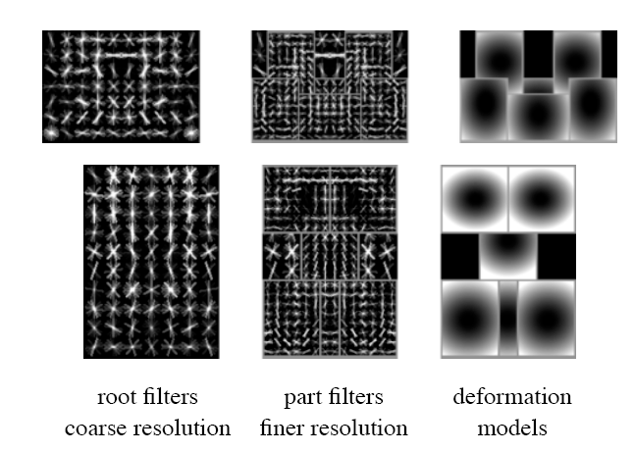
Specifying an object model
3. Hybrid template/parts model
Detections
Template Visualization
Felzenszwalb et al. 2008

Slide 11
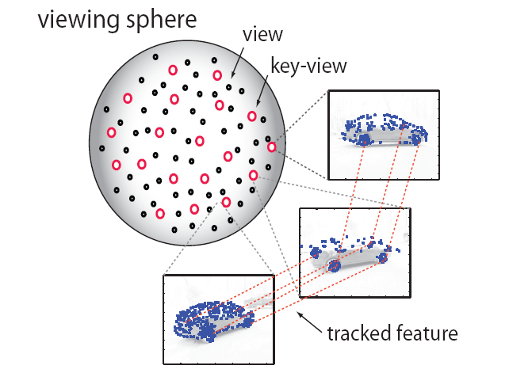
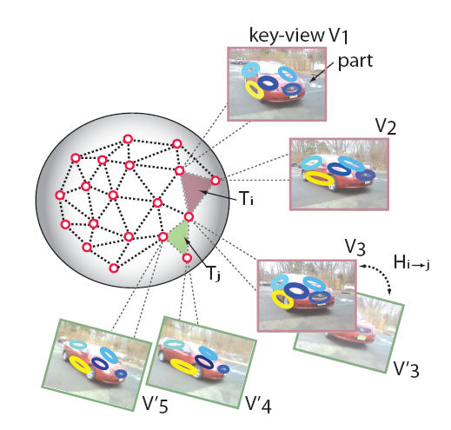
Specifying an object model
3D-ish model
Object is collection of 3D planar patches under affine transformation

Slide 12
General Process of Object Recognition
Specify Object Model
Generate Hypotheses
Propose an alignment of the model to the image
Score Hypotheses
Resolve Detections

Slide 13

Generating hypotheses
Sliding window
  Test patch at each location and scale

Slide 14
Generating hypotheses
Sliding window
  Test patch at each location and scale

Slide 15
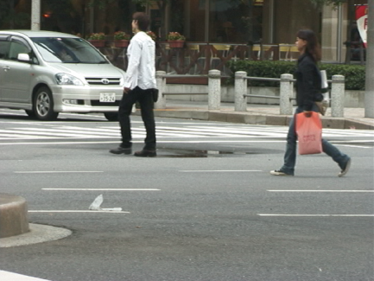
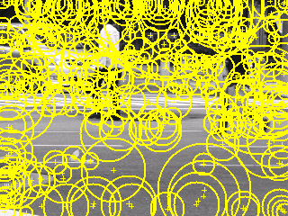
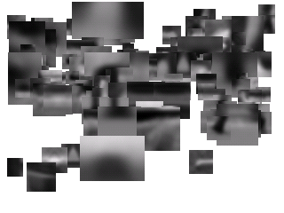
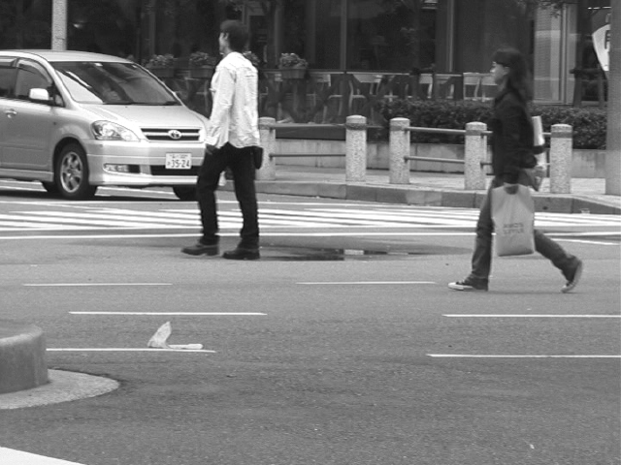
Generating hypotheses
2. Voting from patches/keypoints
Matched Codebook
Entries
Probabilistic
Voting
Interest Points
y
s
3D Voting Space
(continuous)
x
ISM model by Leibe et al.

Slide 16
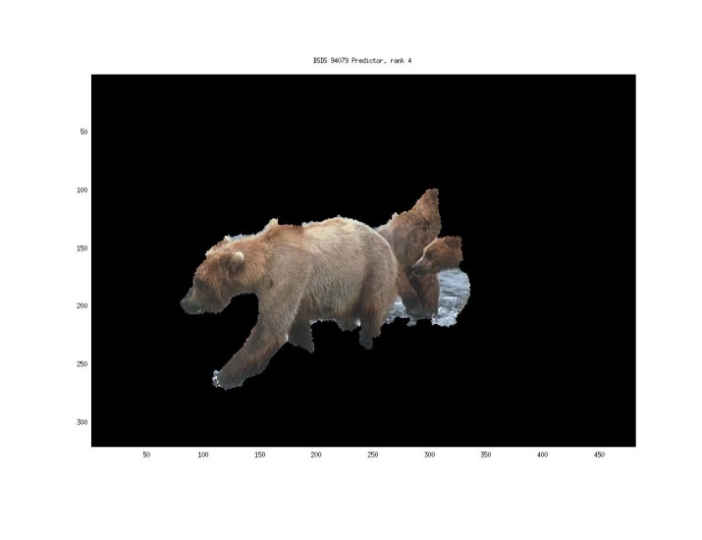
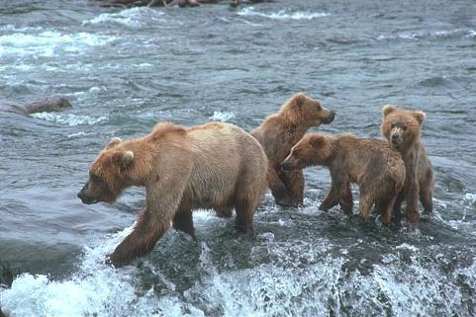
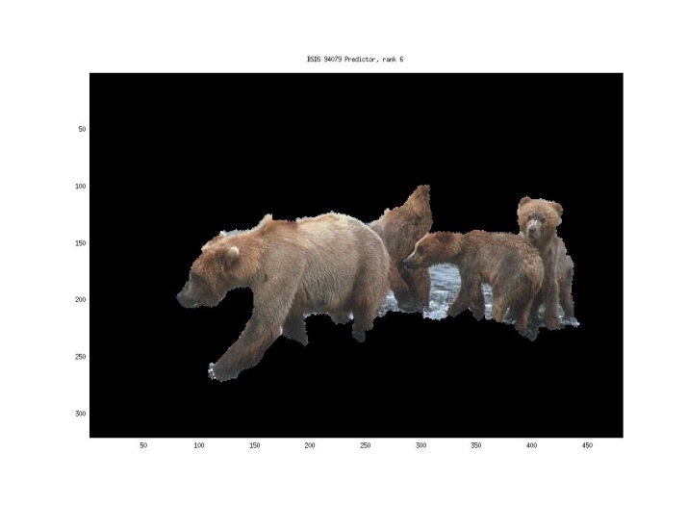
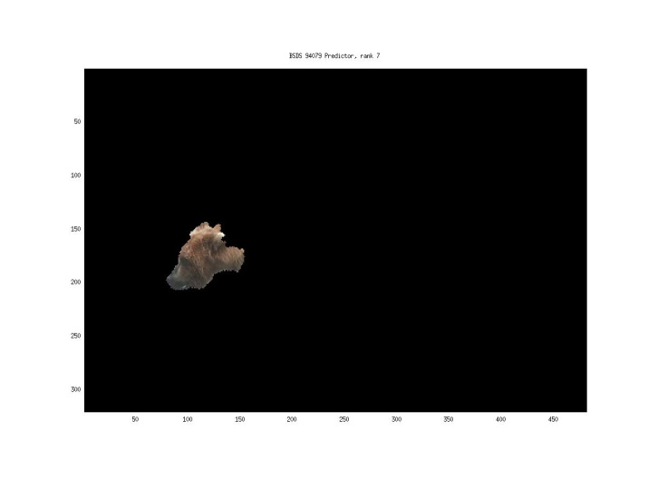
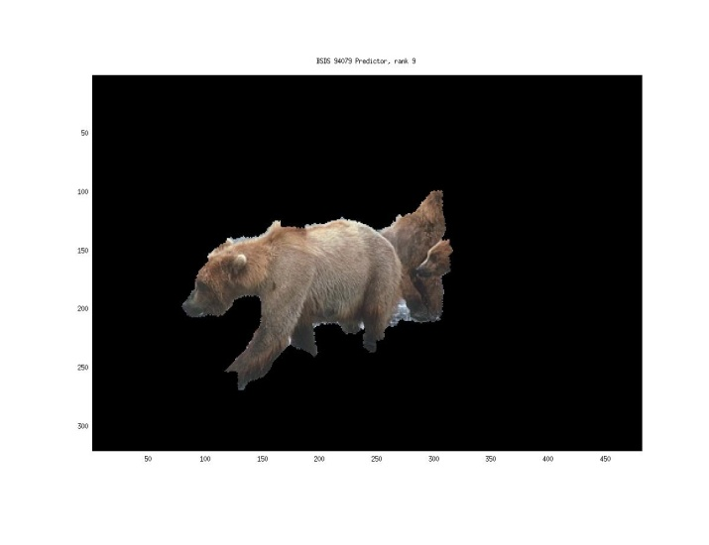
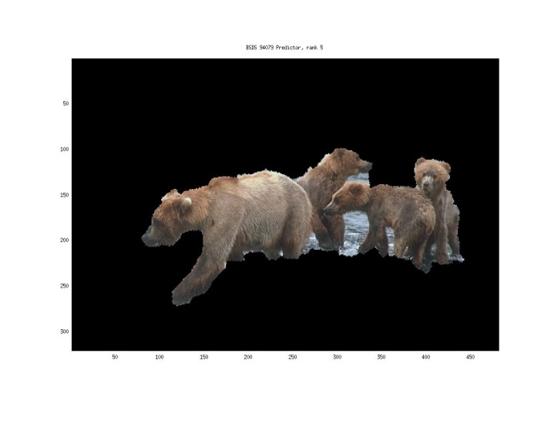
Generating hypotheses
3. Region-based proposal
Endres Hoiem 2010

Slide 17
General Process of Object Recognition
Specify Object Model
Generate Hypotheses
Mainly-gradient based or CNN features, usually based on summary representation, many classifiers
Score Hypotheses
Resolve Detections

Slide 18
General Process of Object Recognition
Specify Object Model
Generate Hypotheses
Score Hypotheses
Resolve Detections
Rescore each proposed object based on whole set

Slide 19
Resolving detection scores
Non-max suppression
Score = 0.8
Score = 0.8
Score = 0.1

Slide 20
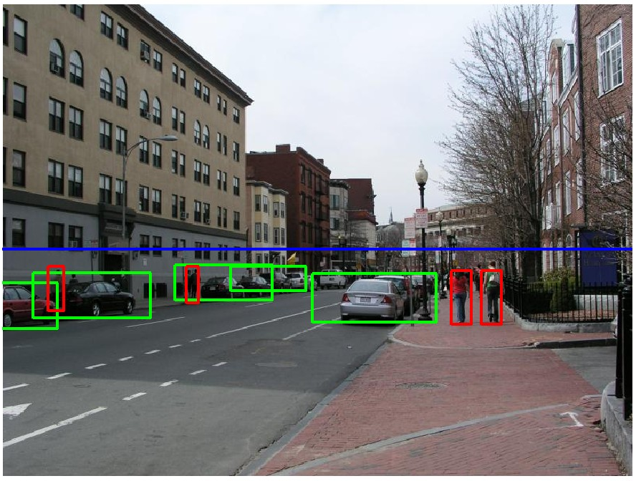
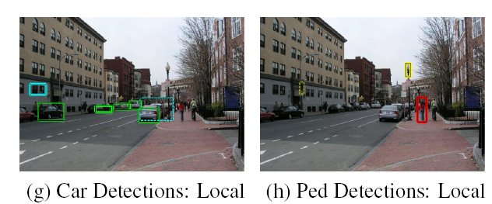
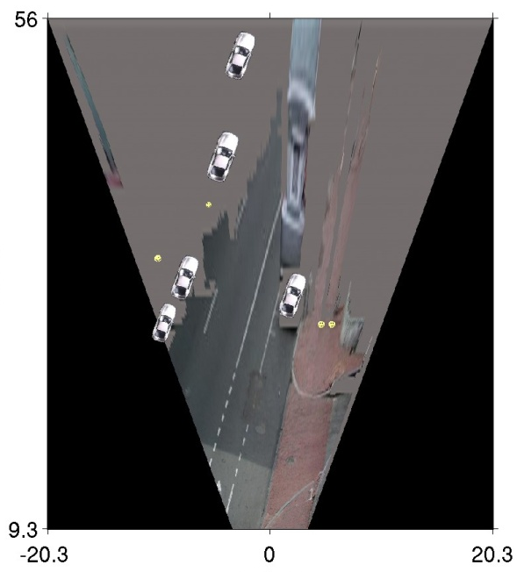
Resolving detection scores
2. Context/reasoning
meters
Hoiem et al. 2006
meters

Slide 21
Object category detection in computer vision
Goal: detect all pedestrians, cars, monkeys, etc in image

Slide 22
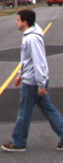
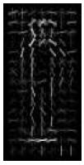
Basic Steps of Category Detection
Align
  E.g., choose position, scale orientation
  How to make this tractable?
Compare
  Compute similarity to an example object or to a summary representation
  Which differences in appearance are important?
Aligned
Possible Objects
Exemplar
Summary

Slide 23
Sliding window: a simple alignment solution
…
…

Slide 24

Each window is separately classified

Slide 25
Statistical Template
Object model = sum of scores of features at fixed positions
?
+3
+2
-2
-1
-2.5
= -0.5
> 7.5
Non-object
?
+4
+1
+0.5
+3
+0.5
= 10.5
> 7.5
Object

Slide 26
Design challenges
How to efficiently search for likely objects
  Even simple models require searching hundreds of thousands of positions and scales
Feature design and scoring
  How should appearance be modeled? What features correspond to the object?
How to deal with different viewpoints?
  Often train different models for a few different viewpoints
Implementation details
  Window size
  Aspect ratio
  Translation/scale step size
  Non-maxima suppression

Slide 27
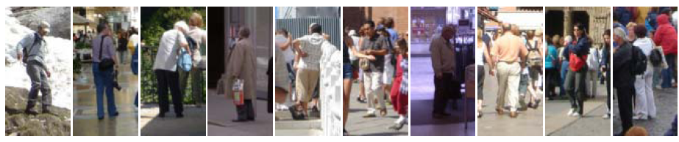
Example: Dalal-Triggs pedestrian detector
Extract fixed-sized (64x128 pixel) window at each position and scale
Compute HOG (histogram of gradient) features within each window
Score the window with a linear SVM classifier
Perform non-maxima suppression to remove overlapping detections with lower scores
Navneet Dalal and Bill Triggs, Histograms of Oriented Gradients for Human Detection, CVPR05

Slide 28

Slides by Pete Barnum
Navneet Dalal and Bill Triggs, Histograms of Oriented Gradients for Human Detection, CVPR05

Slide 29
Tested with
  RGB
  LAB
  Grayscale
Gamma Normalization and Compression
  Square root
  Log
Slightly better performance vs. grayscale
Very slightly better performance vs. no adjustment

Slide 30
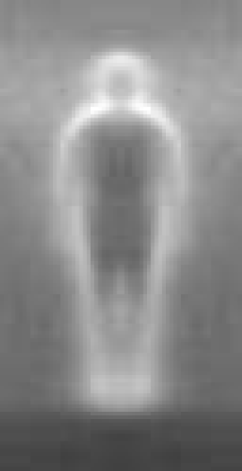

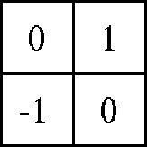

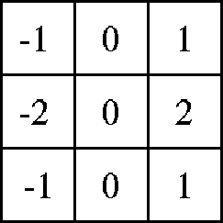

Outperforms
centered
diagonal
uncentered
cubic-corrected
Sobel
Slides by Pete Barnum
Navneet Dalal and Bill Triggs, Histograms of Oriented Gradients for Human Detection, CVPR05

Slide 31

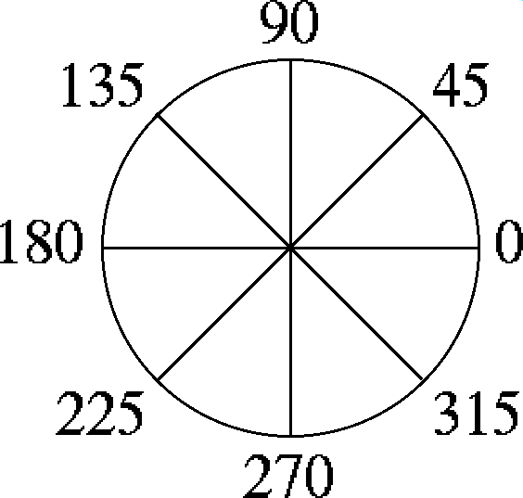
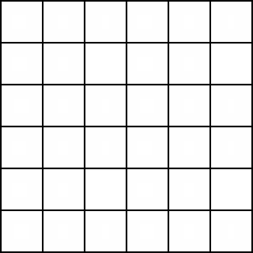
Histogram of gradient orientations
  Votes weighted by magnitude
  Bilinear interpolation between cells
Orientation: 9 bins (for unsigned angles)
Histograms in 8x8 pixel cells
Slides by Pete Barnum
Navneet Dalal and Bill Triggs, Histograms of Oriented Gradients for Human Detection, CVPR05

Slide 32
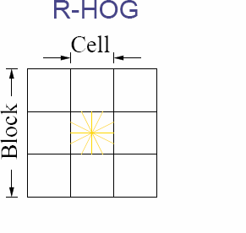
Normalize with respect to surrounding cells
Slides by Pete Barnum
Navneet Dalal and Bill Triggs, Histograms of Oriented Gradients for Human Detection, CVPR05

Slide 33
# orientations
# features = 15 x 7 x 9 x 4 = 3780
X=
# cells
# normalizations by neighboring cells
Slides by Pete Barnum
Navneet Dalal and Bill Triggs, Histograms of Oriented Gradients for Human Detection, CVPR05

Slide 34
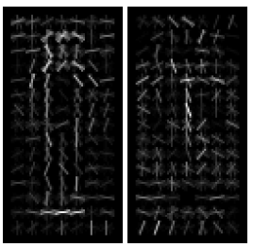
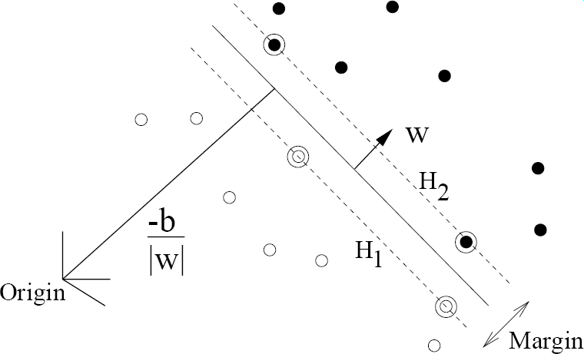
pos w
neg w
Slides by Pete Barnum
Navneet Dalal and Bill Triggs, Histograms of Oriented Gradients for Human Detection, CVPR05

Slide 35
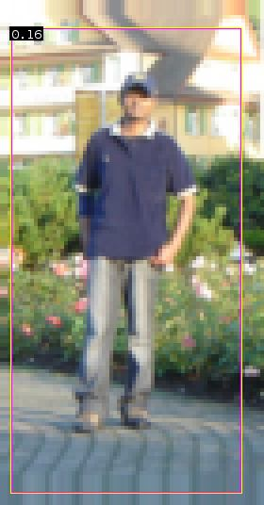


pedestrian
Slides by Pete Barnum
Navneet Dalal and Bill Triggs, Histograms of Oriented Gradients for Human Detection, CVPR05

Slide 36
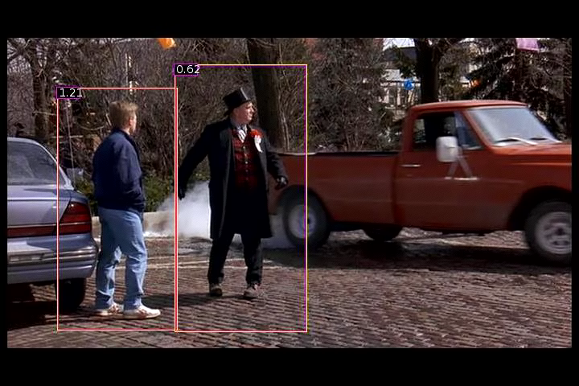
Detection examples

Slide 37
2 minute break
Something to think about…
Sliding window detectors work
  very well for faces
  fairly well for cars and pedestrians
  badly for cats and dogs
Why are some classes easier than others?

Slide 38
Viola-Jones sliding window detector
Fast detection through two mechanisms
Quickly eliminate unlikely windows
Use features that are fast to compute
Viola and Jones. Rapid Object Detection using a Boosted Cascade of Simple Features (2001).

Slide 39
Cascade for Fast Detection
Choose threshold for low false negative rate
Fast classifiers early in cascade
Slow classifiers later, but most examples don’t get there
Stage 1
H₁(x) > t₁?
Yes
Stage 2
H₂(x) > t₂?
Stage N
H_{N}(x) > t_{N}?
Yes
…
Pass
No
No
No
Examples
Reject
Reject
Reject

Slide 40
Features that are fast to compute
“Haar-like features”
  Differences of sums of intensity
  Thousands, computed at various positions and scales within detection window
-1
+1
Two-rectangle features
Three-rectangle features
Etc.

Slide 41
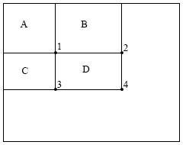
Integral Images
ii = cumsum(cumsum(im, 1), 2)
x, y
ii(x,y) = Sum of the values in the grey region
How to compute B-A?
How to compute A+D-B-C?

Slide 42

Feature selection with Adaboost
Create a large pool of features (180K)
Select features that are discriminative and work well together
  “Weak learner” = feature + threshold + parity
  Choose weak learner that minimizes error on the weighted training set
  Reweight

Slide 43
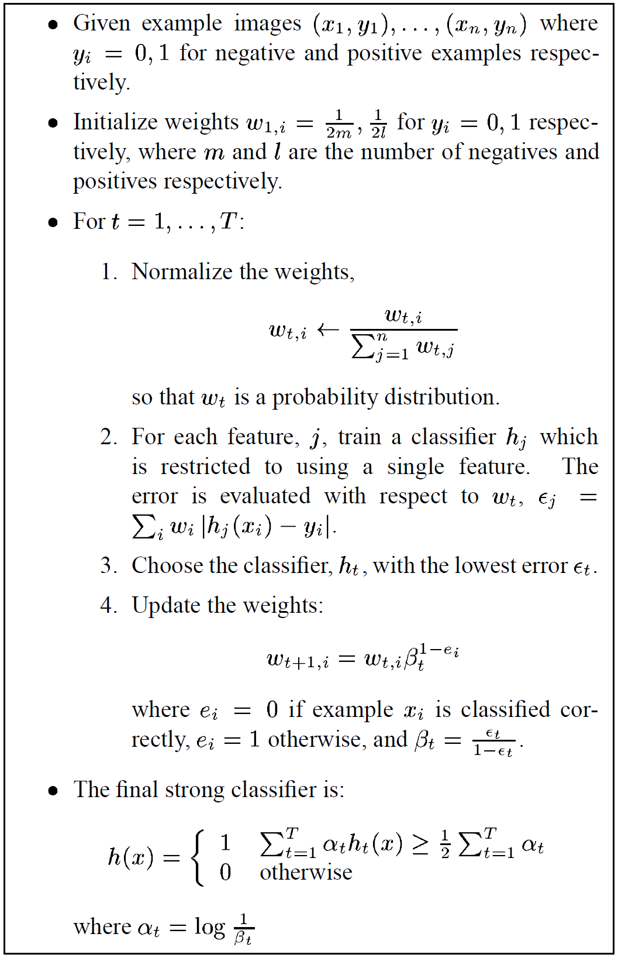
Adaboost

Slide 44
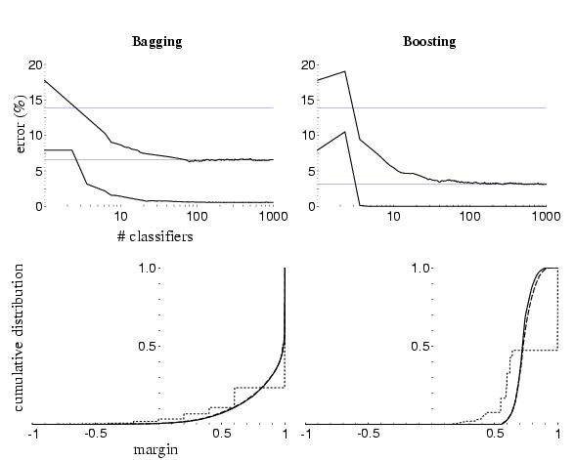
Adaboost: Immune to Overfitting?
Test error
Train error

Slide 45
Adaboost: Margin Maximizer
Test error
Train error
margin

Slide 46

Top 2 selected features

Slide 47
Viola-Jones details
38 stages with 1, 10, 25, 50 … features
  6061 total used out of 180K candidates
  10 features evaluated on average
Training Examples
  4916 positive examples
  10000 negative examples collected after each stage
Scanning
  Scale detector rather than image
  Scale steps = 1.25 (factor between two consecutive scales)
  Translation 1*scale (# pixels between two consecutive windows)
Non-max suppression: average coordinates of overlapping boxes
Train 3 classifiers and take vote

Slide 48


Viola Jones Results
Speed = 15 FPS (in 2001)
MIT + CMU face dataset

Slide 49
R-CNN (Girshick et al. CVPR 2014)
Replace sliding windows with “selective search” region proposals (Uijilings et al. IJCV 2013)
Extract rectangles around regions and resize to 227x227
Extract features with fine-tuned CNN (that was initialized with network trained on ImageNet before training)
Classify last layer of network features with SVM
http://arxiv.org/pdf/1311.2524.pdf

Slide 50
Sliding window vs. region proposals
Sliding window
Region proposals
Comprehensive search over position, scale (sometimes aspect, though expensive)
Typically 100K candidates
Simple
Speed boost through convolution often possible
Repeatable
Even with many candidates, may not be a good fit to object
Search over regions guided by image contours/patterns with varying aspect/size
Typically 2-10K candidates
Random (not repeatable)
Requires a preprocess (currently 1-5s)
Often requires resizing patch to fit fixed size
More likely to provide candidates with very good object fit

Slide 51
HOG Template
Statistical Template Matching
HOG: Dalal-Triggs 2005

Slide 52
Deformable Parts Model (v1-v5)
HOG Template
Better Models of Complex Categories
HOG: Dalal-Triggs 2005 DPM: Felzenszwalb et al. 2008-2012

Slide 53
R-CNN
Regionlets
Deformable Parts Model (v1-v5)
HOG Template
Key Advance: Learn effective features from massive amounts of labeled data and
adapt to new tasks with less data
Better Features
HOG: Dalal-Triggs 2005 DPM: Felzenszwalb et al. 2008-2012 Regionlets: Wang et al. 2013 R-CNN: Girshick et al. 2014

Slide 54
Mistakes are often reasonable
Confident Mistakes
Bicycle: AP = 0.73
R-CNN results

Slide 55
Mistakes are often reasonable
Horse: AP = 0.69
Confident Mistakes
R-CNN results

Slide 56
Misses are often predictable
Bicycle
Small objects, distinctive parts absent or occluded, unusual views
R-CNN results
Notes:
Predictable which objects will be missed

Slide 57
Strengths and Weaknesses of Statistical Template Approach
Strengths
Works very well for non-deformable objects: faces, cars, upright pedestrians
Fast detection
Weaknesses
Sliding window has difficulty with deformable objects (proposals works with flexible features works better)
Not robust to occlusion
Requires lots of training data

Slide 58
Tricks of the trade
Details in feature computation really matter
  E.g., normalization in Dalal-Triggs improves detection rate by 27% at fixed false positive rate
Template size
  Typical choice for sliding window is size of smallest detectable object
  For CNNs, typically based on what pretrained features are available
“Jittering” to create synthetic positive examples
  Create slightly rotated, translated, scaled, mirrored versions as extra positive examples
Bootstrapping to get hard negative examples
  Randomly sample negative examples
  Train detector
  Sample negative examples that score > -1
  Repeat until all high-scoring negative examples fit in memory

Slide 59
Influential Works in Detection
Sung-Poggio (1994, 1998) : ~2100 citations
  Basic idea of statistical template detection (I think), bootstrapping to get “face-like” negative examples, multiple whole-face prototypes (in 1994)
Rowley-Baluja-Kanade (1996-1998) : ~4200
  “Parts” at fixed position, non-maxima suppression, simple cascade, rotation, pretty good accuracy, fast
Schneiderman-Kanade (1998-2000,2004) : ~2250
  Careful feature/classifier engineering, excellent results, cascade
Viola-Jones (2001, 2004) : ~20,000
  Haar-like features, Adaboost as feature selection, hyper-cascade, very fast, easy to implement
Dalal-Triggs (2005) : ~11000
  Careful feature engineering, excellent results, HOG feature, online code
Felzenszwalb-Huttenlocher (2000): ~1600
  Efficient way to solve part-based detectors
Felzenszwalb-McAllester-Ramanan (2008,2010)? ~4000
  Excellent template/parts-based blend
Girshick-Donahue-Darrell-Malik (2014 ) ~300
  Region proposals + fine-tuned CNN features (marks significant advance in accuracy over hog-based methods)

Slide 60




Fails in commercial face detection
Things iPhoto thinks are faces
http://www.oddee.com/item_98248.aspx

Slide 61


Summary: statistical templates
Propose Window
Extract Features
Classify
Post-process
SVM
Boosted stubs
Neural network
Non-max suppression
Segment or refine localization
HOG
Sliding window: scan image pyramid
Fast randomized features
Region proposals: edge/region-based, resize to fixed window
CNN features

Slide 62
Things to remember
Sliding window for search
Features based on differences of intensity (gradient, wavelet, etc.)
  Excellent results require careful feature design
Boosting for feature selection
Integral images, cascade for speed
Bootstrapping to deal with many, many negative examples
Stage 1
H₁(x) > t₁?
Yes
Stage 2
H₂(x) > t₂?
…
Stage N
H_{N}(x) > t_{N}?
Yes
Pass
Examples
No
No
No
Reject
Reject
Reject

Slide 63
Next class
Part-based models and pose estimation

