Slide 1
Classifiers
04/09/15
Computer Vision
CS 543 / ECE 549
University of Illinois
Derek Hoiem

Slide 2
Today’s class
Review of image categorization
Classification
A few examples of classifiers: nearest neighbor, generative classifiers, logistic regression, SVM
Important concepts in machine learning
Practical tips

Slide 3
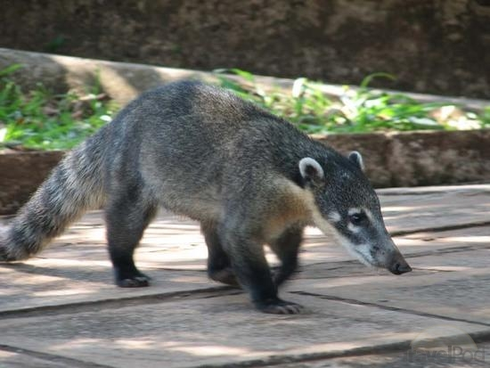
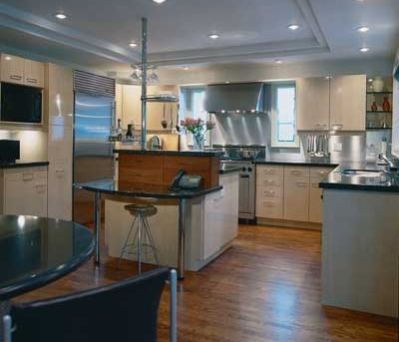
What is a category?
Why would we want to put an image in one?
Many different ways to categorize
To predict, describe, interact. To organize.
Notes:
Category is a group of items – a set. To categorize is to place into a set.
We want to define a sense of similarity, of belonging for our images. We may want to organize them or tag them or predict other things about them. We may want to categorize by event, by objects, by layout.
Animal is a coati

Slide 4
Examples of Categorization in Vision
Part or object detection
E.g., for each window: face or non-face?
Scene categorization
Indoor vs. outdoor, urban, forest, kitchen, etc.
Action recognition
Picking up vs. sitting down vs. standing …
Emotion recognition
Region classification
Label pixels into different object/surface categories
Boundary classification
Boundary vs. non-boundary
Etc, etc.

Slide 5
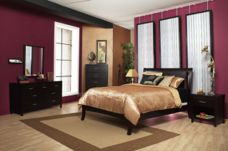
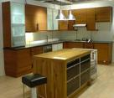
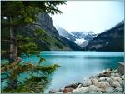
Image Categorization
Training
Training Labels
Training Images
Image Features
Classifier Training
Trained Classifier

Slide 6
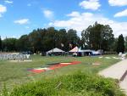
Image Categorization
Training
Training Labels
Training Images
Image Features
Classifier Training
Trained Classifier
Testing
Image Features
Trained Classifier
Prediction
Outdoor
Test Image

Slide 7
Feature design is paramount
Most features can be thought of as templates, histograms (counts), or combinations
Think about the right features for the problem
Coverage
Concision
Directness

Slide 8
Classifier
A classifier maps from the feature space to a label
x
x
x
x
x
x
o
x
x
o
o
o
o
x2
x1

Slide 9
Different types of classification
Exemplar-based: transfer category labels from examples with most similar features
What similarity function? What parameters?
Linear classifier: confidence in positive label is a weighted sum of features
What are the weights?
Non-linear classifier: predictions based on more complex function of features
What form does the classifier take? Parameters?
Generative classifier: assign to the label that best explains the features (makes features most likely)
What is the probability function and its parameters?
Note: You can always fully design the classifier by hand, but usually this is too difficult. Typical solution: learn from training examples.

Slide 10
One way to think about it…
Training labels dictate that two examples are the same or different, in some sense
Features and distance measures define visual similarity
Goal of training is to learn feature weights or distance measures so that visual similarity predicts label similarity
We want the simplest function that is confidently correct

Slide 11
Exemplar-based Models
Transfer the label(s) of the most similar training examples

Slide 12
K-nearest neighbor classifier
x
x
x
o
x
x
x
+
o
o
x
x
o
o
+
o
o
x2
x1

Slide 13
1-nearest neighbor
x
x
x
o
x
x
x
+
o
o
x
x
o
o
+
o
o
x2
x1

Slide 14
3-nearest neighbor
x
x
x
o
x
x
x
+
o
o
x
x
o
o
+
o
o
x2
x1

Slide 15
5-nearest neighbor
x
x
x
o
x
x
x
+
o
o
x
x
o
o
+
o
o
x2
x1

Slide 16
K-nearest neighbor
x
x
x
o
x
x
x
+
o
o
x
x
o
o
+
o
o
x2
x1

Slide 17
Using K-NN
Simple, a good one to try first
Higher K gives smoother functions
No training time (unless you want to learn a distance function)
With infinite examples, 1-NN provably has error that is at most twice Bayes optimal error

Slide 18
Discriminative classifiers
Learn a simple function of the input features that confidently predicts the true labels on the training set
Training Goals
Accurate classification of training data
Correct classifications are confident
Classification function is simple
$$y=f\left(x\right)$$

Slide 19
Classifiers: Logistic Regression
Objective
Parameterization
Regularization
Training
Inference
x
x
x
x
x
x
o
x
x
o
o
o
o
x2
x1
The objective function of most discriminative classifiers includes a loss term and a regularization term.

Slide 20
Using Logistic Regression
Quick, simple classifier (good one to try first)
Use L2 or L1 regularization
L1 does feature selection and is robust to irrelevant features but slower to train

Slide 21
Classifiers: Linear SVM
x
x
x
o
x
x
x
o
x
x
o
o
o
o
x2
x1

Slide 22
Classifiers: Kernelized SVM
x
x
o
o
o
x
x
x
x
x
o
o
x²
o
x
x
x

Slide 23
Using SVMs
Good general purpose classifier
Generalization depends on margin, so works well with many weak features
No feature selection
Usually requires some parameter tuning
Choosing kernel
Linear: fast training/testing – start here
RBF: related to neural networks, nearest neighbor
Chi-squared, histogram intersection: good for histograms (but slower, esp. chi-squared)
Can learn a kernel function

Slide 24
Classifiers: Decision Trees
x
x
x
o
x
x
x
o
x
o
x
o
o
o
o
x2
x1

Slide 25
Ensemble Methods: Boosting
figure from Friedman et al. 2000

Slide 26
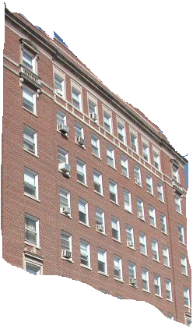
Boosted Decision Trees
High in
Image?
Gray?
Yes
No
Yes
No
Smooth?
Green?
High in
Image?
Many Long
Lines?
…
Yes
No
Yes
No
Yes
No
Yes
No
Blue?
Very High
Vanishing
Point?
Yes
No
Yes
No
Ground Vertical Sky
P(label | good segment, data)
[Collins et al. 2002]

Slide 27
Using Boosted Decision Trees
Flexible: can deal with both continuous and categorical variables
How to control bias/variance trade-off
Size of trees
Number of trees
Boosting trees often works best with a small number of well-designed features
Boosting “stubs” can give a fast classifier

Slide 28
Generative classifiers
Model the joint probability of the features and the labels
Allows direct control of independence assumptions
Can incorporate priors
Often simple to train (depending on the model)
Examples
Naïve Bayes
Mixture of Gaussians for each class

Slide 29
Naïve Bayes
Objective
Parameterization
Regularization
Training
Inference
y
x₁
x₂
x₃

Slide 30
Using Naïve Bayes
Simple thing to try for categorical data
Very fast to train/test

Slide 31
Clustering (unsupervised)
+
x
+
o
+
+
+
x
x
x
+
+
x
+
+
o
x
x
+
o
+
o
+
o
x2
x2
x1
x1

Slide 32
Many classifiers to choose from
SVM
Neural networks
Naïve Bayes
Bayesian network
Logistic regression
Randomized Forests
Boosted Decision Trees
K-nearest neighbor
RBMs
Deep networks
Etc.
Which is the best one?

Slide 33
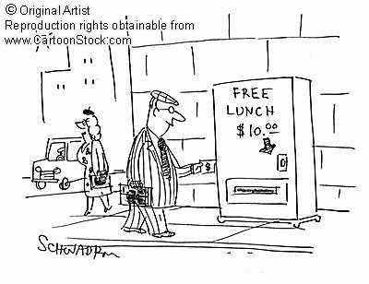
No Free Lunch Theorem
Notes:
You can only get generalization through assumptions.

Slide 34
Generalization Theory
It’s not enough to do well on the training set: we want to also make good predictions for new examples

Slide 35
Bias-Variance Trade-off
E(MSE) = noise² + bias² + variance
Error due to variance parameter estimates from training samples
Unavoidable error
Error due to incorrect assumptions
See the following for explanation of bias-variance (also Bishop’s “Neural Networks” book):
http://www.inf.ed.ac.uk/teaching/courses/mlsc/Notes/Lecture4/BiasVariance.pdf

Slide 36
Bias and Variance
Error = noise² + bias² + variance
Few training examples
Test Error
Many training examples
High Bias
Low Variance
Complexity
Low Bias
High Variance
Notes:
Note: these figures don’t work in pdf

Slide 37
Choosing the trade-off
Need validation set
Validation set is separate from the test set
Test error
Error
Training error
High Bias
Low Variance
Complexity
Low Bias
High Variance

Slide 38
Effect of Training Size
Fixed classifier
Error
Testing
Generalization Error
Training
Number of Training Examples

Slide 39
How to measure complexity?
VC dimension
Other ways: number of parameters, etc.
What is the VC dimension of a linear classifier for N-dimensional features? For a nearest neighbor classifier?
Upper bound on generalization error
Test error <=
Training error +
N: size of training set
h: VC dimension
η: 1-probability that bound holds

Slide 40
How to reduce variance?
Choose a simpler classifier
Regularize the parameters
Use fewer features
Get more training data
Which of these could actually lead to greater error?
Notes:
The simpler classifier or regularization could increase bias and lead to more error.

Slide 41
Reducing Risk of Error
Margins
x
x
x
x
x
x
o
x
x
o
o
o
o
x2
x1

Slide 42
The perfect classification algorithm
Objective function: encodes the right loss for the problem
Parameterization: makes assumptions that fit the problem
Regularization: right level of regularization for amount of training data
Training algorithm: can find parameters that maximize objective on training set
Inference algorithm: can solve for objective function in evaluation

Slide 43
Generative vs. Discriminative Classifiers
Generative
Training
Models the data and the labels
Assume (or learn) probability distribution and dependency structure
Can impose priors
Testing
P(y=1, x) / P(y=0, x) > t?
Examples
Foreground/background GMM
Naïve Bayes classifier
Bayesian network
Discriminative
Training
Learn to directly predict the labels from the data
Assume form of boundary
Margin maximization or parameter regularization
Testing
f(x) > t ; e.g., w^{T}x > t
Examples
Logistic regression
SVM
Boosted decision trees
Notes:
Generative classifiers try to model the data. Discriminative classifiers try to predict the label.

Slide 44
Two ways to think about classifiers
What is the objective? What are the parameters? How are the parameters learned? How is the learning regularized? How is inference performed?
How is the data modeled? How is similarity defined? What is the shape of the boundary?

Slide 45
Comparison
assuming x in {0 1}
Learning Objective
Training
Inference
Naïve Bayes
Logistic Regression
Gradient ascent
Linear SVM
Quadratic programming or subgradient opt.
Kernelized SVM
complicated to write
Quadratic programming
Nearest Neighbor
most similar features → same label
Record data

Slide 46
Characteristics of vision learning problems
Lots of continuous features
E.g., HOG template may have 1000 features
Spatial pyramid may have ~15,000 features
Imbalanced classes
often limited positive examples, practically infinite negative examples
Difficult prediction tasks

Slide 47
When a massive training set is available
Relatively new phenomenon
MNIST (handwritten letters) in 1990s, LabelMe in 2000s, ImageNet (object images) in 2009, …
Want classifiers with low bias (high variance ok) and reasonably efficient training
Very complex classifiers with simple features are often effective
Random forests
Deep convolutional networks

Slide 48
New training setup with moderate sized datasets
Training Labels
Training Images
Tune CNN features and
Neural Network classifier
Trained Classifier
Initialize CNN Features
Dataset similar to task with millions of labeled examples

Slide 49
Practical tips
Preparing features for linear classifiers
Often helps to make zero-mean, unit-dev
For non-ordinal features, convert to a set of binary features
Selecting classifier meta-parameters (e.g., regularization weight)
Cross-validation: split data into subsets; train on all but one subset, test on remaining; repeat holding out each subset
Leave-one-out, 5-fold, etc.
Most popular classifiers in vision
SVM: linear for when fast training/classification is needed; performs well with lots of weak features
Logistic Regression: outputs a probability; easy to train and apply
Nearest neighbor: hard to beat if there is tons of data (e.g., character recognition)
Boosted stumps or decision trees: applies to flexible features, incorporates feature selection, powerful classifiers
Random forests: outputs probability; good for simple features, tons of data
Deep networks / CNNs: flexible output; learns features; adapt existing network (which is trained with tons of data) or train new with tons of data
Always try at least two types of classifiers

Slide 50
What to remember about classifiers
No free lunch: machine learning algorithms are tools
Try simple classifiers first
Better to have smart features and simple classifiers than simple features and smart classifiers
Though with enough data, smart features can be learned
Use increasingly powerful classifiers with more training data (bias-variance tradeoff)

Slide 51
Some Machine Learning References
General
Tom Mitchell, Machine Learning, McGraw Hill, 1997
Christopher Bishop, Neural Networks for Pattern Recognition, Oxford University Press, 1995
Adaboost
Friedman, Hastie, and Tibshirani, “Additive logistic regression: a statistical view of boosting”, Annals of Statistics, 2000
SVMs
http://www.support-vector.net/icml-tutorial.pdf
Random forests
http://research.microsoft.com/pubs/155552/decisionForests_MSR_TR_2011_114.pdf

Slide 52
Next class
Detection using sliding windows and region proposals

