Slide 1
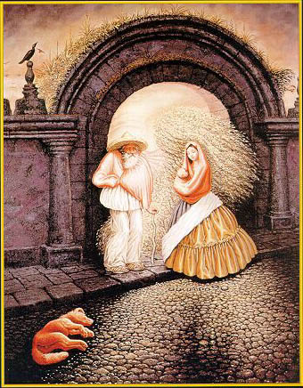
Grouping and Segmentation
03/17/15
Computer Vision
CS 543 / ECE 549
University of Illinois
Derek Hoiem

Slide 2
Announcements
HW 3: due today
  Graded by Tues after spring break
HW 4: out soon
  Mean-shift segmentation
  EM problem for dealing with bad annotators
  Graph cuts segmentation

Slide 3
Today’s class
Segmentation and grouping
  Gestalt cues
  By clustering (mean-shift)
  By boundaries (watershed)
Superpixels and multiple segmentations

Slide 4
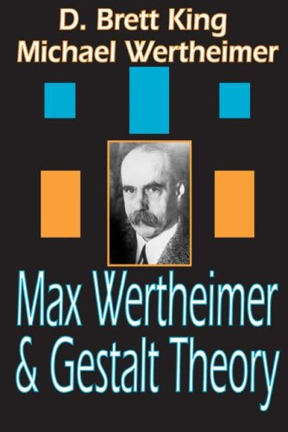
Gestalt psychology or gestaltism
German: Gestalt - "form" or "whole”
Berlin School, early 20th century
Kurt Koffka, Max Wertheimer, and Wolfgang Köhler
View of brain:
whole is more than the sum of its parts
holistic
parallel
analog
self-organizing tendencies
Slide from S. Saverese

Slide 5
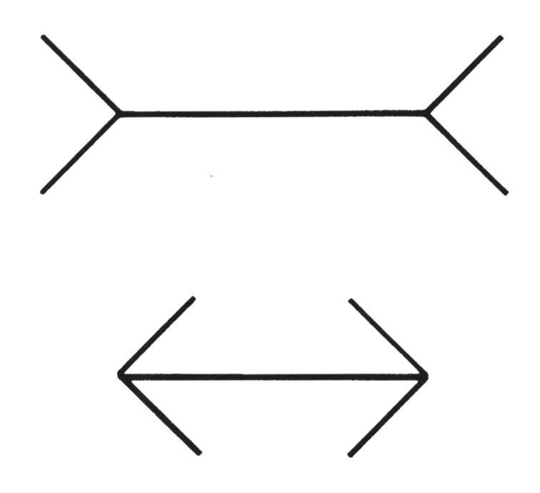
Gestaltism
The Muller-Lyer illusion
Notes:
The famous Muller-Lyer illusion; the point is that the horizontal bar has properties that come only from its membership in
a group (it looks shorter in the lower picture, but is actually the same size) and that these properties can’t be discounted--- you can’t look at this figure and ignore the arrowheads and thereby make the two bars seem to be the same size.

Slide 6
We perceive the interpretation, not the senses
Notes:
In one experiment, children from rural Zambia were less susceptible to the illusion.

Slide 7
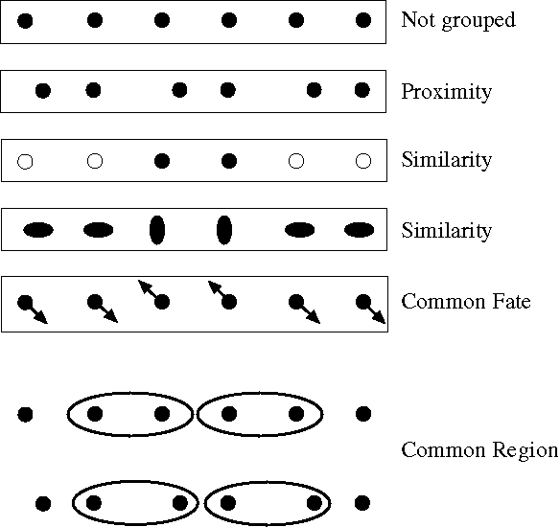
Principles of perceptual organization
From Steve Lehar: The Constructive Aspect of Visual Perception
Notes:
Some criteria that tend to cause tokens to be grouped.

Slide 8
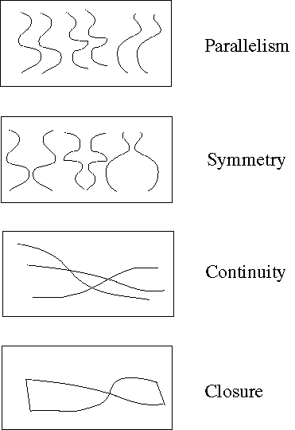
Principles of perceptual organization
Notes:
More such

Slide 9
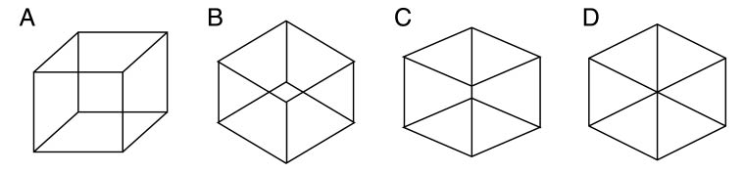
Gestaltists do not believe in coincidence

Slide 10
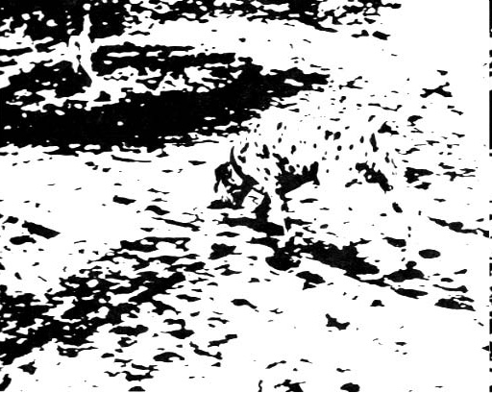
Emergence

Slide 11
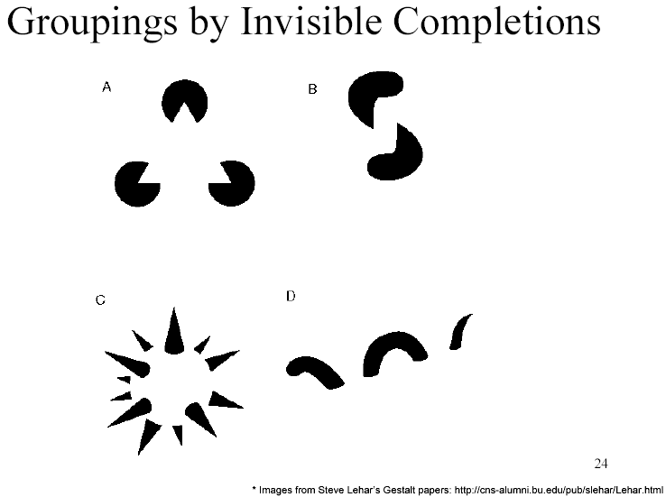
Grouping by invisible completion
From Steve Lehar: The Constructive Aspect of Visual Perception

Slide 12
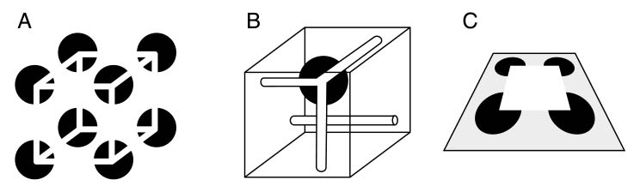
Grouping involves global interpretation
From Steve Lehar: The Constructive Aspect of Visual Perception

Slide 13
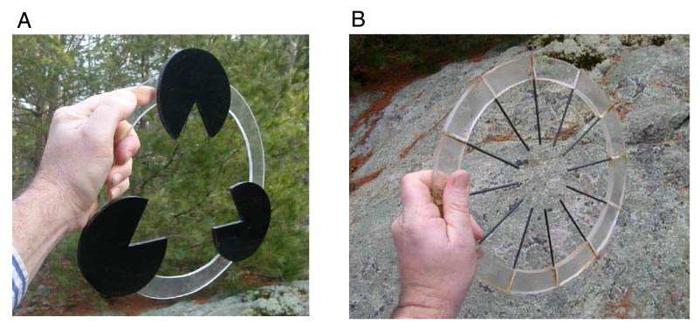
Grouping involves global interpretation
From Steve Lehar: The Constructive Aspect of Visual Perception

Slide 14
Gestalt cues
Good intuition and basic principles for grouping
Basis for many ideas in segmentation and occlusion reasoning
Some (e.g., symmetry) are difficult to implement in practice

Slide 15
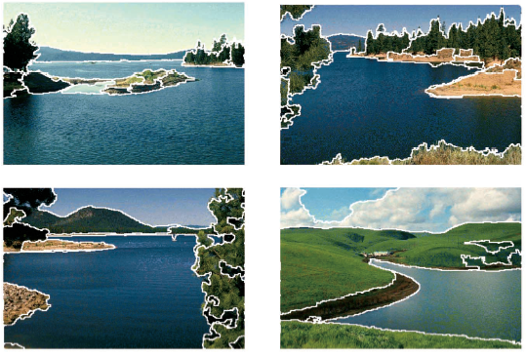
Image segmentation
Goal: Group pixels into meaningful or perceptually similar regions

Slide 16
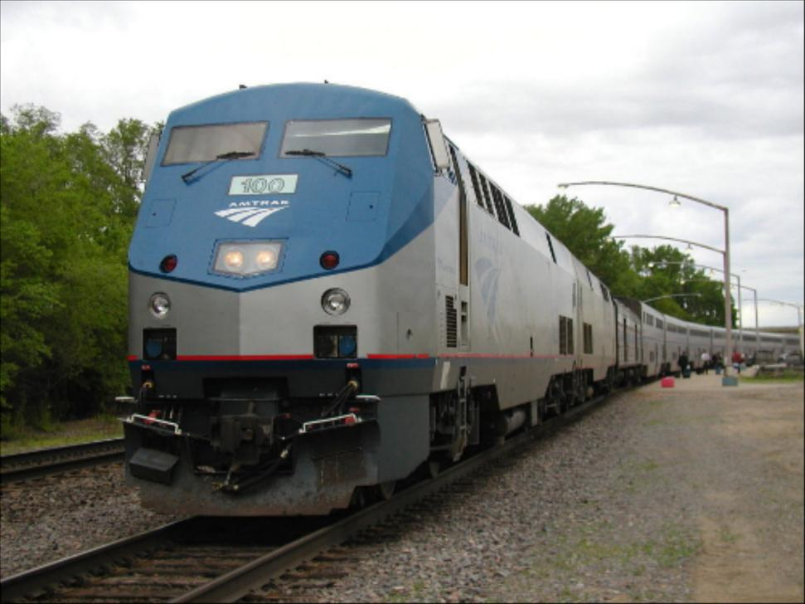
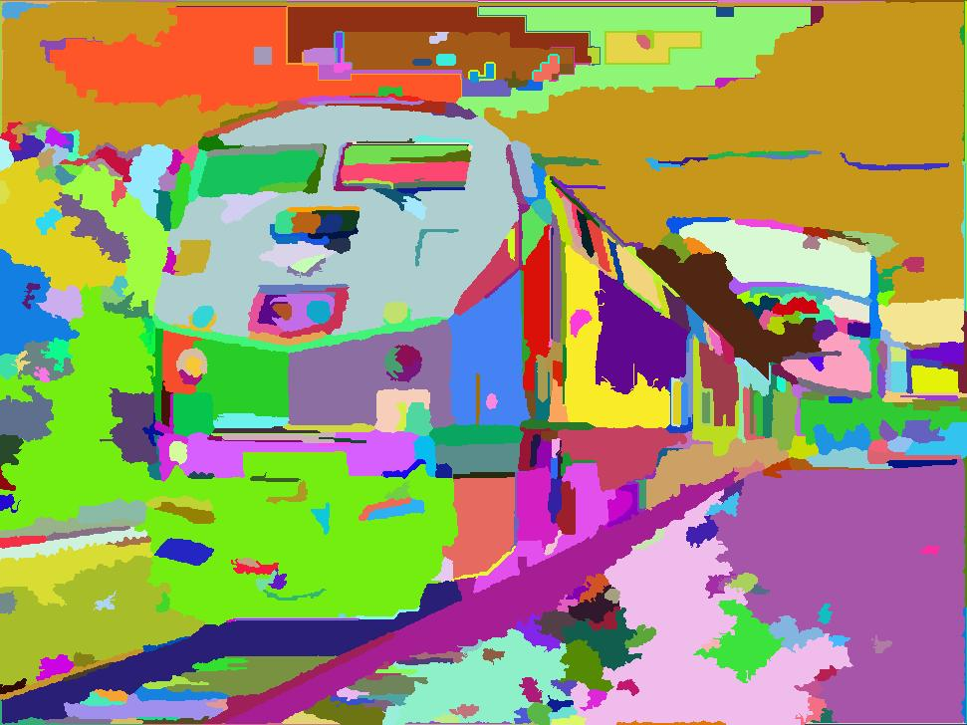
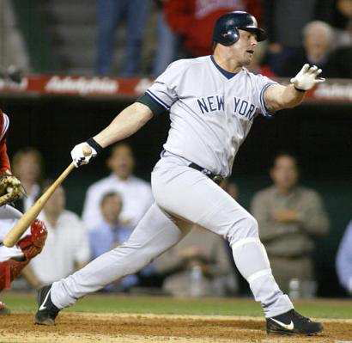
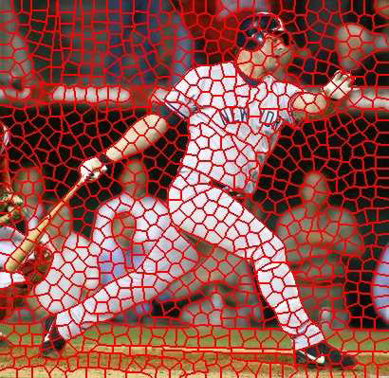
Segmentation for efficiency: “superpixels”
[Felzenszwalb and Huttenlocher 2004]
[Shi and Malik 2001]
[Hoiem et al. 2005, Mori 2005]

Slide 17
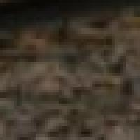

Segmentation for feature support
50x50 Patch
50x50 Patch

Slide 18
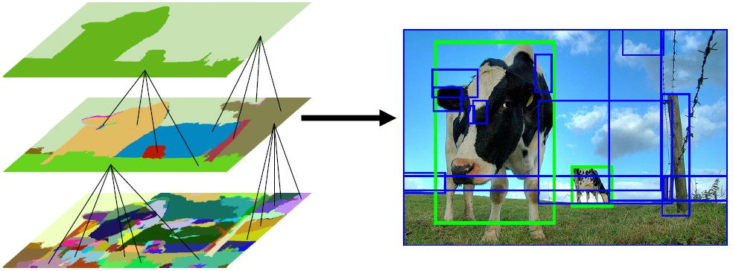
Segmentation for object proposals
“Selective Search” [Sande, Uijlings et al. ICCV 2011, IJCV 2013]
[Endres Hoiem ECCV 2010, IJCV 2014]

Slide 19
Object proposals
Superpixels, proposals, multiple segmentations

Slide 20
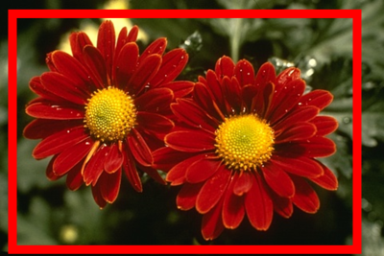
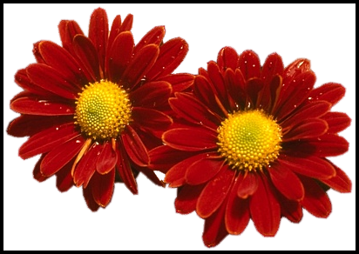
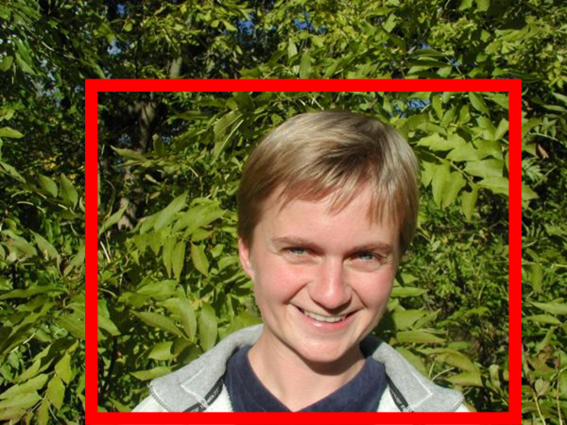
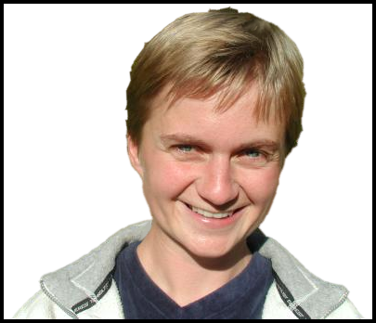
Segmentation as a result
Rother et al. 2004

Slide 21
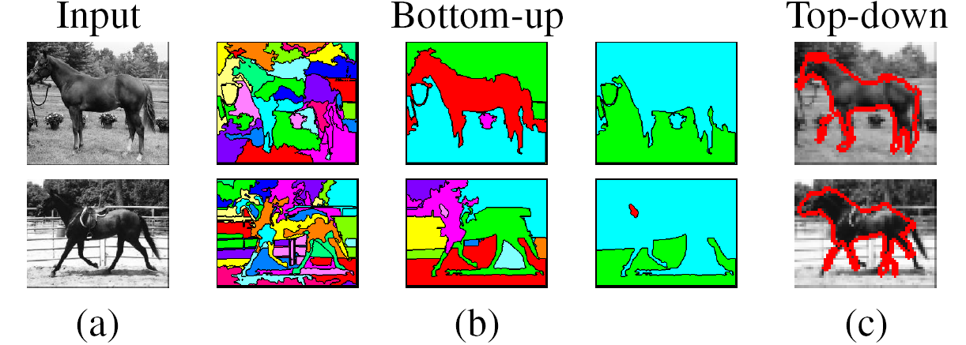
Types of segmentations
Oversegmentation
Undersegmentation
Multiple Segmentations

Slide 22
Major processes for segmentation
Bottom-up: group tokens with similar features
Top-down: group tokens that likely belong to the same object
[Levin and Weiss 2006]

Slide 23
Segmentation using clustering
Kmeans
Mean-shift

Slide 24
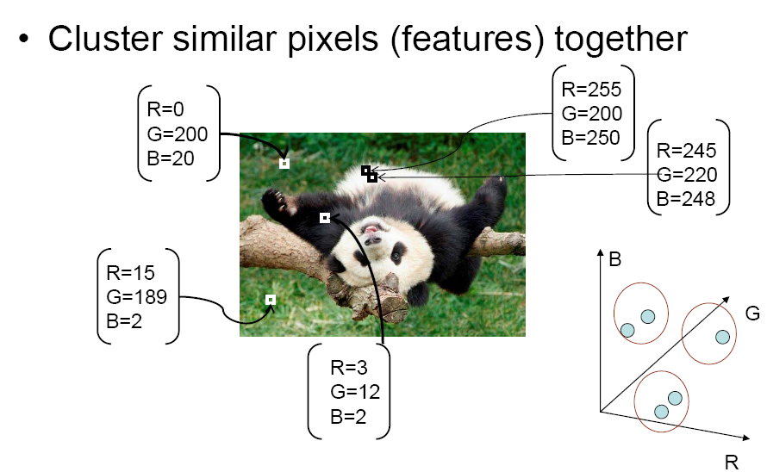
Feature Space
Source: K. Grauman

Slide 25
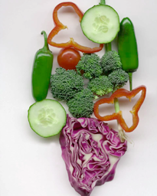
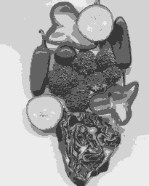
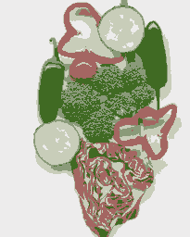
K-means clustering using intensity alone and color alone
Image
Clusters on intensity
Clusters on color
Notes:
I gave each pixel the mean intensity or mean color of its cluster --- this is basically just vector quantizing the image intensities/colors. Notice that there is no requirement that clusters be spatially localized and they’re not.

Slide 26
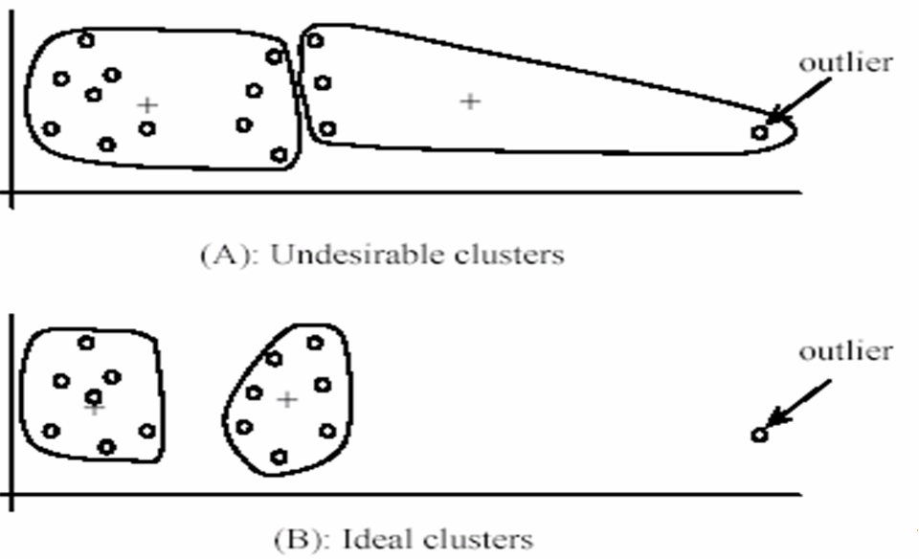
K-Means pros and cons
Pros
  Simple and fast
  Easy to implement
Cons
  Need to choose K
  Sensitive to outliers
Usage
  Rarely used for pixel segmentation

Slide 27
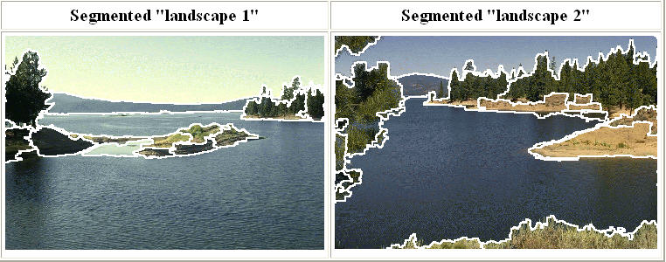
Mean shift segmentation
D. Comaniciu and P. Meer, Mean Shift: A Robust Approach toward Feature Space Analysis, PAMI 2002.
Versatile technique for clustering-based segmentation

Slide 28
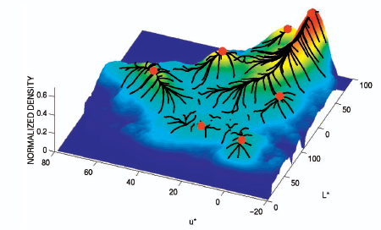
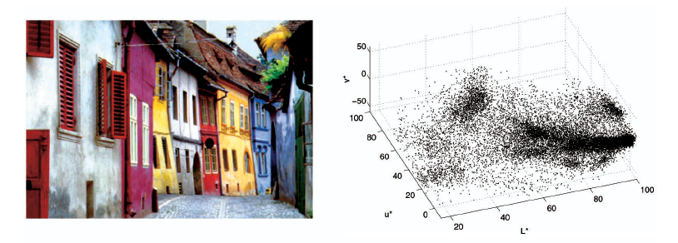
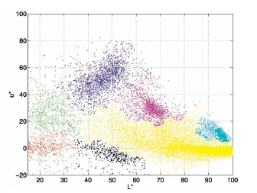
Mean shift algorithm
Try to find modes of this non-parametric density

Slide 29
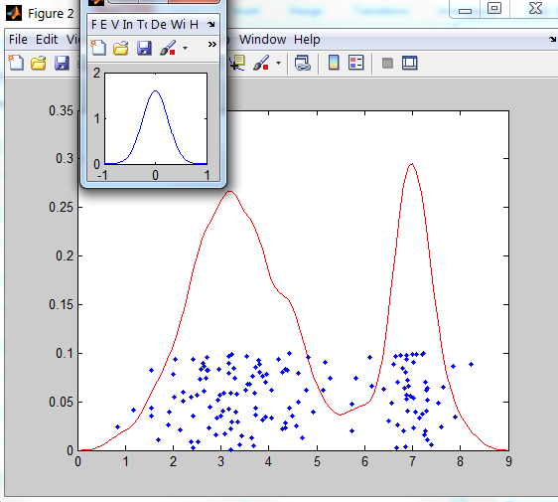
Kernel density estimation
Kernel
Estimated density
Data (1-D)

Slide 30


Kernel density estimation
Kernel density estimation function
Gaussian kernel

Slide 31
Mean shift
Region of
interest
Center of
mass
Mean Shift
vector
Slide by Y. Ukrainitz & B. Sarel

Slide 32
Mean shift
Region of
interest
Center of
mass
Mean Shift
vector
Slide by Y. Ukrainitz & B. Sarel

Slide 33
Mean shift
Region of
interest
Center of
mass
Mean Shift
vector
Slide by Y. Ukrainitz & B. Sarel

Slide 34
Mean shift
Region of
interest
Center of
mass
Mean Shift
vector
Slide by Y. Ukrainitz & B. Sarel

Slide 35
Mean shift
Region of
interest
Center of
mass
Mean Shift
vector
Slide by Y. Ukrainitz & B. Sarel

Slide 36
Mean shift
Region of
interest
Center of
mass
Mean Shift
vector
Slide by Y. Ukrainitz & B. Sarel

Slide 37
Mean shift
Region of
interest
Center of
mass
Slide by Y. Ukrainitz & B. Sarel

Slide 38
Computing the Mean Shift
Simple Mean Shift procedure:
Compute mean shift vector
Translate the Kernel window by m(x)
Slide by Y. Ukrainitz & B. Sarel

Slide 39
Real Modality Analysis

Slide 40
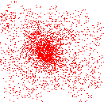
Attraction basin
Attraction basin: the region for which all trajectories lead to the same mode
Cluster: all data points in the attraction basin of a mode
Slide by Y. Ukrainitz & B. Sarel

Slide 41
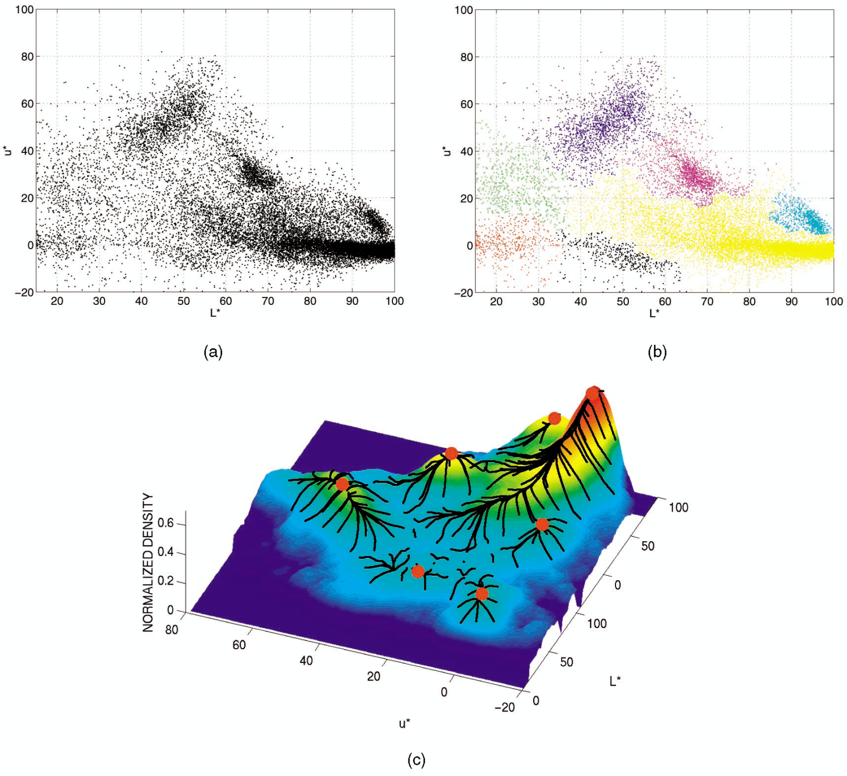
Attraction basin

Slide 42
Mean shift clustering
The mean shift algorithm seeks modes of the given set of points
  Choose kernel and bandwidth
  For each point:
    Center a window on that point
    Compute the mean of the data in the search window
    Center the search window at the new mean location
    Repeat (b,c) until convergence
  Assign points that lead to nearby modes to the same cluster

Slide 43

Segmentation by Mean Shift
Compute features for each pixel (color, gradients, texture, etc); also store each pixel’s position
Set kernel size for features K_{f} and position K_{s}
Initialize windows at individual pixel locations
Perform mean shift for each window until convergence
Merge modes that are within width of K_{f} and K_{s}

Slide 44
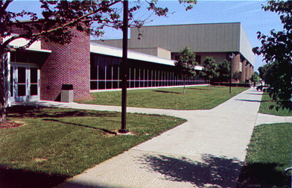
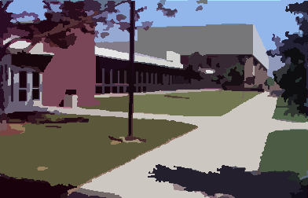
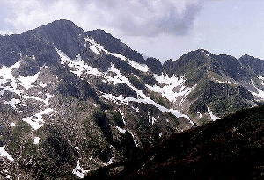
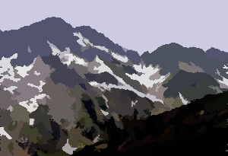
Mean shift segmentation results
http://www.caip.rutgers.edu/~comanici/MSPAMI/msPamiResults.html

Slide 45
http://www.caip.rutgers.edu/~comanici/MSPAMI/msPamiResults.html

Slide 46
Mean-shift: other issues
Speedups
  Binned estimation – replace points within some “bin” by point at center with mass
  Fast search of neighbors – e.g., k-d tree or approximate NN
  Update all windows in each iteration (faster convergence)
Other tricks
  Use kNN to determine window sizes adaptively
Lots of theoretical support
  D. Comaniciu and P. Meer, Mean Shift: A Robust Approach toward Feature Space Analysis, PAMI 2002.

Slide 47
Doing mean-shift for HW 4
Goal is to understand the basics of how mean-shift works
  Just get something working that has the right behavior qualitatively
  Don’t worry about speed
Simplifications
  Work with very small images (120x80)
  Use a uniform kernel (compute the mean of color, position within some neighborhood given by K_{f} and K_{s})
  Can use a heuristic for merging similar modes

Slide 48
Mean shift pros and cons
Pros
  Good general-purpose segmentation
  Flexible in number and shape of regions
  Robust to outliers
  General mode-finding algorithm (useful for other problems such as finding most common surface normals)
Cons
  Have to choose kernel size in advance
  Not suitable for high-dimensional features
When to use it
  Oversegmentation
  Multiple segmentations
  Tracking, clustering, filtering applications
    D. Comaniciu, V. Ramesh, P. Meer: Real-Time Tracking of Non-Rigid Objects using Mean Shift, Best Paper Award, IEEE Conf. Computer Vision and Pattern Recognition (CVPR'00), Hilton Head Island, South Carolina, Vol. 2, 142-149, 2000

Slide 49
Mean-shift reading
Nicely written mean-shift explanation (with math)
http://saravananthirumuruganathan.wordpress.com/2010/04/01/introduction-to-mean-shift-algorithm/
  Includes .m code for mean-shift clustering
Mean-shift paper by Comaniciu and Meer
http://www.caip.rutgers.edu/~comanici/Papers/MsRobustApproach.pdf
Adaptive mean shift in higher dimensions
http://mis.hevra.haifa.ac.il/~ishimshoni/papers/chap9.pdf

Slide 50
Superpixel algorithms
Goal is to divide the image into a large number of regions, such that each regions lie within object boundaries
Examples
  Watershed
  Felzenszwalb and Huttenlocher graph-based
  Turbopixels
  SLIC

Slide 51
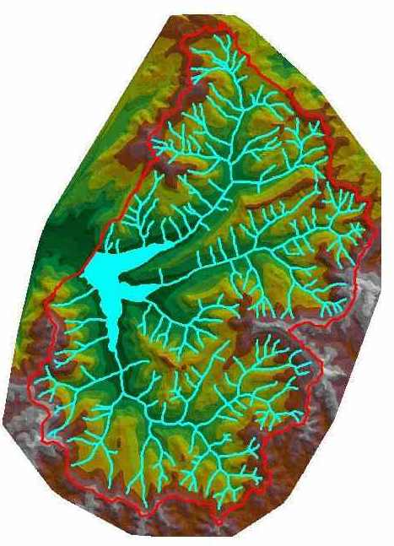
Watershed algorithm

Slide 52

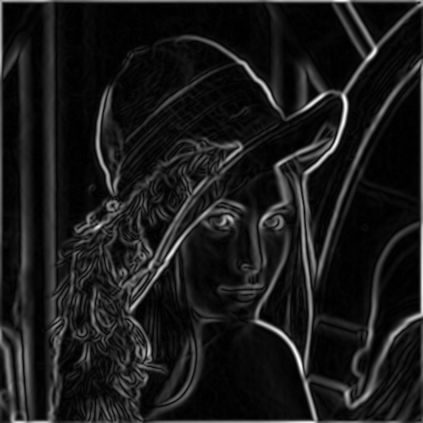
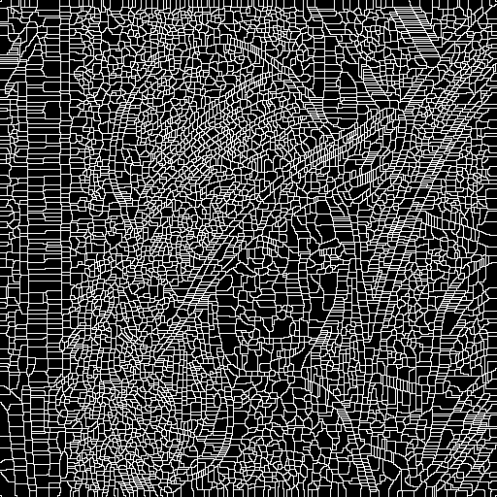
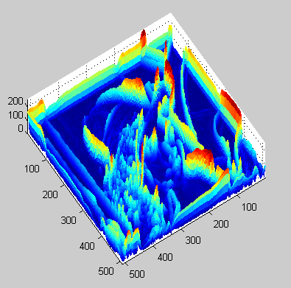
Watershed segmentation
Image
Gradient
Watershed boundaries

Slide 53
Meyer’s watershed segmentation
Choose local minima as region seeds
Add neighbors to priority queue, sorted by value
Take top priority pixel from queue
  If all labeled neighbors have same label, assign that label to pixel
  Add all non-marked neighbors to queue
Repeat step 3 until finished (all remaining pixels in queue are on the boundary)
Matlab: seg = watershed(bnd_im)
Meyer 1991

Slide 54
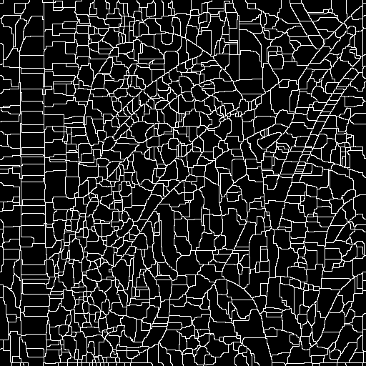
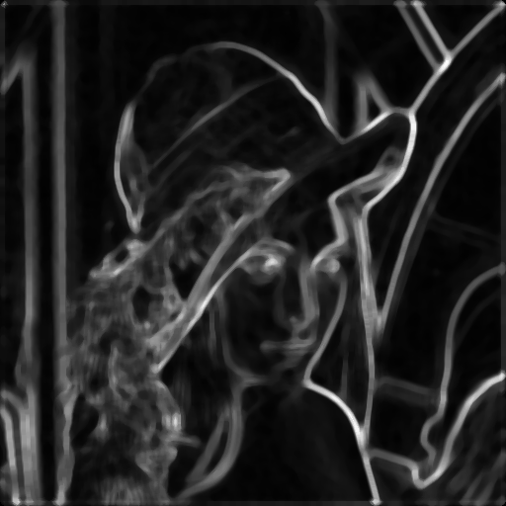
Simple trick
Use Gaussian or median filter to reduce number of regions

Slide 55
Watershed usage
Use as a starting point for hierarchical segmentation
  Ultrametric contour map (Arbelaez 2006)
Works with any soft boundaries
  Pb (w/o non-max suppression)
  Canny (w/o non-max suppression)
  Etc.

Slide 56
Watershed pros and cons
Pros
  Fast (< 1 sec for 512x512 image)
  Preserves boundaries
Cons
  Only as good as the soft boundaries (which may be slow to compute)
  Not easy to get variety of regions for multiple segmentations
Usage
  Good algorithm for superpixels, hierarchical segmentation

Slide 57
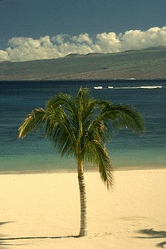
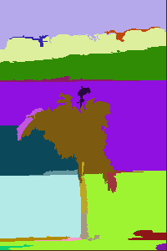
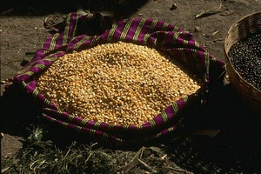
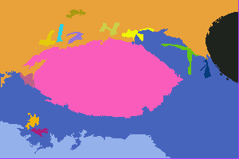
Felzenszwalb and Huttenlocher: Graph-Based Segmentation
    http://www.cs.brown.edu/~pff/segment/
+ Good for thin regions
+ Fast
+ Easy to control coarseness of segmentations
+ Can include both large and small regions
- Often creates regions with strange shapes
- Sometimes makes very large errors

Slide 58
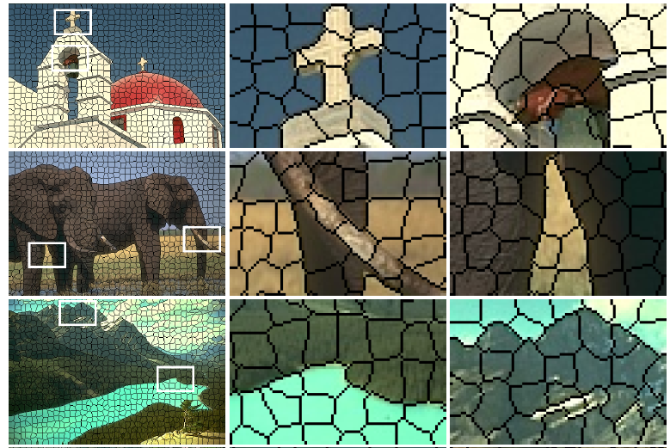
Turbo Pixels: Levinstein et al. 2009
http://www.cs.toronto.edu/~kyros/pubs/09.pami.turbopixels.pdf
Tries to preserve boundaries like watershed but to produce more regular regions

Slide 59
SLIC (Achanta et al. PAMI 2012)
http://infoscience.epfl.ch/record/177415/files/Superpixel_PAMI2011-2.pdf
Initialize cluster centers on pixel grid in steps S
  - Features: Lab color, x-y position
Move centers to position in 3x3 window with smallest gradient
Compare each pixel to cluster center within 2S pixel distance and assign to nearest
Recompute cluster centers as mean color/position of pixels belonging to each cluster
Stop when residual error is small
+ Fast 0.36s for 320x240
+ Regular superpixels
+ Superpixels fit boundaries
- May miss thin objects
- Large number of superpixels

Slide 60
Choices in segmentation algorithms
Oversegmentation
  Watershed + Pb ← my favorite
  Felzenszwalb and Huttenlocher 2004 ← my favorite
    http://www.cs.brown.edu/~pff/segment/
  SLIC ← good recent option
  Turbopixels
  Mean-shift
Larger regions
  Hierarchical segmentation (e.g., from Pb) ← my favorite
  Normalized cuts
  Mean-shift
  Seed + graph cuts (discussed later)

Slide 61
Multiple segmentations
When creating regions for pixel classification or object detection, don’t commit to one partitioning
Strategies:
  Hierarchical segmentation
    Occlusion boundaries hierarchy: Hoiem et al. IJCV 2011 (uses trained classifier to merge)
    Pb+watershed hierarchy: Arbeleaz et al. CVPR 2009
    Selective search: FH + agglomerative clustering
  Vary segmentation parameters
    E.g., multiple graph-based segmentations or mean-shift segmentations
  Region proposals
    Propose seed superpixel, try to segment out object that contains it (Endres Hoiem ECCV 2010, Carreira Sminchisescu CVPR 2010)

Slide 62

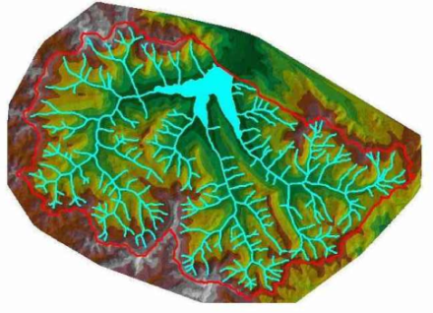
Things to remember
Gestalt cues and principles of organization
Uses of segmentation
  Efficiency
  Better features
  Propose object regions
  Want the segmented object
Mean-shift segmentation
  Good general-purpose segmentation method
  Generally useful clustering, tracking technique
Watershed segmentation
  Good for hierarchical segmentation
  Use in combination with boundary prediction

Slide 63
Next class: EM algorithm
Make sure to bring something to take notes (will include a long derivation)

