Slide 1
Photo Stitching
Panoramas from Multiple Images
03/3/15
Computer Vision
CS 543 / ECE 549
University of Illinois
Derek Hoiem
Notes:
How does image stitching in a camera work?

Slide 2
What about focus, aperture, DOF, FOV, etc?

Slide 3
Adding a lens
“circle of
confusion”
A lens focuses light onto the film
  There is a specific distance at which objects are “in focus”
    other points project to a “circle of confusion” in the image
  Changing the shape of the lens changes this distance

Slide 4

Focal length, aperture, depth of field
F
focal point
optical center
(Center Of Projection)
A lens focuses parallel rays onto a single focal point
  focal point at a distance f beyond the plane of the lens
  Aperture of diameter D restricts the range of rays
Slide source: Seitz

Slide 5
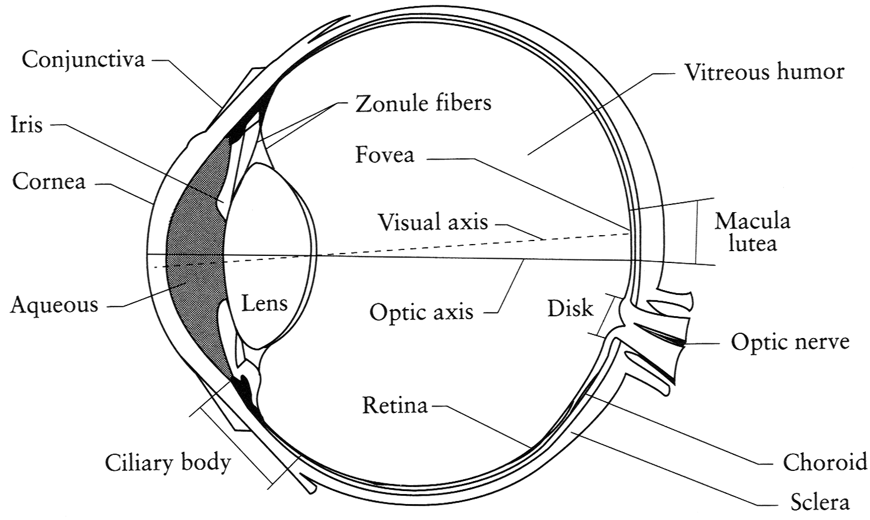
The eye
The human eye is a camera
  Iris - colored annulus with radial muscles
  Pupil (aperture) - the hole whose size is controlled by the iris
  Retina (film): photoreceptor cells (rods and cones)
Slide source: Seitz
Notes:
Note that the retina is curved

Slide 6
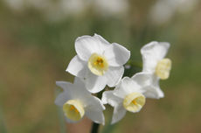
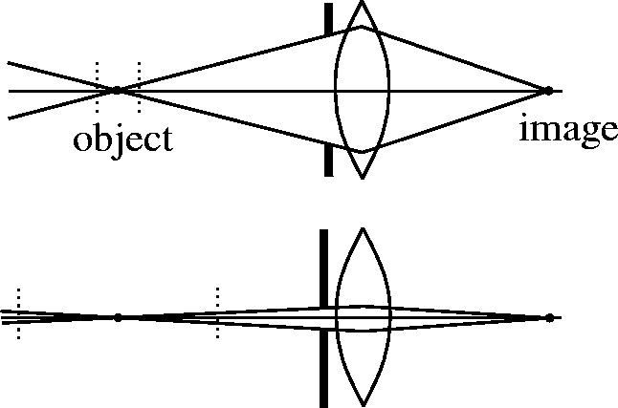
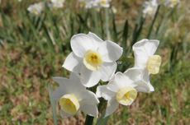
Depth of field
Slide source: Seitz
f / 5.6
f / 32
Changing the aperture size or focal length affects depth of field
Flower images from Wikipedia http://en.wikipedia.org/wiki/Depth_of_field

Slide 7
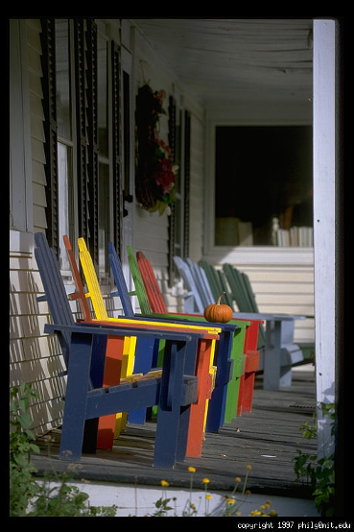
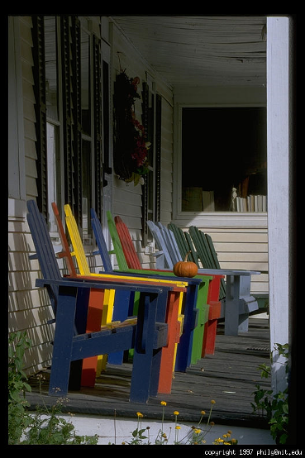
Varying the aperture
Slide from Efros
Large aperture = small DOF
Small aperture = large DOF

Slide 8
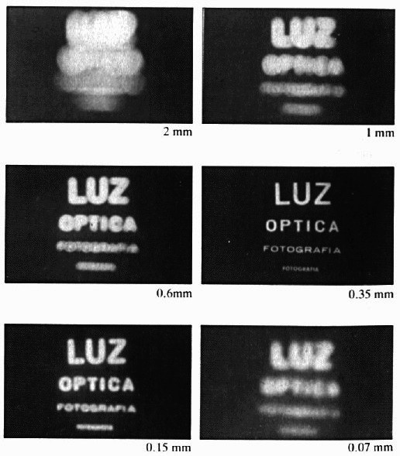
Shrinking the aperture
Why not make the aperture as small as possible?
  Less light gets through
  Diffraction effects
Slide by Steve Seitz

Slide 9
Shrinking the aperture
Slide by Steve Seitz

Slide 10
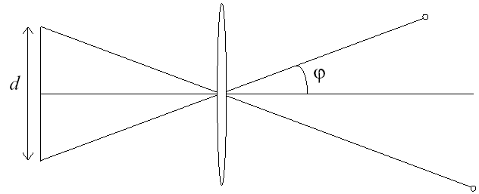
Relation between field of view and focal length
Field of view (angle width)
Film/Sensor Width
Focal length

Slide 11
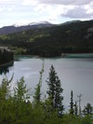
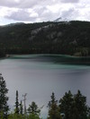
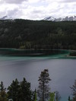
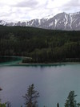
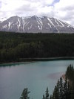
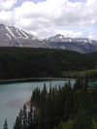
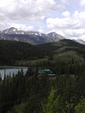
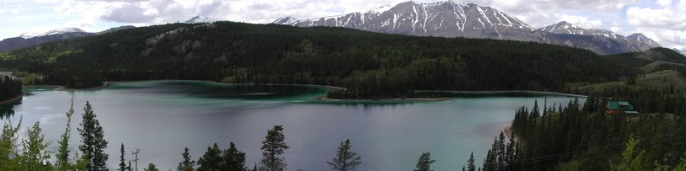
Today: Image Stitching
Combine two or more overlapping images to make one larger image
Add example
Slide credit: Vaibhav Vaish

Slide 12
Concepts introduced/reviewed in today’s lecture
Camera model
Homographies
Solving homogeneous systems of linear equations
Keypoint-based alignment
RANSAC
Blending
How the iphone stitcher works

Slide 13
Photo stitching
P
Q
Camera Center

Slide 14


Illustration
Camera Center

Slide 15
Problem set-up
x = K [R t] X
x' = K' [R' t'] X
t=t'=0
x'=Hx where H = K' R' R⁻¹ K⁻¹
Typically only R and f will change (4 parameters), but, in general, H has 8 parameters
.
X
x
x'
f
f'

Slide 16
Homography
Definition
  General mathematics:
  homography = projective linear transformation
  Vision (most common usage):
  homography = linear transformation between two image planes
Examples
  Project 3D surface into frontal view
  Relate two views that differ only by rotation

Slide 17


Homography example: Image rectification
p’
p
To unwarp (rectify) an image solve for homography H given p and p’: wp’=Hp
Notes:
15 min

Slide 18
Image Stitching Algorithm Overview
Detect keypoints (e.g., SIFT)
Match keypoints (e.g., 1st/2nd NN < thresh)
Estimate homography with four matched keypoints (using RANSAC)
Combine images

Slide 19
Computing homography
Assume we have four matched points: How do we compute homography H?
Direct Linear Transformation (DLT)

Slide 20
Computing homography
Direct Linear Transform
Apply SVD: UDV^{T} = A
h = V_{smallest} (column of V corr. to smallest singular value)
Matlab
[U, S, V] = svd(A);
h = V(:, end);
Explanations of SVD and solving homogeneous linear systems
Notes:
SVD gives the homogeneous least squares solution constrained to have a norm of 1

Slide 21
Computing homography
Assume we have four matched points: How do we compute homography H?
Normalized DLT
Normalize coordinates for each image
  Translate for zero mean
  Scale so that average distance to origin is ~sqrt(2)
  This makes problem better behaved numerically (see HZ p. 107-108)
Compute using DLT in normalized coordinates
Unnormalize:

Slide 22
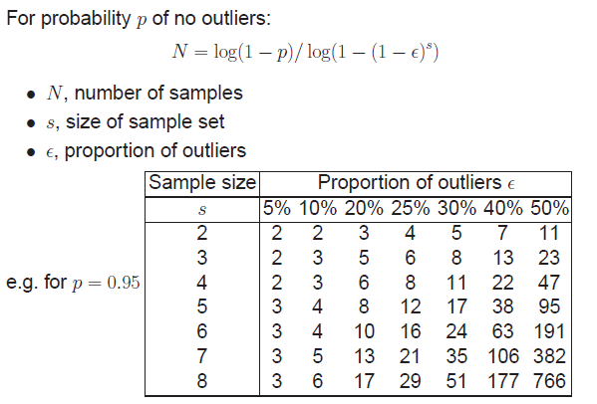
Computing homography
Assume we have matched points with outliers: How do we compute homography H?
Automatic Homography Estimation with RANSAC
Choose number of samples N
HZ Tutorial ‘99

Slide 23
Computing homography
Assume we have matched points with outliers: How do we compute homography H?
Automatic Homography Estimation with RANSAC
Choose number of samples N
Choose 4 random potential matches
Compute H using normalized DLT
Project points from x to x’ for each potentially matching pair:
Count points with projected distance < t
  E.g., t = 3 pixels
Repeat steps 2-5 N times
  Choose H with most inliers
HZ Tutorial ‘99

Slide 24
Automatic Image Stitching
Compute interest points on each image
Find candidate matches
Estimate homography H using matched points and RANSAC with normalized DLT
Project each image onto the same surface and blend
  Matlab: maketform, imtransform

Slide 25




RANSAC for Homography
Initial Matched Points

Slide 26
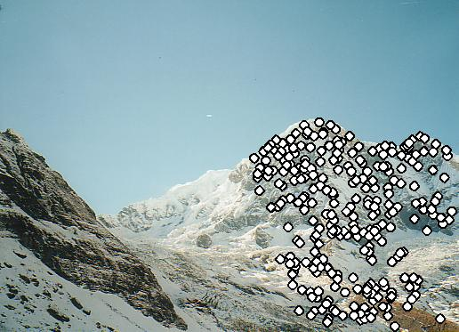
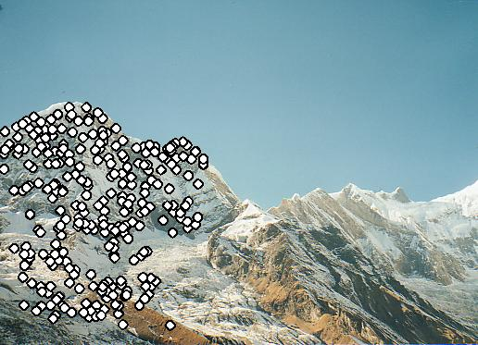
RANSAC for Homography
Final Matched Points

Slide 27
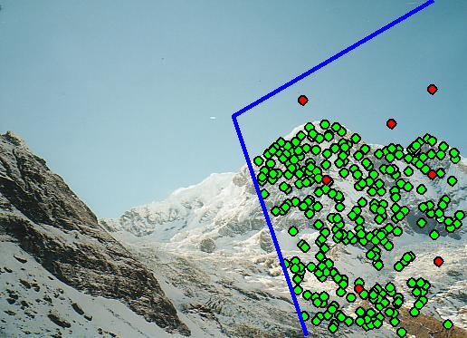
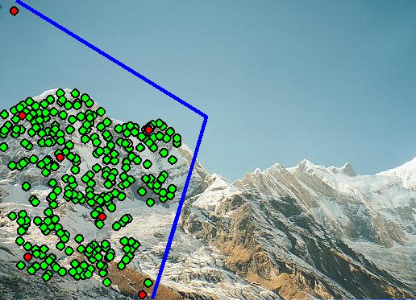
Verification

Slide 28

RANSAC for Homography

Slide 29
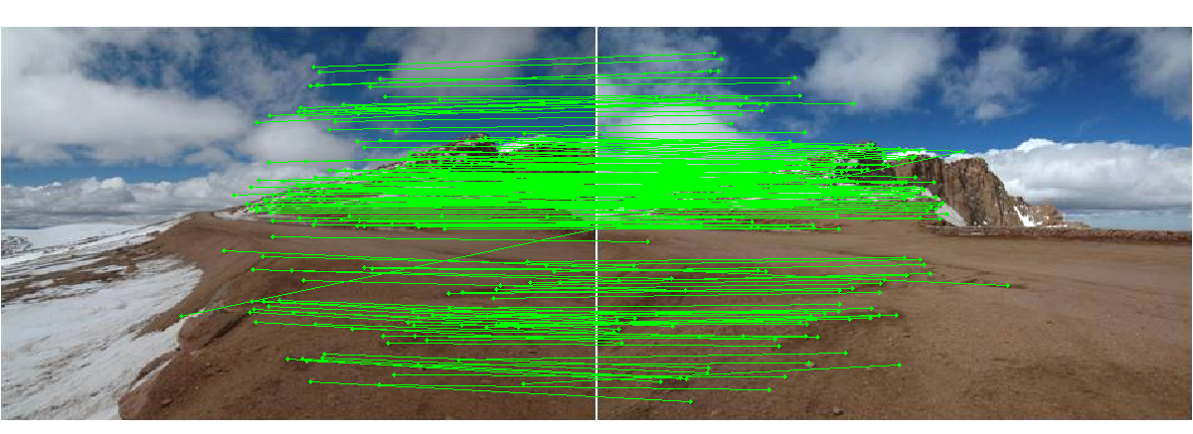
Choosing a Projection Surface
Many to choose: planar, cylindrical, spherical, cubic, etc.

Slide 30
Planar Mapping
x
x
f
f
For red image: pixels are already on the planar surface
For green image: map to first image plane

Slide 31
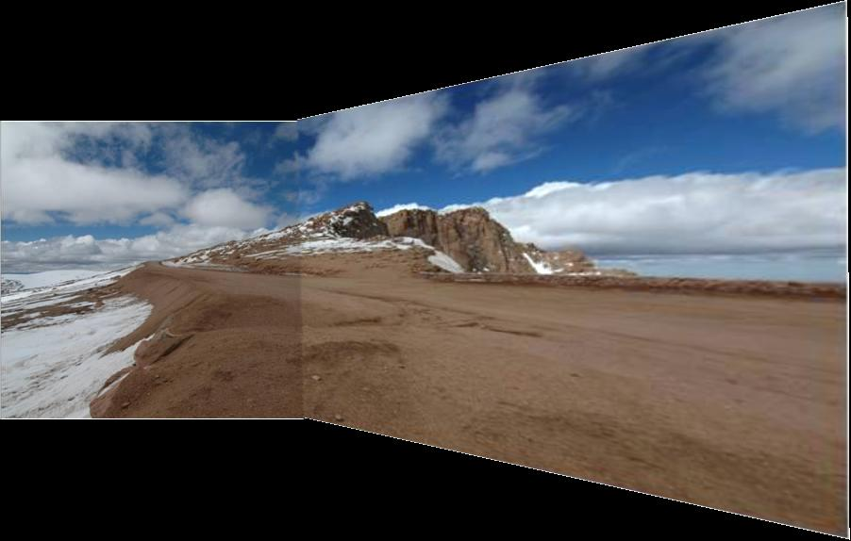
Planar Projection
Planar
Photos by Russ Hewett

Slide 32
Planar Projection
Planar

Slide 33
Cylindrical Mapping
x
x
f
f
For red image: compute h, theta on cylindrical surface from (u, v)
For green image: map to first image plane, than map to cylindrical surface

Slide 34
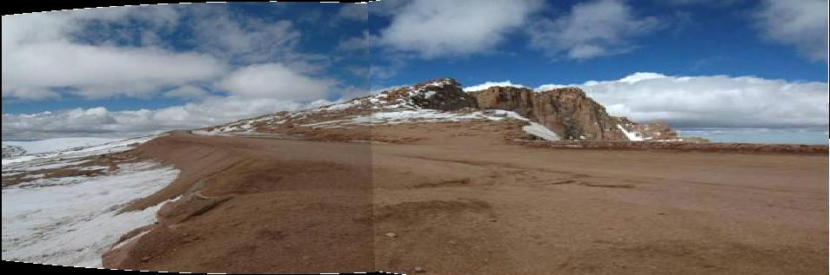
Cylindrical Projection
Cylindrical

Slide 35
Cylindrical Projection
Cylindrical

Slide 36
Planar
Cylindrical

Slide 37
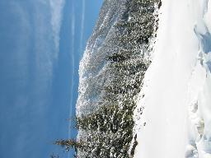
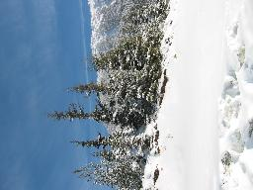
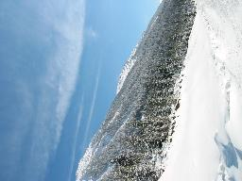
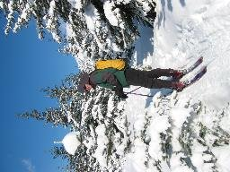
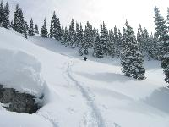
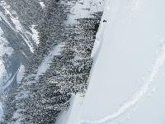
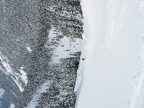
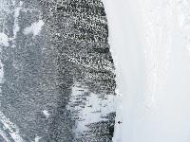
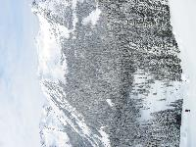
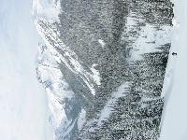
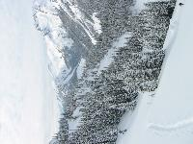
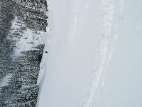
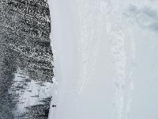
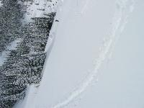
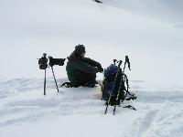
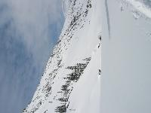
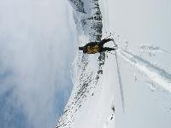
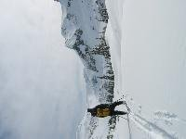
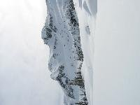
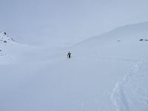
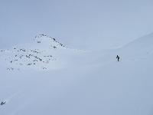
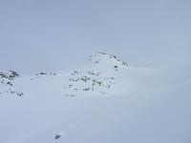
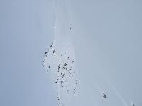
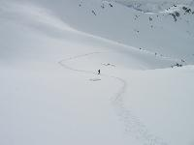
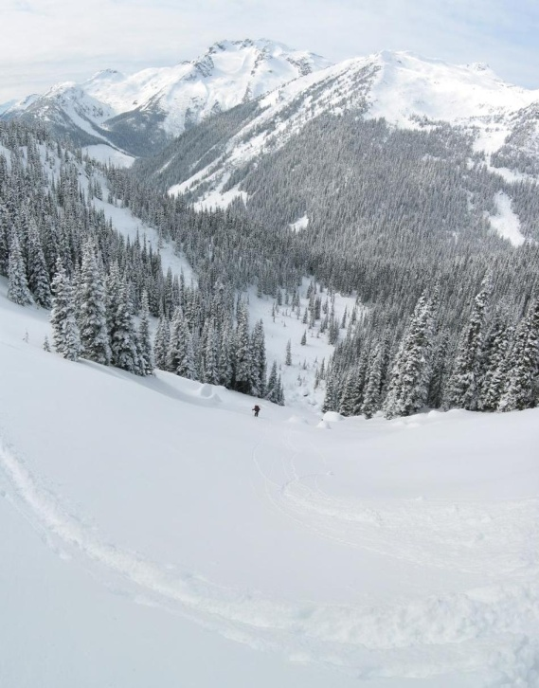
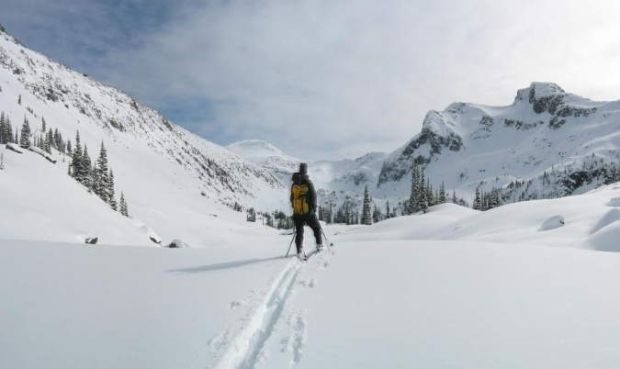


Recognizing Panoramas
Some of following material from Brown and Lowe 2003 talk
Brown and Lowe 2003, 2007

Slide 38
Recognizing Panoramas
Input: N images
Extract SIFT points, descriptors from all images
Find K-nearest neighbors for each point (K=4)
For each image
  Select M candidate matching images by counting matched keypoints (m=6)
  Solve homography H_{ij} for each matched image

Slide 39
Recognizing Panoramas
Input: N images
Extract SIFT points, descriptors from all images
Find K-nearest neighbors for each point (K=4)
For each image
  Select M candidate matching images by counting matched keypoints (m=6)
  Solve homography H_{ij} for each matched image
  Decide if match is valid (n_{i} > 8 + 0.3 n_{f} )
# inliers
# keypoints in overlapping area

Slide 40
Recognizing Panoramas (cont.)
(now we have matched pairs of images)
Find connected components

Slide 41
Finding the panoramas

Slide 42
Finding the panoramas

Slide 43
Finding the panoramas

Slide 44
Recognizing Panoramas (cont.)
(now we have matched pairs of images)
Find connected components
For each connected component
  Perform bundle adjustment to solve for rotation (θ₁, θ₂, θ₃) and focal length f of all cameras
  Project to a surface (plane, cylinder, or sphere)
  Render with multiband blending

Slide 45


Bundle adjustment for stitching
Non-linear minimization of re-projection error
where H = K’ R’ R⁻¹ K⁻¹
Solve non-linear least squares (Levenberg-Marquardt algorithm)
  See paper for details

Slide 46





































Bundle Adjustment
New images initialised with rotation, focal length of best matching image

Slide 47

Bundle Adjustment
New images initialised with rotation, focal length of best matching image

Slide 48


Straightening
Rectify images so that “up” is vertical

Slide 49
Details to make it look good
Choosing seams
Blending

Slide 50
Choosing seams
Easy method
  Assign each pixel to image with nearest center
im1
im2
x
x
Image 2
Image 1

Slide 51
Choosing seams
Easy method
  Assign each pixel to image with nearest center
  Create a mask:
    mask(y, x) = 1 iff pixel should come from im1
  Smooth boundaries (called “feathering”):
    mask_sm = imfilter(mask, gausfil);
  Composite
    imblend = im1_c.*mask + im2_c.*(1-mask);
im1
im2
x
x
Image 2
Image 1

Slide 52

Choosing seams
Better method: dynamic program to find seam along well-matched regions
Illustration: http://en.wikipedia.org/wiki/File:Rochester_NY.jpg

Slide 53


Gain compensation
Simple gain adjustment
  Compute average RGB intensity of each image in overlapping region
  Normalize intensities by ratio of averages

Slide 54


Multi-band Blending
Burt & Adelson 1983
  Blend frequency bands over range ∝ λ

Slide 55

Multiband Blending with Laplacian Pyramid
At low frequencies, blend slowly
At high frequencies, blend quickly
1
0
1
0
1
0
Left pyramid
blend
Right pyramid

Slide 56

Multiband blending
Laplacian pyramids
Compute Laplacian pyramid of images and mask
Create blended image at each level of pyramid
Reconstruct complete image

Slide 57

Blending comparison (IJCV 2007)

Slide 58

Blending Comparison

Slide 59
Further reading
DLT algorithm: HZ p. 91 (alg 4.2), p. 585
Normalization: HZ p. 107-109 (alg 4.2)
RANSAC: HZ Sec 4.7, p. 123, alg 4.6
Rick Szeliski’s alignment/stitching tutorial
Recognising Panoramas: Brown and Lowe, IJCV 2007 (also bundle adjustment)

Slide 60
How does iphone panoramic stitching work?
Capture images at 30 fps
Stitch the central 1/8 of a selection of images
  Select which images to stitch using the accelerometer and frame-to-frame matching
  Faster and avoids radial distortion that often occurs towards corners of images
Alignment
  Initially, perform cross-correlation of small patches aided by accelerometer to find good regions for matching
  Register by matching points (KLT tracking or RANSAC with FAST (similar to SIFT) points) or correlational matching
Blending
  Linear (or similar) blending, using a face detector to avoid blurring face regions and choose good face shots (not blinking, etc)
http://www.patentlyapple.com/patently-apple/2012/11/apples-cool-iphone-5-panorama-app-revealed-in-5-patents.html

Slide 61
Things to remember
Homography relates rotating cameras
Recover homography using RANSAC and normalized DLT
Bundle adjustment minimizes reprojection error for set of related images
Details to make it look nice (e.g., blending)

Slide 62
Next class
Stereo and epipolar geometry

