Slide 1

Edge Detection
02/05/15
Magritte, “Decalcomania”
Computer Vision (CS 543 / ECE 549)
University of Illinois
Derek Hoiem
Many slides from Lana Lazebnik, Steve Seitz, David Forsyth, David Lowe, Fei-Fei Li

Slide 2
Last class
How to use filters for
  Matching
  Compression
Image representation with pyramids
Texture and filter banks

Slide 3
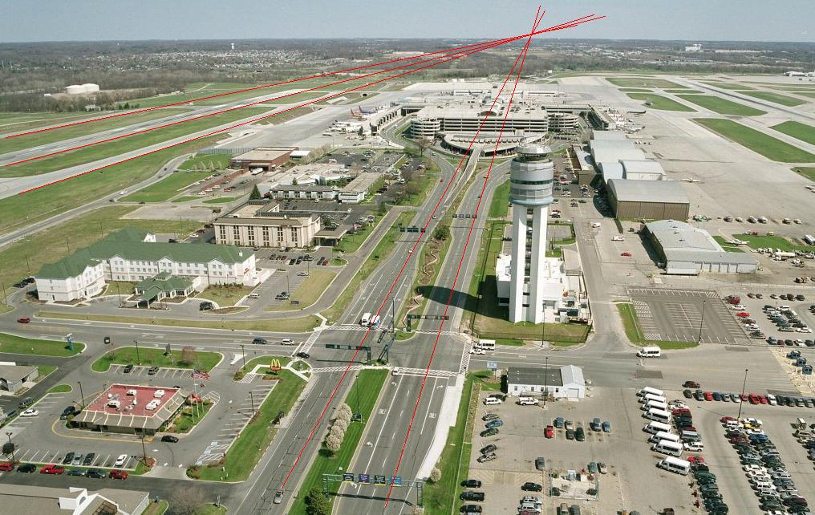
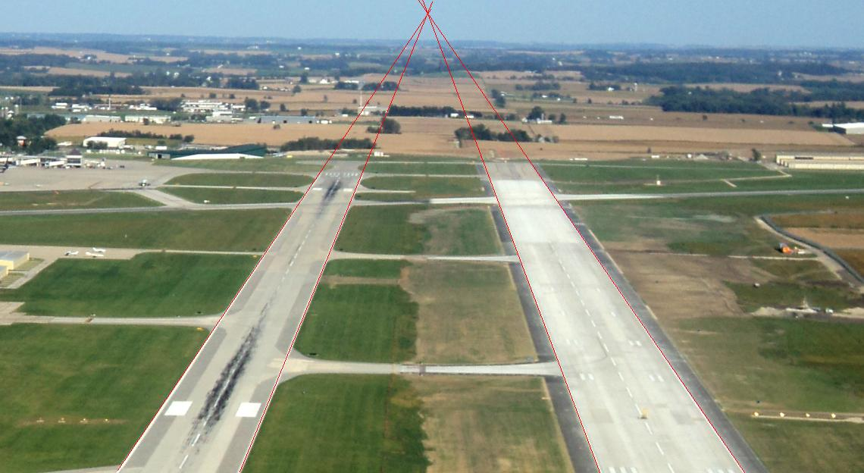
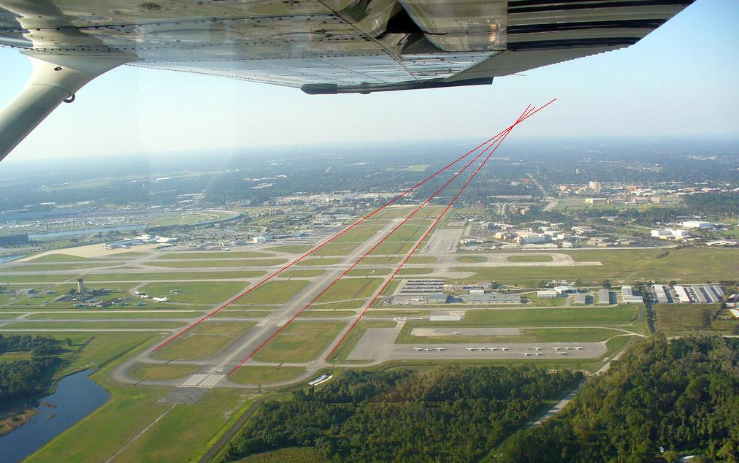
A couple remaining questions from earlier
Does the curvature of the earth change the horizon location?
Illustrations from Amin Sadeghi

Slide 4
A couple remaining questions from earlier
Computational complexity of coarse-to-fine search?
Image 1 Pyramid
Image 2 Pyramid
Size M
Size N
Repeated Local Neighborhood Search O(M)
Downsampling: O(N+M)
Low Resolution Search O(N/M)
Overall complexity: O(N+M)
Original high-resolution full search: O(NM) or O(N logN)

Slide 5
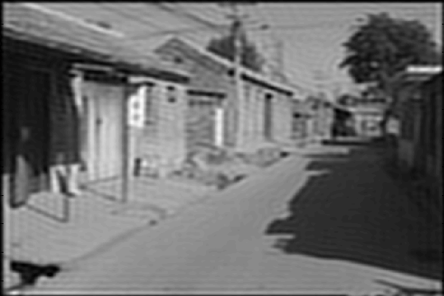
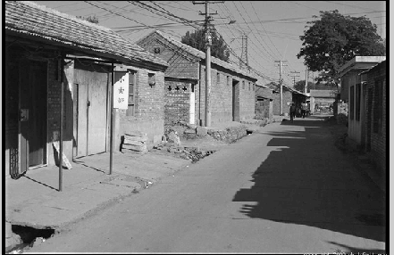
Issue from Tuesday
Why not use an ideal filter?
Answer: has infinite spatial extent, clipping results in ringing
Attempt to apply ideal filter in frequency domain

Slide 6
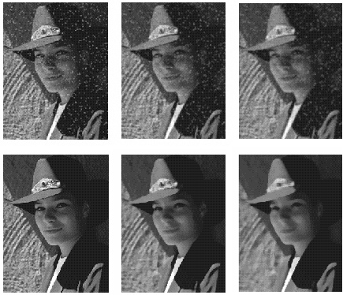
Median vs. Gaussian filtering
3x3
5x5
7x7
Gaussian
Median

Slide 7
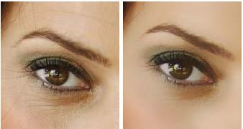
Other non-linear filters
Weighted median (pixels further from center count less)
Clipped mean (average, ignoring few brightest and darkest pixels)
Max or min filter (ordfilt2)
Bilateral filtering (weight by spatial distance and intensity difference)
Bilateral filtering
Image:
http://vision.ai.uiuc.edu/?p=1455

Slide 8
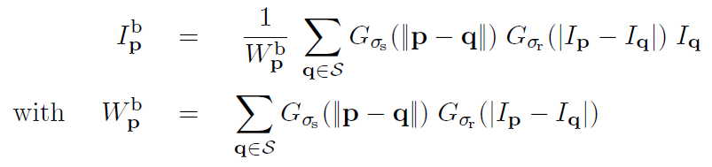
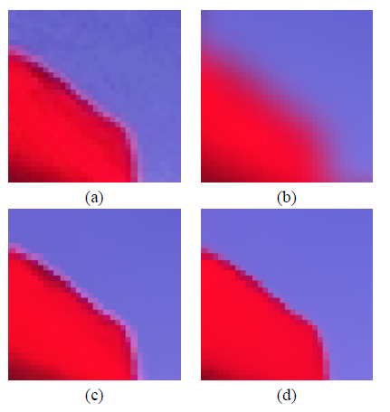
Bilateral filters
Edge preserving: weights similar pixels more
spatial
similarity (e.g., intensity)
Original
Gaussian
Bilateral
Carlo Tomasi, Roberto Manduchi, Bilateral Filtering for Gray and Color Images, ICCV, 1998.

Slide 9
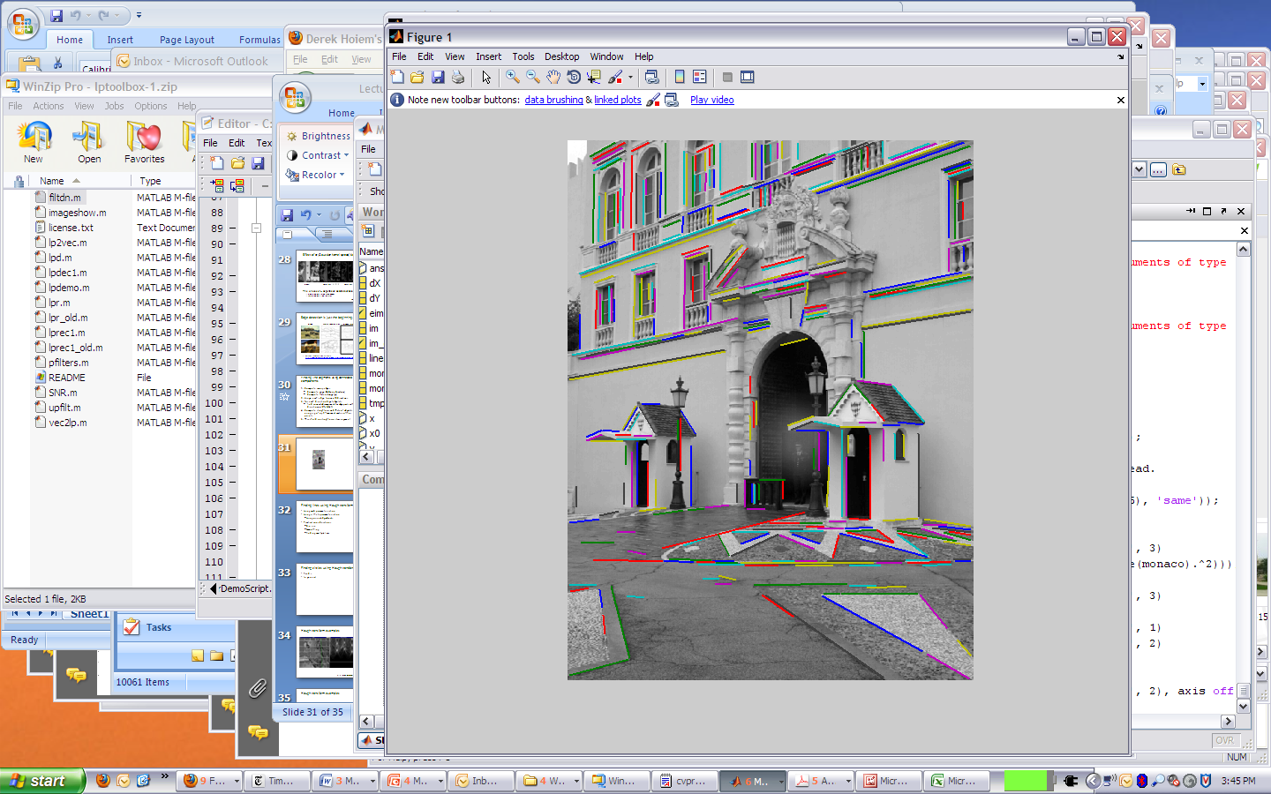

Today’s class
Detecting edges
Finding straight lines

Slide 10

Why do we care about edges?
Extract information, recognize objects
Recover geometry and viewpoint
Vertical vanishing
point
(at infinity)
Vanishing
line
Vanishing
point
Vanishing
point

Slide 11

Origin of Edges
surface normal discontinuity
depth discontinuity
surface color discontinuity
illumination discontinuity
Edges are caused by a variety of factors
Source: Steve Seitz

Slide 12
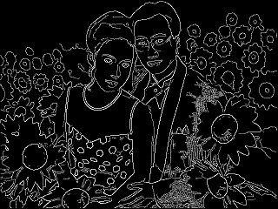
Why finding edges is important
Group pixels into objects or parts
Cues for 3D shape
Guiding interactive image editing

Slide 13
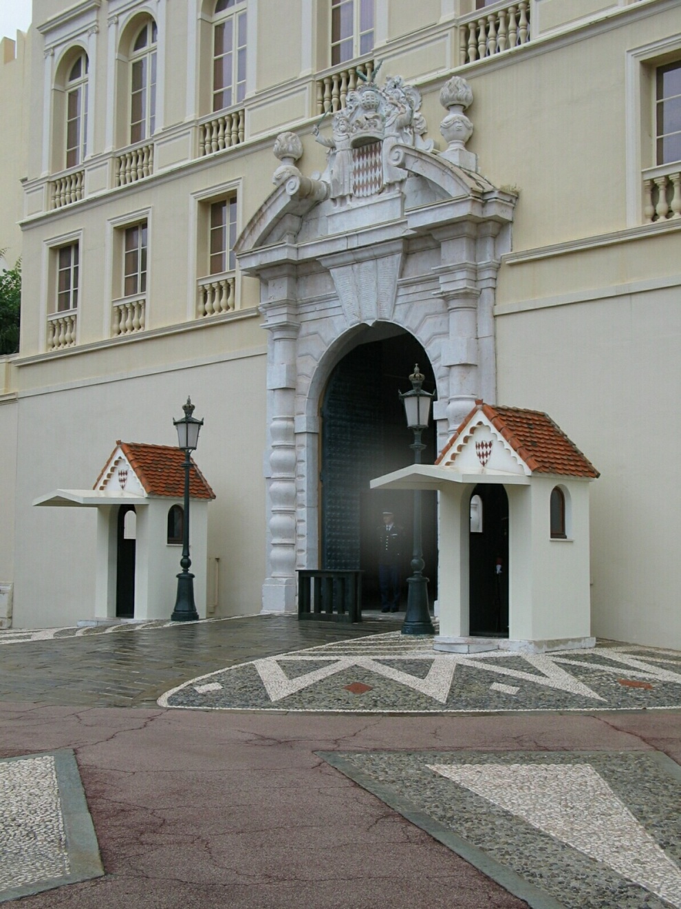
Closeup of edges

Slide 14
Closeup of edges

Slide 15
Closeup of edges

Slide 16
Closeup of edges

Slide 17

Characterizing edges
An edge is a place of rapid change in the image intensity function
intensity function
(along horizontal scanline)
image
first derivative
edges correspond to
extrema of derivative

Slide 18
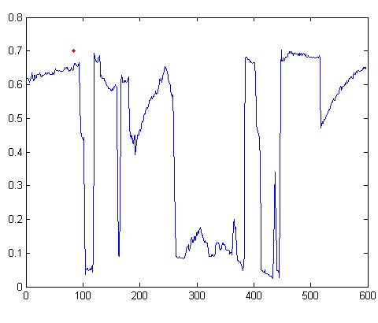

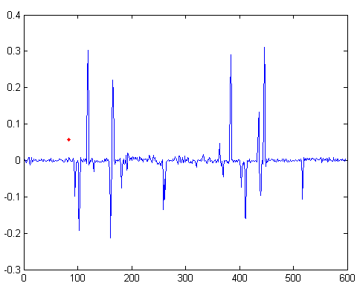
Intensity profile
Intensity
Gradient

Slide 19
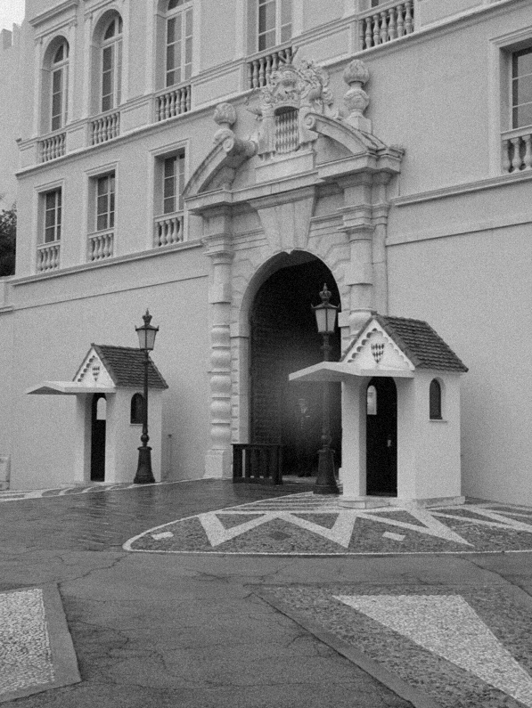
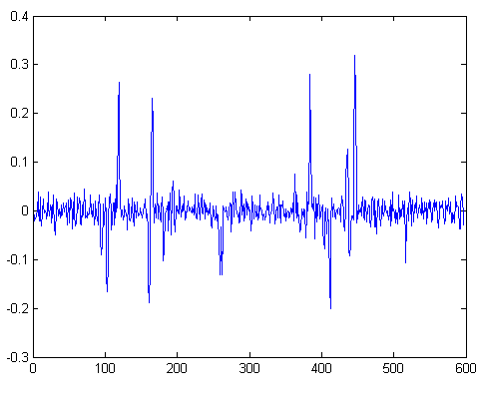
With a little Gaussian noise
Gradient

Slide 20




Effects of noise
Consider a single row or column of the image
  Plotting intensity as a function of position gives a signal
Where is the edge?
Source: S. Seitz
Notes:
How to fix?

Slide 21
Effects of noise
Difference filters respond strongly to noise
  Image noise results in pixels that look very different from their neighbors
  Generally, the larger the noise the stronger the response
What can we do about it?
Source: D. Forsyth

Slide 22
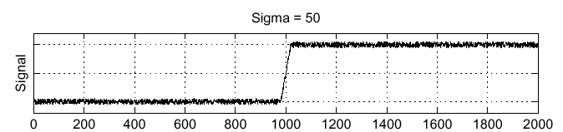
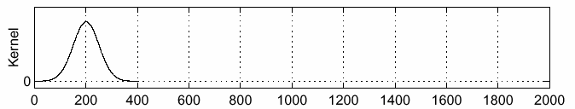
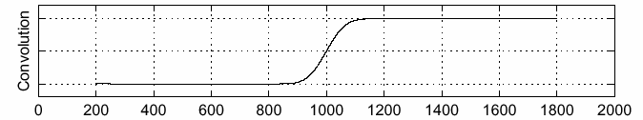
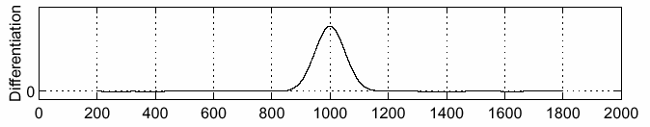
Solution: smooth first
f
g
f * g
To find edges, look for peaks in
Source: S. Seitz

Slide 23

Derivative theorem of convolution
Differentiation is convolution, and convolution is associative:
This saves us one operation:
f
Source: S. Seitz

Slide 24


Derivative of Gaussian filter
* [1 0 -1] =
Is this filter separable?

Slide 25
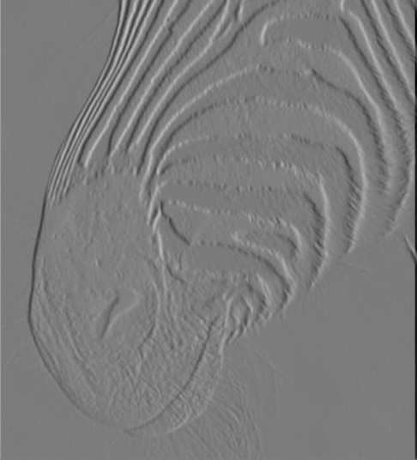
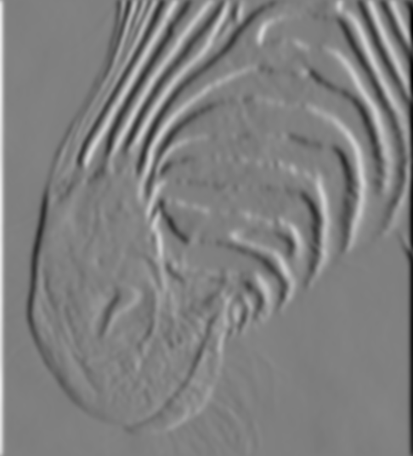
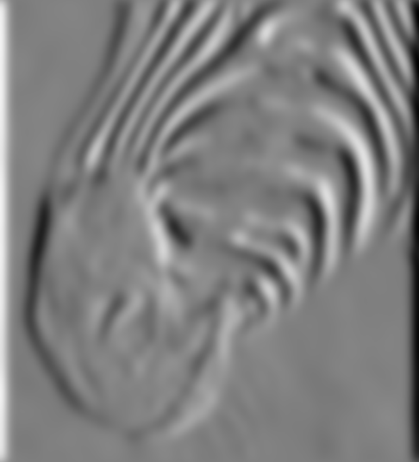
Tradeoff between smoothing and localization
1 pixel
3 pixels
7 pixels
Smoothed derivative removes noise, but blurs edge. Also finds edges at different “scales”.
Source: D. Forsyth

Slide 26
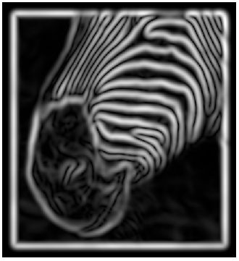
Implementation issues
The gradient magnitude is large along a thick “trail” or “ridge,” so how do we identify the actual edge points?
How do we link the edge points to form curves?
Source: D. Forsyth
Notes:
Figures show gradient magnitude of zebra at two different scales

Slide 27
Designing an edge detector
Criteria for a good edge detector:
  Good detection: find all real edges, ignoring noise or other artifacts
  Good localization
    detect edges as close as possible to the true edges
    return one point only for each true edge point
Cues of edge detection
  Differences in color, intensity, or texture across the boundary
  Continuity and closure
  High-level knowledge
Source: L. Fei-Fei

Slide 28
Canny edge detector
This is probably the most widely used edge detector in computer vision
Theoretical model: step-edges corrupted by additive Gaussian noise
Canny has shown that the first derivative of the Gaussian closely approximates the operator that optimizes the product of signal-to-noise ratio and localization
J. Canny, A Computational Approach To Edge Detection, IEEE Trans. Pattern Analysis and Machine Intelligence, 8:679-714, 1986.
Source: L. Fei-Fei

Slide 29

Example
input image (“Lena”)

Slide 30


Derivative of Gaussian filter
x-direction
y-direction

Slide 31
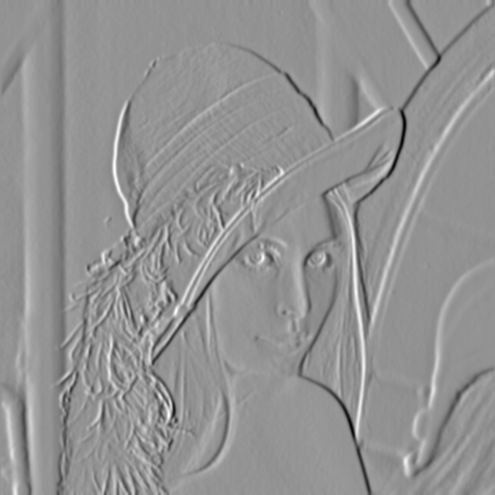
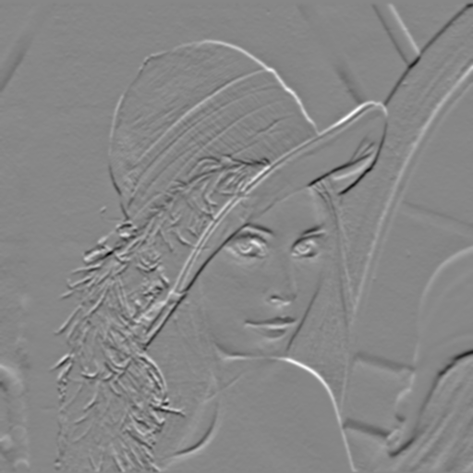
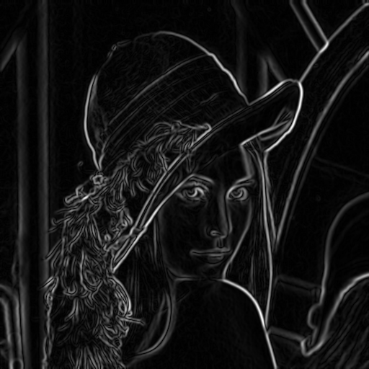
Compute Gradients (DoG)
X-Derivative of Gaussian
Y-Derivative of Gaussian
Gradient Magnitude

Slide 32
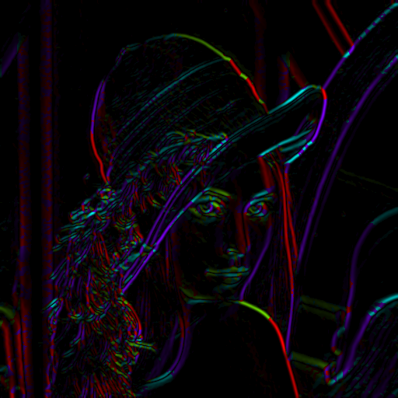
Get Orientation at Each Pixel
Threshold at minimum level
Get orientation
theta = atan2(-gy, gx)
Notes:
-gy because y=2 is below y=1, and we typically want 90 degrees to point up

Slide 33


Non-maximum suppression for each orientation
At q, we have a maximum if the value is larger than those at both p and at r. Interpolate to get these values.
Source: D. Forsyth

Slide 34

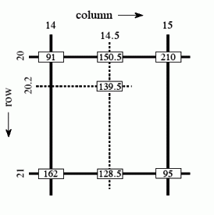
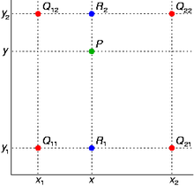
Bilinear Interpolation
http://en.wikipedia.org/wiki/Bilinear_interpolation

Slide 35
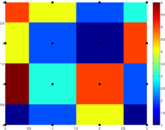
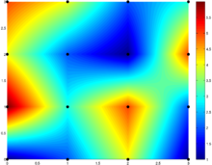
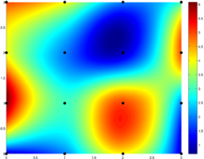
Sidebar: Interpolation options
imx2 = imresize(im, 2, interpolation_type)
‘nearest’
  Copy value from nearest known
  Very fast but creates blocky edges
‘bilinear’
  Weighted average from four nearest known pixels
  Fast and reasonable results
‘bicubic’ (default)
  Non-linear smoothing over larger area
  Slower, visually appealing, may create negative pixel values
Examples from http://en.wikipedia.org/wiki/Bicubic_interpolation

Slide 36
Before Non-max Suppression

Slide 37
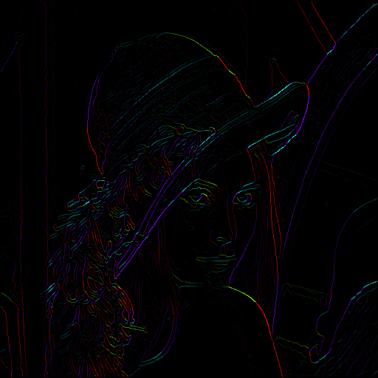
After non-max suppression

Slide 38
Before Non-max Suppression

Slide 39
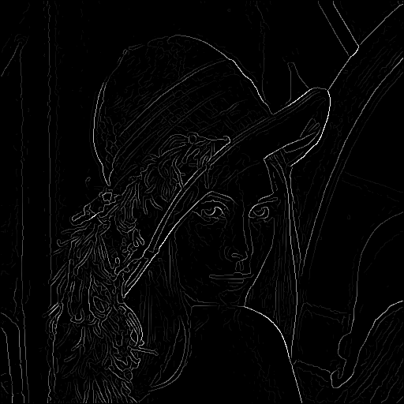
After non-max suppression

Slide 40
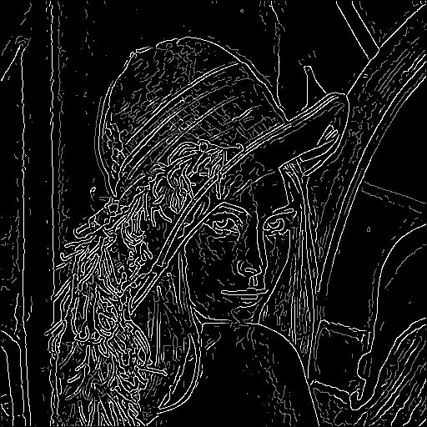
Hysteresis thresholding
Threshold at low/high levels to get weak/strong edge pixels
Do connected components, starting from strong edge pixels

Slide 41
Hysteresis thresholding
Check that maximum value of gradient value is sufficiently large
  drop-outs? use hysteresis
    use a high threshold to start edge curves and a low threshold to continue them.
Source: S. Seitz

Slide 42
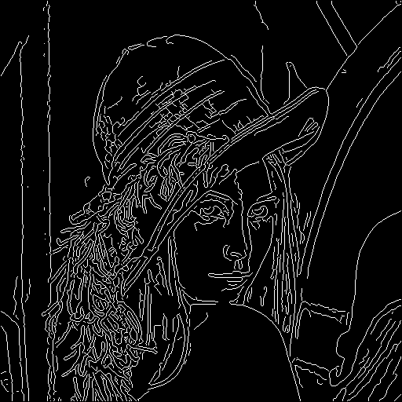
Final Canny Edges

Slide 43
Canny edge detector
Filter image with x, y derivatives of Gaussian
Find magnitude and orientation of gradient
Non-maximum suppression:
  Thin multi-pixel wide “ridges” down to single pixel width
Thresholding and linking (hysteresis):
  Define two thresholds: low and high
  Use the high threshold to start edge curves and the low threshold to continue them
MATLAB: edge(image, ‘canny’)
Source: D. Lowe, L. Fei-Fei

Slide 44





Effect of σ (Gaussian kernel spread/size)
original
Canny with
Canny with
The choice of σ depends on desired behavior
  large σ detects large scale edges
  small σ detects fine features
Source: S. Seitz

Slide 45






Learning to detect boundaries
image
human segmentation
gradient magnitude
Berkeley segmentation database:
http://www.eecs.berkeley.edu/Research/Projects/CS/vision/grouping/segbench/

Slide 46
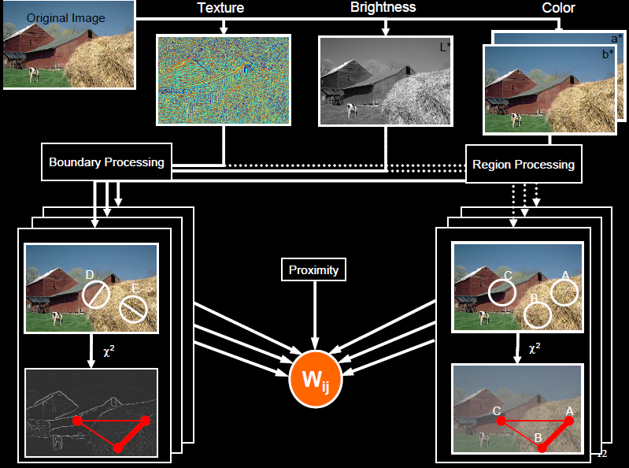
pB boundary detector
Martin, Fowlkes, Malik 2004: Learning to Detection Natural Boundaries…
http://www.eecs.berkeley.edu/Research/Projects/CS/vision/grouping/papers/mfm-pami-boundary.pdf
Figure from Fowlkes

Slide 47
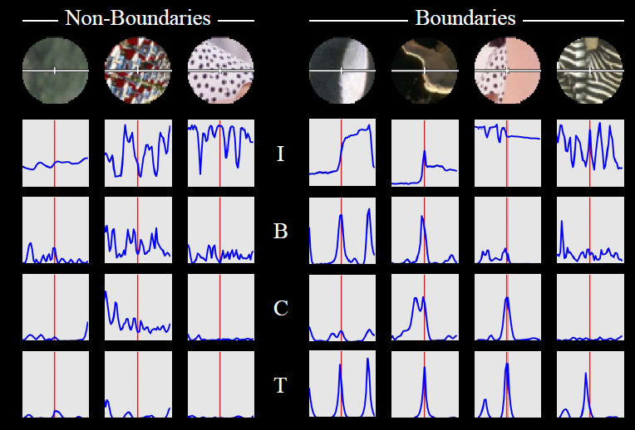
pB Boundary Detector
Figure from Fowlkes

Slide 48
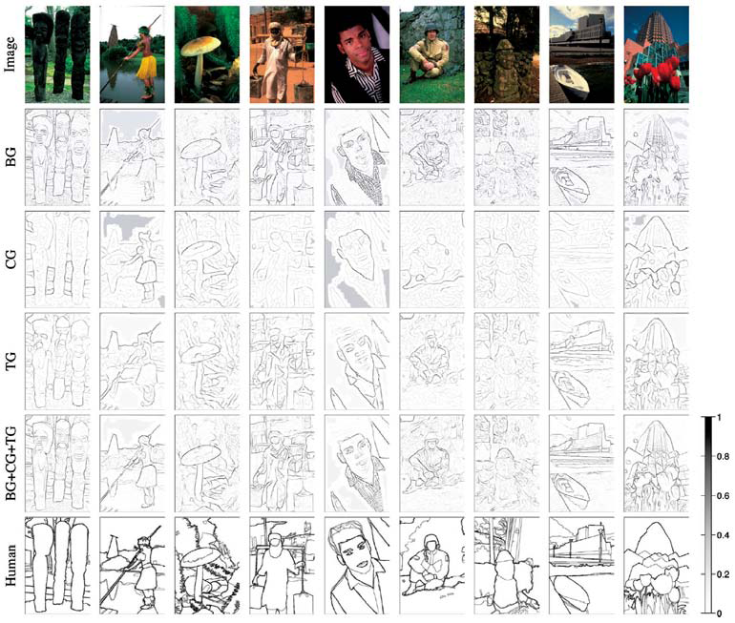
Brightness
Color
Texture
Combined
Human

Slide 49
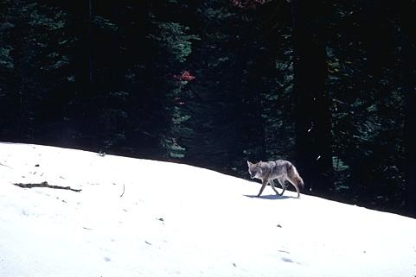
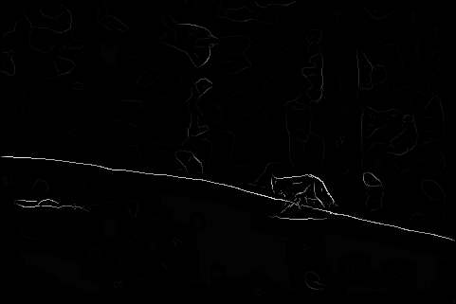
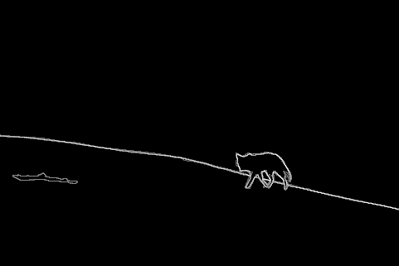
Results
Pb (0.88)
Human (0.95)

Slide 50
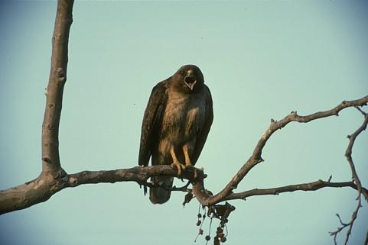
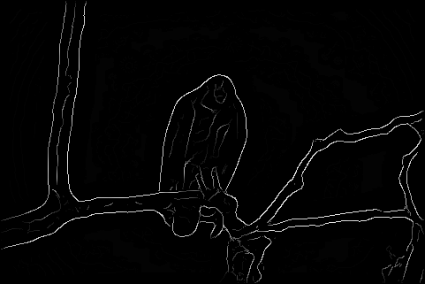
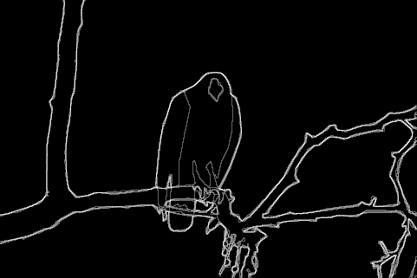
Results
Pb
Pb (0.88)
Global Pb
Human
Human (0.96)

Slide 51
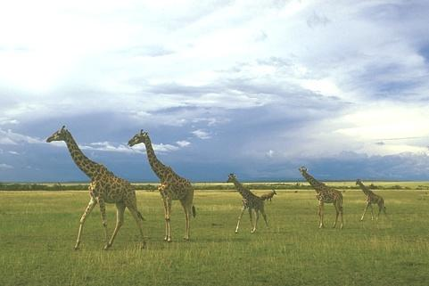
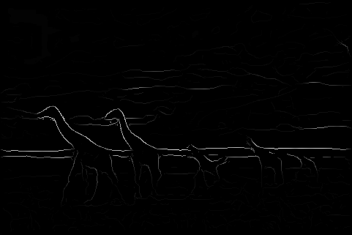
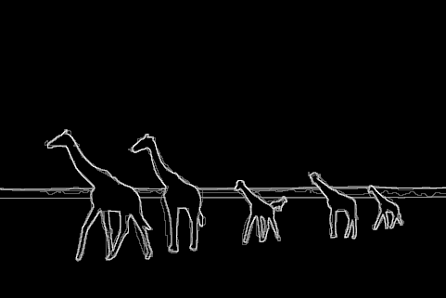
Pb (0.63)
Human (0.95)

Slide 52
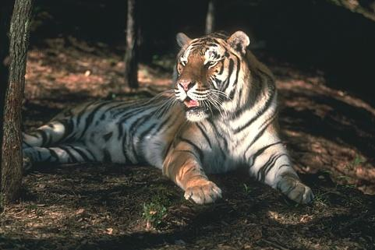


Pb (0.35)
Human (0.90)
For more: http://www.eecs.berkeley.edu/Research/Projects/CS/vision/bsds/bench/html/108082-color.html

Slide 53

Global pB boundary detector
Figure from Fowlkes

Slide 54
Edge Detection with Structured Random Forests (Dollar Zitnick ICCV 2013)
Goal: quickly predict whether each pixel is an edge
Insights
  Predictions can be learned from training data
  Predictions for nearby pixels should not be independent
Solution
  Train structured random forests to split data into patches with similar boundaries based on features
  Predict boundaries at patch level, rather than pixel level, and aggregate (average votes)
Boundaries in patch
http://research.microsoft.com/pubs/202540/DollarICCV13edges.pdf

Slide 55

Edge Detection with Structured Random Forests
Algorithm
  Extract overlapping 32x32 patches at three scales
  Features are pixel values and pairwise differences in feature maps (LUV color, gradient magnitude, oriented gradient)
  Predict $T$ boundary maps in the central 16x16 region using $T$ trained decision trees
  Average predictions for each pixel across all patches

Slide 56
Edge Detection with Structured Random Forests
Results
BSDS 500
NYU Depth dataset edges

Slide 57
Edge Detection with Structured Random Forests
Ground truth
Results (multiscale)

Slide 58
Crisp Boundary Detection using Pointwise Mutual Information (Isola et al. ECCV 2014)
Pixel combinations that are unlikely to be together are edges
Algorithm:
Kernel density estimation
Spectral clustering
http://web.mit.edu/phillipi/www/publications/crisp_boundaries.pdf

Slide 59
Crisp Boundary Detection using Pointwise Mutual Information

Slide 60
State of edge detection
Local edge detection is mostly solved
  Intensity gradient, color, texture
Work on RGB-D edge detection is currently more active
Some methods take into account longer contours, but could probably do better
Often used in combination with object detectors or region classifiers

Slide 61

Finding straight lines

Slide 62
Finding line segments using connected components
Compute canny edges
  Compute: gx, gy (DoG in x,y directions)
  Compute: theta = atan(gy / gx)
Assign each edge to one of 8 directions
For each direction d, get edgelets:
  find connected components for edge pixels with directions in {d-1, d, d+1}
Compute straightness and theta of edgelets using eig of x,y 2nd moment matrix of their points
Threshold on straightness, store segment
Larger eigenvector

Slide 63
2. Canny lines → … →straight edges

Slide 64
Homework 1
Due Feb 16, but try to finish by Tues (HW 2 will take quite a bit more time)
https://courses.engr.illinois.edu/cs543/sp2015/hw/hw1_cs543_sp15.pdf

Slide 65
Things to remember
Canny edge detector = smooth → derivative → thin → threshold → link
Pb: learns weighting of gradient, color, texture differences
  More recent learning approaches give at least as good accuracy and are faster
Straight line detector = canny + gradient orientations → orientation binning → linking → check for straightness

Slide 66
Next classes: Correspondence and Alignment
Detecting interest points
Tracking points
Object/image alignment and registration
  Aligning 3D or edge points
  Object instance recognition
  Image stitching

Slide 67
Finding straight lines
One solution: try many possible lines and see how many points each line passes through
Hough transform provides a fast way to do this

Slide 68
Outline of Hough Transform
Create a grid of parameter values
Each point votes for a set of parameters, incrementing those values in grid
Find maximum or local maxima in grid

Slide 69
Finding lines using Hough transform
Using m,b parameterization
Using r, theta parameterization
  Using oriented gradients
Practical considerations
  Bin size
  Smoothing
  Finding multiple lines
  Finding line segments

Slide 70
1. Image → Canny

Slide 71

2. Canny → Hough votes

Slide 72

3. Hough votes → Edges
Find peaks and post-process

Slide 73

Hough transform example
http://ostatic.com/files/images/ss_hough.jpg

Slide 74


Hough transform examples
OpenCV: probabilistic hough transform

Slide 75
Finding circles using Hough transform
Fixed r
Variable r

Slide 76
Comparison
Hough Transform Method
Connected Components Method

