Slide 1
Object Category Detection: Parts-based Models
04/12/12
Computer Vision
CS 543 / ECE 549
University of Illinois
Derek Hoiem

Slide 2
Previously…
Template Matching
Training Image
Close Match
Not close
Template Matching

Slide 3
Administrative stuff
HW 5 due Tues
I’m out of town Sun to Tues night
Unresponsive on Monday
Amin Sadeghi will teach Tues
Final project posters presented May 4 (1:30-4:30pm)
Final paper: due May 8

Slide 4
Administrative stuff
Projects: next class, each group gives 2 minute summary of projects
Goal
Progress so far
If you want to show an image or figure, e-mail me one image or powerpoint slide by Wed 5pm
Deadlines
HW 3 due April 6
HW 4 due May 4 (should be out April 9)
Projects due in ~5 weeks
Poster session
During finals week
May 11 12:30-2:30 (Tues) or May 13 12:30-2:30 (Thurs)

Slide 5
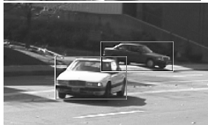
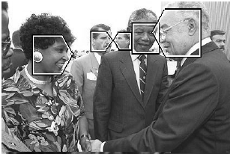
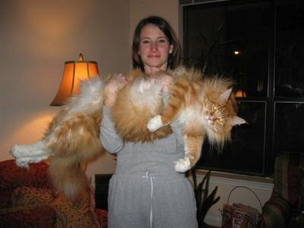
Goal: Detect all instances of objects
Cars
Faces
Cats

Slide 6
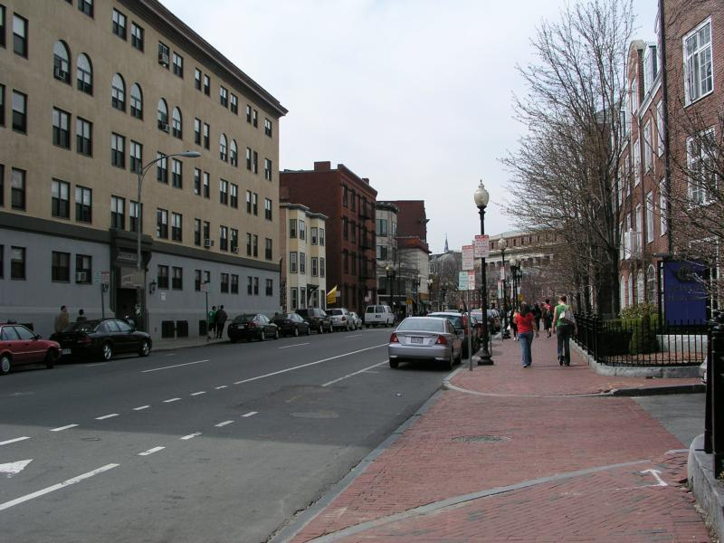
Last class: sliding window detection
…
…
Notes:
The dominant paradigm in computer vision today is local and independent…

Slide 7
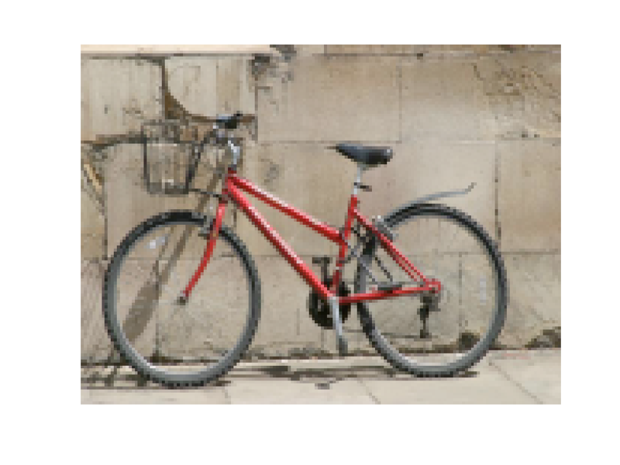
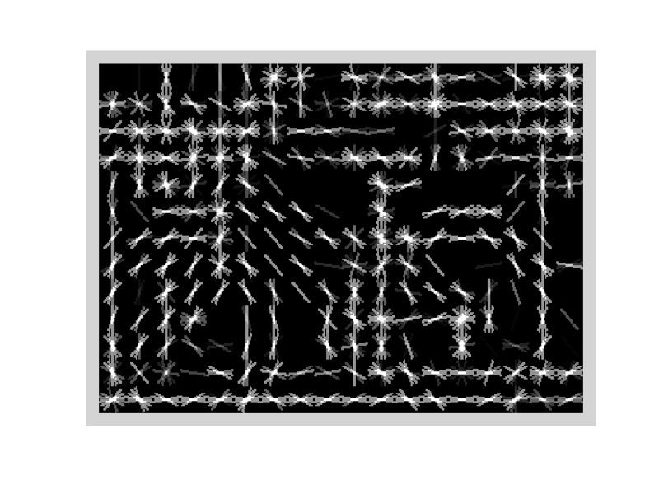
Object model: last class
Statistical Template in Bounding Box
Object is some (x,y,w,h) in image
Features defined wrt bounding box coordinates
Image
Template Visualization
Images from Felzenszwalb

Slide 8
Last class: statistical template
Object model = log linear model of parts at fixed positions
?
+3
+2
-2
-1
-2.5
= -0.5
> 7.5
Non-object
?
+4
+1
+0.5
+3
+0.5
= 10.5
> 7.5
Object

Slide 9
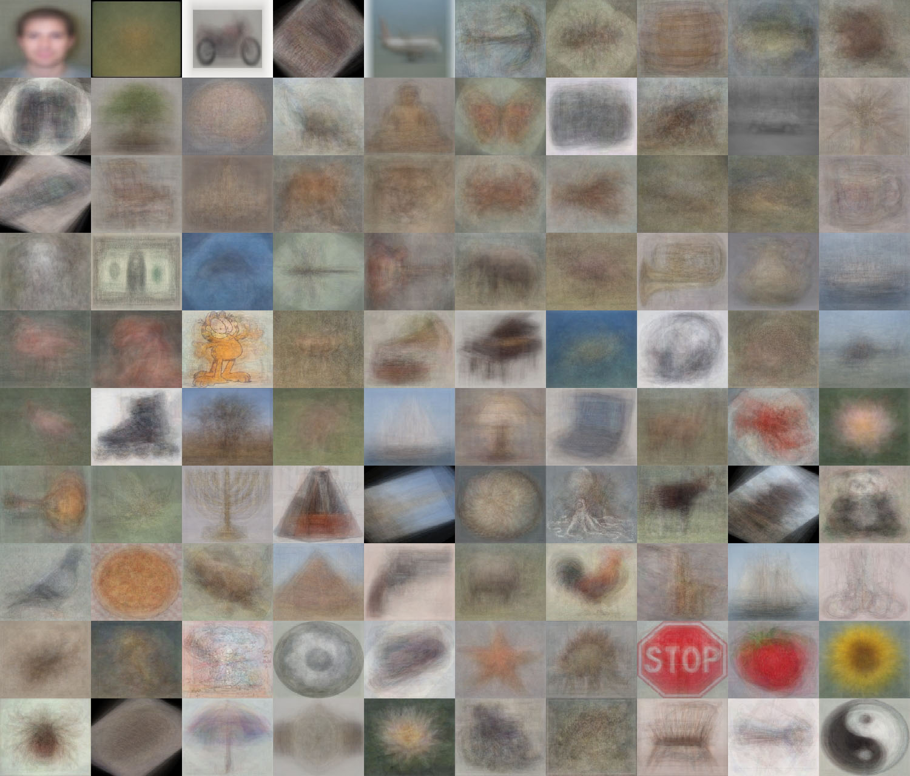
When do statistical templates make sense?
Caltech 101 Average Object Images

Slide 10
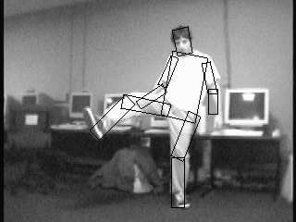
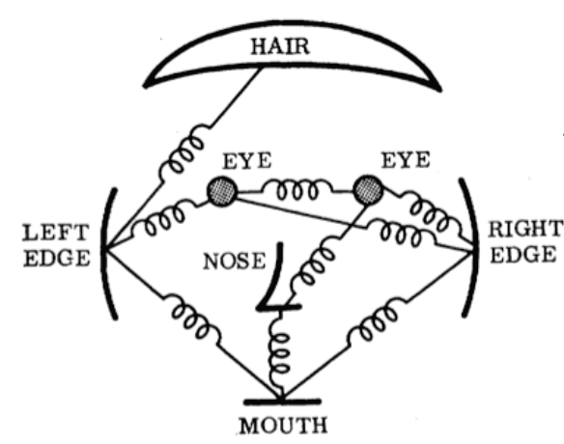
Object models: this class
Articulated parts model
Object is configuration of parts
Each part is detectable
Images from Felzenszwalb

Slide 11
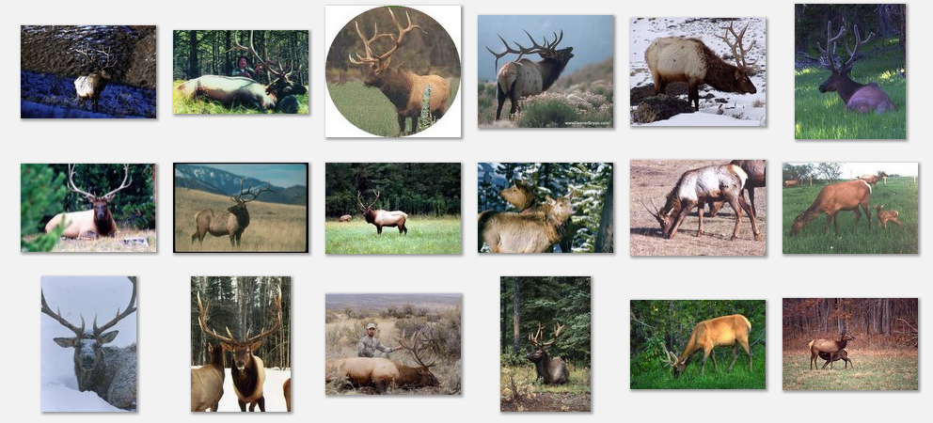
Deformable objects
Images from Caltech-256
Slide Credit: Duan Tran

Slide 12
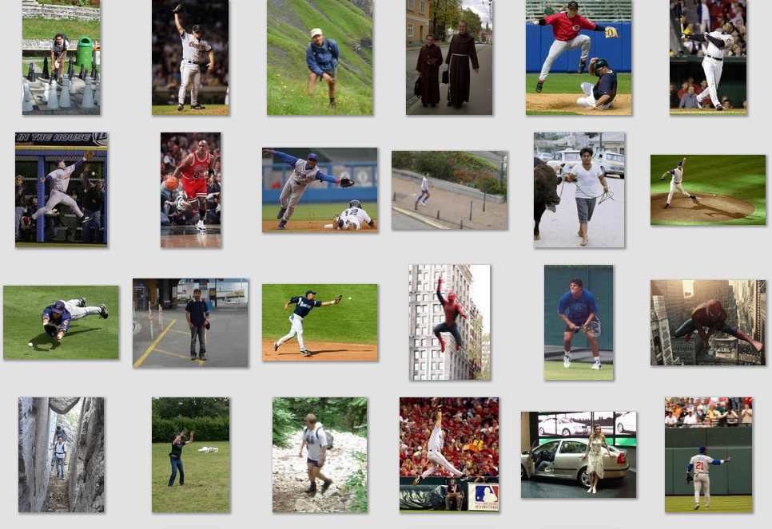
Deformable objects
Images from D. Ramanan’s dataset
Slide Credit: Duan Tran

Slide 13
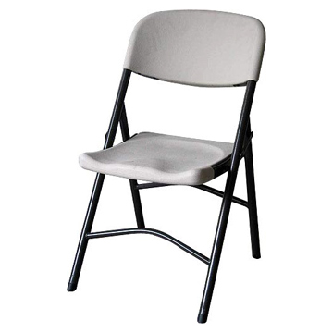
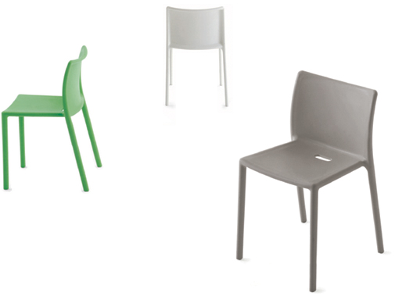
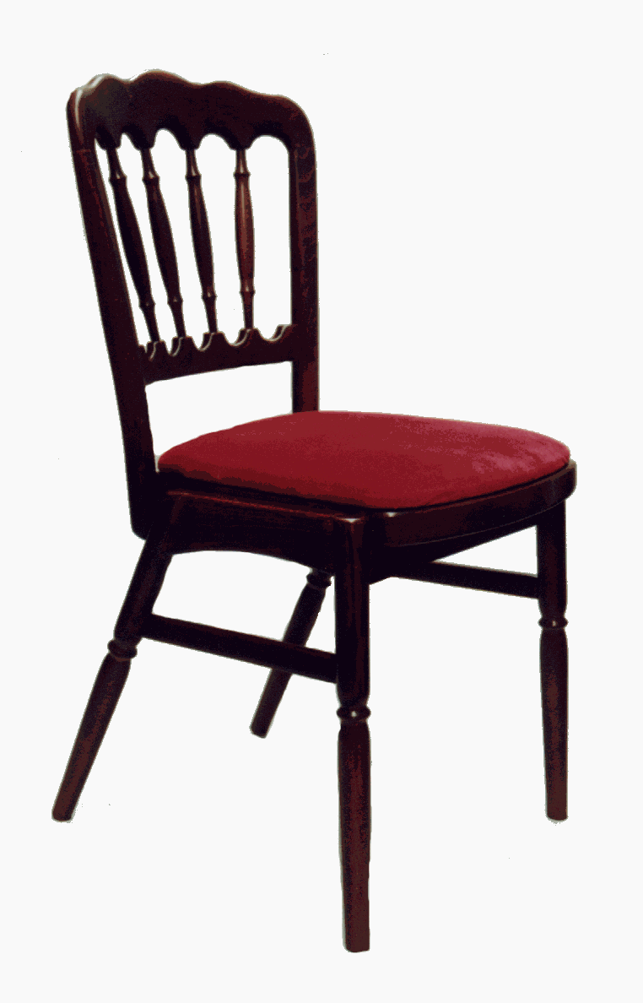
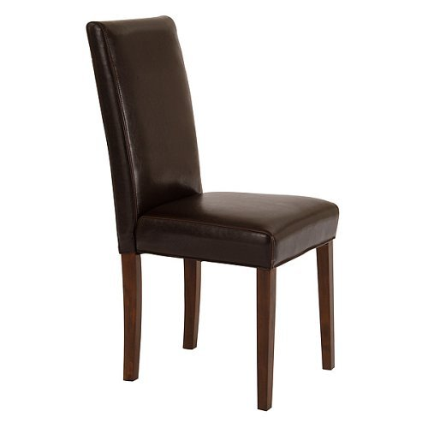
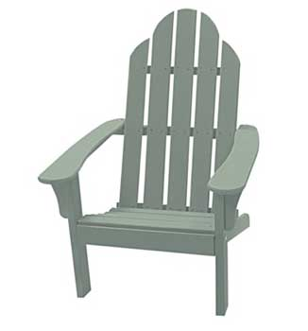
Compositional objects

Slide 14
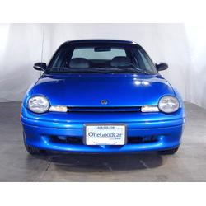
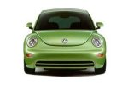
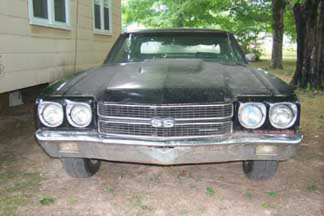
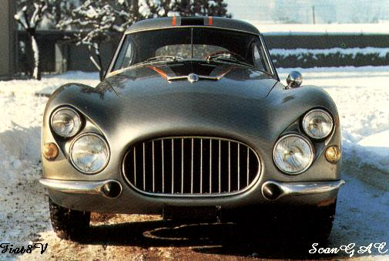
Parts-based Models
Define object by collection of parts modeled by
Appearance
Spatial configuration
Slide credit: Rob Fergus

Slide 15
How to model spatial relations?
One extreme: fixed template

Slide 16
How to model spatial relations?
Another extreme: bag of words
=

Slide 17
How to model spatial relations?
Star-shaped model
Part
Part
Part
Root
Part
Part

Slide 18
How to model spatial relations?
Star-shaped model
=
X
X
≈
Part
Part
Part
X
Root
Part
Part

Slide 19
How to model spatial relations?
Tree-shaped model

Slide 20
How to model spatial relations?
Tree-shaped model

Slide 21
How to model spatial relations?
Many others...
O(N⁶)
O(N²)
O(N³)
O(N²)
Fergus et al. ’03
Fei-Fei et al. ‘03
Leibe et al. ’04, ‘08 Crandall et al. ‘05
Fergus et al. ’05
Crandall et al. ‘05
Felzenszwalb & Huttenlocher ‘05
Csurka ’04
Vasconcelos ‘00
Bouchard & Triggs ‘05
Carneiro & Lowe ‘06
from [Carneiro & Lowe, ECCV’06]

Slide 22
Today’s class
Star-shaped model
Example: ISM
Leibe et al. 2004, 2008
Tree-shaped model
Example: Pictorial structures
Felzenszwalb Huttenlocher 2005
Part
Part
Part
Root
Part
Part

Slide 23
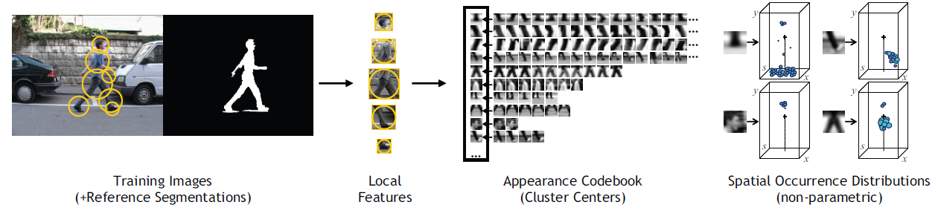
ISM: Implicit Shape Model
Training overview
Start with bounding boxes and (ideally) segmentations of objects
Extract local features (e.g., patches or SIFT) at interest points on objects
Cluster features to create codebook
Record relative bounding box and segmentation for each codeword

Slide 24
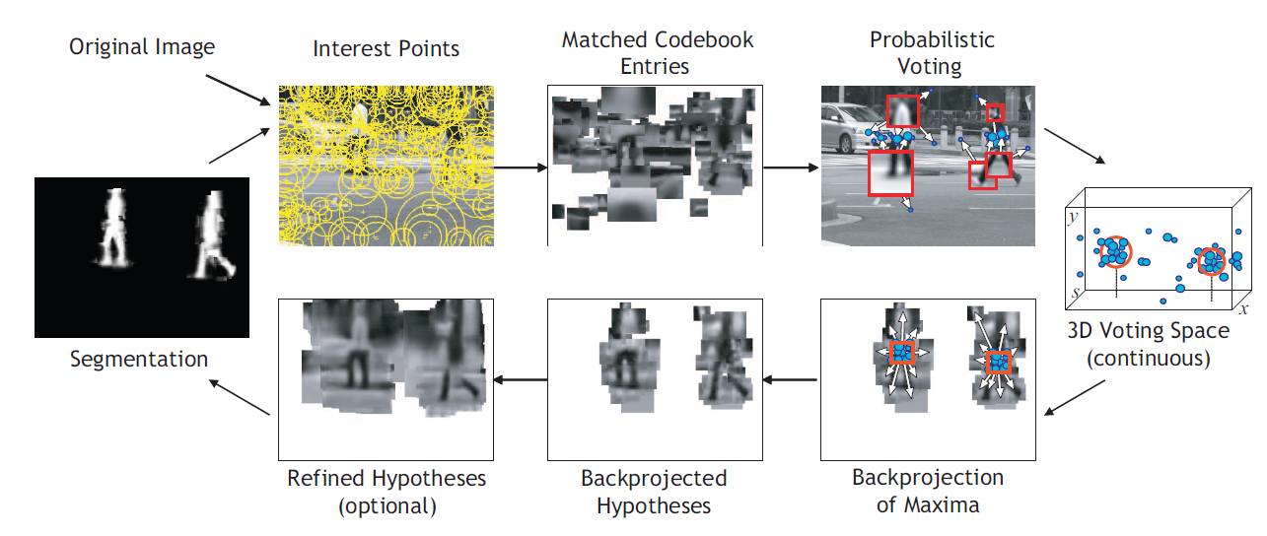
ISM: Implicit Shape Model
Testing overview
Extract interest points in test image
Softly match to codebook entries
Each matched codeword votes for object bounding box
Compute modes of votes using mean-shift
Check which codewords voted for modes
Refine

Slide 25
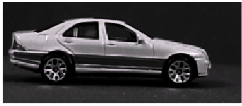
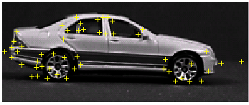
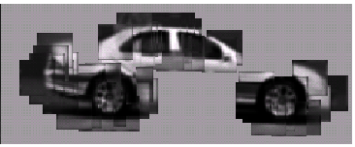
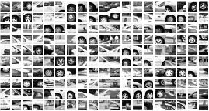
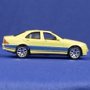
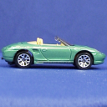
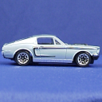
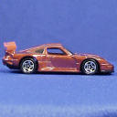
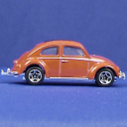
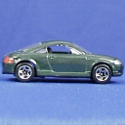
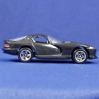
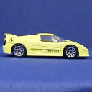
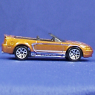
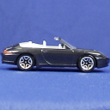
Codebook Representation
Extraction of local object features
Interest Points (e.g. Harris detector)
Sparse representation of the object appearance
Collect features from whole training set
Example:

Slide 26
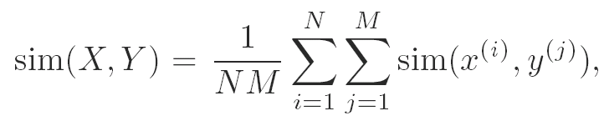
Agglomerative Clustering
Algorithm (Average-Link)
Start with each patch as a cluster of its own
Repeatedly merge the two most similar clusters X and Y, where the similarity between two clusters is defined as the average similarity between their members
Until
Commonly used similarity measures
Normalized correlation
Euclidean distances

Slide 27






Appearance Codebook
Clustering Results
Visual similarity preserved
Wheel parts, window corners, fenders, ...
Store cluster centers as Appearance Codebook
…

Slide 28
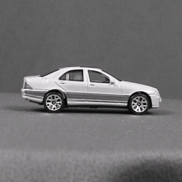
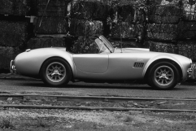
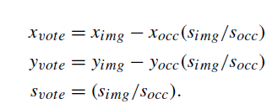
Voting with Local Features
For every feature, store possible “occurrences”
Record relative size and scale of object
For new image, let the matched features vote for possible object positions

Slide 29
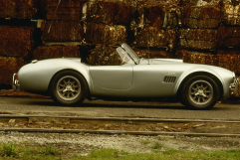
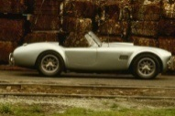


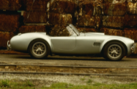
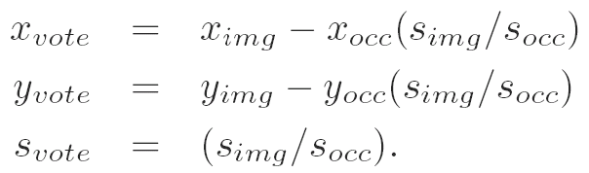
Scale Invariant Voting
Scale-invariant feature selection
Scale-invariant interest points
Rescale extracted patches
Match to constant-size codebook
Generate scale votes
Scale as 3rd dimension in voting space
Search for maxima in 3D voting space
s
Search window
y
x

Slide 30
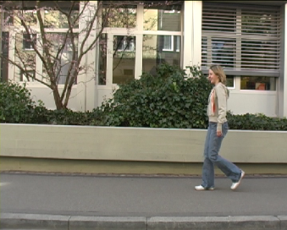

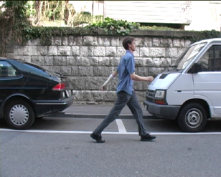

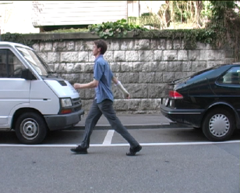
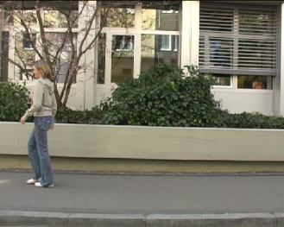

Implicit Shape Model - Representation
…
Learn appearance codebook
Extract local features at interest points
Agglomerative clustering ⇒ codebook
Learn spatial distributions
Match codebook to training images
Record matching positions on object
…
…
…
Training images (+reference segmentation)
…
Appearance codebook
y
y
s
s
x
x
y
y
s
s
x
x
Spatial occurrence distributions

Slide 31
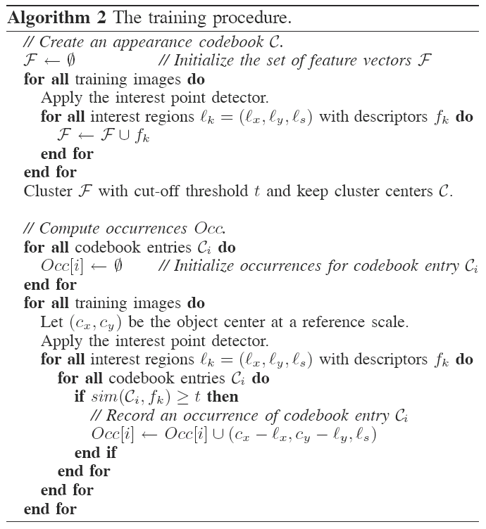
[Leibe04, Leibe08]

Slide 32
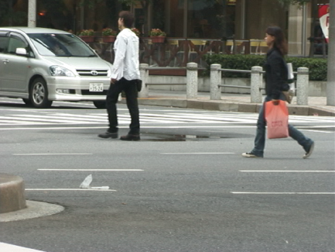



Implicit Shape Model - Recognition
Interest Points
Matched Codebook Entries
Probabilistic Voting
y
Image Feature
Interpretation (Codebook match)
Object Position
s
x
3D Voting Space (continuous)
f
C_{i}
o,x
[Leibe04, Leibe08]

Slide 33

Scale Voting: Efficient Computation
Mean-Shift formulation for refinement
Scale-adaptive balloon density estimator
s
s
s
s
y
y
y
y
x
x
Scale votes
Binned accum. array
Candidate maxima
Refinement

Slide 34

Implicit Shape Model - Recognition
Interest Points
Matched Codebook Entries
Probabilistic Voting
y
s
x
3D Voting Space (continuous)
Backprojected Hypotheses
Backprojection of Maxima
[Leibe04, Leibe08]

Slide 35

Example: Results on Cows
Original image

Slide 36

Example: Results on Cows
Original image
Interest points

Slide 37

Example: Results on Cows
Original image
Interest points
Matched patches

Slide 38

Example: Results on Cows
Original image
Interest points
Prob. Votes
Matched patches

Slide 39

Example: Results on Cows
1st hypothesis

Slide 40

Example: Results on Cows
2nd hypothesis

Slide 41

Example: Results on Cows
3rd hypothesis

Slide 42
ISM: Detection Results
Qualitative Performance
Robust to clutter, occlusion, noise, low contrast

Slide 43
Beyond bounding boxes
Backprojected codewords can vote:
Pixel segmentation
Part layout
Pose
Depth values
Interest Points
Matched Codebook Entries
Probabilistic Voting
y
s
x
3D Voting Space (continuous)
Backprojected Hypotheses
Backprojection of Maxima

Slide 44

Segmentation: Probabilistic Formulation
Influence of patch on object hypothesis (vote weight)
Backprojection to features f and pixels p:
Segmentation information
Influence on object hypothesis
[Leibe04, Leibe08]

Slide 45

ISM – Top-Down Segmentation
Interest Points
Matched Codebook Entries
Probabilistic Voting
y
s
x
3D Voting Space (continuous)
Segmentation
p(figure) Probabilities
Backprojected Hypotheses
Backprojection of Maxima
[Leibe04, Leibe08]

Slide 46

Segmentation
Interpretation of p(figure) map
per-pixel confidence in object hypothesis
Use for hypothesis verification
p(figure)
Original image
Segmentation
p(figure)
p(ground)
p(ground)
[Leibe04, Leibe08]

Slide 47







Example Results: Motorbikes

Slide 48














Example Results: Chairs
Dining room chairs
Office chairs

Slide 49



Inferring Other Information: Part Labels
Training
Test
Output
[Thomas07]

Slide 50





Inferring Other Information: Part Labels (2)
[Thomas07]

Slide 51


Inferring Other Information: Depth Maps
[Thomas07]

Slide 52

Extension: Rotation-Invariant Detection
[Mikolajczyk, Leibe, Schiele, CVPR’06]

Slide 53
2 minute break
Comparing a sliding window/part detector
What are the advantages of the part detector?
What are the advantages of the sliding window detector?

Slide 54
Tree-shaped model

Slide 55



Pictorial Structures Model
Part = oriented rectangle
Spatial model = relative size/orientation
Felzenszwalb and Huttenlocher 2005
Notes:
What is the root of the tree?

Slide 56

Pictorial Structures Model
Appearance likelihood
Geometry likelihood

Slide 57
Modeling the Appearance
Any appearance model could be used
HOG Templates, etc.
Here: rectangles fit to background subtracted binary map
Can train appearance models independently (easy, not as good) or jointly (more complicated but better)
Appearance likelihood
Geometry likelihood

Slide 58



Part representation
Background subtraction

Slide 59



Pictorial structures model
Optimization is tricky but can be efficient
For each l₁, find best l₂:
Remove v₂, and repeat with smaller tree, until only a single part
For k parts, n locations per part, this has complexity of O(kn²), but can be solved in ~O(nk) using generalized distance transform

Slide 60



Distance Transform
For each pixel p, how far away is the nearest pixel q of set S
G is often the set of edge pixels
G: black pixels
p₁
q₁
q₂
p₂

Slide 61
Distance Transform - Applications
Set distances – e.g. Hausdorff Distance
Image processing – e.g. Blurring
Robotics – Motion Planning
Alignment
Edge images
Motion tracks
Audio warping
Deformable Part Models

Slide 62



Generalized Distance Transform
Original form:
General form:
For many deformation costs,
Quadratic
Abs Diff
Min Composition
Bounded

Slide 63
Pictorial structures model
To create multiple likely candidates
Sample root node, then each node given parent, until all parts are sampled

Slide 64

Sample poses from likelihood and choose best match with Chamfer distance

Slide 65

Results for person matching

Slide 66

Results for person matching

Slide 67

Enhanced pictorial structures
BMVC 2009

Slide 68


Deformable Latent Parts Model
Useful parts discovered during training
Detections
Template Visualization
Felzenszwalb et al. 2008

Slide 69
Things to remember
Rather than searching for whole object, can locate “parts” that vote for object
Better encoding of spatial variation
These parts can vote for other things too
Models can be broken down into part appearance and spatial configuration
Wide variety of models
Efficient optimization can be tricky but usually possible

Slide 70
Next classes
Tues: Object tracking with Kalman Filters
Presented by Amin Sadeghi
HW 5 is due
Thurs: Action Recognition
Presented by me

