Slide 1
Photo Stitching Panoramas from Multiple Images
02/28/12
Computer Vision
CS 543 / ECE 549
University of Illinois
Derek Hoiem

Slide 2
Homeworks
HW 2 due today
Will try to have it graded by Mar 8 (ECCV deadline on March 5)
HW 3 has been released (due in 2 weeks)
Who designs/grades?
Derek mainly for HW1, HW3, HW5
Ruiqi mainly for HW2, HW4

Slide 3
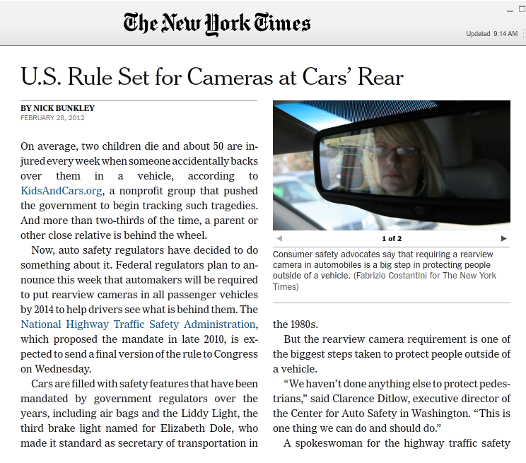
News

Slide 4
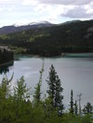
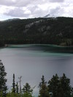
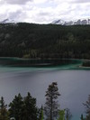
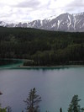
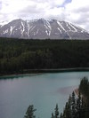
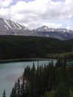
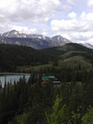
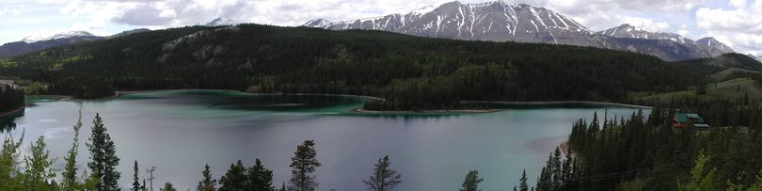
Today: Image Stitching
Combine two or more overlapping images to make one larger image
Add example
Slide credit: Vaibhav Vaish

Slide 5
Photo stitching
P
Q
Camera Center

Slide 6
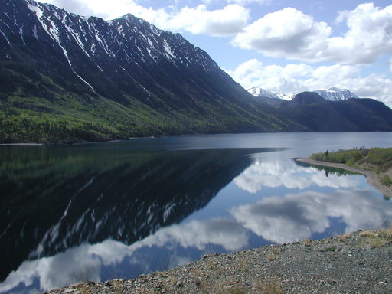
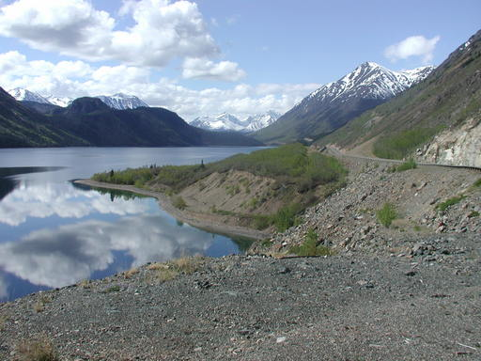
Example
Camera Center

Slide 7
Review of projective geometry

Slide 8
Problem set-up
x = K [R t] X
x' = K' [R' t'] X
t=t'=0
x'=Hx where H = K' R' R⁻¹ K⁻¹
Typically only R and f will change (4 parameters), but, in general, H has 8 parameters
.
X
x
x'
f
f'

Slide 9
Homography
Definition
General mathematics:
homography = projective linear transformation
Vision (most common usage):
homography = linear transformation between two image planes
Examples
Project 3D surface into frontal view
Relate two views that differ only by rotation

Slide 10
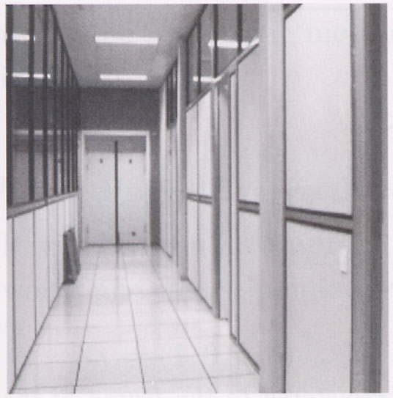
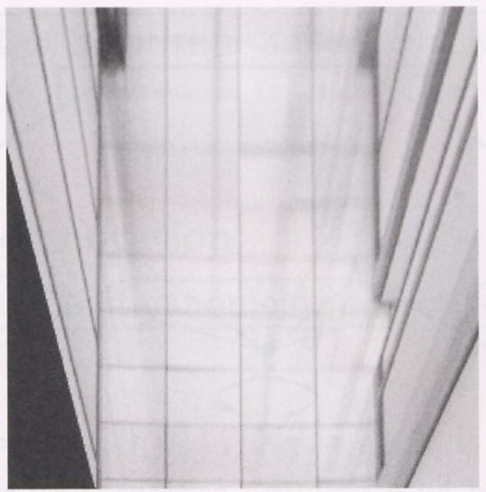
Homography example: Image rectification
p’
p
To unwarp (rectify) an image solve for homography H given p and p’: wp’=Hp
Notes:
15 min

Slide 11
Image Stitching Algorithm Overview
Detect keypoints (e.g., SIFT)
Match keypoints (e.g., 1st/2nd NN < thresh)
Estimate homography with four matched keypoints (using RANSAC)
Combine images

Slide 12
Computing homography
Assume we have four matched points: How do we compute homography H?
Direct Linear Transformation (DLT)

Slide 13
Computing homography
Direct Linear Transform
Apply SVD: UDV^{T} = A
h = V_{smallest} (column of V corr. to smallest singular value)
Matlab
[U, S, V] = svd(A);
h = V(:, end);
Explanations of SVD and solving homogeneous linear systems
Notes:
SVD gives the homogeneous least squares solution constrained to have a norm of 1

Slide 14
Computing homography
Assume we have four matched points: How do we compute homography H?
Normalized DLT
Normalize coordinates for each image
Translate for zero mean
Scale so that average distance to origin is ~sqrt(2)
This makes problem better behaved numerically (see HZ p. 107-108)
Compute using DLT in normalized coordinates
Unnormalize:

Slide 15
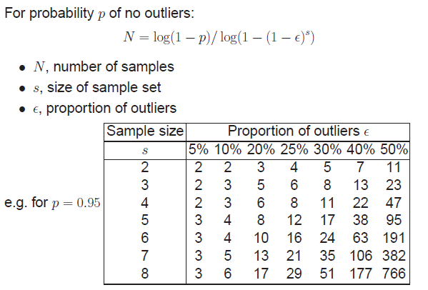
Computing homography
Assume we have matched points with outliers: How do we compute homography H?
Automatic Homography Estimation with RANSAC
Choose number of samples N
HZ Tutorial ‘99

Slide 16
Computing homography
Assume we have matched points with outliers: How do we compute homography H?
Automatic Homography Estimation with RANSAC
Choose number of samples N
Choose 4 random potential matches
Compute H using normalized DLT
Project points from x to x’ for each potentially matching pair:
Count points with projected distance < t
E.g., t = 3 pixels
Repeat steps 2-5 N times
Choose H with most inliers
HZ Tutorial ‘99

Slide 17
Automatic Image Stitching
Compute interest points on each image
Find candidate matches
Estimate homography H using matched points and RANSAC with normalized DLT
Project each image onto the same surface and blend
Matlab: maketform, imtransform

Slide 18
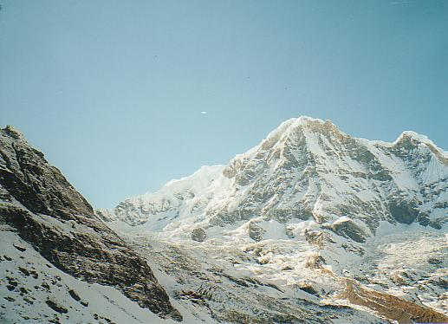
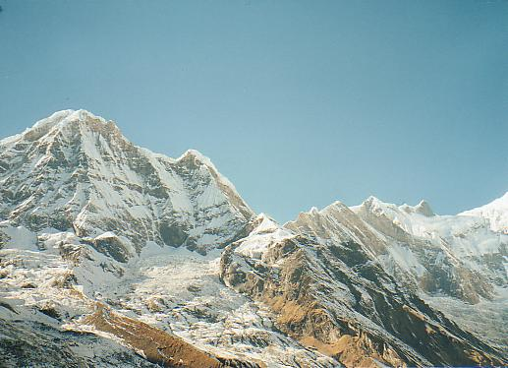
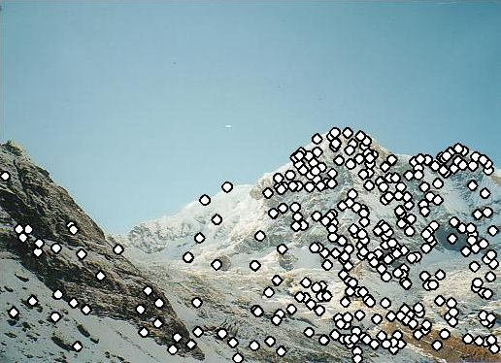
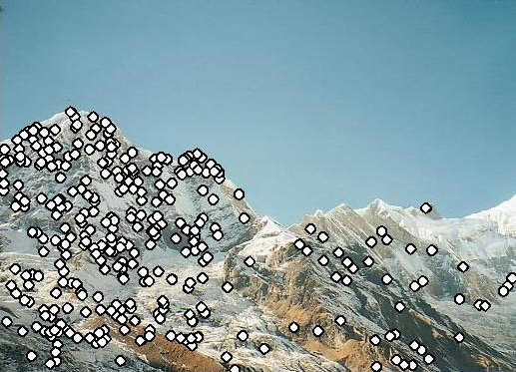
RANSAC for Homography
Initial Matched Points

Slide 19
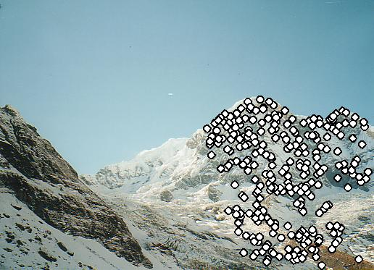
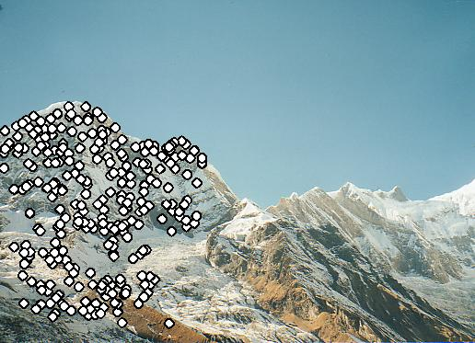
RANSAC for Homography
Final Matched Points

Slide 20
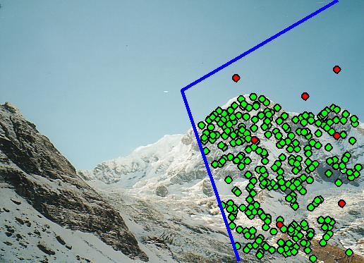
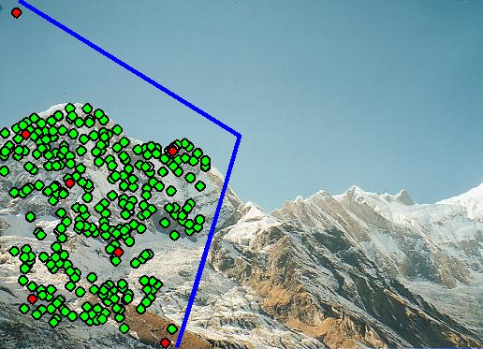
Verification

Slide 21
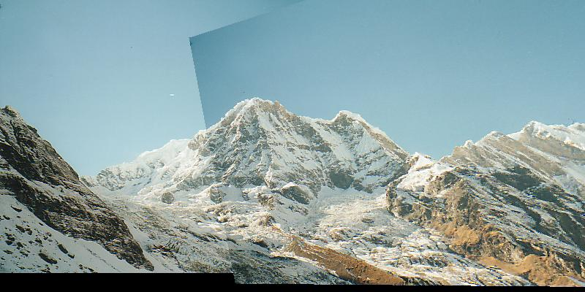
RANSAC for Homography

Slide 22
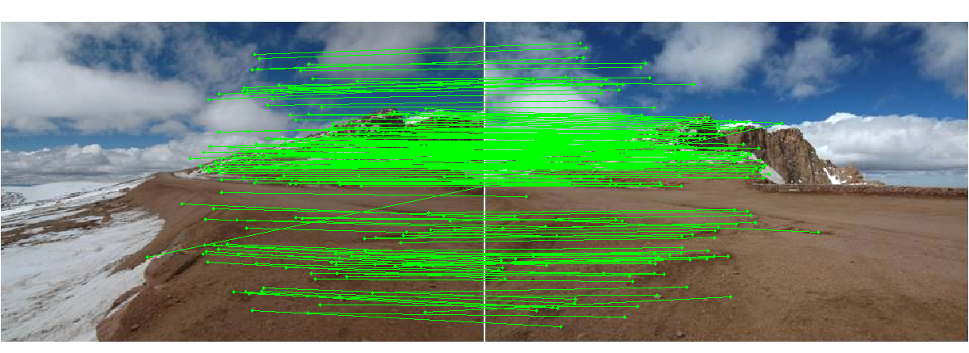
Choosing a Projection Surface
Many to choose: planar, cylindrical, spherical, cubic, etc.

Slide 23
Planar Mapping
x
x
f
f
For red image: pixels are already on the planar surface
For green image: map to first image plane

Slide 24
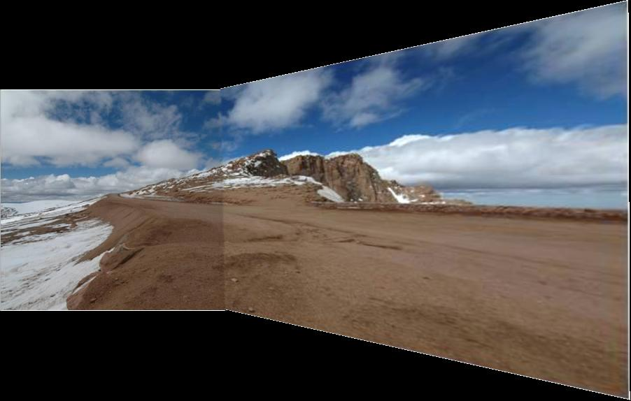
Planar Projection
Planar
Photos by Russ Hewett

Slide 25
Planar Projection
Planar

Slide 26
Cylindrical Mapping
x
x
f
f
For red image: compute h, theta on cylindrical surface from (u, v)
For green image: map to first image plane, than map to cylindrical surface

Slide 27
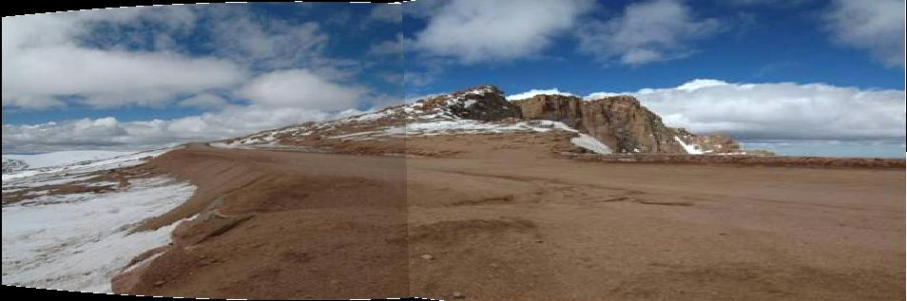
Cylindrical Projection
Cylindrical

Slide 28
Cylindrical Projection
Cylindrical

Slide 29
Planar
Cylindrical

Slide 30
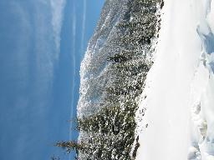
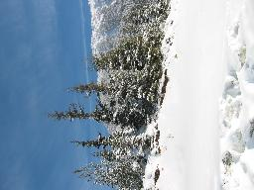
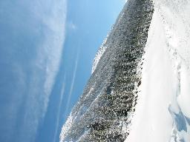
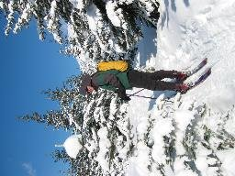
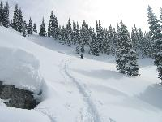
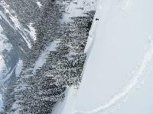
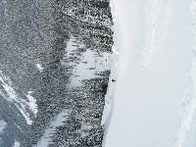
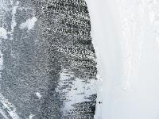
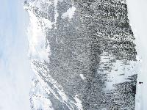
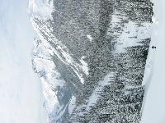
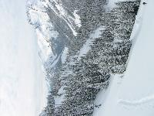
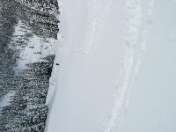
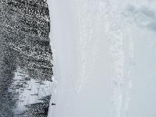
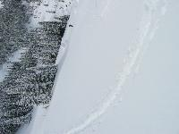
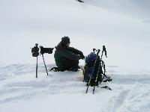
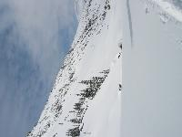
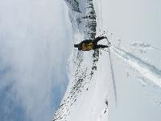
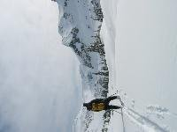
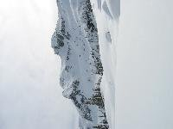
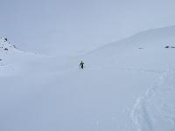
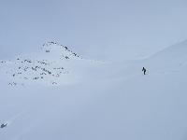
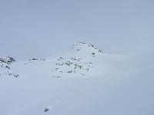
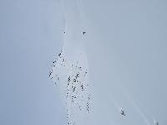
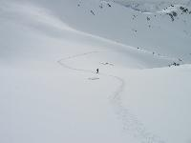




Recognizing Panoramas
Some of following material from Brown and Lowe 2003 talk
Brown and Lowe 2003, 2007

Slide 31
Recognizing Panoramas
Input: N images
Extract SIFT points, descriptors from all images
Find K-nearest neighbors for each point (K=4)
For each image
Select M candidate matching images by counting matched keypoints (m=6)
Solve homography H_{ij} for each matched image

Slide 32
Recognizing Panoramas
Input: N images
Extract SIFT points, descriptors from all images
Find K-nearest neighbors for each point (K=4)
For each image
Select M candidate matching images by counting matched keypoints (m=6)
Solve homography H_{ij} for each matched image
Decide if match is valid (n_{i} > 8 + 0.3 n_{f} )
# inliers
# keypoints in overlapping area

Slide 33
Recognizing Panoramas (cont.)
(now we have matched pairs of images)
Find connected components

Slide 34
Finding the panoramas

Slide 35
Finding the panoramas

Slide 36
Finding the panoramas

Slide 37
Recognizing Panoramas (cont.)
(now we have matched pairs of images)
Find connected components
For each connected component
Perform bundle adjustment to solve for rotation (θ₁, θ₂, θ₃) and focal length f of all cameras
Project to a surface (plane, cylinder, or sphere)
Render with multiband blending

Slide 38


Bundle adjustment for stitching
Non-linear minimization of re-projection error
where H = K’ R’ R⁻¹ K⁻¹
Solve non-linear least squares (Levenberg-Marquardt algorithm)
See paper for details

Slide 39





































Bundle Adjustment
New images initialised with rotation, focal length of best matching image

Slide 40

Bundle Adjustment
New images initialised with rotation, focal length of best matching image

Slide 41


Straightening
Rectify images so that “up” is vertical

Slide 42
Details to make it look good
Choosing seams
Blending

Slide 43
Choosing seams
Easy method
Assign each pixel to image with nearest center
im1
im2
x
x
Image 2
Image 1

Slide 44
Choosing seams
Easy method
Assign each pixel to image with nearest center
Create a mask:
mask(y, x) = 1 iff pixel should come from im1
Smooth boundaries (called “feathering”):
mask_sm = imfilter(mask, gausfil);
Composite
imblend = im1_c.*mask + im2_c.*(1-mask);
im1
im2
x
x
Image 2
Image 1

Slide 45

Choosing seams
Better method: dynamic program to find seam along well-matched regions
Illustration: http://en.wikipedia.org/wiki/File:Rochester_NY.jpg

Slide 46


Gain compensation
Simple gain adjustment
Compute average RGB intensity of each image in overlapping region
Normalize intensities by ratio of averages

Slide 47


Multi-band Blending
Burt & Adelson 1983
Blend frequency bands over range ∝ λ

Slide 48

Multiband Blending with Laplacian Pyramid
At low frequencies, blend slowly
At high frequencies, blend quickly
1
0
1
0
1
0
Left pyramid
blend
Right pyramid

Slide 49

Multiband blending
Laplacian pyramids
Compute Laplacian pyramid of images and mask
Create blended image at each level of pyramid
Reconstruct complete image

Slide 50

Blending comparison (IJCV 2007)

Slide 51

Blending Comparison

Slide 52
Further reading
DLT algorithm: HZ p. 91 (alg 4.2), p. 585
Normalization: HZ p. 107-109 (alg 4.2)
RANSAC: HZ Sec 4.7, p. 123, alg 4.6
Rick Szeliski’s alignment/stitching tutorial
Recognising Panoramas: Brown and Lowe, IJCV 2007 (also bundle adjustment)

Slide 53
Things to remember
Homography relates rotating cameras
Recover homography using RANSAC and normalized DLT
Bundle adjustment minimizes reprojection error for set of related images
Details to make it look nice (e.g., blending)

Slide 54
Next class
Stereo and epipolar geometry

