Slide 1
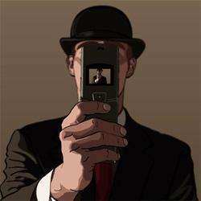
Pixels and Image Filtering
01/24/12
Computer Vision
Derek Hoiem, University of Illinois
Graphic: http://www.notcot.org/post/4068/

Slide 2
Today’s Class: Pixels and Linear Filters
Review of lighting
Reflection and absorption
What is image filtering and how do we do it?
Color models (if time allows)

Slide 3
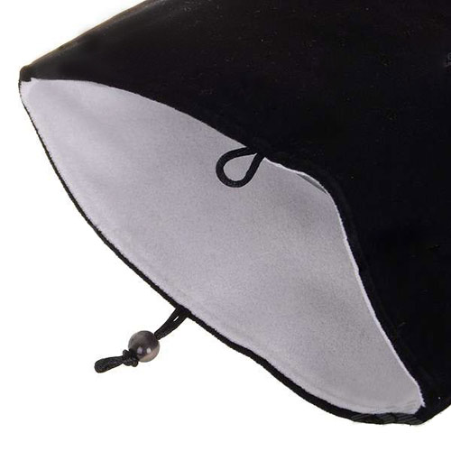
Reflection models
Albedo: fraction of light that is reflected
Determines color (amount reflected at each wavelength)
Very low albedo (hard to see shape)
Higher albedo

Slide 4
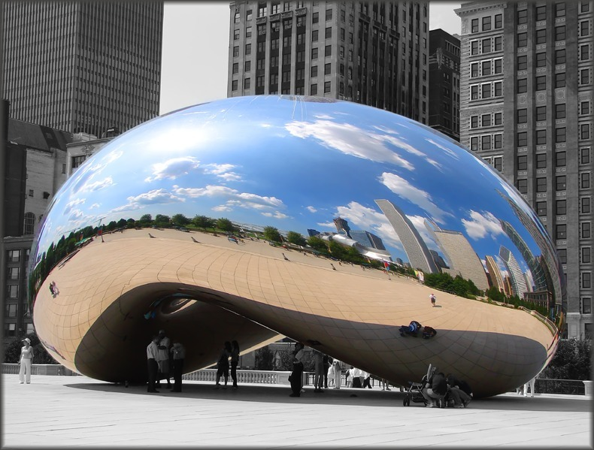
Reflection models
Specular reflection: mirror-like
Light reflects at incident angle
Reflection color = incoming light color

Slide 5
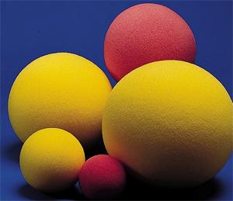
Reflection models
Diffuse reflection
Light scatters in all directions (proportional to cosine with surface normal)
Observed intensity is independent of viewing direction
Reflection color depends on light color and albedo

Slide 6
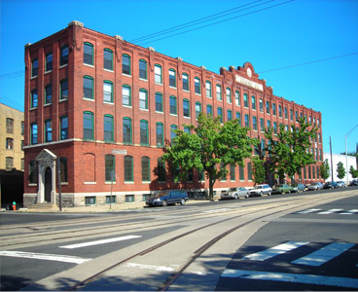
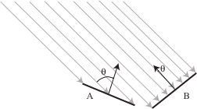

Surface orientation and light intensity
Amount of light that hits surface from distant point source depends on angle between surface normal and source
1
2
$$I\left(x\right)=ρ\left(x\right)\left(S⋅N(x)\right)$$
prop to cosine of relative angle

Slide 7
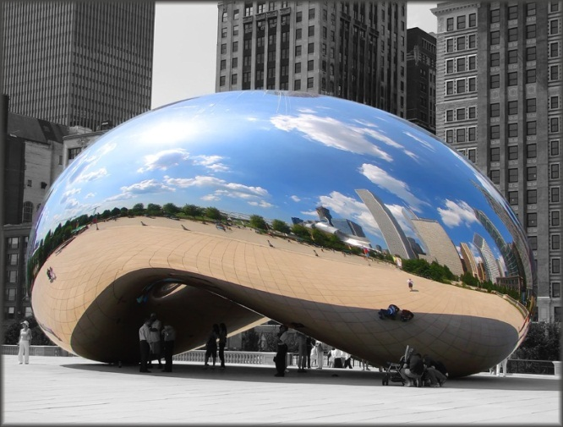
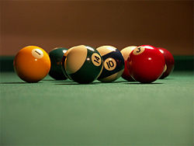
Reflection models
Lambertian: reflection all diffuse
Mirrored: reflection all specular
Glossy: reflection mostly diffuse, some specular
Specularities

Slide 8
Questions
How many light sources are in the scene?
How could I estimate the color of the camera’s flash?
Notes:
im = imread('billiards.png');
figure(1), imshow(im);
figure(1), hold on, plot([0 size(im, 2)], [76 76], 'k', 'linewidth', 1.5)
figure(2), hold off, subplot(3, 1, 1), plot(1:size(im, 2), squeeze(im(76, :, 1)), 'r', 'linewidth', 1.5)
figure(2), hold off, subplot(3, 1, 2), plot(1:size(im, 2), squeeze(im(76, :, 2)), 'g', 'linewidth', 1.5)
figure(2), hold off, subplot(3, 1, 3), plot(1:size(im, 2), squeeze(im(76, :, 3)), 'b', 'linewidth', 1.5)

Slide 9
The plight of the poor pixel
A pixel’s brightness is determined by
Light source (strength, direction, color)
Surface orientation
Surface material and albedo
Reflected light and shadows from surrounding surfaces
Gain on the sensor
A pixel’s brightness tells us nothing by itself

Slide 10
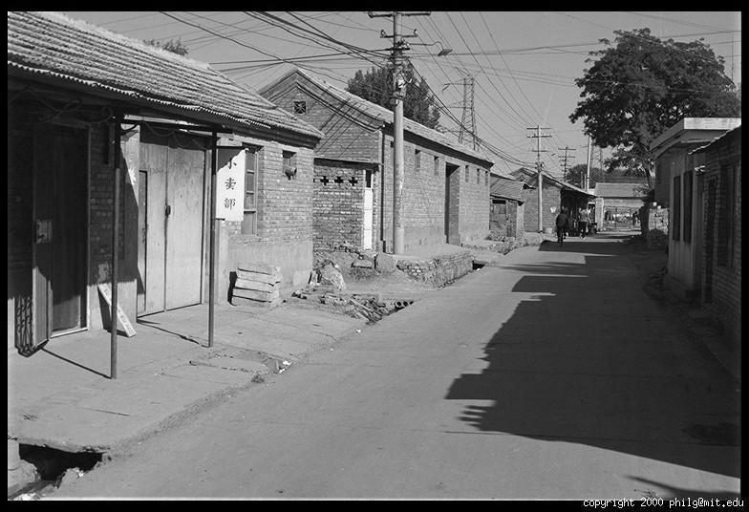
Basis for interpreting intensity images
Key idea: for nearby scene points, most factors do not change much
The information is mainly contained in local differences of brightness

Slide 11
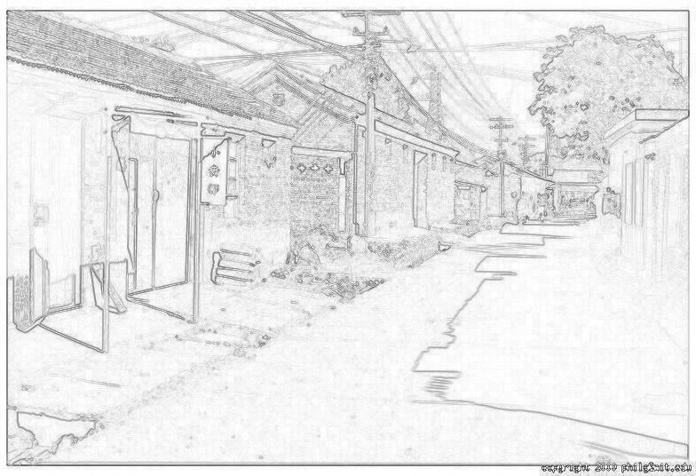
Darkness = Large Difference in Neighboring Pixels

Slide 12
Next three classes: three views of filtering
Image filters in spatial domain
Filter is a mathematical operation of a grid of numbers
Smoothing, sharpening, measuring texture
Image filters in the frequency domain
Filtering is a way to modify the frequencies of images
Denoising, sampling, image compression
Templates and Image Pyramids
Filtering is a way to match a template to the image
Detection, coarse-to-fine registration

Slide 13
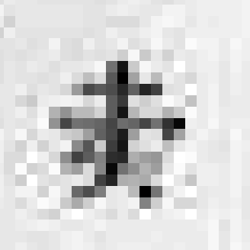
The raster image (pixel matrix)
0.92 | 0.93 | 0.94 | 0.97 | 0.62 | 0.37 | 0.85 | 0.97 | 0.93 | 0.92 | 0.99
0.95 | 0.89 | 0.82 | 0.89 | 0.56 | 0.31 | 0.75 | 0.92 | 0.81 | 0.95 | 0.91
0.89 | 0.72 | 0.51 | 0.55 | 0.51 | 0.42 | 0.57 | 0.41 | 0.49 | 0.91 | 0.92
0.96 | 0.95 | 0.88 | 0.94 | 0.56 | 0.46 | 0.91 | 0.87 | 0.90 | 0.97 | 0.95
0.71 | 0.81 | 0.81 | 0.87 | 0.57 | 0.37 | 0.80 | 0.88 | 0.89 | 0.79 | 0.85
0.49 | 0.62 | 0.60 | 0.58 | 0.50 | 0.60 | 0.58 | 0.50 | 0.61 | 0.45 | 0.33
0.86 | 0.84 | 0.74 | 0.58 | 0.51 | 0.39 | 0.73 | 0.92 | 0.91 | 0.49 | 0.74
0.96 | 0.67 | 0.54 | 0.85 | 0.48 | 0.37 | 0.88 | 0.90 | 0.94 | 0.82 | 0.93
0.69 | 0.49 | 0.56 | 0.66 | 0.43 | 0.42 | 0.77 | 0.73 | 0.71 | 0.90 | 0.99
0.79 | 0.73 | 0.90 | 0.67 | 0.33 | 0.61 | 0.69 | 0.79 | 0.73 | 0.93 | 0.97
0.91 | 0.94 | 0.89 | 0.49 | 0.41 | 0.78 | 0.78 | 0.77 | 0.89 | 0.99 | 0.93

Slide 14
Image filtering
Image filtering: compute function of local neighborhood at each position
Linear filtering: function is a weighted sum/difference of pixel values
Really important!
Enhance images
Denoise, resize, increase contrast, etc.
Extract information from images
Texture, edges, distinctive points, etc.
Detect patterns
Template matching

Slide 15

Example: box filter
1
1
1
1
1
1
1
1
1
Slide credit: David Lowe (UBC)

Slide 16
Image filtering
1
1
1
1
1
1
1
1
1
0 | 0 | 0 | 0 | 0 | 0 | 0 | 0 | 0 | 0
0 | 0 | 0 | 0 | 0 | 0 | 0 | 0 | 0 | 0
0 | 0 | 0 | 90 | 90 | 90 | 90 | 90 | 0 | 0
0 | 0 | 0 | 90 | 90 | 90 | 90 | 90 | 0 | 0
0 | 0 | 0 | 90 | 90 | 90 | 90 | 90 | 0 | 0
0 | 0 | 0 | 90 | 0 | 90 | 90 | 90 | 0 | 0
0 | 0 | 0 | 90 | 90 | 90 | 90 | 90 | 0 | 0
0 | 0 | 0 | 0 | 0 | 0 | 0 | 0 | 0 | 0
0 | 0 | 90 | 0 | 0 | 0 | 0 | 0 | 0 | 0
0 | 0 | 0 | 0 | 0 | 0 | 0 | 0 | 0 | 0
 | 0
0 | 0 | 0 | 0 | 0 | 0 | 0 | 0 | 0 | 0
0 | 0 | 0 | 0 | 0 | 0 | 0 | 0 | 0 | 0
0 | 0 | 0 | 90 | 90 | 90 | 90 | 90 | 0 | 0
0 | 0 | 0 | 90 | 90 | 90 | 90 | 90 | 0 | 0
0 | 0 | 0 | 90 | 90 | 90 | 90 | 90 | 0 | 0
0 | 0 | 0 | 90 | 0 | 90 | 90 | 90 | 0 | 0
0 | 0 | 0 | 90 | 90 | 90 | 90 | 90 | 0 | 0
0 | 0 | 0 | 0 | 0 | 0 | 0 | 0 | 0 | 0
0 | 0 | 90 | 0 | 0 | 0 | 0 | 0 | 0 | 0
0 | 0 | 0 | 0 | 0 | 0 | 0 | 0 | 0 | 0
Credit: S. Seitz
Notes:
ones, divide by 9

Slide 17
Image filtering
1
1
1
1
1
1
1
1
1
0 | 0 | 0 | 0 | 0 | 0 | 0 | 0 | 0 | 0
0 | 0 | 0 | 0 | 0 | 0 | 0 | 0 | 0 | 0
0 | 0 | 0 | 90 | 90 | 90 | 90 | 90 | 0 | 0
0 | 0 | 0 | 90 | 90 | 90 | 90 | 90 | 0 | 0
0 | 0 | 0 | 90 | 90 | 90 | 90 | 90 | 0 | 0
0 | 0 | 0 | 90 | 0 | 90 | 90 | 90 | 0 | 0
0 | 0 | 0 | 90 | 90 | 90 | 90 | 90 | 0 | 0
0 | 0 | 0 | 0 | 0 | 0 | 0 | 0 | 0 | 0
0 | 0 | 90 | 0 | 0 | 0 | 0 | 0 | 0 | 0
0 | 0 | 0 | 0 | 0 | 0 | 0 | 0 | 0 | 0
 | 0 | 10
0 | 0 | 0 | 0 | 0 | 0 | 0 | 0 | 0 | 0
0 | 0 | 0 | 0 | 0 | 0 | 0 | 0 | 0 | 0
0 | 0 | 0 | 90 | 90 | 90 | 90 | 90 | 0 | 0
0 | 0 | 0 | 90 | 90 | 90 | 90 | 90 | 0 | 0
0 | 0 | 0 | 90 | 90 | 90 | 90 | 90 | 0 | 0
0 | 0 | 0 | 90 | 0 | 90 | 90 | 90 | 0 | 0
0 | 0 | 0 | 90 | 90 | 90 | 90 | 90 | 0 | 0
0 | 0 | 0 | 0 | 0 | 0 | 0 | 0 | 0 | 0
0 | 0 | 90 | 0 | 0 | 0 | 0 | 0 | 0 | 0
0 | 0 | 0 | 0 | 0 | 0 | 0 | 0 | 0 | 0
Credit: S. Seitz
Notes:
ones, divide by 9

Slide 18
Image filtering
1
1
1
1
1
1
1
1
1
0 | 0 | 0 | 0 | 0 | 0 | 0 | 0 | 0 | 0
0 | 0 | 0 | 0 | 0 | 0 | 0 | 0 | 0 | 0
0 | 0 | 0 | 90 | 90 | 90 | 90 | 90 | 0 | 0
0 | 0 | 0 | 90 | 90 | 90 | 90 | 90 | 0 | 0
0 | 0 | 0 | 90 | 90 | 90 | 90 | 90 | 0 | 0
0 | 0 | 0 | 90 | 0 | 90 | 90 | 90 | 0 | 0
0 | 0 | 0 | 90 | 90 | 90 | 90 | 90 | 0 | 0
0 | 0 | 0 | 0 | 0 | 0 | 0 | 0 | 0 | 0
0 | 0 | 90 | 0 | 0 | 0 | 0 | 0 | 0 | 0
0 | 0 | 0 | 0 | 0 | 0 | 0 | 0 | 0 | 0
 | 0 | 10 | 20
0 | 0 | 0 | 0 | 0 | 0 | 0 | 0 | 0 | 0
0 | 0 | 0 | 0 | 0 | 0 | 0 | 0 | 0 | 0
0 | 0 | 0 | 90 | 90 | 90 | 90 | 90 | 0 | 0
0 | 0 | 0 | 90 | 90 | 90 | 90 | 90 | 0 | 0
0 | 0 | 0 | 90 | 90 | 90 | 90 | 90 | 0 | 0
0 | 0 | 0 | 90 | 0 | 90 | 90 | 90 | 0 | 0
0 | 0 | 0 | 90 | 90 | 90 | 90 | 90 | 0 | 0
0 | 0 | 0 | 0 | 0 | 0 | 0 | 0 | 0 | 0
0 | 0 | 90 | 0 | 0 | 0 | 0 | 0 | 0 | 0
0 | 0 | 0 | 0 | 0 | 0 | 0 | 0 | 0 | 0
Credit: S. Seitz
Notes:
ones, divide by 9

Slide 19
Image filtering
1
1
1
1
1
1
1
1
1
0 | 0 | 0 | 0 | 0 | 0 | 0 | 0 | 0 | 0
0 | 0 | 0 | 0 | 0 | 0 | 0 | 0 | 0 | 0
0 | 0 | 0 | 90 | 90 | 90 | 90 | 90 | 0 | 0
0 | 0 | 0 | 90 | 90 | 90 | 90 | 90 | 0 | 0
0 | 0 | 0 | 90 | 90 | 90 | 90 | 90 | 0 | 0
0 | 0 | 0 | 90 | 0 | 90 | 90 | 90 | 0 | 0
0 | 0 | 0 | 90 | 90 | 90 | 90 | 90 | 0 | 0
0 | 0 | 0 | 0 | 0 | 0 | 0 | 0 | 0 | 0
0 | 0 | 90 | 0 | 0 | 0 | 0 | 0 | 0 | 0
0 | 0 | 0 | 0 | 0 | 0 | 0 | 0 | 0 | 0
 | 0 | 10 | 20 | 30
0 | 0 | 0 | 0 | 0 | 0 | 0 | 0 | 0 | 0
0 | 0 | 0 | 0 | 0 | 0 | 0 | 0 | 0 | 0
0 | 0 | 0 | 90 | 90 | 90 | 90 | 90 | 0 | 0
0 | 0 | 0 | 90 | 90 | 90 | 90 | 90 | 0 | 0
0 | 0 | 0 | 90 | 90 | 90 | 90 | 90 | 0 | 0
0 | 0 | 0 | 90 | 0 | 90 | 90 | 90 | 0 | 0
0 | 0 | 0 | 90 | 90 | 90 | 90 | 90 | 0 | 0
0 | 0 | 0 | 0 | 0 | 0 | 0 | 0 | 0 | 0
0 | 0 | 90 | 0 | 0 | 0 | 0 | 0 | 0 | 0
0 | 0 | 0 | 0 | 0 | 0 | 0 | 0 | 0 | 0
Credit: S. Seitz
Notes:
ones, divide by 9

Slide 20
Image filtering
1
1
1
1
1
1
1
1
1
0 | 0 | 0 | 0 | 0 | 0 | 0 | 0 | 0 | 0
0 | 0 | 0 | 0 | 0 | 0 | 0 | 0 | 0 | 0
0 | 0 | 0 | 90 | 90 | 90 | 90 | 90 | 0 | 0
0 | 0 | 0 | 90 | 90 | 90 | 90 | 90 | 0 | 0
0 | 0 | 0 | 90 | 90 | 90 | 90 | 90 | 0 | 0
0 | 0 | 0 | 90 | 0 | 90 | 90 | 90 | 0 | 0
0 | 0 | 0 | 90 | 90 | 90 | 90 | 90 | 0 | 0
0 | 0 | 0 | 0 | 0 | 0 | 0 | 0 | 0 | 0
0 | 0 | 90 | 0 | 0 | 0 | 0 | 0 | 0 | 0
0 | 0 | 0 | 0 | 0 | 0 | 0 | 0 | 0 | 0
 | 0 | 10 | 20 | 30 | 30
Credit: S. Seitz
Notes:
ones, divide by 9

Slide 21
Image filtering
1
1
1
1
1
1
1
1
1
0 | 0 | 0 | 0 | 0 | 0 | 0 | 0 | 0 | 0
0 | 0 | 0 | 0 | 0 | 0 | 0 | 0 | 0 | 0
0 | 0 | 0 | 90 | 90 | 90 | 90 | 90 | 0 | 0
0 | 0 | 0 | 90 | 90 | 90 | 90 | 90 | 0 | 0
0 | 0 | 0 | 90 | 90 | 90 | 90 | 90 | 0 | 0
0 | 0 | 0 | 90 | 0 | 90 | 90 | 90 | 0 | 0
0 | 0 | 0 | 90 | 90 | 90 | 90 | 90 | 0 | 0
0 | 0 | 0 | 0 | 0 | 0 | 0 | 0 | 0 | 0
0 | 0 | 90 | 0 | 0 | 0 | 0 | 0 | 0 | 0
0 | 0 | 0 | 0 | 0 | 0 | 0 | 0 | 0 | 0
 | 0 | 10 | 20 | 30 | 30
?
Credit: S. Seitz
Notes:
ones, divide by 9

Slide 22
Image filtering
1
1
1
1
1
1
1
1
1
0 | 0 | 0 | 0 | 0 | 0 | 0 | 0 | 0 | 0
0 | 0 | 0 | 0 | 0 | 0 | 0 | 0 | 0 | 0
0 | 0 | 0 | 90 | 90 | 90 | 90 | 90 | 0 | 0
0 | 0 | 0 | 90 | 90 | 90 | 90 | 90 | 0 | 0
0 | 0 | 0 | 90 | 90 | 90 | 90 | 90 | 0 | 0
0 | 0 | 0 | 90 | 0 | 90 | 90 | 90 | 0 | 0
0 | 0 | 0 | 90 | 90 | 90 | 90 | 90 | 0 | 0
0 | 0 | 0 | 0 | 0 | 0 | 0 | 0 | 0 | 0
0 | 0 | 90 | 0 | 0 | 0 | 0 | 0 | 0 | 0
0 | 0 | 0 | 0 | 0 | 0 | 0 | 0 | 0 | 0
 | 0 | 10 | 20 | 30 | 30
 |  |  |  | 50
?
Credit: S. Seitz
Notes:
ones, divide by 9

Slide 23
Image filtering
1
1
1
1
1
1
1
1
1
0 | 0 | 0 | 0 | 0 | 0 | 0 | 0 | 0 | 0
0 | 0 | 0 | 0 | 0 | 0 | 0 | 0 | 0 | 0
0 | 0 | 0 | 90 | 90 | 90 | 90 | 90 | 0 | 0
0 | 0 | 0 | 90 | 90 | 90 | 90 | 90 | 0 | 0
0 | 0 | 0 | 90 | 90 | 90 | 90 | 90 | 0 | 0
0 | 0 | 0 | 90 | 0 | 90 | 90 | 90 | 0 | 0
0 | 0 | 0 | 90 | 90 | 90 | 90 | 90 | 0 | 0
0 | 0 | 0 | 0 | 0 | 0 | 0 | 0 | 0 | 0
0 | 0 | 90 | 0 | 0 | 0 | 0 | 0 | 0 | 0
0 | 0 | 0 | 0 | 0 | 0 | 0 | 0 | 0 | 0
 | 0 | 10 | 20 | 30 | 30 | 30 | 20 | 10
 | 0 | 20 | 40 | 60 | 60 | 60 | 40 | 20
 | 0 | 30 | 60 | 90 | 90 | 90 | 60 | 30
 | 0 | 30 | 50 | 80 | 80 | 90 | 60 | 30
 | 0 | 30 | 50 | 80 | 80 | 90 | 60 | 30
 | 0 | 20 | 30 | 50 | 50 | 60 | 40 | 20
 | 10 | 20 | 30 | 30 | 30 | 30 | 20 | 10
 | 10 | 10 | 10 | 0 | 0 | 0 | 0 | 0
Credit: S. Seitz

Slide 24
Box Filter
What does it do?
Replaces each pixel with an average of its neighborhood
Achieve smoothing effect (remove sharp features)
1
1
1
1
1
1
1
1
1
Slide credit: David Lowe (UBC)

Slide 25
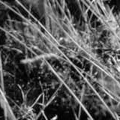
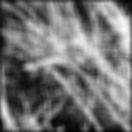
Smoothing with box filter

Slide 26
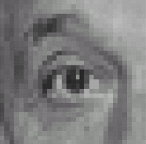
Practice with linear filters
0
0
0
?
0
1
0
0
0
0
Original
Source: D. Lowe

Slide 27
Practice with linear filters
0
0
0
0
1
0
0
0
0
Original
Filtered
(no change)
Source: D. Lowe

Slide 28
Practice with linear filters
0
0
0
?
0
0
1
0
0
0
Original
Source: D. Lowe

Slide 29
Practice with linear filters
0
0
0
0
0
1
0
0
0
Original
Shifted left
By 1 pixel
Source: D. Lowe

Slide 30
Practice with linear filters
0
0
0
-
1
1
1
?
0
2
0
1
1
1
0
0
0
1
1
1
(Note that filter sums to 1)
Original
Source: D. Lowe

Slide 31
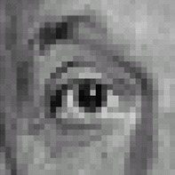
Practice with linear filters
0
0
0
-
1
1
1
0
2
0
1
1
1
0
0
0
1
1
1
Original
Sharpening filter
Accentuates differences with local average
Source: D. Lowe

Slide 32
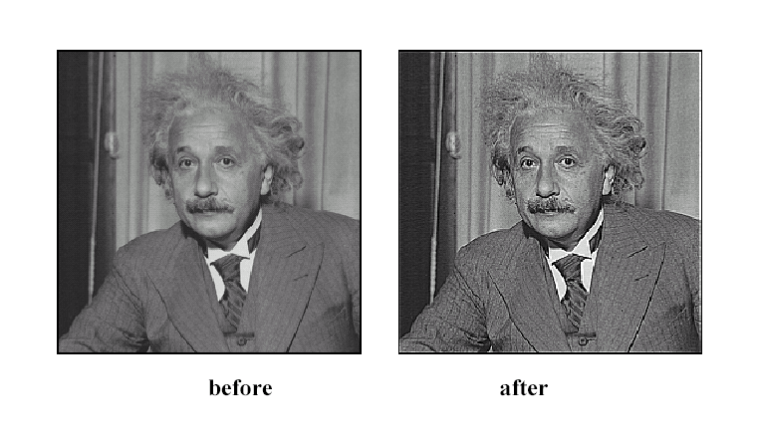
Sharpening
Source: D. Lowe

Slide 33
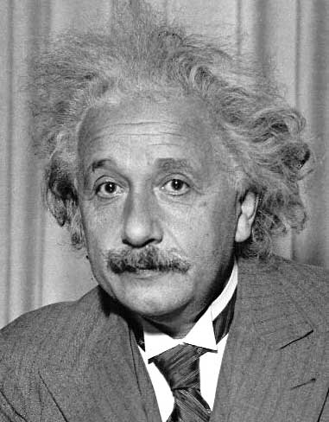
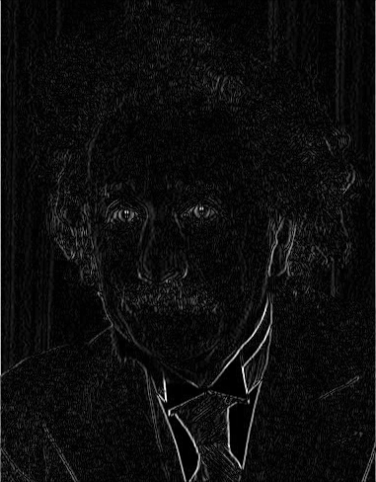
Other filters
1
0
-1
2
0
-2
1
0
-1
Sobel
Vertical Edge
(absolute value)

Slide 34
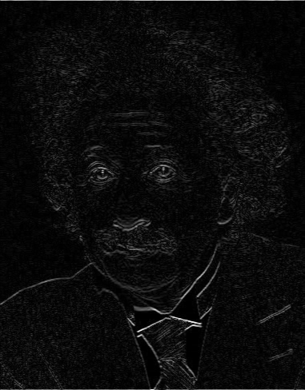
Other filters
1
2
1
0
0
0
-1
-2
-1
Sobel
Horizontal Edge
(absolute value)

Slide 35
Basic gradient filters
Horizontal Gradient
Vertical Gradient
0
0
0
0
1
0
-1
0
1
-1
0
1
0
0
0
or
0
0
0
0
-1
0
or
-1
0
1

Slide 36
Example

Slide 37
How could we synthesize motion blur?
theta = 30; len = 20;
fil = imrotate(ones(1, len), theta, 'bilinear');
fil = fil / sum(fil(:));
figure(2), imshow(imfilter(im, fil));

Slide 38
Filtering vs. Convolution
g=filter
f=image
2d filtering
h=filter2(g,f); or h=imfilter(f,g);
2d convolution
h=conv2(g,f);

Slide 39
Key properties of linear filters
Linearity:
filter(f₁ + f₂) = filter(f₁) + filter(f₂)
Shift invariance: same behavior regardless of pixel location
filter(shift(f)) = shift(filter(f))
Any linear, shift-invariant operator can be represented as a convolution
Source: S. Lazebnik

Slide 40
More properties
Commutative: a * b = b * a
Conceptually no difference between filter and signal
Associative: a * (b * c) = (a * b) * c
Often apply several filters one after another: (((a * b₁) * b₂) * b₃)
This is equivalent to applying one filter: a * (b₁ * b₂ * b₃)
Distributes over addition: a * (b + c) = (a * b) + (a * c)
Scalars factor out: ka * b = a * kb = k (a * b)
Identity: unit impulse e = [0, 0, 1, 0, 0], a * e = a
Source: S. Lazebnik

Slide 41
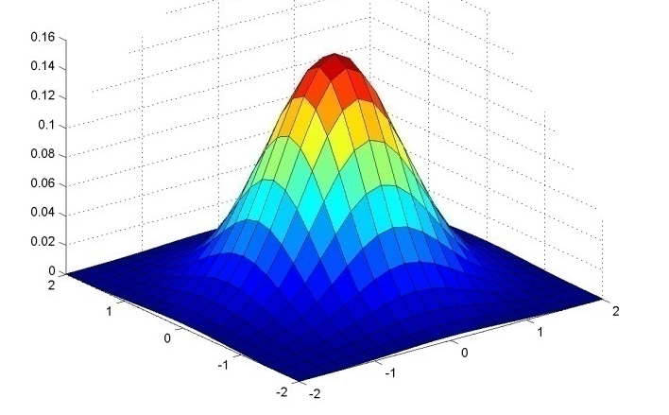
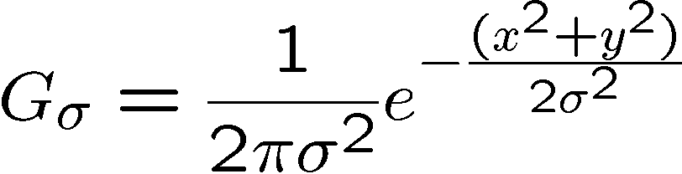
Important filter: Gaussian
Spatially-weighted average
0.003 0.013 0.022 0.013 0.003
0.013 0.059 0.097 0.059 0.013
0.022 0.097 0.159 0.097 0.022
0.013 0.059 0.097 0.059 0.013
0.003 0.013 0.022 0.013 0.003
5 x 5, σ = 1
Slide credit: Christopher Rasmussen

Slide 42

Smoothing with Gaussian filter

Slide 43
Smoothing with box filter

Slide 44
Gaussian filters
Remove “high-frequency” components from the image (low-pass filter)
Images become more smooth
Convolution with self is another Gaussian
So can smooth with small-width kernel, repeat, and get same result as larger-width kernel would have
Convolving two times with Gaussian kernel of width σ is same as convolving once with kernel of width σ√2
Separable kernel
Factors into product of two 1D Gaussians
Source: K. Grauman
Notes:
Linear vs. quadratic in mask size

Slide 45
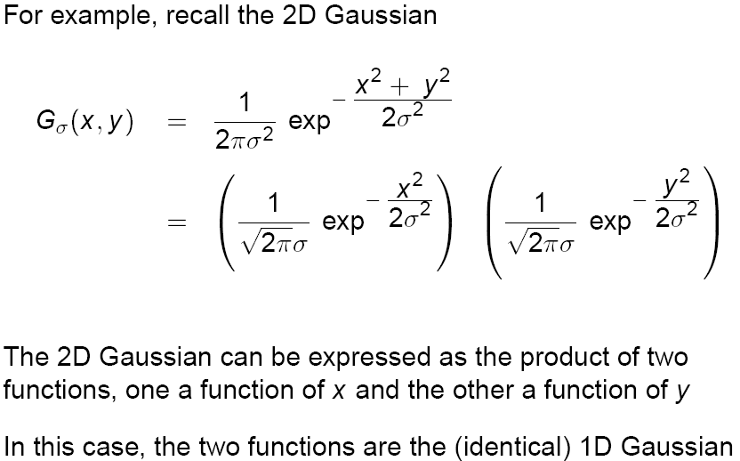
Separability of the Gaussian filter
Source: D. Lowe

Slide 46
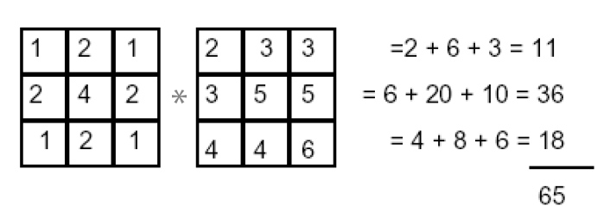
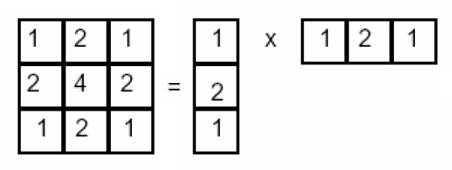
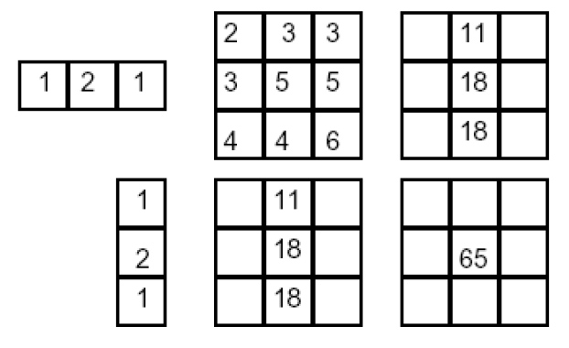
Separability example
2D filtering (center location only)
The filter factors into a product of 1D filters:
Perform filtering along rows:
*
=
Followed by filtering along the remaining column:
*
=
Source: K. Grauman

Slide 47
Separability
Why is separability useful in practice?

Slide 48
Some practical matters

Slide 49
Practical matters
How big should the filter be?
Values at edges should be near zero ← important!
Rule of thumb for Gaussian: set filter half-width to about 3 σ

Slide 50
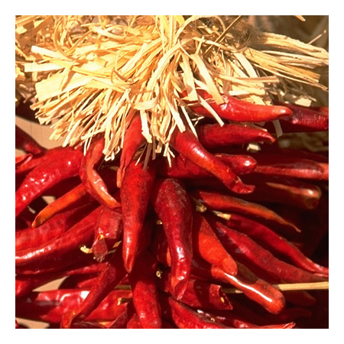
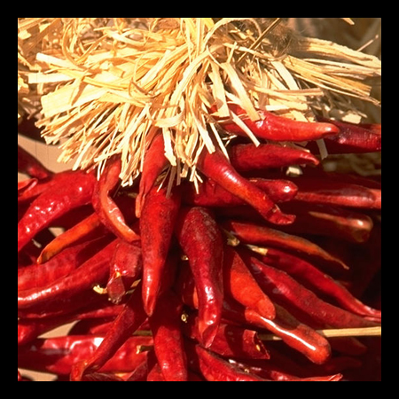

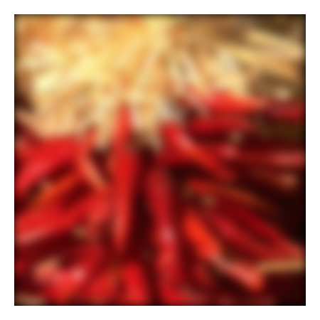
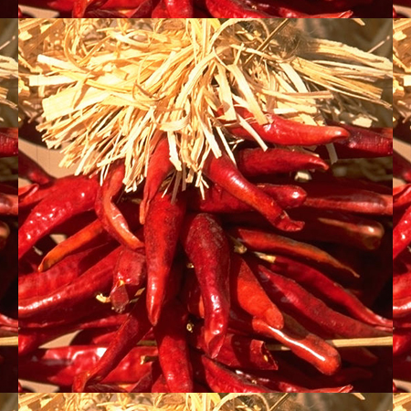

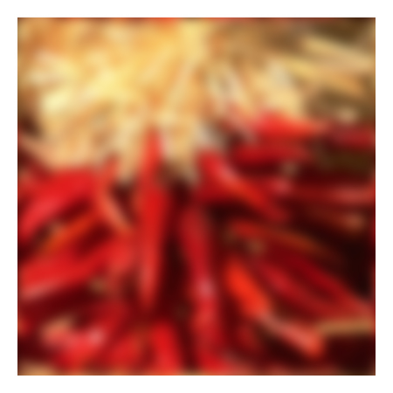



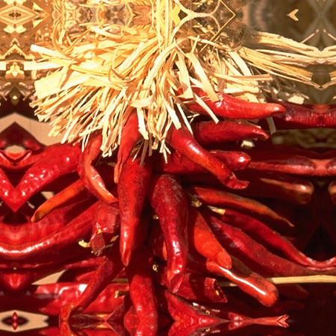


Practical matters
What about near the edge?
the filter window falls off the edge of the image
need to extrapolate
methods:
clip filter (black)
wrap around
copy edge
reflect across edge
Source: S. Marschner

Slide 51
Practical matters
methods (MATLAB):
clip filter (black): imfilter(f, g, 0)
wrap around: imfilter(f, g, ‘circular’)
copy edge: imfilter(f, g, ‘replicate’)
reflect across edge: imfilter(f, g, ‘symmetric’)
Source: S. Marschner

Slide 52
Practical matters
What is the size of the output?
MATLAB: filter2(g, f, shape)
shape = ‘full’: output size is sum of sizes of f and g
shape = ‘same’: output size is same as f
shape = ‘valid’: output size is difference of sizes of f and g
full
same
valid
g
g
g
g
f
f
f
g
g
g
g
g
g
g
g
Source: S. Lazebnik

Slide 53
A little more about color…

Slide 54
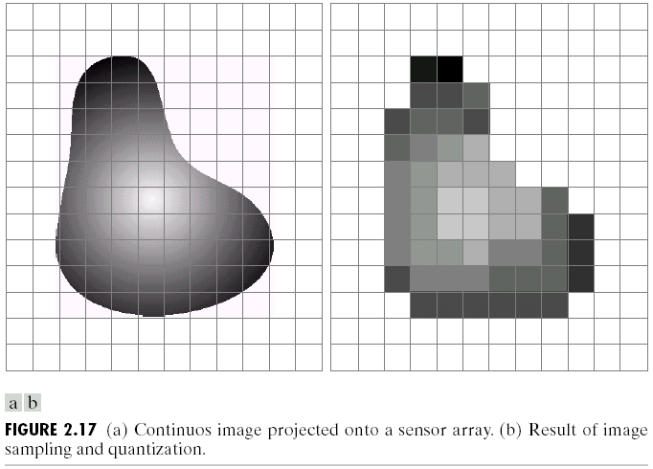
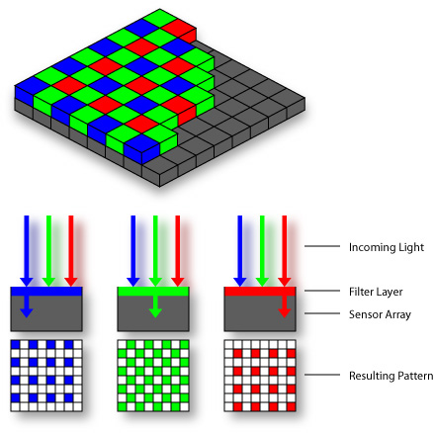
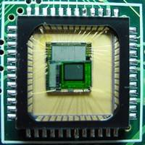
Digital Color Images
Bayer Filter
CMOS sensor

Slide 55
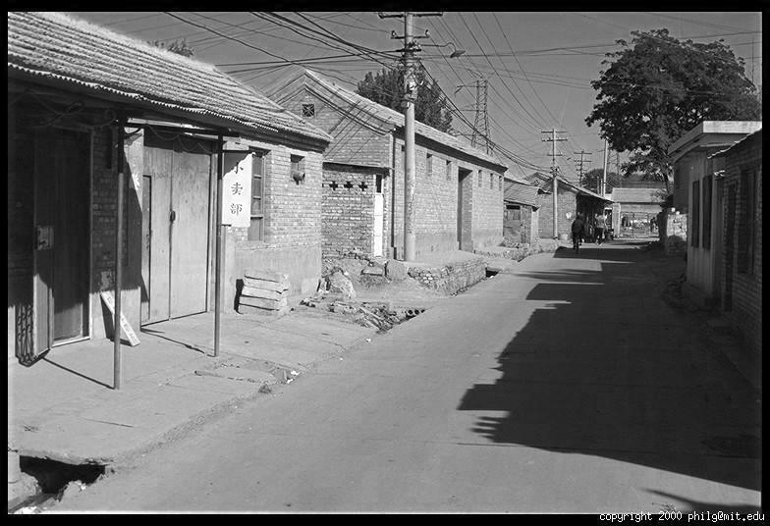
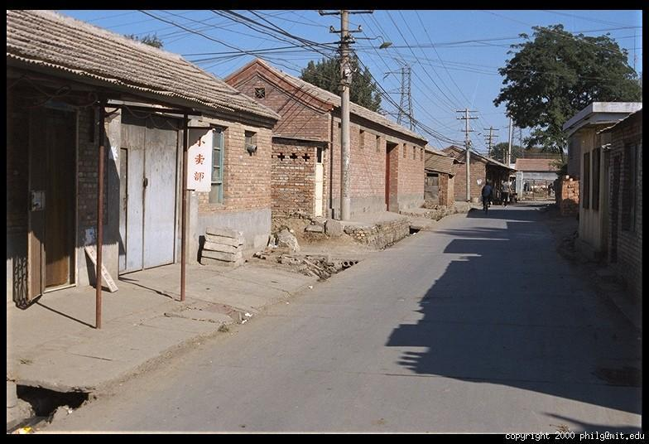
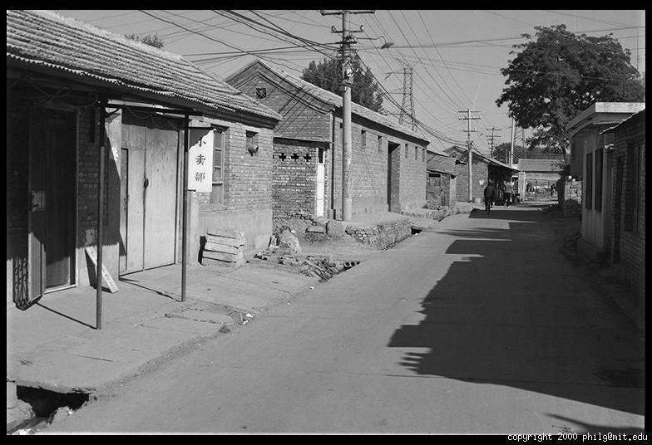
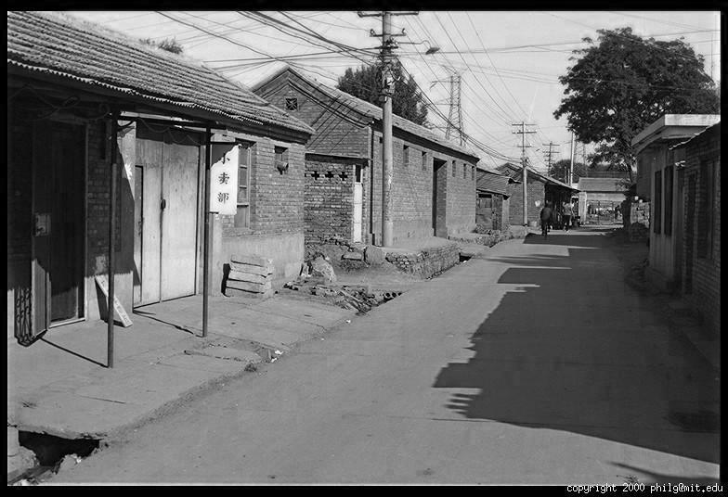
Color Image
R
G
B

Slide 56
Images in Matlab
Images represented as a matrix
Suppose we have a NxM RGB image called “im”
im(1,1,1) = top-left pixel value in R-channel
im(y, x, b) = y pixels down, x pixels to right in the b^{th} channel
im(N, M, 3) = bottom-right pixel in B-channel
imread(filename) returns a uint8 image (values 0 to 255)
Convert to double format (values 0 to 1) with im2double
column
row
R
0.92 | 0.93 | 0.94 | 0.97 | 0.62 | 0.37 | 0.85 | 0.97 | 0.93 | 0.92 | 0.99
0.95 | 0.89 | 0.82 | 0.89 | 0.56 | 0.31 | 0.75 | 0.92 | 0.81 | 0.95 | 0.91
0.89 | 0.72 | 0.51 | 0.55 | 0.51 | 0.42 | 0.57 | 0.41 | 0.49 | 0.91 | 0.92
0.96 | 0.95 | 0.88 | 0.94 | 0.56 | 0.46 | 0.91 | 0.87 | 0.90 | 0.97 | 0.95
0.71 | 0.81 | 0.81 | 0.87 | 0.57 | 0.37 | 0.80 | 0.88 | 0.89 | 0.79 | 0.85
0.49 | 0.62 | 0.60 | 0.58 | 0.50 | 0.60 | 0.58 | 0.50 | 0.61 | 0.45 | 0.33
0.86 | 0.84 | 0.74 | 0.58 | 0.51 | 0.39 | 0.73 | 0.92 | 0.91 | 0.49 | 0.74
0.96 | 0.67 | 0.54 | 0.85 | 0.48 | 0.37 | 0.88 | 0.90 | 0.94 | 0.82 | 0.93
0.69 | 0.49 | 0.56 | 0.66 | 0.43 | 0.42 | 0.77 | 0.73 | 0.71 | 0.90 | 0.99
0.79 | 0.73 | 0.90 | 0.67 | 0.33 | 0.61 | 0.69 | 0.79 | 0.73 | 0.93 | 0.97
0.91 | 0.94 | 0.89 | 0.49 | 0.41 | 0.78 | 0.78 | 0.77 | 0.89 | 0.99 | 0.93
G
0.92 | 0.93 | 0.94 | 0.97 | 0.62 | 0.37 | 0.85 | 0.97 | 0.93 | 0.92 | 0.99
0.95 | 0.89 | 0.82 | 0.89 | 0.56 | 0.31 | 0.75 | 0.92 | 0.81 | 0.95 | 0.91
0.89 | 0.72 | 0.51 | 0.55 | 0.51 | 0.42 | 0.57 | 0.41 | 0.49 | 0.91 | 0.92
0.96 | 0.95 | 0.88 | 0.94 | 0.56 | 0.46 | 0.91 | 0.87 | 0.90 | 0.97 | 0.95
0.71 | 0.81 | 0.81 | 0.87 | 0.57 | 0.37 | 0.80 | 0.88 | 0.89 | 0.79 | 0.85
0.49 | 0.62 | 0.60 | 0.58 | 0.50 | 0.60 | 0.58 | 0.50 | 0.61 | 0.45 | 0.33
0.86 | 0.84 | 0.74 | 0.58 | 0.51 | 0.39 | 0.73 | 0.92 | 0.91 | 0.49 | 0.74
0.96 | 0.67 | 0.54 | 0.85 | 0.48 | 0.37 | 0.88 | 0.90 | 0.94 | 0.82 | 0.93
0.69 | 0.49 | 0.56 | 0.66 | 0.43 | 0.42 | 0.77 | 0.73 | 0.71 | 0.90 | 0.99
0.79 | 0.73 | 0.90 | 0.67 | 0.33 | 0.61 | 0.69 | 0.79 | 0.73 | 0.93 | 0.97
0.91 | 0.94 | 0.89 | 0.49 | 0.41 | 0.78 | 0.78 | 0.77 | 0.89 | 0.99 | 0.93
B
0.92 | 0.93 | 0.94 | 0.97 | 0.62 | 0.37 | 0.85 | 0.97 | 0.93 | 0.92 | 0.99
0.95 | 0.89 | 0.82 | 0.89 | 0.56 | 0.31 | 0.75 | 0.92 | 0.81 | 0.95 | 0.91
0.89 | 0.72 | 0.51 | 0.55 | 0.51 | 0.42 | 0.57 | 0.41 | 0.49 | 0.91 | 0.92
0.96 | 0.95 | 0.88 | 0.94 | 0.56 | 0.46 | 0.91 | 0.87 | 0.90 | 0.97 | 0.95
0.71 | 0.81 | 0.81 | 0.87 | 0.57 | 0.37 | 0.80 | 0.88 | 0.89 | 0.79 | 0.85
0.49 | 0.62 | 0.60 | 0.58 | 0.50 | 0.60 | 0.58 | 0.50 | 0.61 | 0.45 | 0.33
0.86 | 0.84 | 0.74 | 0.58 | 0.51 | 0.39 | 0.73 | 0.92 | 0.91 | 0.49 | 0.74
0.96 | 0.67 | 0.54 | 0.85 | 0.48 | 0.37 | 0.88 | 0.90 | 0.94 | 0.82 | 0.93
0.69 | 0.49 | 0.56 | 0.66 | 0.43 | 0.42 | 0.77 | 0.73 | 0.71 | 0.90 | 0.99
0.79 | 0.73 | 0.90 | 0.67 | 0.33 | 0.61 | 0.69 | 0.79 | 0.73 | 0.93 | 0.97
0.91 | 0.94 | 0.89 | 0.49 | 0.41 | 0.78 | 0.78 | 0.77 | 0.89 | 0.99 | 0.93

Slide 57
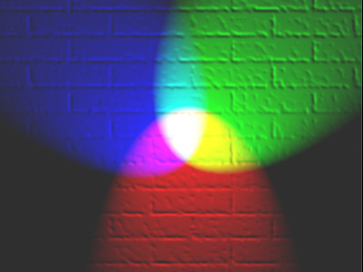
Color spaces
How can we represent color?
http://en.wikipedia.org/wiki/File:RGB_illumination.jpg

Slide 58

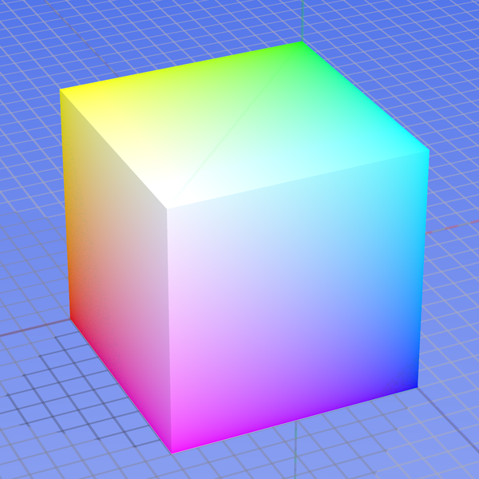
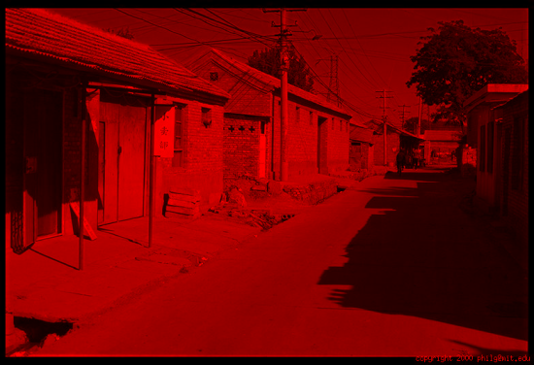
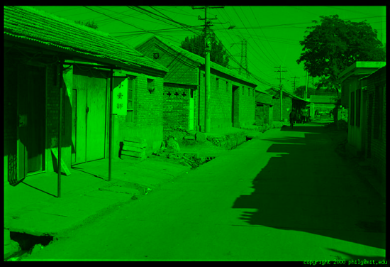
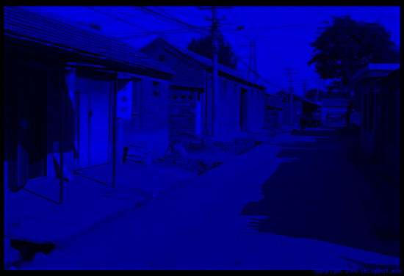
Color spaces: RGB
Default color space
0,1,0
R
(G=0,B=0)
1,0,0
G
(R=0,B=0)
0,0,1
B
(R=0,G=0)
Some drawbacks
Strongly correlated channels
Non-perceptual
Image from: http://en.wikipedia.org/wiki/File:RGB_color_solid_cube.png

Slide 59
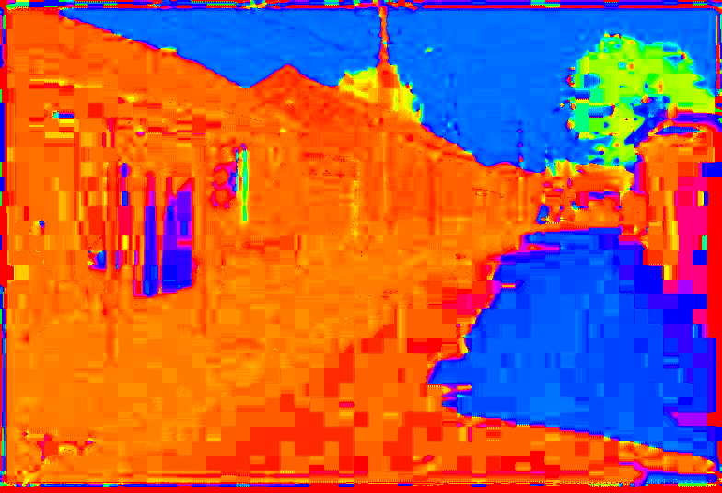
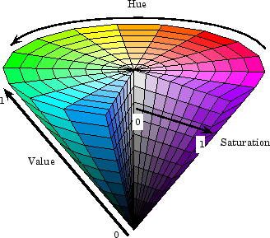
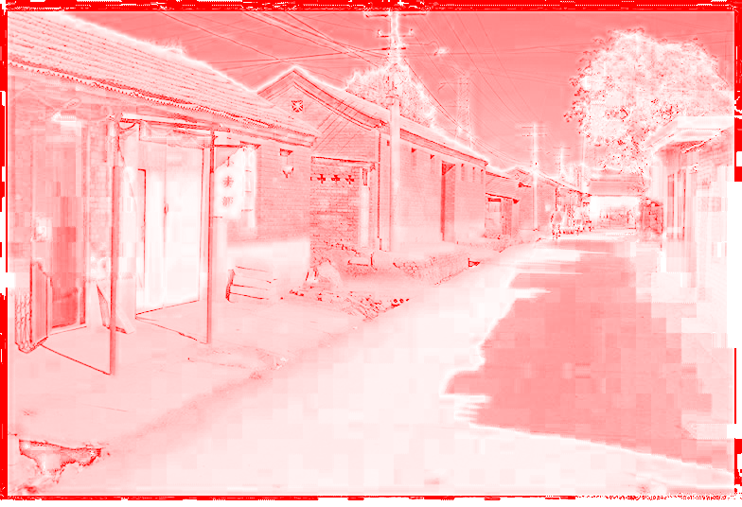
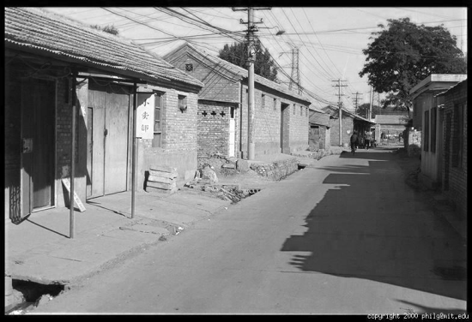
Color spaces: HSV
Intuitive color space
H
(S=1,V=1)
S
(H=1,V=1)
V
(H=1,S=0)

Slide 60
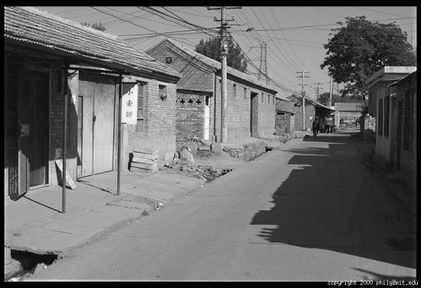





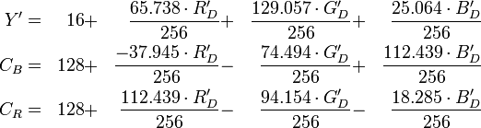
Color spaces: YCbCr
Fast to compute, good for compression, used by TV
Y=0
Y=0.5
Y
(Cb=0.5,Cr=0.5)
Cr
Cb
(Y=0.5,Cr=0.5)
Cb
Y=1
Cr
(Y=0.5,Cb=05)

Slide 61

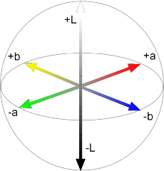


Color spaces: CIE L*a*b*
“Perceptually uniform” color space
L
(a=0,b=0)
a
(L=65,b=0)
b
(L=65,a=0)
Luminance = brightness
Chrominance = color

Slide 62
Which contains more information? (a) intensity (1 channel) (b) chrominance (2 channels)

Slide 63
If you had to choose, would you rather go without luminance or chrominance?

Slide 64

Most information in intensity
Only color shown – constant intensity

Slide 65
Most information in intensity
Only intensity shown – constant color

Slide 66
Most information in intensity
Original image

Slide 67


Take-home messages
Image is a matrix of numbers (light intensities at different orientations)
Interpretted mainly through local comparisons
Linear filtering is sum of dot product at each position
Can smooth, sharpen, translate (among many other uses)
Attend to details: filter size, extrapolation, cropping
Color spaces beyond RGB sometimes useful
=
0.92 | 0.93 | 0.94 | 0.97 | 0.62 | 0.37 | 0.85 | 0.97 | 0.93 | 0.92 | 0.99
0.95 | 0.89 | 0.82 | 0.89 | 0.56 | 0.31 | 0.75 | 0.92 | 0.81 | 0.95 | 0.91
0.89 | 0.72 | 0.51 | 0.55 | 0.51 | 0.42 | 0.57 | 0.41 | 0.49 | 0.91 | 0.92
0.96 | 0.95 | 0.88 | 0.94 | 0.56 | 0.46 | 0.91 | 0.87 | 0.90 | 0.97 | 0.95
0.71 | 0.81 | 0.81 | 0.87 | 0.57 | 0.37 | 0.80 | 0.88 | 0.89 | 0.79 | 0.85
0.49 | 0.62 | 0.60 | 0.58 | 0.50 | 0.60 | 0.58 | 0.50 | 0.61 | 0.45 | 0.33
0.86 | 0.84 | 0.74 | 0.58 | 0.51 | 0.39 | 0.73 | 0.92 | 0.91 | 0.49 | 0.74
0.96 | 0.67 | 0.54 | 0.85 | 0.48 | 0.37 | 0.88 | 0.90 | 0.94 | 0.82 | 0.93
0.69 | 0.49 | 0.56 | 0.66 | 0.43 | 0.42 | 0.77 | 0.73 | 0.71 | 0.90 | 0.99
0.79 | 0.73 | 0.90 | 0.67 | 0.33 | 0.61 | 0.69 | 0.79 | 0.73 | 0.93 | 0.97
0.91 | 0.94 | 0.89 | 0.49 | 0.41 | 0.78 | 0.78 | 0.77 | 0.89 | 0.99 | 0.93
1
1
1
1
1
1
1
1
1

